Slide 1
Sexual and gender identity
Social and Emotional Development (PSY624)
D. Messinger, PhD

Slide 2

•Sexual system operates as an attachment-facilitating device.
•Attachment processes link sexuality with relationship quality.
•Sexual desire functions as a gauge of romantic compatibility.
•Desire becomes sensitive to different partner traits as relationships develop.
•Desire is important for relationship persistence when relationships are fragile.

Slide 3
Overview
Attachment and sexuality
Adolescent sexuality (the elephant in the room)
Same sex and other sex attraction—bisexual dynamics
Transgender and cisgender development

Slide 4

Becoming a sexual being: the ‘elephant in the room’ of adolescent brain development
Woodard

Slide 5
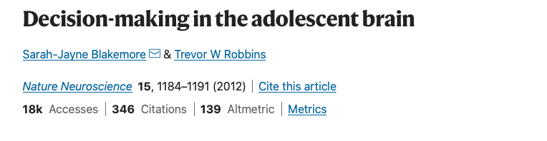
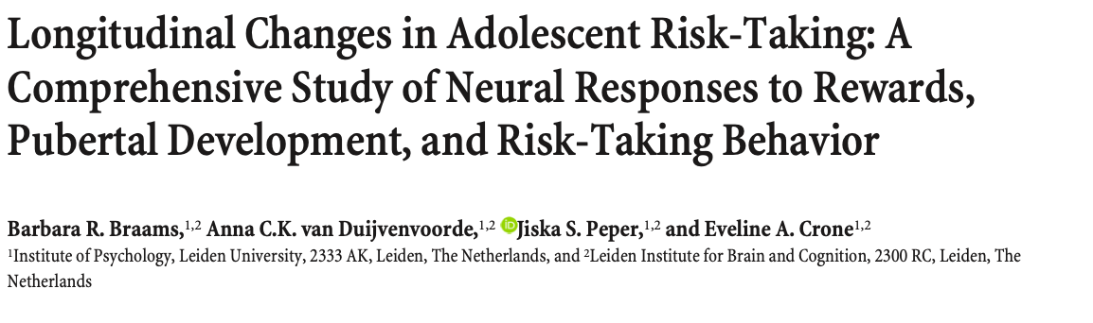
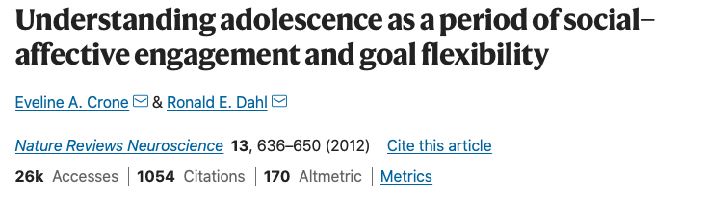
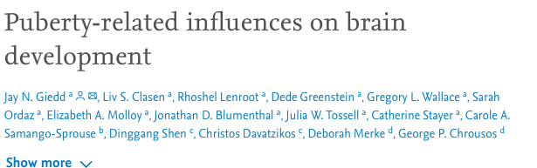
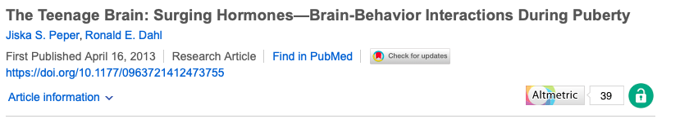
Woodard
Notes:
despite the emergence of many excellent models highlighting the importance of puberty for neural development and new, adaptive learning, these models give limited consideration to the importance of adolescence as a sensitive period for romantic and sexual developmen

Slide 6
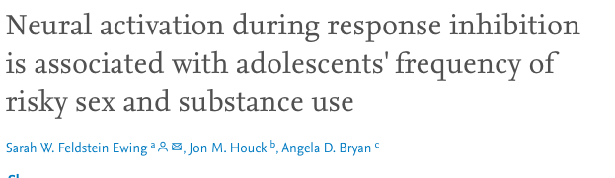
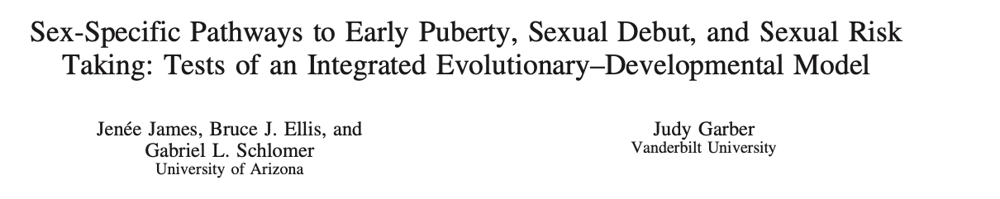
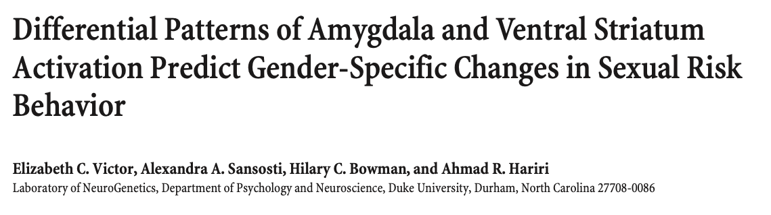
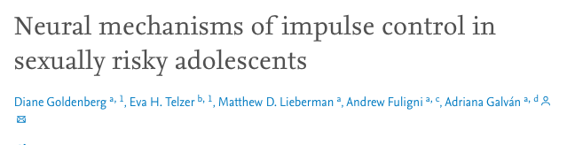
Woodard
Notes:
In the few cases when romance and sexuality are considered in these developmental models, they tend to emphasize sexual development as negative risk behavior (i.e., a risk-framework of sexual behavior). Studies using a sexual risk framework have helped to identify some of the underlying neural correlates associated with healthharming sexual decision-making, but, unfortunately, these studies have done little to expand our understanding of normative sexual development trajectories.

Slide 7
The evolutionary importance of puberty
An important window of opportunity for learning an experience to shape neural networks
  Neuroplasticity
  More time with peers
  Orientation to social and emotional information processing
  Novel social behaviors and contexts
  Sensitization to reward learning
  Significant sex-specific structuring of the brain
A wide range of early romantic and sexual experiences likley shapes developing neural networks in enduring easy to support lifelong romantic and sexual trajectories
Woodard

Slide 8
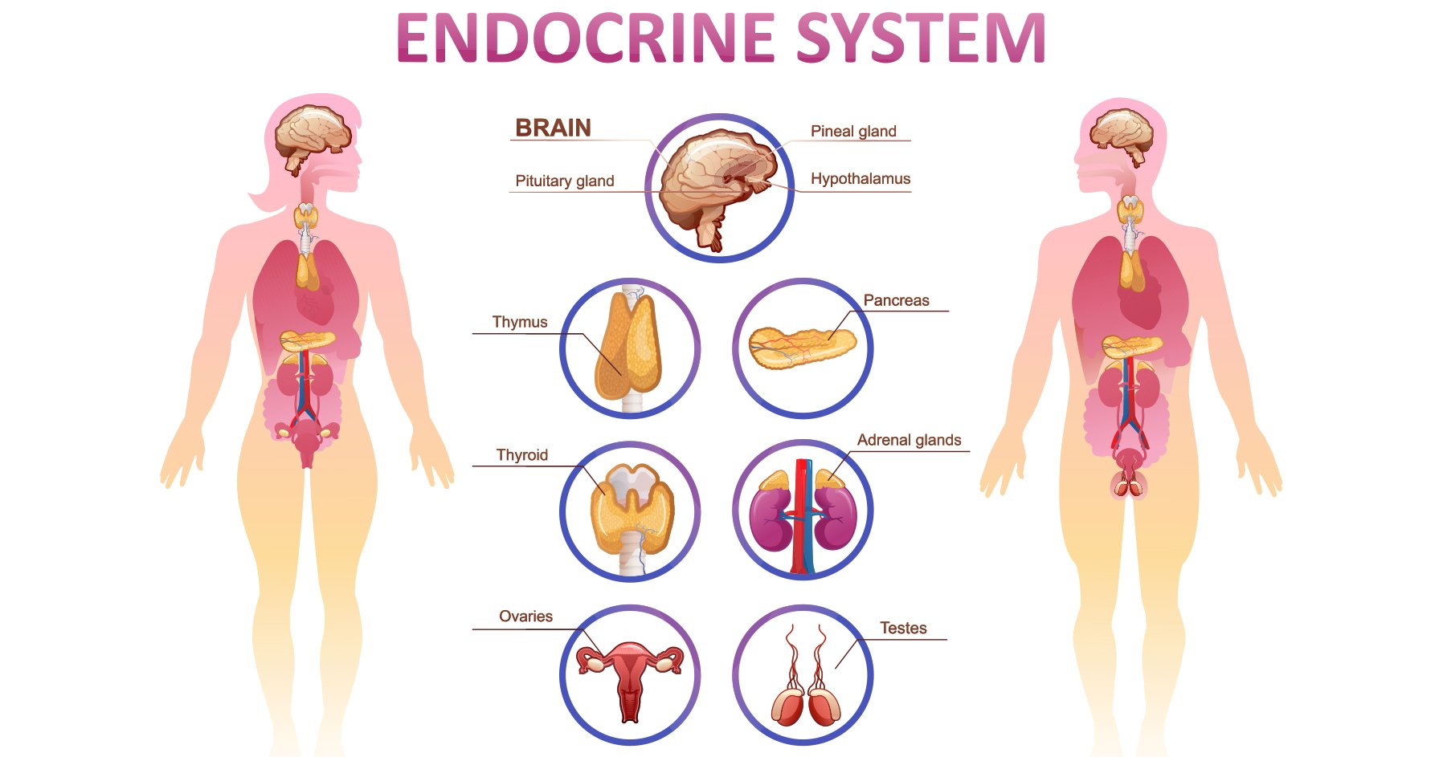
Hormones
Gonadal hormones contribute to secondary sex characteristic development and neural circatry reshaping
Oxytocin, vasopressin, dopamine, serotonin, and cortisol also are activated or enhanced during puberty and influence how people experience romantic love
Collectively, these changes in hormones and neurotransmitters create an ideal physiological climate for fostering young people’s interest in learning about romantic love and sexual attraction
Woodard

Slide 9
Hormones
Testosterone- what does it do? | Estrogen- what does it do?
Social hormone: motivating status seeking, status maintenance, risk taking, aggression | Physical development of females, earlier than males. Limited research on brain development.
Relationship to sexual behavior may depend on developmental stage and relationship context | Limited research…
Woodard

Slide 10

Parents and Peers
Positive parent relationships are associated with decreases intentions to have sex and later age of first sexual acitvity
Positive parent relationships + open communication is associated with less sexual experinece, increased condom usage, later sexual debut, fewer unintended pregnancies, and fewer sexual partners
In adolescents specifically, presence or suggested presence of peers increases activation of reward circuitry
Having sexually active peers is associated with earlier first sexual activity, more frequent sexual acitvity, and more partners
Woodard

Slide 11

Media
Little is known about the effects of exposure to sexual media content on brain development
  However, violent media content does have effects on brain development and violent behavior
“Super sexual peer” influencing youth
  Over 70% of television contains sexual content or dialouge
  Between 23-29% of 10-19 year olds report viewing online pornography; 84% report it was unwanted or unintentional
  Association between increase pornography exposure and less restrictive sexual attitudes
Is there a positive effect of sexual media? How do we enhance it? How do we minimize harm?
Woodard

Slide 12
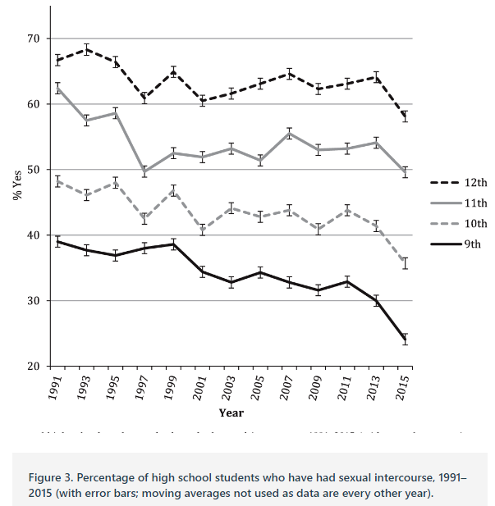
But…sex

Slide 13
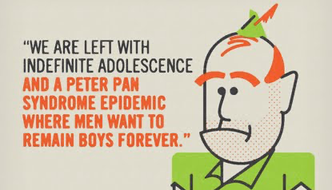

Extended adolescence?
Definition: “time of preparation for adult reproductive life,” spanning the period between achieving physical readiness to engage in sexual activity and having social permission to reproduce
  What is the beginning of adolescence? What is the end?
Earlier trends of the beginning of puberty, especially for girls
  Do you think this coincides with changes in brain development?
Later trends in serious partnerships and having children
Thus, many individuals now spend a decade or more of their lives feeling biologically, physiologically, and motivationally primed to engage in romantic and sexual relationships outside of the context of reproduction. What consequences might this have?
Woodard

Slide 14
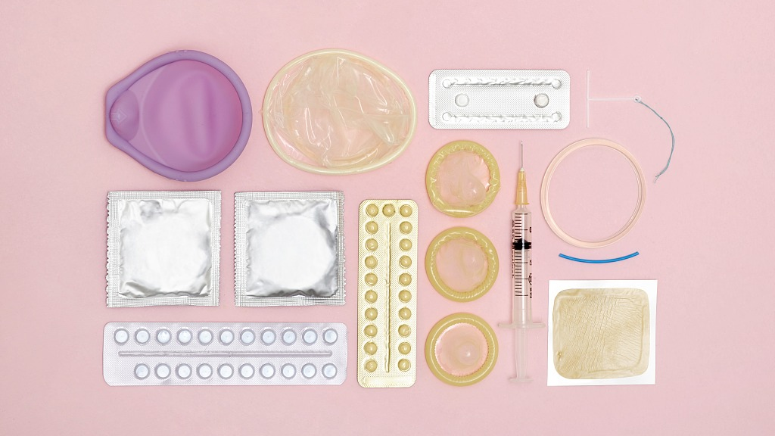
Contraceptive Innovation?
Many people begin having sex before they want to have children, and thus use birth control
  Global age of sexual debut for males is 16.5-24.5, for females 15.5-21.5
Combined oral contraceptives (containing estrogen and progestin) are the most common form of birth control and suppress up to 50% of testosterone in women
  Side effect?
  Chronic suppression effects?
  Effects if taken during sexual development?
Woodard

Slide 15

Childbearing and parenting?
Clear negative social and neurodevelopmental effects
of early parenthood (< 15)
  What about late parenthood?
Neural flexibility peaks in 30s
Men have different levels of testosterone based on relationship/parenthood status regardless of age
  What if you decouple typical neurobiological development trends from parenthood?
Overwhelming majority of people in the US and Europe have sexual and romantic relationships before committing to a single partner; similar trends beginning in Africa
  Differences between those who have multiple, high-intensity relationships and those who do not?
  Differences between those who have children at different ages?
Woodard
Doss talk. Thursday #:30

Slide 16
Homosexuality as a Discrete Class
Previous research on the latent structure of sexual orientation has returned conflicting results, with some studies finding a dimensional structure (i.e., ranging quantitatively along a spectrum) and others a taxonic structure (i.e., categories of individuals with distinct orientations).
  sample (N = 33,525) from the National Epidemiologic Survey on Alcohol and Related Conditions (NESARC).
  taxometric analyses using three indicators of sexual orientation: identity, behavior, and attraction.
Low-base-rate same-sex-oriented taxa: men (base rate = 3.0%), women (base rate = 2.7%).
  Generally, taxon membership conferred an increased risk for psychiatric and substance-use disorders.
Taxa were present for men and women, but women demonstrated greater sexual fluidity:
any level of same-sex sexuality conferred taxon membership for men but not for women.
  Norris, A. L., Marcus, D. K., & Green, B. A. (2015). Psychological Science. doi: 10.1177/0956797615598617

Slide 17
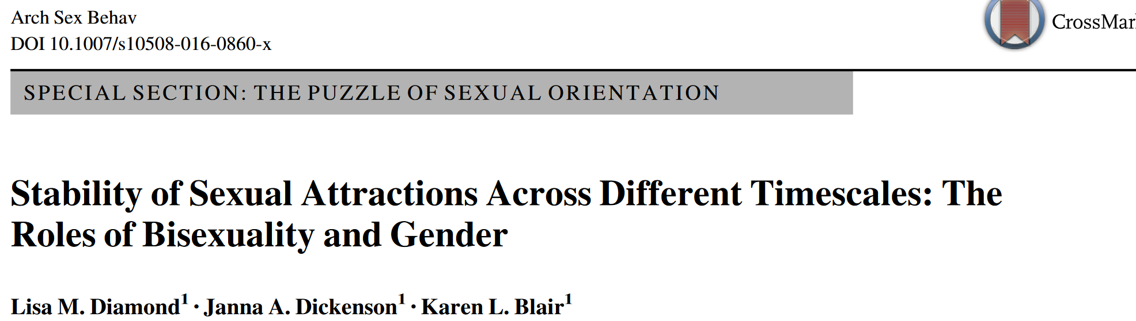
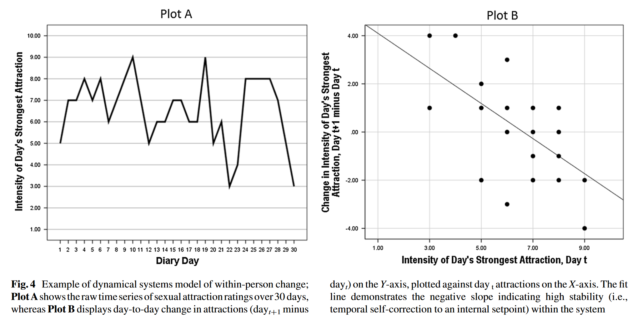
stability of same- & other-sex attractions in 294 heterosexual, lesbian, gay, and bisexual men and women (18 -40 years)
Women’s attractions showed less day-to-day stability than men’s
  female sexual fluidity
    heightened sensitivity to context

Slide 18

Female Bisexuality From Adolescence to Adulthood: A 10-Year Longitudinal Study. L. Diamond.
Dev Psychol. 2008 Jan;44(1):5-14. doi: 10.1037/0012-1649.44.1.5.
3 conceptualizations of bisexuality
  1. “Transitional phase”
  2. Third type of sexual orientation
  3. Heightened capacity for fluidity
Present study
  79 non-heterosexual women
  10 years, 5 assessment points. At each:
    Label self sexual identity
      Lesbian, bisexual, “unlabeled”
    % daily attractions that are same-sex
    #of sexual contacts with men & women (since last assessment)

Slide 19
Changing Identity
Bisexual and unlabeled women more likely to change identity labels > lesbians
    73% of T1 bisexuals
    83% of T1 “unlabeled”
    48% of T1 lesbians
  More likely to switch between bisexual and unlabeled IDs than to settle on lesbian or heterosexual labels.
    2/3 of ID changes: adopting bisexual or unlabeled.
  % identifying as bisexual or “unlabeled”
    T1 T2 T3 T4 T5
    57% 47% 51% 57% 58%

Slide 20
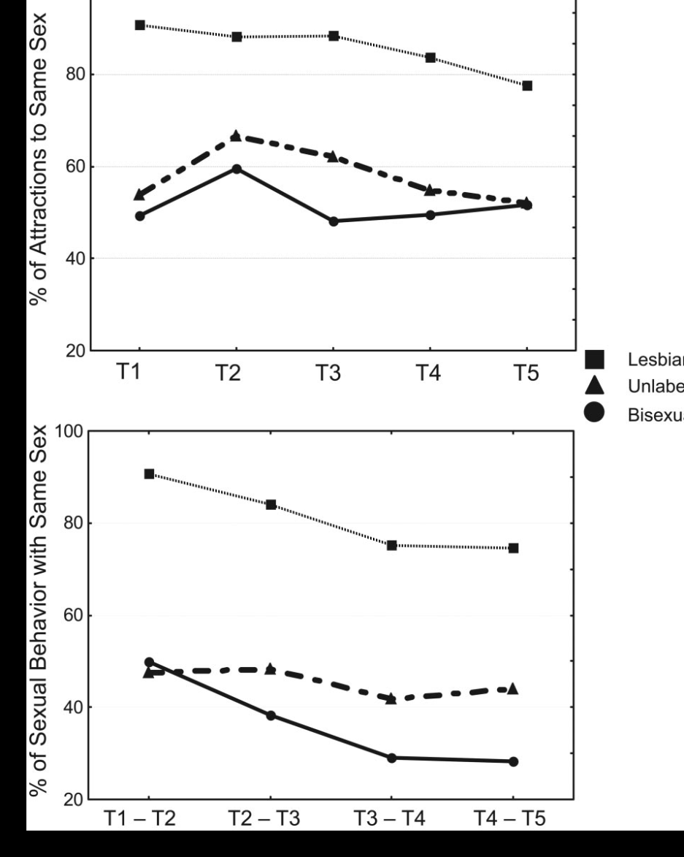
Sexual Attractions
  Women who gave up bisexual /lesbian IDs still reported bisexual patterns of attraction in T5
  Same-sex attractions declined significantly among lesbians only
Notes:
Lesbian women had significantly higher same-sex attractions

Slide 21
Sexual Behavior
  Consistent decline in same sex behavior among all women
  NOT matched by a parallel decline in same-sex attractions
  By 2005, most women involved in long term monogamous relationships.
    70% of T5 lesbians, 89% of bisexuals, 85% of unlabeled women, 67% of heterosexuals
  By 2005, 60% of T1 lesbians had had sexual contact with a man, and 30% had been romantically involved with a man
    Resolved by change in identity to bisexual/unidentified
Notes:
In 1995, behavior evenly distributed
By 2005, bimodal distribution (either exclusively with men or women)

Slide 22
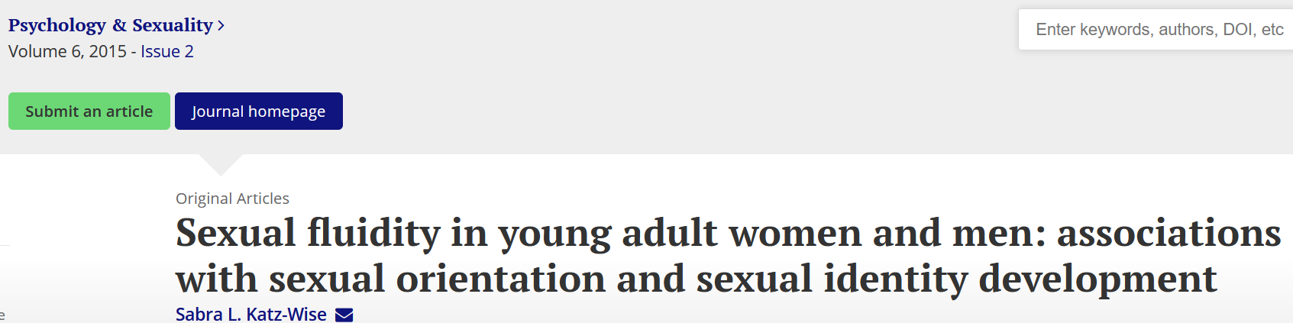
199 (124 female, 75 male) US sexual minority young adults, ages 18–26 years
Sexual fluidity in attractions was reported by 64% of women and 52% of men, with 49% of those women and 36% of those men reporting sexual fluidity in sexual identity based on experiencing changes in attractions, with no significant gender differences. Sexually fluid women used a range of sexual identities, whereas most sexually fluid men identified as completely homosexual/gay.
Notes:
Results consistent with both “third orientation” and “heightened fluidity” models, not “transitional stage” model

Slide 23
Discussion
Bisexuality as stable pattern of attraction to both sexes, with balance varying based on personal and situational factors.
Identity change more common than identity stability
ID change reflects shifting experiences
  Adopt labels consistent with relationship status
  Seek to maximize fit with own prevailing pattern of attraction/behavior
Notes:
Results consistent with both “third orientation” and “heightened fluidity” models, not “transitional stage” model

Slide 24
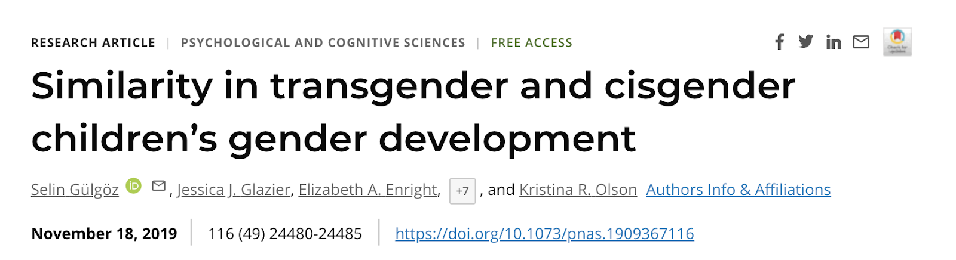
Romero, 2022

Slide 25
KEY TERMS
Assigned Sex: sex announced the day a child is born.
  “Assigned males” are children who have genitalia and chromosomes indicating a male sex at birth
  “Assigned females” are children who have the genitalia and chromosomes indicating a female sex at birth
Social Transition: A change in a child’s outward appearance and gender pronoun use.
Transgender: children who have socially transitioned and are using binary pronouns that differ from the binary pronouns used to describe them at birth.
Cisgender: children who live and present as the gender that is typically associated with their assigned sex.
Romero, 2022
Notes:
In the study the term assigned sex refers to the sex announced the day the child is born. The children this study were all assigned male or female at birth.
They use the term Social transition in the study to represent a change in a child’s outward appearance and gender pronoun use.
So for example, an assigned male would be said to socially transition if this child grew long hair, started wearing dresses and was referred to with pronouns “her” and “she.”
In the study, the pronoun change was used as the key criteria that a transition has occurred.
A social transition, in this study, does not indicate any medical (either hormonal or surgical) changes have occurred.
The researchers use the term transgender to refer to children who have socially transitioned and are using the binary pronouns (he or she) that differ from the binary pronouns used to describe them at birth.

Slide 26

METHODS
The study included 317 transgender children, 189 of their siblings, and 316 cisgender controls.
They completed measures of:
  Gender identity
    (how much they feel like a boy, a girl, something else)
  Gender-typed preferences
    (e.g., toys, clothing stereotypically associated in our culture with a gender)
Romero, 2022
Notes:
Transgender children (317 children, 3 to 12 years) were tested on various established measures of gender development, with emphasis on gender identity and gender-typed preferences and behaviors. The same measures were used in testing two comparison groups: a group of cisgender siblings of transgender participants (189 children, 3 to 12 years), and a group of cisgender controls who were unrelated to the participants in the study and were matched by age and gender to each transgender participant (316 children, 3 to 12 years).
Researchers traveled across the U.S. and Canada to meet families in their homes, or in local private settings.
They met with each family for about an hour, during which children and parents were administered separate questionnaires/interviews.
For example, children were shown some toys or clothes that varied in how stereotypically masculine or feminine they were, and the children indicated which toys or clothes they preferred. On other items, they were asked how similar they felt to boys and how similar they felt to girls.
The parents were asked about their transgender child’s gender identity, preferences and behaviors.
Children in the cisgender control group were recruited in the Seattle area and participated in their research lab, answering the exact same questions as the transgender children and their siblings.

Slide 27
MAIN FINDINGS
Researchers found that 3- to 12-year-old transgender children showed strong identification with their current gender and showed strong preferences for toys, clothing, etc., typically associated with their current gender, not their assigned sex.
The magnitude of their identification and preferences was unrelated to how long they had lived as their current gender.
Transgender children’s identities and preferences generally did not differ from their same-gender cisgender peers.
Romero, 2022
Notes:
This study showed that transgender children gender development shows similar patterns when compared to cisgender children.
The study had three main findings:
First, the study found that 3- to 12- year-old transgender children show strong identification and preferences aligned with their current gender, and not the gender associated with their assigned sex.
Second, the length of time that transgender children had spent living as their current gender (i.e., the time that had passed since they had socially transitioned) was not associated with the strength of their gender identity or the extremity of their gender-typed preferences. That is, on average, a child who socially transitioned five years ago, and a child who socially transitioned less than a year ago did not differ in the extent to which they identified with their current gender.
Third, when compared to a group of unrelated cisgender control children and a group of cisgender siblings of transgender participants, transgender children showed remarkable similarity in their gender development. That is, transgender girls (assigned as boys at birth) were similar in gender development to children who were assigned at birth as girls.
Further, both transgender and cisgender children showed similar variability in terms of how stereotype-consistent their gender development was.
So for example, among both transgender and cisgender girls, there were girls who showed preferences for toys and clothing that were very stereotypically feminine (e.g., frilly dresses, play make-up sets), and there were girls who showed counter-stereotypical preferences (e.g., cargo pants, balls).

Slide 28
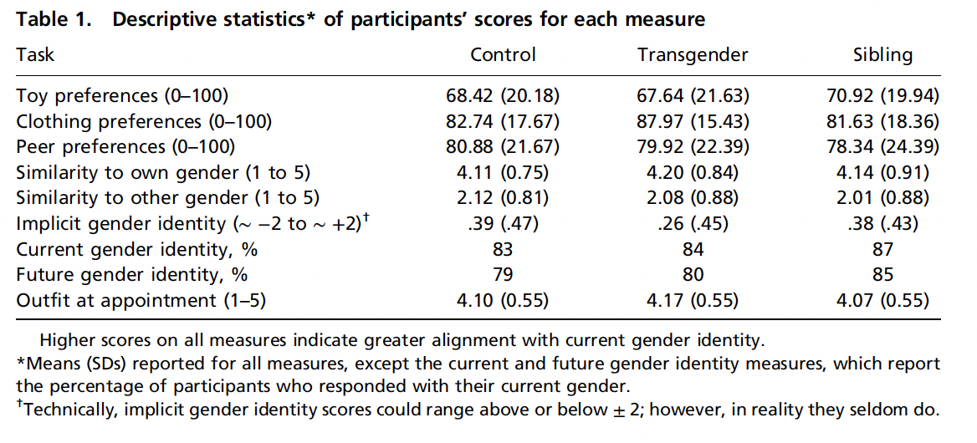

Slide 29
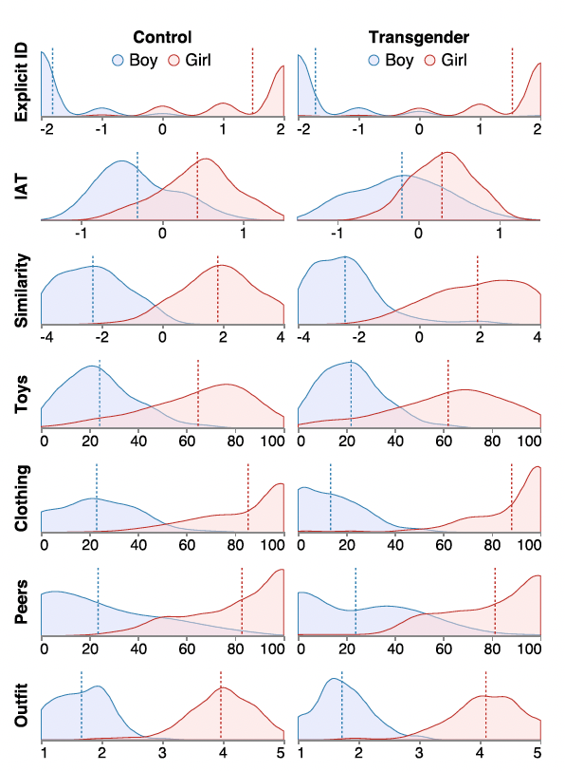
Density plots depicting distributions of girls’ and boys’ responses on each child measure across the 3 participant groups.
Higher scores on the x axis indicate greater identification/association with girls; lower scores on the x axis indicate greater identification/association with boys.
Vertical dotted lines in graphs represent means.
Romero, 2022

Slide 30

OTHER FINDINGS
Transgender and cisgender children’s gender development showed coherence.
Transgender and cisgender children’s gender development did not vary as a function of demographic variables
  race, geographic location, and parent education level.
Parents and children provided similar reports of children’s gender development.
Romero, 2022
Notes:
Apart from their main findings, the researchers did additional exploratory analysis.
First, they found that transgender and cisgender children’s gender development showed coherence. Past literature had suggested that cisgender children show coherence—or associations— between different aspects of gender development (e.g., for instance, between their identity and clothing preferences). They found the same pattern within our transgender (and cisgender) samples.
Second, they found that transgender and cisgender children’s gender development did not vary as a function of demographic variables such as race, geographic location, and parent education level. But a caveat to this finding is that their participants overall were of a restricted range of demographics (for example most of the participants had parents with college educations or above, about two-thirds were White)
And thirdly, the researchers found that parents and children provided similar reports of children’s gender development.

Slide 31
SIGNIFICANCE
Children might not be simply learning about gender based on what their parents tell them about their own gender or how they treat them early on (which would be about the gender associated with their assigned sex).
Instead, the findings suggest that children may be selectively attending to broader social messages regarding the gender they feel they are, from early ages.
Romero, 2022
Notes:
How children become aware of their gender identity and begin to show gender-typed preferences in things like clothing and toys have been and still are topics of debate among researchers.
By studying gender development in children whose current gender identity and expressions do not align with their assigned sex, this research gives some insight into the process of gender development.
Their findings suggest that children might not be simply learning what their parents tell them about their own gender or how they are treated early on but instead, they might selectively attend to broader social messages regarding the gender they feel they are.
Overall, the current findings suggest that once children identify themselves as a girl or a boy (regardless of what their assigned sex is), they might look for ways in which people around them fulfill these roles and then try to be like them.

Slide 32
DISCUSSION QUESTIONS
Sample from US and Canada with more children being from homes with higher income and higher parental education. Do you think these findings extend to other demographic groups and cultures?
The transgender participants in the study have all socially transitioned and in families that affirmed child’s current gender identity. How would results differ if researchers had studied children who identify as transgender but have not yet transitioned or who live in less supportive environments?
This study focused on children who use “he” and “she” pronouns exclusively and did not focus on nonbinary children (who are sometimes include in the broader societal use of the word “transgender”). How would the results differ if nonbinary children had been included?
Romero, 2022
Notes:
First question (can reference demographics table in the next slide) (sample very homogenous in income, parental education, and political views)
The transgender participants in the current study have all socially transitioned and live in families that that affirmed their child’s current gender identity through a social transition. The researchers do not know how the results may have differed if they had studied children who identify as transgender but have not yet transitioned, or children who live in less supportive environments

Slide 33
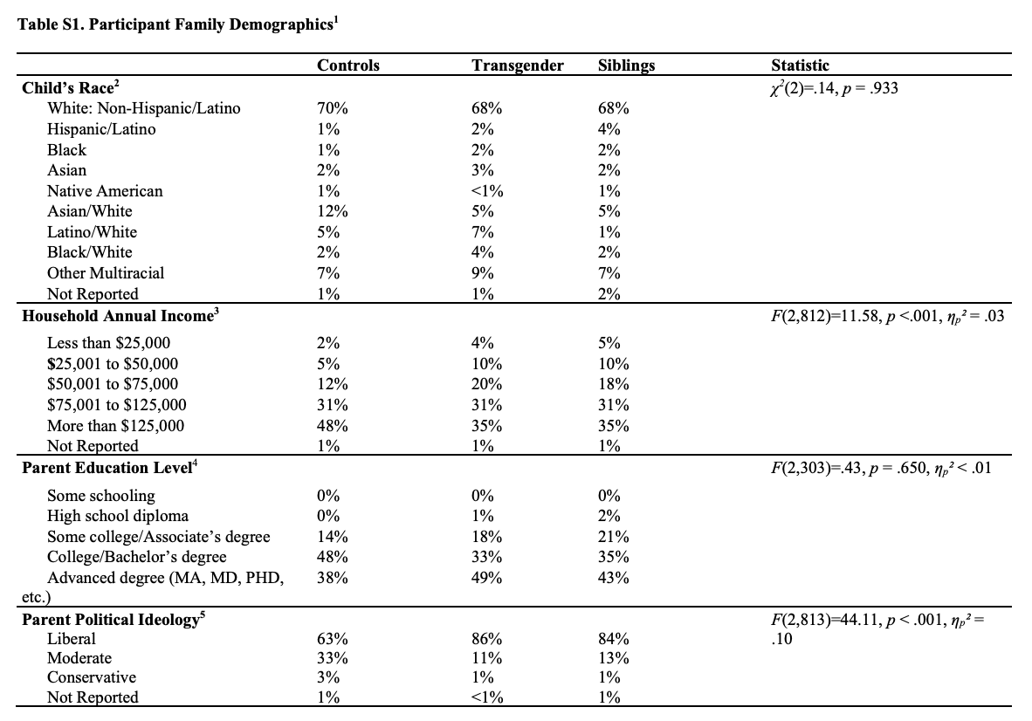
Notes:
A limitation is that all children in the current sample were from U.S. and Canadian families that often had high incomes and included parents with high levels of education. If these findings extend to children from other demographic groups and cultures is currently unknown.

Slide 34
Leland, 2023

Slide 35
KEY TERMS
Assigned Sex: sex announced the day a child is born.
  “Assigned males” are children who have genitalia and chromosomes indicating a male sex at birth
  “Assigned females” are children who have the genitalia and chromosomes indicating a female sex at birth
Social Transition: A change in a child’s outward appearance and gender pronoun use.
Transgender: children who have socially transitioned and are using binary pronouns that differ from the binary pronouns used to describe them at birth.
Cisgender: children who live and present as the gender that is typically associated with their assigned sex.
Leland, 2023
Notes:
In the study the term assigned sex refers to the sex announced the day the child is born. The children this study were all assigned male or female at birth.
They use the term Social transition in the study to represent a change in a child’s outward appearance and gender pronoun use.
So for example, an assigned male would be said to socially transition if this child grew long hair, started wearing dresses and was referred to with pronouns “her” and “she.”
In the study, the pronoun change was used as the key criteria that a transition has occurred.
A social transition, in this study, does not indicate any medical (either hormonal or surgical) changes have occurred.
The researchers use the term transgender to refer to children who have socially transitioned and are using the binary pronouns (he or she) that differ from the binary pronouns used to describe them at birth.

Slide 36
INTRODUCTION AND RESEARCH QUESTIONS
Transgender children → Unique historical period
Cisgender children’s gender identity is understood by ~3
Gender Development: Assigned sex, gender identity, and socialization
Transgender children’s identification: stronger or weaker?
What does transgender children’s gender development look like?
How does it compare to cisgender gender development?
Do transgender children show gender coherence and is coherence related to length of time since transition?
Leland, 2023
Notes:
- The current population of transgender children are very unique - although there have been transgender people for thousands of years, prior generations transitioned from one gender to the other in adolescence or adulthood. Nowadays, children as young as preschoolers are transitioning but they are often the first in thier community to do so and thus are the ones breaking barriers, creating new social norms, etc
- Assigned sex, gender identity, and socialization all contribute to gender development but hard to know what role each plays in cisgender populations - examining the role of each in transgender populations can help us untangle their effects
- Stronger bc they feel like their identity is threatened
Weaker because they have not been socialized to identify with that gender
Do transgender children show coherence in their gender identity, expression and preferences? What role does self socialization play in gender identity?

Slide 37
METHODS
The study included 317 transgender children, 189 of their siblings, and 316 cisgender controls (ages 3 – 12)
They completed measures of:
  Gender identity
    (how much they feel like a boy, a girl, something else)
  Gender-typed preferences
    (e.g., toys, clothing stereotypically associated in our culture with a gender)
Leland, 2023
Notes:
Transgender children (317 children, 3 to 12 years) were tested on various established measures of gender development, with emphasis on gender identity and gender-typed preferences and behaviors. The same measures were used in testing two comparison groups: a group of cisgender siblings of transgender participants and a group of cisgender controls who were were matched by age and gender to each transgender participant
For example, children were shown some toys or clothes that varied in how stereotypically masculine or feminine they were, and the children indicated which toys or clothes they preferred. On other items, they were asked how similar they felt to boys and how similar they felt to girls.
The parents were asked about their transgender child’s gender identity, preferences and behaviors.

Slide 38
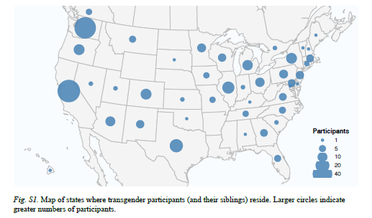
METHODS CONTINUED
Notes:
Children from all over, children in cis-gender control group all from Seattle
note that almost all children in the TG group came from families where the parents were liberal and had at least a college degree.

Slide 39
MAIN FINDINGS
Researchers found that 3- to 12-year-old transgender children showed strong identification with their current gender and showed strong preferences for toys, clothing, etc. (coherence), typically associated with their current gender, not their assigned sex.
The magnitude of their identification and preferences was unrelated to how long they had lived as their current gender.
Transgender children’s identities and preferences generally did not differ from their same-gender cisgender peers.
Parents and children provided similar reports of children’s gender development.
Leland, 2023
Notes:
This study showed that transgender children gender development shows similar patterns when compared to cisgender children.
The study had three main findings:
First, the study found that 3- to 12- year-old transgender children show strong identification and preferences aligned with their current gender, and not the gender associated with their assigned sex.
Second, the length of time that transgender children had spent living as their current gender was not associated with the strength of their gender identity or the extremity of their gender-typed preferences. That is, on average, a child who socially transitioned five years ago, and a child who socially transitioned less than a year ago did not differ in the extent to which they identified with their current gender.
Third, when compared to a group of unrelated cisgender control children and a group of cisgender siblings of transgender participants, transgender children showed remarkable similarity in their gender development. That is, transgender girls (assigned as boys at birth) were similar in gender development to children who were assigned at birth as girls.
Further, both transgender and cisgender children showed similar variability in terms of how stereotype-consistent their gender development was.
So for example, among both transgender and cisgender girls, there were girls who showed preferences for toys and clothing that were very stereotypically feminine (e.g., frilly dresses, play make-up sets), and there were girls who showed counter-stereotypical preferences (e.g., cargo pants, balls).

Slide 40
TRANSGENDER GENDER DEVELOPMENT
Leland, 2023
Notes:
Transgender children identify with their gender and favor things/peers that stereotypically match the gender they identify with the same way as cisgender children

Slide 41
GENDER IDENTIFICATION
Density plots depicting distributions of girls’ and boys’ responses on each child measure across the 3 participant groups.
Higher scores on the x axis indicate greater identification/association with girls; lower scores on the x axis indicate greater identification/association with boys.
Vertical dotted lines in graphs represent means.
Variability across all children
Leland, 2023
Notes:
participants across groups showed similarity in their mean responses, and also in terms of within-group variability; for example, within both transgender and
cisgender groups, while some girls showed strongly feminine responses, others showed much less feminine responses.

Slide 42
SIGNIFICANCE
Children might not be simply learning about gender based on what their parents tell them about their own gender or how they treat them early on (which would be about the gender associated with their assigned sex).
Appears as if self identification has stronger effect than socialization on children's gender identity, preferences and behaviors.
Notes:
How children become aware of their gender identity and begin to show gender-typed preferences in things like clothing and toys have been and still are topics of debate among researchers.
By studying gender development in children whose current gender identity and expressions do not align with their assigned sex, this research gives some insight into the process of gender development.
Their findings suggest that children might not be simply learning what their parents tell them about their own gender or how they are treated early on but instead, they might selectively attend to broader social messages regarding the gender they feel they are.
Overall, the current findings suggest that once children identify themselves as a girl or a boy (regardless of what their assigned sex is), they might look for ways in which people around them fulfill these roles and then try to be like them.

Slide 43
DISCUSSION QUESTIONS
The sample was from US and Canada and was skewed with more children being from homes with higher income and higher parental education. Do you think these findings extend to other demographic groups and cultures?
The transgender participants in the study have all socially transitioned and lived in families that affirmed their child’s current gender identity. How would these results differ if the researchers had studied children who identify as transgender but have not yet transitioned or who live in less supportive environments?
This study focused on children who use “he” and “she” pronouns exclusively and did not focus on nonbinary children (who are sometimes include in the broader societal use of the word “transgender”). How would the results differ if nonbinary children had been included?
Romero, 2022
Notes:
First question (can reference demographics table in the next slide) (sample very homogenous in income, parental education, and political views)
The transgender participants in the current study have all socially transitioned and live in families that that affirmed their child’s current gender identity through a social transition. The researchers do not know how the results may have differed if they had studied children who identify as transgender but have not yet transitioned, or children who live in less supportive environments

