Slide 1
(Attachment and) romantic relationships
Social and Emotional Development (PSY624)
D. Messinger, PhD

Slide 2
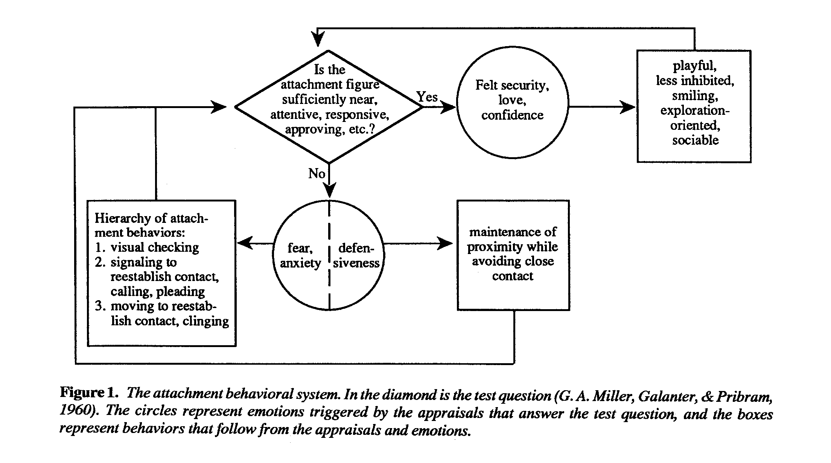
Attachment Review
Attachment: From the cradle to the grave, Hazan & Shaver, 1994

Slide 3
Can I count on my attachment figure to be available/responsive?
Yes – Secure
  Exploration
No – Insecure/Avoidant
  Defensiveness
Maybe – Insecure/Resistant
  Anxiety

Slide 4
Attachment Theory
Hazan, C. & Shaver, P. R. (1994). Attachment as an organizational framework for research on close relationships. Psychological Inquiry, 5(1), 1-22.
Humans predisposed to form close relationships
  satisfy most fundamental basic need for security
Supported by behavioral systems related to survival/reproduction
  Attachment, caregiving, sexual mating
Individual differences: adaptation to social environment
  E.g. attachment styles
Maintained by mental models
  Expectations that attachment figure will respond, that self will be responded to
  Resistant to change (over-learned, subconscious, default strategy of assimilation)
  Somewhat flexible (through reflection, “corrective” relationship experiences)

Slide 5
Close relationships as attachments
Prototypical pair bond
  Attachment
  Care-giving
  Sexual mating
Integrated under attachment?
  Maybe sexuality is or can be different?

Slide 6
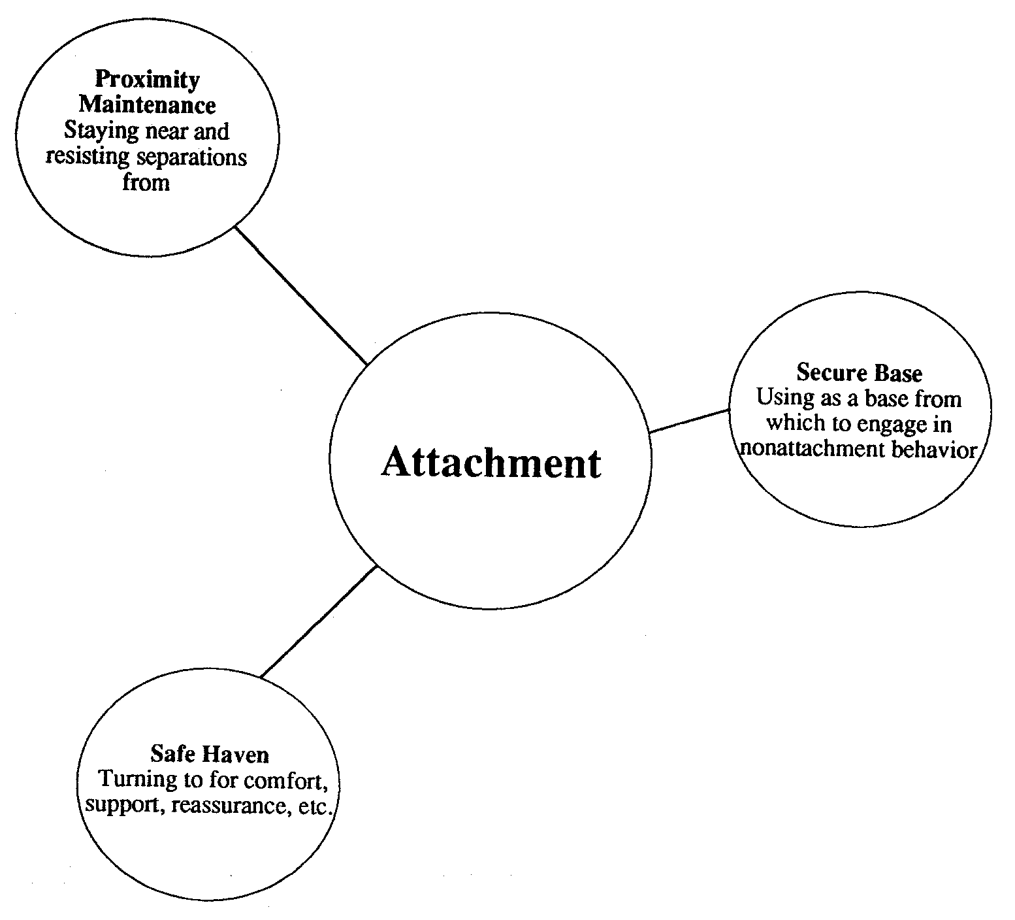
Three features

Slide 7
Attachment from Infancy to Adulthood
Attachment behaviors shift from parent to peers
Early childhood Early adolescence Adulthood
proximity maintenance → proximity maintenance → proximity maintenance
safe haven safe haven
secure base
Infant Attachment | Adult Attachment
Activated by anxiety and distress
complementary roles (child & adult) | reciprocal roles (two peers)
externally represented (touch) | more internally represented (beliefs)
“attachment” behavior system | integrated with “caregiving” & “sexual mating”

Slide 8
Attachment development
Phase | Parents | Peers
Infancy | Proximity Safe haven Secure base
Early childhood | Safe haven Secure base | Proximity
Late childhood/ adolescence | Secure base | Proximity Safe haven
Adulthood |  | Proximity Safe haven Secure base

Slide 9
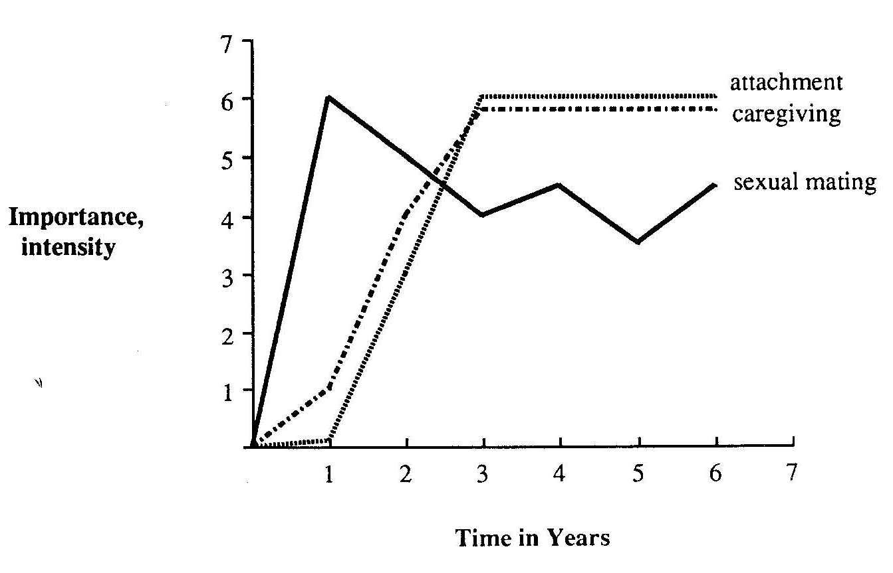
Fundamental questions
What makes a potential relationship partner appealing?
  Cues for attachment system: familiarity & responsiveness
    similarity to ourselves, mere exposure, positive response to us, anxiety
  Cues for caregiving system
    “babyness”, distress (shift at puberty)
  Cues for sexual mating system
    evidence of youth and health
How is a relationship formed, developed?
  Initiated by motivation for physical proximity
    may be from attachment system or sexual mating in adults
  Both infants and adults look for signs of responsiveness
  Bond strengthens as partner becomes safe haven
    sensitive, responsive care becomes more important than attraction

Slide 10
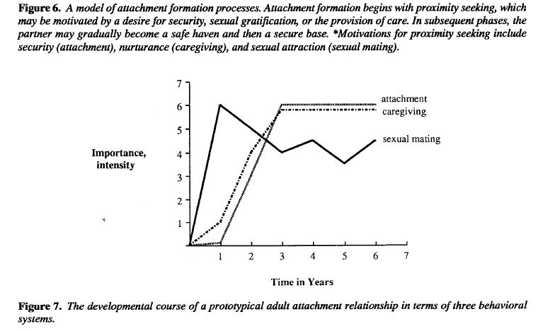
Attachment formation to partner

Slide 11
Fundamental questions
What makes relationships satisfying or enduring?
  how well they meet basic needs for comfort, care, sexual gratification
    …at least compared to alternatives
  fear of separation from attachment figure activates attachment system
    even if needs not being met
Why do relationships dissolve?
  relative importance of basic needs changes
    lack of caregiving exposed when sexual passion declines
What are the reactions to relationship breakup?
  attachment system activated
    separation-protest to seek proximity
  sadness & detachment
  re-attachment to another
    sometimes premature

Slide 12
Generic Insights
Miscommunication – sex vs. safe haven
Attachment can prolong relationship
Surface after relationship dissolution
  For both instigator and recipient
  Rumination, searching or avoidance
  Evidencing attachment bond

Slide 13
Different strategies for maintaining felt security
Inconsistent responsiveness → anxious/ambivalent attachment
    preoccupation with keeping others close
      (fall in love easily, early self-disclosure)
    intense expression of distress
      (view partners as insufficiently responsive)
    diminished exploratory behavior
Consistent unresponsiveness → avoidant attachment
    avoiding intimacy
    compensatory engagement in non-social activities (work)
    regulation anxiety through other means
      (uncommitted sex, substance use, distraction)
      Gender
      no differences in attachment styles
      females more oriented to caregiving, males to sex

Slide 14
Specific insights
Security (55%)
  Needs met, successful conflict resolution
Avoidance (25%)
  Needs unexpressed, infidelity?
Resistance (20%)
  Needs unmet, remaining in unsatisfactory relationships?
Sex differences not evident
  Attachment develops before gender roles

Slide 15
Parent ←→ Peer ←→ Partner
Attachment representations of the three relationships are distinct yet related
Attachment style
  Parent - Peer (friend) concordance
  Peer – Partner (romantic) concordance
  Not Parent – Partner
    Peer relationships appear to be a mediator
  Furman, W., Simon, V. A., Shaffer, L., & Bouchey, H. A. (2002). Adolescents' working models and styles for relationships with parents, friends, and romantic partners. Child Development, 73(1), 241-255.

Slide 16
Longitudinal predictors of adult attachment
Ongoing environmental impacts
  continued parental sensitivity
  social functioning
  friendship

Slide 17
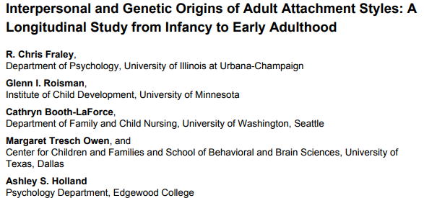

Slide 18
Background
Secure attachment → positive relationships with peers, ego resilient, good adolescent friendships
Examine the antecedent attachment styles longitudinally
  Maternal sensitivity: availability, dependability, and responsiveness
  Social competence : cooperation and self control
  Friendship: Quality of peer relationships
  Temperament
  Genetic polymorphisms
Past longitudinal attachment studies:
  Use retrospective memories
  Not as comprehensive

Slide 19
Measures
Participants:
  Data from NICHD Study of Early Child Care and Youth Development (SECCYD)
  N = 707 out of the original 1,364
  Birth to 15 years of age
Adult Attachment:
  Global attachment styles: Attachment-related Avoidance and Attachment-related Anxiety
  Romantic attachment styles: Romantic-related Avoidance and Romantic-related Anxiety
Caregiving Environment:
  Maternal sensitivity
  Maternal depression
  Father absence
Social competence:
  Mothers and teachers rating
Friendship Quality:
  Child’s rating of friendship with best friend
Early Temperament:
  Maternal rating: Restlessness/Activity, Shyness, Attentional focusing, Passivity, Fear
Genotyping
  A LOT of polymorphisms associated with adult attachment
Control variables: child gender, child ethnicity, maternal education, family income

Slide 20
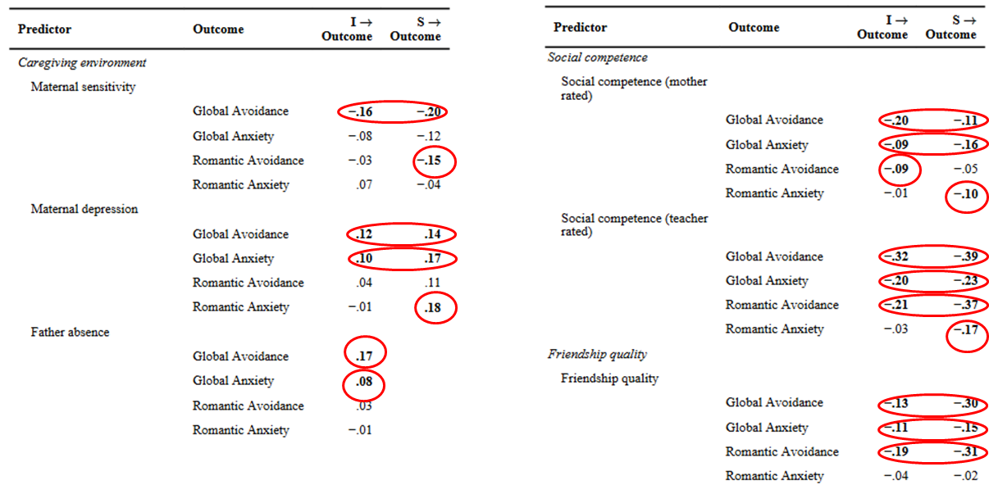
Adult Attachment Outcome
I → Outcome = regression of outcome on intercepts of the predictor. S → Outcome = regression of outcome on slopes of the predictor.

Slide 21
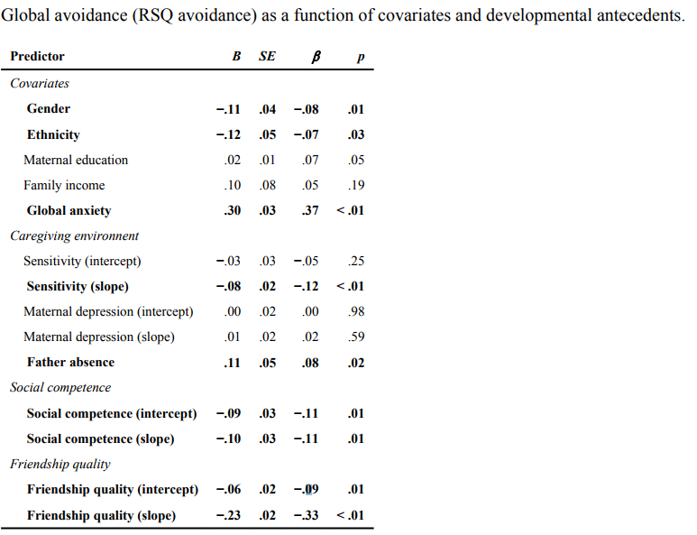
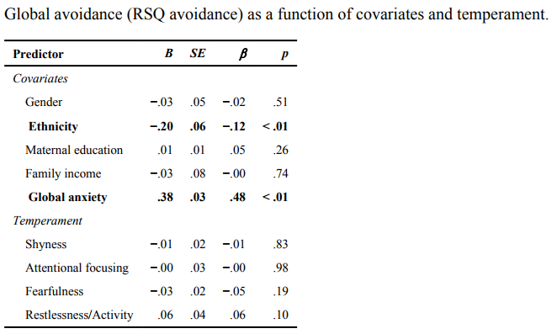

Slide 22
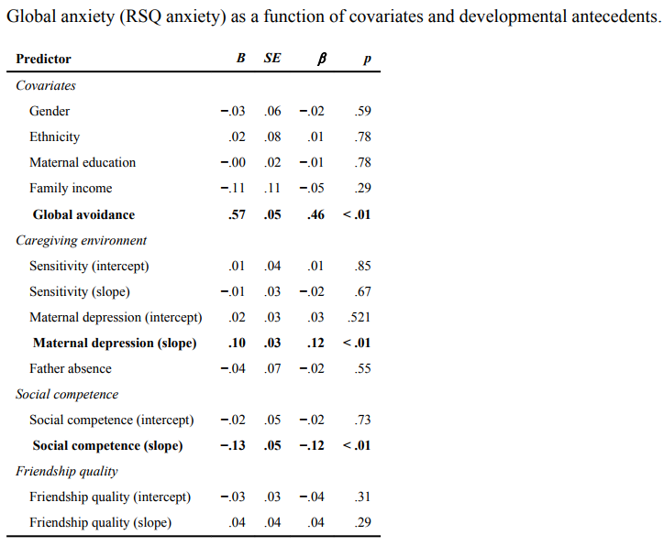
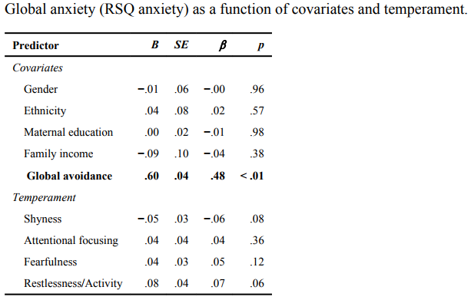

Slide 23
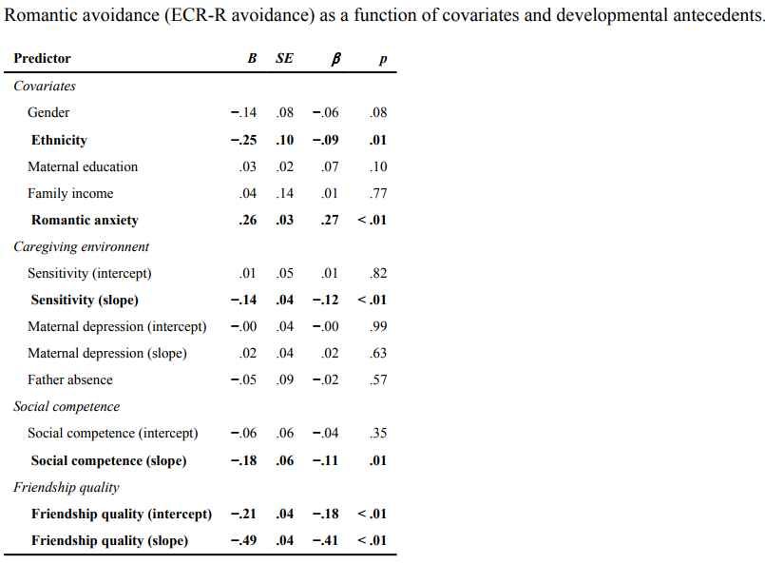
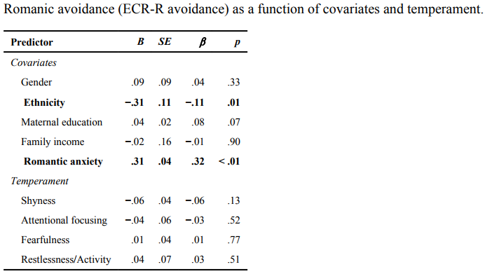

Slide 24
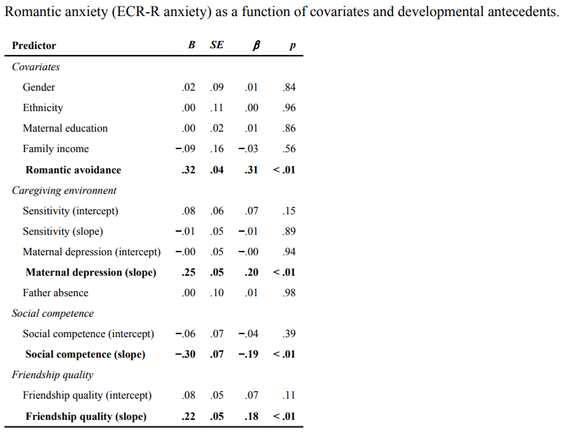
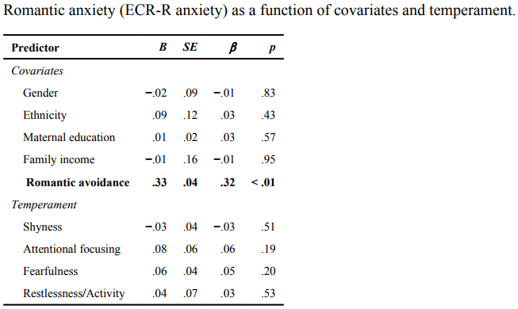

Slide 25
Developmental history → differences in adulthood
Adult attachment differences attributable to:
  Variations in quality of caregiving
  Emerging social competence
  Quality of best friendship
    Serotonin Receptor gene (HTR2A rs6313- with 2 C alleles) → higher attachment—replicated??
Adult attachment differences NOT attributable to:
  Temperament
  Most genetic polymorphisms

Slide 26
Gender and Group Process: A Developmental Perspective
Eleanor E. Maccoby
Gender identity
Sex typing
Same-sex social groups
Gender implication in the formation, interaction processes, and socialization functions
  Dyads vs. individual child

Slide 27
Gender composition of children’s groups
Group size
Interactions in same-sex groups
Formation of distinctive subcultures
Socialization within same-sex groups
Future Research

Slide 28
Adolescents' social relationships…
Can support or interfere with the development of successful romantic relationships.
  Adolescents with fewer other-sex friends, less positive & more negative interactions with best friends → high levels of dating anxiety.
  Never having a romantic relationship, no current romantic partner, and less positive & more negative interactions with their romantic partners → higher levels of dating anxiety.
La Greca, Annette M .; Mackey, Eleanor Race Journal of Clinical Child and Adolescent Psychology. Vol 36(4),2007, 522-533.

Slide 29
Multiple Dimensions of Peer Influence in Adolescent Romantic and Sexual Relationships: A Descriptive, Qualitative Perspective.
PSY- 624
Arushi Malik

Slide 30
Introduction
Peers play a significant role in influencing adolescent behaviors: good and bad.
Given romantic and sexual relationships are social, it is important to understand role of peer influence.
This study uses qualitative methods to to better understand how peer influence influences decision making in adolescent romantic and sexual relationships
Malik

Slide 31
Peer Influence
Conceptual model by Brown et al., (2008) as adolescents encounter peer influence, they engage in a cyclical, transactional process in which they experience and respond to (e.g., accept or reject) the peer influence; engage in subsequent attitudes and/or behavior; and establish peer influence for other peers. E.g.: peer pressure, peer contagion & behavioral reinforcement
Primary tasks during adolescence is to gain knowledge and experience to help them navigate “the complexities of human social interactions”
The salience of social comparison coupled with the neurodevelopment occurring in adolescence shapes adolescent behavior.
Malik

Slide 32
Adolescent Romantic and Sexual Relationships
Many adolescents spend increasingly more time with romantic partners & receive majority of their social support within these relationships.
Likelihood increases linearly with age and serve as a context to explore self
As young people navigate romantic and sexual relationships, they gain experience, knowledge and skills that will shape their future romantic and sexual behavior.
Malik

Slide 33
Sex Differences
Similar age of sexual debut, however there are cultural differences related to race/ ethnicity.
Females are more socially oriented leading them to become preoccupied with romantic relationships. Talk more openly about sex related topics
Males tend to be more avoidant or dismissive leading them to be less attentive or aware of interpersonal dynamics
Less expectations of monogamy
Impact of gender roles can have impact on motivation to engage in romantic and sexual relationships.
Malik

Slide 34
Peer Influence in Romantic and Sexual Behavior
Close friends, romantic peers, and broader peer contexts in which adolescents engage in romantic and sexual behaviors.
Peer pressure appears to mediate the relationship between risky sexual behavior and individual differences.
High salience of social belonging resulted in increased vulnerability to peer influence to engage in high-risk sexual behavior
Malik

Slide 35
The current study explores the role of peer influence in adolescent sexual development and looks beyond explicit peer pressure to capture some of the nuances of the role of peer influence in adolescents’ romantic and sexual relationships.
Malik

Slide 36
Methods
Participants: 40 English speaking youth aged 15-19 years
Procedure: consent, demographic survey & semi structured interview by female researcher
  Probes about perceptions of participant’s first romantic relationships, emotions related to romantic relationships and sexual behavior, and beliefs and perceptions about sexual behavior.
Any comments on methods?
Malik

Slide 37
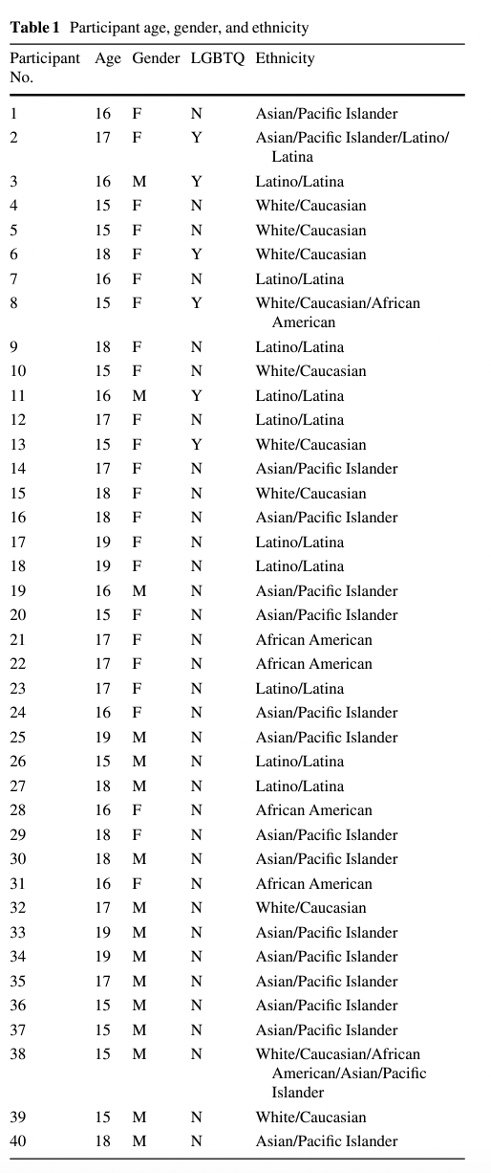
Participant demographics
Malik

Slide 38
Analysis
Each interview was transcribed, verified, and entered into HyperResearch (v. 3.0.3).
First author kept careful journals reflecting her thoughts and assumptions about the data and the interviewees
Themes emerged from the data and aligned with existing theory
  Themes for peer influence were extracted and recoded
Malik

Slide 39
Results
All spoke about peers and their influence on romantic relationship
85 % of young people reported being interested in romantic relationship before entering high school (30 % reported interest prior to middle school and 55 % reported developing an interest at some point during middle school).
Theme of pleasing partners differed between genders.
Malik

Slide 40
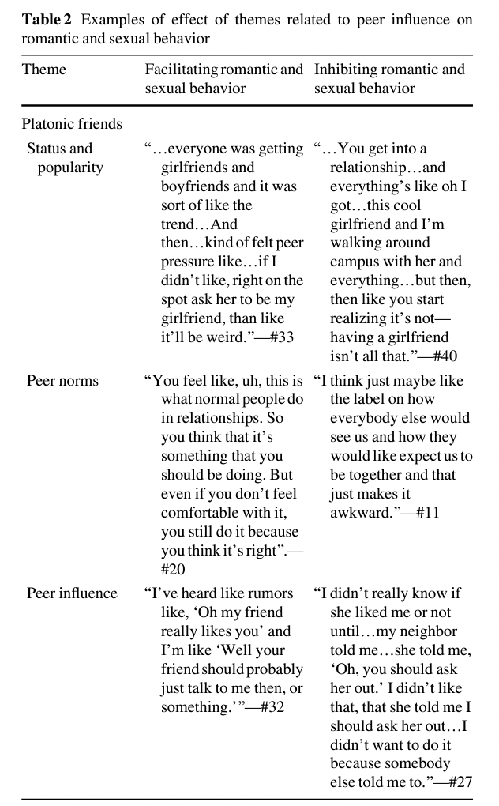
Themes related to peer influence
Malik

Slide 41
Results
Peer Norms and Expectations
Influence of Platonic Friends
Majority (90 %) of interviewees had engaged in at least one relationship due to peer influence.
Show world imp of relationship
, ‘‘…once you already have that person, you can already like, you know, show the world.’’
Most adolescents (60 %) mentioned that their friends influenced their choice to engage in relationships
‘‘Everyone was in a relationship…when you see someone has a boyfriend, you kind of want one too.’’
Malik

Slide 42
Results (Cont.)
Positive Influence from Friends
Negative Influence from Friends
(45 %) reported that their friends provided a range of support that positively affected their romantic and sexual behaviors.
‘‘Like, um, the Teen Clinic is here to help us, you know—please don’t like throw this awesome resource like away…’’.
(48 %) shared that engaging in relationships due to peer influence led to a range of negative outcomes.
‘‘…it’s my friends and I don’t want to disappoint them, and it’s kind of like, and I just went with it. And then—just awful. Yeah, it was awful.’’
Malik

Slide 43
Results (Romantic partner)
Avoiding Hurting Others
Pleasing Partners
Public Displays of Affection
(45 %) articulated that they were motivated to be in their first relationships because they wanted to avoid hurting the feelings
“They were interested in me, and…I just kind of didn’t want to say, ‘No, I don’t like you back.’…cause I didn’t want to hurt any feelings and, you know.”
(60 %) valued PDA to show
people the commitment in one’s relationship and confer popularity to observers.
“…showing the world that I want to be with you.”
(55 %) described a desire to please their partners.
Many youth felt that this motivation to please their partners was especially salient in relationships during early adolescence
Malik

Slide 44
Pleasing Partners
Female
Male
(52 %) recognized the importance of balancing the needs of their romantic partners with their own desires.
Feeling of comfort in pleasing partner- even sacrificing her belief
“I think a really common fear is having your partner lose interest in you. Like a lot of people tell me that if you wait too long, they’re going to lose interest in you so you want to keep it interesting. And that’s probably why it’s hard to speak up and that’s not going to make your partner happy so you want to stretch it out.”
(44 %) reported pleasing their partners out of concern for their partners’ welfare. E.g. reaction to breakup
Males were often motivated to please their female partners, unconvinced that young women could advocate for themselves.
So it’s more about if she’s happy, then I’m happy…”
This motivation to please female partners was compounded by the social perception of men as sexual aggressors.
Malik

Slide 45
Any comments?
Any theme which stood out to you?
Any theme you think should have come up?
Malik

Slide 46
Discussion
Peer influence to engage in romantic and sexual behavior.
- Positive and negative
Types of pressures
- Direct
- Subtle forms (behavioral display- modelling & reinforcement- PDA)
Engaging in several behaviors to please their peers and romantic partners, which often resulted in negative outcomes
Peer influence is reciprocal and transactional process
Tailoring interventions
Malik
Notes:
Limitations sample size, provide rationale for feelings & inter rater agreement

Slide 47
Discussion questions
What was the biggest take away from this study?
How can you strengthen the method of the study?
What can be possible confounds to this conclusion?
us
Malik

Slide 48
Adolescents' social relationships…
Can support or interfere with the development of successful romantic relationships.
  Adolescents with fewer other-sex friends, less positive & more negative interactions with best friends → high levels of dating anxiety.
  Never having a romantic relationship, no current romantic partner, and less positive & more negative interactions with their romantic partners → higher levels of dating anxiety.
La Greca, Annette M .; Mackey, Eleanor Race Journal of Clinical Child and Adolescent Psychology. Vol 36(4),2007, 522-533.

Slide 49
Do Adolescent Relationships Predict Social Anxiety and Depression?
Peer crowd affiliations (high and low status), positive qualities in best friendships, and a dating relationship protected adolescents against social anxiety
  But relational victimization and negative best friendship interactions predicted social anxiety.
Affiliation with a high-status crowd afforded some protection against depressive affect
  But relational victimization and negative qualities of best friendships & romantic relationships predicted depressive symptoms.
        La Greca, Annette M.; Harrison, Hannah Moore Journal of Clinical Child and Adolescent Psychology. Vol 34(1), Feb 2005, 49-61.
Notes:
Some moderating effects for ethnicity were observed.

Slide 50
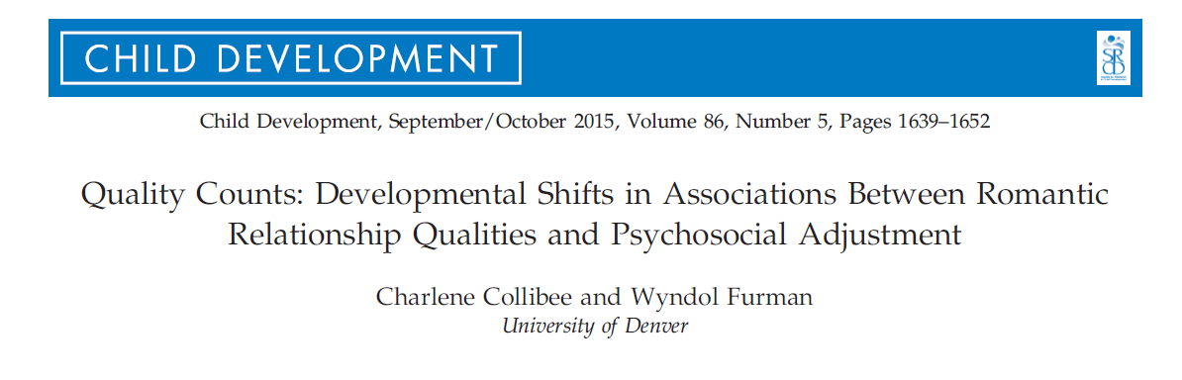

Slide 51
Methods
Followed 100 male & 100 female participants over 9 years
  From age 15-24
Assessed relationship quality
  Support
  Negative Interactions
  Relationship satisfaction
Assessed adjustment
  Internalizing and externalizing
  Substance use
  Dating satisfaction
Collibee & Furman, 2015

Slide 52
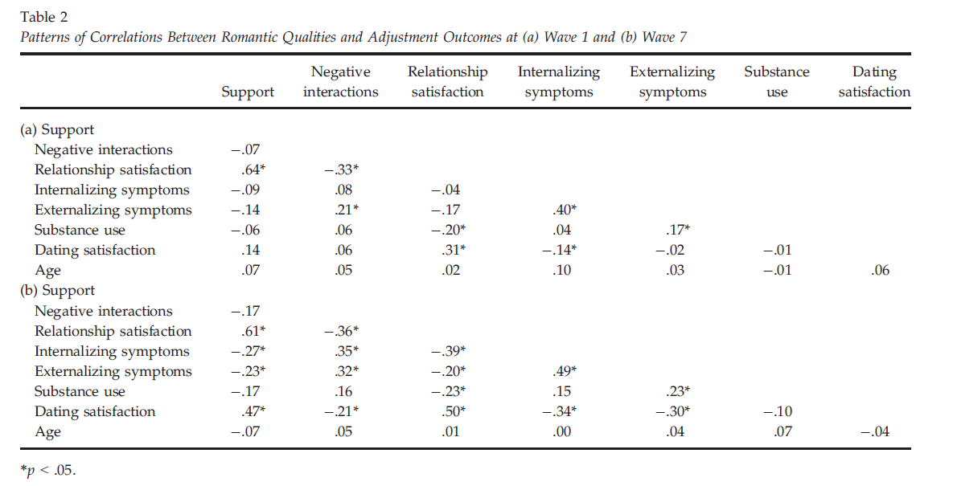
Results
Collibee & Furman, 2015

Slide 53
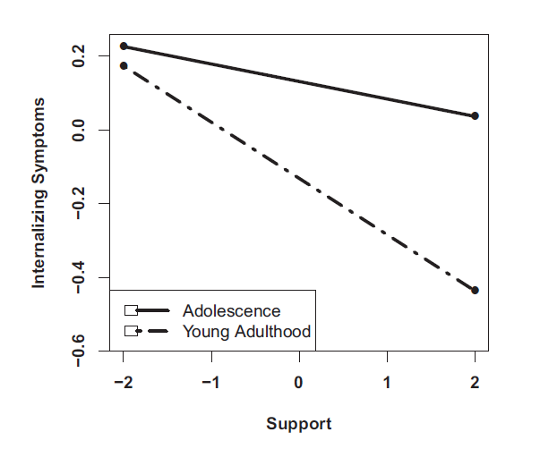
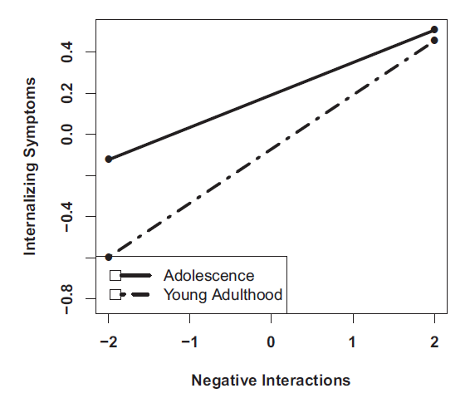
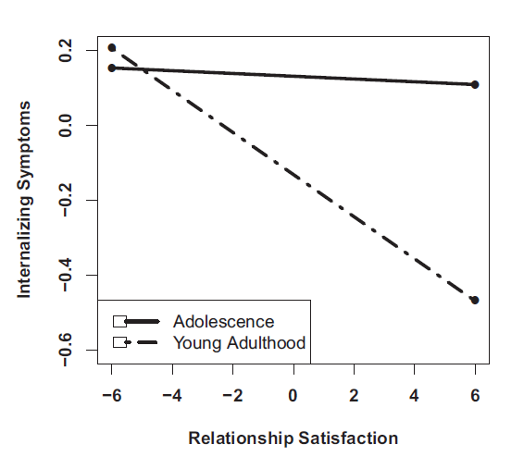
Internalizing Symptoms
Collibee & Furman, 2015

Slide 54
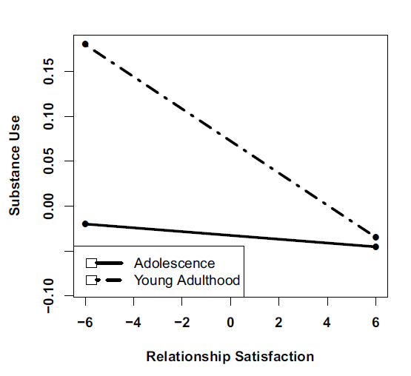
Externalizing Symptoms and Substance Use
Substance use:
Increases with age
More substance use related to more negative interactions
Teens: substance use is associated with relationship satisfaction
Externalizing symptoms:
Decreases with age
Negatively associated with romantic support, and relationship satisfaction
Associated with negative interactions
Collibee & Furman, 2015

Slide 55
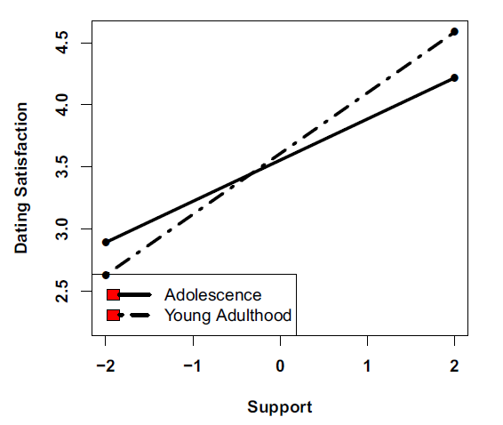
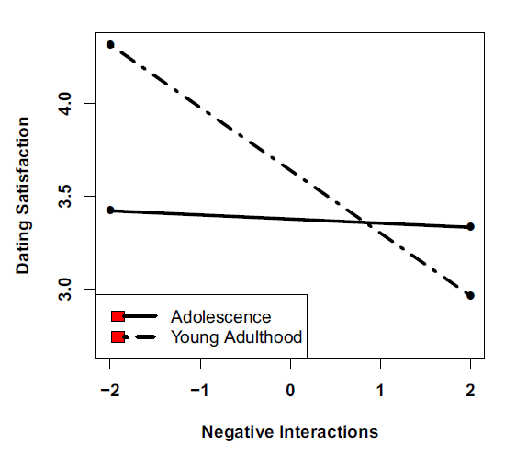
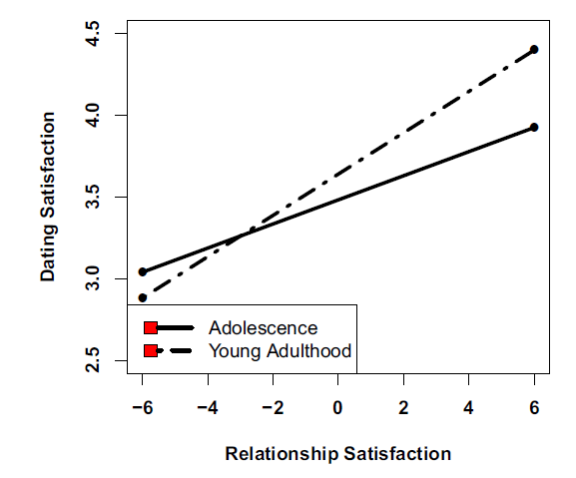
Overall Satisfaction with Dating
Collibee & Furman, 2015

Slide 56
Developmental Task Theory
Romantic relationships become more salient over time
  Adolescence—Emerging Task
    Quality matters less
    Not closely linked with future outcomes or concurrent adjustment
  Adulthood—Salient Task
    Quality matters more
    More closely tied to current and future functioning
The nature of romantic relationships change as a function of development
  Relationships become more of a secure base over time
  Being in a relationship as a teen can have negative associations
    More internalizing, externalizing, and drug use
  Being in a relationship as an adult has the opposite effect
Collibee & Furman, 2015

Slide 57
Same-sex relationships
Normative challenges in the context of disapproval/restriction
Female gender identity / relationships
  Non-linear course
Male gender identity / relationships
  More-linear course
Same-sex and mixed-sex parenting indistinguishable

Slide 58
Romantic Relationship Development: The Interplay Between Age and Relationship Length
Lantagne & Furman (2017)
Leung

Slide 59

Relationship Changes by Age
  Behavioral Systems Theory
  Romantic relationships increase in positive qualities with age
  Social Exchange Theory
    Romantic relationships increase in both positive and negative qualities with length
Leung

Slide 60
Relationship Changes by Length
Social Exchange Theory
Romantic relationships increase in both positive and negative qualities with length
200 adolescents over ages 15 years to 25 years
Measures of support, negative interactions, control, and jealousy
  Network of Relationships Inventory, Multidimensional Jealousy Scale, and Romantic Interview
Leung

Slide 61
Current Study
200 adolescents over ages 15 years to 25 years
Measures of support, negative interactions, control, and jealousy
  Network of Relationships Inventory, Multidimensional Jealousy Scale, and Romantic Interview
Leung

Slide 62
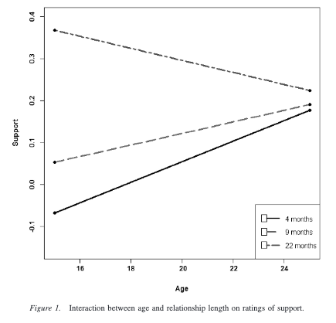
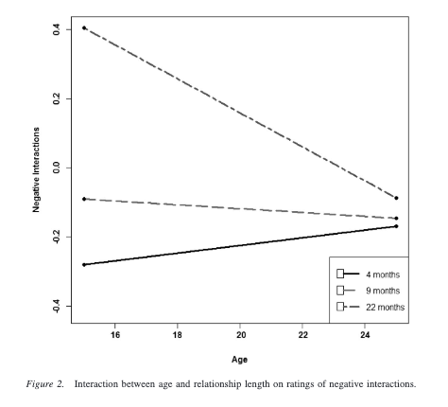
Support and Negative Interactions

Slide 63
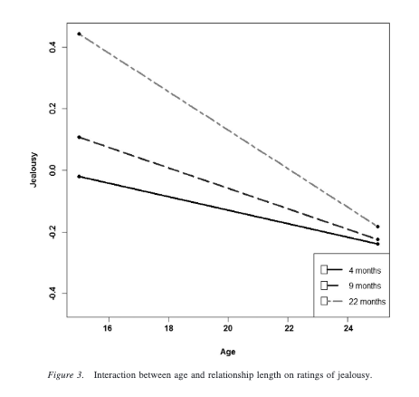
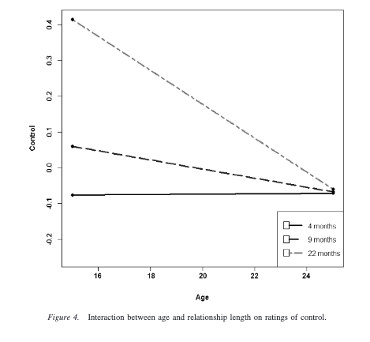
Jealousy and Control

Slide 64
Discussion
Underlying processes may influence multiple relationships qualities.
Interventions should provide adolescents with tools to build healthy relationships.
Previously understood age effects may actually be length effects.
  We should simultaneously consider both age and length.
Leung

Slide 65
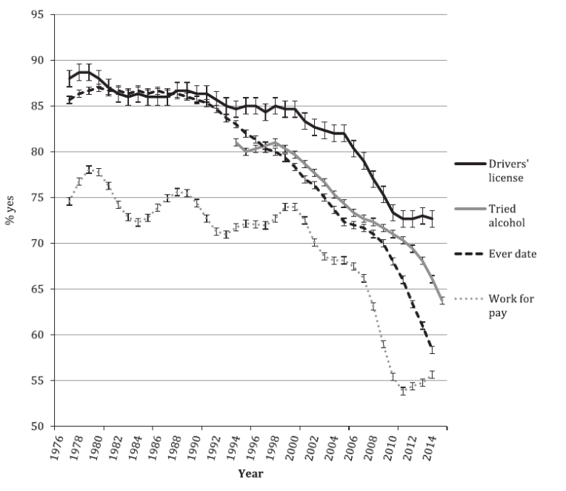
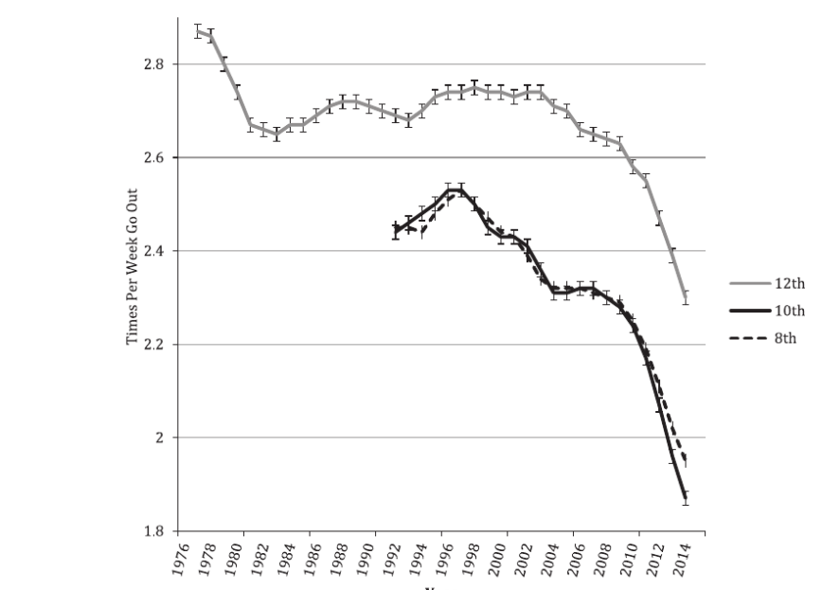
The Decline in Adult Activities Among U.S. Adolescents, 1976–2016
Twenge, J. M., & Park, H. (2017). The Decline in Adult Activities Among U.S. Adolescents, 1976-2016. Child Dev. doi:10.1111/cdev.12930

Slide 66
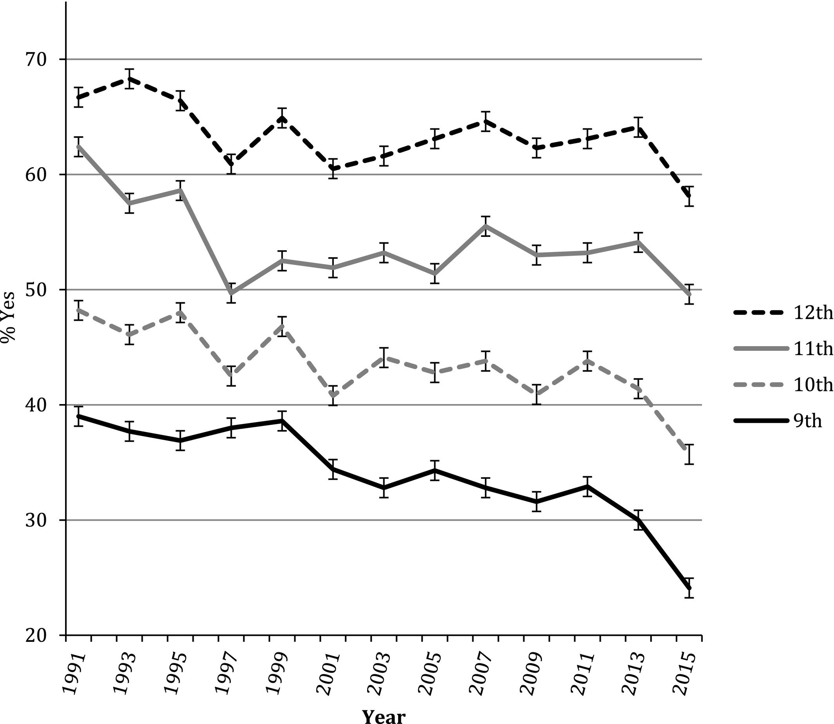
Percentage of high school students who have had sexual intercourse, 1991–2015
Child Development, Volume: 90, Issue: 2, Pages: 638-654, First published: 18 September 2017, DOI: (10.1111/cdev.12930)
Notes:
Percentage of high school students who have had sexual intercourse, 1991–2015 (with error bars; moving averages not used as data are every other year).
IF THIS IMAGE HAS BEEN PROVIDED BY OR IS OWNED BY A THIRD PARTY, AS INDICATED IN THE CAPTION LINE, THEN FURTHER PERMISSION MAY BE NEEDED BEFORE ANY FURTHER USE. PLEASE CONTACT WILEY'S PERMISSIONS DEPARTMENT ON PERMISSIONS@WILEY.COM OR USE THE RIGHTSLINK SERVICE BY CLICKING ON THE 'REQUEST PERMISSIONS' LINK ACCOMPANYING THIS ARTICLE. WILEY OR AUTHOR OWNED IMAGES MAY BE USED FOR NON-COMMERCIAL PURPOSES, SUBJECT TO PROPER CITATION OF THE ARTICLE, AUTHOR, AND PUBLISHER.

Slide 67
Homosexuality as a Discrete Class
Previous research on the latent structure of sexual orientation has returned conflicting results, with some studies finding a dimensional structure (i.e., ranging quantitatively along a spectrum) and others a taxonic structure (i.e., categories of individuals with distinct orientations).
  The current study used a sample (N = 33,525) from the National Epidemiologic Survey on Alcohol and Related Conditions (NESARC). A series of taxometric analyses were conducted using three indicators of sexual orientation: identity, behavior, and attraction.
Low-base-rate same-sex-oriented taxa for men (base rate = 3.0%) and women (base rate = 2.7%).
  Generally, taxon membership conferred an increased risk for psychiatric and substance-use disorders.
Although taxa were present for men and women, women demonstrated greater sexual fluidity, such that any level of same-sex sexuality conferred taxon membership for men but not for women.
  Norris, A. L., Marcus, D. K., & Green, B. A. (2015). Psychological Science. doi: 10.1177/0956797615598617

Slide 68

Female Bisexuality From Adolescence to Adulthood: A 10-Year Longitudinal Study. L. Diamond.
Dev Psychol. 2008 Jan;44(1):5-14. doi: 10.1037/0012-1649.44.1.5.
3 conceptualizations of bisexuality
  1. “Transitional phase”
  2. Third type of sexual orientation
  3. Heightened capacity for fluidity
Present study
  79 non-heterosexual women
  10 years, 5 assessment points. At each:
    Label self sexual identity
      Lesbian, bisexual, “unlabeled”
    % daily attractions that are same-sex
    #of sexual contacts with men & women (since last assessment)

Slide 69
Changing Identity
Bisexual and unlabeled women more likely to change identity labels > lesbians
    73% of T1 bisexuals
    83% of T1 “unlabeled”
    48% of T1 lesbians
  More likely to switch between bisexual and unlabeled IDs than to settle on lesbian or heterosexual labels.
    2/3 of ID changes: adopting bisexual or unlabeled.
  % identifying as bisexual or “unlabeled”
    T1 T2 T3 T4 T5
    57% 47% 51% 57% 58%

Slide 70
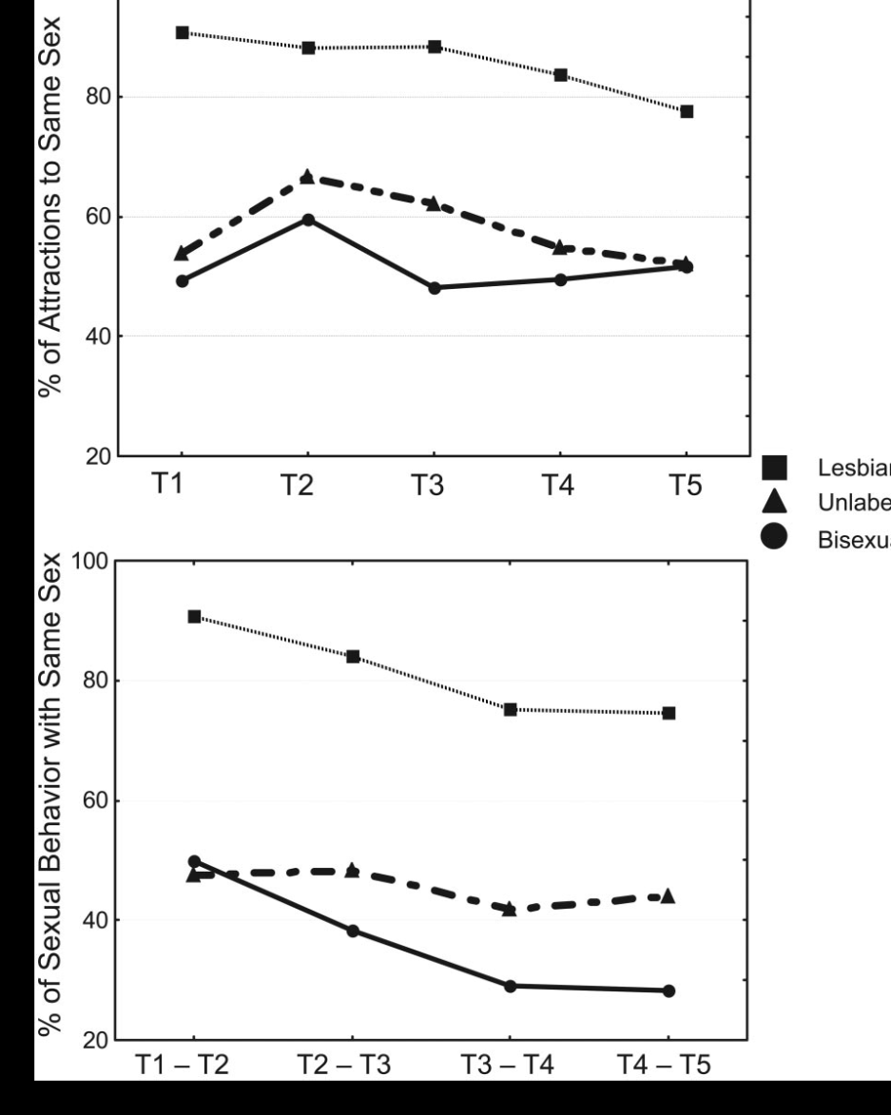
Sexual Attractions
  Same-sex attractions declined significantly among lesbians only
  Women who gave up bisexual /lesbian IDs still reported bisexual patterns of attraction in T5
Notes:
Lesbian women had significantly higher same-sex attractions

Slide 71
Sexual Behavior
  Consistent decline in same sex behavior among all women
  NOT matched by a parallel decline in same-sex attractions
  By 2005, most women involved in long term monogamous relationships.
    70% of T5 lesbians, 89% of bisexuals, 85% of unlabeled women, 67% of heterosexuals
  By 2005, 60% of T1 lesbians had had sexual contact with a man, and 30% had been romantically involved with a man
    Resolved by change in identity to bisexual/unidentified
Notes:
In 1995, behavior evenly distributed
By 2005, bimodal distribution (either exclusively with men or women)

Slide 72
Discussion
Bisexuality as stable pattern of attraction to both sexes, with balance varying based on personal and situational factors.
Identity change more common than identity stability
ID change reflects shifting experiences
  Adopt labels consistent with relationship status
  Seek to maximize fit with own prevailing pattern of attraction/behavior
Notes:
Results consistent with both “third orientation” and “heightened fluidity” models, not “transitional stage” model

Slide 73
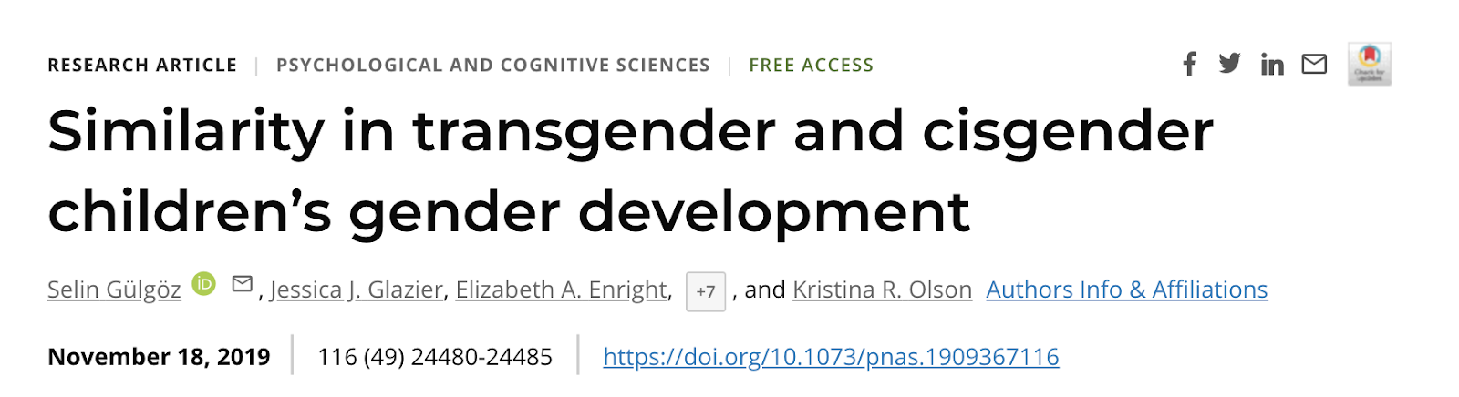
Romero, 2022

Slide 74
KEY TERMS
Assigned Sex: sex announced the day a child is born.
  “Assigned males” are children who have genitalia and chromosomes indicating a male sex at birth
  “Assigned females” are children who have the genitalia and chromosomes indicating a female sex at birth
Social Transition: A change in a child’s outward appearance and gender pronoun use.
Transgender: children who have socially transitioned and are using binary pronouns that differ from the binary pronouns used to describe them at birth.
Cisgender: children who live and present as the gender that is typically associated with their assigned sex.
Romero, 2022
Notes:
In the study the term assigned sex refers to the sex announced the day the child is born. The children this study were all assigned male or female at birth.
They use the term Social transition in the study to represent a change in a child’s outward appearance and gender pronoun use.
So for example, an assigned male would be said to socially transition if this child grew long hair, started wearing dresses and was referred to with pronouns “her” and “she.”
In the study, the pronoun change was used as the key criteria that a transition has occurred.
A social transition, in this study, does not indicate any medical (either hormonal or surgical) changes have occurred.
The researchers use the term transgender to refer to children who have socially transitioned and are using the binary pronouns (he or she) that differ from the binary pronouns used to describe them at birth.

Slide 75

METHODS
The study included 317 transgender children, 189 of their siblings, and 316 cisgender controls.
They completed measures of:
  Gender identity
    (how much they feel like a boy, a girl, something else)
  Gender-typed preferences
    (e.g., toys, clothing stereotypically associated in our culture with a gender)
Romero, 2022
Notes:
Transgender children (317 children, 3 to 12 years) were tested on various established measures of gender development, with emphasis on gender identity and gender-typed preferences and behaviors. The same measures were used in testing two comparison groups: a group of cisgender siblings of transgender participants (189 children, 3 to 12 years), and a group of cisgender controls who were unrelated to the participants in the study and were matched by age and gender to each transgender participant (316 children, 3 to 12 years).
Researchers traveled across the U.S. and Canada to meet families in their homes, or in local private settings.
They met with each family for about an hour, during which children and parents were administered separate questionnaires/interviews.
For example, children were shown some toys or clothes that varied in how stereotypically masculine or feminine they were, and the children indicated which toys or clothes they preferred. On other items, they were asked how similar they felt to boys and how similar they felt to girls.
The parents were asked about their transgender child’s gender identity, preferences and behaviors.
Children in the cisgender control group were recruited in the Seattle area and participated in their research lab, answering the exact same questions as the transgender children and their siblings.

Slide 76
MAIN FINDINGS
Researchers found that 3- to 12-year-old transgender children showed strong identification with their current gender and showed strong preferences for toys, clothing, etc., typically associated with their current gender, not their assigned sex.
The magnitude of their identification and preferences was unrelated to how long they had lived as their current gender.
Transgender children’s identities and preferences generally did not differ from their same-gender cisgender peers.
Romero, 2022
Notes:
This study showed that transgender children gender development shows similar patterns when compared to cisgender children.
The study had three main findings:
First, the study found that 3- to 12- year-old transgender children show strong identification and preferences aligned with their current gender, and not the gender associated with their assigned sex.
Second, the length of time that transgender children had spent living as their current gender (i.e., the time that had passed since they had socially transitioned) was not associated with the strength of their gender identity or the extremity of their gender-typed preferences. That is, on average, a child who socially transitioned five years ago, and a child who socially transitioned less than a year ago did not differ in the extent to which they identified with their current gender.
Third, when compared to a group of unrelated cisgender control children and a group of cisgender siblings of transgender participants, transgender children showed remarkable similarity in their gender development. That is, transgender girls (assigned as boys at birth) were similar in gender development to children who were assigned at birth as girls.
Further, both transgender and cisgender children showed similar variability in terms of how stereotype-consistent their gender development was.
So for example, among both transgender and cisgender girls, there were girls who showed preferences for toys and clothing that were very stereotypically feminine (e.g., frilly dresses, play make-up sets), and there were girls who showed counter-stereotypical preferences (e.g., cargo pants, balls).

Slide 77
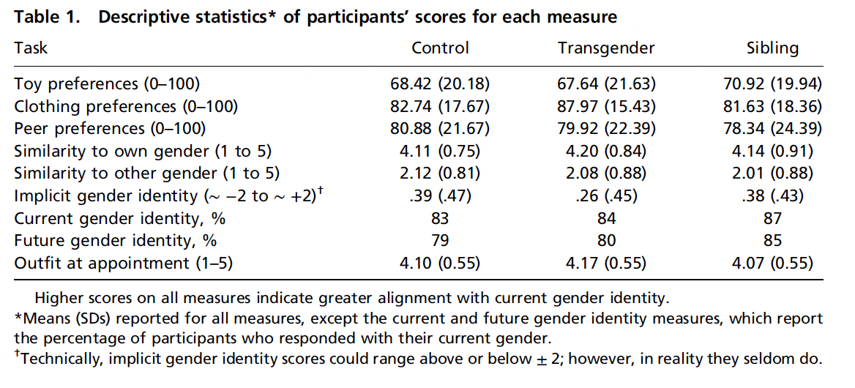

Slide 78
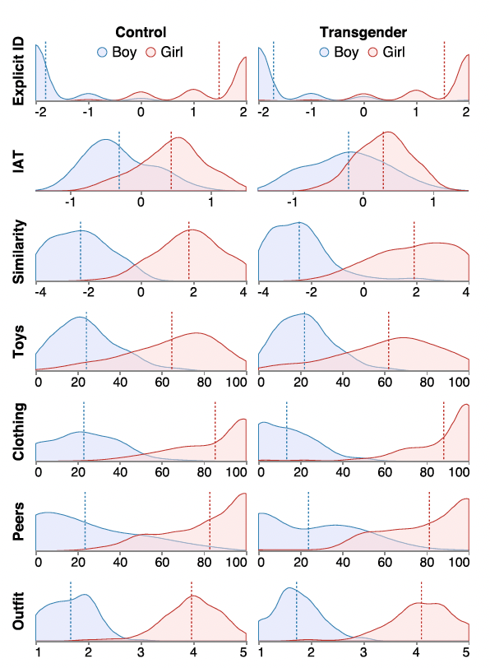
Density plots depicting distributions of girls’ and boys’ responses on each child measure across the 3 participant groups.
Higher scores on the x axis indicate greater identification/association with girls; lower scores on the x axis indicate greater identification/association with boys.
Vertical dotted lines in graphs represent means.
Romero, 2022

Slide 79

OTHER FINDINGS
Transgender and cisgender children’s gender development showed coherence.
Transgender and cisgender children’s gender development did not vary as a function of demographic variables
  race, geographic location, and parent education level.
Parents and children provided similar reports of children’s gender development.
Romero, 2022
Notes:
Apart from their main findings, the researchers did additional exploratory analysis.
First, they found that transgender and cisgender children’s gender development showed coherence. Past literature had suggested that cisgender children show coherence—or associations— between different aspects of gender development (e.g., for instance, between their identity and clothing preferences). They found the same pattern within our transgender (and cisgender) samples.
Second, they found that transgender and cisgender children’s gender development did not vary as a function of demographic variables such as race, geographic location, and parent education level. But a caveat to this finding is that their participants overall were of a restricted range of demographics (for example most of the participants had parents with college educations or above, about two-thirds were White)
And thirdly, the researchers found that parents and children provided similar reports of children’s gender development.

Slide 80
SIGNIFICANCE
Children might not be simply learning about gender based on what their parents tell them about their own gender or how they treat them early on (which would be about the gender associated with their assigned sex).
Instead, the findings suggest that children may be selectively attending to broader social messages regarding the gender they feel they are, from early ages.
Romero, 2022
Notes:
How children become aware of their gender identity and begin to show gender-typed preferences in things like clothing and toys have been and still are topics of debate among researchers.
By studying gender development in children whose current gender identity and expressions do not align with their assigned sex, this research gives some insight into the process of gender development.
Their findings suggest that children might not be simply learning what their parents tell them about their own gender or how they are treated early on but instead, they might selectively attend to broader social messages regarding the gender they feel they are.
Overall, the current findings suggest that once children identify themselves as a girl or a boy (regardless of what their assigned sex is), they might look for ways in which people around them fulfill these roles and then try to be like them.

Slide 81
DISCUSSION QUESTIONS
Sample from US and Canada with more children being from homes with higher income and higher parental education. Do you think these findings extend to other demographic groups and cultures?
The transgender participants in the study have all socially transitioned and in families that affirmed child’s current gender identity. How would results differ if researchers had studied children who identify as transgender but have not yet transitioned or who live in less supportive environments?
This study focused on children who use “he” and “she” pronouns exclusively and did not focus on nonbinary children (who are sometimes include in the broader societal use of the word “transgender”). How would the results differ if nonbinary children had been included?
Romero, 2022
Notes:
First question (can reference demographics table in the next slide) (sample very homogenous in income, parental education, and political views)
The transgender participants in the current study have all socially transitioned and live in families that that affirmed their child’s current gender identity through a social transition. The researchers do not know how the results may have differed if they had studied children who identify as transgender but have not yet transitioned, or children who live in less supportive environments

Slide 82
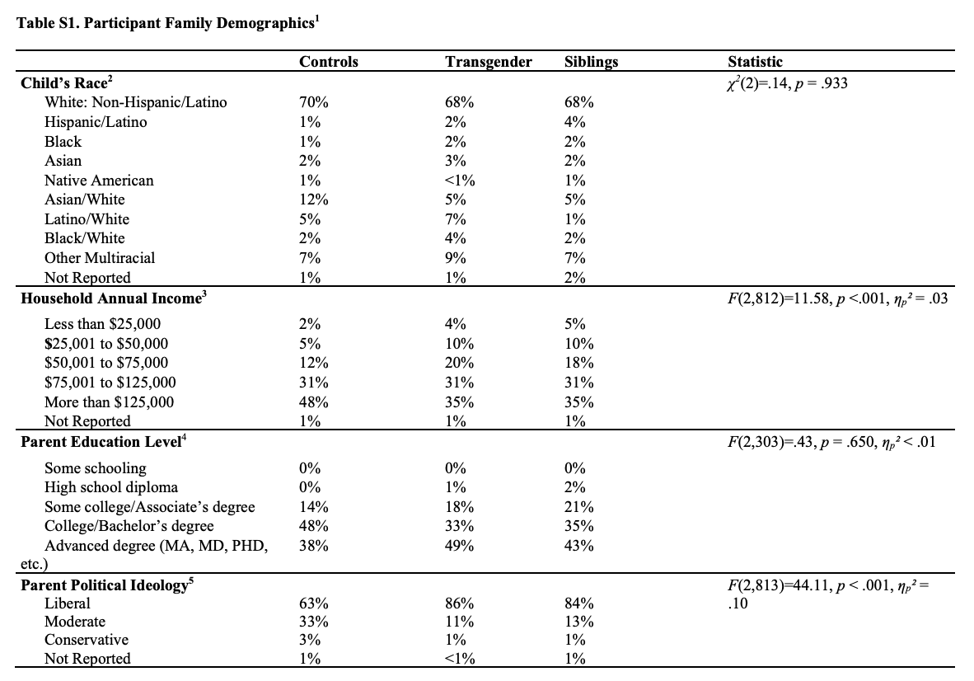
Notes:
A limitation is that all children in the current sample were from U.S. and Canadian families that often had high incomes and included parents with high levels of education. If these findings extend to children from other demographic groups and cultures is currently unknown.

