Slide 1
Social and Emotional Development
PSY 624
Daniel Messinger, PhD

Slide 2
Peer Acceptance and Social Outcomes
Aggressive rejection predicts externalizing problems
Anxious/withdrawn rejection predicts internalizing problems
Potential mechanisms?

Slide 3
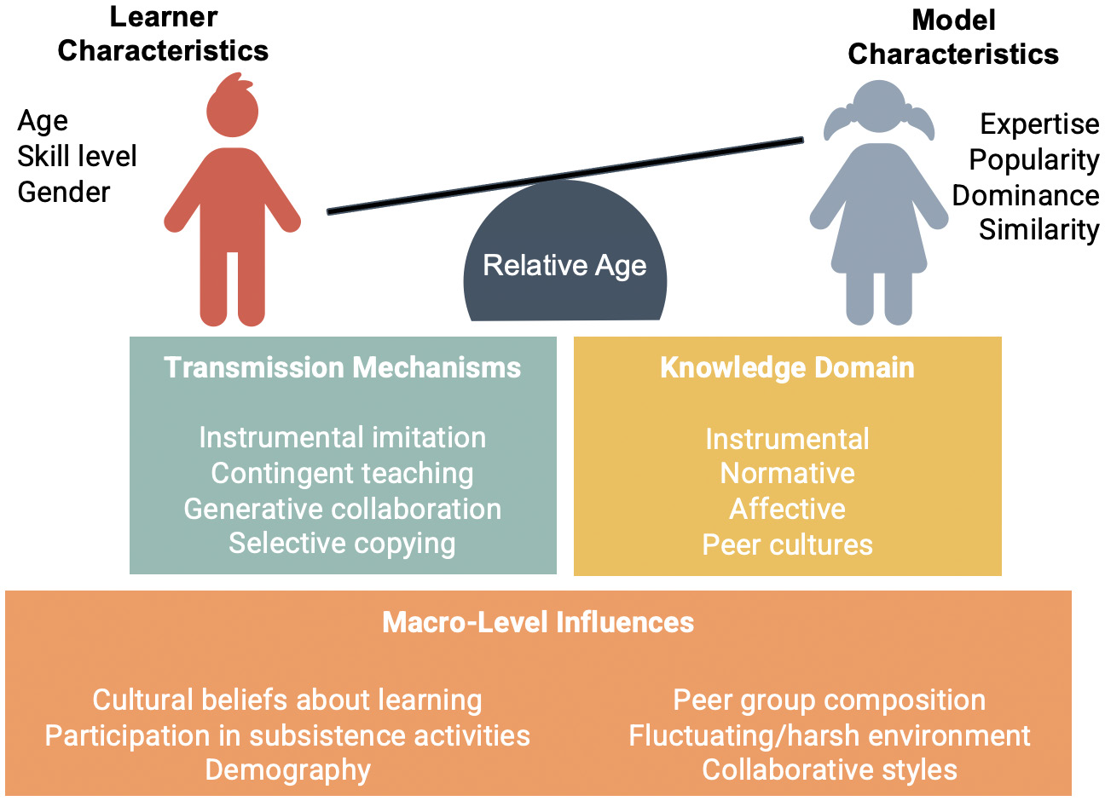
Phylogenetic Spread of Peer Learning?
Young primates spend more time with their parents in the early years, giving lots of time to learn from adults
Peer learning opportunities may vary by species - social structure, social tolerance, life history
This may constrain instrumental skill acquisition .
Puzzle box experiments with 3-to-4-year-olds and capuchin monkeys & chimpanzees showed children have a greater likelihood to collaborate
with peers than other primates

Slide 4
Overview
Transition: inhibition→social reticence→ psychopathology
Aggression and relationships (non-human primates)
Aggression and development
Relational and overt
Proactive and reactive
Slight negative association with ToM
Sources
Parental physical control
Video game violence
Your projects

Slide 6
Background
Behavioral Inhibition (BI)
Temperament assessed in toddler period
Wariness of novelty/uncertainty (i.e., novel contexts, objects, unfamiliar adults)
Social Reticence (SR)
Onlooking, unoccupied behavior in presence of unfamiliar peers
Do not engage in social or solitary play
BI has been linked to child and adolescent SR and social anxiety but ..
not all end up experiencing such outcomes
Less than 1/3 of sample displayed both behavior patterns at 2 years
Many patterns that do exist do not hold from ages 2-4 years
BI and social reticence also linked to anxiety disorders in later childhood
AIM
Examine differential trajectories from BI (temperament) to behavioral consequences (SR and psychopathology)

Slide 7
Longitudinal Method
Participants:
315 total in sample (199 complete data)
selected for temperamental reactivity to novelty at 4 months, both high and low reactive, and both positively and negatively reactive
Behavioral Inhibition (24 & 36 months)-
assessed behavior and affect using BI paradigm (stranger, robot, and tunnel tasks)
composite BI measure created for toddlerhood (average score)
Social Reticence (24, 36, 48, & 60 months)-
interacted in laboratory with unfamiliar peer
(free play, cleanup, and social problem solving tasks)
composite SR measure created based on social wariness from free play, proportion of time unoccupied on looking from cleanup, and proportion of passive problem-solving techniques used (average score)
Behavioral Outcomes (Psychopathology at 60-months or 5 years)-
mothers report behavior problems (symptom measures)- CBCL, HBQ
externalizing & internalizing composite scores created from subscales of measures

Slide 8
Analytic Plan
Used growth mixture modeling (SEM) to examine longitudinal trajectories of social reticence across early childhood:
Latent growth trajectories estimated using SR measures at 4 time points
BI then estimated as predictor of probability of membership to latent growth trajectory
Symptom-based psychopathology measures estimated within each growth trajectory and most probable trajectory membership analyzed secondarily using ANOVA

Slide 9
Social Reticence Trajectories
3 Class Model of Social Reticence Trajectories
High-Stable (n=43, 16% of sample): High level of social reticence at 2 years, with consistently higher levels and small increase over time
High-Decreasing (n=112, 43% of sample): High level of SR at 2 years, with significant decrease over time
Low-Increasing (n=107, 41% of sample): Lower level of SR at 2 years, with significant increase but still consistently low SR over time

Slide 10
BI →Probability of SR Trajectory
High-Stable/High-Decreasing SR > BI than Low-increasing SR trajectory
BI did not
As BI increases, odds of following High-Stable or High-Decreasing SR trajectories higher, but odds of Low-Increasing SR trajectory are lower
BI did not differentiate between High-Stable and High-Decreasing

Slide 11
SR Trajectory Predicts Psychopathology Symptoms
Trajectories significantly different for internalizing and externalizing problems:
High-Stable SR trajectory predicted greatest internalizing problems
Low-Increasing SR trajectory predicted greatest externalizing problems
High-Decreasing SR trajectory predicted least problems
** But all very much subclinical

Slide 12
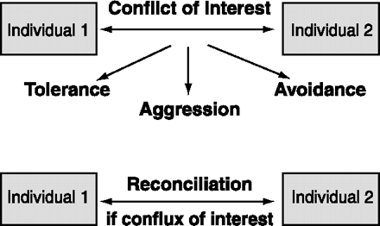
Aggression iarger context: Relational model
Other possible ways are tolerance (e.g., sharing of resources), or avoidance of confrontation (e.g., by subordinates to dominants).

Slide 13
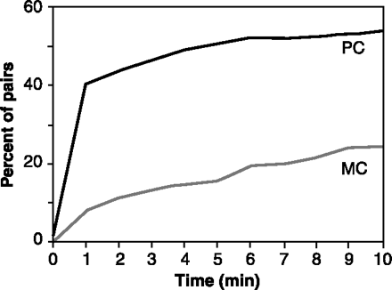
Most primates show a dramatic increase in body contact between former opponents during post conflict (PC) as compared with matched-control (MC) observations
The cumulative percentage of opponent-pairs seeking friendly contact during a 10-min time window after 670 spontaneous aggressive incidents in a zoo group of stumptail macaques

Slide 14
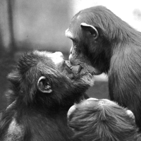
Kiss to make-up
Fig. 2. Chimpanzees typically seal a postconflict reunion, or reconciliation, with a mouth-to-mouth kiss, as here by a female (right) to the dominant male.
Aggression
De Waal, F. B. M. (2000). Primates--a natural heritage of conflict resolution. Science, 289(5479), 586-590.

Slide 15
Reconciliations allow rhesus monkeys to maintain tight kinship bonds despite frequent intrafamilial squabbles.
Shortly after two adult sisters bit each other, they reunite sitting on the left and right of their mother, the alpha female of the troop, each female holding her own infant. The sisters smack their lips while the matriarch loudly grunts.

Slide 16
Reconciliation
The nature of the social relationship determines whether repair attempts will be made, or not.
If there is a strong mutual interest in maintenance of the relationship, reconciliation is most likely.
Parties negotiate the terms of their relationship by going through cycles of conflict and reconciliation.
Examples?

Slide 17
Bonobo chimps (Pan paniscus)
The species is distinguished by an upright gait, a matriarchal and egalitarian culture, and the prominent role of sexual activity in their society.
one of the two species comprising the chimpanzee genus, Pan. The other species in genus Pan is Pan troglodytes, or the Common Chimpanzee.
http://en.wikipedia.org/wiki/Bonobo

Slide 18
Bonobo videos
http://www.youtube.com/watch?v=eubDSQrFako sex, walking, wonder
http://www.youtube.com/watch?v=Q_izpq0Ar-Y Evolution: "Why Sex?" [Chimps vs. Bonobos], evolutionary speculation

Slide 19
Human aggression
Types
Reactive and proactive aggression
Overt and covert anti-social behavior

Slide 20
Processes
Under-socialized aggressive conduct disorder associated with weak inhibition system (BIS)
Impulsivity a key (Quay)
Information Processing
Real-time processes
Somebody bumps into you at a party

Slide 21
Stability of aggression
The earlier aggression starts, the more intense the form of aggression and the longer it lasts
Stability of aggression can be as high as .76
Remarkably stable over up to 10 years
The aggressive remain so
One of the more stable psychological characteristics
But developmentally variable
Highest among 2-year-olds?
In decline by 25

Slide 22
Behavior genetics
One inherits a propensity toward anti-sociality which interacts with an environment in its (non)emergence
Genetic effects greater for self-reported than adjudicated measures of aggression
Environmental, genetic, and interactive effects evident in petty crime

Slide 23
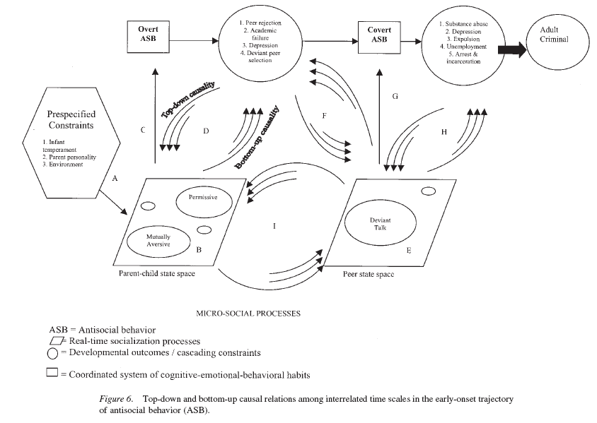
Granic & Patterson, 2006

Slide 24
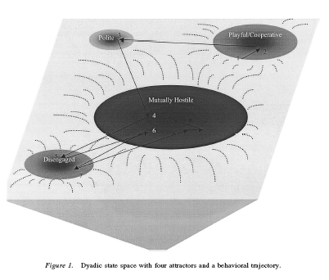
Real-time coercion
A parent–child dyad with two main interaction patterns:
A cooperative, mutually positive pattern and a hostile–withdrawn pattern in which the parent berates the child and the child ignores the parent.
As mutual positivity declines in early adolescence, existing habits of withdrawal will constrain the interactions that emerge next.
A repertoire of distance and disengagement may characterize the adolescent period, leading eventually to complete estrangement and alienation in adulthood.
(Granic & Patterson, 2006).

Slide 25
A cascade from disregard for rules of conduct at preschool age to parental power assertion at early school age to antisocial behavior in early preadolescence: Interplay with the child’s skin conductance level
GRAZYNA KOCHANSKA, REBECCA L. BROCK, AND LEA J. BOLDT
Notes:
We propose such a multilevel developmental approach, bridging several literatures: research on children’s early internalization of rules of conduct, their psychophysiology, and the parenting they receive. We test our model in a study of community families (mothers, fathers, and children) followed longitudinally from preschool age to early preadolescence.

Slide 26
Background
High levels of disregard for rules in childhood may be early signs of a trajectory toward disruptive conduct problems.
This trajectory begins early and is relatively stable
Link between children’s disregard for conduct rules and future antisocial behavior
Mediated via harsh or power-assertive discipline?
Link between parental power assertion & antisocial behavior
A developmental cascade from early disregard for rules to parental power assertion to future antisocial behavior expected for children who have low skin conductance level (SCL).
Notes:
The child’s disregard for rules or failing to feel discomfort after misbehaving is an important aspect of oppositional, disruptive conduct problems
that parents deploy toward children who display a high level of disregard for rules.
SCL is a measure of the functioning of the autonomic nervous system that reflects variations in the ease with which electrical current passes across the skin due to fluctuations in sweat gland activity.
Such children presumably fail to respond to subtle, gentle levels of parental discipline, in contrast to children with high SCL.

Slide 27
Methods
Two-parent families of typically developing infants (N = 102)
At 4.5 years, children’s disregard for rules of conduct was observed in multiple paradigms
Behavioral codes: avoiding gaze, facial tension, bodily tension, and overall distress
At 5.5 and 6.5 years, parental power-assertive discipline was observed
Behavioral codes: no interaction, social exchange, gentle guidance, control, and forceful control
At age 8, SCL was assessed
At ages 10 and 12, children’s antisocial behavior was rated by mothers and fathers.
Notes:
Avoiding gaze was coded when the child looked away, downward, or askance (if gaze avoidance lasted throughout the entire segment, it was multiplied by 2). Facial tension was coded as present when the child displayed the following: twisting or biting lips, raising/furrowing eyebrows, squinting eyes, or crinkling nose. Bodily tension was coded when the child showed squirming, backing away, hanging head down, hunching shoulders, hugging self, or covering face with hands
“no interaction,” “social exchange,” “gentle guidance,” “control,” and “forceful, negative control” and records of all physical techniques (“assertive interventions,” such as holding the child’s hand firmly, physically preventing the child from leaving the chore, blocking access to toys, and “forceful interventions,” such as handling the child roughly, wresting a toy angrily away from the child).

Slide 28
Results

Slide 29
Mediation for low skin conductance children

Slide 30
Environmental impacts: TV
Age 8 TV violence viewing predicts self-reported aggression and arrests at age 30 after statistical controls
TV accounts for 10% of child aggression variance in meta-analyses
Videogames? The armed forces?

Slide 31
Relational aggression
“Attempts to harm the victim through the manipulation of relationships, threat of damage to them, or both” (Crick et al, ’02 p.98)
Associated with internalizing/externalizing problems and later peer rejection
Preschool
Direct, face-to face behaviors
Exclusion from party
Middle Childhood
More sophisticated, direct and indirect behaviors
Direct: refuse to choose as a team member
Adolescence
Sophisticated and focused on opposite-sex relationships
Indirect: spread a rumor
Stealing a boyfriend

Slide 32
Provocation → aggression
Physically aggressive children exhibited hostile attributional biases and reported relatively greater distress for instrumental provocation situations
Getting pushed into the mud
Relationally aggressive children exhibited hostile attributional biases and reported relatively greater distress for relational provocation contexts
Not getting invited to a birthday party.
662 third- to sixth-grade children
Crick et al., 2002. CD.

Slide 34
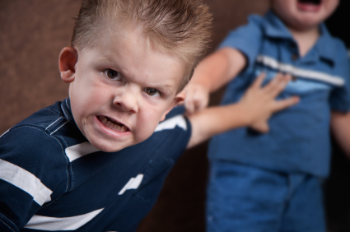
Background
Aggression- behavior intended to hurt, harm, or injure another person
Forms:
Physical
Relational
Functions:
Proactive
Reactive
Most measures confound function and form

Slide 35
Purpose of Study
Goal 1: Test developed measurement and analysis system in early childhood
Goal 2: Examine stability of aggression subtypes
Goal 3: Examine whether risk factors for aggression predicted subtypes and increases of subtypes over time

Slide 36
Hypotheses
1: young children will show four distinct forms and functions
Associations between forms and functions would be higher in early childhood than older samples
2: Forms stable but functions unstable over time
Hypothesis 3:
Girls → Relational; Boys → Physical
Older → Relational and Proactive
Social Dominance → Physical, Relational, and Proactive
Peer Exclusion → Relational and Reactive

Slide 37
Methods
Participants (N=101)
61 Girls
45.09 months (3.75 years)
Middle-Class families
Longitudinal design
2 time points
4-5 months apart

Slide 38
Measures
Observer Ratings
Teacher report
Observations of Aggression
Ratings of Aggression
Preschool Social Behavior Scale- Observer Form
Ratings of Form and Function of Aggression
Preschool Proactive and Reactive Aggression- Observer Report
Report of Exclusion
Child Behavior Scale
Report of Social Dominance and Resource Control

Slide 39
Forms and Functions of Aggressive Behavior (Murray-Close & Ostrov, 2009)
Measures (T1 & T2)
Observations of aggression
Problem?
Observer ratings of aggression
Teacher reports
Exclusion
Social Dominance
Notes:
Hypothesize more overlap in early childhood (principle of increasing differentiation with development)
Hypothesize less stability of functions than forms; expect stability in physical aggression, though
Predictors = gender, age, social dominance, experienced exclusion

Slide 40
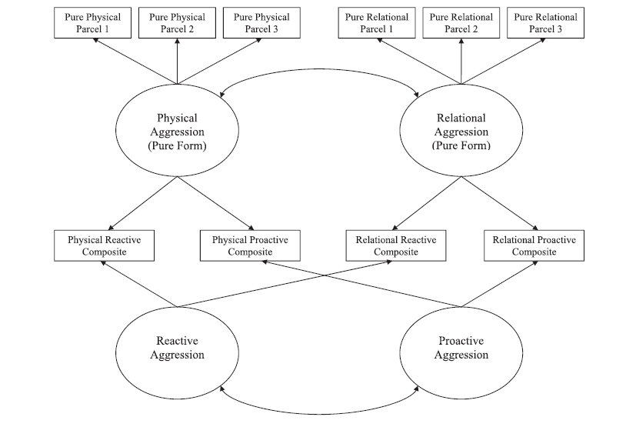
Forms and Functions of Aggressive Behavior (Murray-Close & Ostrov, 2009)
Notes:
Moderate association between physical and relational aggression
Proactive and reactive were positively associated
Overall structure supports relatively distinct forms and functions of aggression
Same structure at T1 and T2

Slide 41
Forms and Functions of Aggressive Behavior (Murray-Close & Ostrov, 2009)
Physical aggression
Less related to relational vs. older kids
Decreases with age
Forms – stable but functions – not stable
Lack of gender differences in physical
Fewer age-related changes than expected
Notes:
Longitudinal analyses control for initial levels
Therefore interpreted as change
Concurrent
Girls more relationally aggressive at T1; but boys not more physically aggressive
Older children less likely to use physical aggression
Social dominance predicted relational aggression; but not physical aggression; not proactive aggression
Exclusion associated with proactive aggression
Longitudinal Analyses
Social dominance predicted decreases in physical aggression
Exclusion predicted increases in relational

Slide 42
4 latent aggression factors: Physical, relational, proactive, & reactive
Physical, relational, proactive, and reactive
Proactive and reactive positively correlated
Physical and relational moderately associated
Forms stable but functions unstable over time
Proactive associated with increase in physical
Notes:
Relational marginally associated with decrease in physical and increase in proactive

Slide 43
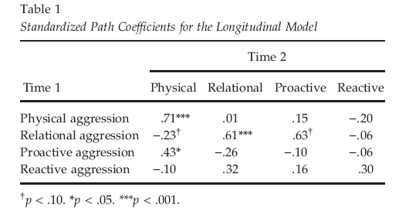
Stability over 1 year
Notes:
Both forms of aggression (physical/relational) stable over time
BUT functions (proactive/reactive) were not: WHY?

Slide 44
Predictors

Slide 45
Conclusion
Distinct forms and functions of aggression emerged by early childhood
Child-level risk factors that are associated with aggression
Intervention work may benefit from tailoring programs based on forms and functions of aggression and considering these child-level risk factors

Slide 46
Highly correlated
Physical aggression showed greater stability than, and was a precursor to, relational aggression, whereas both proactive and reactive aggression were stable and bidirectional.
All subtypes—especially reactive and physical aggression—were robustly associated with peer rejection but not with academic performance or depressive symptoms

Slide 47
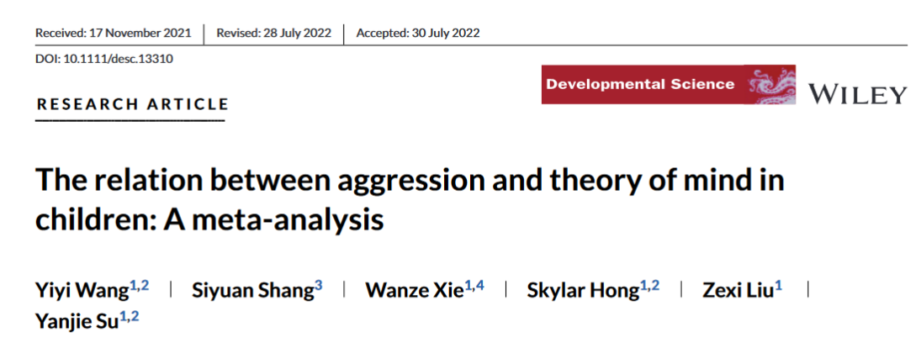
Meta-analysis combining cross-sectional and longitudinal findings from 53 studies including a total of 11,579 children aged between 2 and 15 years. The overall negative correlation between ToM and aggression was small but significant (r = −0.08). The negative correlation was robust, with the magnitude of the correlation being similar across physical versus relational aggression, proactive versus reactive aggression, cognitive versus affective ToM, preschoolers versus school-aged children, different aggression measurements, and different levels of societal individualism. Moreover, the negative correlation was found regardless of whether ToM and aggression were measured concurrently or at different time points, but the correlation was the largest when ToM was measured before aggression. Whether the aggression was bullying or not also moderated the association, with ToM only being negatively related to non-bullying aggression but not bullying. Together, these findings suggest that ToM is a single-edged sword to decrease general aggression and that aggression might also give rise to lower ToM capacity during development.

Slide 48
Trajectories of proactive-reactive aggression latent classes (K-5th)
Aggression variables were measured on a scale from 1 (Never) to 5 (Almost Always

Slide 49
Social-emotional and school outcomes for youth
Notes:
Social-emotional and school outcomes for youth in each latent aggression trajectory class. Note. Dependent variable units are represented on the y-axis, for peer problems (Panels a and b), depressive symptoms (Panels c and d), and school outcomes (Panels e–g). Development over time is represented on the x-axis by grade level (3rd to 5th) and semester (f = fall, s = spring) for all panels. See Table 3 for parameter estimates and comparison of aggression (Classes 2–4) to normative (Class 1) trajectories.

Slide 50
stereotypes
don’t-touch-task
Physical strategies include holding or pushing the child back, moving the toys out of reach, taking the toys fromthe child’s hand, or blocking the way toward the toys (see Kochanska et al., 2009). More harsh strategies such as spanking or yanking the child's arm away from the toys were also included, but these hardly ever occurred in our sample.
The task con-sists of congruent blocks in which participants are requested to sort career attributes to the male cate-gory and family attributes to the female category, and incongruent blocks in which participants have to sort career attributes to women and family attributes to men.

Slide 51
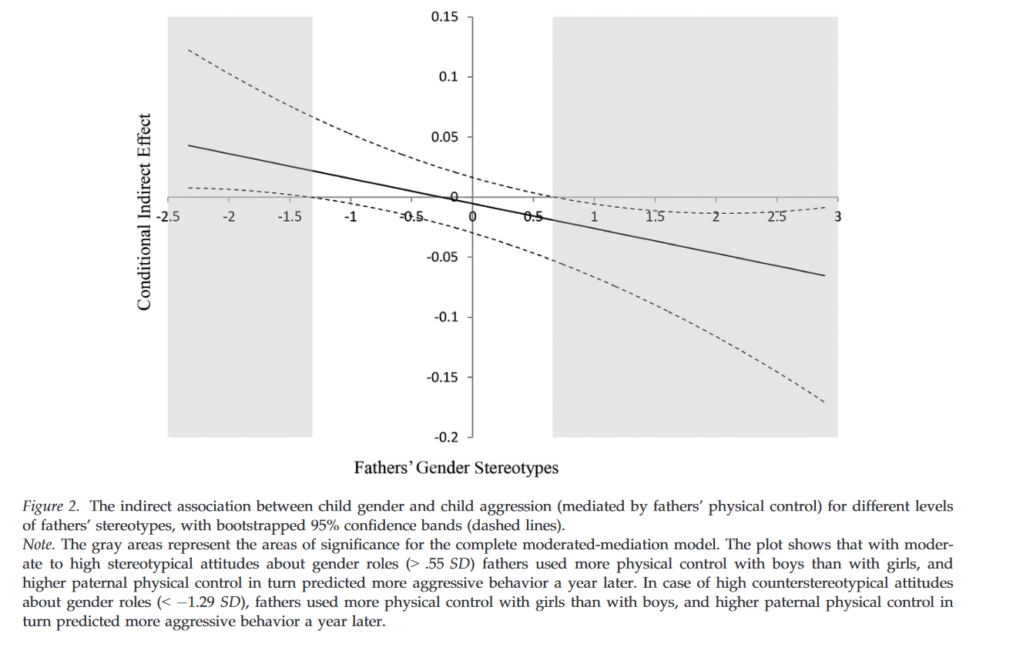
Father gender stereotypes—> father physical control (girls v boys)

Slide 52
Metaanalysis of the relationship between violent video game play and physical aggression over time
Prescott, Sargent, & Hull (2018)
Leung

Slide 53
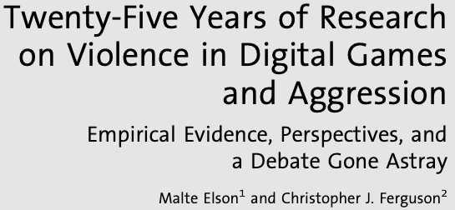
Controversy surrounding VGV aggression link
Previous studies and metaanalyses have reported a relationship between VGV and aggression.
Some researchers argue that there are fundamental issues with these studies.
Measures of “nonserious aggression”
Lack of statistical controls
Publication bias
Weak effect sizes
Leung

Slide 54
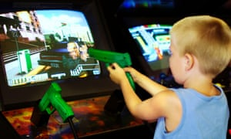
Present Metaanalysis
24 studies that assessed the link between VGV and later overt physical aggression
Over 17,000 participants
Ages 9 to 19 years
Time lags ranging 3 months to 4 years
Leung

Slide 55
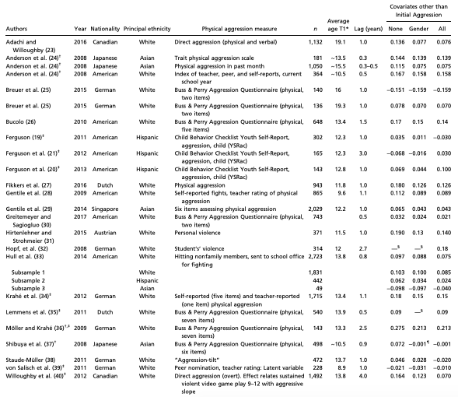
Characteristics of included studies

Slide 56
Results
VGV is associated with later overt physical aggression.
Consideration of moderators
Ethnicity
Age
Time lag
Ethnicity=White
Ethnicity=Asian
Ethnicity=Hispanic
0.4
0.2
0
-0.2
Leung
-0.4

Slide 57
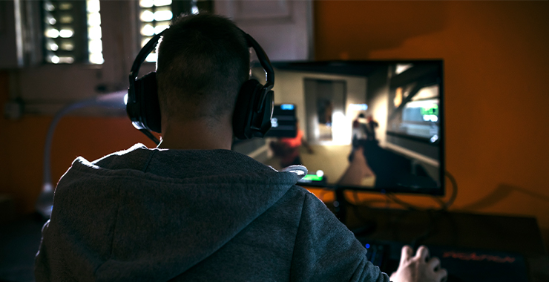
Discussion
Overall, the link between VGV and overt physical aggression may be impacted by ethnicity.
Cross-cultural differences may influence interpretation of violence.
Further findings may continue to influence policy.
Leung

Slide 58
Questions to Think About
Would these findings be different in experimental settings?
Are there differences between games where players are both perpetrators and victims of violence versus just perpetrators of violence?
Does mimicking differences in physical distance impact effects?
Leung

Slide 59
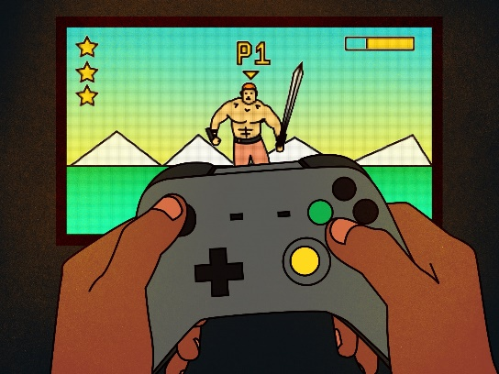
Malik

Slide 60
Introduction
Controversy regarding impact of video game violence and impact on aggression.
Studies report effects across cultures, gender and game type (Anderson et al. 2010)
Common criticism for this relationship:
Use of non serious aggression
Lack of statistical control
Publication bias
Weak effect size
Potential moderating role of ethnicity and cultures
Malik
Notes:
Violent video game play is associated with aggressive behavior, cognition, and affect, as well as negatively associated with empathy for victims of violence and with prosocial behavior (Anderson at al 2010)

Slide 61
Method
24 studies that assessed the link between VGV and later overt physical aggression
Across cultures
Over 17,000 participants
Ages 9 to 19 years
Time lags ranging 3 months to 4 years
Malik

Slide 62
Study characteristics
Malik

Slide 63
Results
Positive estimates indicate violent videogame play was associated with increases physical aggression controlling for covariates.
No publication bias
Moderator analysis
Ethnicity
Time lag
Age
Ethnicity=White
Ethnicity=Asian
Ethnicity=Hispanic
0.4
0.2
0
-0.2
-0.4
Malik

Slide 64
Standardized regression coefficients
Malik

Slide 65
Discussion
Longitudinal studies indicate a relationship between VGV and aggression controlling for covariates.
Cross-cultural differences may influence interpretation of violence.
Modest effect size .11
Practically meaningful. Any opinions?
Policy implications
Malik

Slide 66
Discussion Questions
Are you convinced of the relationship between the VGV and aggression?
What other factors can mediate this role?
Role of peers
Can video games also be used to increase prosocial behaviors?
Malik

