Slide 2
Maltreatment

Slide 3
Family environment and maltreatment
Patterns seen across maltreatment types
Family environment of coercion and abuse of power
Lower levels of prosocial behavior and verbal communication
Undervaluing of children
Deviant affective displays
Maternal intrusiveness and non-responsiveness

Slide 4
Overlap with risky behaviors
Increased likelihood to engage in a greater array of risky behaviors
Certain types of maltreatment associated with a greater number of sexual partners and heavier alcohol consumption
Adult survivors likely to engage in substance abuse, criminal and antisocial behavior, and eating disorders

Slide 5
Social development and abuse
Maltreated children often suffer from low self-esteem, self-blame, and negative affect toward self
Abuse negatively impacts peer relationships particularly if its frequent and of long duration
The longer maltreatment occurs, the greater the likelihood of peer rejection, perhaps because of tendency to engage in coercive, aggressive interactions with peers as result of abuse
Though a strong friendship may attenuate this relationship
Investigated with 107 children experiencing various types of abuse and 107 comparison children between 2nd and 7th grade
Bolger et al 1998

Slide 6
Specificity of abuse effects
Sexual abuse predicted low self-esteem
but not peer relationship problems.
Emotional maltreatment was related to difficulties in peer relationships
but not to low self-esteem.
For some groups of maltreated children, having a good friend was associated with improvement over time in self-esteem.
Bolger et al., 1998

Slide 7
Social and emotional adjustments
Maltreated children often suffer from low self-esteem, self-blame, and negative affect toward the self
Greater risk for peer rejection
The longer maltreatment occurs, the greater the likelihood of rejection, perhaps because of tendency to engage in coercive, aggressive interactions with peers as result of abuse

Slide 8
Bolger et al., 1998
107 children (56 males, 52 females) from the Charlottesville Longitudinal Study, the Child Abuse and Neglect Information System, and local files from departments of social services in Virginia
Children grouped according to maltreatment subtype and severity

Slide 9
Timing and type of maltreatment influence consequences
Chronic maltreatment - less popular
Earlier emotional maltreatment
less likely to have a reciprocated best friend
Chronic physical abuse
decreasing friendship quality
Chronic and frequent maltreatment
Low & decreasing reciprocated playmates
Sexual abuse and frequent physical abuse
lower self-esteem

Slide 10
Good friendships protect
High friendship quality and reciprocated friendships associated with resistance to negative impact of chronic maltreatment and physical abuse on self-esteem
Figs 5 - 7

Slide 11
Chronically maltreated kids likely to be rejected by peers
Maltreatment chronicity → higher levels of aggressive behavior
reported by peers, teachers, and children
Aggressive behavior accounted for association of maltreatment and rejection.
Withdrawn behavior associated with peer rejection
but doesn’t account for association of chronic maltreatment & rejection.
Bolger & Patterson, 2001

Slide 12
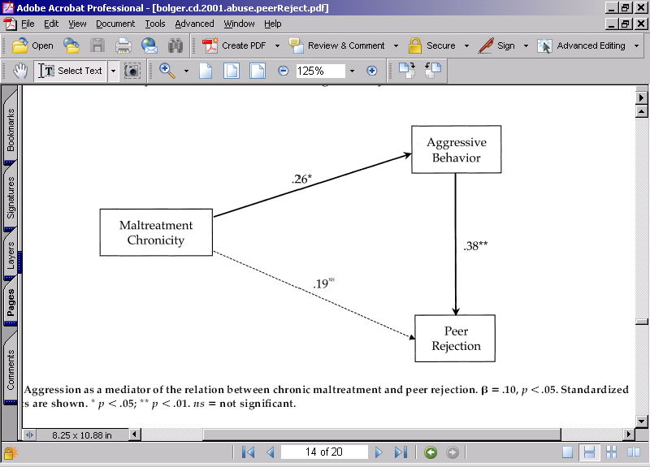
Maltreatment, aggression, & rejection

Slide 13
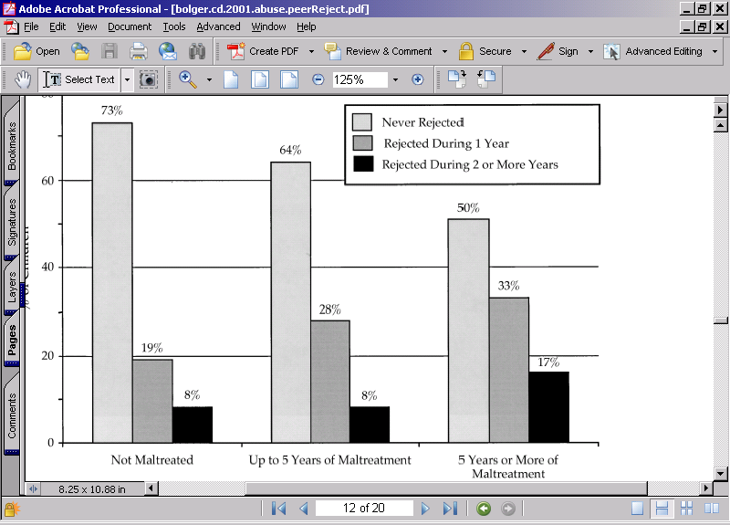
Maltreatment chronicity → peer rejection

Slide 14
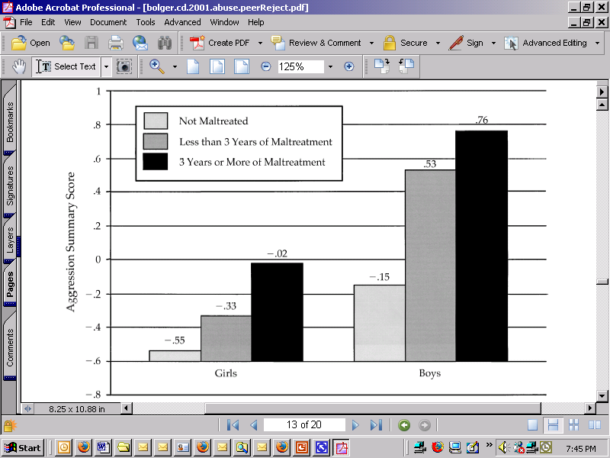
Maltreatment → Aggression
Results hold for girls and boys
Bolger & Patterson, 2001

Slide 15
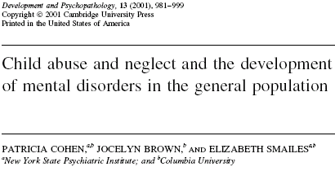
Does abuse predict malfunction?
Many children/ adolescents who suffer maltreatment become well-functioning adults
Maltreatment can result in significant negative consequences that continue into adulthood
Although many survivors function well in adulthood, others suffer serious psychological distress and disturbance

Slide 16
Why?
Maltreating parents may fail to produce opportunities for positive social interaction for their children
Children who experienced a lack of parental supervision were less likely to be accepted by peers
Tendency to engage in unskilled or aggressive behavior

Slide 17
Possible buffers
Maltreating parents may fail to produce opportunities for positive social interaction for their children
Opportunities found elsewhere (i.e., other family members, friends, teachers, etc.)
Maltreated children with best friends are more likely to experience increased self-esteem and self-concept than other maltreated children

Slide 18
Cognitive adaptations
Maltreated children create defensive structure in reaction to trauma
Cognitive distortions, dissociation, vigilance
Hypervigilance: constant scanning of environment and development of ability to detect subtle variations in it
Dissociation: alter level of self-awareness in an effort to escape an upsetting event or feeling
Psychological escape
Notes:
Attempt to be alert to possible abuse

Slide 19
Emotion regulation
Involves ability to modify, redirect, and control emotions
Maltreated children engage in efforts to avoid, control or suppress emotion
Modulation difficulties: extreme depressive reactions and intense angry outbursts
Internalizing behavior problems

Slide 20
Anger recognition & physical abuse
Physically abused children displayed a response bias for angry facial expressions.
abused 8-11-year-olds demonstrated increased attentional benefits on valid angry trials
demonstrated delayed disengagement when angry faces served as invalid cues.
.
Pollak & Tolley-Schell. Journal of Abnormal Psychology. 112(3), Aug 2003, 323-338

Slide 21
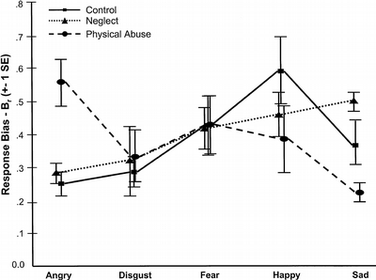
Abused see more anger
8-11-year-olds
Pollak & Tolley-Schell, 2003

Slide 22
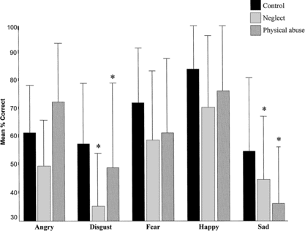
At expense of ?
sadness
Pollak & Tolley-Schell, 2003

Slide 23
Recognizing emotion in faces
Controls viewed discrete emotions discretely
Neglected children saw fewer distinctions
Neglected children had more difficulty discriminating emotional expressions than control or physically abused children.
Physically abused children showed the most variance across emotions.
Pollak, Cicchetti, Hornung, Reed, Developmental Psychology. 36(5), Sep 2000, 679-688.

Slide 24
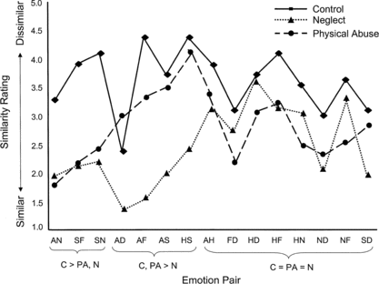
Neglected children don’t distinguish emotion expression pairs
Mean similarity ratings by emotion pair for control (C; solid line), neglected (N; dotted line) and physically abused (PA; dashed line) children. A = angry, N = neutral, S = sad, F = fearful, D = disgusted, H = happy

Slide 25
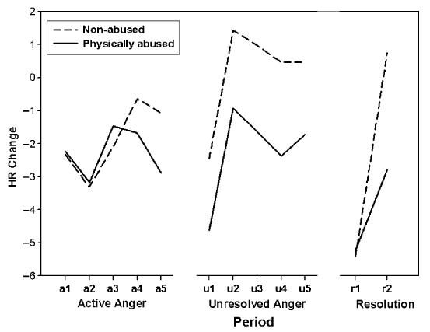
Heart rate in response to…
Active anger: Large initial deceleration for abused & non-abused children
Attentional orienting response
Unresolved anger: Eventual recovery from initial deceleration (only group effect, p<.05)
Resolution: Greater recovery for non-abused than abused children
Time only for non-abused
(bpm)
Group, p<.05
Pollak, Vardi, Bechner, & Curtin (2005). Physically Abused

Slide 26
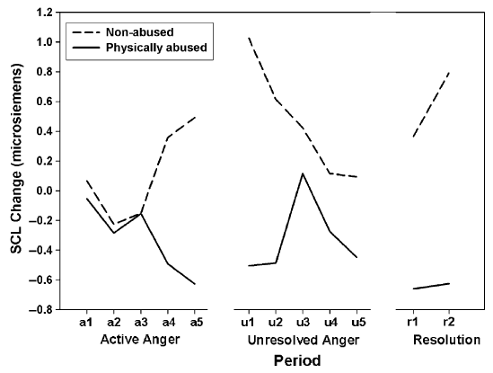
Skin conductance level change scores
Active anger: Non-abused children had emotional arousal response during second half
Abused children had relatively steady decline in SCL
Unresolved anger: Abused children had increased mid-way
Non-abused children steadily declined
Resolution: No significant main effects or interactions

Slide 27
Impact on emotion recognition
Influence of early adverse experience on children's selective attention to threat-related signals is a mechanism in the development of psychopathology.
As children's experience varies, so will their interpretation of emotion expressions.
Pollak & Tolley-Schell. Journal of Abnormal Psychology. 112(3), Aug 2003, 323-338.

