Slide 1
Advanced Developmental Psychology
PSY 620P

Slide 2
Parenting and identity
Parental divorce and children’s adjustment.
When fathers' supportiveness matters most: Maternal and paternal parenting and school readiness.
No Differences? Meta-Analytic Comparisons of Psychological Adjustment in Children of Gay Fathers and Heterosexual Parents
Adoptive Gay Father Families: Parent–Child Relationships and Children's Psychological Adjustment.
Coparenting Among Lesbian, Gay, and Heterosexual Couples: Associations With Adopted Children's Outcomes.
Similarity in transgender and cisgender children’s gender development

Slide 3
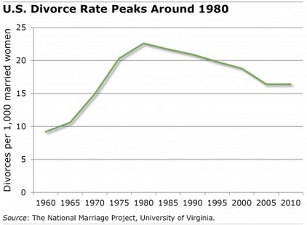
First, some stats . . .
50% of American children will experience their parents’ divorce
In the U.S., between 43% and 50% of first marriages end in divorce
Divorce has profound long-term negative effects on children’s development and mental health
vs.
Divorce has no measurable long-term impact on children

Slide 4
Parental Divorce and Children’s Adjustment
“The majority of children whose parents divorce do not have long-term adjustment problems, but the risk of externalizing behaviors, internalizing problems, poorer academic achievement, and problematic social relationships is greater for children whose parents divorce than for those whose parents stay together.” (p. 142)
Lansford, J. E. (2009). Perspectives on Psychological Science, 4, 140-152.
Notes:
Parental divorce and children’s adjustment

Slide 5
Primary Aim: Review the links between parental divorce and children’s long- and short-term adjustment
How is divorce related to different aspects of children’s adjustment?
Are there moderators of the relationship between divorce and adjustment?
Are there mediators of relationship between divorce and adjustment?
Also discusses limitations of the literature and how legal policies might affect adjustment

Slide 6
Previous Methodological Concerns . . .
not controlling for variables associated with divorce and/or adjustment
May overestimate effects of divorce on children
Example = SES & children living with single mother
Example = pre-divorce adjustment
cross-sectional designs
Adjustment is poorest in close proximity to divorce and improves over time
Examining trajectories is key

Slide 7
Divorce and Adjustment
Negative Outcome | Caveats
*Increase in internalizing & externalizing through adulthood | *Effect on externalizing symptoms may be stronger *Boys vs. girls for externalizing (may only apply to boys, younger = poorer LT outcome)
*Greater difficulties in adult romantic relationships & relationships with parents | *Romantic relationships: especially if both partners experienced divorce
*Lower academic achievement
*25% individuals experience LT social, emotional, or psychological problems as adults | *Most children whose parents divorce do not have LT adverse outcomes, & effect sizes are small

Slide 8
Moderators
Moderator | Effect
Child age at time of divorce | *Mixed due to methodological limitations *Younger= poorer outcomes *K-5 = externalizing and internalizing; 6-10 = grades
Demographics | *Results for gender mixed, hard to draw conclusions *Effect sizes for adjustment smaller for African-Americans
Pre-Divorce Adjustment | *Short-term: larger effect for children with higher pre-divorce adjustment *Long-term: larger effect for children with lower pre-divorce adjustment
Stigmatization | *Smaller effect sizes for studies from more recent decades *Less difficulties with post-divorce adjustment in U.S. than other countries

Slide 9
Mediators
Mediator | Results
Income | *Differences in poverty for single mothers (28%) vs. intact families (8%) *Some studies have found that many differences in adjustment between divorced and non-divorced children disappear after controlling for income
Conflict | *Findings that high interparental conflict related to adjustment, either controlling for or regardless of family structure *Children’s problems decrease when parents in high-conflict marriage divorce
Parenting | *Divorce thought to disrupt parenting practices BUT *Parents who divorce may have more problematic parenting before the divorce; controlling for parenting qualities attenuates effect sizes

Slide 10
Complicating Factors
Remarriage: rarely examined
Genetics: divorce is heritable
Heritable differences in positive emotionality, negative emotionality partly account for divorce,
Do genetic contributions to divorce also account for child adjustment problems?

Slide 11
Long-term issues
Cherlin et al. (1998), children born in 1958 in Great Britain.
Prior to their parents’ divorce, individuals whose parents eventually divorced had more internalizing and externalizing problems than did individuals whose parents did not divorce.
However, divorce itself also contributed to higher levels of long-term internalizing and externalizing problems into adulthood.

Slide 12
Subsequent divorce
Intergenerational studies suggest that parental divorce doubles the risk that one’s own marriage will end in divorce, in part because individuals whose parents have divorced are less likely to view marriage as a lifelong commitment (Amato & DeBoer, 2001); the risk is exacerbated if both spouses experienced their parents’ divorce (Hetherington & Elmore, 2004).

Slide 13
Lansford (2009) – Parental Divorce
Mixed results suggest some, but not all, children are negatively impacted by divorce
Moderating factors that differentiate those who are most affected?
To link to policy and intervention need to better understand mediating factors
Gender, age, ethnicity, prior adjustment/
Competence, interparent conflict, subsequent parenting
Divorce
Child Outcomes
Notes:
Moderators: Children’s age at divorce, children’s adjustment PRIOR to divorce, cultural stigmatization
Mediators = FAMILY PROCESS VARIABLES, interparental conflict, parenting, family income, parents’ well-being; DIRECT genetic effects

Slide 14
Legal Issues
No-fault vs. Fault-based divorces
Custody Policies
How much time with each parent?
Legal vs. physical custody
Joint custody has been associated with better adjustment
Child Support and Alimony

Slide 15
Protecting Children From the Consequences of Divorce: A Longitudinal Study of the Effects of Parenting on Children’s Coping
Do intervention-induced changes in mother–child relationship quality and discipline lead to short-term (6 months) and long-term (6 years) changes in children’s coping processes in 240 youth (9–12 years)?
Three-wave prospective mediational analyses revealed that intervention-induced improvements in relationship quality led to:
Increases in coping efficacy at 6 months and to increases in coping efficacy and active coping at 6 years.
Randomized, experimental trial of a parenting-focused preventive intervention designed to improve children’s postdivorce adjustment.
Vélez, C. E., S. A. Wolchik, J.-Y. Tein and I. Sandler (2011). "Protecting Children From the Consequences of Divorce: A Longitudinal Study of the Effects of Parenting on Children’s Coping Processes." Child Development 82(1): 244-257.
Tests of the mediated effects were significant for all 3 indirect paths.

Slide 17
Sample
NICHD Study of Early Child Care and Youth Development
1,364 children across 10 sites in United States
Followed from 1 month old to fifth grade
723 children selected who had lived with two parents at 54 months of age
Parents did not need to be married or biologically related to children

Slide 18
Measures
Supportiveness measured at 54 months old
Maternal Supportiveness
15 minute videotaped interaction with mother during a laboratory visit
Three tasks
Maze on Etch-A-Sketch (challenging task)
Constructing towers using blocks (challenging task)
Play with puppets (free play)
Paternal Supportiveness
15 minute videotaped interaction with father during home visit
Two tasks
Build structure with chutes and ramps for marbles to run though (challenging task)
Play with animals and jungle toys (free play)
Coded using 7-point scale
Supportive Presence
Stimulation of Cognitive Development
Notes:
Could differences in measures of maternal versus paternal supportiveness influence findings?

Slide 19
Measures
Academic Outcomes
Teacher report measures in first grade and kindergarten
Letter-Word Identification and Applied Problems from WJA administered during first grade
Social Outcomes
Kindergarten and first grade teachers rated social competency

Slide 20
Maternal>paternal supportiveness
Maternal supportiveness → all outcomes
Paternal supportiveness → teacher-rated social competence in kindergarten
Significant (if modest) negative interaction for all teacher-rated competencies

Slide 21
Fathers’ supportiveness buffers mothers’ unsupportiveness
paternal supportiveness and academic competence in kindergarten
paternal supportiveness and social competence in kindergarten
Maternal Supportiveness
Maternal Supportiveness
a. The association between paternal supportiveness and academic competence in kindergarten decreased as maternal supportiveness increased
b. The association between paternal supportiveness and social competence in kindergarten decreased as maternal supportiveness increased

Slide 22
Maternal supportiveness mattered more when paternal supportiveness lower
maternal supportiveness and academic competence in kindergarten
maternal supportiveness and social competence in kindergarten
Paternal Supportiveness
Paternal Supportiveness
c. The association between maternal supportiveness and academic competence in kindergarten decreased as paternal supportiveness increased
d. The association between paternal supportiveness and social competence in kindergarten decreased as maternal supportiveness increased
Maternal supportiveness associated with positive outcomes across a wider range of paternal supportiveness

Slide 23
Negative interaction effect
Paternal supportiveness most strongly associated with positive outcomes (academic and social competence) when maternal supportiveness is lowest
Paternal supportiveness only associated with academic and social competence when mothers scored at or below the mean on supportiveness
Maternal supportiveness only associated with social competence when fathers below the mean on supportiveness
Maternal supportiveness was associated with academic competence even when fathers scored one standard deviation above the mean on supportiveness

Slide 24
Hypothesis: Paternal supportiveness matters most when maternal supportiveness is low
Rationale
Mothers are typically children’s primary caregivers
Mothers have greater influence on children because children more exposed to mother parenting
When maternal support is high, this is sufficient to set children on positive developmental trajectory, with paternal support reinforcing maternal support
When maternal support is low, paternal support is more important

Slide 25
Background
Small field of research on gay parenting
Gay parents may be better prepared for child rearing; more egalitarian parenting
Stigma associated with same-sex parents may be detrimental
Most agree children of same-sex couples fare the same as children of heterosexual couples

Slide 26
Background
Extant research methodologically flawed
Small sample sizes
Primarily lesbian couples
Convenience and purpose sampling
No meta-analysis comparing the psychological adjustment among children of gay fathers to those of heterosexual parents
Quality-effects model

Slide 27
Current Study
H₁: Children of gay parents and children of heterosexual parents would have no statistically significant differences in psychological adjustment
H₂: The quality-effects model of meta-analyses would provide stronger statistical evidence for the no difference hypothesis

Slide 28
Methods
Searched for studies from 2005 onwards
Distinct statistics for children of gay fathers
Reported some child outcome (i.e., psychological adjustment)
Control sample
N = 10 studies; 35 standardized mean differences
Quality-effects model weighted methodological soundness of each study

Slide 29
Results
Study characteristics
19 non-US; 16 US SMDs
Sample sizes for heterosexual couples: 8 – 935
Samples for gay couples: 11 – 86
Children ranged in age from 1.5 – 18 years old
Publication bias
Include 2 studies (4 SMDs) from unpublished dissertations
Egger’s regression test showed no publication bias

Slide 30
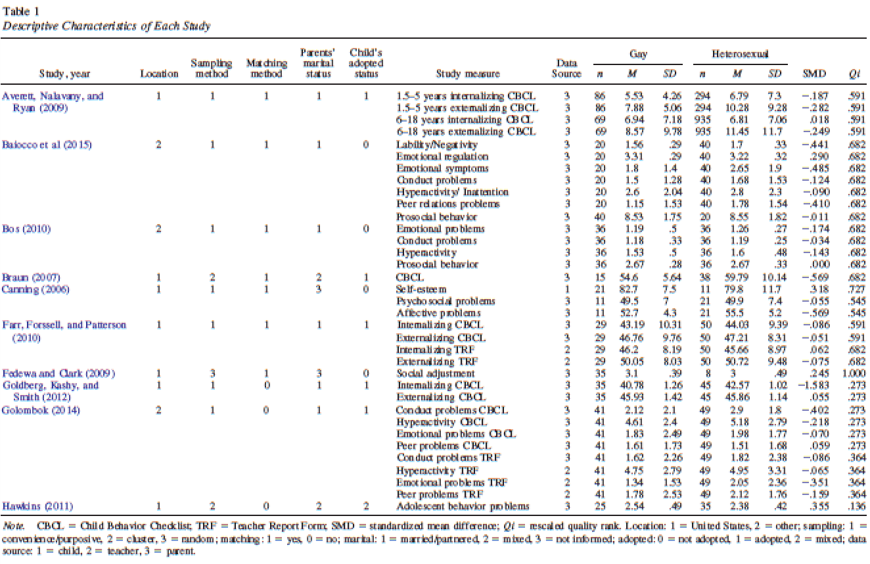

Slide 31
Children of gay parents better outcomes than children of heterosexual parents
Fixed-effects model 95% CI [-0.023, -0.091]; Random-effects model 95% CI [-0.257, -0.065]; Quality-effects model 95% CI [-0.249, -0.042]
All models were significant
Test of homogeneity indicated that fixed-effects model was not appropriate

Slide 32
Discussion
H₁ supported?
Children of gay parents actual had better outcomes
H₂ supported?
Yes, quality-effects model provided the most support for the no difference hypothesis with a CI closest to zero
So may H₁ really was supported?
When quality of studies’ methodology was accounted for, CI was closest to zero, suggesting no difference

Slide 33
Discussion
The authors cite many explanations for these findings (e.g., gay fathers are better prepared, higher income, more egalitarian parenting etc.); do you think there could be other explanations?
Do you think they appropriately assessed publication bias?
Do you buy there argument based on the 95% CI for the quality effects model?
What else could they have done about the potentially influential Goldberg and Kashy et al. article?
What did you think about the child outcomes included? And their raters? What are some other child outcomes you’d be interested in exploring?
What are the implications of these findings for parenting advice? And those involved in adoption and surrogacy processes for gay couples?

Slide 34
Crowl, Ahn & Baker (2008)
Limitations of past studies examining adjust in children of same-sex parents?
Goals of meta-analysis
Parents’ sexual orientation in relation to six domains of child functioning
Are relations moderated by participant characteristics or study design?
Notes:
Difficult to obtain random, representative sample of gay and lesbian parents (how do volunteer parents differ from other gay/lesbian parents)?
Inidividual studies based on small sample sizes, low statistical power
Small samples also homogeneous (usual only lesbian mothers; confounding of parental gender with family structure)

Slide 35
Crowl, Ahn & Baker (2008)
Dependent variables
Parent-child relationship quality
Child cognitive development
Child gender role behavior
Child gender identity
Child sexual preference
Child social and emotional development (adjustment)

Slide 36
Same-Sex parents and adjustment in adolescence (Wainright et al., 2004)
Comparison of
Family structure
Within family characteristics
Multiple domains of adjustment as DVs
Psychosocial (depression, anxiety, self-esteem)
School functioning (GPA, school connectedness)
Romantic relationships, attractions, behaviors
Family Variables (parental warmth & caring; quality of relationship with child)

Slide 37
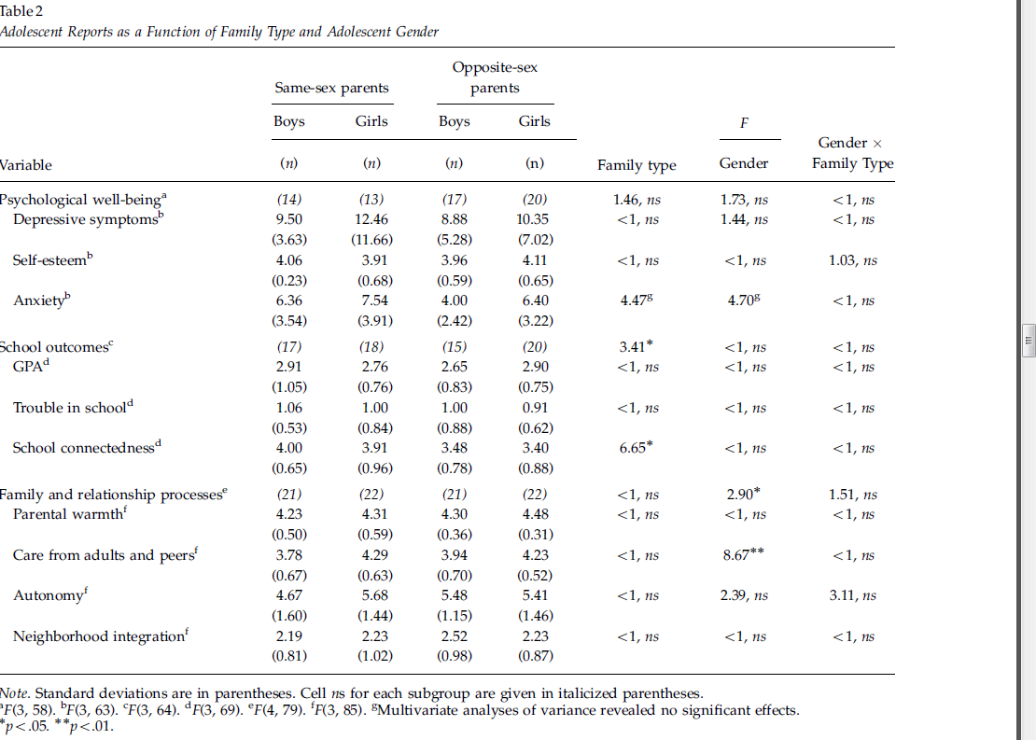
Family structure effects
Crowl, Ahn & Baker (2008)

Slide 38
Crowl, Ahn & Baker (2008)

Slide 39
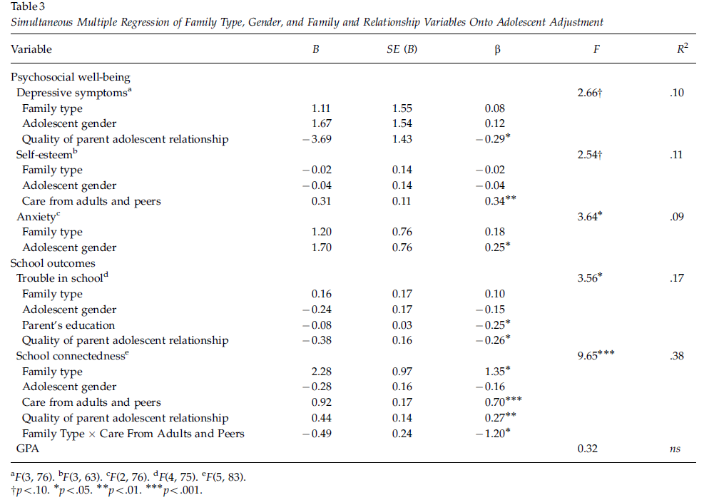
Associations with Family Functioning Variables

Slide 40
Generalizability of findings:
Other domains of development?
Other ages?
Other family configurations?

Slide 41
2014 UK Study
41 gay father families, 40 lesbian mother families, and 49 heterosexual parent families with an adopted child aged 3–9 years.
More positive parental well-being and parenting in gay father families compared to heterosexual parent families.
Child externalizing problems were greater among children in heterosexual families.
Family process variables, particularly parenting stress, rather than family type were found to be predictive of child externalizing problems.
Golombok, S., L. Mellish, S. Jennings, P. Casey, F. Tasker and M. E. Lamb (2014). "Adoptive Gay Father Families: Parent–Child Relationships and Children's Psychological Adjustment." Child Development 85(2): 456-468.

Slide 42
Coparenting Among Lesbian, Gay, and Heterosexual Couples: Associations With Adopted Children’s Outcomes
Rachel H. Farr & Charlott J. Patterson (2013)
Sun-Suslow

Slide 43
Coparenting
The degree of coordination between two adults in their roles are parents.
Ways to carry out tasks of parenting (e.g. division of labor)
Discrepancies in parental investment
Parental behaviors (supportive, undermining)
Strongly tied with child adjustment
Often studied with only heterosexual couples and their biological children
Nowlan/Sun-Suslow/Walsh
Notes:
Strongly tied with child adjustment (more so than other factors of couple relationship, and beyond that of marital quality and individual parent-child interactions; Feinberg, 2003; Teubert & Pinquart, 2010)
A predictor of children’s behavior adjustment from preschool to school age (Teubert & Pinquart, 2010)
Supportive and undermining coparenting when children are 3 years old was predicted of 4 year old externalizing behaviors

Slide 44
Why is coparenting important?
A predictor of children’s behavior adjustment from preschool to school age (Teubert & Pinquart, 2010)
Supportive and undermining coparenting when children are 3 years old was predicted of 4 year old externalizing behaviors (Schoppe et al., 2001)
Aggression
Noncompliance
Inattention
Hyperactivity
Good for Child Adjustment!
Sun-Suslow

Slide 45
Lesbian and Gay Couples
Coparenting in these couples has generally only focused on “division of labor”
Division of labor relatively even (Goldberg, 2010)
Lesbian and gay couples report wanting to divide childcare labor equally
Heterosexual women report ideally wanting to somewhat more than half
Heterosexual men report ideally wanting less than half
Patterson, Sutfin, & Fulcher, 2004
Sun-Suslow

Slide 46
Coparenting, division of labor, and child adjustment
Research suggests how parents feel about arrangement is important:
The closer actual arrangement is to ideal arrangement→ better child outcomes! (Patterson & Farr, 2011)
Fewer child behavior problems
Greater couple relationship satisfaction
Do you think it is a proxy to relationship satisfaction, which might affect child outcomes?
Nowlan/Sun-Suslow/Walsh

Slide 47
The current study
1. Compared reports about division of labor among lesbian, gay, and heterosexual couples (includes satisfaction with child-care arrangements and perceptions of parenting competence)
2. Family play interactions (observational) to assess similarities and differences in coparenting among groups.
3. Examined associations among observations, divisions of labor, parenting competence, and child adjustment across family types.
Nowlan/Sun-Suslow
Notes:
Study included 104 families with legally recognized adoptions. Only family with children ages 1 through 5 were included and parents had to be living with their children. Of note, more than half included same sex couples. Fore more information about couples, see article.

Slide 48
The current study
Parent observation
Reports of couples’ division of child-care labor
Perception of parent competence
Child outcomes
1. Compared reports about division of labor among lesbian, gay, and heterosexual couples (includes satisfaction with child-care arrangements and perceptions of parenting competence)
2. Family play interactions (observational) to assess similarities and differences in coparenting among groups.
3. Examined associations among observations, divisions of labor, parenting competence, and child adjustment across family types.
Sun-Suslow

Slide 49
Methods
Participants from 5 adoption agencies
Openly lesbian and gay couples
Openness in adoption
From jurisdictions permitting same-sex couple adoptions
Parents legally recognized, living with adoptive child (1-5 years)
N=104 families (25 lesbian, 29 gay, 50 heterosexual)
Mean parent age (42.25, SD=5.83)
Mean child age (36.07 months, SD=15.53)
Sun-Suslow/Walsh
Notes:
Heterosexual couples were less likely than lesbian or gay couples to participate in study (recruited by email or letter) = 41% vs 75% response rates.

Slide 50
Methods
Participants from 5 adoption agencies
Openly lesbian and gay couples
Openness in adoption
From jurisdictions permitting same-sex couple adoptions
Parents legally recognized, living with adoptive child (1-5 years)
N=104 families (25 lesbian, 29 gay, 50 heterosexual)
Mean parent age (42.25, SD=5.83)
Mean child age (36.07 months, SD=15.53)
Sun-Suslow/Walsh
Notes:
Heterosexual couples were less likely than lesbian or gay couples to participate in study (recruited by email or letter) = 41% vs 75% response rates.

Slide 51
Methods
Division of Labor
Observations of coparenting
In lab or home visits, videotaped unstructured play on blanket for 10 minutes
Coparenting Behavior Coding scale
Supportive
Undermining
Child adjustment (internalizing and externalizing behaviors)
Nowlan/Sun-Suslow
Notes:
Supportive = pleasure, cooperation, interactiveness, warmth
Undermining = displeasure, coldness, anger, competition

Slide 52
Hypotheses
On average, parents would demonstrate more supportive than undermining behavior, but lesbian and gay couples would demonstrate higher levels of cooperation than heterosexual couples.
Other observations of parenting would be similar.
Across groups, more supportive and less undermining behavior would be associated with greater child outcomes.
Sun-Suslow

Slide 53
Hypotheses
Greater satisfaction with division of child-care labor would be associated with more supportive coparenting and less coparenting, regardless of family type.
Also, greater satisfaction with division would be associated with greater child adjustment.
Sun-Suslow

Slide 54
Division of Child-Care Labor Reports
1 = My partner does it all
9 = I do it all
Mother
Father
Higher scores reflect greater dissatisfaction.
Mother
Father
More specialization of labor in heterosexual couples
mothers had greater dissatisfaction of arrangement
Sun-Suslow

Slide 55
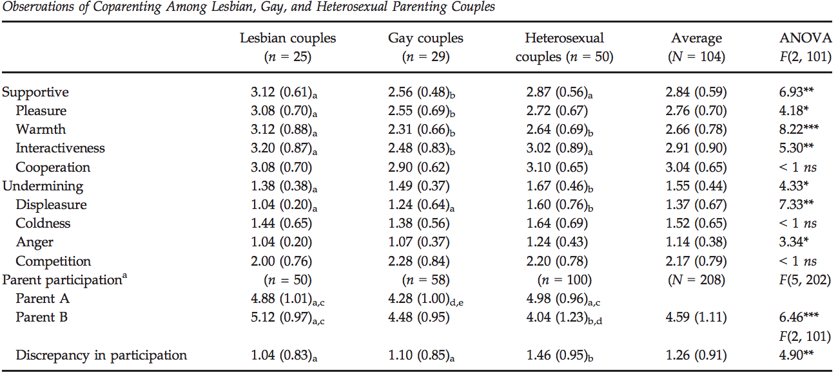
Observations of coparenting
Everyone is more supportive and less undermining
Sun-Suslow
Notes:
Lesbias couples showed most supportive interactions. Gay couple showed the least.
Heterosexuals were the most undermining
Lesbian couples showed most pleasure in play, gay couples showed the least.
Lesbian couples were the most warm, gay couples were the least warm
Interactiveness=lesbians highest, gay couples lowest
Displeasure=lesbians were lowest, heterosexuals the highest
Anger=highest in heterosexual
Coldness and cooperation=not different
cooperation=no differences between the groups
Fathers participated less in heterosexual relationships than heterosexual moms and lesbian moms.

Slide 56
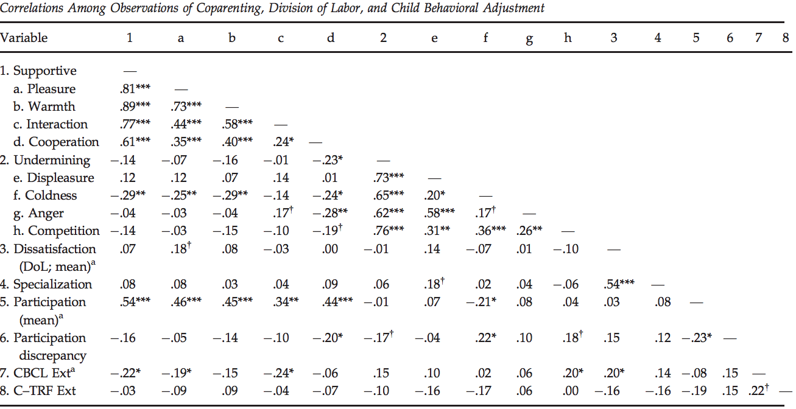
Sun-Suslow
Notes:
Parent reports of child externalixing correlated well with each other
Teacher and parent reports were associated, but only moderately
No sig association between childrens adjustment and degree to which couples specialized in child care
Hoewver, sig association between child adjustment and satisfactions with child-care arrangements.
Composite supportive parenting score was associated with decrease exteernalixing problems.
Undermining coparenting was associated with higher externalixing outcomes.

Slide 57
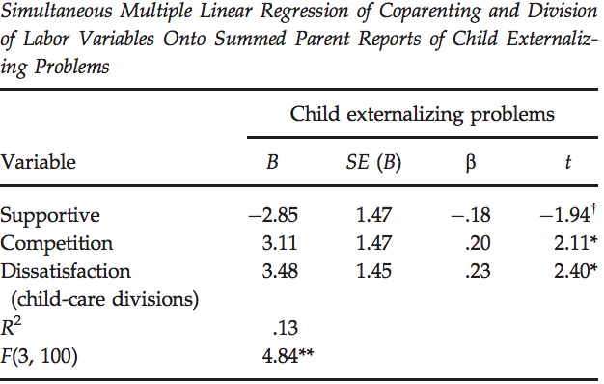
Sun-Suslow
Notes:
Moderations was not significant, functions did not differ by famiyl type (aka lesbian, gay, heterosexual)

Slide 58
Discussion Questions
Thoughts on methods?
How could results impact treatment regarding parental training?
Should we add a division of labor module?
Why do you think lesbian parents showed the most generally supportive parenting interactions in comparison to the other two groups? Can we overcome role of gender?
Did authors miss areas of observation or factors specific to same sex couples that may have impacted results?
Where can research go from here?
Nowlan/Walsh
Notes:
What could these results mean for traditional Parent Management Training interventions for children with externalizing behaviors?
Should we add a division of labor module?

Slide 59
Presenter: Katie Little
Little, 2021

Slide 60
Co-parenting: What is it?
Defined as the “degree of coordination between two adults in their roles as parents” (Farr & Patterson, 2013)
Divisions of labor / perceptions of competence
Supportive or undermining parenting behaviors (either overt or covert)
Little, 2021
Notes:
In discussion section (Naysha):
supportive parenting behaviors (warmth, cooperation, interactivness, pleasure) example – father handing his partner a tea cup for a tea party and smiling at each other (warmth) + mother talking to her partner about her day while they played with the child (interactivenss)
Undermining parenting behaviors (displeasure, coldness, anger, competition) example – parents talking over each other / suggesting different toys for child to play with

Slide 61
Co-parenting: Why is it important?
Supportive and undermining coparenting when children are 3 years old was predicted of 4-year-old externalizing behaviors
Little, 2021
Notes:
Prior research predominantly focused on heterosexual couples with biological children
Impact on child behavior beyond just associations with marital quality or parent-child relationship
Lesbian and gay couples often divide parenting labor more evenly
Less “specialization”

Slide 62
Division of Labor & Child Adjustment
Unclear how division of labor relates to child development
Predominantly, research suggests that it is less important how labor is divided
More important how parents feel about division of labor
Little, 2021
Notes:
Lesbian and gay couples report less specialization
In heterosexual couples, some debate whether there are gender-specific differences in parenting that are relevant to child outcomes

Slide 63
Gaps in the research
Mostly on biological parents / heterosexual couples

Slide 64
Recruitment
5 adoption agencies
Follow up recruitment with 4 additional agencies
Final sample of 104 families
Majority of parents (81%) were White
54 couples were same-sex couples
Children were approximately 3 years on average (only 42% white)
Little, 2021
Notes:
Both parents legally recognized; had to be in areas allowing same-sex adoptions
14% interracial couples
Children all adopted domestically

Slide 65
Division of Labor and Parenting Competence
Division of child-care labor: Who Does What? (Cowan & Cowan, 1990)
Modified for use with same-sex couples
Used a continuous variable representing specialization
Calculated using the absolute value of the difference between each of the 2 parents’ reports on each item, then calculating the mean
9 = My partner does it all
1 = I do it all
Little, 2021

Slide 66
Coparenting
Observations of co-parenting: Coparenting Behavior Coding Scale
Undermining (1-5): displeasure, coldness, anger, competition
Supportive (1-5): pleasure, cooperation, interactivenss, warmth
Children played on a 54 x 66 inch blanket
10 minutes, rated by 2 coders (3rd tiebreaker)
Toys provided, 1 set for 1-2.5 yo and 1 set for 3-5 yo
Little, 2021

Slide 67
Child Adjustment: Parent and Teacher / Caregiver Reports
Child adjustment: CBCL and C-TRF
74 teachers or caregivers of the children (71% response rate)
Focus of this study was just the externalizing symptoms
Little, 2021

Slide 68
HLM for Nested Model
Level 1: individual partners
Level 2: couples – lesbian v. heterosexual and gay v. heterosexual (heterosexual mean rating was the intercept for outcome variable of interest: either child care or perceptions of parenting competence)
Little, 2021
Notes:
Distinguishable dyads (same-sex male and female couples) v. distinguishable dyads (heterosexual couples)

Slide 69
Comparisons of Heterosexual, Lesbian, and Gay Couples
Heterosexual fathers participated less in play than mothers in any group
Couples equally satisfied across groups; heterosexual moms less satisfied than dads
Most supportive interactions
Least supportive interactions
Highest specialization
Most interactiveness
Least interactiveness
Most undermining interactions
Most warmth
Least warmth
Most displeasure
Most pleasure
Least pleasure
Highest anger
Least displeasure
Little, 2021
Notes:
OVERALL THE SAMPLE HAD HIGH LEVELS OF SUPPORTIVE PARENTING AND LOW LEVELS OF UNDERMINING

Slide 70
Relationships Among Child Adjustment, Division of Labor, and Coparenting
Child Externalizing Behaviors
X
Little, 2021
Notes:
RESULTS ARE ALL FOR PARENT REPORT NOT TEACHER REPORT
No sig association between childrens adjustment and degree to which couples specialized in child care
However, sig association between child adjustment and satisfactions with child-care arrangements.

Slide 71
Relationships Among Child Adjustment, Division of Labor, and Coparenting
Child Externalizing Behaviors
Supportive parenting
Pleasure
Interactiveness
Competition
(undermining dimension)
Little, 2021
Notes:
**CONTRARY TO HYPOTHESIS** Satisfaction NOT related to more supportive / less undermining coparenting

Slide 72
The Big Picture
No significant moderation by family type (heterosexual/lesbian/gay) for any of these associations
Multiple regression to see which predictors were most salient
Competition (coparenting)and dissatisfaction with child-care division
Trending significance for supportive parenting
Little, 2021
Notes:
Variables that were significant in predicting child externalizing problems in the simple linear models were entered into a multiple regression model

Slide 73
Importance for Adoptive Couples
Relatively high levels of supportive coparenting and low levels of undermining coparenting behaviors
Consistent with previous findings that adoptive parents have similar, and sometimes more favorable, psychological adjustment relative to biological parents
Little, 2021
Notes:
May be because there is a significant screening process for adoptive parents

Slide 74
Discussion Questions
“How might stereotyped expectations of gender play a role in cis men’s interactions with their partner and child?” (Hannah)
How would results differ if the authors used “more relationship satisfaction measures outside of parenting to better understand the couples’ dynamic” (Naysha)?
Could play skill be “potentially be responsive to intervention (teaching parents to play). If unrelated to experience, then these interactions may be related to underlying dissatisfaction with caregiving division of labor and perhaps would require different intervention (couples counseling.)” (Liz)
How are observable parenting behaviors similar or different to other observed parenting dimensions from this semester? (i.e., fluency and connectedness, joint attention, etc.) To what extent do we think these constructs overlap or have unique predictive ability for child outcomes?
What about minority stress experiences? Or invalidating parenting experiences (i.e., not being immediately recognized as the child’s parent) for either same-sex or opposite-sex adoptive couples?
Little, 2021

Slide 75
Adoptive Gay Father Families: Parent–Child Relationships and Children's Psychological Adjustment
Golombok et al., (2014)

Slide 76
Little is known about gay fathers families
Most same-sex parenting research has focused on lesbian mothers
Women better suited for parenting?
More nurturing (Biblaz & Stacey, 2010)
Double discrimination for gay fathers?
Less sex-typed behaviors in children with gay fathers (Goldberg, Kashy, and Smith (2012)

Slide 77
Social Climate
Increasing number of gay men wanting to adopt
Adoption assoc. with increased risk of psychosocial adjustment in adoptees
High parenting stress for adopters
In U.S., children with most difficult backgrounds and most challenging behaviors often placed with same-sex parents
In 2005, UK allowed gay and lesbian couples to become legal parents

Slide 78
Hypotheses
May lead to less positive parenting and child adjustment in gay father families
Family structure is less predictive of child adjustment than the quality of dyadic relationships
Analyses compared: gay vs. lesbian and gay vs. heterosexual
Family structure and family processes

Slide 79
Method
41 gay father families, 40 lesbian mother families, and 49 heterosexual parent families with an adopted child aged 3–9 years.
With family for at least 12 months
Demographics: diffs in age of adoption, length of placement, gender, employment status of parent, ethnicity, and relationship status
Boys more likely to be adopted by gay fathers and girls by lesbian mothers

Slide 80
Procedure
Parenting: The Trait Anxiety Inventory, Edinburgh Depression Scale, and the PSI
Interview: adapted questionnaire of parent-child relationship
Interview coded for warmth, sensitive responding, enjoyment of play, amount of interaction, quality of interaction, frequency of battle, level of battle, disciplinary indulgence, and disciplinary aggression

Slide 81
Procedure
Etch-A-Sketch task and co-construction task
Coded for child and parent responsiveness, dyadic reciprocity and cooperation (1 to 7 scale)
Child Adjustment – Strength and Difficulties Questionnaire (parent and teacher) w/ focus on externalizing and internalizing problems
Sex-typed behaviors – Preschool Activities Inventory

Slide 82
Results
Used regression to assess differences between family types
Controlled for age at adoption and length of placement
Question: Should any other covariates be included?
MANCOVAS for: SDQ and PSAI

Slide 83
Gay fathers compared to heterosexual families
Lower levels of parental depression & stress
Higher levels of self-reported warmth and more interactions
Interaction with child: greater responsiveness, and lower levels of disciplinary aggression
No differences between gay and lesbian families

Slide 84
Higher rates of externalizing problems in heterosexual families (according to parents)
Family process variables, particularly parenting stress (2ndarily disciplinary aggression), rather than family type, were predictive of child externalizing problems.
No differences for sex-typed child behaviors

Slide 85
Conclusion
Children in gay or lesbian families are functioning similarly to their peers in heterosexual families
Gay fathers display positive parenting traits
Gay and lesbian couples should be allowed to adopt

Slide 86
Lucette, 2017

Slide 87
Background
Psychological adjustment comparable in children in same-sex parent and heterosexual parent families
Golombok et al. (2014) found better outcomes in adoptive gay father families compared to heterosexual parent families
Children born through surrogacy differ in several aspects
Greater emotional/behavioral problems at 7 in children born to surrogacy
Lucette, 2017

Slide 88
Background
Little research on children born to surrogacy
A few questionnaire-based studies
Good psychological adjustment
Current study
Controlled and in-depth
Hypothesis: gay father families experience greater difficulties than lesbian mother families
Lucette, 2017

Slide 89
Methods
40 gay father families
55 lesbian mother families
Children age 3-9
Outcomes
Quality of parenting (interview)
Parent child interaction (Observation)
Perceived stigma (questionnaire)
Children’s adjustment (questionnaire + interview)
Lucette, 2017

Slide 90
Results
Lucette, 2017

Slide 91
Comparisons between the 2 groups
No difference on parenting quality, perceived stigma, externalizing behaviors, parent-child interaction
No difference with regard to psychiatric disorder
Predictors of children’s adjustment
Quality of parenting and perceived stigma x externalizing behaviors
Lucette, 2017

Slide 92
Conclusion
Social and family processes have a greater impact on child adjustment than gender and sexual orientation of parents
Lucette, 2017

Slide 93
Discussion
What would be a good follow up study?
Why might perceived stigma/poor parenting be related to poorer adjustment only when children’s behaviors were rated by parents?
Impact of recruitment protocol/small sample size on findings?
(clinical) implications?
Lucette, 2017

Slide 94
Romero, 2022

Slide 95
KEY TERMS
Assigned Sex: sex announced the day a child is born.
“Assigned males” are children who have genitalia and chromosomes indicating a male sex at birth
“Assigned females” are children who have the genitalia and chromosomes indicating a female sex at birth
Social Transition: A change in a child’s outward appearance and gender pronoun use.
Transgender: children who have socially transitioned and are using binary pronouns that differ from the binary pronouns used to describe them at birth.
Cisgender: children who live and present as the gender that is typically associated with their assigned sex.
Romero, 2022
Notes:
In the study the term assigned sex refers to the sex announced the day the child is born. The children this study were all assigned male or female at birth.
They use the term Social transition in the study to represent a change in a child’s outward appearance and gender pronoun use.
So for example, an assigned male would be said to socially transition if this child grew long hair, started wearing dresses and was referred to with pronouns “her” and “she.”
In the study, the pronoun change was used as the key criteria that a transition has occurred.
A social transition, in this study, does not indicate any medical (either hormonal or surgical) changes have occurred.
The researchers use the term transgender to refer to children who have socially transitioned and are using the binary pronouns (he or she) that differ from the binary pronouns used to describe them at birth.

Slide 96
METHODS
The study included 317 transgender children, 189 of their siblings, and 316 cisgender controls.
They completed measures of:
Gender identity
(how much they feel like a boy, a girl, something else)
Gender-typed preferences
(e.g., toys, clothing stereotypically associated in our culture with a gender)
Romero, 2022
Notes:
Transgender children (317 children, 3 to 12 years) were tested on various established measures of gender development, with emphasis on gender identity and gender-typed preferences and behaviors. The same measures were used in testing two comparison groups: a group of cisgender siblings of transgender participants (189 children, 3 to 12 years), and a group of cisgender controls who were unrelated to the participants in the study and were matched by age and gender to each transgender participant (316 children, 3 to 12 years).
Researchers traveled across the U.S. and Canada to meet families in their homes, or in local private settings.
They met with each family for about an hour, during which children and parents were administered separate questionnaires/interviews.
For example, children were shown some toys or clothes that varied in how stereotypically masculine or feminine they were, and the children indicated which toys or clothes they preferred. On other items, they were asked how similar they felt to boys and how similar they felt to girls.
The parents were asked about their transgender child’s gender identity, preferences and behaviors.
Children in the cisgender control group were recruited in the Seattle area and participated in their research lab, answering the exact same questions as the transgender children and their siblings.

Slide 97
MAIN FINDINGS
Researchers found that 3- to 12-year-old transgender children showed strong identification with their current gender and showed strong preferences for toys, clothing, etc., typically associated with their current gender, not their assigned sex.
The magnitude of their identification and preferences was unrelated to how long they had lived as their current gender.
Transgender children’s identities and preferences generally did not differ from their same-gender cisgender peers.
Romero, 2022
Notes:
This study showed that transgender children gender development shows similar patterns when compared to cisgender children.
The study had three main findings:
First, the study found that 3- to 12- year-old transgender children show strong identification and preferences aligned with their current gender, and not the gender associated with their assigned sex.
Second, the length of time that transgender children had spent living as their current gender (i.e., the time that had passed since they had socially transitioned) was not associated with the strength of their gender identity or the extremity of their gender-typed preferences. That is, on average, a child who socially transitioned five years ago, and a child who socially transitioned less than a year ago did not differ in the extent to which they identified with their current gender.
Third, when compared to a group of unrelated cisgender control children and a group of cisgender siblings of transgender participants, transgender children showed remarkable similarity in their gender development. That is, transgender girls (assigned as boys at birth) were similar in gender development to children who were assigned at birth as girls.
Further, both transgender and cisgender children showed similar variability in terms of how stereotype-consistent their gender development was.
So for example, among both transgender and cisgender girls, there were girls who showed preferences for toys and clothing that were very stereotypically feminine (e.g., frilly dresses, play make-up sets), and there were girls who showed counter-stereotypical preferences (e.g., cargo pants, balls).

Slide 98
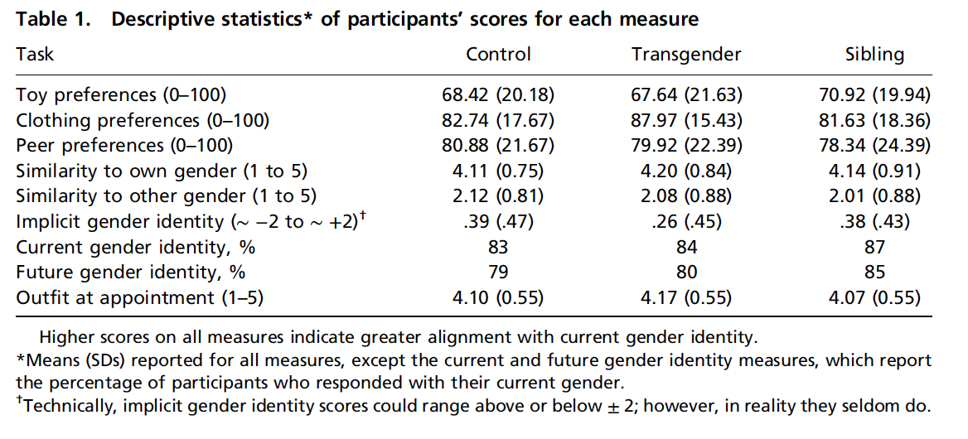

Slide 99
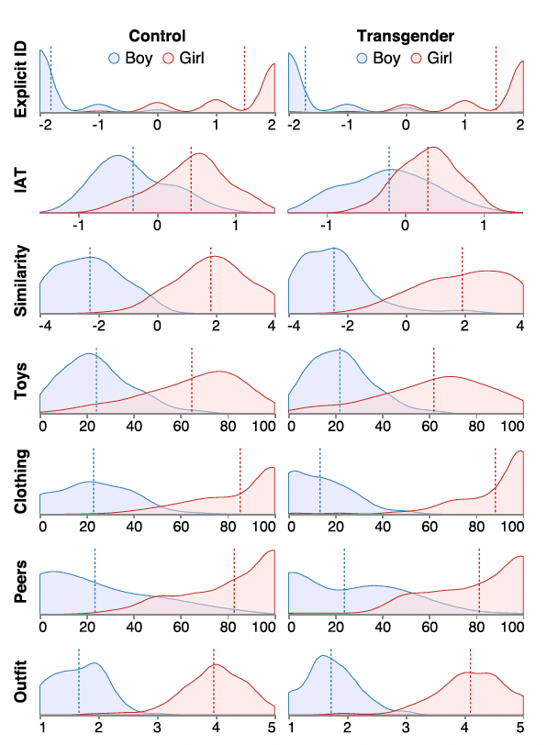
Density plots depicting distributions of girls’ and boys’ responses on each child measure across the 3 participant groups.
Higher scores on the x axis indicate greater identification/association with girls; lower scores on the x axis indicate greater identification/association with boys.
Vertical dotted lines in graphs represent means.
Romero, 2022

Slide 100
OTHER FINDINGS
Transgender and cisgender children’s gender development showed coherence.
Transgender and cisgender children’s gender development did not vary as a function of demographic variables such as race, geographic location, and parent education level.
Parents and children provided similar reports of children’s gender development.
Romero, 2022
Notes:
Apart from their main findings, the researchers did additional exploratory analysis.
First, they found that transgender and cisgender children’s gender development showed coherence. Past literature had suggested that cisgender children show coherence—or associations— between different aspects of gender development (e.g., for instance, between their identity and clothing preferences). They found the same pattern within our transgender (and cisgender) samples.
Second, they found that transgender and cisgender children’s gender development did not vary as a function of demographic variables such as race, geographic location, and parent education level. But a caveat to this finding is that their participants overall were of a restricted range of demographics (for example most of the participants had parents with college educations or above, about two-thirds were White)
And thirdly, the researchers found that parents and children provided similar reports of children’s gender development.

Slide 101
SIGNIFICANCE
Children might not be simply learning about gender based on what their parents tell them about their own gender or how they treat them early on (which would be about the gender associated with their assigned sex).
Instead, the findings suggest that children may be selectively attending to broader social messages regarding the gender they feel they are, from early ages.
Romero, 2022
Notes:
How children become aware of their gender identity and begin to show gender-typed preferences in things like clothing and toys have been and still are topics of debate among researchers.
By studying gender development in children whose current gender identity and expressions do not align with their assigned sex, this research gives some insight into the process of gender development.
Their findings suggest that children might not be simply learning what their parents tell them about their own gender or how they are treated early on but instead, they might selectively attend to broader social messages regarding the gender they feel they are.
Overall, the current findings suggest that once children identify themselves as a girl or a boy (regardless of what their assigned sex is), they might look for ways in which people around them fulfill these roles and then try to be like them.

Slide 102
DISCUSSION QUESTIONS
The sample was from US and Canada and was skewed with more children being from homes with higher income and higher parental education. Do you think these findings extend to other demographic groups and cultures?
The transgender participants in the study have all socially transitioned and lived in families that affirmed their child’s current gender identity. How would these results differ if the researchers had studied children who identify as transgender but have not yet transitioned or who live in less supportive environments?
This study focused on children who use “he” and “she” pronouns exclusively and did not focus on nonbinary children (who are sometimes include in the broader societal use of the word “transgender”). How would the results differ if nonbinary children had been included?
Romero, 2022
Notes:
First question (can reference demographics table in the next slide) (sample very homogenous in income, parental education, and political views)
The transgender participants in the current study have all socially transitioned and live in families that that affirmed their child’s current gender identity through a social transition. The researchers do not know how the results may have differed if they had studied children who identify as transgender but have not yet transitioned, or children who live in less supportive environments

Slide 103
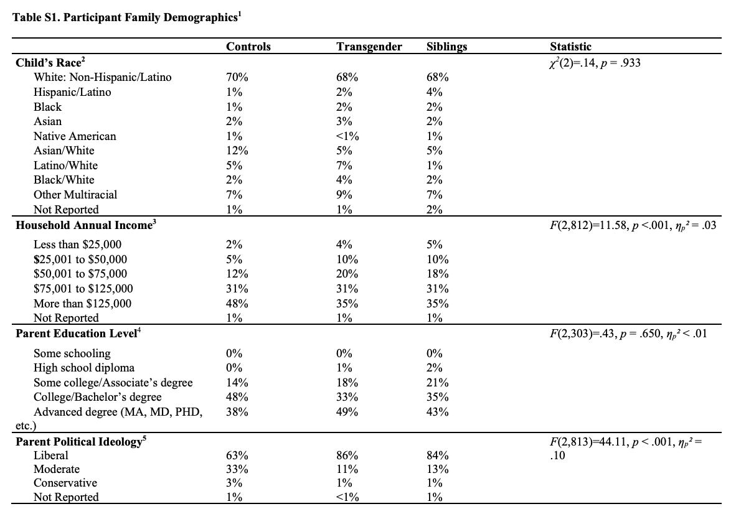
Notes:
A limitation is that all children in the current sample were from U.S. and Canadian families that often had high incomes and included parents with high levels of education. If these findings extend to children from other demographic groups and cultures is currently unknown.

