Slide 1
Classroom effects and outcomes
Daniel Messinger, PhD

Slide 2
Previously…
Jutagir | Schaefer et al., 2010

Slide 3
Effects of child and classroom characteristics on peer play (Howes et al., 2008)
Study goals
  Relative influence of child vs. context characteristics on change in peer interactions over 6 months
  Child characteristics
    Age
    Gender
    Ethnicity
    Ethnic match
    Language match
  Classroom characteristics
    Classroom diversity
    Entry policy
Notes:
Sample = 170 ethnically-diverse low income children; T1 mean age = 3 yrs; T2 mean age = 3.5 yrs
Entry policy = all together vs. staggered entry

Slide 4
Peer Interaction Measures
  Revised Peer Play Scale
    Peer engagement (parallel, simple social, reciprocal, cooperative, complex social)
    Complex play (reciprocal, cooperative, complex social)
  Affective Quality of Play
    Anxious
    Aggressive
    Prosocial

Slide 5
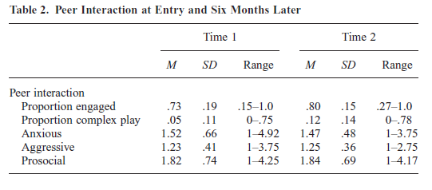
Peer Interaction at Entry vs. 6 months
Proportion engaged increase with time
Prosocial increase with time
  Proportion engaged increase with time
Notes:
Prosocial increase with time
Ethnicity on behavior ratings; af amer higher aggression; asian amer higher anxiety

Slide 6
Classroom context effects

Slide 7
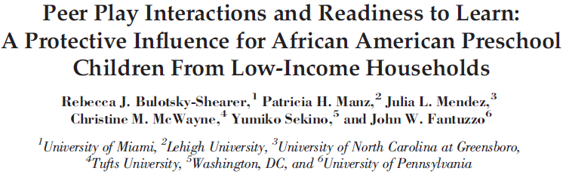
Reviews positive influence of peer play on academic and social outcomes for African American preschool children
  Previous research mostly on white & middle-income children
Strengths-based resiliency framework
Developmental ecological theory
  Within-group variability
Transactional and bidirectional effects

Slide 8
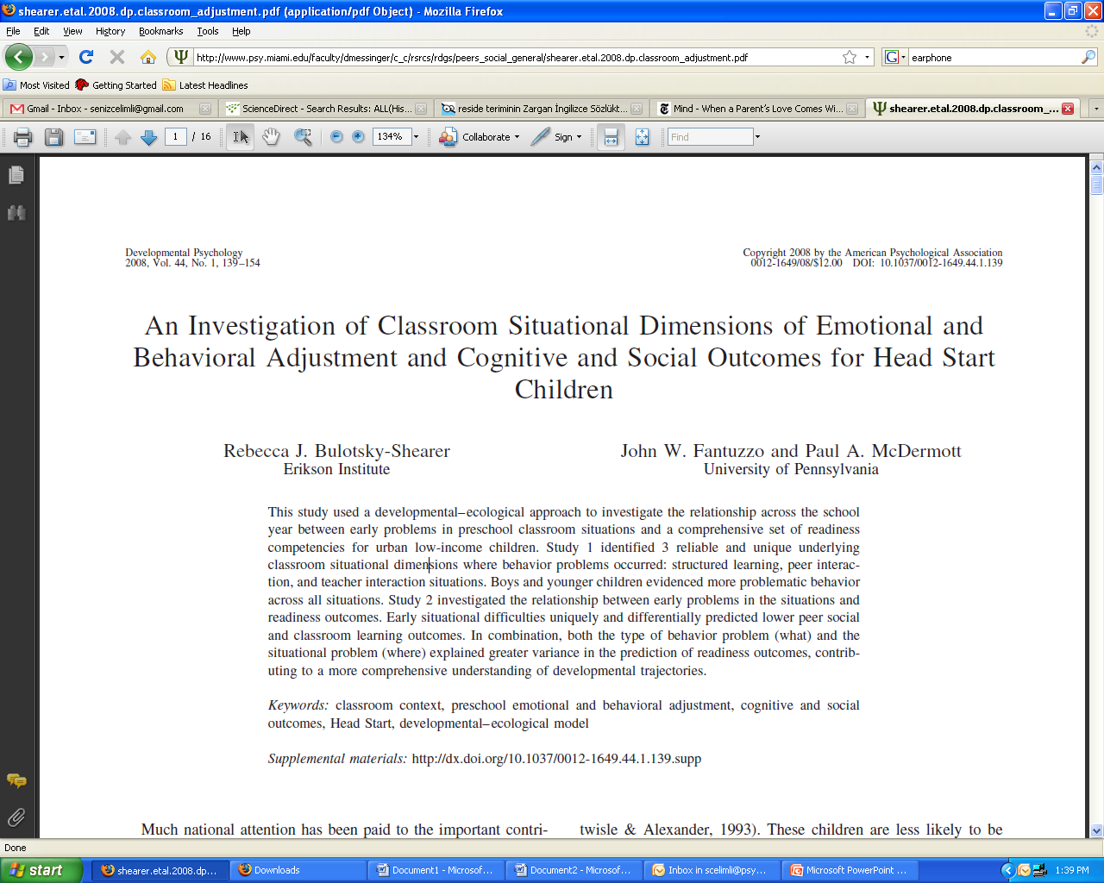

Slide 9
EMOTIONAL & BEHAVIORAL ADJUSTMENT
Within Routine Classroom Situations
(Situational Needs)
Problems in
Structured Learning
Problems in
Peer Interactions
Problems in
Teacher Interactions
Involvement in class activities
Taking part in games with
others
Maintaining companions/
friends
Paying attention in class
Sitting during teacher directed activities
Free play/individual choice
Working with hands (art)
Getting along with peers
Behaving in classroom
Respect for others’
belongings
Reaction to correction
Telling the truth
Standing in line
Talking to teacher
General manner with teacher
Answering teacher questions
Greeting teacher
Seeking teacher help
Helping teacher with jobs

Slide 10
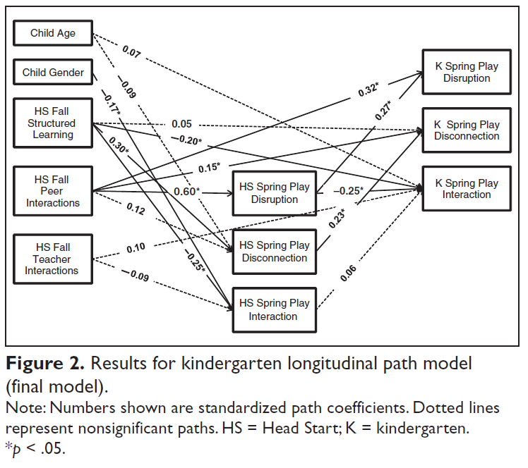
Fall Head Start Situational Interactions Predict
Later Head Start and Kindergarten Social Competence
Problems in peer interactions directly and indirectly affected play disruption at the end of kindergarten through effect on play disruption at the end of Head Start
Problems in structured learning situations indirectly predicted play disconnection at the end of kindergarten through effect on play disconnection at the end of Head Start.
Bulotsky-Shearer, Dominguez, Bell, Rouse, & Fantuzzo, 2010

Slide 11
Effects of child and classroom characteristics on peer play
Preschoolers particularly sensitive to contextual influences on social interaction skills
  Adaptive outcomes depend on goodness-of-fit between child characteristics and context
Howes, C., Sanders, K., & Lee, L. (2008). Entering a new peer group in ethnically and linguistically diverse childcare classrooms. Social Development, 17,
Notes:
Why?
b/c peer skills are still developing (still reliant on scaffolding/support from environment)
The classroom context (nesting of children within classroom, diversity, and entry policy) accounted for more of the variance in both complex play and peer anxiousness ratings than did child characteristics.

Slide 12
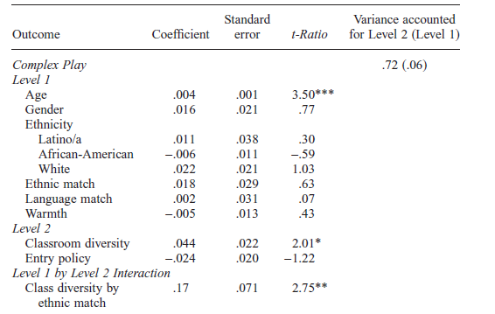
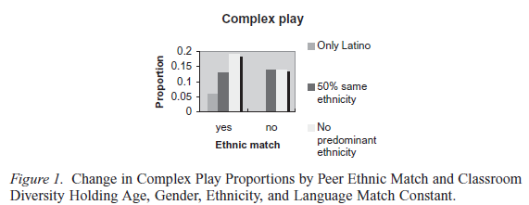
More diverse classes → Complex Play increase, particularly if ethnically matched peer present
Notes:
Older changed most in complex play
On average more diverse classes had greater increase, particularly if had an ethnically matched peer

Slide 13
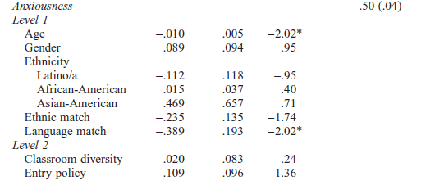
Anxiousness
Younger children decreased more (b/c very high to start with)
Children who had a peer with shared home language had larger decreases
Decreases for children who had a peer with shared home language
Notes:
Younger children decreased more (b/c very high to start with)
Children who had a peer with shared home language had larger decreases

Slide 14
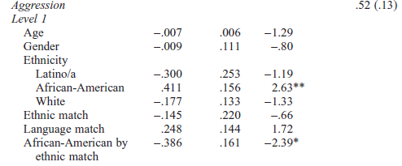
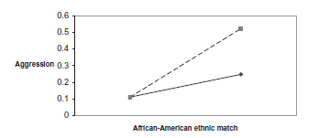
Aggression
African-Americans had greatest increase in aggression if no ethnically matched peer

Slide 15
Context
  Classroom variations accounted for up to 72 percent of the variance in complex play and at least 50 percent of the variance in peer ratings (anxiousness ratings).
  The classroom context (nesting of children within classroom, diversity, and entry policy) accounted for more of the variance in both complex play and peer anxiousness ratings than did child characteristics.

Slide 16
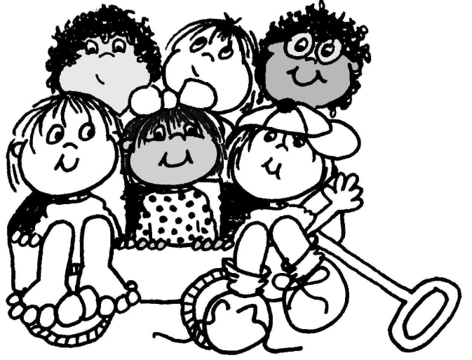

Classroom-composition effects
  A child’s externalizing behavior is explained by the child-care histories of children in their classrooms above and beyond their own
Child-care History, Classroom Composition, and Children’s Functioning in Kindergarten. Dmitrieva, Steinberg, Belsky. 2007.
http://pss.sagepub.com/content/18/12/1032.abstract
Notes:
Peer contagion
Non-parental child care associated with
Elevated levels of externalizing behavior
Enhanced linguistic, cognitive, and academic functioning

Slide 17
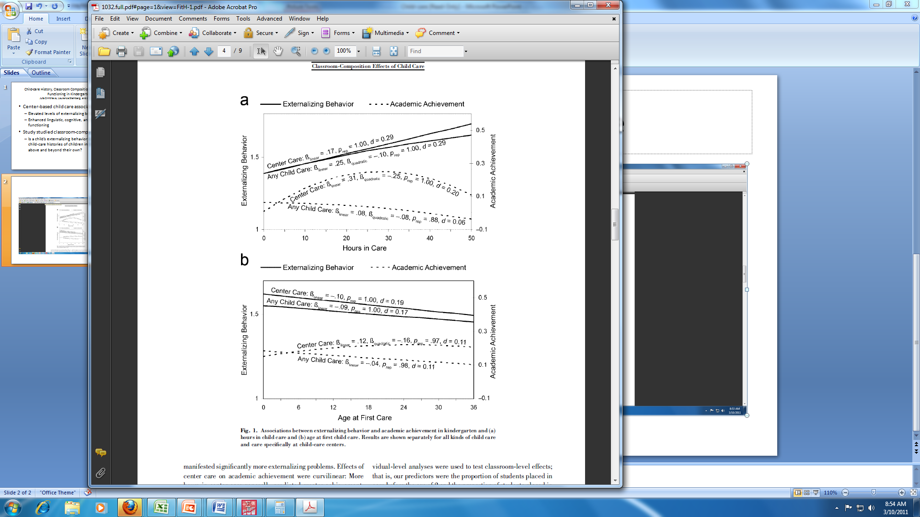
Effects of care
Predictors of poorer achievement
  >30 hrs/week
  initiation at center
  before 2 years of age
Used as classroom level predictors
  proportion of children in classroom
Center care versus any child care

Slide 18
Classroom-level effects > individual effects
Variance in class-level characteristics
  externalizing behavior
    15% (T1) and 19% (T2) of variance
  achievement
    35% (T1) and 31%(T2) of variance
Significant classroom level effects

Slide 19
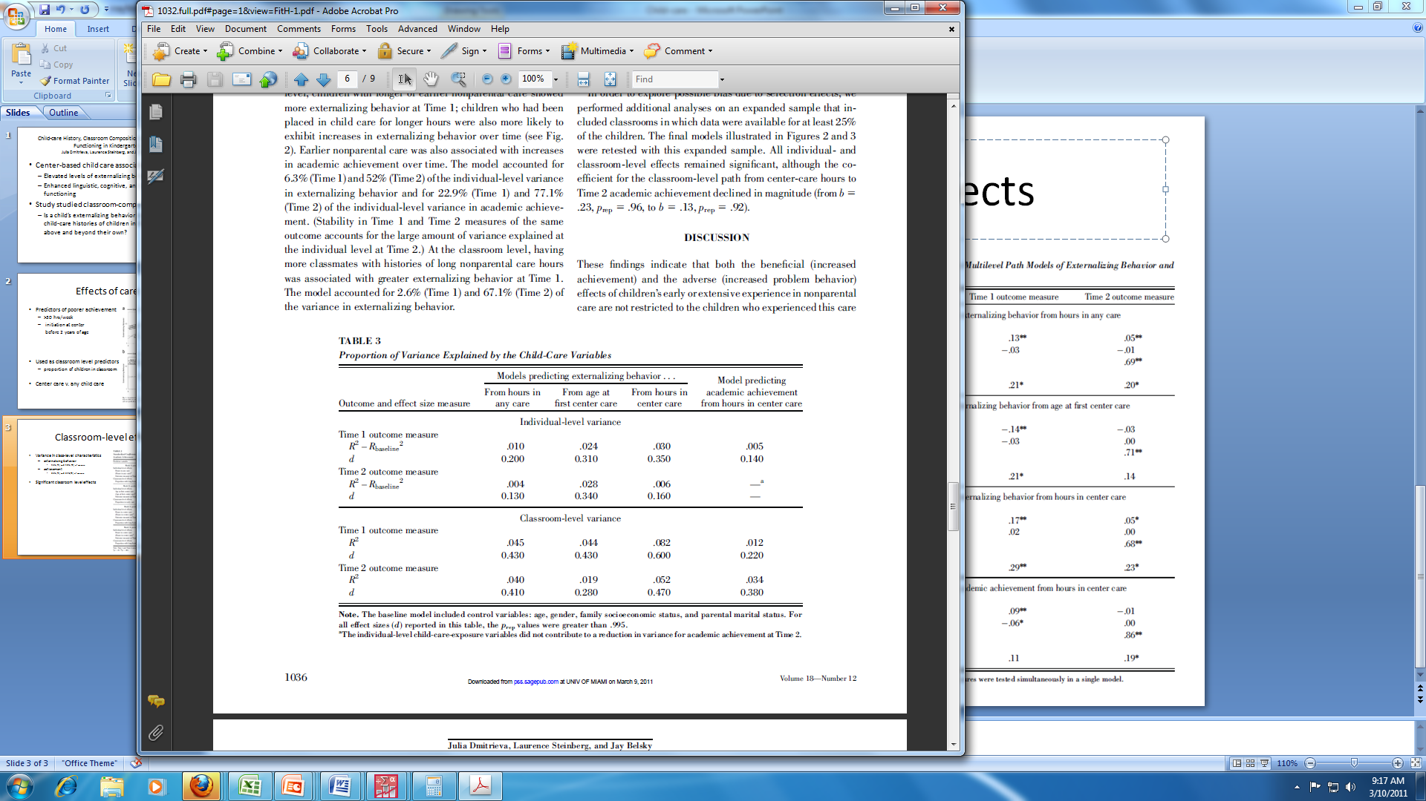
Classroom-level effects > individual effects

Slide 20
Conclusions and Discussion
Effects of early or extensive non-parental care affect not only the child, but their classmates as well
Being in a class with high proportion of students with child-care histories affects all children, independent of personal experience
Notes:
Are effects amplified or attenuated over years of schooling?

Slide 21


Slide 22
Individual level effects

Slide 23
Child-care thru age 3
& peer competencies
More time in child-care → more positive and skilled in peer play in child care (observed)
  caregivers rated as more negative with playmates.
  observed peer play not related to quantity of care.
Child-care not associated with peer competence as rated by mothers or as observed in dyadic play with a friend.
Positive responsive caregiver behavior most consistently associated with positive skilled peer interaction
Maternal sensitivity and children's cognitive and language competence predicted peer competence across all settings and informants
  family and child-care contexts may play complementary roles in development of early individual differences in peer interaction.
    NICHD_Early_Child_Care_Research_Network (2001). "Child care and children's peer interaction at 24 and 36 months: The NICHD study of early child care." Child Development 72(5): 1478-1500

Slide 24
Two and three-year-olds in child-care
“More experience in child-care settings with other children present were … more positive and skilled in their peer play in child care
  Although their caregivers rated them as more negative with playmates.
  Ss who spent more hours in child care were rated by their caregivers as more negative in peer play, but their observed peer play was not related to the quantity of care.
  Child-care experiences were not associated with peer competence as rated by mothers or as observed in dyadic play with a friend.
Maternal sensitivity and children's cognitive and language competence predicted peer competence across all settings and informants.”
  NICHD_Early_Child_Care_Research_Network (2001). "Child care and children's peer interaction at 24 and 36 months: The NICHD study of early child care." Child Development 72(5): 1478-1500.

Slide 25
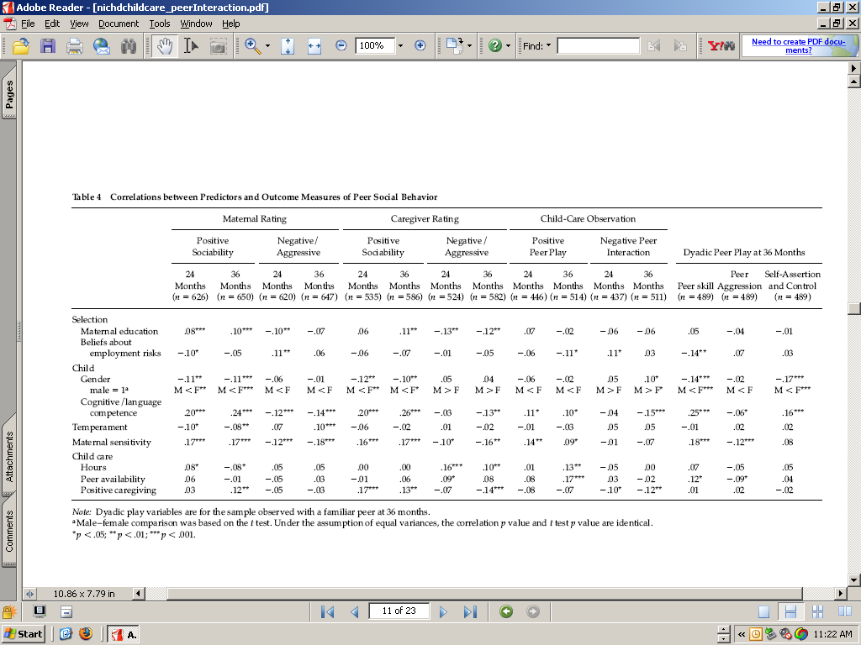

Slide 26
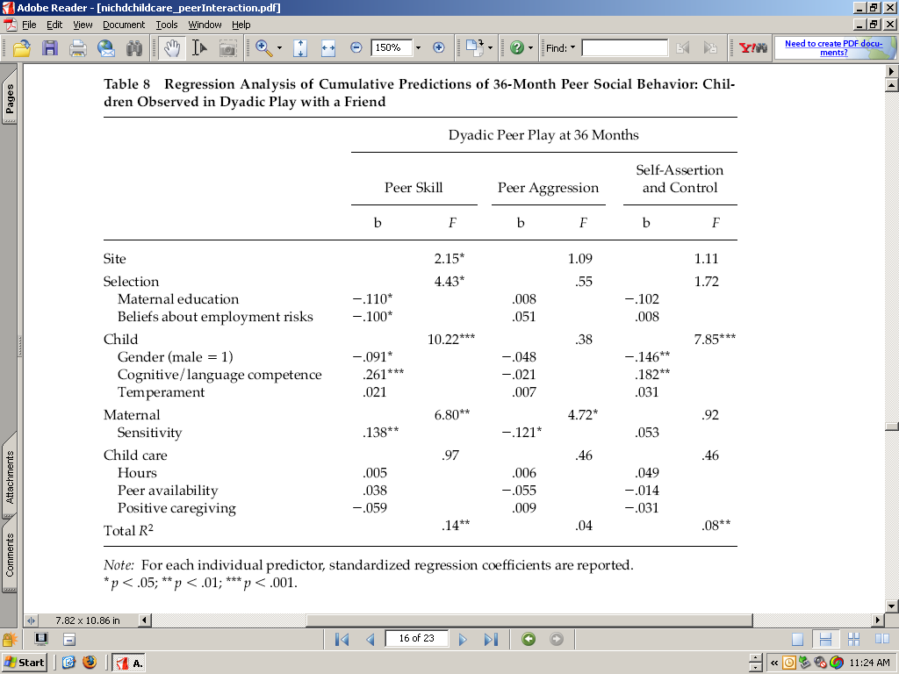
No child care effects on observed interaction
?

Slide 27
Child-Care Effect Sizes through 4.5 years
Early Child Care and Youth Development
NICHD Early Child Care Research Network
Children (n 1,261) were recruited at birth and assessed at 15, 24, 36, and 54 months.
Exclusive maternal care did not predict child outcomes
Higher quality child care related to advanced cognitive, language, and preacademic outcomes at every age and better socioemotional and peer outcomes at some ages.
More childcare hours predicted more behavior problems and conflict, according to care providers.
More center-care time was related to higher cognitive and language scores and more problem and fewer prosocial behaviors, according to care providers.

Slide 28
54 Month Outcomes

Slide 29
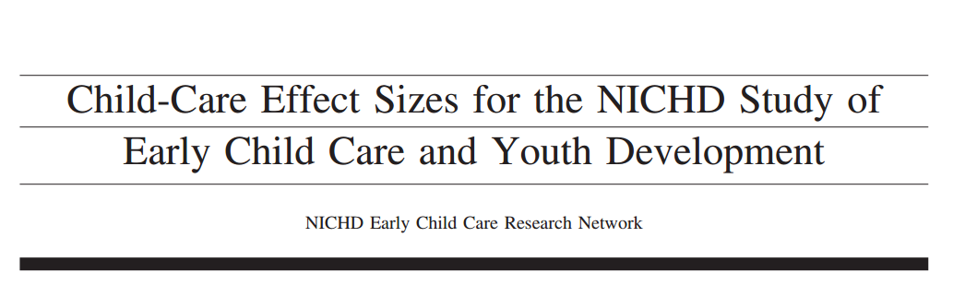
ADD TITLE SLIDE HERE!

Slide 30
Background
Children attending child care has increased from under 25% to over 80%
This has generated questions about the effects of child care on children’s development
National Institute of Child Health and Human Development (NICHD) conducted a longitudinal study to observe these effects

Slide 31
Purpose of Study
To examine how variations in early child care experiences were related to children’s:
  Social-emotional adjustment
  Cognitive and linguistic performance
  Health
Compare effect sizes for quantity, quality, and type of care with effect sizes of parenting

Slide 32
Methods
Participants (N=1364)
  (N=1,095 by 54 months)
24% ethnic minority
Assessed at 1, 6, 15, 24, 36, and 54 months

Slide 33
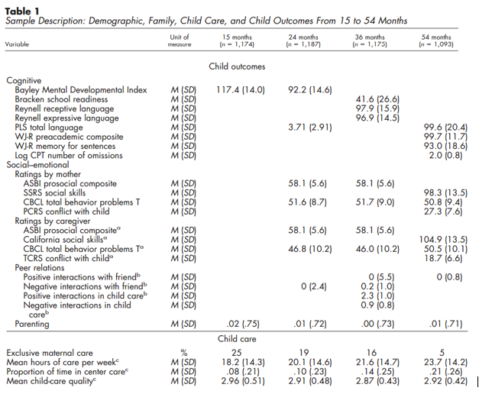
Measures

Slide 34
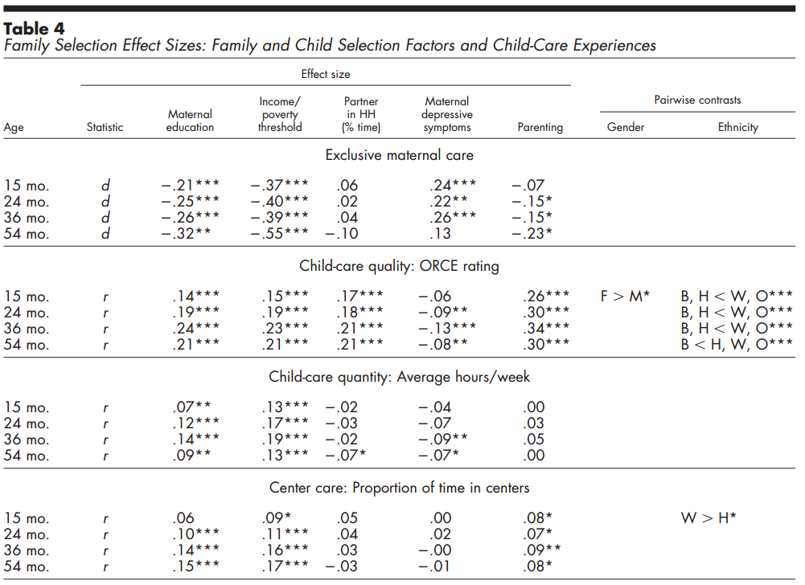
Family Characteristics and Child-Care
INCLUDE TABLE 4 AND PUT BOXES AROUND FINDINGS WANT TO SHOW!

Slide 35
Maternal Care and Parenting
Maternal care was not related to better or worse outcomes for children
Children with parents who were more responsive and stimulating had significantly higher cognitive, language, social-emotional, and peer outcomes

Slide 36
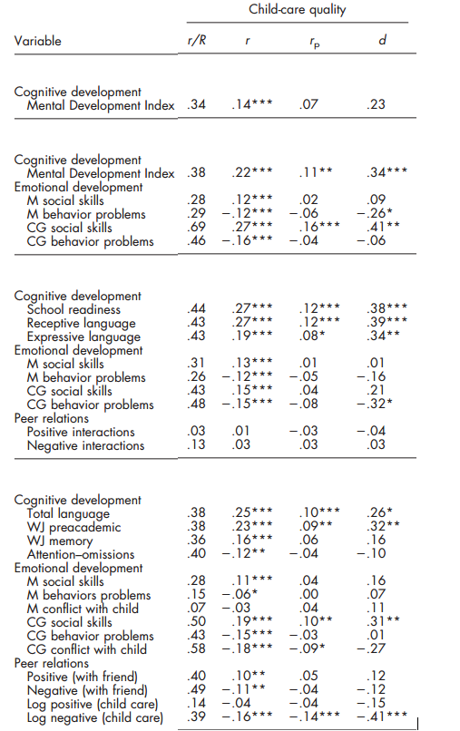
Child-Care Quality and Child Outcomes

Slide 37
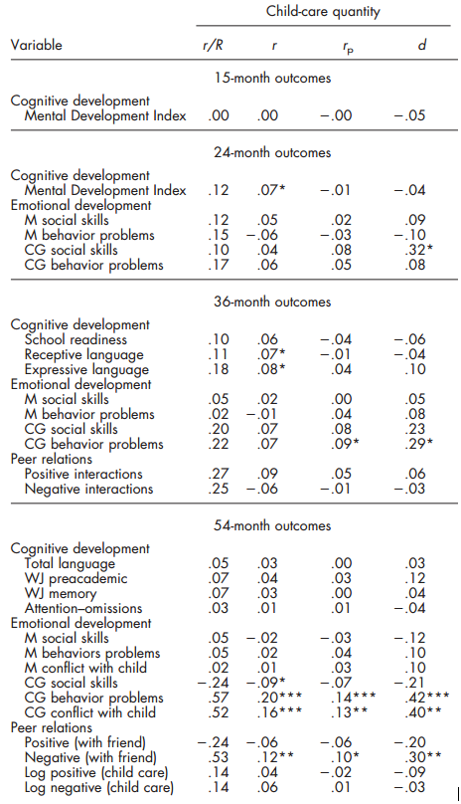
Child-Care Quantity and Child Outcomes

Slide 38
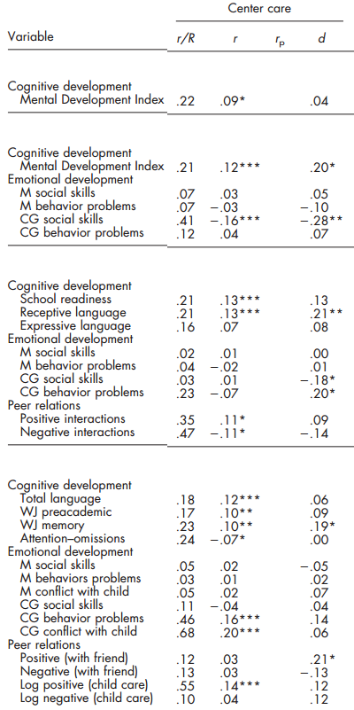
Center Care and Child Outcomes

Slide 39
Conclusion
Parenting was a predictor of all child outcomes and matters more than child care
Quality, quantity, and type of care are related to children’s development
Exclusive maternal care not related to children’s outcomes

Slide 40
Discussion Questions
Why do you think quantity of child care was mostly related to social outcomes rather than academic and language outcomes later in age?
What type of care would you choose for your child and for how long based on this information?
What are the implications of these findings?

Slide 41
Long-Term Effects of Early Child Care?
Parenting a stronger and more consistent predictor of children’s development than early child-care
Higher quality care predicted higher vocabulary scores and more exposure to center care predicted more teacher-reported externalizing problems.
        Belsky et al., 2007

Slide 42
WHAT MAKES A DIFFERENCE: EARLY HEAD START EVALUATION FINDINGS IN A DEVELOPMENTAL CONTEXT JOHN M. LOVE, RACHEL CHAZAN-COHEN, HELEN RAIKES, AND JEANNE BROOKS-GUNN (2013
Randomized efficacy trial of 17 EHS programs
  Federal Early Head Start (EHS) began in 1995
3,001 low-income families
  35% African American, 24% Hispanic, and 37% White
  pregnant women or an infant under the age of 12 months
Randomly assigned to treatment or control
    91% of treatment group receiving some services
(1) impacts of EHS at ages 2 and 3 (when services were being offered) and at age 5, and (2) contributions of early education experiences across first 5 years
Experiment
DOI: 10.1111/j.1540-5834.2012.00699.x

Slide 43
Developmental effects
At 2 and 3 years, EHS benefited children and families: impacts were seen in all domains
  effect sizes .10 -.20
At 5, EHS children had better attention, approaches toward learning, fewer behavior problems
  But no effect on early school achievement
A higher percentage of EHS than control children were enrolled center-based preschool.
At 5, children and families who experienced EHS followed by formal programs fared best overall.
Notes:
age 5 cognitive impacts for African American children
language impacts for Hispanic children who spoke Spanish.
Some significant family benefits.
Earlier treatment effects on child cognition and engagement with parent contributed to age 5 effects

Slide 44
Supplementary analyses
A higher percentage of EHS than control children were enrolled center-based preschool.
Nonexperimental analyses suggested that formal program participation enhanced children's readiness for school while also increasing parent-reported aggression.
At 5, children and families who experienced EHS followed by formal programs fared best overall.
Notes:
Although fewer than half the children enrolled in center-based preschool programs between ages 3 and 4, almost 90% participated in the year preceding kindergarten
Benefits in language, behavior, and parenting were associated primarily with EHS; benefits in early school achievement were associated primarily with preschool attendance.

Slide 46
Aim
Extend previous research by examining the links between routine early child-care experiences and adolescent functioning in a large and economically diverse sample
Early child-care is thought of two ways:
  Early child-care is associated with poorer social outcomes
  Early child-care promotes social and academic skills before entry to kindergarten
Notes:
Research supports both viewpoints:
Experimental studies of high-quality early intervention programs can enhance social, cognitive and academic development of economically disadvantaged children
Higher quality child care is associated with better cognitive and academic outcomes
Viewpoint: Early childcare causes attachment issues and disruptive behavior problems
More time in center-type settings has been related to negative social and behavioral outcomes but potitive academic outcomes
Main take-away: In general, higher quality of child care was related to higher cognitive-academic performance, whereas more hours of child care (especially by non-relatives) was related to more behavior problems.

Slide 47
Background Information
This study wanted to see if the effects of early child-care:
  Fade away over time
  Development builds on prior experience
Low income children in high-quality child care show
  Better academic outcomes through high school
  Higher rates of employment
  Less criminal activity as adults
Notes:
Fade away over time: by the time young people are in high school subsequent life experiences override child-care experiences that occurred a decade or more earlier
Builds on prior experience: builds on prior periods and some effects of early experience may not manifest themselves until adolescent (sleeper effects), some effects of early child care may remain even among teens
A report based on a large national survey found that children of low income families benefited more in terms of cognitive–academic performance when they experienced more hours of child care (labeled a compensatory effect), whereas children of middle-income households functioned more poorly when they experienced more hours of child care
more time in center care predicted larger academic gains among low-income than middle-income children
This study extends previous research by examining the links between routine early child-care experience
(i.e., not high-quality early intervention programs) and adolescent functioning at age 15 in a
large and economically diverse sample.

Slide 48
Research Questions
Are early child-care quality, quantity, and type related to adolescent functioning at age 15?
Are pathways from early child care to adolescent functioning mediated through prior functioning?
Do child gender or familial risk moderate the relationship between early child care and adolescent outcomes?
Notes:
Question 1: cognitive-academic achievement and behavior problems
In sum, this report provides new insights into potential long-term child-care effects by tracking a large sample of American children to 15 years of age to determine whether variations in early childcare quality, quantity, and type are related to cognitive development, academic achievement, and socioemotional functioning in adolescence.

Slide 49
Method
1,364 families were randomly selected from the National Institute of Child and Human Development Study of Early Child Care and Youth Development (NICHD SECCYD)
Demographics:
  26% of the mothers had no more than a high school education
  21% of families had incomes no greater than 200% of the poverty level
  22% were a minority
Notes:
Part of the National Institute of Child and Human Development Study of Early Child Care and Youth Development (NICHD SECCYD)
Families had to speak English
Were recruited from 10 locations in the U.S.

Slide 50
Measures
Construct | Measure | Time Points
Child-care type (type of child care arrangement: home-based care, father care, grandparent care) | Telephone and personal interviews with the mother | Every 3 months until the child reached 36 months and every 4 months until the child was 54 months
Child-care hours | Amount of hours per week child was in non-maternal care | 6, 15, 24 ,36, and 54 months
Child-care quality | Observational Record of Caregiving Environment (ORCE) | 6, 15, 24 ,36, and 54 months
Cognitive-academic achievement | Woodcock-Johnson Psycho-Educational Battery Revised | 54 months, 1st Grade, 3rd Grade, 5th Grade, Age 15
Risk Taking | Audio computer-assisted self-interview | Age 15
Impulsivity | Questionnaire | Age 15
Externalizing Problems | Teacher Report or Youth Self-Report | 54 months, 1st Grade, 3rd Grade, 5th Grade, & Age 15 (YSR)
Notes:
Child-care type- telephone and personal interviews (3 month intervals) to 4.5 years of age; moms reported types and hours of regularly used nonmaternal care; mom’s reported all of the care arrangements used since the previous interview; center, child-care home, in-home care, father care, or grandparent care. If child received at least 10 hours a week of that type of care it represented the type of care
WJ-
54 months and 1st grade: letter-word identification
3rd and 5th grade: broad reading (passage comprehension), applied problems (analyzing and problem solving in math), picture vocabulary (children’s ability to name objects)
age 15 Picture vocabulary and verbal analogies

Slide 51
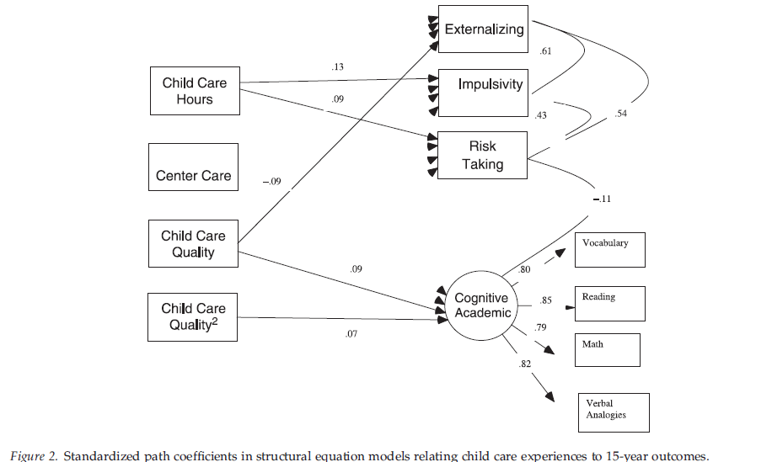
Child Care Quality, Quantity and Type as Predictors
Notes:
Child care quality showed significant associations with children’s cognitive-academic achievement at age 15.
Children who experienced higher quality care had significantly higher levels of cognitive-academic achievement at age 15
Child care quality was linked to academic outcomes for adolescents whose care on average was moderate quality or better, with the magnitude of the quality effects being larger at higher levels of quality
Higher quality care is associated with higher academic outcomes but and lower externalizing scores at age 15
Adolescents who experienced more hours of nonrelative child care across their first 4.5 years reported more risk-taking and greater impulsivity at age 15
Exposure to center care was not related to academic achievement or problem behaviors at age 15
More hours in non relative care predicted poorer social adjustment

Slide 52
Results: Quality, Quantity and Type as Predictors
Child-care quality showed significant associations with children’s cognitive-academic achievement at age 15
Children who experienced higher quality care had significantly higher levels of cognitive-academic achievement at age 15
Higher quality care is associated with higher academic outcomes but and lower externalizing scores at age 15
Adolescents who experienced more hours of nonrelative child care across their first 4.5 years reported more risk-taking and greater impulsivity at age 15
More hours in nonrelative care predicted poorer social adjustment
Notes:
Child care quality was linked to academic outcomes for adolescents whose care on average was moderate quality or better, with the magnitude of the quality effects being larger at higher levels of quality
Exposure to center care was not related to academic achievement or problem behaviors at age 15

Slide 53
Academic Achievement as Mediator
The observed association between child-care quality and age 15 cognitive-academic achievement can be explained at least partially by the association between child-care quality and academic skills at entry to school, which are then maintained into high school
Notes:
The observed association between child-care quality and age 15 cognitive-academic achievement can be explained at least partially by the association between child-care quality and academic skills at entry to school, which are then maintained into high school

Slide 54
Results: Academic Achievement as a Mediator
The observed association between child-care quality and age 15 cognitive-academic achievement can be explained at least partially by the association between child-care quality and academic skills at entry to school, which are then maintained into high school

Slide 55
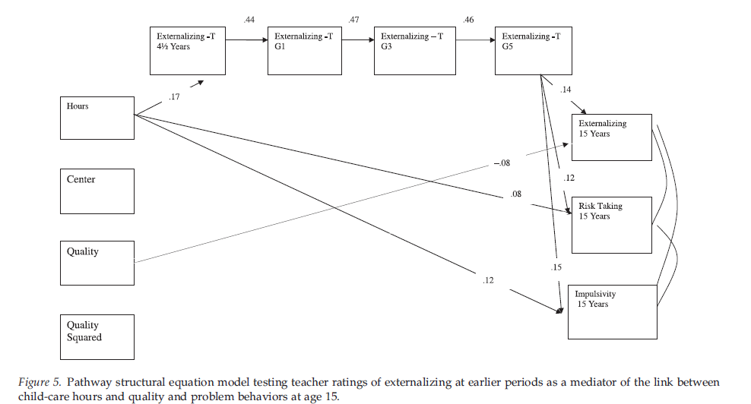
Problem Behavior as a Mediator
Notes:
Higher hours spent in childcare significantly predicted higher risk taking behaviors and impulsivity at 15 years.
Modest levels of mediation when looking at the association between hours spent in childcare and externalizing behavior problems mediated by behavior problems beginning at 4.5 years old through 5th grade
This may be due to the changing informant of behavior problems. First the caregiver, then teacher (who switches) and then adolescent self report.
Higher quality non-relative childcare significantly predicted less externalizing behaviors at age 15.

Slide 56
Results: Problem Behavior as a Mediator
Higher hours spent in childcare significantly predicted higher risk taking behaviors and impulsivity at 15 years of age
There were modest levels of mediation when examining the association between hours spent in childcare and externalizing behavior problems at age 15
  May be due to the informant changing
Higher quality non-relative childcare significantly predicted less externalizing behaviors at age 15

Slide 57
Familial Risk and Gender as Moderators
No evidence emerged supporting the hypothesis that familial risk or gender moderates this relationship for problem behaviors or cognitive-academic outcomes
Notes:
Do child gender or familial risk moderate the relationship between early child care and adolescent outcomes?

Slide 58
Link between child care, cognitive-academic outcomes, & problem behaviors consistent over 10 years
Early child care quality predicts cognitive-academic achievement
  Moderate to high quality care produces greatest effects
Quality of early child care long lasting effects on all children despite SES
Higher quality nonrelative childcare → less externalizing at 15
More hours in child care & more center-type care related to higher levels of behavior problems

Slide 59
Discussion Questions
If early child-care quality predicts greater cognitive-academic outcomes and hours spent in child-care predicts more externalizing problems at age 15, how do you find the right balance of child-care that produce the best outcomes?
Notes:
Why do you think time spent in child-care and quality of child-care were better predictors of adolescent outcomes than type of child-care?

Slide 61
Background Information
Higher quality childcare is associated with better cognitive and academic outcomes
Quality of care has been shown to interact with maternal sensitivity
  Low quality of care, low maternal sensitivity
Diathesis-stress – highly negative children will suffer in low quality environment
Differential susceptibility - highly negative children will be more reactive to the environment

Slide 62
Study Aim
Does difficult temperament in infancy continue to moderate effects of childcare quality on problem behavior in adolescence (15 years)?
  842 total participants
    High-difficulty vs. Low-difficulty subgroup for temperament
    Quality of care observed

Slide 63
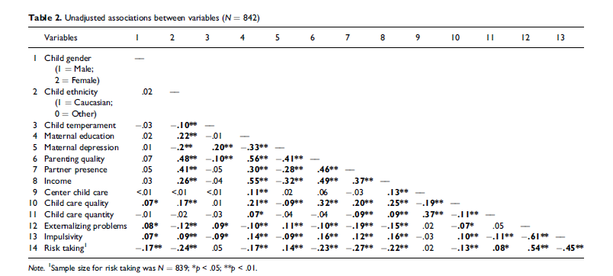
Measures
Notes:
Bivariate correlations between study variables
Child temperament associated with externalizing behavior problems

Slide 64
Results
Externalizing behavior problems were greater for:
  females, single parent homes
Greater risk-taking :
  Males, non-Caucasian ethnicity, lower family income, higher proportion of partner absence
Greater Impulsivity:
  Lower family incomes, greater exposure to any non-maternal child care in the early childhood years

Slide 65
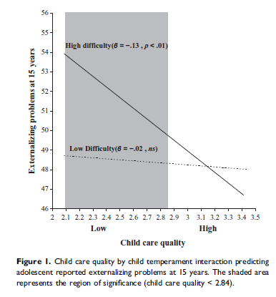
Difficult temperament→externalizing only in low child care quality
Consistent with diathesis stress model
Externalizing problems only significant when child care quality was less than 2.84
Higher scores reflect children’s experience with caregivers who were more attentive, stimulating, positively affectionate, less intrusive and negative

Slide 66


School Belonging—individual level variable?
  A Longitudinal Study of School Belonging and Academic Motivation Across High School. Gillen-O’Neel & Fuligni
Hoffman

Slide 67
Background
School belonging (SB) is high among elementary school children
  Also linked to academic achievement
Little known about SB in HS
  Is SB related to academic achievement and values?
  Relationship among these variables across ethnic groups
Hoffman

Slide 68

Background
For most part, SB declines over early adolescence (middle school)
Results in HS are more mixed
  Muddled by cross-sectional research, varied operationalizations, and samples
Hoffman

Slide 69
Background
Stage-environment fit theory
  Mismatch between developmental needs and school environment
    Need for autonomy and positive adult relationships
    Many schools have authoritarian rules and few opportunities for teacher relationships
  Hard to project forward into HS
Hoffman
Notes:
Changes in developmental needs may lead to more congruency

Slide 70
Link to Academic Outcomes
SB → connection to academic institution → internalization of academic values and behaviors →ACADEMIC SUCCCCCCESSSSS!
Again, cross-sectional research and study differences make it hard to draw conclusions
In contrast, link between SB and academic values is consistently found
SB → persevering in school for intrinsic reasons
Hoffman

Slide 71
Group Differences
Girls have higher SB than boys
  Effect may decrease in later years
Ethnic minorities may have lower SB, but findings mixed
  Many environmental factors may affect minority experience
  Functional substitution – any resource is especially influential among students who have fewer resources in general
Hoffman

Slide 72
Current Study Hypotheses
Examined SB longitudinally over each year of HS, and its relationship to academic achievement/values
Girls higher SB than boys
No prediction about ethnic backgrounds
Strongest association between SB and academic achievement/values in Latin American boys
Hoffman

Slide 73
Methodology
Tracked kids for 4 years, N = 572
3 HS in Los Angeles, with focus on Latin, Asian, and European children who come from low, middle and high SES groups
Schools differed on achievement
Data from kids who completed 2 assessment points (88% of those enrolled completed 12th grade assessment)
Hoffman

Slide 74
Methodology
SB measure - Revised institutional engagement measure from Tyler & Degoey, 1995
  Averaged scores on 5 point Likert scale of 7 questions, e.g., “I feel like I am a part of my school”
Academic Achievement – GPA measured across classes for the year
Value – intrinsic value measured using 2 items; utility value measured using 3
Hoffman

Slide 75
Results
Asian and high GPA students more likely to complete assessment
Controlling for SES and ethnicity, no differences on major variables across schools, with exception of utility value
  Greater for school 1 vs 2 + 3 (lowest SES school)
HLM 3 level model with nesting for schools, but results from simpler 2 level model
Hoffman

Slide 76
School Belonging
Females higher SB than males in 9th grade
  Decline over time (6.92%)
  No changes for males in SB over time
No ethnic differences in baseline or slope
Interaction effect for Latin females
  Greater slope compared to males than in other groups
Hoffman

Slide 77
School Belonging and Academic Outcomes
No within-person association between SB and GPA (in a given year)
  Did not differ by gender or ethnicity
Significant relationship between SB and academic values
  Higher than average SB associated with higher value rankings
  Utility value differed by gender; stronger association in males
Hoffman

Slide 78
Discussion
SB higher in girls than boys initially, but does not hold throughout high school
Males remain high consistent in SB ratings throughout high school
Any thoughts on why we see gender diffs?
No relationship between SB and GPA
SB is related to academic motivation…so what?
Hoffman

Slide 79
Questions
Most Latin kids had Mexican backgrounds and Asian kids had Chinese backgrounds…
  Implications for lack of differences across ethnicity
What do results this mean for stage-environment fit theory?
  Authors argue that fit is at least enough to stop dramatic decline
Hoffman

Slide 80
Bullying as a social phenomenon
Not just an individual (the bully), not just a dyad (bully and victim)
Classroom phenomenon
“Bullying is more likely in classrooms characterized by poor climate, strong status hierarchy, and probullying norms.
Bystanders’ responses contribute to the bullying dynamic by either rewarding or sanctioning the behavior of the perpetrators.
Bullying functions not only for individual perpetrators but also for the whole peer group by, for instance, providing a common goal and a semblance of cohesion for the group members.
                Saarento, S., & Salmivalli, C. (2015). The Role of Classroom Peer Ecology and Bystanders’ Responses in Bullying. Child Development Perspectives, 9(4), 201-205. doi: 10.1111/cdep.12140

Slide 81
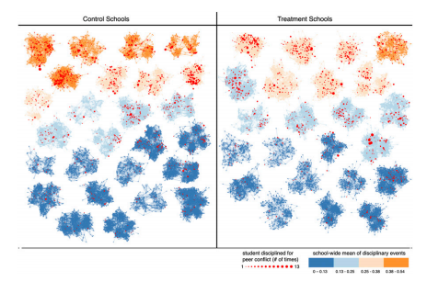
Changing climates of conflict: A social network experiment
Randomly selected groups of 20–32 students from randomly selected schools assigned to intervention that encouraged their public stance against conflict.
Disciplinary reports of student conflict at treatment schools reduced by 30% over 1 year.
56 schools with 24,191 students.

Slide 82
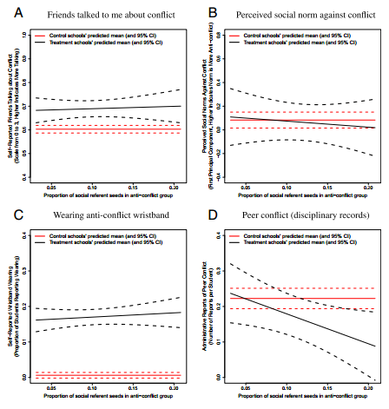
Changing climates of conflict: A social network experiment
Stronger effect when seed group contained more “social referent” students who, as network measures reveal, attract more student attention.
Paluck, E. L., Shepherd, H., & Aronow, P. M. (2016). Changing climates of conflict: A social network experiment in 56 schools. Proceedings of the National Academy of Sciences. doi: 10.1073/pnas.1514483113
Notes:
Network analyses of peer-to-peer influence show that social referents spread perceptions of conflict as less socially normative.

