Slide 1
Social and Emotional Development
PSY 624
Daniel Messinger, PhD

Slide 2
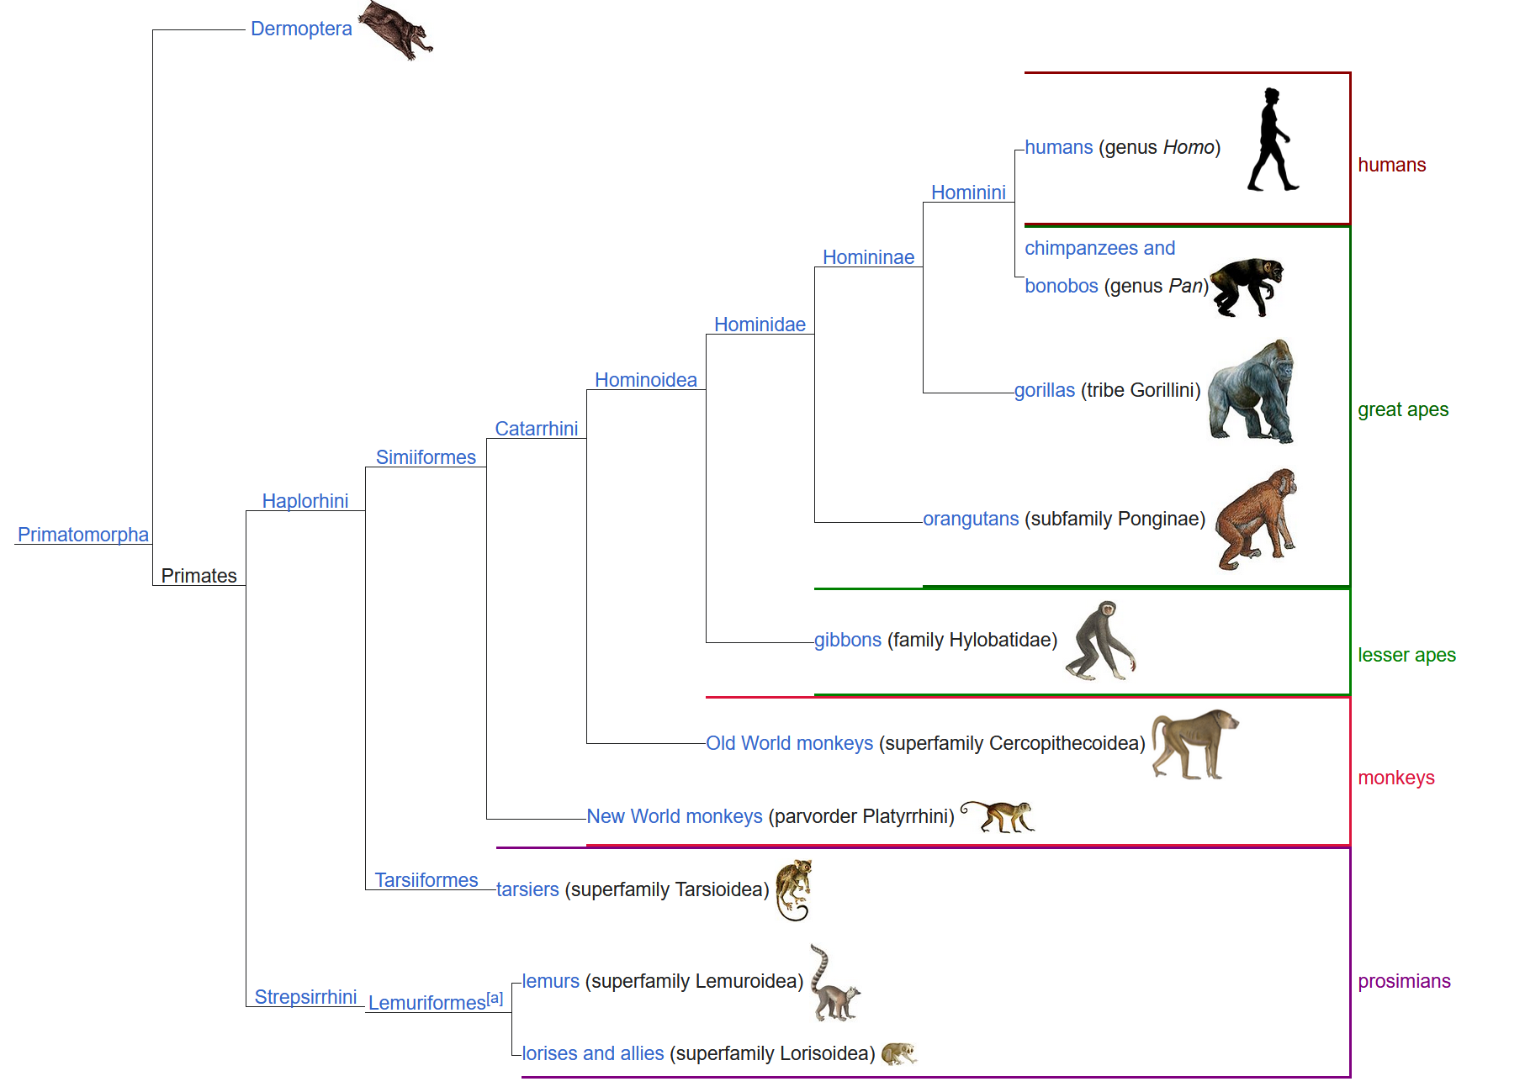

Slide 3
Standardized regression coefficients
Malik

Slide 4
Overview
Secular decline in ‘adult’ activities
Positive risk taking
When is an adolescent an adult?
d’ to emotion faces
Adolescent risk-taking
Peer driving game
Adolescent effect (ventral striatum & cortex)
Emotional stroop effect
Adult presence mitigates
$ discounting

Slide 5
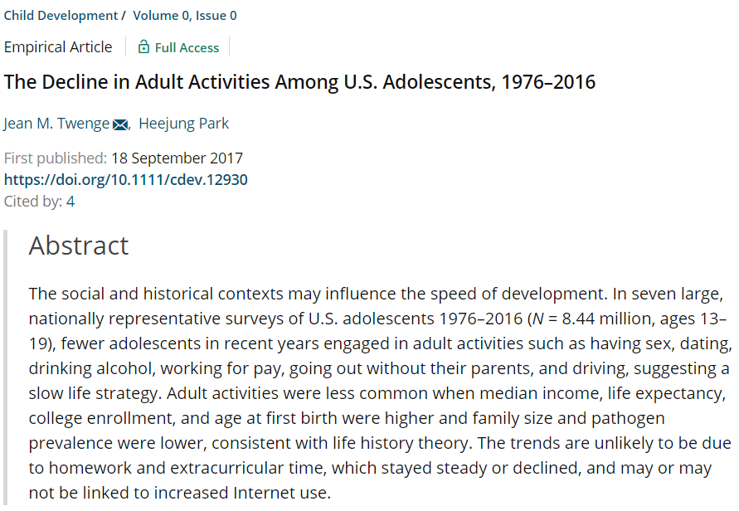

Slide 6
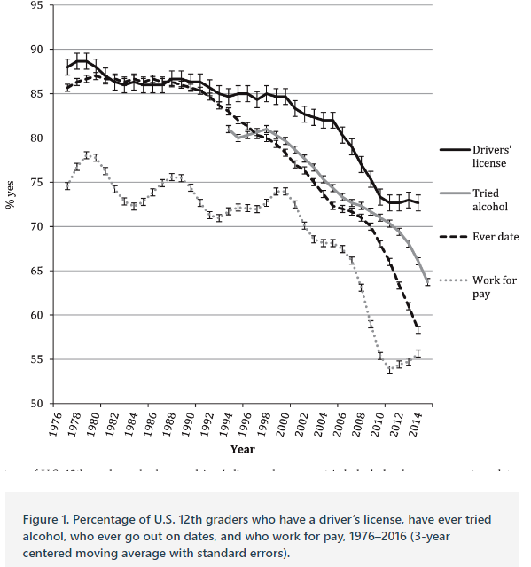
12 grader decline in alcohol, work, drive

Slide 7
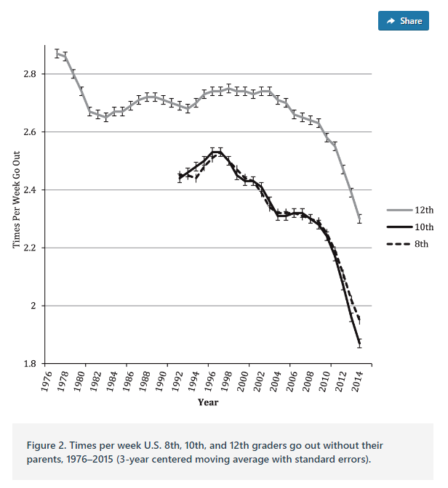
12 grader decline in going out alone

Slide 8
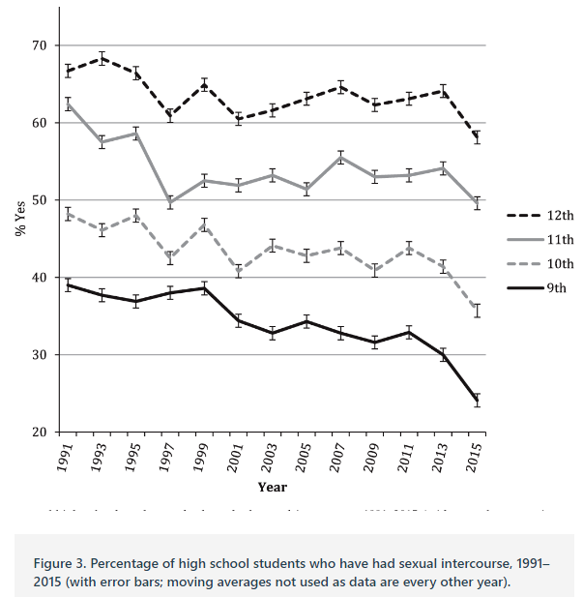
Sexual intercourse decline

Slide 9
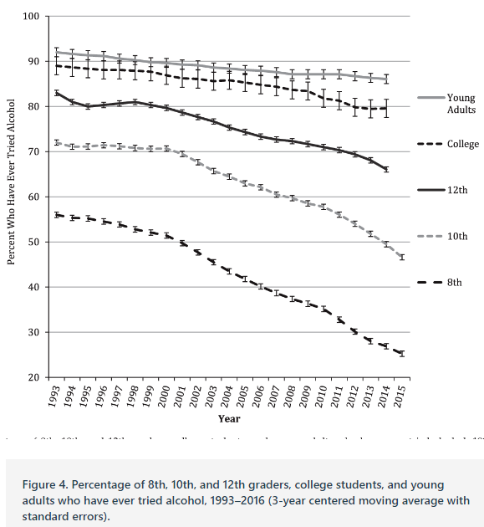
Tried alcohol

Slide 10
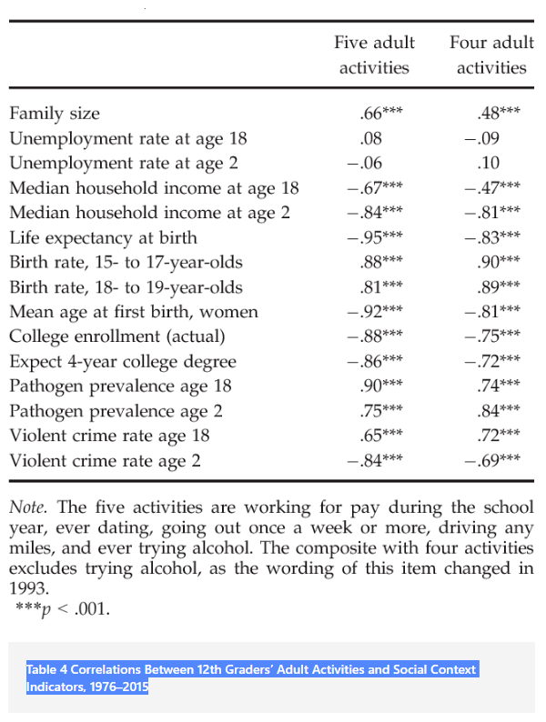

Slide 11
Positive Risk Taking in Adolescence
Duell & Steinberg, 2019
Zhang

Slide 12
Definitions
Risk:
(a) potential for both rewards and costs
(b) variability in the likelihood of potential outcomes being realized
(c) uncertainty about the outcomes
Positive risk:
Socially acceptable and constructive risk
Negative risk:
Illegal or dangerous behavior
Zhang

Slide 13
Positive Risk Taking
1. Positive risks benefit adolescents’ well-being.
2. Positive risks carry potential costs that are mild in severity, at least relative to those associated with negative risks.
3. Positive risks are legal and socially acceptable. In the case of positive risk taking, social acceptability refers to the views of adults rather than those of other adolescents (although the positive risks youth take are often supported by their peers).
Example:
An adolescent initiating a friendship with a new peer group.
Why? Related to social expectation?
Zhang

Slide 14
Research on positive risk taking
Greater positive risk taking is associated with greater negative risk taking
Team sports and substance use
Domain-general propensity for risk taking that can be manifested in both positive and negative forms.
Influence of peers?
Sensation seeking is linked to higher rates of both positive and negative risk taking.
Self regulation/ impulse control
Low self regulation is linked to greater negative risk taking
High self regulation is associated with higher levels of certain type of positive risk taking
Performance scale
Physical scale
Higher performance, but not physical, was associate with higher impulse control
Why?
Zhang

Slide 15
Measuring positive risk taking
Previous risk-taking measures
Reflect physical thrill seeking rather than risk taking, such as riding a roller coaster → may conflated the association between positive risk taking and sensation seeking.
Lack language emphasizing the riskiness of the behaviors.
For example, “played a sport” to “tried a new sport where you may have embarrassed yourself”
Zhang

Slide 16
Measuring positive risk taking
The current measure
Self report
Wider range: socially acceptable and developmentally constructive risks from various life domains
Social risks (e.g., spent time with a new group of people when you were not sure you would fit in)
Academic risks (e.g., took a class in a subject you knew nothing about or that seemed challenging)
Extracurricular risks (e.g., joined a new club or activity when you were not sure you would like it).
What do you think about this measure?
Zhang

Slide 17
Discussion (some possibilities)
Dual systems theories
Development in brain regions implicated in reward processing is more or less complete by adolescence, whereas development in prefrontal brain regions implicated in executive control is not fully developed
Connections between these regions are not fully established until early adulthood
Other reasons
Family
Peer
Longer term goal
Social support
What else?
Future research ideas?
Zhang

Slide 18
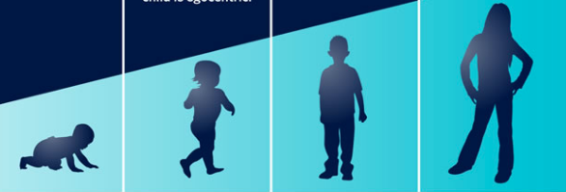
When is an adolescent an adult? Assessing cognitive control in emotional and nonemotional contexts
Cohen et al., 2016
puccetti
Notes:
https://www.rch.org.au/studentorientation/Differences_between_children_and_adults/

Slide 19
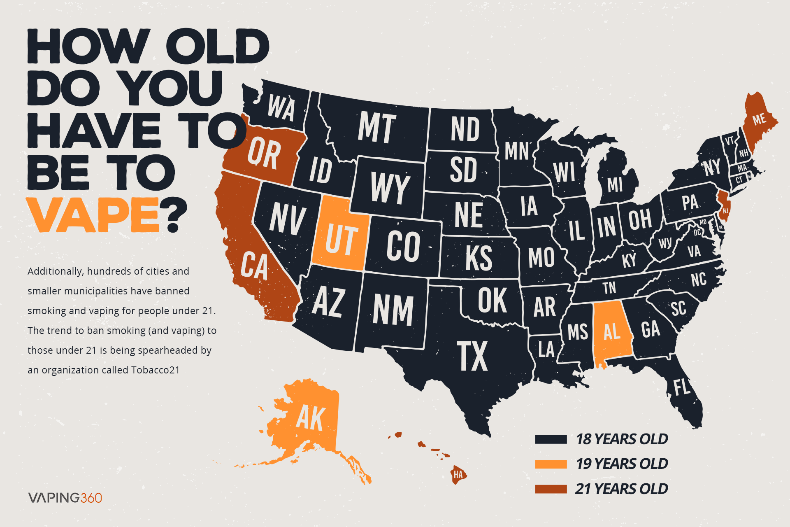
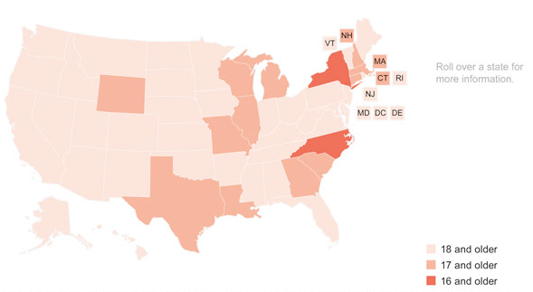
Background
Adolescents (13-17yrs) display heightened sensitivity to motivational, social, and emotional information
Cognitive control in adolescents sometimes matches adults...
But may be susceptible to incentive, threat, and peer influence
Cognitive performance within emotional contexts is especially relevant for policy (*18-21)
Juveniles tried as adults in US
puccetti

Slide 20
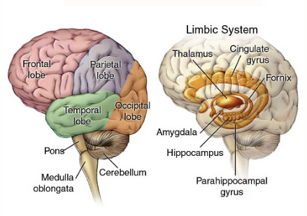
Background
Consider both behavioral and neural maturation to inform policy
Risky and impulsive adolescent behavior can be attributed to ‘dynamic and asymmetric’ brain development:
Subcortical limbic structures: nonlinear trajectory with sensitization in adolescence
PFC: linear trajectory of functional ‘growth’ that stabilizes in the 20’s
puccetti

Slide 21
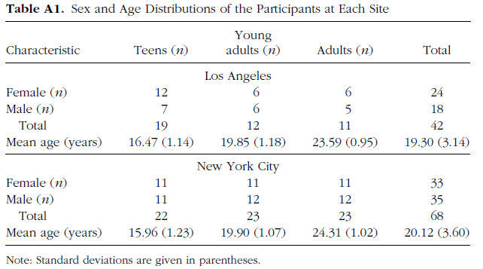
Hypothesis
Young adults (18-21) would A) differ from adults (>21) in cognitive control in emotional conditions and B) this shift would correlate with brain function in PFC
Sample
110 subjects: N(13-17)= 41
N(18-21)=35, N(22-25)=34
32.7% Caucasian 27.3 African American 24.6% Hispanic 12.7% Asian
puccetti

Slide 22
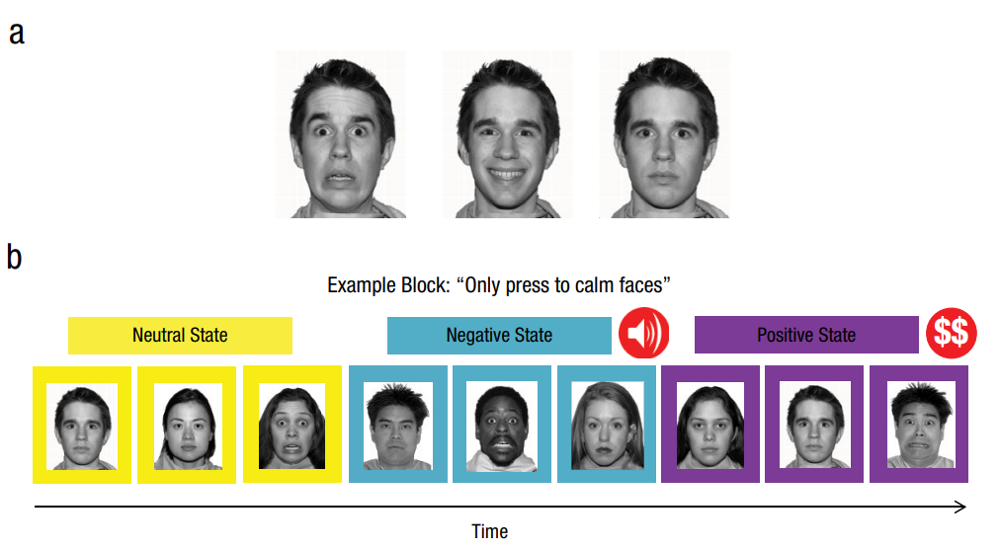
Behavioral paradigm
Fearful Happy Calm
~50 minutes
~10sec
per trial
CUES
STATES
TARGET changed every block
Calm = GO Fearful = NO GO
Fearful = GO Happy = NO GO
Etc. with all pairwise combos used
GO/NO GO = Press button when you see the TARGET
2 cues per state/block (GO stim/NO GO stim or TARGET/NONTARGET)
puccetti

Slide 23
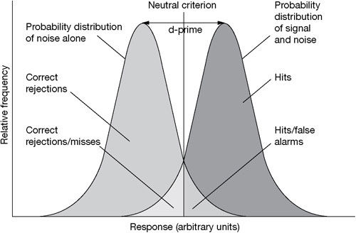
Data analysis
Behavioral: d’ is a sensitive accuracy measure = Z(H) - Z(FA)
H = correctly GO on a GO cue
FA = incorrectly GO on a NO GO cue
Larger d’ indicates BETTER cognitive control or better discrimation between GO and NO GO
Proposed behavioral ANOVAs:
Age
Age X Cue (happy,fearful,calm faces) within neutral state only
Age X State (sad,happy,neutral) with calm cue faces only
Whole-brain Analysis: Group linear mixed effects
Effects of CUES on GO and NO GO trials
Effects of STATES on GO and NO GO trials
NO GO
GO
Task-dependent functional connectivity:
2 PFC ‘seed’ regions
puccetti

Slide 24
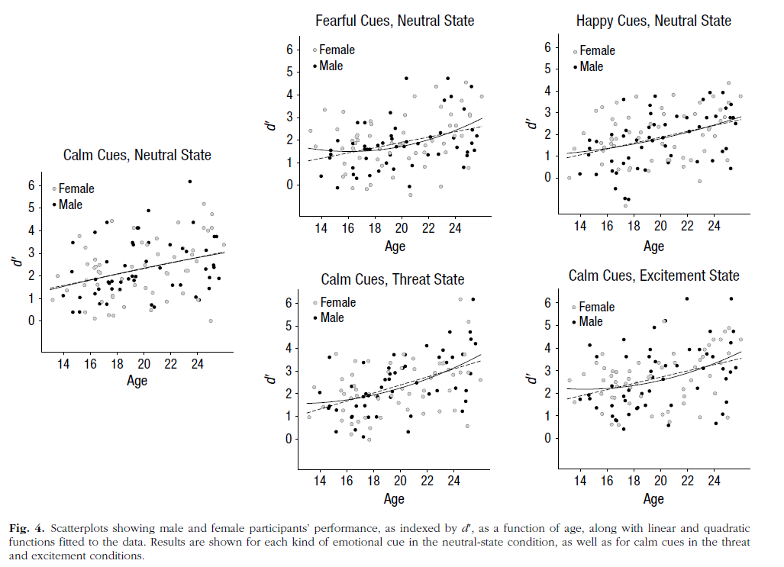
Increase in d’ with age
Relationship between age and
performance in different emotion
conditions (by gender)
puccetti

Slide 25
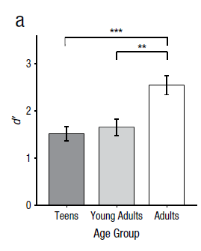
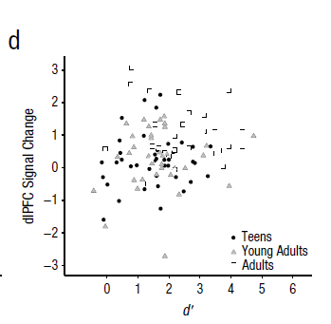
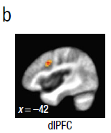
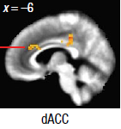
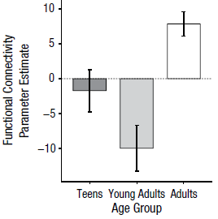
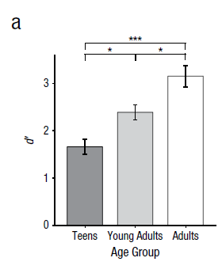
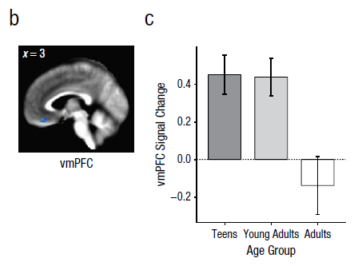
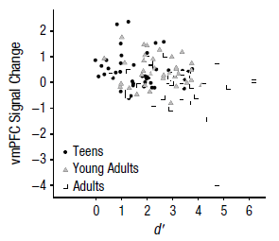
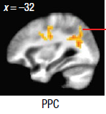
Results
110 subjects: N(13-17)= 41
N(18-21)=35, N(22-25)=34
d’ in response to fearful cues in neutral state: A > YA and T
*did not survive when controlling for age
d’ in response to calm cues in threat state: A > YA > T
*no regions survived whole brain correction
puccetti
Notes:
neutral state FEAR: (A > YA and T) HAPPY: (A and YA > T) CALM: (A > T)
threat state CALM: (A > YA > T)
excitement state: CALM: (A > T)
Fig 1 set – take away DLpfc significantly diff by age but NOT robustly related to performance; dACC and Pariental related to age AND d’ thus important for task performance
Fig 2 set – take away PFC corrected: greater vmPFC activation related to poorer behavioral performance

Slide 26
Conclusions
Young adults (YA) cognitive control differs from adults in brief and prolonged emotional conditions
Related to % signal change and poorer functional connectivity in PFC
dlPFC in YA- implicated in cognitive and affective regulation
vmPFC in YA- implicated in affective integration/regulation and self-referential thought
-greater sensitivity to threat
-less coupling w/ dACC and parietal regions*
Differences are primarily in negative relative to neutral and positive conditions
Individual differences in pos. perhaps related to risk for mania?
Potential advantage of emotional sensitivity: meeting socioemotional pressures?
Disadvantage: vulnerable to poor decision-making
Courts: immature cognitive functioning plays a role in determining culpability*
Should juveniles be tried as adults
puccetti
Notes:
Disclaimer – I found the discussion to be lacking!

Slide 27
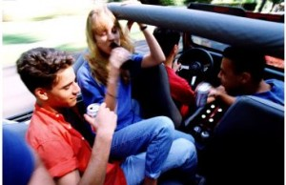

Slide 28
Hypotheses
Increase in risk taking due to two brain systems:
The ventral striatum, nucleus accumbens, and the orbitofrontal cortex: an incentive processing system
Lateral prefrontal cortex: a cognitive control system
During adolescence, changes to the incentive processing system results in heightened sensitivity to rewards while the cognitive control systems are gradually maturing
Peer presence may heighten the activation of reward valuation
Notes:
System 1: biases decision-making based on the valuation and prediction of potential rewards and punishments
System 2: supports goal-directed decision making by keeping impulses in check and by providing the mental machinery needed for deliberation regarding alternative choices
Risky decisions are seen as increased engagement of incentive processing and decreased engagement of cognitive control activity due to an immature capacity to down-regulate reward system outputs through control signaling, which biases adolescents toward risk taking

Slide 29
Background
Teenagers engage in more risky behaviors than adults
More likely to binge drink, smoke cigarettes, have casual sex, be involved in a fatal or serious car crash
Adolescents take a substantially greater number of risks when driving when observed by peers
Risk-taking related to brain systems:
Incentive processing system
Cognitive control system

Slide 30
Background
Incentive processing system
The ventral striatum, orbitofrontal cortex, and others
Decision making = valuation and predication of rewards/punishments
Under re-organization during adolescence = heightened sensitivity to reward
Cognitive control system
The lateral prefrontal cortex
Decision making = goal-directed, keeping impulses in check
Gradual and protracted development until early 20’s
Adolescence = heightened sensitivity to reward and under-developed impulse control
Notes:
System 1: biases decision-making based on the valuation and prediction of potential rewards and punishments
System 2: supports goal-directed decision making by keeping impulses in check and by providing the mental machinery needed for deliberation regarding alternative choices
Risky decisions are seen as increased engagement of incentive processing and decreased engagement of cognitive control activity due to an immature capacity to down-regulate reward system outputs through control signaling, which biases adolescents toward risk taking

Slide 31
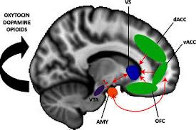
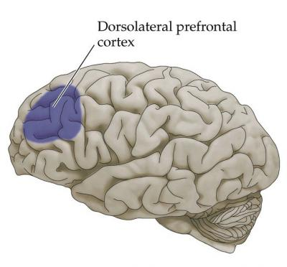
Lateral prefrontal cortex: cognitive control system
ventral striatum, nucleus accumbens, and the orbitofrontal cortex: an incentive processing system

Slide 32
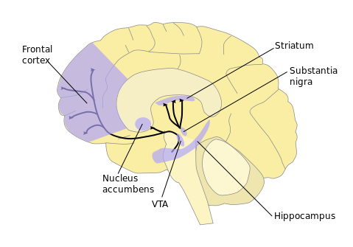
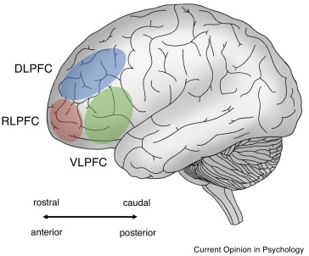
Risky Behavior and Decision making
Reward processing
OFC
Impulsive control
Zeng

Slide 33
Participants
 | n | Female | Age
Adolescents | 14 | 8 | 14-18 (M=15.7, SD=1.5)
Young Adults | 14 | 7 | 19-22 (M=20.6, SD=0.9)
Adults | 12 | 6 | 24-29 (M=25.6, SD=1.9)
TOTAL | 40

Slide 34
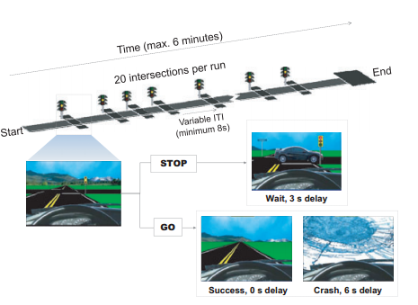
The Stoplight driving game
As you approach intersection, light turns yellow
Chance crash or brake and wait
Risk-taking = not braking for yellow light
Notes:
While in the scanner…
The Stoplight task (Figure 1) is a simple driving task in which subjects control the progression of a vehicle along a straight track, from a driver’s point of view.
Subjects completed four rounds of the task; two in the first social condition and two in the second social condition.
Each round used a track with 20 intersections (treated as separate trials), which took under 6 minutes to traverse (dependent on subjects’ choices and providence).
At each intersection subjects rendered a decision (by button press) about whether or not to brake as the vehicle approached a changing traffic signal (which cycled from green to yellow to red).
As the vehicle approached the intersection, the traffic signal turned yellow, and the subject decided whether to chance a possible crash in the intersection (GO decision), or to brake and wait for the light to return to green (STOP
Both the timing of the traffic signals and the probability of a crash in the associated intersections were varied so as to be unpredictable by the participant
Risk taking was encouraged by offering monetary incentives for completing the course in a timely fashion
Barratt: individual differences in impulsivity
Zuckerman: sensation seeking
RPI: resistance to peer influence

Slide 35
Methods
Manipulation of social context (peer vs. alone conditions)
All participants brought two same-age, same-sex, friends
Change of social context = “Surprise manipulation”
Self-report questionnaires:
Complete after fMRI session
Barratt Impulsiveness Scale
Zuckerman Sensation Seeking Scale
Resistance to Peer Influence (RPI) Scale

Slide 36
Adolescents showed more risky Go’s in Peer condition
Predicted by sensation seeking
While in the ‘Alone’ condition, self-reported…
Sensation seeking predicted greater risky driving behavior
Impulsivity did not predict risky driving behavior
14 adolescents (14-18 yrs)
14 young adults
(19-22 yrs)
12 adults
(24-29 yrs)
Notes:
Adolescents and adults behaved comparably alone, but adolescent performance was sensitive to social context – did not reach statistical significance (they attribute to sample size)
Behavior was significantly predicted by sensation seeking, but not impulsivity
- Driven more by incentive processing system?

Slide 37
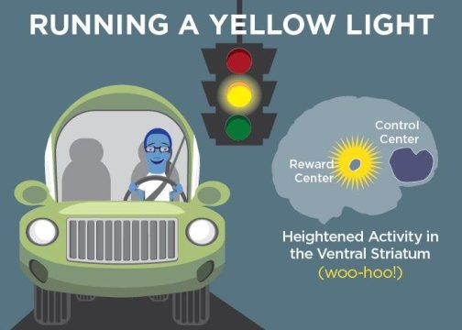
fMRI Results
Notes:
lateral prefrontal cortex activation in older group > strategic decision making
ventral striatum, orbitofrontal cortex, activation

Slide 38
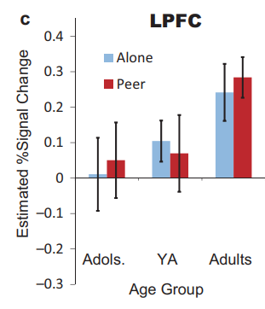
Older > Younger: LPFC across conditions
*
*
*
Zeng

Slide 39
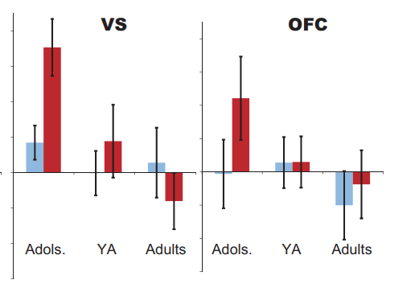
Age x Social: VS & OFC
*
*
Zeng

Slide 40
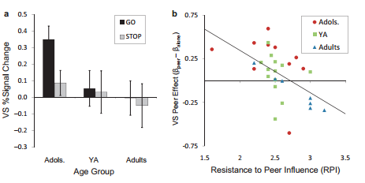
Self-reported resistance to peer influence correlated with neural peer effect
Notes:
Sensation seeking and impulsivity not predicted by fMRI data; but self-reported resistance to peer influence correlated with individual variation in the neural peer effect (Peer vs. Alone) (bigger difference between conditions associated with less resistance)
What if RPI was replaced with LPFC activity?
we treated the obtained
LPFC, VS, and OFC clusters as regions-of-interest
(ROI) and compared activity in these regions during GO
versus STOP trials (collapsing across social context).
Among adolescent subjects, greater activity in both the
VS (Figure 4a) and OFC was associated with risky
decision-making, as indicated by significantly increased
activity in these regions for GO relative to STOP trials.
No decision-dependent differences were found in these
regions for older age groups, and activity in the LPFC
was statistically equivalent for GO and STOP trials
regardless of age (additional detailing of activation in the
VS, OFC, and LPFC clusters is provided with the online
Supporting Information).

Slide 41
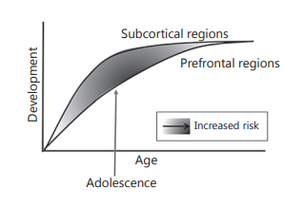
Development Mismatch
peers
Mills et al. (2013)
Zeng

Slide 42
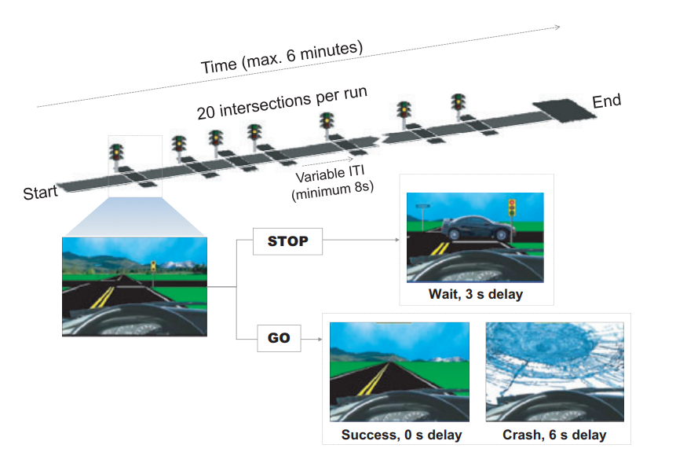
Design
Participants:
Stoplight Task * 4 (within subjects: 2 w/ peers, 2 w/o peers)
Questionnaires (impulsivity, sensation seeking, resistance to peer)
14 adolescents (14-18 yrs)
14 young adults
(19-22 yrs)
12 adults
(24-29 yrs)
Zeng

Slide 43
Adolescents showed more risky Go’s in Peer condition.
*
*
Predicted by sensation seeking
Zeng

Slide 44
Discussion
Why do you think the presence of peers sensitizes the incentive processing system?
The authors also reported a negative associations between resistance to peer influence and VS peer effect. What do you think this represent?
Do you think that the characteristics of peers (e.g., more conservative friends) will affect the relationship found in the study?
Zeng

Slide 45
Notes:
-What is the unique message of the article
-presentations should cover the article’s unique contribution, integrative themes across the readings (particularly for that day), the pros and cons of different research methods for addressing the topic, and ideas regarding potential future directions/applications of the findings
-Stronger presentations often focus on key strengths and results.

Slide 46
Adolescents take risks more often than children and adults
The Dual Systems Model of adolescent risk-taking
Incentive processing system (socio-emotional rewards) reaches peak reactivity during adolescence, while the cognitive control system (self-regulation) matures more gradually.
Heightened reward-seeking in the context of under-developed cognitive control = risk-taking
However, previous studies examining the association between cognitive control (impulsivity) and risk-taking in adolescents have yielded mixed results.
Hypothesized Explanation
In adolescents, the cognitive control system may function adequately under affectively neutral (cold) conditions, but is overwhelmed under affectively arousing (hot) conditions
Notes:
-Asynchronous maturation
U shaped vs linear
-individual differences

Slide 47
Present Study
Aim 1: Examine whether a task measuring cognitive control under an emotionally arousing condition could serves as a better predictor of individual differences in adolescent risk-taking than a non-emotional cognitive task.
Aim 2: Examine gender differences.
Based on data showing that males are more risky than females in real-world situations, and females process emotional information more quickly and accurately than their male counterparts.

Slide 48
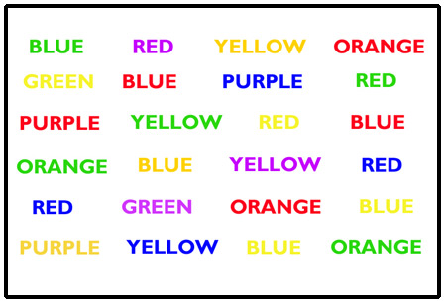
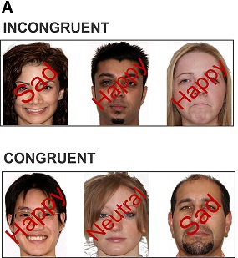
Methods
Participants
104 Adolescents between the ages of 13-17 (M=15.44)
Recruited from a large metropolitan area
42.3% males
Ethnically diverse sample
63.5% African American
Measures
Cognitive Stroop task
Emotional Stroop task
NOTE: In contrast to the Cognitive Stroop, the Emotional Stroop did not have a time limit
Risk-taking: Stoplight task

Slide 49
The Stoplight driving game
As you approach intersection, light turns yellow
Risk-taking = not braking for yellow light
Notes:
Ecological validity it a strength
Goal is to complete as fast as possible

Slide 50
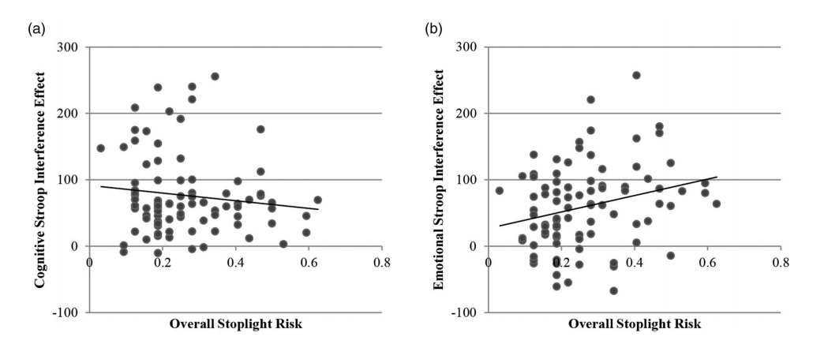
Emotional Stroop>cognitive stroop
Stroop Interference Effect
Participants responded more quickly (and accurately) on congruent than non-congruent trials, across the cognitive and emotional conditions
Emotional Stroop interference effect was significantly associated with risk-taking on the stoplight test (b), whereas Cognitive Stroop interference effect was not (a)
Only Emotional Stroop interference effect significantly associated with risk taking when examined with Cognitive Stroop interference effect in regression
Notes:
Correlation were sig different

Slide 51
Gender Differences
Cognitive Stroop
No gender differences (speed, accuracy, interference)
Emotional Stroop
Males were significantly less accurate and slower than females on incongruent trial
No difference in interference effect
Risk taking on the Stoplight task
No statistically significant difference
Male Emotional Stroop performance more robustly predicted Stoplight risk- taking (r = .39, p < .02) than female performance (r = .13, p = .37).
However, gender did not moderate the relationship between performance on the emotional Stroop task and the Stoplight task.
Males were slower and less accurate than females on the Emotional Stroop task, but comparable to females on Cognitive Stroop

Slide 52
Conclusions
Individual differences in performance on the Emotional Stroop task predicted risk taking in the Stoplight task, but performance on the Cognitive Stroop task did not.
Findings suggest, for the first time, that measuring cognitive control under affective arousal (“hot” conditions) may be a better predictor of individual differences in risk-taking than a task measuring cognitive control in a non-emotional context (“cold” conditions).
Results support the dual systems model, and more specifically support the idea that emotional context (“hot” vs. “cold”) is vital to understanding the link between cognitive control and risk-taking in adolescents.
Gender differences on the Emotional Stroop task support the notion that males exhibit a greater propensity to take dangerous risks, especially in the context of heightened emotional arousal.
HOWEVER, no significant gender difference in Emotional Interference effect or Stoplight risk-taking

Slide 53
Discussion Questions
Do you think this pattern of findings is unique to adolescents? How could this be tested?
What do you think these results would look like in younger children? Adults?
Does valence of emotional arousal matter?
Unlike the Cognitive Stroop, there was no time limit for the Emotional Stroop. How might this have impacted the results?
How might future studies extend these findings to better understand adolescent risk-taking in the real-world?
Other than the Emotional Stroop, how else could researchers examine the association between cognitive control and risk-taking in “hot” vs. “cold” conditions?
How would you incorporate neuroimaging methods to further examine the Dual Systems Model and role of emotional arousal in the link between cognitive control and risk-taking in adolescents?
How might these findings inform efforts to reduce risky decision making in adolescents?
Stoplight risk-taking and Emotional Stroop interference did not significantly differ between males and females. What do you make of this? Does this fit/not fit with authors’ conclusions about gender differences?

Slide 54
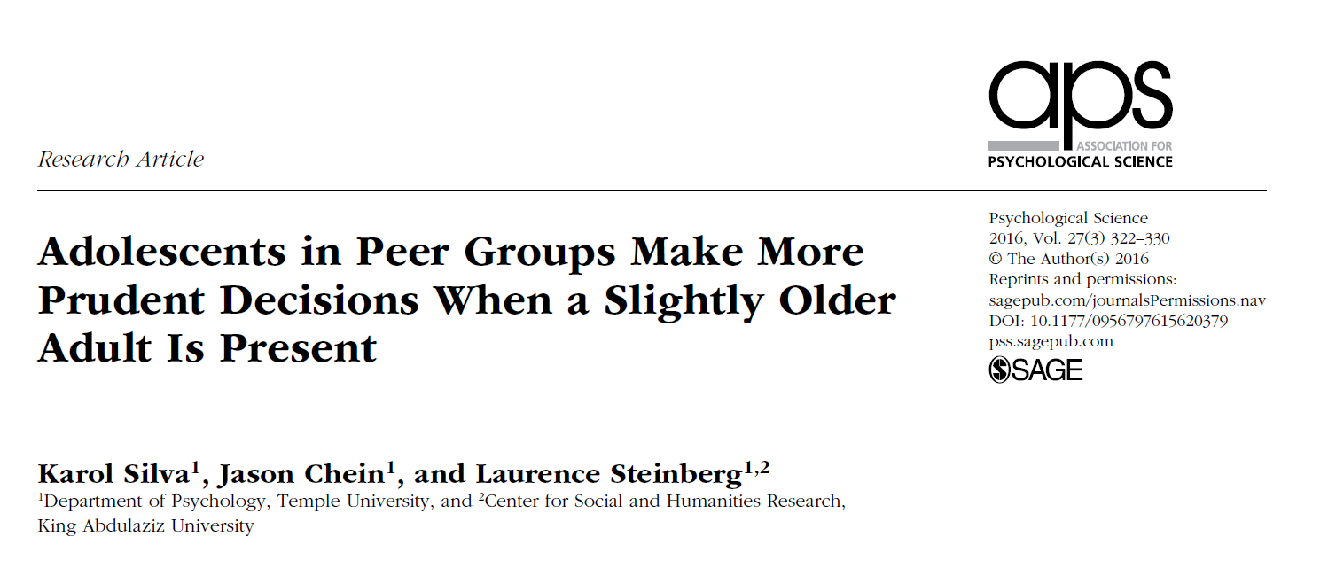
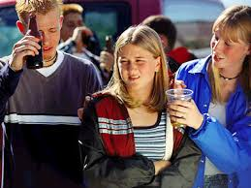
Borenstein

Slide 55
Background
Presence of peers increases risk tasking among youth
Real or illusory
Effects not observed in adults
Prior research focused on link between parental monitoring and teen misbehavior
Do non-familial adults affect risky decision making within groups?
Borenstein

Slide 56
Background
Impact of peers on adolescents’ risk taking is often unconscious
Peers heighten adolescents’ sensitivity to potential rewards
Especially true for immediately available rewards
Temporal discounting of rewards steeper when observed by peers
Could these mechanisms account for the moderating effect of adult’s presence on risky decision making?
Borenstein

Slide 57
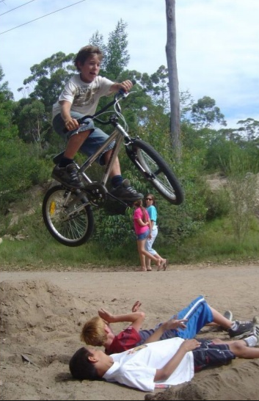
Hypotheses
The presence of a somewhat older adult mitigates the peer effect on adolescents’ risk taking
This mitigation is explained by attenuation of the impact of peers on adolescents’ preference for immediate rewards
Borenstein

Slide 58
Methods
Funded by the U.S. Army
How best to group soldiers in combat teams
Males in late adolescence recruited from colleges in Philadelphia, PA
Other subjects recruited via Temple University’s intro psychology classes
18-22 years of age
3 social-context situations
Solo- tested alone
Peer-group- observed by 3 same-age peers
Adult-present- 2 same-age peers and 25-30 year old confederate
Borenstein

Slide 59
Methods (Cont.)
Peer and adult present conditions constructed to resemble fire teams employed by the military
Testing completed in 2 phases
Recruitment and testing of solo and peer group conditions
Recruitment and testing of adult-present condition
Recruitment stopped when N=100 per condition
Effect sizes of d=.47 and d=.4 found in similar prior studies
10 subjects excluded from final analysis due to incomplete data
Borenstein

Slide 60
Procedure
Encouraged participants to recommend friends to act as peers
Phase 1: Group of 5 - four subjects randomly assigned to peer group and one to alone condition
One member from peer group randomly assigned as subject and performed test while others observed
Left in room for 10 minutes to interact naturally
Phase 2: three instead of four subjects (adult-present condition)
12 confederates took turns acting as the fourth subject
Left in room for 10 minutes to interact naturally AND share their names/year in school (confederate introduced as grad student)
56-59% of group conditions included friends
Borenstein

Slide 61
Measures
Risk Taking – Stop light computerized driving task
Goal to reach end of track as quickly as possible
32 intersections with yellow lights
Decide whether to stop vehicle via spacebar and lose time, or go through the intersection with possibility of crash
Proportion of intersections crossed w/out stopping = risk
Subjects and observers told about $15 bonus for performance
Preference for Immediate Rewards – Delay discounting task
Small immediate reward vs. large delayed reward
Delayed reward constant at $1,000
Delay interval (1wk, 1mo, 6mo, 1yr, 5yrs, 15yrs) (randomized)
Immediate reward = $200, $500, or $800 (randomized)
Nine choices presented in succession – previously chosen rewards cut in half for next choice (e.g., delayed choice= $1,000 -> next delayed option = $500)
Ending value reflects discounted value of the delayed reward (average indifference point)
Borenstein

Slide 62
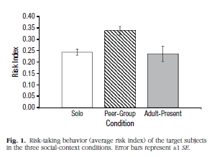
The presence of an adult mitigates risk-taking
Peer group subjects took significantly more risks in the game, when compared to solo (p<.001) and adult present conditions (p<.002)
Subjects in the adult present condition did not differ from the solo condition (p=.83)
Borenstein

Slide 63
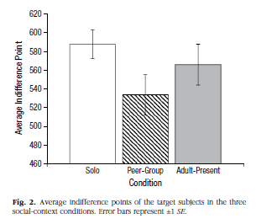
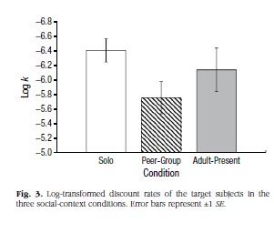
Adult presence reduces peer influence on immediate reward preference
Peer group -- lower indifference point
Significantly different than solo
Marginally different than adult-present
Discount rates paralleled indifference points
Higher discount rate= greater orientation towards an immediate reward
Peer group exhibited significantly greater discount rate, compared to solo and adult-present
No differences between solo and adult-present groups for indifference points and discount rates
Borenstein

Slide 64
Discussion
Male adolescents took more risks and expressed stronger preferences for immediate rewards when grouped with same age/sex peers
Adding a male mid-late 20’s can mitigate these effects
Adults influence the effect of peers on adolescent risk taking, through dampening increased activities in the brain’s reward centers
Risky choice to express bravado among peers
Safe choice to appear more prudent in presence of adult
Under conditions of emotional arousal, late adolescents may share certain characteristics with their younger counterparts
A slightly older adult may help compensate for adolescents’ neurobiological immaturity
Borenstein

