Slide 1
Perception
Daniel Messinger, PhD

Slide 2
Perceptual Narrowing During Infancy: A Comparison of Language and Faces
Maurer and Werker (2013)

Slide 3
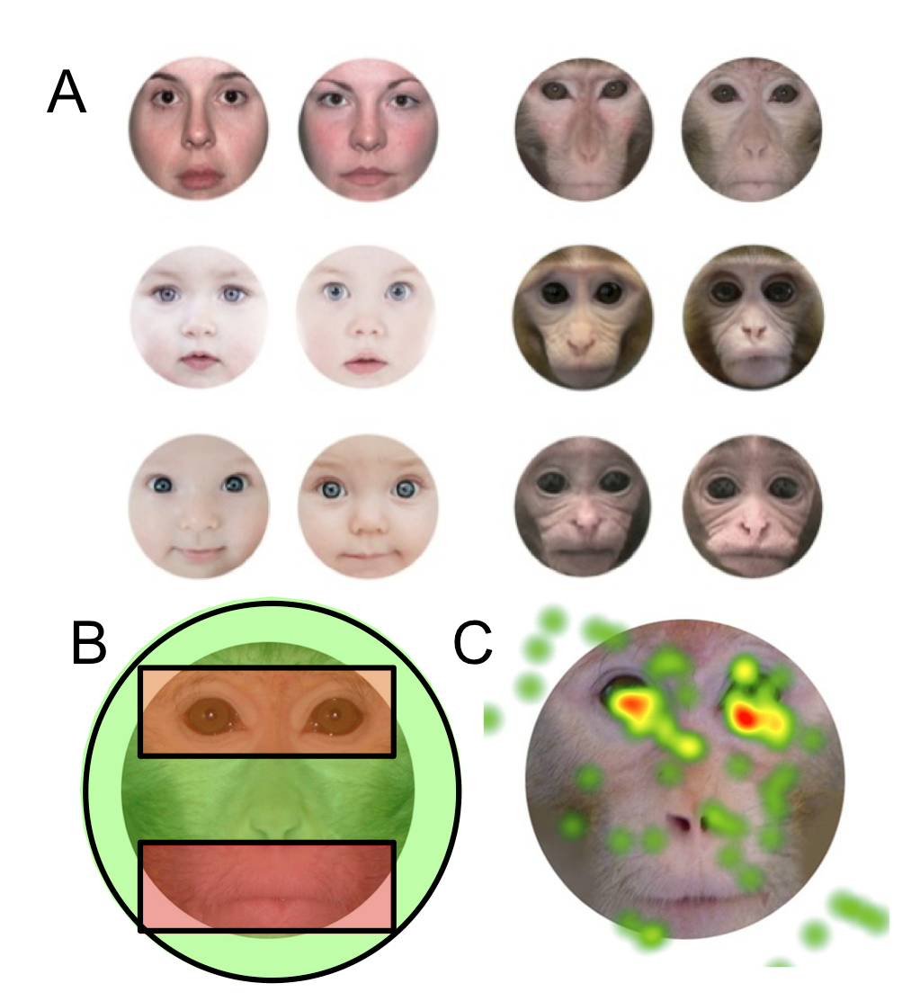

Simpson example
Analysis
  Identified areas of interest (AOIs) around each face
  Measured look duration at novel and familiar faces
  Measured proportion of time looking to the novel face during the first three seconds of looking
  Eye-mouth viewing index (eye / eye + mouth) [EMI]

Slide 4
Perceptual Narrowing
Young infants show greater preparedness to respond to any potential social signal
  Set of experience-expectant sensitivities that have adaptive significance
  Minimal input needed to maintain sensitivities

Slide 5
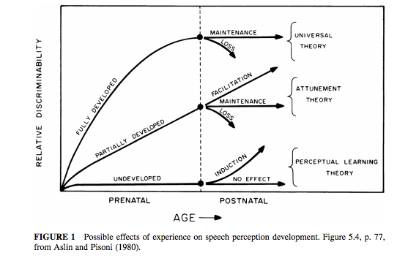
“Critical” Initial Formulation
Similarity in timing

Slide 6
Development
Newborns prefer listening to speech & looking at faces
  But not human specific
At 3 months
  Preference specific to human faces and voices
At 3-6 months, discriminate
  within native & non-native speech contrasts
  within own- & other-species faces and voices
  And other non-native distinctions (lexical tone, sign categories, other-race faces)
Older infants fail these distinctions
Notes:
Prenatal listening history may explain voice bias, but not fully
Infants can discriminate both native and non-native consonant and vowel contrasts at birth

Slide 7
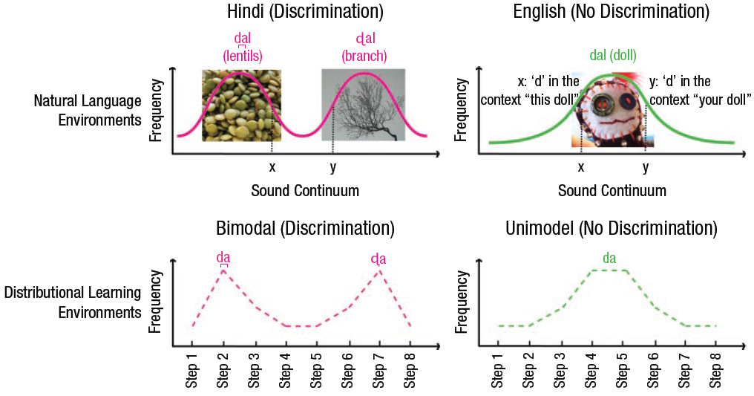
Perceptual Narrowing During Infancy: A Comparison of Language and Faces
Maurer and Werker (2013)

Slide 8
Qualifying the Construct
Not only a decline in perception of non-experience stimuli
Improvement in perception of experienced stimuli
Experience dependent cascading windows
  Infants attune to rhythmical properties of the native language before the segmental properties
Critical period
  Biologically based timetable in language processing
  Learning based timetable in face processing

Slide 9
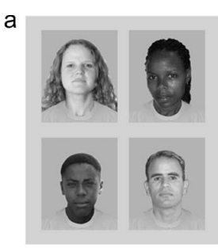
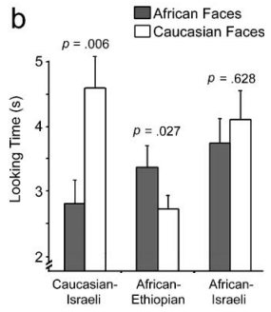
Preface to Vogel:
Face Processing preference
  Bar-Haim et al., 2006

Slide 10
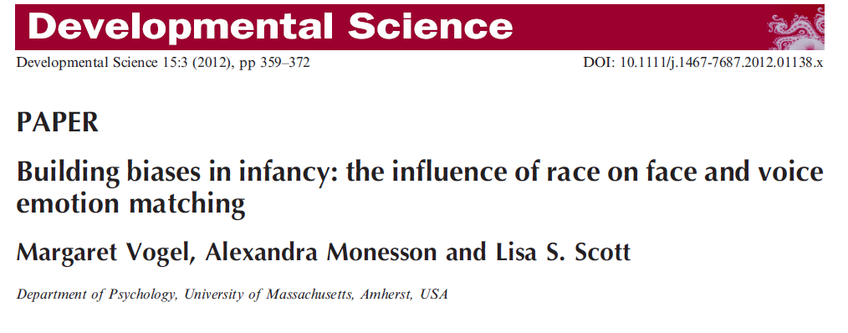

Slide 11
Experience and emotion processing
Perceptual narrowing- infants become attuned to faces that they are exposed to more in the environment (own-race faces) relative to less frequently encountered faces (other-race faces)
Origin of the other-race effect (ORE)

Slide 12
Background cont.
3 ERP components associated with both face and emotion processing in infants
Posterior ERP components related to perception:
  N290
  P400
Anterior ERP component related to attention:
  Negative control component (Nc)

Slide 13
Purpose of Study
Examine whether decline in ability to recognize other-race faces influences the ability to match emotion sounds with faces expressing congruent or incongruent emotional expressions

Slide 14
Hypotheses
9 month olds will differentiate own race faces
Expect impaired processing of emotion sound/ face pairs for other races but not own race faces in 9 mo infants
The Nc, N290, and P400 neural networks will be engaged while infants complete the task

Slide 15
The Role of Experience in Perceptual Development (cont)
Face Processing (Vogel et al., 2012)
  Study of differential processing of own-race vs. other-race member
    Processing advantage for same-race faces based on perceptual narrowing
      Differential experience hypothesis
  Goal of study to examine whether decline in ability to recognize other-race faces during 1st year influences ability to accurately match emotion sounds with images of faces
  Participants
    5 & 9 month old infants
  Method
    Visual paired comparison (VPC) to index ability to discriminate
    ERP (Nc, N290, P400) in response to faces of different races and with compatible vs. incompatible vocal sounds

Slide 16
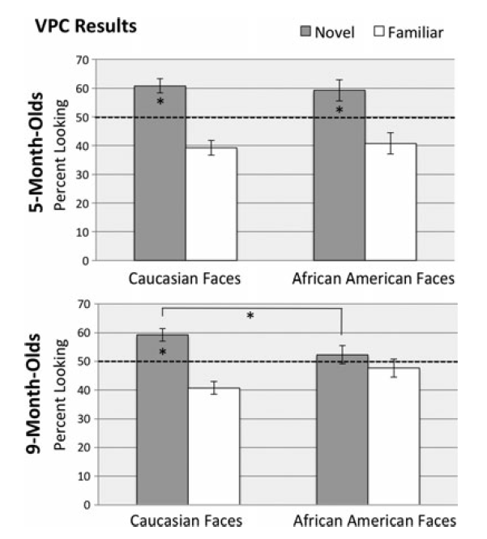
Behavioral visual-paired comparison (VPC) results
Notes:
Figure 3 Behavioral visual-paired comparison (VPC) results. All infants completed one VPC task for Caucasian faces and a second VPC for African American faces. Pictured is mean percent looking (±SE) toward the novel and familiar stimuli after 30 seconds of familiarization to the familiar face. Whereas 5-month-old infants looked longer to the novel Caucasian and African American faces, showing evidence of discrimination for both races, 9-month-old infants only looked longer to novel Caucasian faces.

Slide 17
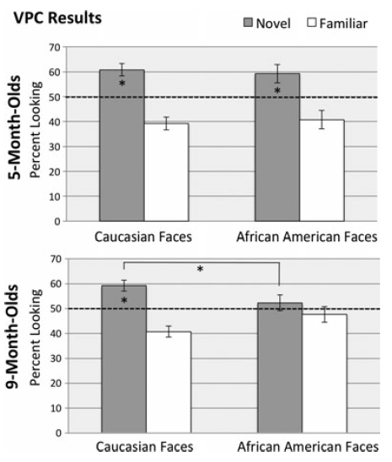
Face Processing (Vogel et al., 2012)--Behavioral Findings
Viewed familiarized happy face paired, side-by-side, with a novel happy face of same race for accumulated looking time of 10 s.
  Side of stimulus presentation switched after 5 seconds.
  Then completed task using faces from the race not previously viewed.
Notes:
Figure 3 Behavioral visual-paired comparison (VPC) results.
All infants completed one VPC task for Caucasian faces and a
second VPC for African American faces. Pictured is mean
percent looking (±SE) toward the novel and familiar stimuli
after 30 seconds of familiarization to the familiar face.
Whereas 5-month-old infants looked longer to the novel
Caucasian and African American faces, showing evidence of
discrimination for both races, 9-month-old infants only looked
longer to novel Caucasian faces.
Familiarized to two, side-by-side, images of same smiling face for 30 s accumulated looking time

Slide 18
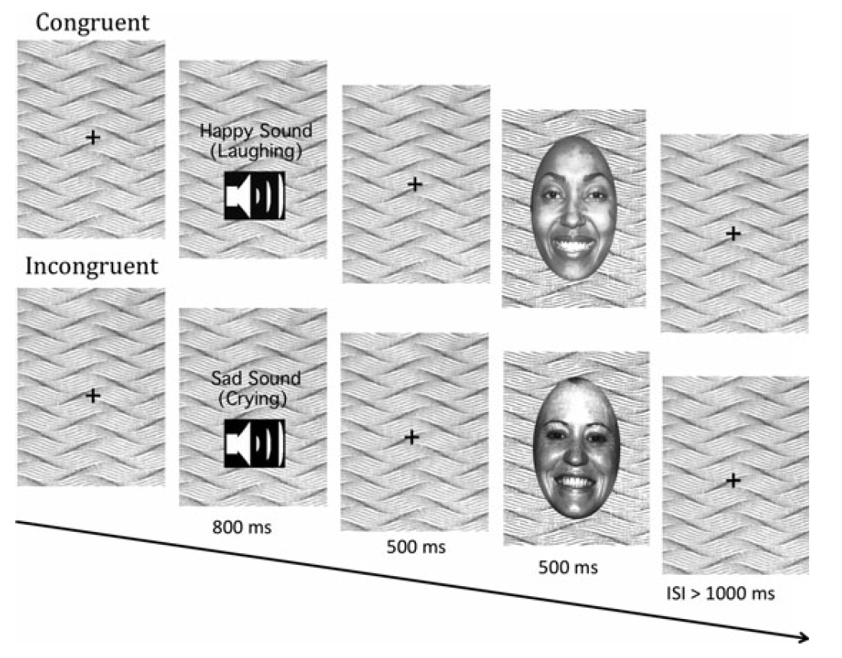
Electrophysiological procedure
ERP recorded
Method
Sample
  Caucasian infants (5 mo and 9 mo) who have little or no previous experience with African Americans
Behavioral procedure
  Visual paired comparison (VPC)

Slide 19

Figure 2 Regions selected for ERP analyses for the Nc (frontal and central regions) and the N290 and P400 (left occipital-temporal, middle occipital, right occipital-temporal) components.

Slide 20
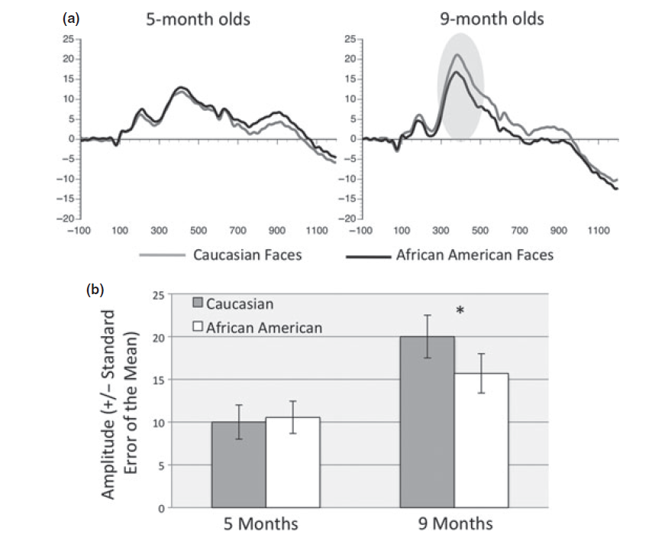
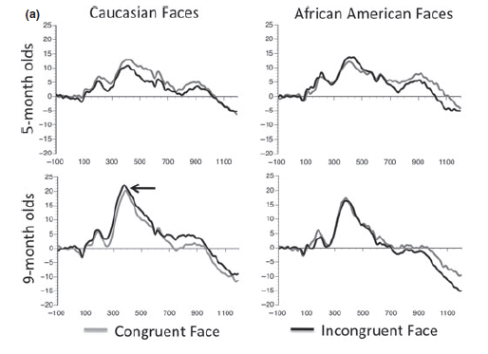
ERP Results (P400 amplitude)
Notes:
Figure 5 Perceptual processing of own- and other-face faces. (a) P400 component in response to African American and Caucasian faces, collapsed across congruent and incongruent trials. The P400 response to Caucasian faces was significantly greater than the response to African American faces in 9- but not 5-month-old infants (shaded area denotes significant amplitude difference). (b) Mean amplitude (±SEM) for the P400 for both ages

Slide 21
Effect of congruency on latency is specific to Caucasian faces at 9 months
Face Processing (Vogel et al., 2012)
Notes:
Figure 6 Perceptual processing of congruency. (a) Illustrates the P400 component in response to African American and
Caucasian congruent and incongruent sound ⁄ face pairs in 5-month-old and 9-month-old infants (arrow denotes significant latency differences).
(b) Mean Latency (±SEM) for the P400, across conditions, for both ages. In 9-month-old infants the latency in response to the Caucasian incongruent condition peaked faster than the Caucasian congruent condition. No differences were found for
5-month-old infants.

Slide 22

Conclusions
Perceptual narrowing and the ORE influence emotion processing
Notes:
Neural networks used to process emotion change during development

Slide 23
Voice versus face perception
Distinctions can be reestablished
  By increasing exposure time or training
Induction of new skills and reorganization of existing skills
  At 9 months items from native face categories are processed differently than at 3 months
In later childhood and adulthood
  Other-race face distinctions can be reacquired
  Phonetic distinctions are not as successful
Differences in timing of perceptual narrowing
  Present earlier for other-race faces and vowels and for other-species faces and consonants

Slide 24
Discussion Questions
o Why is the other-race effect so important to study? What are the real world implications of this phenomenon?
o Do you think their decision to include infants that didn’t make it through both tasks was a valid one?
o What about only including Caucasian infants with limited exposure to other races?
o Why do you think they chose to present the faces in grey scale instead of in full color? What are the advantages/disadvantages of presenting the faces in this way?
o Where do you think findings like this could have real implications (i.e., training infants to continue this better recognition of faces in other races)?

Slide 25
Discussion Questions
Do you think these results would be replicated with more similar ethnicities?
What do you think would happen for infants raised in biracial households?
Why do you think this research is important to the broader field?

Slide 26
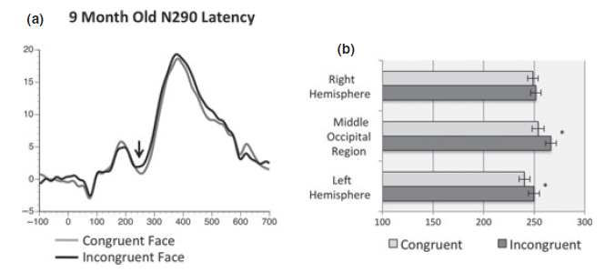
N290 component in 9-month-old infants
Notes:
Figure 4 N290 component in 9-month-old infants: (a) ERP response to congruent versus incongruent faces. The response to
congruent faces peaked earlier than the response to incongruent faces. (b) This earlier peaking N290 was primarily driven by latency
differences recorded over in the left hemisphere and middle occipital regions.

Slide 27
The Role of Experience in Perceptual Development
Early visual deprivation and later development
  Developmental changes in capabilities that eventually recover (e.g., low spatial frequency sensitivity)?
  But some capabilities are permanently damaged
    Mid and high spatial frequency
    Holistic face processing
    Face recognition based on spacing of features
  Differences between spared vs. permanently damaged domains in terms of their typical developmental course?

Slide 28
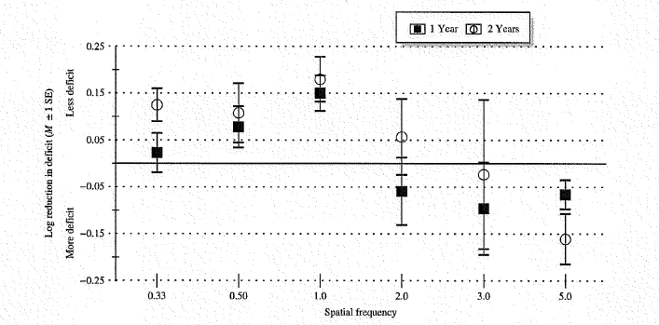
Sleeper Effect in Contrast Sensitivity
Increasing deficit for high spatial frequencies
  Compared to typically developing controls
Maurer, Ellemberg, & Lewis, 2006
Notes:
Figure 1 Reduction in patients’ deficit in contrast sensitivity when re-tested 1 or 2 years after the initial assessment. The first test
was between age 4 and 7 years. The graph shows how the patients’ deficit, compared to visually normal controls, changed when
they were re-tested 1 and 2 years later. For low spatial frequencies (wide stripes: up to 1.0 cycle per degree), patients’ sensitivity
improved more than that of controls, eliminating all or most of their deficit. For mid spatial frequencies (3–5 cycles per degree),
there was improvement in the control group but not in the patients, so that patients’ deficit increased. For high spatial frequencies
(10–20 cycles per degree), patients were unable to see the stripes at any test point. Reprinted from Maurer, Ellemberg & Lewis
(2006, Figure 4).

Slide 29
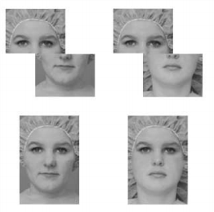
Holistic Face Processing: Misaligned and composite stimuli
Is top half the same?
LeGrand, Mondloch, Maurer, & Brent, 2004
Same?
Notes:
Figure 2 Test stimuli for the composite face effect. On ‘same’
trials, the top halves of the two sequential faces are the same
but they are combined with different bottom halves. The
subjects’ task is to indicate that the tops are the same. When
the halves are aligned in upright faces, visually normal adults
find the task difficult on same trials because holistic processing
creates the impression of two different faces. When the halves
are misaligned to break holistic processing, the task is much
easier. Reprinted from Le Grand, Mondloch, Maurer & Brent
(2004, Figure 1, left panel).

Slide 30
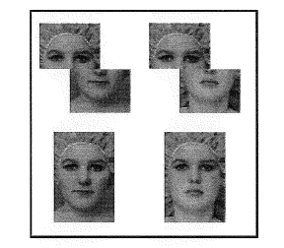
The Role of Experience in Visual and Auditory Development
Holistic Face Processing
LeGrand, Mondloch, Maurer, & Brent, 2004

Slide 31
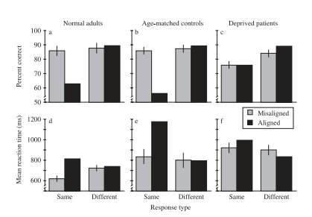
Holistic Face Processing
LeGrand, Mondloch, Maurer, & Brent, 2004
Notes:
Figure 3 Results for the composite face task for patients treated for bilateral congenital cataract and age-matched controls.
On
the critical probe trials (same/aligned), the control group is less accurate and has longer reaction times compared to both the patient group and their own performance when the holistic interference from the irrelevant bottom half is reduced by misalignment (same/misaligned).
Patients’ superior performance on same/aligned trials and their identical performance on same trials for the aligned
and misaligned blocks both provide evidence that the patients do not process faces holistically. Reprinted from Le Grand, Mondloch,
Maurer & Brent (2004, Figure 2).

Slide 32
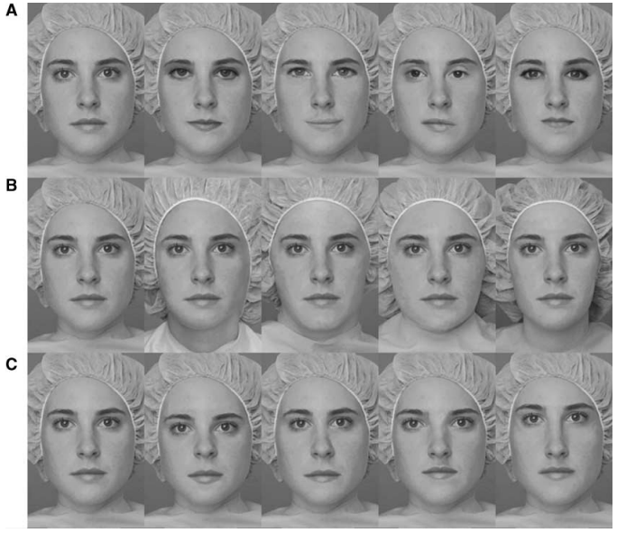
Face Recognition
Eye/mouth shape
Shape of external contour
Spacing of internal features
Notes:
Figure 4 The stimulus sets used to test sensitivity to differences among faces in the shape of the eyes and mouth (set A), the shape
of the external contour (set B), and the spacing of the internal features (set C). ‘Jane’ is shown as the left-most face in each panel,
along with her sisters differing along one of the three dimensions. For the tests, stimuli were presented almost life size. Patients
treated for bilateral congenital cataract have a deficit only when asked to discriminate faces in the spacing set (C). Reprinted from
Le Grand, Mondloch, Maurer & Brent (2003, Figure 1).

Slide 33
The Role of Experience in Perceptual Development (cont)
Interpretations of developmental mechanisms underlying sleeper effects
  Loss of optimal neural architecture
    Lack of visual input → loss of essential neural connections or reallocation of resources for different forms of processing
  Effects of altered timing and/or sequence of input
    Mismatch between input and prior experience
      No visual input → rapid increase in acuity
      Side effect of rapid increase =
        doesn’t give time to process ‘globally’
          sas in typical development

Slide 34

Individual Differences in Infant Fixation Duration Relate to Attention and Behavioral Control in Childhood
(Papageorgiou et al., 2014)

Slide 35
What We Know…
Fixation duration = reliable measure of attentional control in adults
Evidence of continuity of attention from infancy → preadolescence
Children with ADHD exhibit a trend toward shorter fixations
Individual Differences in Infant Fixation Duration
Temperament & Behavior in Childhood
What We Don’t Know…
?
Notes:
Fixation Duration: Time between saccadic eye movements when eyes are relatively stable
Infant attention correlates with attention in toddlerhood/preadolescence
Infant attention correlates with IQ at age 11
Individual Differences in Infant Fixation Duration (Papageorgiou et al., 2014)

Slide 36
Individual Differences in Infant Fixation Duration (Papageorgiou et al., 2014)
Fixation
Executive Attention
Effortful Control
Surgency
?
Emotion regulation
Temperament
Extraversion, Motor activity, Impulsivity
Notes:
Executive attention & Temperament
Fixation relates to Executive attention because it involves a conflict between keeping eyes stationary & disengaging
Time spent resolving conflict (Stroop) correlates with parent reports of Effortful Control – temperament trait of ability to regulate emotions & inhibit dominant response to activate a subdominant response
E.C. is negatively correlated with Surgency (trait aspect temperament in which person exhibits high levels of extraversion, motor activity, and impulsivity), impulsivity, and hyperactivity
E.C. differentiates reliably between typically developing children & those with ADHD (children w/ADHD score lower on E.C.)

Slide 37
Individual Differences in Infant Fixation Duration (Papageorgiou et al., 2014)
Fixation
Executive Attention
Hyperactivity & Impulsivity
?
Among children with ADHD
Behavior
Notes:
Executive attention & Temperament
Fixation relates to Executive attention because it involves a conflict between keeping eyes stationary & disengaging
Time spent resolving conflict (Stroop) correlates with parent reports of Effortful Control – temperament trait of ability to regulate emotions & inhibit dominant response to activate a subdominant response
E.C. is negatively correlated with Surgency (trait aspect temperament in which person exhibits high levels of extraversion, motor activity, and impulsivity), impulsivity, and hyperactivity
E.C. differentiates reliably between typically developing children & those with ADHD (children w/ADHD score lower on E.C.)

Slide 38
1st Study to combine eye tracking with a longitudinal design
Sample
  Infant Eye Tracking (4-10 mo.) → Parent Qnr (mean age = 41.59 mo.)
  N = 271 – 51 (did not return Qnr) = 172
  Caucasian, middle SES, London residents
Measures
  2-stage analysis for eye tracking data: algorithm + hand-moderated
  Temperament: Early Childhood Behavior Questionnaire (ECBQ) and Children’s Behavior Questionnaire (EBQ)
  Behavior: Revised Rutter Parent Scale for Preschool Children (RPSPC) and Strengths and Difficulties Qnr (SDQ)

Slide 39
Individual Differences in Infant Fixation Duration (Papageorgiou et al., 2014)
Method
Parent-reported Childhood Temperament
Preschool: Early Childhood Behavior Qnr (ECBQ) School-age: Children’s Behavior Qnr (CBQ)
Effortful Control | Attentional focusing
 | Inhibitory control
 | Low-intensity pleasure
 | Perceptual sensitivity
Surgency | Activity level
 | High-intensity pleasure
 | Impulsivity
 | Shyness (reverse-scored

Slide 40
Individual Differences in Infant Fixation Duration (Papageorgiou et al., 2014)
Results
Parent-reported Childhood Temperament
Preschool: Early Childhood Behavior Qnr (ECBQ) School-age: Children’s Behavior Qnr (CBQ)
Effortful Control | Attentional focusing
 | Inhibitory control
 | Low-intensity pleasure
 | Perceptual sensitivity
Surgency | Activity level
 | High-intensity pleasure
 | Impulsivity
 | Shyness (reverse-scored
Infant Fixation Duration
Covariates: Child’s age, Qnr version, Child’s sex, Total # of eye tracking trials completed and fixations detected

Slide 41
Individual Differences in Infant Fixation Duration (Papageorgiou et al., 2014)
Method
Parent-reported Childhood Behavior
Hyperactivity-Inattention Scale
Preschool: Revised Ruttner Parent Scale (RRPSPC) -- Rate frequency of 4 different behaviors School-age: Children’s Behavior Qnr (CBQ) -- Rate frequency of 5 different behaviors

Slide 42
Individual Differences in Infant Fixation Duration (Papageorgiou et al., 2014)
Results
Parent-reported Childhood Behavior
Hyperactivity-Inattention Scale
Preschool: Revised Ruttner Parent Scale (RRPSPC) -- Rate frequency of 4 different behaviors School-age: Children’s Behavior Qnr (CBQ) -- Rate frequency of 5 different behaviors
Infant Fixation Duration
Covariates: Child’s age, Qnr version, Child’s sex, Total # of eye tracking trials completed and fixations detected

Slide 43
Age as a moderator
    The variance of childhood surgency accounted for by variation in infant fixation duration increases as the age of the infant increases
Infant Age
Individual Differences in Infant Fixation Duration
SURGENCY in Childhood
Notes:
To shed light on the developmental mechanisms that link attention in infancy to temperament and behavior in childhood, we explored whether the interactive effect of infant fixation duration and age of the infant explained variation in effortful control, surgency, and hyperactivity- inattention. Table S4 in the Supplemental Material pres- ents the results of the regression model. The Mean Fixation Duration × Infant Age interaction was signifi- cantly associated with surgency in childhood (β = −0.20, R2 = .03, p = .05). This result suggests that the direction of the association between mean fixation duration and sur- gency remains the same (negative) irrespective of the age of the infant; the fact that the association is significant suggests that the variance of childhood surgency accounted for by variation in infant fixation duration increases as the age of the infant increases.

Slide 44
Individual Differences in Infant Fixation Duration (Papageorgiou et al., 2014)
Conclusions
Associations were moderate in magnitude – “to be expected”
  Effortful control (2% variance), Surgency (7%), Behavior (6%)
Potential implications:
  Studying fixation duration can help us understand mechanisms through which executive control develops
  Investigating the causes of individual differences in infant fixation duration could inform interventions for executive attention
  Future: Fixation duration might be used to identify individuals at risk for developing ADHD

Slide 45


Slide 46
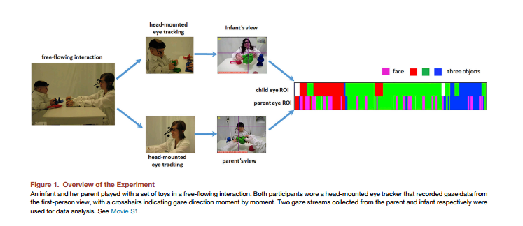

Slide 47
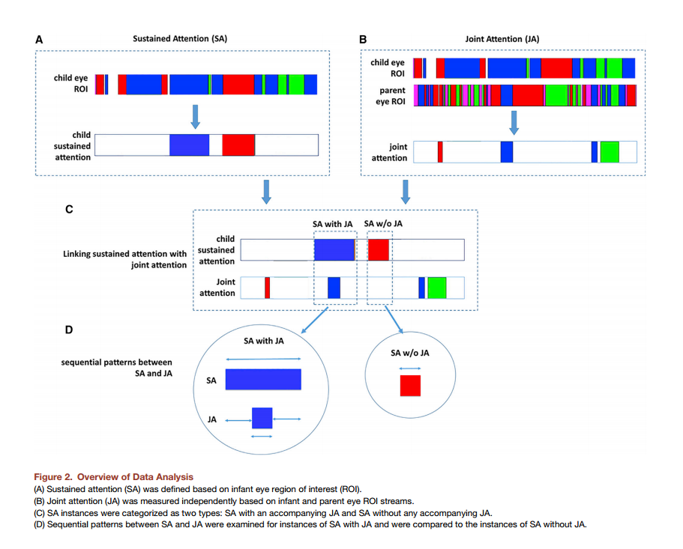

Slide 48
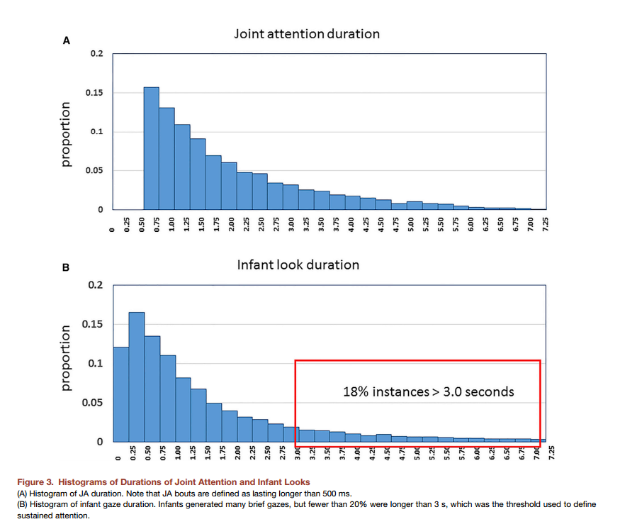

Slide 49
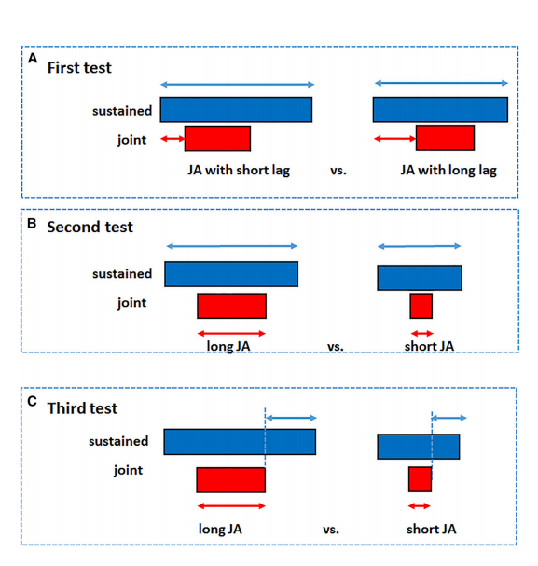

Slide 50
Attention to eyes is present but in decline in 2–6-month-old infants later diagnosed with autism
Jones & Klin, 2013

Slide 51
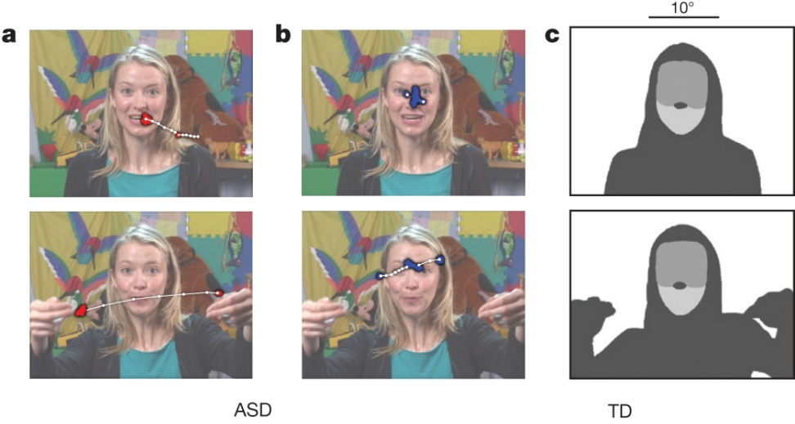

Example stimuli, visual scanpaths, regions-of-interest, and
longitudinal eye-tracking data from 2 until 24 months of age.
W Jones & A Klin Nature 000, 1-5 (2013) doi:10.1038/nature12715

Slide 52
Do babies at risk for ASD like faces?
Infants prefer familiar voices, faces, bio motion
Are these preferences disrupted in autism?
  Later ASD: lack of eye contact, joint attention, inability to recognize emotions
Baby sibling longitudinal design
  Tested at 2,3,4,5,6,9,12,15,18,24 months
  110 infants (59 High Risk for Autism)
  12 with ASD at 3 year outcome
  Current study only looks at males (11 ASD, 25 LR-TD)

Slide 53
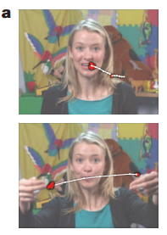
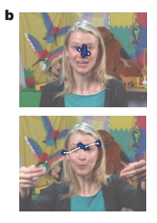
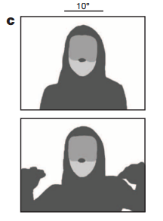
Methods
Tracked eye gaze during naturalistic “caregiver interaction” videos
Measured percentage of visual fixation to eyes, mouth, body and objects in a naturalistic video
Tracked this over time

Slide 54
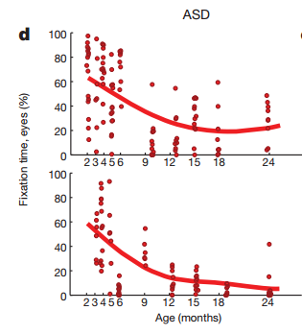
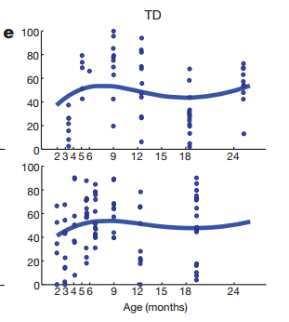
TD vs ASD
TD
Look more at eyes than anywhere else from 2 to 6 months
Mouth fixation increases during 1st year, peaks at 18 months
Body and object fixation drops through first year
ASD
Eye Fixation declines from 2-24 months
Fixation on the mouth increases until 18m
Object and body fixation declines slowly in 1st year
Object fixation rises in 2nd year

Slide 55
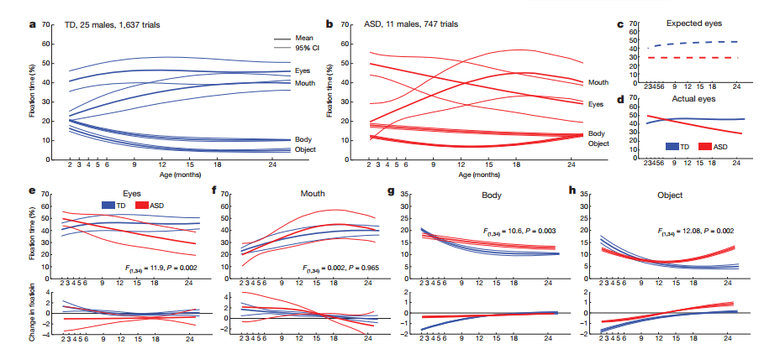

Slide 56
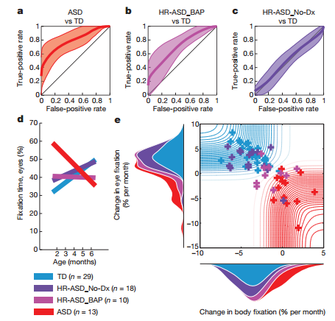

Slide 57
Questions
What benefit do babies get from looking at their caregivers’ eyes?
Why do you think attention to the mouth increases over time and peaks at 18 months in TD kids?
Why is that trajectory the same in kids with ASD?

Slide 58
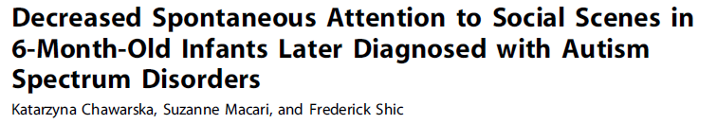
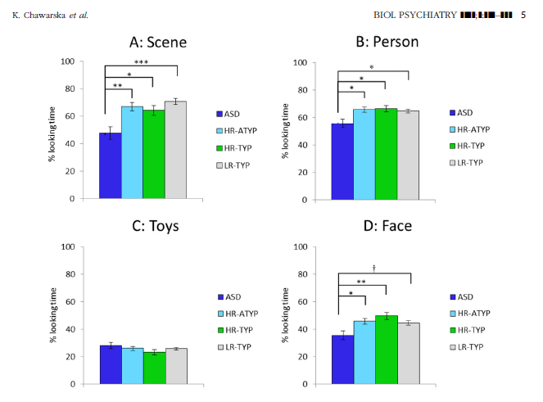

Slide 59
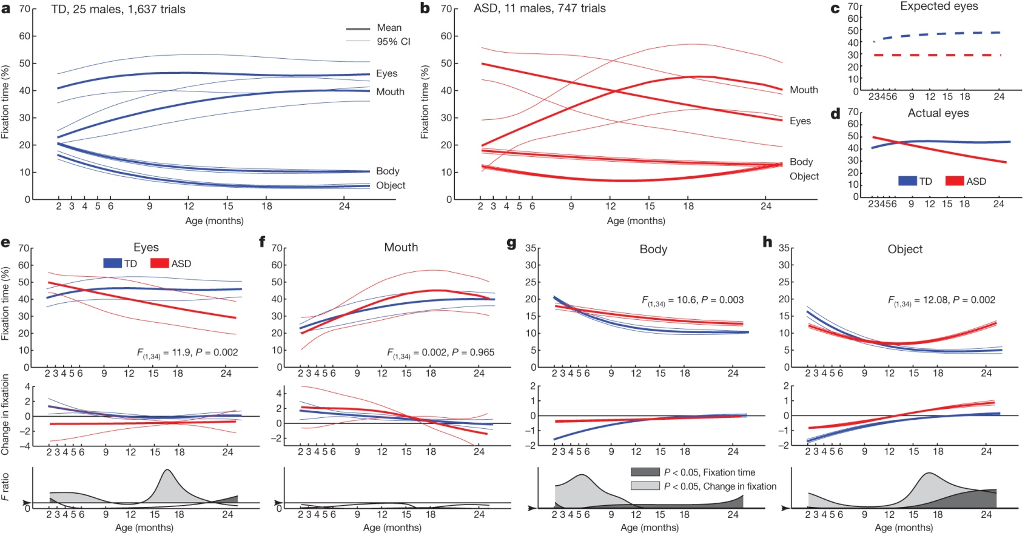
Growth charts of social visual engagement for typically
developing children and children diagnosed with ASD.
W Jones & A Klin Nature 000, 1-5 (2013) doi:10.1038/nature12715

Slide 60
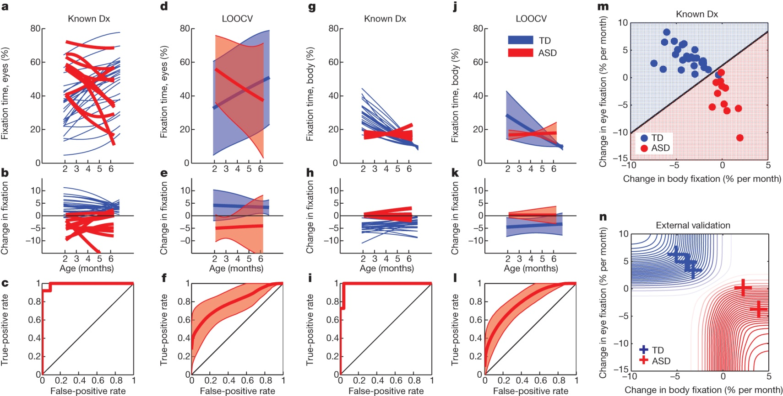
Visual fixation between 2 and 6 months of age relative to diagnosis at year 3.
W Jones & A Klin Nature 000, 1-5 (2013) doi:10.1038/nature12715

Slide 61
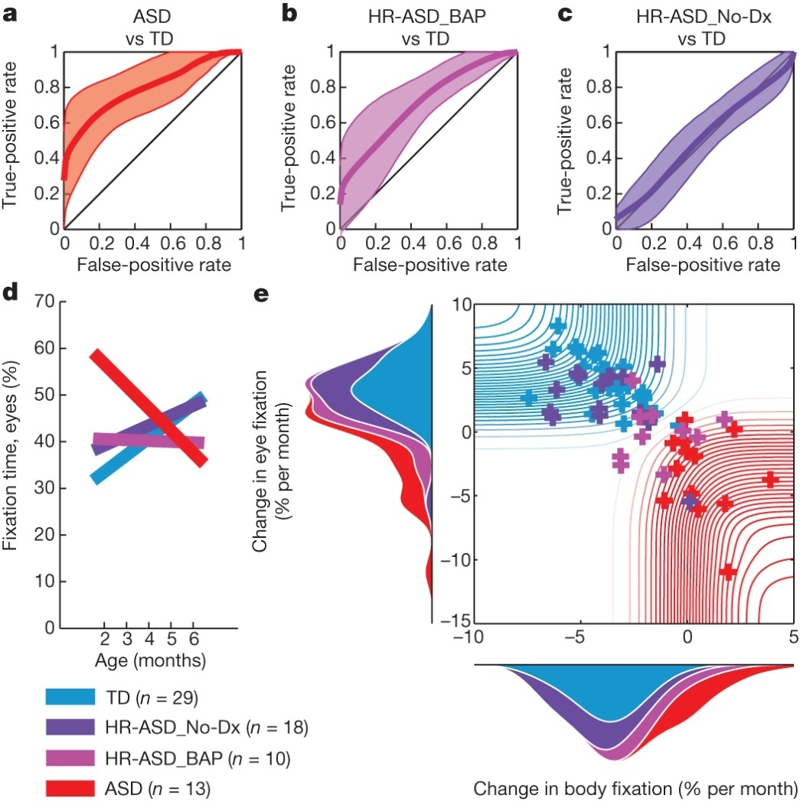
Visual fixation between 2 and 6 months of age relative to outcome
levels of affectedness.
W Jones & A Klin Nature 000, 1-5 (2013) doi:10.1038/nature12715

