Slide 1
Infant Perception
Daniel Messinger, Ph.D.

Slide 2
Perceptual Development
Perception
  Nature/Nurture influences
  Methodology
    Psychophysiology
    Behavioral
  Development by Sense
    Adaptiveness?
Notes:
Lifespan Development

Slide 3
Perception as the foundation of cognition
The organism’s input
Epistemology
  Origins of different forms of knowledge
Nature/Nativism
  The structure of reality is in the organism
    vs.
Nurture/Empiricism
  The structure of reality develops as the organism interfaces with the environment
Your belief

Slide 4
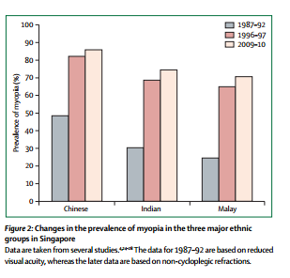
Historical & regional differences myopia rates (nearsightedness)
How would you interpret these data?
Notes:
‘Highest prevalences of myopia for young adults of Chinese ancestry.
Evidence that the prevalence of myopia are based primarily on genetic diﬀerences.
E.g., generally lower prevalences in rural areas than in urban areas.’

Slide 5
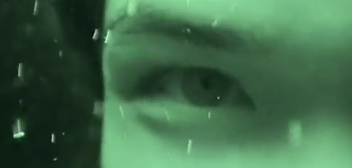
What do you see in this picture?
Phenomenon: www.youtube.com/watch?v=YIKm3Pq9U8M (54s)
Gislén, A., Warrant, E. J., Dacke, M., & Kröger, R. H. H. (2006). Visual training improves underwater vision in children. Vision Research, 46(20), 3443-3450. doi: http://dx.doi.org/10.1016/j.visres.2006.05.004
Notes:
Training: http://www.deepdyve.com/lp/elsevier/visual-training-improves-underwater-vision-in-children-NyLb24uM7W

Slide 6
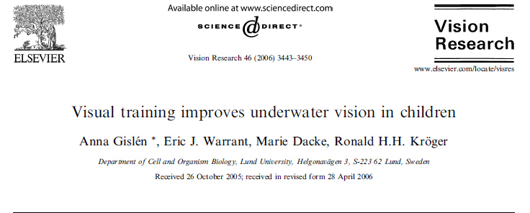

Slide 7
The Role of Experience in Perceptual
Development
Audition and Aging
  Nature/Nurture and
  loss of hearing
Hearing test by age: http://www.youtube.com/watch?v=AXhRmv1mrs4
Baltes, Reese, Nesselroade, 1977

Slide 8
How can perfect pitch develop?
Perfect pitch
  Experience- based changes in the ability to identify and reproduce a pitch: http://perfectpitchtest.com/
  Distorted tunes test (long)
    http://www.nidcd.nih.gov/tunetest/pages/dtt.aspx
Notes:
http://www.youtube.com/watch?v=fSfc21RDkbw-
http://www.youtube.com/watch?v=AXhRmv1mrs4
-true>
Lewkowiz
voicing
Changes in hearing acuity over the lifespan:
http://www.youtube.com/watch?v=AXhRmv1mrs4

Slide 9
Methods for Studying Perceptual Development
HR, HR variability, RSA
Absolute thresholds and/or Difference thresholds
Psychophysiology
  CNS Measures
    Neurological anatomy
    Single cell recordings
    Functional recordings
      EEG/ERP
      PET
      fMRI
    ANS Measures (HR, HR variability, RSA)
Behavioral Measures
  Naturally occurring behaviors
  Preference paradigms
  Conditioning paradigms
  Habituation/Dishabituation
Notes:
Ans measures include HR, HR variability, RSA; sensitive to changes in attention state; reflect orienting, sustained attention, state changes
Problems with inferring perceptual experiences from physio measures; extraneous variables and interpretation takes a lot of inference

Slide 10
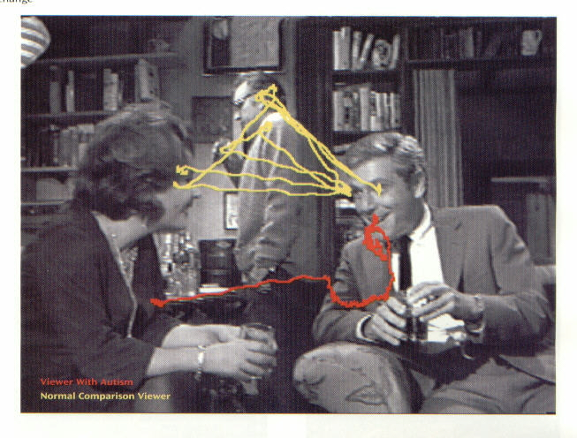
Behavioral Measures
Naturally occurring behaviors
  Eye Tracking

Slide 11
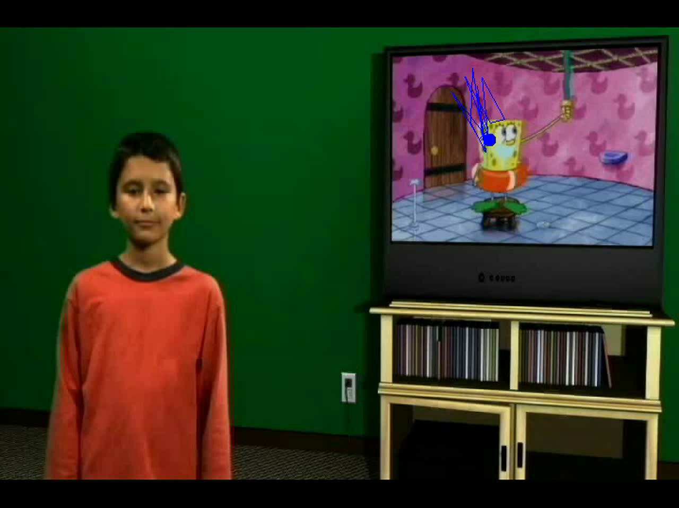
Eye-tracking in the wild?

Slide 12
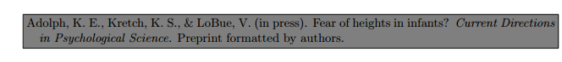
Visual cliff and fear of heights?
Do crawling infants avoid crossing the brink of a dangerous drop-off because they are afraid of heights?
No, avoidance and fear are conflated.
Instead, infants avoid crawling or walking over an impossibly high drop-off because they perceive affordances for locomotion—the relations between their own bodies and skills and the relevant properties of the environment—that make descent impossible.
    Visual cliff
    https://www.youtube.com/watch?v=p6cqNhHrMJA
    Databrary https://nyu.databrary.org/volume/5
Notes:
http://www.youtube.com/watch?v=4OelrPzpQ6Q (not working)

Slide 13
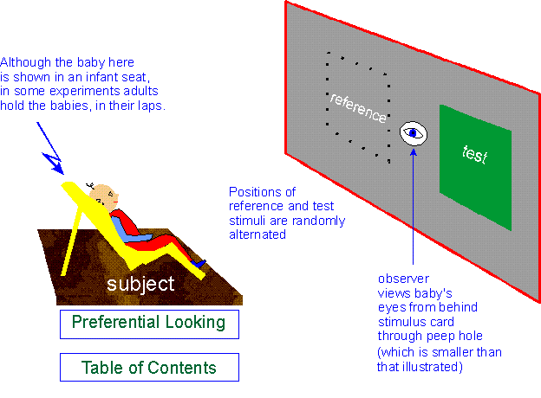
Preference paradigms for Studying Perceptual Development
    (see Bar-Haim et al., 2006)
Notes:
Preference is clear; but lack of preference doesn’t necessarily mean difference not detected; therefore often rely on conditioning paradigms that involve less inference of null result

Slide 14
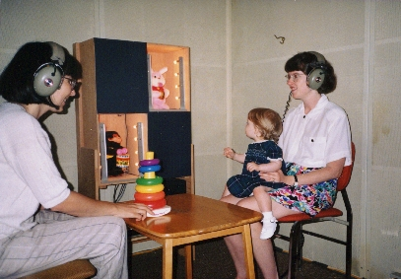
Conditioning paradigms
Reinforcement of a voluntarily controlled motor activity leads to it being repeated

Slide 15
Stimulus

Slide 16
This pattern
Was presented to 93 premature infants for 60 sec.
Infants who gazed at the pattern for more time had lower intelligence at 18 years if age.
Infants who gazed at the pattern for less time had higher intelligence
Fixation duration in infancy and score on the intelligence test, r(91) = -.36, p < .0002.
Why?
  Sigman, M., Cohen, S. E., & Beckwith, L. (1997). Why does infant attention predict adolescent intelligence? Infant Behavior & Development, 20(2), 133-140.

Slide 17
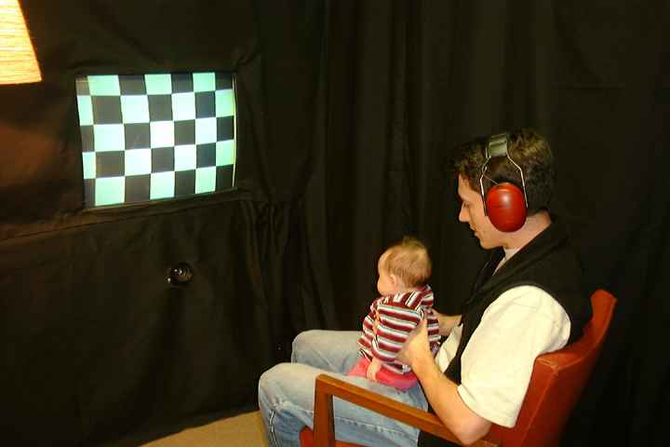
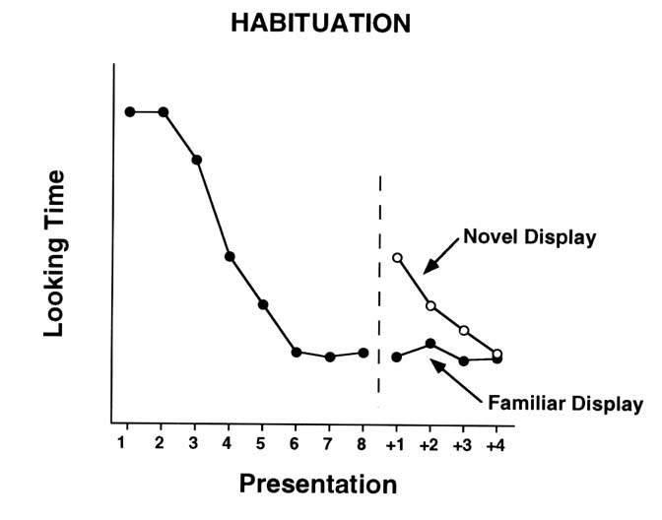
Habituation/Dishabituation
Habituation reflects building of mental representation of the stimulus; comparison of presented stimulus to internal representation
https://www.youtube.com/watch?v=dlilZh60qdA

Slide 18
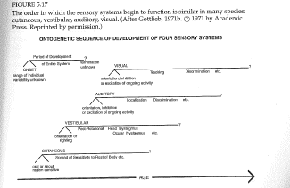
Sensory system development

Slide 19
Adaptiveness in Patterns of
Growth?
Adaptiveness of initial perceptual sensitivities?
  Touch/smell well developed at birth
    Approach/withdrawal responses
  Optimal hearing in mid-frequencies
    Sensitivity to lower/higher frequencies later
  Gradual development of acuity with clearest image at 12 inches in newborn
Notes:
p. 306 “the window of modifiability in perceptual adaptation appears to open early in life so that organisms can prepare quickly, efficiently, and optimally for the particular ecology in which they develop”

Slide 20
Order of prenatal experience impacts sensory development
Hearing typically develops before sight
Rats, ducklings, and quail chicks exposed to visual stimulation prenatally
  before they normally would
Lose hearing ability at birth
Normal sensory development contingent on extra-fetal environment
  being enclosed
                Lickleiter et al.

Slide 21
Development by Sense
Differential development rates by sense
  Adaptiveness
Touch
  Sensitive at birth
    Questions regarding pain sensitivity prenatally and neonatally
Notes:
Adaptive to stagger developmental paths/timetables by sense to reduce mutual competition among systems for ambient stimulation; allowing heightened sensory organization and integration\
Overall patterns suggests that there is substantial but incomplete perceptual competency at birth

Slide 22
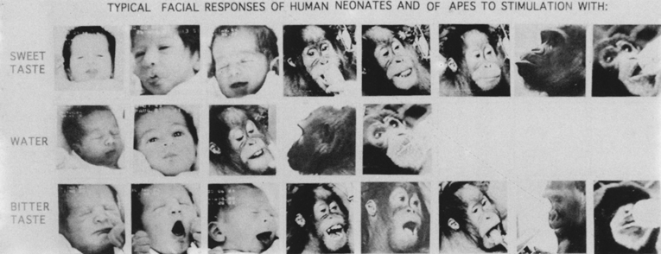
Development by Sense
Taste/Smell
  Differential behavioral responses to sweet, sour, bitter at birth (saltiness at 4mos)
    Reactions organized around approach/withdrawal
From Steiner & Glaser, 1995
Notes:
Overall patterns suggests that there is substantial but incomplete perceptual competency at birth

Slide 23
Taste/Smell
Taste
  Discriminate bitter, neutral, and sweet (Oster)
    Prefer sweet
Smell
  Turn down the corners of their mouths to bad smells, such as rotten eggs
  Facial relaxation to sweet smells like chocolate
  Porter et al.: preferential orienting to mom’s odors at 2 weeks
Controlled by subcortical regions of brain

Slide 24
Development by Sense
Hearing
  Both adults and children have preferential hearing for mid-frequencies (1000 Hz)
    Infants close to adult levels for mid-frequencies but low/high frequency hearing develops over 20 years
  Speech perception
    Phonemic discriminations at 6 mos
    Sensitive to timing & pauses in naturally occurring speech
    Across childhood sharpening of boundaries between
      Speech categories

Slide 25
Sensory capacity: Vision
Vision is functional from birth
But acuity is 1/25 that of adults
  20:500,
  blurry but in color
Improves to 20:20 by six months

Slide 26

Vision
  Orienting from birth esp. to faces
  Clear preferences
    Curved > straight
    Moderate density > high density
    Contours > inner elements
  Gradual development of acuity
    At birth 20/400 vision, maximum acuity at 12 inches
      Rapid development through 3-4 years
  Depth perception
    Binocular vision 4/5 mos

Slide 27
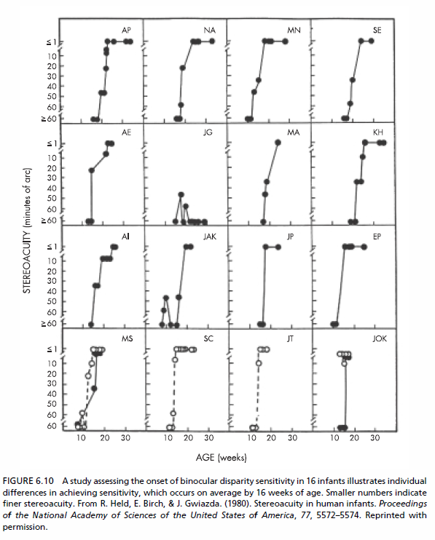
Development of stereoacuity
Requires binocular vision
What can we conclude about development?

Slide 28
Developmental Changes across Childhood
Increasing overlap with cognitive and language development – methodological challenge
  E.g., Table line drawing errors
Refinement of perceptual skills over childhood due to:
  Maturation of perceptual systems
  Maturation of complementary (e.g., motor) systems
  Experience
Increased application of perceptual skill to other domains
  Visually-guided reaching
  Cross-modal transfer
  Visual cues and postural stability
Notes:
Methodological challenge of overlap with cognition/language = increasingly difficult to separate how children perceive the world from how they act on it and what they know about it

Slide 29
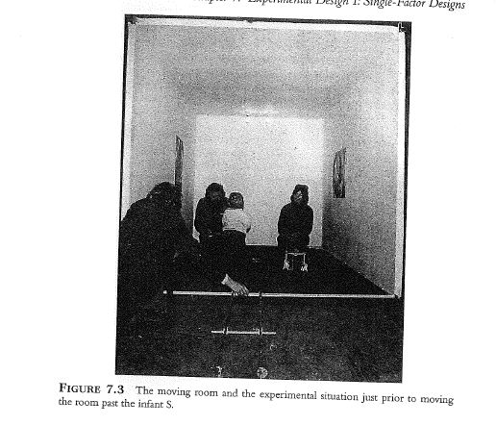
Developmental Changes across Childhood
Visual cues and
postural stability
Schmuckler, 1997

Slide 30
Theoretical possibilities regarding nature/nurture influences on perceptual development
Theoretical possibilities regarding nature/nurture influences on perceptual development
Aslin, 1981
** e.g., historical and regional differences in rates of myopia (nearsightedness)

Slide 31
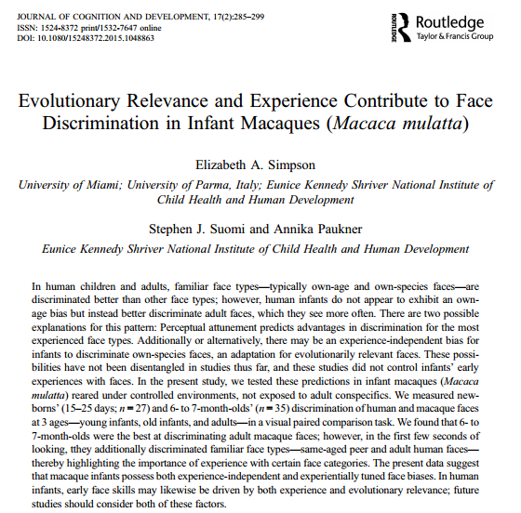
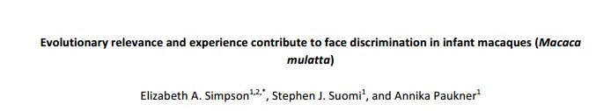

Slide 32
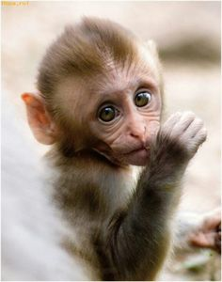
Experience vs. functionalism
    Exposure must be accompanied by individuation (individual names)
Are developmental changes in face discrimination consistent with perceptual attunement or functionalist approach
Perceptual attunement
    Experience driven biases improve with exposure and decline without
Functionalist approach
  Face-processing skills reflect age-appropriate developmental goals
  Biggest threat = absence of caregivers or presence of strangers
  Are differences in discrimination the consequence of face viewing patterns during familiarization?
Background
Familiar face discrimination
  Race, peers, gender, species

Slide 33
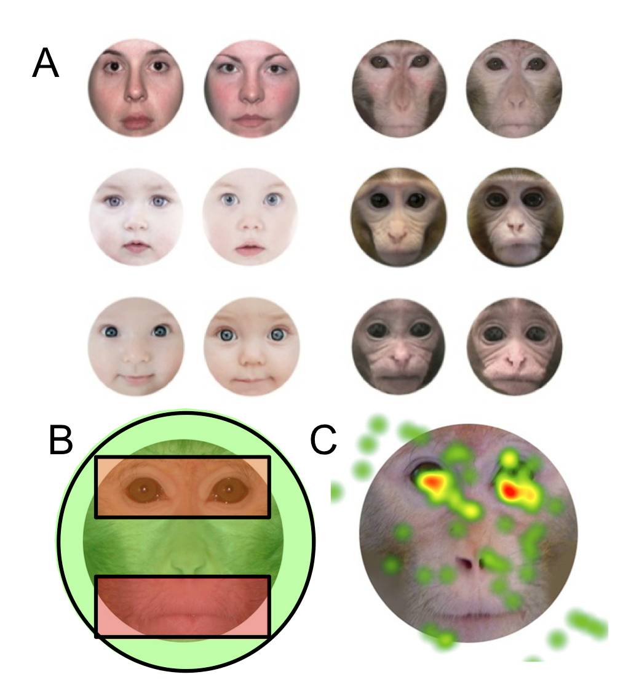

Slide 34
Methods
Rhesus macaques
  Newborns: 15-25-day-old (n = 27, 16 males)
  6-7 month-olds (n = 35, 21 males)
    More face experiences, especially for older infant macaques
Eye tracking
  60 distinct faces, 10 per face type (Adult, older infant, younger infant)
  Familiarized with a face for 10 sec. of cumulative looking; then familiar face next to a novel face for 5 seconds
  Viewed 1 of 6 face types a day
    5 face pairings per day (30 trials across six days)
Analysis
  Identified areas of interest (AOIs) around each face
  Measured look duration at novel and familiar faces
  Measured proportion of time looking to the novel face during the first three seconds of looking
  Eye-mouth viewing index (eye / eye + mouth) [EMI]

Slide 35
6-7 mo look more at the novel adults macaque faces
    No Bonferroni-corrected differences among newborns
  Early stimulus viewing (first 1 - 2 seconds)
      6-7 mo looked at novel human adult faces
      6-7 mo looked at novel monkey adult faces & same-aged peer (older infant) monkey faces
    No significant differences among newborns
  Eye–mouth-index (EMI) and face discrimination
    Newborns: EMI’s greater than chance for adult faces only
    6-7 mo: EMI’s were greater than chance for all age groups

Slide 36
Effect of EMI at encoding on discrimination of faces with high or low ecological validity or familiarity
    EMI ecological relevance = (adult monkey – adult human)
    EMI ecological familiarity = (infant monkey – infant human)
    Discrimination = total time looking at novel stimuli / total time looking at both stimuli
      Calculated discrimination relevance and familiarity measures
    EMI predicting Discrimination
      6-7 mos: EMI infants sig. predicted discrimination for Infants stimuli
        Non-significant for adults
      Newborns: Neither model significant

Slide 37
Evidence for both perceptual attunement & functional approaches
  Infants may have developed predisposed attention to familiar adults due to necessity of a caregiver and threat of strangers
  Sensitivity to eye region of face increases with age
    Attending to the eye region of own-race faces predicts greater discrimination of own race faces
Notes:
Testing macaques at a later age may reveal stronger effects

Slide 38
Alternative explanations for these findings?
  Is this experiential/functional developmental trajectory consistent with the acquisition of other perception abilities?
  Does experiential development occur only during a sensitive period or early life?
Notes:
What would you have done differently?
How might there results relate to your research?

Slide 39


Slide 40


Slide 41


Slide 42
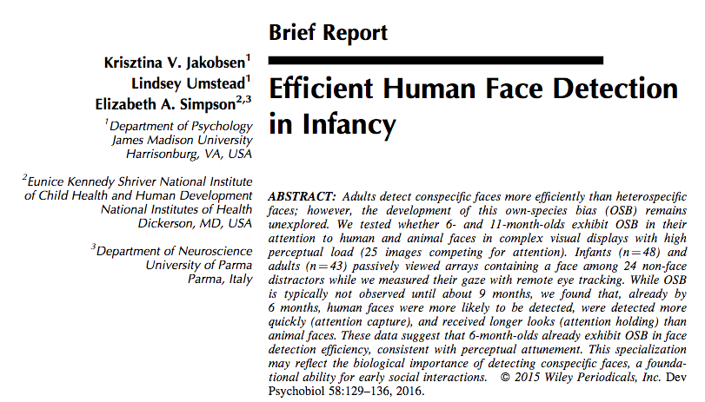
Own Species Bias
Attentional Efficiency
detection, attention capture, attention holding
Jakobsen, K., Umstead, L., & Simpson, E. (2015). Efficient
human face detection in infancy. Developmental Psychobiology, 58(1), 129-136.
C. Morris

Slide 43
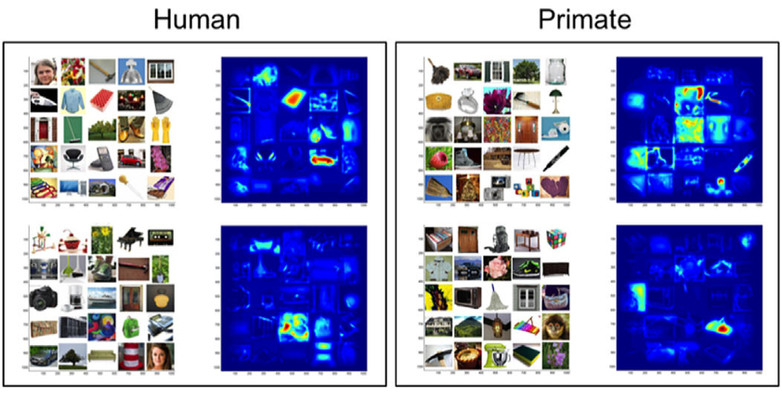
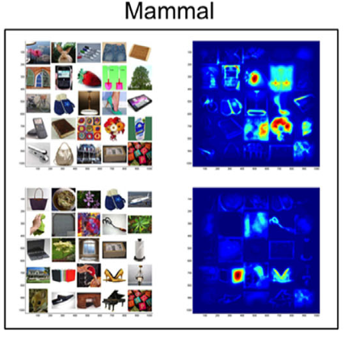
Arrays and salience maps
C. Morris
Notes:
There were 12 25-item arrays (5x5 matrices) each containing a unique neutral face of a human, non-human primate, or non-primate mammal surrounded by man-made and natural items. Salience groups - most salient regions are red, least are blue

Slide 44
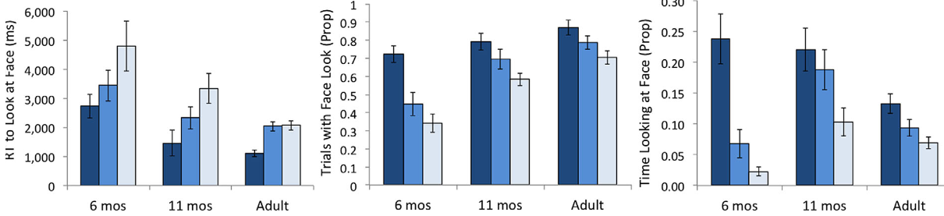
Results
attention
capture
attention
holding
detection
*Interaction
*Interaction
C. Morris

Slide 45
Discussion
  Pattern was similar across development for all three attentional measures
  By 6-months, human faces are more likely to be detected, and detected quicker, and hold attention longer
  By 6-months, infants already have adult-like OSB
Limitations
  Whether the face template is present at birth or requires experience

Slide 46
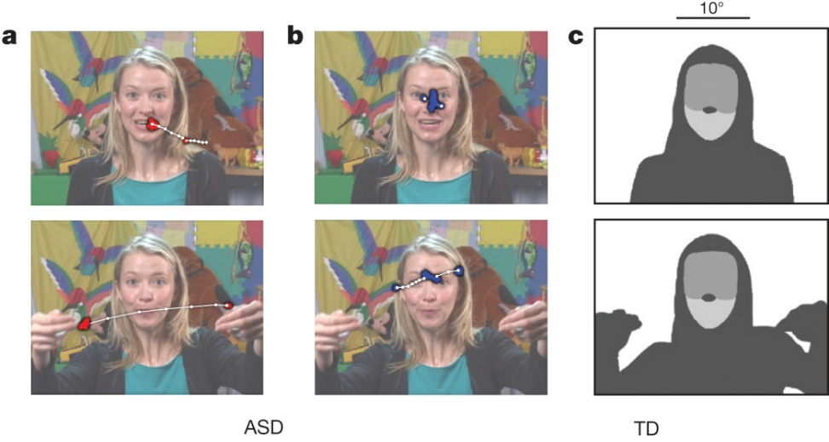

Example stimuli, visual scanpaths, regions-of-interest, and
longitudinal eye-tracking data from 2 until 24 months of age.
W Jones & A Klin Nature 000, 1-5 (2013) doi:10.1038/nature12715

Slide 47
Individual Differences: The Role of Experience in Perceptual Development (cont)
Early visual deprivation and later development
  See video
  See Maurer et al., 2007
  First hearing compilation https://www.youtube.com/watch?v=0ym1ybKPC8Y
  Older woman
        https://www.youtube.com/watch?v=0AKod_YEok4 (2:41, tears)
Notes:
Taste not affected
Debate over cause of declines…nervous system degeneration/organ impairment vs. diminished psychological judgment
Over life span rate of change follows inverted U-shaped function with development being most active early and late in the life cycle

Slide 48
What’s going on?
English-learning infants hear Hindi contrast better than English-speaking adults
Almost as well as adult Hindi-speakers

