Slide 1
Infant Development
Messinger, PhD
PSY 430

Slide 2
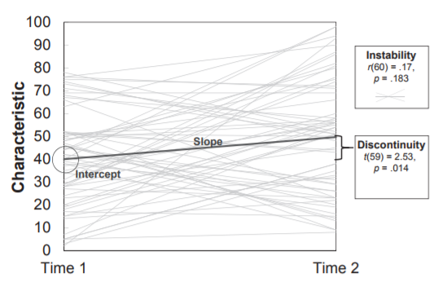
Questions?

Slide 3
Genetics overview
Behavioral genetics
  Twins
  A critique
Molecular genetics
  Common and rare variants
  Limitations
Epigenetics
  Maternal depression
  Adolescent perceived rejection
  Limitations and implications

Slide 4
Genetics overview
Behavioral genetics
  Twins
  A critique
Molecular genetics
  Common and rare variants
  Limitations
Epigenetics
  Maternal depression
  Limitations and implications

Slide 5
2 perspectives on gene*environment interface
Quantitative
  The influence of genetic and environmental factors be distinguished and the influence of each can be quanitified using behavioral genetic methods (Plomin)
Transactional
  “It is not nature vs. nurture, but the interaction of nature and nurture that drives development.” Urie Bronfrenbrenner
Notes:
2

Slide 6
Sources of Variance in Behavior
Genetic (heritability)
Environmental
Gene x environment interaction
Error

Slide 7
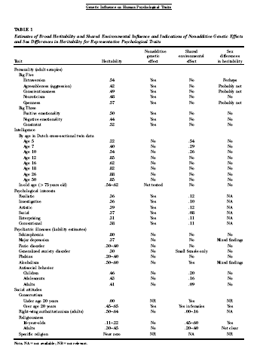
“Most, if not all, reliably measured psychological traits, normal and abnormal, are substantively influenced by genetic factors.”
Bouchard, T. J. (2004). "Genetic Influence on Human Psychological Traits: A Survey." Current Directions in Psychological Science 13(4): 148-151.

Slide 8
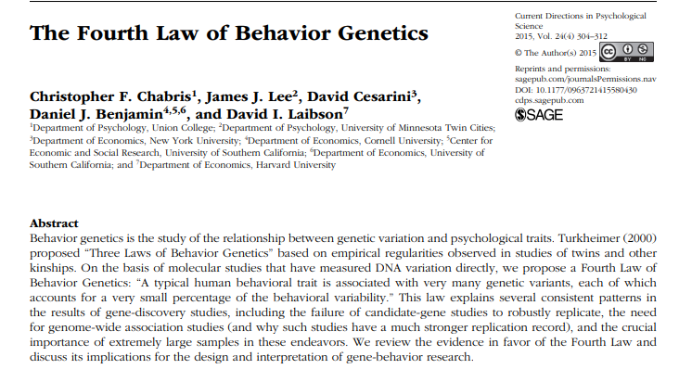
‘A typical human behavioral trait is associated with many genetic variants, each accounts for a very small percentage of behavioral variability.

Slide 9
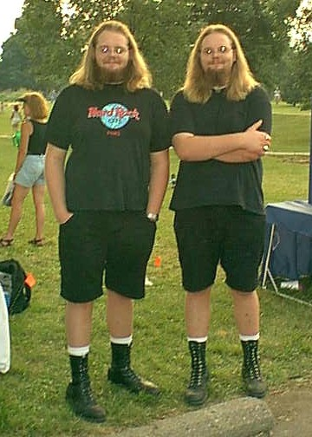
Twin studies
Identical (MZ) twins share 100% of their genes
  genetic duplicates.
Fraternal (DZ) twins share 50% of their genes
  on average
Both types of twins have similar environments . . .
Greater behavioral similarity of identical twins indexes greater genetic influence
      http://www.psych.umn.edu/psylabs/mtfs/special.htm

Slide 10
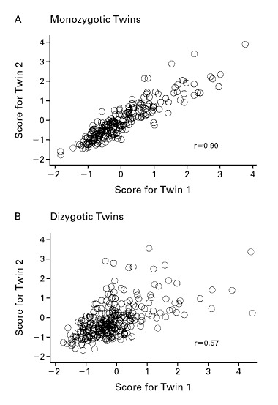
Behavior genetics logic

Slide 11
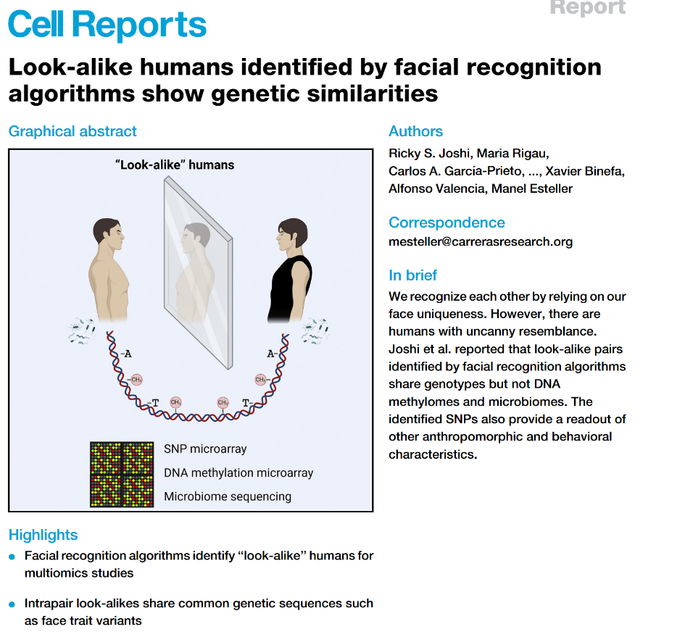
10.1016/j.celrep.2022.111257

Slide 12
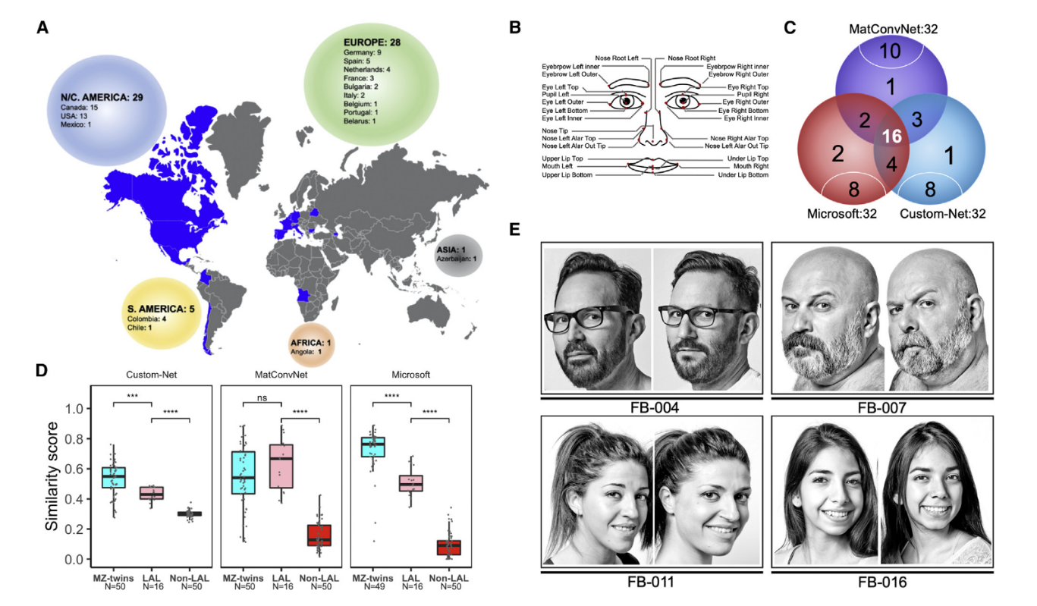

Slide 13
A (additive genetics) C (common environment) and E (unique environment)—ACE Model
Correlation between MZ twins provides an estimate of A + C : r_{mz} = A + C
Dizygous (DZ) twins share common environment & mean 50% of genes:
  correlation between DZ twins is an estimate of ½A + C: r_{dz} = ½A + C
Twice the difference between MZ and DZ twins gives us A:
  additive genetic effect
  difference between the MZ and DZ correlations is half the genetic similarity…
C is simply the MZ correlation minus our estimate of A.
  C = r_{mz} – A = 2 r_{dz} – r_{mz}
The random (unique) factor E is estimated by how much the MZ twin correlation deviates from 1. E = 1 – r_{mz}
  A = 2 (r_{mz} – r_{dz})
Variance estimates depend on relative genetic and environmental variation.
http://en.wikipedia.org/wiki/Twin_study

Slide 14
Estimates of genetic and environmental influence
Proportional in samples
  Greater environmental variation
    Will minimize genetic variation
      E.g. Poverty
  Greater genetic variation
    Will minimize environmental variation
      E.g. Downs Syndrome
Variance estimates depend on relative genetic and environmental variation.

Slide 15
2 perspectives on gene*environment interface
Quantitative
  The influence of genetic and environmental factors be distinguished and the influence of each can be quanitified using behavioral genetic methods (Plomin)
Transactional
  “It is not nature vs. nurture, but the interaction of nature and nurture that drives development.” Urie Bronfrenbrenner
Notes:
2

Slide 16
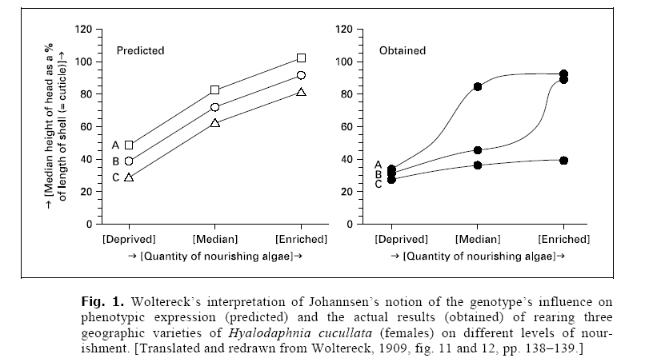
Gene*Environment Interaction
What does this mean for our calculations?

Slide 17
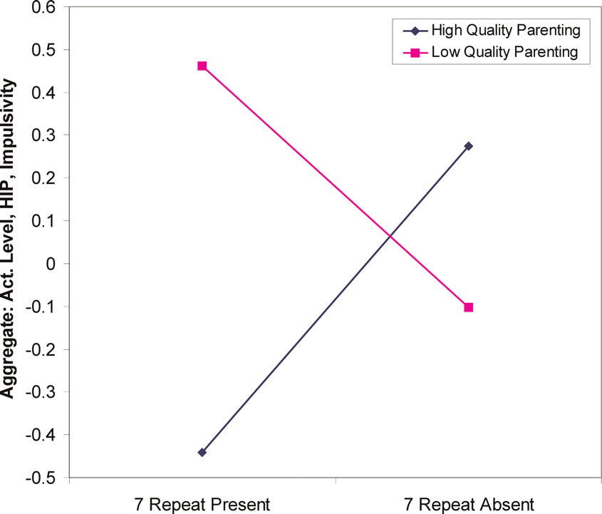
Genes influence relation between parenting and temperament
18-21 month olds
DRD4 48 (7-repeat allele) “long” allele increased sensitivity to environmental factors such as parenting.
  Lower quality parenting→ higher sensation seeking.
  Higher quality parenting→ lower sensation seeking
  Parenting quality interacts with genetic variation in dopamine receptor D4 to influence temperament in early childhood Sheese BE, et al. Dev Psychopathol 2007 19(4):1039-46
  Lower quality parenting→ higher sensation seeking.
  Higher quality parenting→ lower sensation seeking

Slide 18
Initial Evidence: Gene * Environment Interaction
Caspi et al., 2003

Slide 19
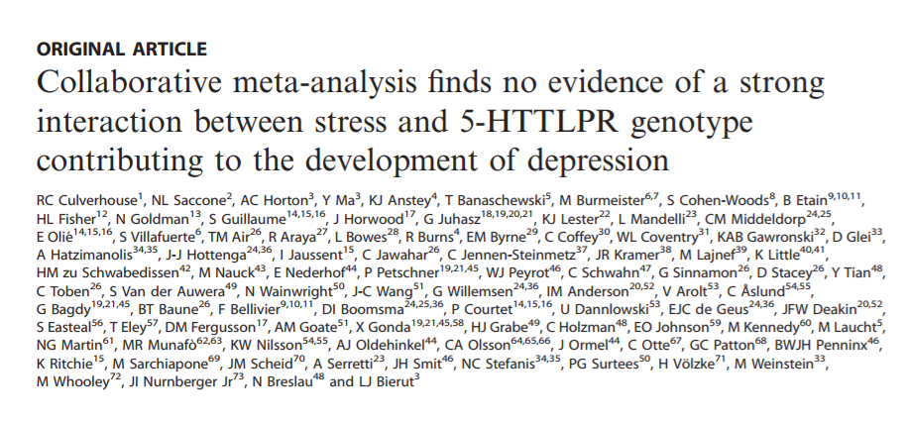
But not supported

Slide 20
“What will it take to make behavioral genetics truly developmental?”
Analysis of the bi-directional relations from gene action to the external environment over the life course, including the prenatal period. Gottlieb, G. (2003). Human Development 46(6): 337-355.

Slide 21
Contextual Determinants of Gene Function
Gene = sequence of DNA
Transcription = enzymes “read” DNA
Environment around DNA makes it possible to “read” DNA
Epigenetic – “in addition to genetic”
  Influences that determine expression without altering the DNA
Notes:
“Epigenetics refers to modification of genetic information not encoded in the DNA sequence of genomes.
Epigenetics marks can change a gene expression pattern without a change in primary nucleotide sequence - without changing an A, C, G or T.
Changes in gene expression often correspond with epigenetic changes such as methylation of DNA, changes in chromatin conformation (methylation, acetylation), and expression of non-coding RNAs.”
http://www.sickkids.ca/Research/Weksberg-Lab/Research-focus/BWS/Genetic-Imprinting-and-Epigenetics/index.html

Slide 22
Molecular genetics
In vitro
Genes
  Sequences of DNA in each cell
  Information on cell functioning & reproduction
Chromosomes
  Larger groupings of DNA
  All non-gamete cells have 23 pairs of chromosomes
  Half of each pair came from each parent
Ordered by karotyping

Slide 23
Human genome project
identify the ~30,000 genes in human DNA,
determine the sequences of the 3 billion chemical base pairs that make up human DNA,
99% (of nucleotide bases) are the same in all people

Slide 24
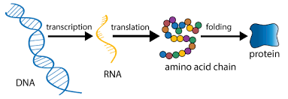
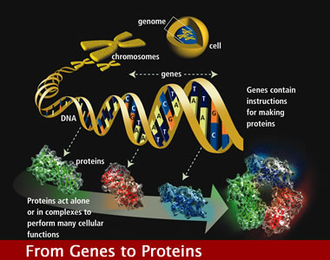
Proteomics
Identify the protein machines that carry out critical life functions and the gene regulatory networks that control these machines

Slide 25
Rare variants (autism example)
Rare variant mutations with a minor allele frequency < 1%
  Associated with ASD:
  CHD8, CNTNAP2, NLGN4, NRXN1, and CNTN4
But no specific gene accounts for a majority of ASD cases
  In fact, among siblings both diagnosed with ASD, most do not share the same ASD risk genes.
    D’Abate, et al. 2019
    All apples are fruit but not all fruit are apples

Slide 26
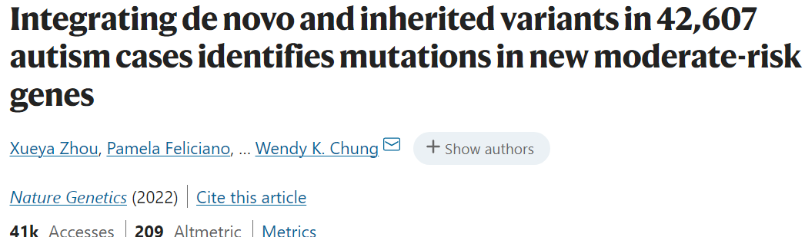
To capture the full spectrum of genetic risk for autism, we performed a two-stage analysis of rare de novo and inherited coding variants in 42,607 autism cases, including 35,130 new cases recruited online by SPARK. We identified 60 genes with exome-wide significance (P < 2.5 × 10⁻⁶), including five new risk genes (NAV3, ITSN1, MARK2, SCAF1 and HNRNPUL2). The association of NAV3 with autism risk is primarily driven by rare inherited loss-of-function (LoF) variants, with an estimated relative risk of 4, consistent with moderate effect. Autistic individuals with LoF variants in the four moderate-risk genes (NAV3, ITSN1, SCAF1 and HNRNPUL2; n = 95) have less cognitive impairment than 129 autistic individuals with LoF variants in highly penetrant genes (CHD8, SCN2A, ADNP, FOXP1 and SHANK3) (59% vs 88%, P = 1.9 × 10⁻⁶). Power calculations suggest that much larger numbers of autism cases are needed to identify additional moderate-risk genes.

Slide 27
Common variants
Polymorphisms occurring in > 1–2% of the population
May comprise a substantial portion of the risk heritability of ASD
However, identified common variants that in combination or alone influence ASD susceptibility have not been well replicated
  But what is the phenotype we’re predicting?
  Focus on the genetic basis of behaviors relevant to ASD may be productive

Slide 28
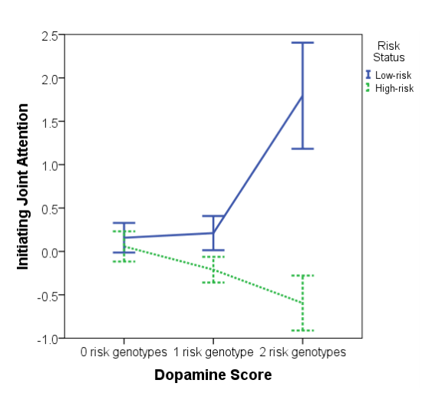
Dopaminergic genes & joint attention
Gangi et al., 2016

Slide 29
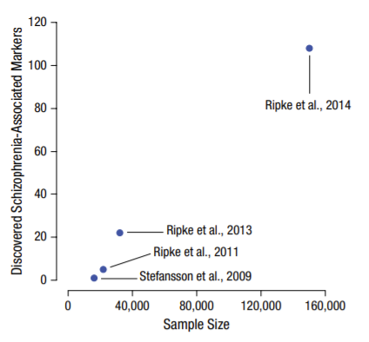
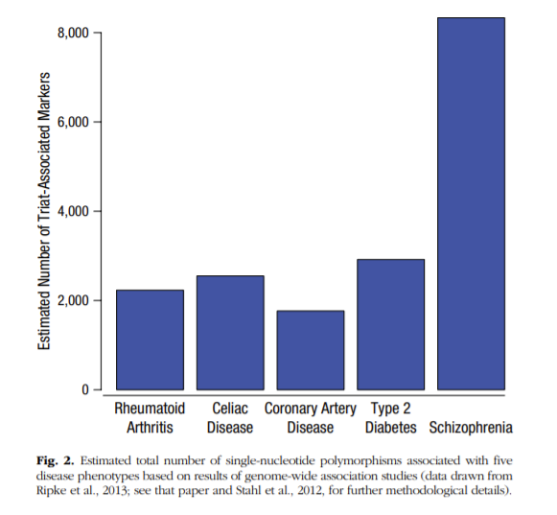
‘The SNP rs9320913 is estimated to account for only 0.02% of the overall variability in educational attainment, but biometrical studies show that the total percentage of variability owed to genetic differences is three orders of magnitude larger (Heath et al., 1985; Rietveld et al., 2013).’

Slide 30
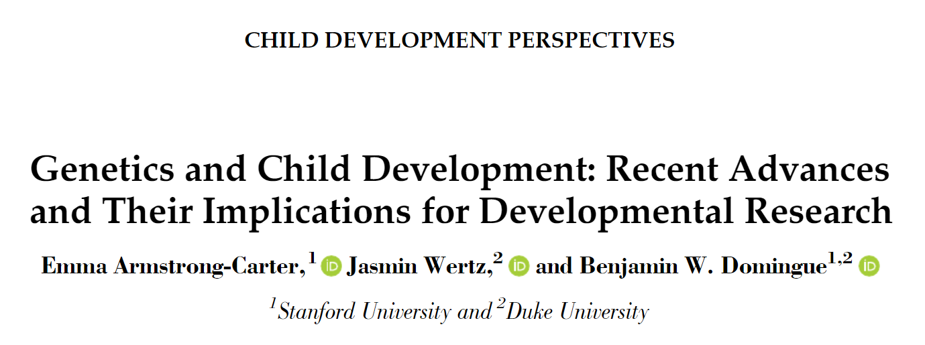
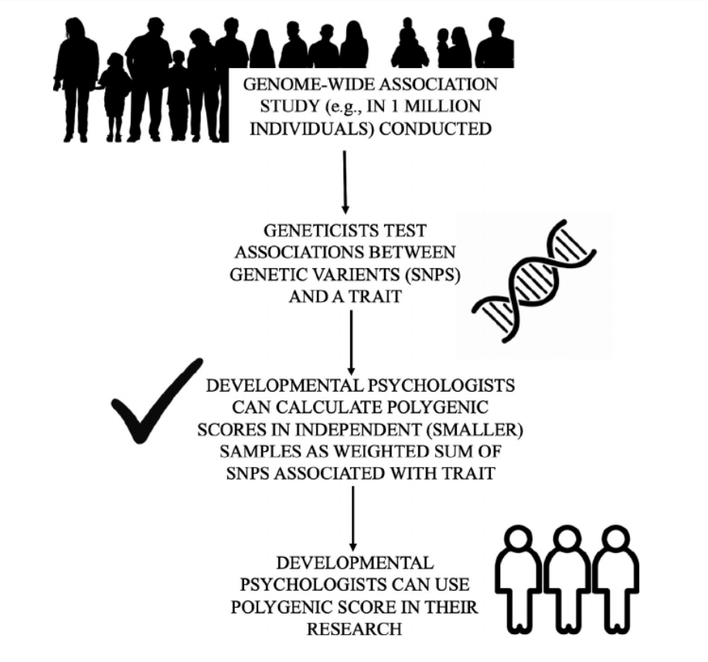

Slide 31

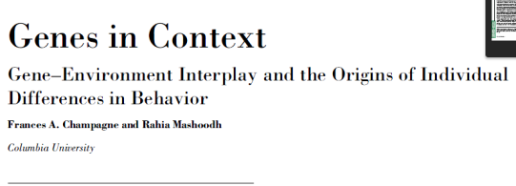
Epigenetics in Rodents
Extension to later mothering
  Less mothering attention -> Greater methylation
    Less mothering attention in the next generation
Roth and Sweatt (2009)
  Stressed mothers spend less time nurturing
  Lower BDNF hormone -> Greater methylation - > Lower neural growth
    Linked to anxiety in mice, responds to antidepressants
    Miller and Sweatt (2007)- Inhibition of methylation →detrimental to memory
Nestler et al. (2010) Cocaine exposure
  Higher acetylation and methylation of histones
    Stimulates reward circuitry

Slide 32
Genetics and epigenetics
Why epigenetics?
  Genome-wide associations point to certain rare alleles associated with psychopathology
  However, “structural variations in sequence have accounted for only a small fraction of human phenotypic variation and human disease” (Szyf & Bick, 2012)
DNA function determined not only by variation in sequence, but also by manner in which it is stably programmed

Slide 33
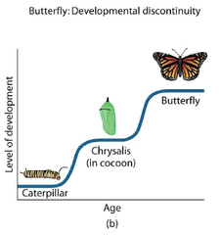
Do caterpillar, chrysalis, and butterfly have different DNA?

Slide 34

Epigenetics: A clue
How can an organism have different cell types yet one genome?
“The idea that DNA function could be stably diversified without changing the sequence comes from the study of cellular differentiation during embryonal development.” (Szyf & Bick, 2012)
Do caterpillars and
butterflies have the
same DNA?

Slide 35
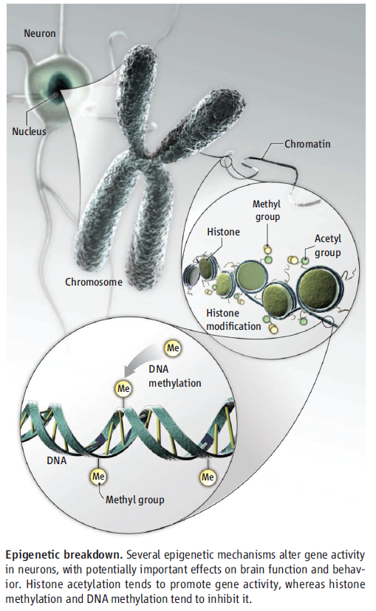
Epigenetic mechanisms
Histone acetylation tends to promote gene activity
Histone methylation and DNA methylation tend to inhibit it.

Slide 36


DNA transcription: the process of DNA being read by an enzyme called RNA polymerase > leading to the production of mRNA > which is then translated into a protein
DNA methylation: one type of epigenetic mechanism; reduces the accessibility of DNA and can lead to “silencing” of the gene
Epigenetic influences do NOT alter the sequence of DNA
(Champagne & Mashoodh, 2009; Syzf & Bick, 2012)
Rumper
(Champagne & Mashoodh, 2009; Syzf & Bick, 2012)
Notes:
Former belief: individual differences result from differences in sequence/structure of DNA
Transcriptome: what is transcribed from the genome
Former belief: once DNA methylation patterns are generated during embryogenesis, they remain “fixed” throughout life

Slide 37

Imagine you have access to a library…
1 DNA Sequence = 1 Book
Epigenetics influence book availability
(Champagne & Mashoodh, 2009; Syzf & Bick, 2012) Rumper

Slide 38
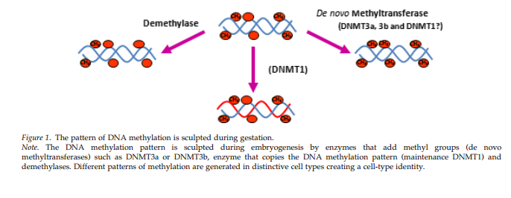
Methylation and demethylation during gestation → tissue types
demethylation
De novo
methylation
Maintenance
methylation
Szyf & Bick, 2012

Slide 39
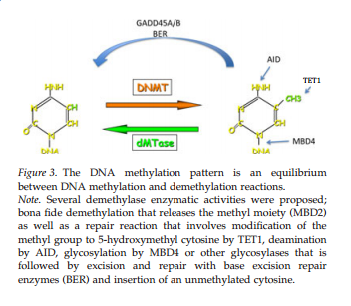
Dynamic DNA methylation
Szyf & Bick, 2012

Slide 40
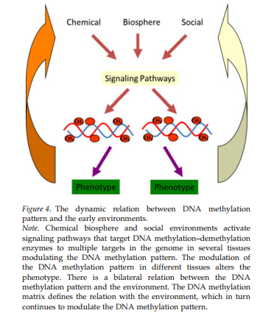
DNA methylation adaption are system wide and involve multiple gene circuitries

Slide 41
Global Epigenomic Reconfiguration During Mammalian Brain Development (Lister et al., 2013)
Background
Early postnatal burst of synaptogeneis → activity-dependent pruning of excess synapses during adolescence
  This process forms the basis for experience-dependent plasticity
  Disruption leads to behavioral alterations & neuropsychiatric disorders
Epigenome: Network of chemical compounds surrounding DNA that modify genomic expression without altering DNA sequences
  Dynamic epigenetic changes occur during brain development, maturation, & learning
  DNA METHYLATION PLAYS KEY ROLE
    Major transcriptional changes → adult electrophysiological characteristics in neocortical neurons

Slide 42
Goals of the Article
Better understand the unique role of DNA methylation in brain development and function → Unravel the genetic program and experience-dependent epigenetic modifications leading to a fully differentiated nervous system
Methods: Integrate empirical data of genome-wide composition, patterning, cell specificity, and dynamics of DNA methylation at single-base resolution in human & mouse frontal cortex at different developmental stages
Offer framework for testing the role of epigenome in:
Healthy function vs. Pathological disruptions of neural circuitry

Slide 43
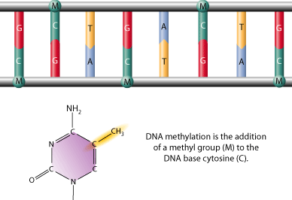
Global Epigenomic Reconfiguration During Mammalian Brain Development (Lister et al., 2013)
DNA methylation is a stable covalent modification that persists in post-mitotic cells throughout their lifetime, helping define their cellular identity
Types
1. mCG
2. mCH
(where H = A, C, or T)

Slide 44
Methylation occurs as neurons are created
Widespread methylome reconfiguration during fetal to young adult development is coincident with synaptogenesis– becomes dominant form of DNA methylation in mature human neurons
  Demonstrates large-scale reconfiguration of neuronal epigenome
Global Epigenomic Reconfiguration During Mammalian Brain Development (Lister et al., 2013)
Notes:
Widespread methylome reconfiguration occurs during fetal to young adult development, coincident with synaptogenesis.
Fig. 1. Methylcytosine in mammalian frontal cortex is developmentally dynamic and abundant in CG and CH contexts
(C) Synaptic density (for mouse, per 100 μm2; for human, per 100 μm3) and mC level in CG and CH contexts through development in mouse and human frontal cortex. †Synaptic density quantitation from De Felipe et al. (27) and Huttenlocher and Dabholkar (28). (E) Fraction of cytosine base calls with each modification in fetal and adult mouse frontal cortex.

Slide 45
Inaccessible genomic regions are protected from de novo methylation
  A2: Timing matters!
Example: Central nervous system deletion of Dnmt3a
If during late gestation → Motor deficits, premature death ☹
If during second postnatal week → Plays critical role in establishing normal brain methylation profile and allowing healthy brain development ☺
Notes:
Figure 1: (G) Transcript abundance, chromatin accessibility [8-week mouse cortex ChIP input and DNaseI hypersensitivity (HS) normalized read density], and mC levels in 5-kb bins at the mouse immunoglobulin VH locus. (H) Density (z) plot of 10-week mouse frontal cortex mCH level (x) versus 8-week mouse cortex ChIP-input normalized read density (y) for all 10-kb bins of the mouse genome.
Note: Although mCG is unaffected in these regions, lower chromatin accessibility appears to be highly inhibitory to deposition of mCH and hmC, potentially via inaccessibility to de novo methyltransferases and Tet mC hydroxylases. Furthermore, this indicates that accumulation of mCH and hmC during mammalian brain development occurs via processes that are at least partly independent from methylation at CG dinucleotides.

Slide 46
Neurons and glia show cell type-specific DNA methylation patterns
  Suggests a role for DNA methylation in distinguishing these 2 broad classes of cortical cells!
Notes:
During this period, highly conserved non-CG methylation (mCH) accumulates in neurons, but not glia, to become the dominant form of methylation in the human neuronal genome.
Fig. 2. mCH is positionally conserved and is the dominant form of DNA methylation in human neurons
(A) Browser representation of mCG and mCH in NeuN+ and NeuN− cells. Human NeuN+/ NeuN− samples: R1, 53-year-old female; R2, 55-year-old male. Mouse NeuN+/NeuN− samples: R1, 7-week males; R2, 6-week females; R3, 12-month females (not shown). (B) Percentage of methylated base calls in each sequence context throughout the genome.

Slide 47
Global Epigenomic Reconfiguration During Mammalian Brain Development (Lister et al., 2013)
Other Key Findings:
The mCH position is highly conserved:
  Precise positioning of mCG and mCH marks (which are conserved between individuals and across humans and mice) is consistent with a functional role
X chromosome shows gender-specific DNA methylation patterns

Slide 48
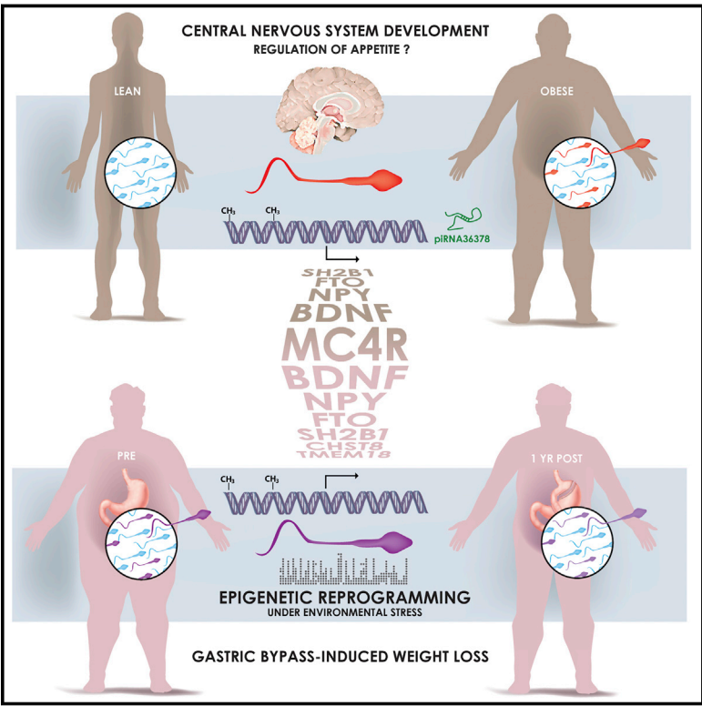
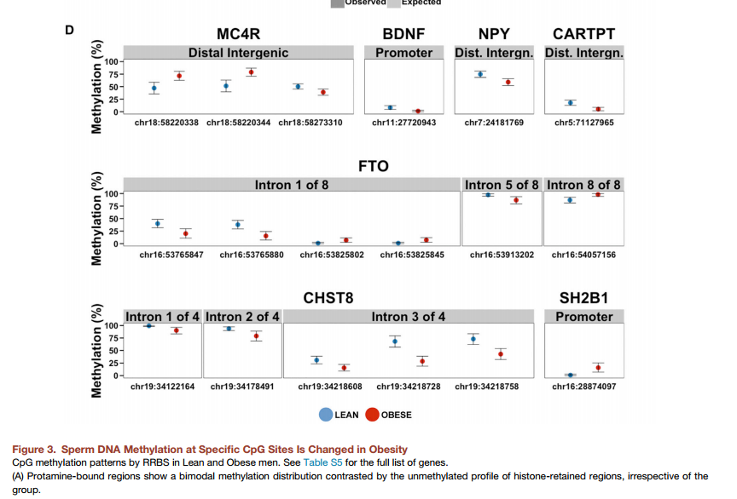
“[S]urgery-induced weight loss was associated with a dramatic remodeling of sperm DNA methylation, notably at genetic locations implicated in the central control of appetite.”
Donkin, I., Versteyhe, S., Ingerslev, L. R., Qian, K., Mechta, M., Nordkap, L., . . . Barres, R. (2015). Obesity and Bariatric Surgery Drive Epigenetic Variation of Spermatozoa in Humans. Cell Metab. doi: 10.1016/j.cmet.2015.11.004
Notes:
Obesity is a heritable disorder, with children of obese fathers at higher risk of developing obesity. Environmental factors epigenetically influence somatic tissues, but the contribution of these factors to the establishment of epigenetic patterns in human gametes is unknown. Here, we hypothesized that weight loss remodels the epigenetic signature of spermatozoa in human obesity. Comprehensive profiling of the epigenome of sperm from lean and obese men showed similar histone positioning, but small noncoding RNA expression and DNA methylation patterns were markedly different. In a separate cohort of morbidly obese men, surgery-induced weight loss was associated with a dramatic remodeling of sperm DNA methylation, notably at genetic locations implicated in the central control of appetite. Our data provide evidence that the epigenome of human spermatozoa dynamically changes under environmental pressure and offers insight into how obesitymay propagate metabolic dysfunction to the next generation.

Slide 49
Environmental Influences on Gene Activity
In rodents:
  Prenatal exposure to chronic stress → hi methylation
  Low maternal care → high methylation
Less nurturing mothering leads to poorer stress response in rat pups
    Fewer corticosterone receptors
    Linked to DNA methylation
    Enzymes reverse methylation, improve receptor numbers
      Szyf & Meany (2004)

Slide 50
Unexplained patterns
What?
“Mothers who were pregnant during a 1944 famine in the Netherlands, for example, were more likely to have children—and grandchildren—prone to heart disease, diabetes, and obesity.
Female mice that are underfed during pregnancy give birth to pups that are more likely to develop diabetes—and their male offspring have epigenetic changes in their sperm. The offspring of those males are also prone to diabetes.
        http://www.sciencemag.org/news/2015/12/weight-gain-and-loss-can-alter-men-s-sperm
Notes:
Male rats that are overfed, when mated with healthy females, also had offspring that were prone to developing diabetes.”

Slide 51
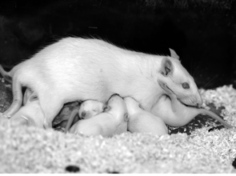
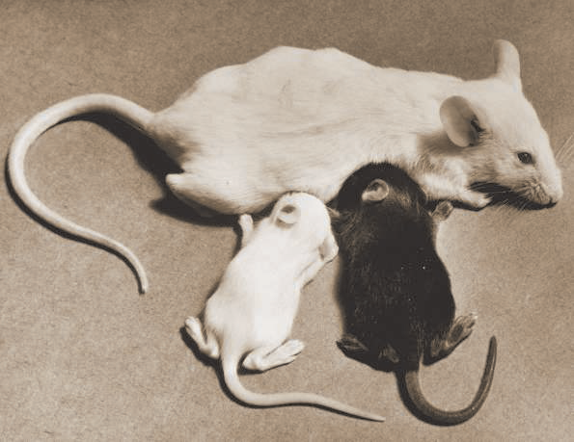
Environmental Influences on Gene Activity in Rodents
Prenatal exposure to chronic stress → hi methylation
  Low maternal care → high methylation
Less nurturing mothering → poorer pup stress response
    Fewer corticosterone receptors
    Linked to DNA methylation
    Enzymes reverse methylation, improve receptor numbers
      Szyf & Meany (2004)

Slide 52
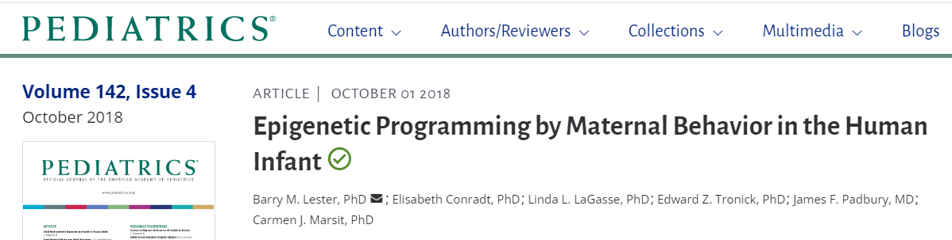
‘We used breastfeeding as a proxy for a high level of maternal nurturing behavior in the rodents to replicate the epigenetic effects of maternal care on the glucocorticoid receptor gene promoter region.’
Lester, B. M., Conradt, E., LaGasse, L. L., Tronick, E. Z., Padbury, J. F., & Marsit, C. J. (2018). Epigenetic Programming by Maternal Behavior in the Human Infant. Pediatrics. doi:10.1542/peds.2017-1890

Slide 53
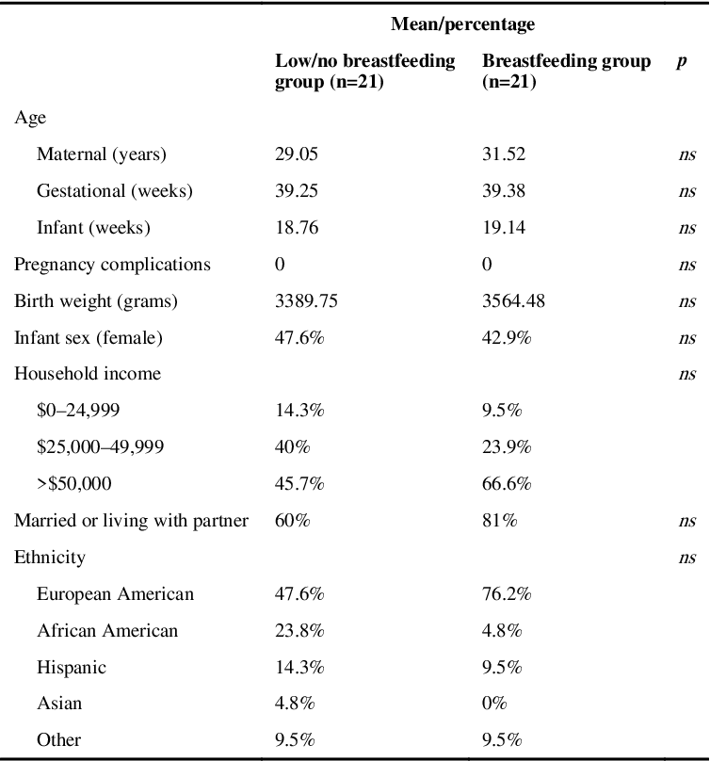
Quasi- (natural) experiment
Mothers who breastfed their infants continuously over the first 5 months were in the high breastfeeding group (n = 21). Mothers who did not breastfeed their infants at all or who stopped breastfeeding by 3 weeks were in the low breastfeeding group (n = 21)

Slide 54
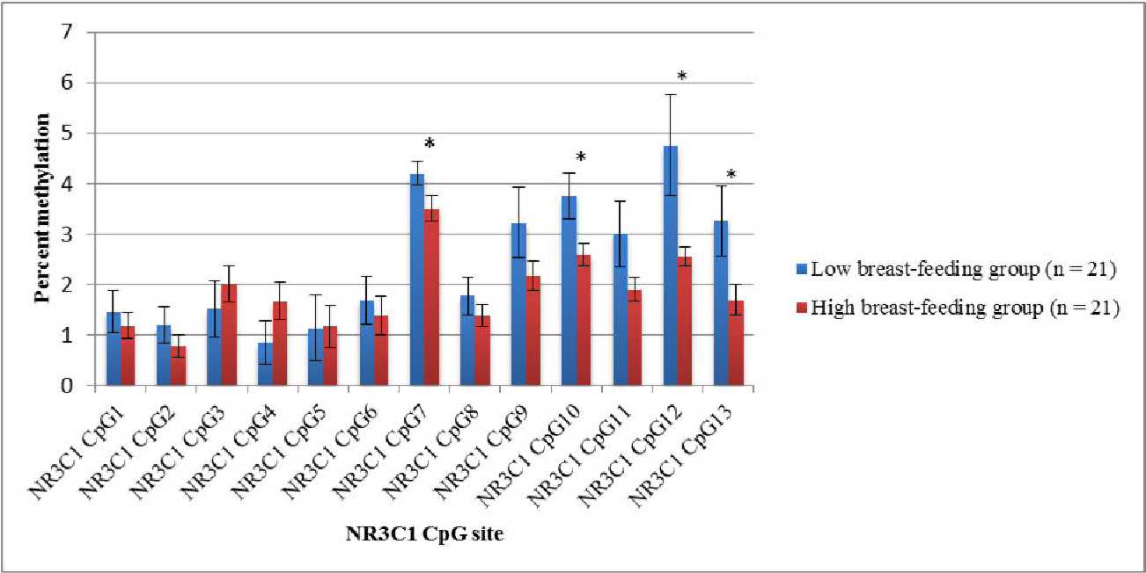
High breastfeeding infants have less methylation at CpG sites 7, 10, 12 & 13 in glucocorticoid receptor gene exon 1F promoter region

Slide 55
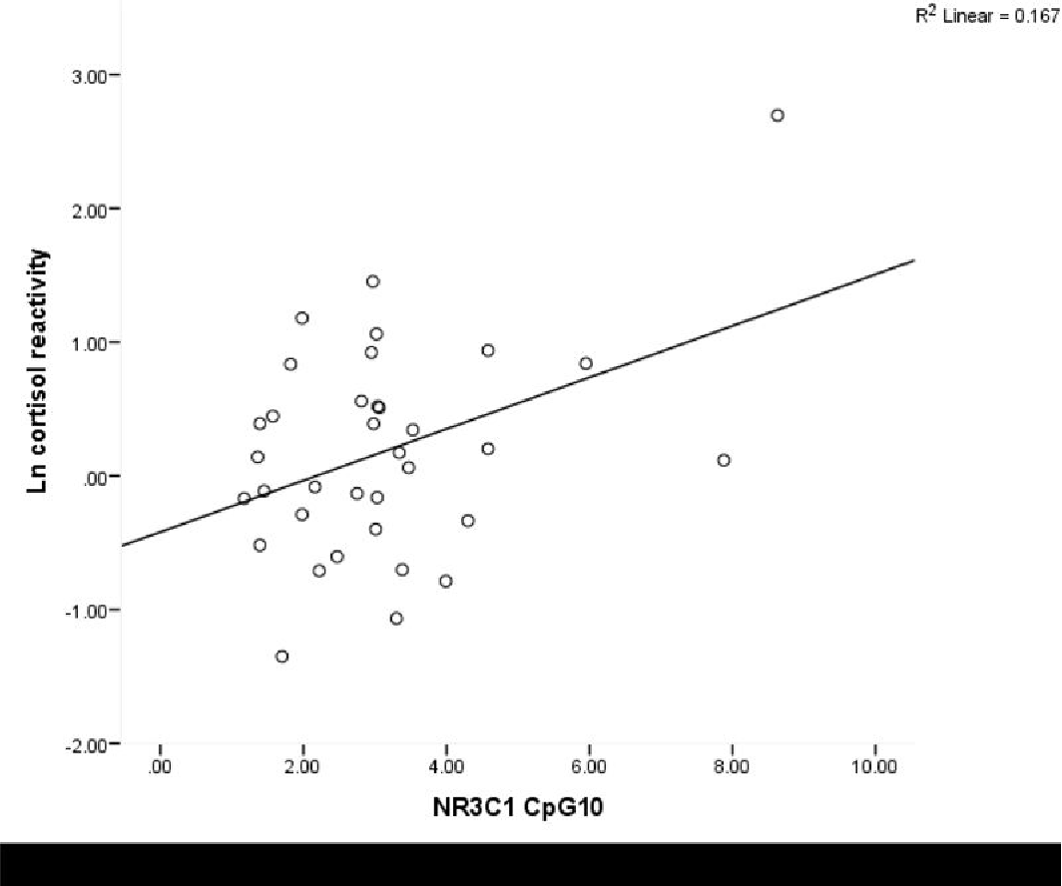
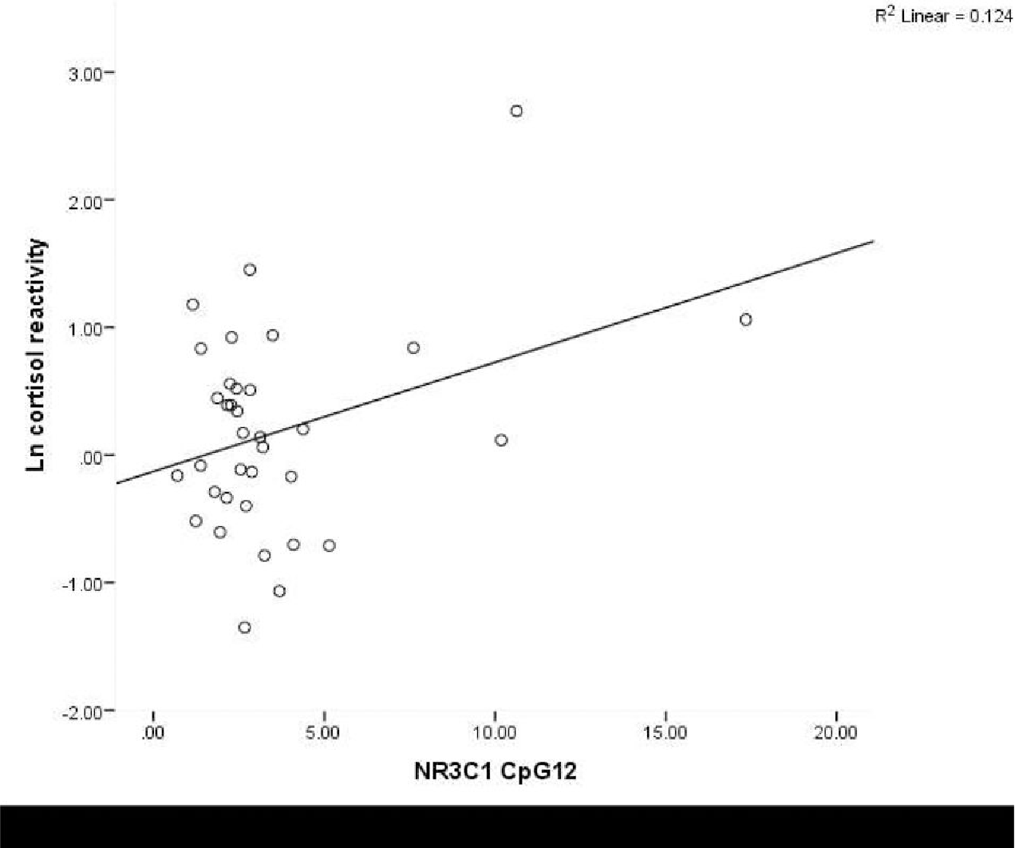
Lower DNA methylation at CpG sites 10 (r = .41) & 12 (r = .35), decreased infant cortisol reactivity
Thoughts?

Slide 56
Thus….
discuss

Slide 57
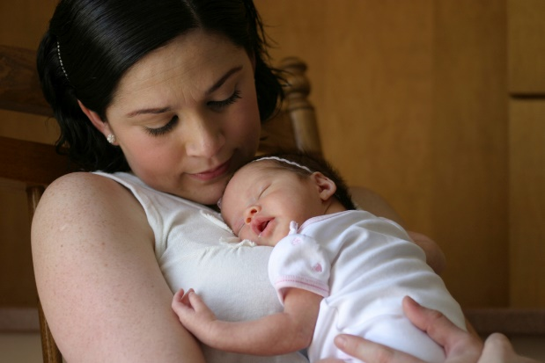
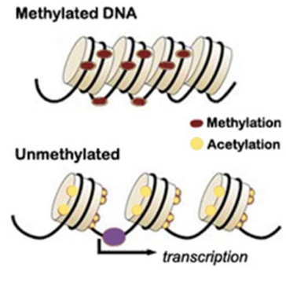
Conradt, E., Hawes, K., Guerin, D., Armstrong, D. A., Marsit, C. J., Tronick, E., & Lester, B. M. (2016). The contributions of maternal sensitivity and maternal depressive symptoms to epigenetic processes and neuroendocrine functioning. Child development, 87(1).

Slide 58
Background
Maternal
Depression
Greater
Methylation?
NR3C1 fewer receptors present for binding
11B-HSD-2 no longer converts maternal cortisol into cortisone
Maternal Sensitivity and Responsiveness?
Maternal depression can lead to negative child outcomes
Through what mechanisms does maternal depression affect children’s genetic expression?
Previous studies examined the process in rodents
Conradt et al., 2016
Milrad
Notes:
Increased exposure to glucocorticoids or inhibition of 11B-HSD-2 leads to decreased birth weight, increases in hyperglycemia, hypertension, HPA axis reactivity and anxiety (in rodents)

Slide 59
NR3C1 Function
Limbic brain region (Hypothalamus) stimulate the release of Corticotropin Releasing Factor (CRF)
CRF activates Pituitary Gland to release Adrenocorticotropic Hormone (ACH)
Individual perceives stress
ACH activates Adrenal cortex to release cortisol
Cortisol binds to glucocorticoid receptor (GR), NR3C1
H
DNA Methylation of NR3 C1, which is a GR results in fewer GRs for binding cortisol, resulting in higher levels of cortisol in the blood.
Negative feedback loop inhibits release of CRF and shuts down HPA axis.
P
A
Notes:
NR3C1 (Nuclear Receptor Subfamily 3 Group C Member 1) is a Protein Coding gene. Diseases associated with NR3C1 include Glucocorticoid Resistance,

Slide 60
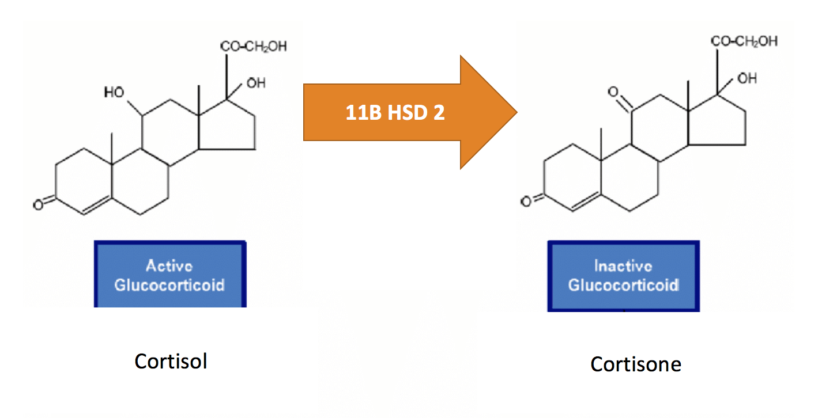
11B HSD2 Function

Slide 61
Aim 1
Maternal Sensitivity and Responsiveness
Infant’s DNA Methylation
Maternal depressive symptoms
Conradt et al., 2016
Rumper

Slide 62
Aim 2
Maternal Sensitivity and Responsiveness
Maternal depressive symptoms
Infant’s cortisol levels
(Pre and post-stress)
DNA Methylation
Conradt et al., 2016
Milrad

Slide 63
Aim 3: Social Buffering Hypothesis
Maternal Sensitivity and Responsiveness
DNA Methylation
Maternal depressive symptoms
Infant’s pre-stress cortisol levels
Infant’s cortisol reactivity
Milrad
Conradt et al., 2016

Slide 64
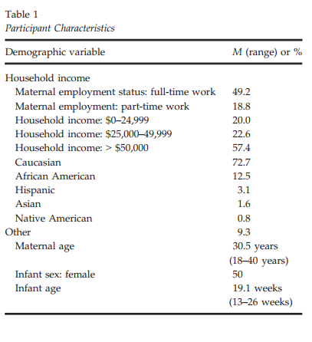
Methods
Mother:
  Anxiety
  Depression
  Sensitivity and Responsiveness:
    Acceptance /Nondemanding
    Responsiveness/Appropriate Touch
Infant:
  Cortisol x 3
  Buccal Sample Collection
Rumper
Conradt et al., 2016

Slide 65
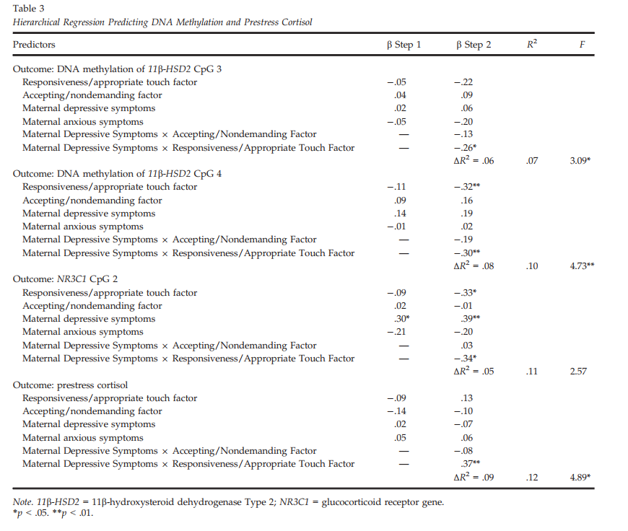
Results
Rumper
Conradt et al., 2016

Slide 66
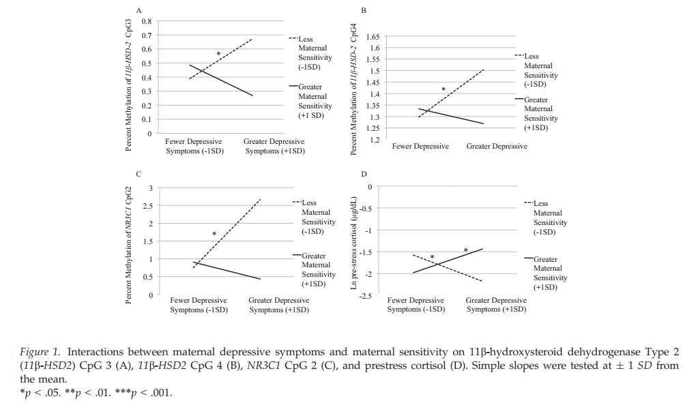
Methylation highest with greater depressive symptoms and less maternal sensitivity
Milrad
Conradt et al., 2016

Slide 67
Major Take-Aways
Aim 1: Increased levels of accepting/nondemanding factor correlated with greater 11β-HSD2 CpG1methylation.
  Odd? What are some possible explanations?
Aim 2: No main effects of maternal sensitive behaviors (responsiveness/appropriate touch and accepting/nondemanding factor), maternal depression, and pre-stress cortisol and cortisol reactivity

Slide 68
Aim 3: Buffering by responsiveness?
  Interaction between maternal depressive sx and maternal responsiveness/appropriate touch predicted 11β-HSD2 CpG3
    highest methylation among mothers who were less responsive and had high depressive sx (otherwise no differences)
  Main effect for maternal depressive sx and responsiveness/appropriate touch on DNA methylation of 11β-HSD2 CpG4 and NR3C1 CpG2, with a significant interaction
  No main effects for pre-stress cortisol but interaction with maternal responsiveness and depressive sx,
  Infants with high depressive sx and low responsiveness had lowest pre-stress cortisol levels
  Infants whose mothers had high depressive sx and responsiveness had highest pre-stress cortisol levels.

Slide 69
Genetics overview
Behavioral genetics
  Twins
  A critique
Molecular genetics
  Common and rare variants
  Limitations
Epigenetics
  Maternal depression
  Limitations and implications

Slide 70
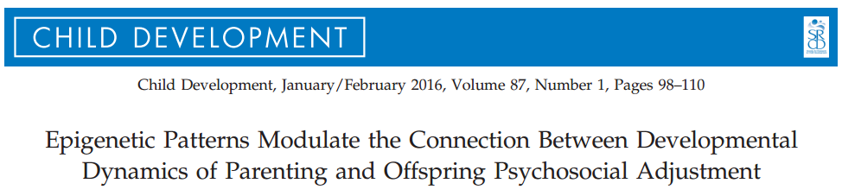

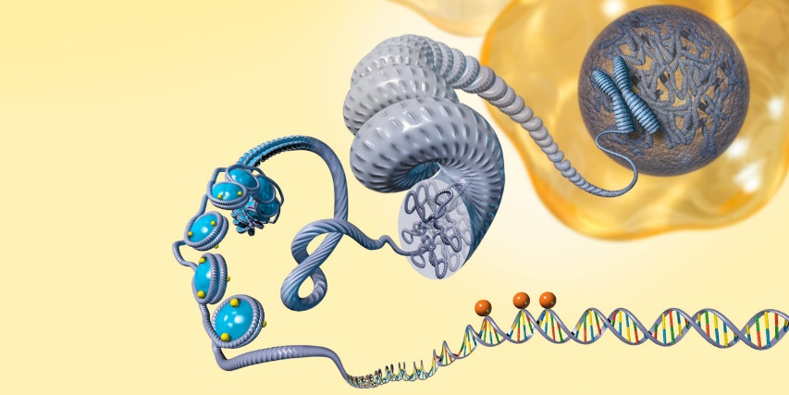
Brown 2017

Slide 71
Epigenetic modulation?
Naumova, O. Y., Hein, S., Suderman, M., Barbot, B., Lee, M., Raefski, A., Dobrynin, P. V., Brown, P. J., Szyf, M., Luthar, S. S., & Grigorenko, E. L.
Societal factors: amount & quality of child care
Parenting
Parental stress and mental health
Neurobiology: low stress reactivity; PFC function
Child adjustment
Mechanisms?

Slide 72


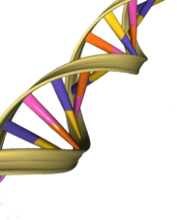
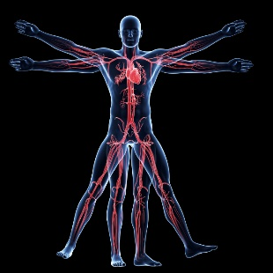
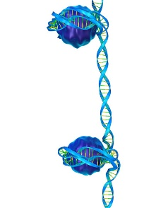
Epigenetic mechanisms
Naumova, O. Y., Hein, S., Suderman, M., Barbot, B., Lee, M., Raefski, A., Dobrynin, P. V., Brown, P. J., Szyf, M., Luthar, S. S., & Grigorenko, E. L
Emerging research
  Mechanisms of epigenetic regulation (e.g., DNA methylation)
  Types of social experiences that may impact epigenome reactivity

Slide 73
Hypotheses
Indicators of parenting across three developmental periods (middle childhood, adolescence, and adulthood) are sensitive to capturing an association with changes in methylome
Impact of parenting over time on epigenome influenced by
  Stability of parenting
  Type of parenting

Slide 74
Methods
35 offspring from sample of 361 low-income, ethnically diverse urban mother-offspring dyads
  Controlled for age, gender, SUD, psychopathology
  All African American; 19 female
Assessed 3x over course of 15 years
  Parental Acceptance-Rejection Questionnaire (PARQ)
  Parenting Stress Index (PSI)
  Behavior Assessment System for Children – College Version (BASC-CV)
  Genome-Wide DNA Methylation Profiling (T3 only)
Notes:
Sud—substance use disorder

Slide 75
Analyses
Regressed methylation levels of the 480,172 autosomal fragments with the most variance (ME markers) on the covariates and one of the 4 parenting indicators
Regressed BASC composite scores on methylation levels of parenting-associated ME markers and covariates
Related parenting-associated ME markers to genes and functional genomic regions

Slide 76
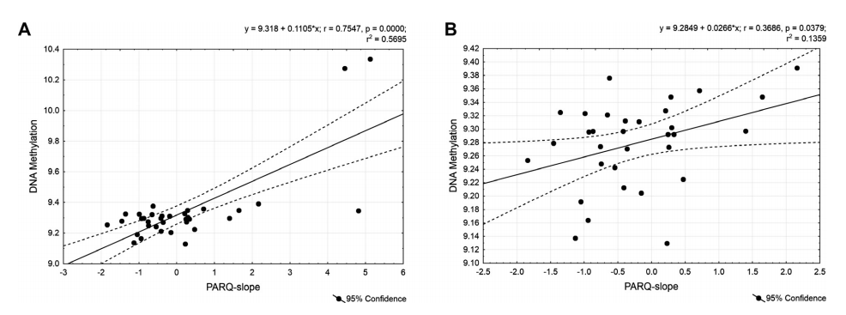
Parental Acceptance-Rejection Questionnaire (PARQ)
(with outliers without outliers)
Notes:
the slope of perceived parental rejection across the 3 time points was related to an increase in methylation, or a potential downregulation, of 565 genes thought to be involved in the control of a broad spectrum of biological functions generally related to cellular signaling

Slide 77
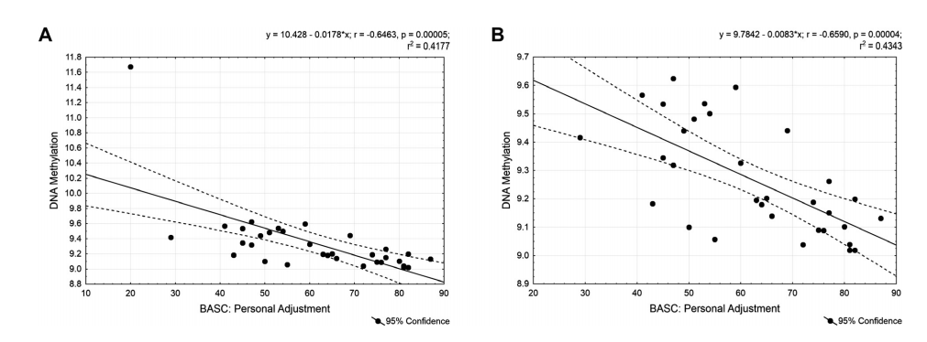
  Behavior Assessment System for Children – College Version (BASC-CV)
Notes:
A subset of these epigenetic marks, clustered in 23 genes, some of which participate in the development and functioning of the CNS, were in turn associated with psychosocial adjustment as captured by interpersonal relationships and emotional self-evaluation.

Slide 78
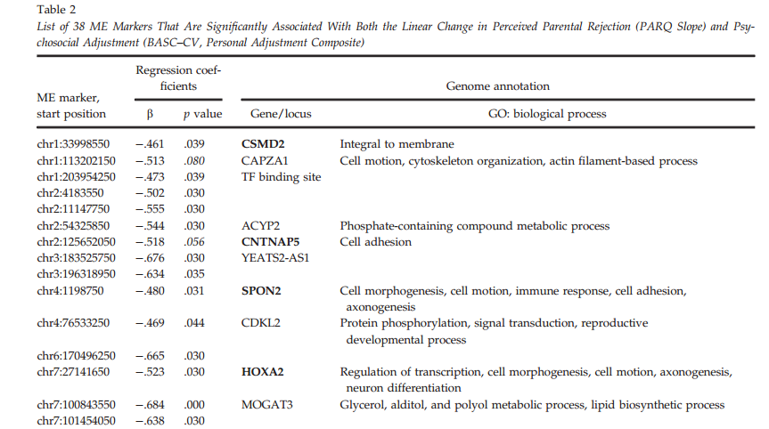
Methyl markers associated with perceived rejection and adjustment

Slide 79
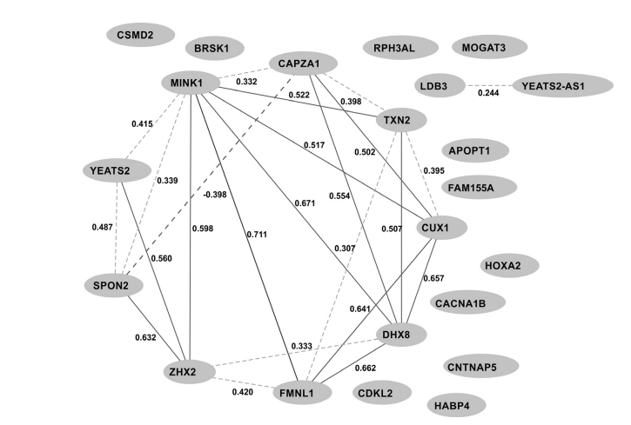
Methyl marker gene co-expression network
Figure 3. The tissue (blood)-specific coexpression network for the 23 genes associated with both the Parental Acceptance–Rejection Questionnaire slope and the college version of the Behavior Assessment System for Children Personal Adjustment Composite Personal Adjustment, constructed based on Genotype–Tissue Expression (GTEx) project database (Lonsdale et al., 2013) via a WebQTL resource (http://www.genenetwork.org). Interactions for absolute correlations above .50 are shown; Pearson pairwise correlations are represented. The nodes contain the symbols of genes. Notably, 12 of these 23 genes are known to be expressed in blood cells, and 9 of 12 active genes showed a high covariability in their expression levels among individuals.

Slide 80
Culture and Neuroscience in Developmental Psychology (Miller & Kinsbourne, in press)
Possible influences of culture on neural maturation
  Structural differences between cultures
  Cultural differences in patterns of utilization that mirror behavioral differences
  Cultural differences in patterns of utilization not reflected in behavioral differences
Reviews of recent findings
  Genetics as potential and influences of environment determine which of the potentials will be realized

Slide 81
Biological Bases of Development
Developmental Neuroscience
  Methods
    Direct vs. indirect assessment
  Brain Development
    Pre- and Postnatal development
      Differential growth rates
        and individual differences (see Shaw et al., 2006)
    Activity-dependent differentiation
    Functional effects of specialization
    Plasticity

Slide 82
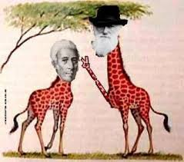

Epigenetics and Lamark
Structural inheritance. In ciliates such as Tetrahymena and Paramecium, genetically identical cells show heritable differences in the patterns of ciliary rows on their cell surface. Experimentally altered patterns can be transmitted to daughter cells. It seems existing structures act as templates for new structures. The mechanisms of such inheritance are unclear, but reasons exist to assume that multicellular organisms also use existing cell structures to assemble new ones.^{[80][81][82]}
https://en.wikipedia.org/wiki/Epigenetics

Slide 83


Schizophrenia risk from complex variation of complement component 4
schizophrenia is increased with inheritance of specific variants in a gene related to "synaptic pruning“
http://www.sciencedaily.com/releases/2016/01/160127141400.htm risk
C4 structures, C4A expression, and schizophrenia risk
A Sekar et al. Nature 1–6 (2016) doi:10.1038/nature16549

Slide 84


Parent-specific DNA Methylation in mice
Using a recently established DNA methylation reporter, Stelzer et al. study parent-specific methylation dynamics at the Dlk1-Dio3 imprinted control region. Reporter activity uncovered tissue- and cell-dependent signatures through mouse development and in adult tissues, suggesting that dynamic methylation changes regulate imprinted gene expression in pre- and postnatal animals.
Parent-of-Origin DNA Methylation Dynamics during Mouse DevelopmentYonatan Stelzer, Hao Wu, Yuelin Song, Chikdu S. Shivalila, Styliani Markoulaki, Rudolf Jaenisch
Cell Reports
Volume 16, Issue 12, Pages 3167-3180 (September 2016)
DOI: 10.1016/j.celrep.2016.08.066
Copyright © 2016 The Authors Terms and Conditions

Slide 85

A word on identity
“Cells from a fetus pass through the placenta and establish cell lineages within the mother.” Wikipedia
Amy M. Boddy, Angelo Fortunato, Melissa Wilson Sayres, Athena Aktipis. Fetal microchimerism and maternal health: A review and evolutionary analysis of cooperation and conflict beyond the womb.BioEssays, 2015; DOI: 10.1002/bies.201500059
We report that 63% of the females (37 of 59) tested harbored male microchimerism in the brain. Chan et al., (2012) https://www.ncbi.nlm.nih.gov/pmc/articles/PMC3458919/

Slide 86
New section

Slide 87
Methods in Developmental
Neuroscience
Direct Assessments
  EEG/ERP
  Functional Magnetic Resonance Imaging (fMRI)
  Near Infrared Spectroscopy (NIRS)
Indirect Assessments
  Marker Tasks
Notes:
ERP = electrical activity of brain generated as groups of neurons fire synchronously; electrodes on head;
EEG = spontaneous natural rhythm of the brain; ERP = electrical activity induced by presentation of a stimulus;
With high density recording can infer position and orientation fo brain source of activity (=dipoles) ased o pattern of scalp surface electrical activity
Good temporal; less good spatial reso
The marker task is one in which the neural control of behavior in the task is well specified. For example, several aspects of the covert orienting of attention in the spatial cueing task are mediated by the superior colliculus and the parietal cortex. This has been shown in adults with diseases of the superior colliculus or with lesions to the parietal cortex brought about by strokes or illness (e.g., Rafal, 1998). Johnson (1997) proposes that such tasks may be used with infants and that developmental changes in the behavior may be used to infer developmental changes in the brain area upon which this behavior is based. The marker task approach is used widely to study the neurodevelopmental models of infant visual attention.lution

Slide 88






EEG/ERP Assessments

Slide 89

The EEG signal
Baseline/Resting EEG
  Ongoing EEG-- summation of all electrical activity occurring in the brain at a given moment
  Frequency distributions -- indicators of state (sleep/wake) and trait (arousal) marker

Slide 90

Event-Related Potentials (ERPs)
EEG data is time-locked to a specific stimulus or event and then averaged
  Averaging allows filtering of unrelated/background EEG

Slide 91

Development

Slide 92

Brain Development
Activity-dependent specialization –
  Face Processing example
    N170 to faces becomes specialized for upright faces by 12 months; prior to that elicited to inverted and upright (de Haan et al., 2002; Halit et al., 2003)
Notes:
Does not imply innateness b/c most humans have very similar pre- and postnatal environments

Slide 93

MRI
Uses magnet and radio waves to image bodily tissues
  Structural
  Functional

Slide 94

L. Liu et al. / Developmental Cognitive Neuroscience 6 (2013) 40–50

Slide 95

Intellectual ability & cortical development (structural)
IQ group and change in cortical thickness
(Shaw et al., 2006)

Slide 96

“[I]ntelligence is related to dynamic properties of cortical maturation”
“the superior intelligence
group has a thinner superior prefrontal cortex at the earliest age (purple
regions). There is then a rapid increase in cortical thickness (red, green and
yellow regions) in the superior intelligence group, peaking at age 13 and
waning in late adolescence.”
(Shaw et al., 2006)
Notes:
Figure 4 | Developing differences in cortical thickness between the
superior and average intelligence groups. Group differences are
represented by t-statistics (t . 2.6), and show that the superior intelligence
group has a thinner superior prefrontal cortex at the earliest age (purple
regions). There is then a rapid increase in cortical thickness (red, green and
yellow regions) in the superior intelligence group, peaking at age 13 and
waning in late adolescence.

Slide 97
Intelligence and changes in cortical thickness
Superior minus average intelligence groups
(Shaw et al., 2006)
Notes:
Figure 4 | Developing differences in cortical thickness between the
superior and average intelligence groups. Group differences are
represented by t-statistics (t . 2.6), and show that the superior intelligence
group has a thinner superior prefrontal cortex at the earliest age (purple
regions). There is then a rapid increase in cortical thickness (red, green and
yellow regions) in the superior intelligence group, peaking at age 13 and
waning in late adolescence.

Slide 98
    More distributed pattern of activation in children vs. adults
    face matching task (functional)
From Passarotti et al., 2003
Notes:
Relate distributed pattern of activation back to synaptic pruning and behavioral performance

Slide 99

  Dynamic Reconfiguration of Structural and Functional Connectivity Across Core Neurocognitive Brain Networks with Development. Uddin, et al., 2011
’Right fronto-insular cortex (rFIC) is a component of a salience network (SN) mediating interactions between large-scale brain networks involved in externally oriented attention [central executive network (CEN)] and internally oriented cognition [default mode network (DMN)].
The causal influence of the rFIC on nodes of the SN and CEN was greater in adults than children.

Slide 100

Changes in Task-Related Functional Connectivity across Multiple Spatial Scales Are Related to Reading Performance. Wang, et al., 2013. PlosOne
Figure 2. Determination of task-responsive network and hierarchical partitioning to form three levels of functional hierarchy. (A) We determine group-level GLM random effects contrasts of lexical minus fixation trials (task-positive) and fixation minus lexical trials (task-negative) to define two functional systems encompassing task-responsive brain regions. Voxels within these regions are coarse-grained to 66666 mm3 ROIs to form the highest-resolution units of our network, called nodes. Time series of hemodynamic response are extracted from these nodes and are pairwise cross-correlated to define a weighted connectivity matrix for all subjects. (B) Schematic illustration and dendrogram of hierarchical partitioning. All nodes are pooled together and iteratively partitioned using modularity-based clustering algorithms to form a hierarchical network of relations. Each group on a higher level is partitioned to yield subgroups on the next lower level. Three levels of partitioning are defined, with various numbers of groups on each level: 2 ‘‘systems,’’ 9 ‘‘blocks,’’ and 33 ‘‘clusters.’’ (C) Matrix of Fisher’s Z-transformed correlation coefficients averaged over all subjects. Nodes are ordered to keep clusters, blocks, and systems contiguous. Colored bars and dendrogram along the sides indicate group membership of nodes at all three levels and correspond to those from (B). (D) Categorization of link type depends on the lowest level at which the two associated nodes are classified in the same group; i.e. same cluster (‘‘cluster links,’’ brown), same block but different clusters (‘‘block links,’’ tan), same system but different blocks (‘‘system links,’’ beige), or between systems (‘‘cross links,’’ white). Colored bars illustrate the partition of nodes into different groups at the three levels, similar to (B) and (C), but the specific groupings in (D) are conceptual only and do not represent real data doi:10.1371/journal.pone.0059204.g002

Slide 102

Changes in Synaptic Density
Like a
growing
forest
Notes:
Does not imply innateness b/c most humans have very similar pre- and postnatal environments

Slide 103
Brain Development
Postnatal Development
  Differentiation of cerebral cortex
  Synaptic density growth curves
Notes:
Post natal changes
1. Volume of brain quadruples between birth and adulthood (due in large part to mylenization ) helps conduct electrical signals
See large increase postnatally in size and complexity of dendritic tree of many neurons
DID YOU KNOW? Touch is the first sense to develop. The developing fetus responds to touch of the lips and cheeks by 8 weeks and to other parts of its body at 14 week. The sense of taste may develop by 12 weeks and that of sound at 22-24 weeks.

Slide 104

Synaptic Density Growth Curves
See Thompson-Schill et al.
(2009) for interesting
Discussion of benefits of
Protracted PFC
development
Notes:
Does not imply innateness b/c most humans have very similar pre- and postnatal environments
Adaptive significance of different developmental windows? (differences in relative periods of time region can be influences by )
Similar postnatal rise and fall developmental sequence seen in other measures (eg PET)
comparable to adult resting patterns by 1 yr but peak in glucose uptake at early chidhood
fMRI: gray matter to 4 yrs changes in white matter as indicator of change in inter-regional communication

Slide 105
Functional regressions in face perception
(Pascalis, de Haan, & Nelson, 2002)

Slide 106
Brain Development
Differentiation of Cerebral Cortex
  Reflection of innate modularity or experience-dependent processes?
    Adults tend to have similar functions housed within same regions of cortex
      Does this imply innateness?
  Likely a combination of both
    Generic large scale regions with functional specialization dependent on activity
Notes:
Does not imply innateness b/c most humans have very similar pre- and postnatal environments
Idea of innate modularity (eg language acquisition device)

