Slide 1
Language Development
Daniel Messinger, Ph.D.

Slide 2
Some definitions
Language - a socially shared code or conventional system for representing concepts through use of arbitrary symbols and the rule governed combinations of those symbols
Speech - a verbal means of communicating or conveying meaning
Gestural forms of speech
Gestural precursors to speech
Kim Oller

Slide 3
Language Development
Traditional Theories of Language Development
Six dimensions of Language Learning
Audition
Articulation
Words
Grammar
Communication
Literacy
Notes:
Language as outcome/result of interactions/coordination of all other domains of functioning; perception (audition)/motor (articulation)/cognition(recall vs. recognition memory; executive functions/planning; perspective taking); social = pragmatics/

Slide 4
Language Development – Three Theories
Behaviorist Perspective
Language acquired via operant conditioning
Enough to explain complexities of language development?
Influential Nativist Perspective (Noam Chomsky→Pinker)
Language (grammar, sentence organization) too complex to be directly taught or acquired by young child
must be innate
Proposed a Language Acquisition Device (LAD)

Slide 5
Evidence for a biological preparedness for language learning
Cross-cultural similarities in timing and sequence of language milestones
Very difficult to teach nonhuman primates language (esp. complex grammatical forms)
Specialized language areas in the brain
Sensitive periods for language development

Slide 6
Criticisms of Chomsky’s model
Hard to identify universal grammar system
Language acquisition more gradual than predicted, suggesting greater role of learning
Hard to localize the LAD at a neural level

Slide 7
Second language learning and the brain
Broca’s area
Language production
Wernicke’s area
Language comprehension
Notes:
Broca’s = frontal
Wernicke’s = temporal
If language acquired later remain spatial separate; BUT if language acquired earlier have common neural representation
Regardless of age of learning temporal lobe shows overlap across regions
Early = simultaneous childhood learning
Late = 2nd language learning as young adult

Slide 8
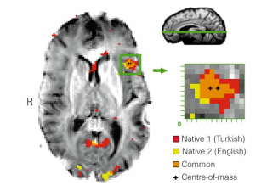
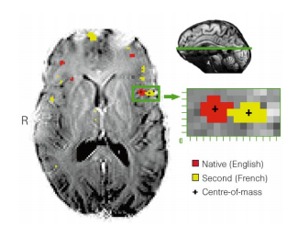
“Distinct cortical areas associated with native and second languages.”
Second language learning and the brain
Frontal Broca’s area
EARLIER LEARNERS
LATER LEARNERS
Kim KHS, Relkin NR, Lee K-M, Hirsch J: Distinct cortical areas associated with native and second languages. Nature 1997, 388:171-174.
Notes:
Figure 1 A representative axial slice from a ‘late’ bilingual subject (A) shows all
voxels that pass the multistage statistical criteria at P # 0:0005 as either red
(nativelanguage)oryellow(secondacquiredlanguage).Anexpandedviewofthe
pattern of activity in the region of interest (inferiorfrontal gyrus,Brodmann’s area
44 (refs 2, 3,18),correspondingtoBroca’sarea1–3
)indicatesseparatecentroids(+)
of activity for the two languages. Centre-of-mass calculations indicate that the
centroidsareseparatedonthisplaneby7.9mm.Thegreenlineontheupperright
mid-sagittal view indicates the plane location. R indicates the right side of the
brain.

Slide 9
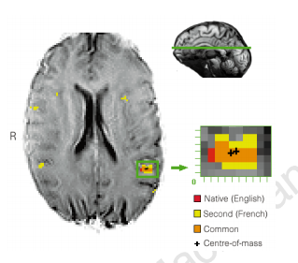
Little posterior difference
Posterior Wernicke’s area

Slide 10
Second language learning and the brain
Different patterns depending on region and timing of second language learning
EARLIER LEARNERS
Frontal Broca’s area

Slide 11
Language Development Theories– Interactionist Perspective
Language development most likely occurs via interactions between inner capacities and environmental influences
Focus on social context of language learning
First two theories are at the extremes of nature-nurture debate

Slide 12
Auditory Development
At birth audition among best developed senses
Sensitivity to contrasts (e.g., /p/ vs. /b/)
Ability to store auditory sequences
Focus on stressed syllables and syllables immediately following stressed syllables
Preference for language/voice of mother experienced prenatally
DeCasper & Fifer, 1980
Notes:
Cross-species similarities and competencies suggest fundamental processes in mammalian ear and cochlear nucleus
Despite sophisticated auditory abilities still no connection between sound patterns and meanings

Slide 13
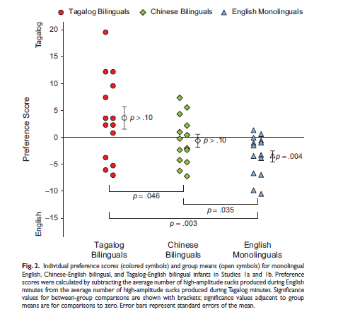
Auditory Development
Prenatally experienced language preference
Byers-Heinlein et al. (2010)
Psychological Science
Notes:
Cross-species similarities and competencies suggest fundamental processes in mammalian ear and cochlear nucleus
Despite sophisticated auditory abilities still no connection between sound patterns and meanings

Slide 14
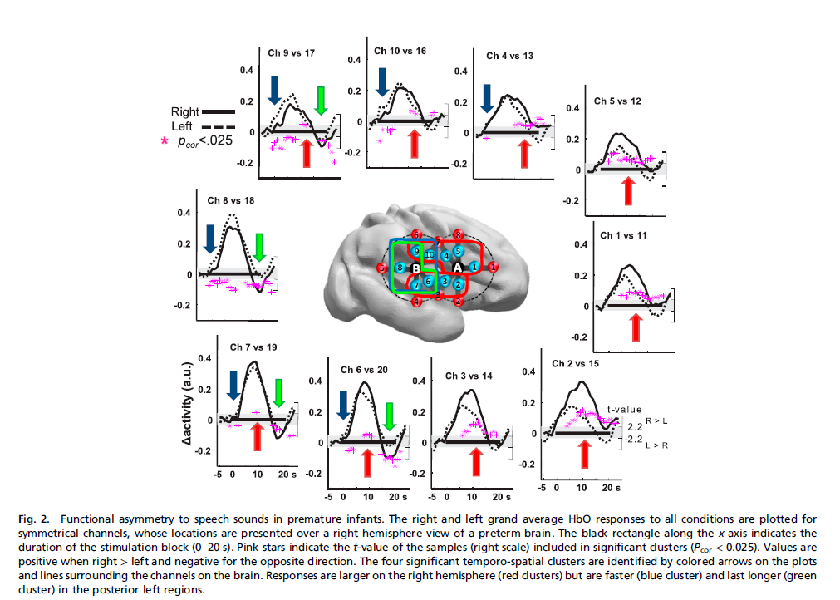
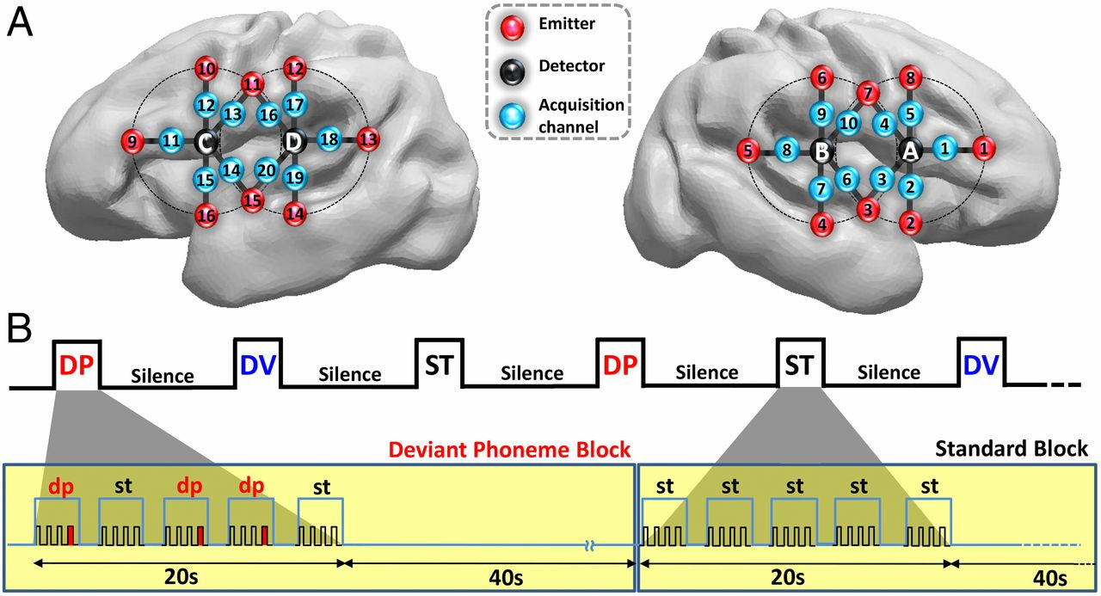
(A) Estimated projection of the optodes (channels 1–10: right hemisphere; channels 11–20: left hemisphere) on the brain of a 30 wGA preterm infant (Fig.
Mahmoudzadeh M et al. PNAS 2013;110:4846-4851
©2013 by National Academy of Sciences
Notes:
(A) Estimated projection of the optodes (channels 1–10: right hemisphere; channels 11–20: left hemisphere) on the brain of a 30 wGA preterm infant (Fig. S1). (B) Experimental paradigm, deviant phoneme (DP), deviant voice (DV), and standard (ST) blocks (Materials and Methods).

Slide 15
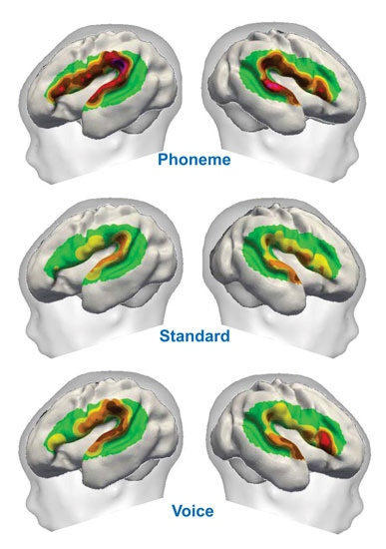
Prenatal sensitivity to language
NIRS with preterm infants (LAD?)
Distinguish
Voice (male vs. female)
Phonemes (/ga and /ba)
Habituation design
Similar areas of activation as adults during speech processing
Mahmoudzadeh et al. Syllabic discrimination in premature human infants prior to complete formation of cortical layers. PNAS, 2013, 110:4846-4851.
Notes:
Cross-species similarities and competencies suggest fundamental processes in mammalian ear and cochlear nucleus
Despite sophisticated auditory abilities still no connection between sound patterns and meanings

Slide 16
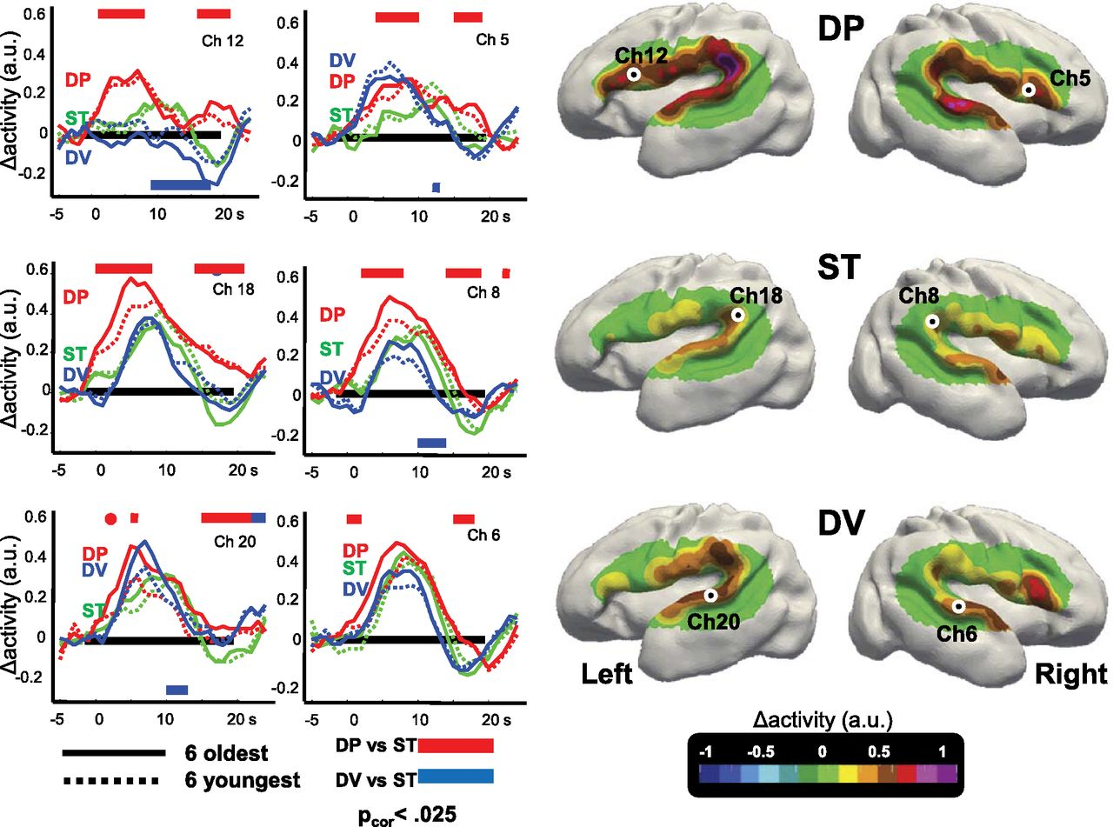
Discriminative responses to auditory stimuli in premature infants.
Mahmoudzadeh M et al. PNAS 2013;110:4846-4851
©2013 by National Academy of Sciences
Notes:
Discriminative responses to auditory stimuli in premature infants. (Right) Surface-based topographic color map of the HbO response at the peak of the hemodynamic response for the three conditions. (Left) HbO time courses for the youngest and oldest subsets of six infants, recorded over left Broca’s area (ch 12), left planum temporale (ch 18), left superior temporal gyrus (ch 20), and their counterlateral right channels (ch 5, ch 8, and ch 6, respectively). The colored rectangles indicate the time windows during which the deviant conditions differ significantly from the standard condition using cluster-based statistics over the whole group. The direction of the effect is given by the location of the bar under or above the x-line. Preterm infants discriminate the change of phoneme, notably in the left inferior frontal region. This effect was stable across our age range (28–32 wGA).

Slide 17
Auditory Development (cont)
In first six months
Lose ability to make discriminations in foreign languages
Bilingual exposure preserves flexibility
Notes:
Loss of non-exposed discriminations allows for greater quickness and automaticity in native tongue
** The secret life of the brain video***
Despite sophisticated auditory abilities still no connection between sound patterns and meanings

Slide 18
Crying
Earliest vocalization –Curvilinear development
at birth cry 1-1 1/2 hrs/day
6 wks cry 2-4 hrs/day
12 wks crying decreases
Individual differences in quantity
Naturally occurring behavior
Then recruited for communication
Continuum of intentionality
Both directed and undirected crying still present at 12 months
Gustafson, G E.; Green, J A. Developmental coordination of cry sounds with visual regard and gestures. Infant Behavior & Development. 1991 Jan-Mar Vol 14(1) 51-57

Slide 19
Two crying functions
“[N]aturally occurring cry in 26 infants
(aged 2.8-13.2 mo) and their mothers at home.
By 12 mo, most infants sometimes directed their crying toward the caregiver and elaborated the sounds by the use of gestures.
But most continued to exhibit simple, undirected crying.
Crying is both intentional and not intentional
Shows increasing variability and sophistication in form and function.
Gustafson, G E.; Green, J A. Developmental coordination of cry sounds with visual regard and gestures. Infant Behavior & Development. 1991 Jan-Mar Vol 14(1) 51-57

Slide 20
Different acoustic patterns
Basic hunger cry
rhythmic pattern of loud crying, silence, inhalation
Pain cry
loud, long shrill cry, then breath-holding silence
Fake cry
low pitch and intensity, poorly articulated moans

Slide 21
Crying judgments
Adults have some capacity to distinguish
Judgment depends on care giving context as well as acoustics
Perceived aversiveness is important dimension of judgments about meaning of cries
Cries of children with autism

Slide 22
Cries sound bad
There appears to be an underlying continuum of perceived aversiveness in young infants’ cries
That can be predicted by their duration, dysphonation, and proportion of energy in various frequencies
Parents and undergraduate non-parents perceive the cries as equally aversive.
Gustafson, G. E.; Green, J. A. ‘Acoustic features of cry perception: Infant development. ’Child Development. 1989 Aug Vol 60(4) 772-780

Slide 23
Articulatory Development
Notes:
Role of experience in babbling – proprioceptive and somaesthetic feedback from hearing self speak
Liam-video squealing and precrawling
By 12 months, structure of babbling becomes clearer, more controlled, and more organized
Piagetian explanation of babbling; child assimilates schema of mouth motions to the perceptual schema of audition, proprioception and oral somaesthesia
Despite sophisticated auditory abilities still no connection between sound patterns and meanings

Slide 24
Prelinguistic speech
Use of sounds in a communicative manner before speech (no words or grammar)
Progress through stages culminating in speech-like vocalizations
Phonation, Gooing, Expansion, Canonical
Some overlap in vocalizations characteristic of stages
Kim Oller

Slide 25
Phonation Stage, 0-2/3 months
Vowel-like (“quasi-resonant”)
Produced with normal speech like phonation involving vibration of the larynx but with the vocal tract at rest
“comfort or pleasure” sounds - can sound like grunts
The infant’s tongue almost completely fills the mouth limiting the sounds newborns can make
the infant’s mouth is almost closed; sounds are flat and nasal sounding

Slide 26
Cooing/Gooing Stage, 1 - 4 months
Still vowel-like
/e/ & /u/
but last longer
more guttural & throaty
produced in the back of the vocal cavity
thought to be precursors to consonants
/k/ /g/

Slide 27
Expansion Stage, 3 - 8 months
Isolated vowel-like sounds
Usually produced with the mouth open
Full vowels (“fully resonant nuclei”)
Vocal repertoire expands dramatically
Infant experiments with sound production, varying pitch, volume, & rate
Intentional communicative play
Already beyond pre-set animal calls
Which have set form and set causes
Infant vocalizes for pleasure (just to have fun) or displeasure

Slide 28
Checking out the new sound system
Yells/whispers: playing with amplitude/intensity
yells = high intensity, whispers = low intensity
Squeals & Growls: playing with pitch
squeals = high pitch, growls = low pitch
Raspberries
labial trill & vibrants
Cannot transcribe as adult syllables
Marginal babbles
consonant-vowel (CV) sequences
the transition between C & V is slow and drawn out
immature syllables

Slide 29
Articulatory Development
Cooing (3 mos)
Consonant-vowel syllables (e.g., /ta/ /pe/) (6 mos) → babbling
Babbling maintained and refined by linguistic experiences & auditory feedback
Deaf babies lose interest in verbal babbling after 6 mos
Babbling becomes less universal and more similar to native language by 12 months
Nature vs. Nurture perspectives on change
Notes:
Role of experience in babbling – proprioceptive and somaesthetic feedback from hearing self speak
Liam-video squealing and precrawling
By 12 months, structure of babbling becomes clearer, more controlled, and more organized
Piagetian explanation of babbling; child assimilates schema of mouth motions to the perceptual schema of audition, proprioception and oral somaesthesia
Despite sophisticated auditory abilities still no connection between sound patterns and meanings

Slide 30
Functional flexibility of infant vocalization. Oller, et al. 2013. PNAS
‘Three types of infant vocalizations (squeals, vowel-like sounds, and growls) express a full range of emotional content—positive, neutral, and negative by 3–4 mos.
Contrast: cry and laughter are species-specific signals apparently homologous to vocal calls in other primates, show functional stability, with cry overwhelmingly expressing negative and laughter positive emotional states.’

Slide 31
‘Functional flexibility is a sine qua non in spoken language
Appears before syntax, word learning, and even joint attention, syllable imitation, and canonical babbling. The appearance of functional flexibility early in the first year of human life is a critical step in the development of vocal language and may have been a critical step in the evolution of human language, preceding protosyntax and even primitive single words.’

Slide 32
Signal flexibility—a prerequisite for functional flexibility
Mirrors species’ language development?
Oller, K.

Slide 33
Canonical Babbling Stage, 6-10 mos
CV sequences
/ma/ /da/ /ada/
Transition between CV are crisp
Sounds like natural syllables in parent’s language
Parents good at identifying this stage
Reduplicated babbling
/baba/ /dadada/ /mama/

Slide 34
Importance of Babbling
Involves increasing control over the articulatory mechanism
Important pre-speech developmental milestone
Should be present by 10 months!
Occurs in Down Syndrome, premature, low SES kids and in all cultures
But its delayed in hearing impaired infants and deaf children

Slide 35
Limitations of Babbling
At end of stage, infants begin to use patterns or rising intonation that resemble adult speech
also known as gibberish, jargon, or conversational babbling
It has intonation contours of language being learned
Infants learn the music before the words
Does not refer (to objects, people, etc.)
Is not language

Slide 36
Integrative stage (9-18 months)
Beginning of meaningful speech
Some mixing of babbled utterances and words
Gibberish: (jargon) use of adult intonation patterns but what they say makes no sense
sounds like the child is having a conversation but you can’t understand what they are saying
http://www.wimp.com/babyboys/
alternate site: http://www.youtube.com/watch?v=PfSOYjkFQog

Slide 37
Infant directed speech
Slower rate, higher pitch, longer pauses
Repetitive & reduplicated
Brief, grammatically correct sentences
Use of simple syntax
Key words at end, spoken in a higher & louder voice
Diminutive used
Vocabulary is concrete
Objects may be over described
https://www.youtube.com/watch?v=cSCXMfeo74Q
Golinkoff, R. M., Can, D. D., Soderstrom, M., & Hirsh-Pasek, K. (2015). (Baby)Talk to Me: The Social Context of Infant-Directed Speech and Its Effects on Early Language Acquisition. Current Directions in Psychological Science, 24(5), 339-344. doi: 10.1177/0963721415595345

Slide 38
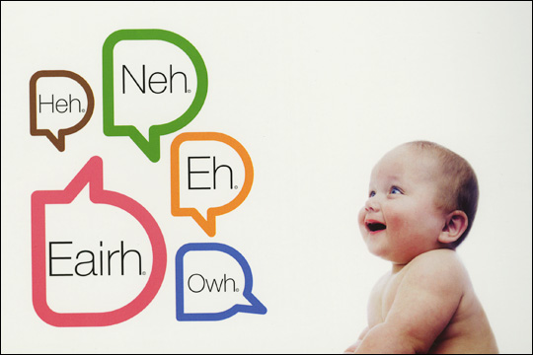
Automated Vocal Analysis of Naturalistic Recordings from Children with Autism, Language Delay, and Typical Development (Oller et al., 2010)

Slide 39
The study of vocal development and its role in language has been labor intensive.
Requires human transcribers and analysts to code and take measurements from small recorded samples
Oller et al. (2010) illustrates a method to obtain measures of early speech development through automated analysis of massive quantities of day-long audio recordings collected naturalistically in children’s homes

Slide 40
Sample
232 children
106 typically developing
49 language delayed
77 with autism
Alert

Slide 41
Naturalistic Recordings
Children: 106 typically developing, 49 language delayed, 77 with autism
Notes:
Automatic Language Assessment in Three Steps (Lena Foundation):
1. Insert recorder into clothing at start of day. 2. At end of recording session, plug recorder into computer. 3. Software processes the audio file, analyzes the language, and generates reports.
Records up to 16 hours of continuous speech data (for children 2 to 48 months)
This device has been used since 2006 with the three subsamples examined in this study: typically developing language, language delay, and autism.

Slide 42
Automated Vocal Analysis
1,486 all-day recordings from 232 children, with more than 3.1 million automatically identified child utterances
Identify speech-related child utterances (SCUs) and discard child cries and vegetative sounds
Divide SCUs into speech-related vocal islands (SVIs) → high energy periods (salient syllables in SCUs) bounded by low-energy periods
SVIs were analyzed on 12 infrastructural acoustic features reflecting rhythmic/syllabic articulation and voice and known to play roles in speech development
Organized in 4 conceptual groupings: RhSy, LtHp, BwLp, and duration
The algorithm determined whether the SVIs had each of the 12 features
Notes:
Autism diagnosis is based heavily on “negative markers” such as joint attention deficit and associated communication deficits. Abnormal vocal characteristics would constitute a positive marker that might enhance precision of screening or diagnosis. (Oller et al, p. 13355)
Four conceptual Groupings:
rhythm/syllabicity (RhSy),
(ii) low spectral tilt/high pitch control (LtHp, designed to reflect certain voice characteristics)
(iii) high bandwidth/low pitch control (BwLp, designed to reflect additional voice characteristics)
(iv) duration
the term “meaningful speech” has been used to refer to speech- related vocalizations. The present work adopts the term “speech-related” to ensure the understanding that both speech and many prespeech vocalizations such as cooing and babbling are understood to be included under the term.

Slide 43
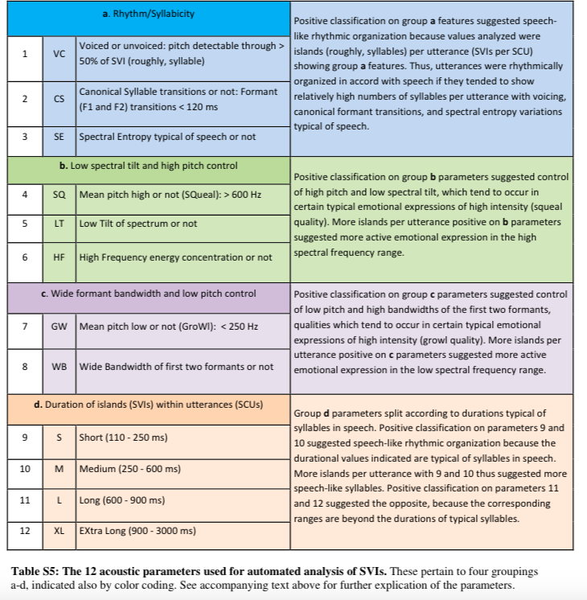
Automated Vocal Analysis
1,486 all-day recordings from 232 children, with more than 3.1 million automatically identified child utterances
Identify speech-related child utterances (SCUs) and discard child cries and vegetative sounds
Divide SCUs into speech-related vocal islands (SVIs) → high energy periods (salient syllables in SCUs) bounded by low-energy periods
SVIs were analyzed on 12 infrastructural acoustic features reflecting rhythmic/syllabic articulation and voice and known to play roles in speech development
4 Conceptual Groupings: RhSy, LtHp, BwLp, and duration
Each SVI classified as present (+) or absent (-) for each feature
Notes:
Autism diagnosis is based heavily on “negative markers” such as joint attention deficit and associated communication deficits. Abnormal vocal characteristics would constitute a positive marker that might enhance precision of screening or diagnosis. (Oller et al, p. 13355)
Four conceptual Groupings:
rhythm/syllabicity (RhSy),
(ii) low spectral tilt/high pitch control (LtHp, designed to reflect certain voice characteristics)
(iii) high bandwidth/low pitch control (BwLp, designed to reflect additional voice characteristics)
(iv) duration
the term “meaningful speech” has been used to refer to speech- related vocalizations. The present work adopts the term “speech-related” to ensure the understanding that both speech and many prespeech vocalizations such as cooing and babbling are understood to be included under the term.

Slide 45
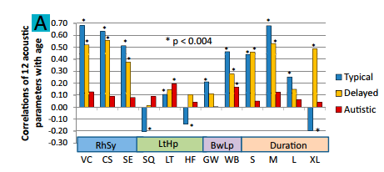
Vocal parameters change with age for typical developing/language-delayed
Notes:
Correlations between child age and SVI/SCU ratios for the 12-parameters showed clear evidence that the automated analysis predicts development.
All 12 correlations for the typically developing sample and 7of 12 for the language-delayed sample were statistically significant after Bonferroni correction (P < 0.004).
Sample.
Participants: boys appeared disproportionately in disordered groups (language delayed, autism); mothers’ educational level was higher for children with language disorders
232 children in entire sample: 106 typically developing, 49 language delayed, and 77 autism

Slide 46
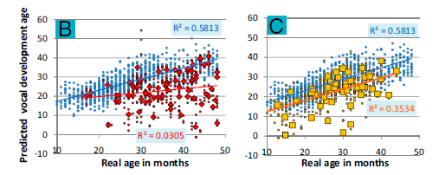
ASD children’s vocal parameters do not change with age
Blue—Typical
Red—ASD
Blue—
Typical/Language Delay
Gold—Child Means

Slide 47
Vocal parameters did not change with age for children with autism
Blue—Typical
Red—ASD
Notes:
The autistic sample showed little evidence of development on the parameters, all correlations of acoustic parameters with age were lower than +- 0.2
Overall: Typically developing children are changing in ways that are predictable, but the autistic children are changing relatively little in respect to these same parameters over time.

Slide 48
Allowing for Identification
Estimated posterior probability of
“not typically developing” classification
Posterior probability threshold for
“not typically developing” classification
Notes:
Linear discriminant analysis (LDA) used to model classification of children into the groups based on the acoustic parameters.
-> Fig A bubble graph Autism and Typically Developing: For 26/77 children with autism, probability of autism was nearly 1. For 27/106 typically developing children, probability of autism was nearly 0.
Fig B: 86% of children with autism correctly identified and 86% of typically developing children correctly identified.
Fig. 3. LDA with LOOCV indicating differentiation of child groups. Estimated classification probabilities were based on the 12 acoustic parameters. Results
are displayed in bubble plots, with each bubble sized in proportion to the number of children at each x axis location (the number of children represented by
the largest bubble in each line is labeled). The plots indicate classification probabilities (Left) and proportion-correct classification (Right) for LDA in (A and B)
children with autism (red) versus typically developing children (blue) and (C and D) a combined group of children with autism (red) or language delay (gold)
versus typically developing children (blue).

Slide 49
Developmental Tracking and Group Differentiation
Primary factor: child’s control of infrastructural features of syllabification
Differentiated between children with and without a language disorder with higher accuracy than between the two language disorder groups (autism and language delay)
Notes:
- Vocalization patterns, particularly the ability to form syllables, were a significant predictor of future language development and could distinguish children with ASD from those who were developing typically and, to a lesser degree, from those with language delay.
However, in the typically developing sample, the PC most associated with control of the RhSy parameters was highly predictive of age, but in the autism sample, no such predictiveness was found.
A typically developing child’s age can be predicted at high levels (accounting for more than two thirds of variance) based on this first attempt at totally automated acoustic modeling with all-day recordings.
Conclusions:
Informative analysis of acoustic content of infant vocalizations by automated means
Massive scale of analysis, no human intervention
Developmental tracking + Group Classification possible

Slide 50
LDA Showing Group Discrimination

Slide 51
Automated analysis algorithms can:
Differentiate vocalizations from typically developing children and children with autism or language delay
Predict a typically developing child’s age
Differentiated between children with and without a language disorder with higher accuracy than between the two language disorder groups (autism and language delay)
An objective means of screening and diagnosing early disorders
Notes:
- Vocalization patterns, particularly the ability to form syllables, were a significant predictor of future language development and could distinguish children with ASD from those who were developing typically and, to a lesser degree, from those with language delay.
However, in the typically developing sample, the PC most associated with control of the RhSy parameters was highly predictive of age, but in the autism sample, no such predictiveness was found.
A typically developing child’s age can be predicted at high levels (accounting for more than two thirds of variance) based on this first attempt at totally automated acoustic modeling with all-day recordings.
Conclusions:
Informative analysis of acoustic content of infant vocalizations by automated means
Massive scale of analysis, no human intervention
Developmental tracking + Group Classification possible

Slide 52
Future Directions
Method may be used to better distinguish among various developmental disorders
Examine child’s vocal environment and how it relates to language development
Conversations with parents, siblings, etc.
Clinical implications?
Develop better interventions
Notes:
See how SES and other factors may relate to child vocalizations

Slide 53
Automated vs. Manual Analysis
Studying automated children’s vocalization is not just a method or technology. It’s a movement. – Oller
(Contemporary Pediatrics, 2014)
Strengths
Weaknesses
Solution?

Slide 54
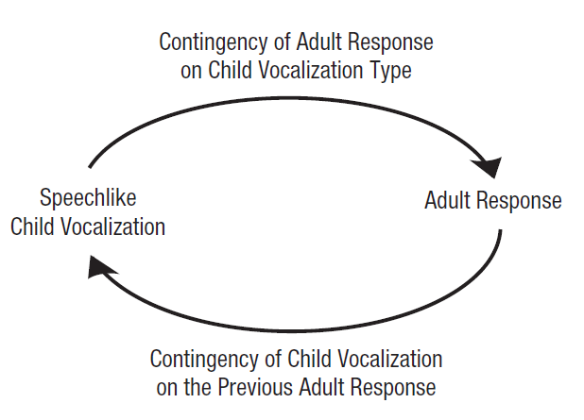
Vocal interaction and ASD development?

Slide 55
Interaction automatically-identified from recordings
child’s non-speech-related vocalizations
child’s speech-related vocalizations;
female and male adults,
dashed curves–whether child’s vocalization followed a previous speech-related vocalization that received an adult response (green) or did not receive an adult response (red)
Yellow (“CH/S”) -- child’s speech-related vocalizations; dark gray (“CH/C”) --child’s non-speech-related vocalizations; light gray (“CH”) --child’s unspecified vocalizations; blue (“FA” and “MA”) to vocalizations of female and male adults, respectively; and white (“SIL,” “EL,” “NO,” and “OL”) to silence, electronic sounds, noise, and overlap, respectively.

Slide 56
Age-related increase in of speech-related vocalization proportion slower in ASD group
Speech and non-speech related should diverge

Slide 57
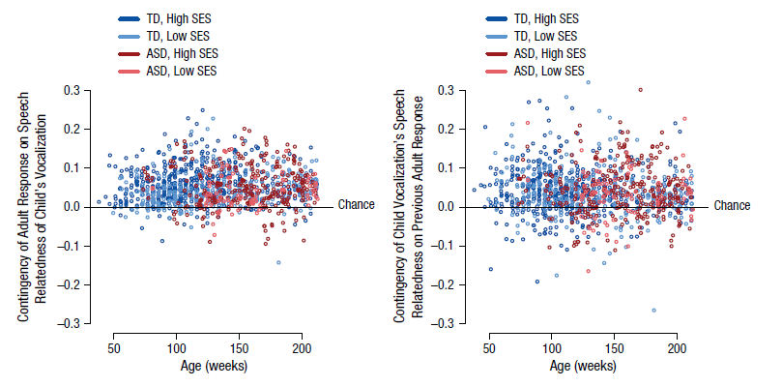
Two-way contingencies
child speech-relatedness
→ adult response
Adult response
→ child speech-relatedness
difference between the proportion of children’s speech-related vocalizations receiving an immediate adult response and the proportion of children’s non-speech-related vocalizations receiving an adult response
Proportion significant but weaker for ASD
Proportion significant, no ASD difference

Slide 58
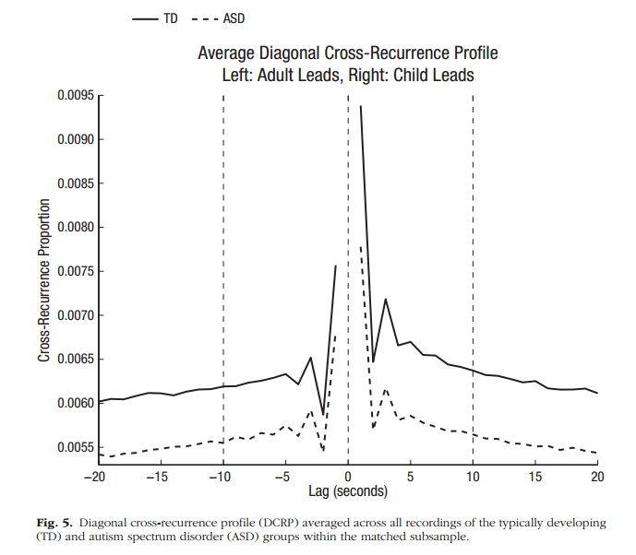
The ratio of the right side’s height (lag 0 to lag 10) to the left side’s height (lag −10 to lag 0) indicates how much the child initiated as opposed to followed. This ratio was lower in the ASD group than in the TD group, β = −0.266, p < .001.

Slide 59
Epilogue
http://pss.sagepub.com/content/early/2016/09/23/0956797616668558.full.pdf+html

Slide 60
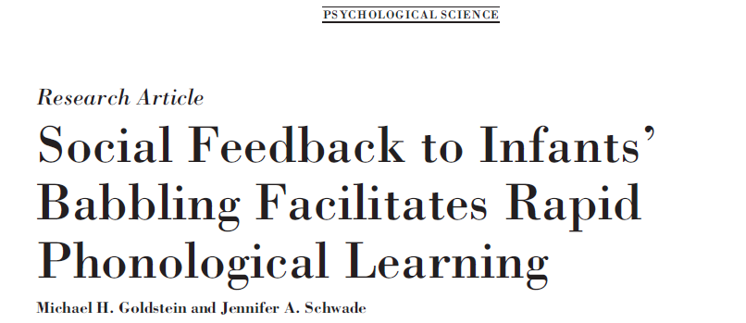
2008

Slide 61
First word definitions
Function
They are first words because they refer
Arbitrary sound is paired with an object
Often but not always nouns in the environment

Slide 62
First word learning
Comprehension > Production
Production lags behind perception
Words as simplifications of adult forms (sip vs. ship)
Drop unstressed syllables, repeat consonants
Notes:
Reinforced preferential learning paradigms show that comprehension preceeds production by about 2-3 months
Infants don’t have innate knowledge that words NEED to involve some spoken verbal form; (or else deaf kids would have trouble learning sign language)—also check literature on sign language learning in Typically developing kids
First words expressed based on dynamic interaction of developments; (1) ability to record sound of words; (2) ability to control vocal productions, (3) symbolic function (as represented in play, imitation, object manipulation)
Children acquire words in receptive vocabulary more than twice as fast as into their productive vocabulary
U-shaped learning processes; series of regressions and re-emergences as new forms are learned

Slide 63
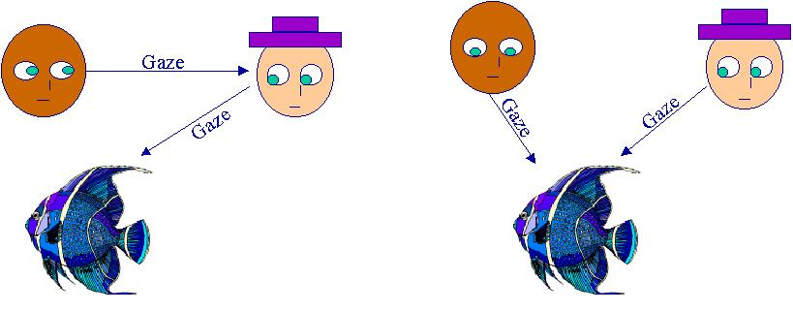
Word learning
Word learning is contextually-situated
Socially-mediated cues
Meaning conveyed through attentional, gestural, & postural cues from others
Autism associated with failure to pick up on gestural and intentional cues
What a beautiful fish
Notes:
Learning of words in direct presence of the referent
INSERT PICTURE OF “SILLY ROOSTER” from Baldwin studies
Gesture, posture, intonation, and gaze used to establish shared attention for word learning
Object learning is simpler than action learning b/c direct perceptual referent for objects p.367; nouns easier than verbs; in English; but other languages (Korean, Mandarin Chinese) children produce more verbs than nouns; in these language verbs are much more likely to appear at end of utterance vs. English where last word tends to be noun; AND Korean and Mandarin mothers tend to talk about actions more than English moms; among English moms those who use more nouns tend to have infants with higher proportion of nouns in vocabulary

Slide 64
Word learning
What a beautiful fish
Word meaning (cont)
Notes:
Learning of words in direct presence of the referent
INSERT PICTURE OF “SILLY ROOSTER” from Baldwin studies
Gesture, posture, intonation, and gaze used to establish shared attention for word learning
Object learning is simpler than action learning b/c direct perceptual referent for objects p.367; nouns easier than verbs; in English; but other languages (Korean, Mandarin Chinese) children produce more verbs than nouns; in these language verbs are much more likely to appear at end of utterance vs. English where last word tends to be noun; AND Korean and Mandarin mothers tend to talk about actions more than English moms; among English moms those who use more nouns tend to have infants with higher proportion of nouns in vocabulary

Slide 65
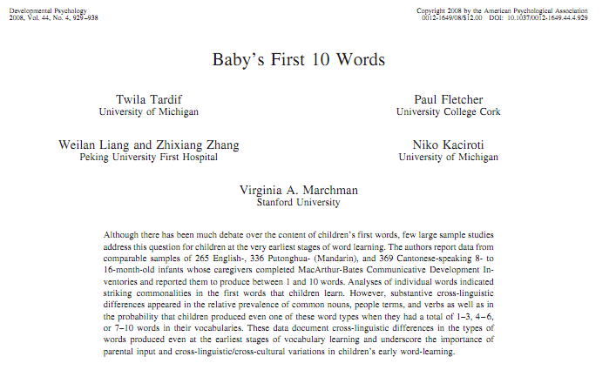

Slide 66
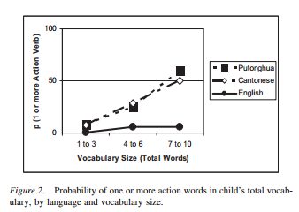
Cross-cultural differences in first words

Slide 67
Word learning
Syntactically-mediated cues (Fast-mapping)
Meaning is derived based on surrounding words and sentence form
Here is a pum
Here is Pum
I am pumming
I pummed the duck
I need some pum
This is the pum one
Notes:
Fast mapping – Susan Carey= induction of word meaning from syntactic context; child quickly picks up general idea of the meaning of a new word; altough tends to be fast but shallow mapping of new words to new meanings (vs. socially-mediated this is later appearing…around 2 yrs of age)

Slide 68
Syntax = grammar
Evidence of syntax
Nonrandom combinations
Development of syntax
Takes place with no explicit instruction.
Parents may teach new words but don’t teach syntax.
`The emphasis is on what the child is saying rather than how the child says it.
Innate or modeled?

Slide 69
Children’s early comprehension of syntax
Assessment methods involving action such as
diary studies (parents document conditions under which the child can or cannot understand)
act-out tasks (in which the experimenter asks the child to act out a sentence using toys)
direction tasks (in which the child is asked to carry out a direction, such as “tickle the duck”)
picture-choice tasks (in which the child must select the picture that best represents the linguistic form being tested)
Have limitations leading to confusion about children’s comprehension abilities.

Slide 70
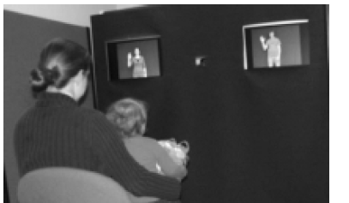
Preferential looking paradigm
Child hears, “Cookie Monster is tickling Big Bird”
one screen showed Cookie Monster tickling Big Bird
one screen showed Big Bird tickling Cookie Monster.
Children at 17 months of age spent more time looking at the screen that matched the statement.
Children can comprehend word order before they begin using two-word sentences.

Slide 71
The duck is gorping the bunny
https://nyu.databrary.org/volume/44
Naigles, L. (1990). Children use syntax to learn verb meanings. Journal of Child Language, 17(02), 357. doi:10.1017/s0305000900013817 (external link)
DESCRIPTION
Verb learning is clearly a function of observation of real-world contingencies; however, it is argued that such observational information is insufficient to account fully for vocabulary acquisition. This paper provides an experimental validation of Landau & Gleitman's (1985) syntactic bootstrapping procedure; namely, that children may use syntactic information to learn new verbs. Pairs of actions were presented simultaneously with a nonsense verb in one of two syntactic structures. The actions were subsequently separated, and the children (MA = 2;1) were asked to select which action was the referent for the verb. The children's choice of referent was found to be a function of the syntactic structure in which the verb had appeared.

Slide 72
Statistical learning: Learning patterns in the world

Slide 73
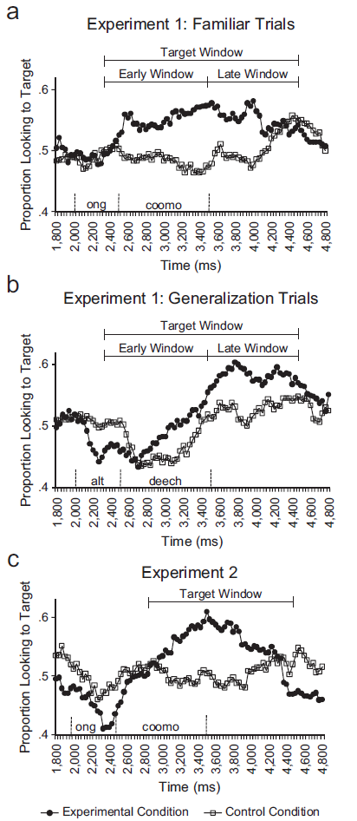
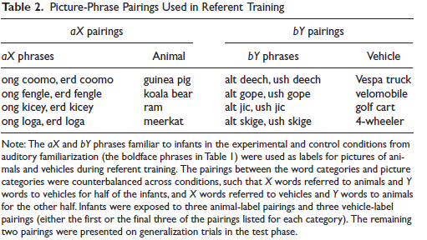
Statistical learning: Learning patterns in the world
Artificial language

Slide 74
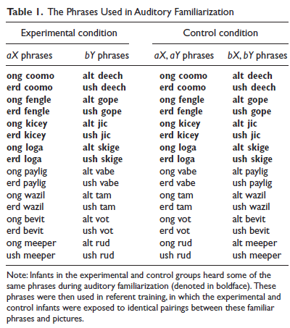

Slide 75
Statistical rules → Learning

Slide 76
Grammatical Development
Single words → successive single-word utterances → true word combinations
Temporal gap decreases with experience and development
Want cookie
Want cookie
Combinations require understanding of which words go together and how to coordinate sentences (breathing, pauses etc.)
Statistical learning of likely word combinations
Notes:
Temporal gap between words shortens with development to increase flow
Chimps can form successive single-word utterances; but can’t get beyond that

Slide 77
Syntax of 2 word sentences
Emerge 15 – 24 months, mean is 18
Usually have 50 words in vocabulary before combining words
7 months after their first words
1st sentences typically have nouns, verbs & adjectives
Pivot word
frequently occurring word attached to a variety of other words
More: Mommy, milk, hug
Uses: name, locate, negate, question, etc.

Slide 78
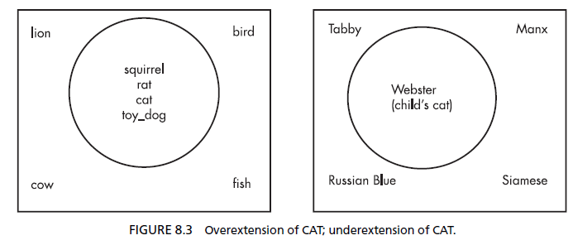
Common Errors
Overextension
Word refers to over-large class
“Car” = all big things with wheels
Underextension
Word refers to particular exemplar
“Car” = family’s car
Interplay between two yields correct word usage (?)

Slide 79
Measuring grammatical development
Mean length of utterance (MLU) is a measure of syntactic development.
Average length calculated in morphemes (not words)
Morpheme is the smallest unit of meaning in a word
free morpheme: can stand as a word by itself (e.g., kind)
bound morpheme exist only in a word (-ly, -ness, -s, -ed, ‘s)
Each new morpheme reflects new linguistic knowledge.
“I running” = 3 morphemes (not 2 words)

Slide 80
MLU length
Children who have similar MLUs are at the same level of linguistic maturity, and their language is at the same level of complexity.
Children have MLUs of
1.0 to 2.0 1-2 years
2.0 to 3.0 2-3 years
3.0 to 4.0 3-4 years

Slide 82
Grammatical Development
Confusions in word meanings reflected in word use
Undergeneralizations
E.g., Car refers only to family car not all cars
Eventually corrected based on wider range of exposure
Overgeneralizations
Incorrect application of smaller label to larger class
e.g., banana = all fruit
e.g., Ellie = all dogs
Notes:
Getting rid of undergeneralizations – each new context is compared with current meaning; features that match are strengthened; those that don’t match are weakened; when specific feature becomes sufficiently weak it drops out of schema requirement completely
Will example of undergeneralization …. Fire truck = long with ladder, otherwise = red police car
Language development generally precedes from undergeneralization to gradual generalization
Overgeneralization less frequent
b/c not yet learned the words they need to express their intentions; not that child THINKS tiger is kittie..just that they don’t have the word to express it and notices broad similarities

Slide 83
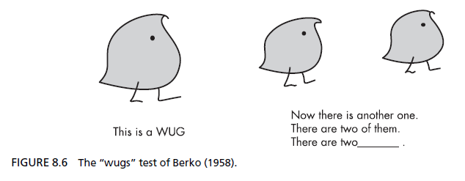
Grammatical Development
Irregular forms
Overgeneralizations of ‘affixes’ (-ed, -ing) tend to occur after correct irregular forms are produced (went, saw vs. goed, sawed)
U-shaped pattern of production
Why?
Notes:
Temporal gap between words shortens with development to increase flow
Chimps can form successive single-word utterances; but can’t get beyond that

Slide 84
Parsing grammar
From MacWhinney, 2011

Slide 85
Communicative Development
Conversation takes on many forms prior to linguistic
Used not just to get needs met but to engage as social members of dyads and groups
Parents naturally engage infants in ‘conversation’
Model turn-taking
Interpret/expand infant behaviors with
words
Scaffold verbal responses to child’s gestures
Notes:
See website on p. 379
Neena/Liam interaction
Check website on 380
Chimps can form successive single-word utterances; but can’t get beyond that

Slide 86
Role of gesture
Rudimentary forms of initiation take place by 12 mos
RJA by 10 mos
IJA by 12 mos
*** ESCS video***
Early participation in conversational interactions as primary support for initial stages of language acquisition
Notes:
Find ESCS examples
See website on p. 379
Neena/Liam interaction
Chimps can form successive single-word utterances; but can’t get beyond that
Language learning depends on construction of shared intersubjective understanding of parents’ intention

