Slide 1
Oxytocin and Interaction
Daniel Messinger, PhD

Slide 2
Parenting (overview)
Biology of parenting
Oxytocin and fathers
Oxytocin and dams
Transition to parenthood
Parenthood and happiness

Slide 3
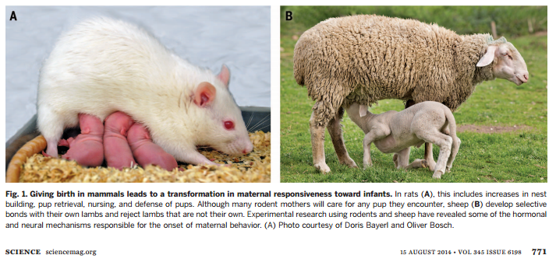

Slide 4
The biology of mammalian parenting – its effect on offspring social development Rilling & Young
What biological mechanisms are implicated during birth and postnatal bonding?
Parent-infant relationship affects brain development and social regulation
What can we learn from rodents?
How does that differ from humans?
Ehrlich

Slide 5
Rodent Moms and Dads
Virgin rodents (and other species) find infant stimuli aversive
Postpartum rodent moms demonstrate a switch in the valence of infant stimuli
One study demonstrated that blood transfusions from a pregnant to a virgin rodent resulted in increased maternal responsiveness
Why?
Estrogen and progesterone during pregnancy + progesterone at birth maximizes brain sensitivity to oxytocin and prolactin

Slide 6
Rodents v. Sheep
Oxytocin
Implicated broadly in social bonding and parenting
Is released centrally during birth, plays a role in transitioning toward approach behavior in mothers
Rodents are promiscuous parents
Sheep form selective mother-infant bonds
Oxytocin signaling at play

Slide 7
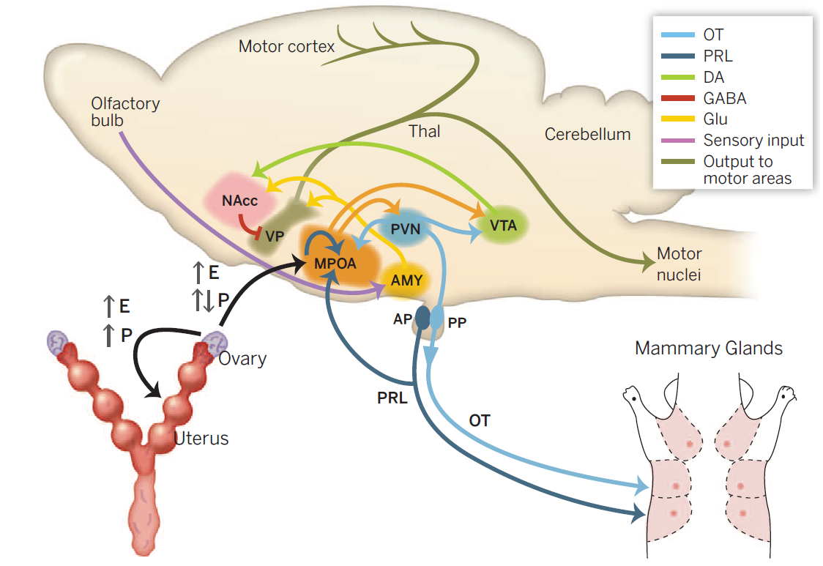
Rodent Moms and Dads
VTA - ventral tegmental area
MPOA - Medial Preoptic Area
Notes:
Medial Preoptic Area robustly activated by infant stimuli, destruction of MPOA abolishes maternal care; master control region
Ventral tegmental area: maternal motivation; activated by MPOA at birth, triggers cascade of events through nucleus accumbens and ventral pallidum which all culminates in the expression of maternal nurturing responses.
More: medial preoptic area (MPOA) senses the course of pregnancy by monitoring changes in steroid hormone concentrations, and is likely the region responsible for the transition from pup aversion to attraction at parturition through suppressing amygdala to anterior hypothalamic and enhancing mesolimbic dopaminergic pathways. MPOA neurons are robustly activated by pup stimuli, and destruction of the MPOA abolishes maternal care.

Slide 8
00 APRIL 2015 | VOL 0 | NATURE | 1

Slide 9
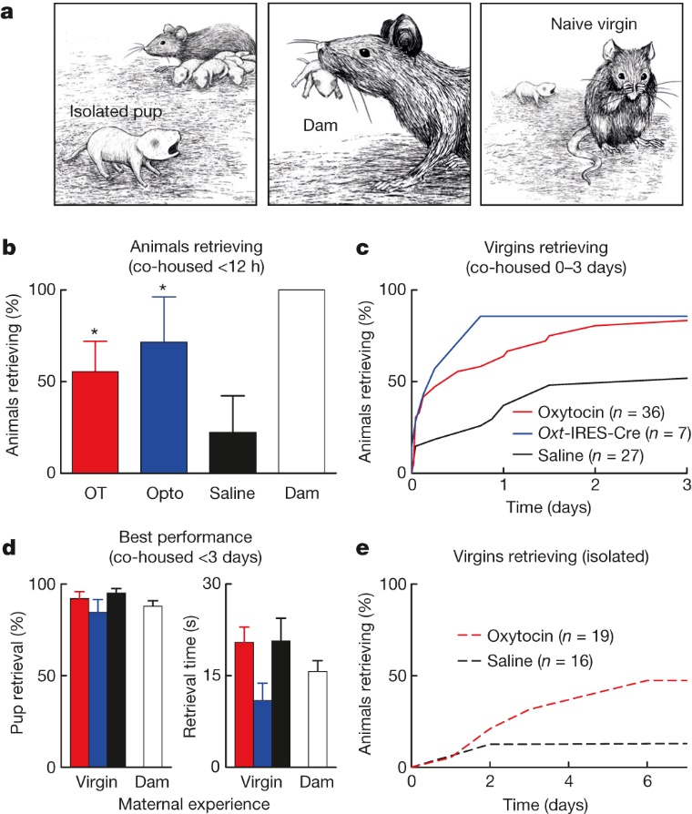
Oxytocin enables pup retrieval
www.nature.com/nature/journal/vaop/ncurrent/full/nature14402.html#videos
Oxytocin is synthesized in the paraventricular nucleus (PVN) and supraoptic nucleus of the hypothalamus,
BJ Marlin et al. Nature 000, 1-6 (2015) doi:10.1038/nature14402

Slide 10
Human Moms and Dads
fMRI studies demonstrate activation in mesolimbic dopamine system
VTA
Nucleus accumbens
Medial orbitofrontal cortex
Evident for both mothers and fathers
Different from rodents in that
Nonparents activate these regions as well
Nulliparous women: nucleus accumbens activation directly related to baby cuteness
Notes:
Fathers with more instrumental care stronger VTA acitivation
Mothers with more positive engagement, less intrusiveness = nucleus accumbens

Slide 11
Human Moms and Dads
Infant crying triggers neural responses
Mesolimbic dopamine system
Anterior insula (empathy)
Prefrontal cortex (emotion regulation)
Notes:
Empathic overarousal can lead to interfering distress. Fathers with MODERATE anterior insula activation are most involved in instrumental care giving
Prefrontal cortex associated with increased sensitivity, decreased stress hormones at separation, more secure attachment

Slide 13
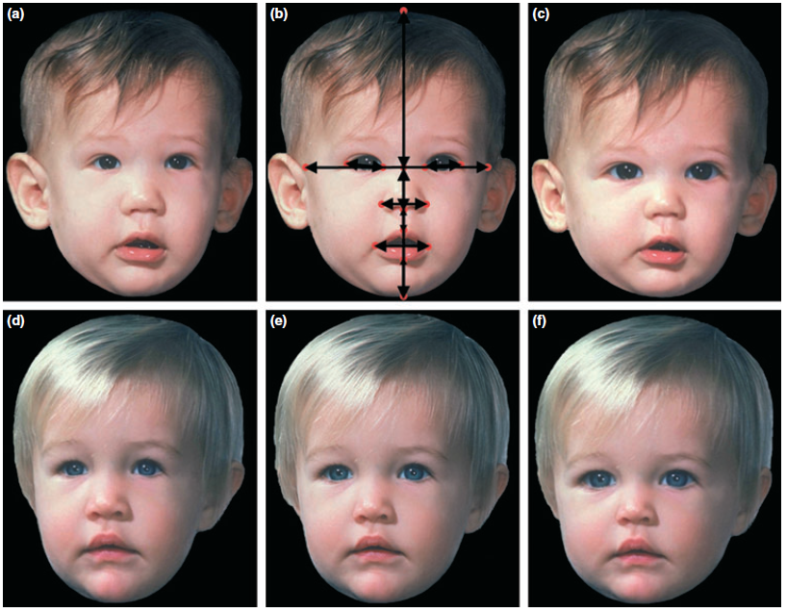
Differences
Glocker et al., 2009
Notes:
MORE NOTES:
Examples of low (narrow face, low forehead, small eyes, big nose and mouth), unmanipulated, and high (round face, high forehead, big eyes, small nose and mouth) baby schema faces. (Modified from ref.10, copyright Blackwell Verlag GmbH.)

Slide 14
Human Moms and Dads
Oxytocin:
Is positively correlated with affectionate contact and positive engagement
Studied via intranasal administration in fathers
Genetic studies demonstrate oxytocin’s relationship to parenting
Notes:
Oxytocin seems to motivate paternal behaviors that facilitate father-infant bonding, decreases paternal hostility and frustration

Slide 15
Paternal Care
Rats are absentee dads
Little attention paid to oxytocin in nonhuman dads
Mixed evidence surrounding testosterone
Some mammals: increase in vasopressin

Slide 16
Paternal Care
Men and testosterone
Higher testosterone implicated in mating effort, associated with
Less sympathy for other people’s crying babies
Lower paternal caregiving
Lower responsiveness to infants
Testosterone decreases when men become fathers, associated with
Increased empathy
Increased frustration tolerance
Decreased sexual motivation (that could compete with parenting effort)
Notes:
Teste size human and nonhuman models weak but significant negative correlation with instrumental caregiving

Slide 17
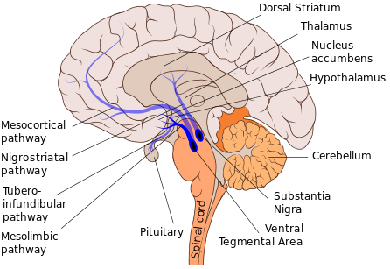
Social Development
Licking and grooming (L&G)
Rats reared by low L&G moms demonstrate low L&G when they become mothers
Effects seen in mesolimbic dopamine pathway through adulthood
Later-life pair bonding
Disrupted by repeated neonatal social isolations
Oxytocin neurons stimulated pharmacologically facilitate better later-life pair bonding
Paternal Care
Prairie voles raised with absentee dads show impairments in pair bonding behavior and less L&G

Slide 18
Mesolimbic dopamine pathway VTA—NAcc (nucleus accumbens)
VTA - ventral tegmental area
MPOA - Medial Preoptic Area
Notes:
Medial Preoptic Area robustly activated by infant stimuli, destruction of MPOA abolishes maternal care; master control region
Ventral tegmental area: maternal motivation; activated by MPOA at birth, triggers cascade of events through nucleus accumbens and ventral pallidum which all culminates in the expression of maternal nurturing responses.
More: medial preoptic area (MPOA) senses the course of pregnancy by monitoring changes in steroid hormone concentrations, and is likely the region responsible for the transition from pup aversion to attraction at parturition through suppressing amygdala to anterior hypothalamic and enhancing mesolimbic dopaminergic pathways. MPOA neurons are robustly activated by pup stimuli, and destruction of the MPOA abolishes maternal care.

Slide 19
Social Development
Research on children raised in orphanages
Focus on amygdala and prefrontal cortex
Postinstitutionalized children demonstrate
Larger amygdala volumes
Increased amygdala response to fearful faces
Altered connectivity between amygdala and medial prefrontal cortex
Notes:
Big amygdala positively correlated with anxiety and internalizing problems

Slide 20
Social Development
Oxytocin
Girls with childhood neglect or abuse show lower oxytocin in cerebrospinal fluid as adults
Implicated in attachment
High levels of oxytocin in securely attached parents might facilitate more affectionate behavior toward child, who then becomes more securely attached.
Insecurely attached mothers have lower oxytocin response to their children

Slide 21
Discussion
Is parenting a developmental transition?
How can this information be applied to our understanding of developmental concepts like maternal sensitivity, coparenting, etc.?
Are we doomed by our upbringings?

Slide 22
Kelly Shaffer

Slide 23
Background
Oxytocin (OT) underlies formation of social bonds and is associated with positive parenting behaviors for mothers and fathers
Parental OT and the amount of parenting behavior the infant receives shape the organization of OT receptors in the infant’s brain and its ensuing lifetime effects on social adaptation
Marissa Alert
Notes:
Research indicates that Oxytocin (OT) underlies the formation of social bonds and is associated with positive parenting behaviors for mothers and fathers
In humans, it’s been shown that OT administration increases affiliative behavior, including trust, empathy, theory of mind and social reciprocity.
Parental OT may shape the capacity for social engagement in the child as studies have found that Parental OT and the amount of parenting behavior the infant receives shape the organization of OT receptors in the infant’s brain and its ensuing lifetime effects on social adaptation.
Hormone’s central involvement in the formation of the parent-infant bond enhances physiological and behavioral systems that underpin human social engagement throughout life

Slide 24
Background
Oxytocin (OT) underlies formation of social bonds and is associated with positive parenting behaviors for mothers and fathers
Parent-infant OT responses are related – a “cross-generational link”
Parental OT system functioning likely shapes the capacity for social engagement in the child
Notes:
Hormone’s central involvement in the formation of the parent-infant bond enhances physiological and behavioral systems that underpin human social engagement throughout life

Slide 25
Background & Aims
Unknown whether:
Increasing parental OT can enhance parental-infant bonding
Pharmacologic interventions to the parent can have parallel effects on the infant
Tested the effects of OT administration to the father on the father’s and infant’s hormonal, autonomic, and behavioral responses during social interactions
Marissa Alert
Notes:
Currently unknown
1) whether manipulations that increase parental OT can enhance parental-infant bonding by increasing the parent’s physiological and behavioral response in systems that support social engagement.
OT admin → increased physiological and behavioarl response in systems that support social engagement→ enhanced parent infant bond 2) whether pharmacologic interventions to the parent can have parallel effects (increase in phys & behav responses in sytems that support social engagement) on the infant without direct hormonal manipulation to the child.

Slide 26
Known and unknown…
Intranasal OT administration increases peripheral OT
OT related to many social and parenting behaviors and cognitions cross-sectionally
Do manipulations in parental OT increase parents’ social engagement with their child?
Do manipulations in parental OT have parallel effects on the infant?

Slide 27
Hypotheses
OT administration to Fathers will
Enhance father’s peripheral OT, parasympathetic activity (RSA), and father-typical social behavior
Have parallel effects on infants’ OT, RSA, and behavioral responses to the father
RSA = Respiratory Sinus Arrhythmia
Measure of parasympathetic activity indexing capacity to respond flexibly to environment → enhances ability to be socially engaged

Slide 28
Methods
35 father-infant (5 mo) dyads at 2 visits
Face-to-Face/
Still-Face
Follow-up Saliva
Assessments
Baseline
Reunite
0 mins
40 mins
45 mins
65 mins
85 mins
Fathers only:
PANAS
Saliva
RSA
OT/PL admin
Fathers & Infants:
Saliva
Fathers & Infants:
RSA
Behavioral coding
Fathers & Infants:
Saliva
Repeated 1 week later
Fathers | Infants
Social gaze | Social gaze
Positive affect | Positive affect
Father vocalizations | Exploratory play

Slide 29
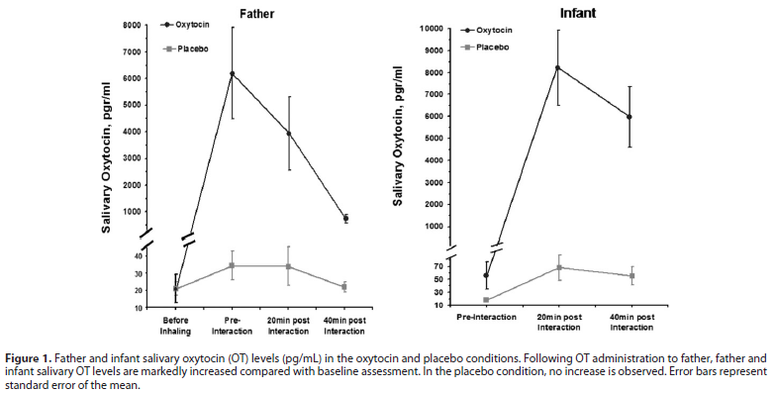
Results – Salivary OT
Shaffer | Weisman et al., 2012
Notes:
Fathers: Marked increase in salivary OT from BL to rest of assessments in OT condition
No change in OT for PL
Infants: Marked differences in infant’s OT reactions according to “father’s OT status”
Marked increase when fathers had been administered OT
No change in OT for PL

Slide 30
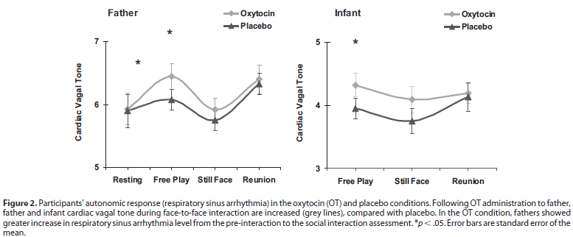
Results – RSA
Shaffer | Weisman et al., 2012
Notes:
Calculated RSA separately across the phases of the face-to-face/still-face paradigm
Fathers: higher RSA in free play → greater autonomic readiness for social engagement
Greater INCREASE in RSA from baseline to free play
Infants’ RSA related pattern: RSA higher during Free Play when father admin OT
- BUT: not higher overall → effect specific to the free-play condition

Slide 31
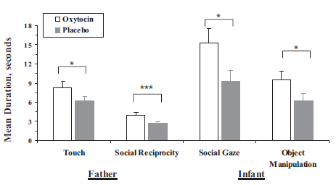
Results – Social Engagement Behavior
Positive affective expression?
Shaffer | Weisman et al., 2012
Notes:
Fathers: under OT, showed longer episodes of touch and more moments of infant-oriented vocalizations and encouragement of infant orientation to the social context
Children: when fathers under OT, showed longer episodes of object manipulation and longer moments of social gaze
also: took longer to avert gaze from father’s face (“closer focus on the social context”)
No differences in child/father positive affective expressions. Paper: findings specific to affiliative processes – what is your reaction to that?

Slide 32
Results – Miscellaneous!
Infants’ OT increases correlated with
Fathers’ OT increases after administration
Synchronous social behavior with Father
No differences in father’s self-reported emotions between OT and placebo visits
Notes:
Correlation of OT response: corroboration of earlier research showing OT systems interrelated between parents and children
Synchronous behavior: shared touch, gaze

Slide 33
OT administration to a parent
Enhances parent’s physiological and behavioral systems that facilitate parent-child interaction
Increased salivary OT
Higher RSA during free play
Parenting behavior (touch, social reciprocity)
Has parallel effects on infant
Increased salivary OT
Higher RSA during free play
Greater social engagement (social gaze, exploration)
Marissa Alert
Notes:
Overall, the findings suggest that OT administration enhances functioning in physiological and behavioral systems that underpin parental-infant bonding in humans and that OT administration to parent can have parallel effects on the child without direct hormonal manipulation to the infant.
Peripheral OT and RSA have been associated
with higher levels of infant social behavior (3,35), and disruptions
to parental-infant bonding, in cases such as premature birth or
maternal postpartum depression, are expressed in lower peripheral
OT (14), lower RSA (53), and reduced social behavior

Slide 34
Implications – Neuropeptide Therapy
OT administration improves symptoms of autism and schizophrenia
Maternal postpartum depression and premature birth associated with disruptions in OT, parasympathetic NS, and social-behavioral systems
Notes:
What are your reactions to intranasal OT as a preventive therapy for ameliorating risk in these situations?
What additional research would you like to see done before recommending this therapy?
-- e.g., how long does this effect last (dosing schedule)?
-- e.g., for what age ranges is this beneficial?

Slide 35
What are your reactions to OT therapy?
What additional research would you want to see done before recommending (or not)?
Fathers only: risk of administration to nursing mothers
How might this effect compare in mothers?
Notes:
Use of fathers was listed as a limitation. But in what ways is this cool? Do you expect to see same findings among mothers?
Listed benefit of this parallel response that you could administer to parents without to children. But if administering to nursing mom mean you’d also be administering to child, does that limit that benefit?

Slide 36
Conclusion
Synchronized OT between humans may be critical biological basis for human social cognition by representing another’s state in one’s own physiology

Slide 37
‘Commercially available EIA assays without extraction two orders of magnitude higher than conventional RIA methods with extraction’
http://www.psy.miami.edu/faculty/mmccullough/Papers/McCullough-Churchland-Mendez-Final.pdf
‘commercially available EIA assays without extraction…guaranteed to obtain values…two orders of magnitude higher than... conventional RIA methods with extraction
Notes:
Using
commer-
cially
available
EIA
assays
without
extraction,
one
is
guaranteed
to
obtain
values
that
are
two
orders
of
magnitude
higher
than
those
obtained
using
conventional
RIA
methods
with
extraction

Slide 38
00 APRIL 2015 | VOL 0 | NATURE | 1

Slide 39
Oxytocin enables pup retrieval
www.nature.com/nature/journal/vaop/ncurrent/full/nature14402.html#videos
Oxytocin is synthesized in the paraventricular nucleus (PVN) and supraoptic nucleus of the hypothalamus,
BJ Marlin et al. Nature 000, 1-6 (2015) doi:10.1038/nature14402

Slide 40
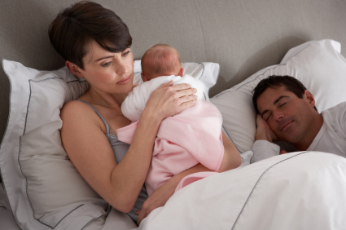
The Effect of the Transition to Parenthood on Relationship Quality: An 8-Year Prospective Study
(Doss et al., 2009)

Slide 41
Background
What is the impact of the transition to parenthood on marital functioning?
Little agreement
Different methodologies have been used
Cross-sectional studies of parenthood
Longitudinal studies beginning in pregnancy
Inclusion of nonparents in longitudinal samples
Interrupted time-series (ITS) design
Isolates change that can be attributed to birth from change that was expected based on ongoing changes in the couples’ relationship.

Slide 42
Predictors of relationship changes over the transition to parenthood
Vulnerability-Stress-Adaptation (VSA) model (Karney & Bradbury, 1995)
Enduring vulnerabilities (e.g., family of origin, cohabitation before marriage, religiosity)
Stressful event (e.g., unplanned pregnancy, timing of birth after marriage, income at birth, child’s gender)
Adaptive processes (e.g., relationship qualities)

Slide 43
Questions
Q1: Within parents, is there evidence of change in relationship functioning following the birth of the baby that is distinct from any change that was occurring before birth?
Q2: If a change in relationship functioning is evident, what types of changes (e.g., sudden or gradual) occur?
Q3: Will there be significant between-individual variability in observed changes in relationship functioning?
Q4: Which enduring vulnerabilities, aspects of the stressful event, and adaptive processes will predict variability in changes in relationship functioning seen after the birth of the baby?
Q5: Are similar changes in relationship functioning found in a sample of nonparents?

Slide 44
Method
Relationship Variables | Marital satisfaction Observed negative communication Relationship confidence Relationship dedication Poor conflict management Problem intensity
Enduring Vulnerabilities | Demographic information (e.g., income, religiosity) Family of origin Premarital cohabitation history
Nature of Stressful Event | Child’s gender Timing of pregnancy Planned or unplanned pregnancy Financial stress
Other variables that are likely important to relationship functioning after birth?
T1
T2
T3-T10
Premarital education
Marriage
Notes:
Couples had participated in a larger investigation of relationship development and the effectiveness of pre-marital education. Recruited before marriage through religious organizations that would perform their weddings.
Study 1 (Parents): 132 couples who had their first child during first 8 years of the study
Study 2 (Nonparents): 86 couples who did not have children before or during the first 8 years of the study
-- same measures used in study 1 and study 2
Study 1: 3 couples divorced, 3 withdrew
Study 2: 18 couples divorced, 22 withdrew (this is consistent with previous research of nonparents that begins just after marriage)
Religious organizations were randomly assigned to require couples using their wedding services to receive either naturally occurring premarital education services within the religious organization or the Prevention and Relationship Enhancement Program (PREP)
At each time point completed questionnaires individually and completed a videotaped 10-15 min problem-solving discussion together
Parents were more confident about their relationships and had more years of education than nonparents (at initial assessment)
T1: Before married and before premarital education, T2: Just after education, T3-10: Yearly thereafter

Slide 45
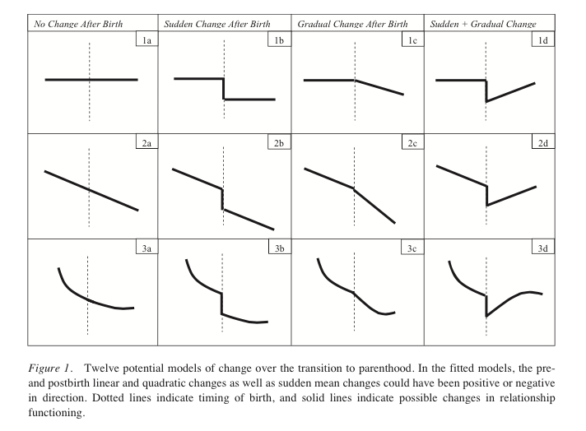
Theoretical Models
1a: No change in construct either before, immediately following, or after the birth of the baby
2a: Linear changes in the construct both before and after birth
3a: Initial steep decreases in the construct with a gradual slowing of those decreases; however, this slowing is not attributable to birth
Notes:
THEORETICAL MODELS: 12 potential models were fit to each individual's data (Figure 1) to identify the best fitting model for six constructs: marital satisfaction, negative observed communication, poor conflict management, problem intensity, relationship confidence and dedication. These models based on model suggesting that postbirth change could occur gradually or suddenly and be maintained or not over time.
First 3 models tested, if identified as the best fitting model, would indicate no effect of the transition to parenthood because there were no changes at or after birth that could be attributed to the birth of the child.
The remaining nine models expand on the three base models and indicate a potential effect of the transition to parenthood on the construct.
Models 1b, 2b, and 3b indicate a sudden vertical shift (either increase or decrease) in the construct in the year following the birth of the baby.
Models 1c, 2c, and 3c indicate a more gradual shift (either increase or decrease) in the construct over several years following birth that differs from the rate of change in that construct before birth
Finally, Models 1d, 2d, and 3d combine Models b and c to include both a sudden vertical shift in the year after birth as well as more gradual changes in the construct in the following years.

Slide 46
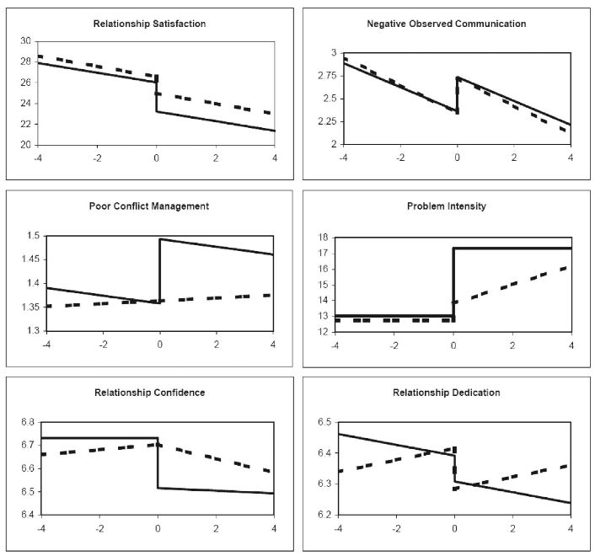
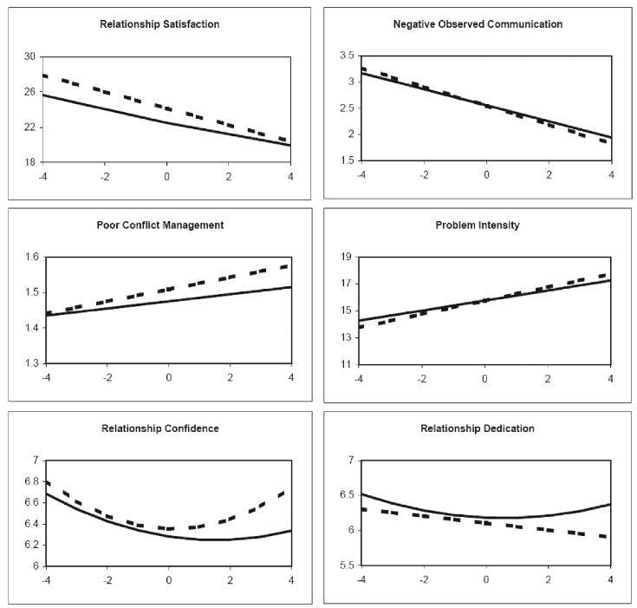
Results: Change Patterns
Parents: dotted = fathers, solid = mothers
Nonparents: dotted = males, solid = females
Parents
Nonparents
dotted = males, solid = females
Notes:
Parents: dotted = fathers, solid = mothers
Nonparents: dotted = males, solid = females

Slide 47
Results
Is there evidence of change in relationship functioning following the birth of the baby that is distinct from any change that was occurring before birth?
YES, the majority of the relationship constructs examined in the study demonstrated patterns of change consistent with an immediate or delayed impact of the transition to parenthood.
What types of changes (e.g., sudden or gradual) occur?
All relationship constructs that demonstrated effects of the transition to parenthood showed significant and sudden worsening of the relationship in either mothers or fathers.

Slide 48
Variability in individuals’ reactions to transition to parenthood?
YES, In addition to mean changes in relationship functioning after birth, there was also significant between-individual variability in many of the variables examined.
For mothers and fathers, sudden changes in marital satisfaction, problem intensity, and relationship dedication varied significantly between individuals.
Mothers’ sudden changes in poor conflict management and relationship confidence showed significant between-individual variability.

Slide 49
Results
Q4: What predicts variability in changes in relationship functioning seen after the birth of the baby?
Enduring vulnerabilities
History of parental divorce or conflict → larger decreases in marital satisfaction [mothers]
Living together before marriage → greater observed negative communication [mothers and fathers]
*Not predictive: ethnicity, level of religiosity
Nature of stressful event
Female children → larger decreases in marital satisfaction [mothers] and larger increases in problem intensity [fathers]
Having a child quickly after marriage → greater decreases in marital satisfaction [fathers]
Lower income (but not more financial stress) at birth → larger decreases in marital satisfaction [fathers]
* Not predictive: planned or unplanned pregnancy, financial stress before birth

Slide 50
Results
Relationship adaptive processes
Higher marital satisfaction at birth → larger decreases in marital satisfaction after birth [mothers and fathers]
Higher relationship confidence at birth → smaller decreases in marital satisfaction after birth [fathers]
Higher relationship confidence at birth and/or higher reported poor conflict management at birth → larger increases in problem intensity after birth [mothers and fathers]
Higher relationship confidence at birth and/or higher observed negative communication at birth → larger increases in poor conflict management after birth [mothers]
Q5: Are similar changes in relationship functioning found in nonparents?
Nonparents showed no sudden changes
Gradual deterioration in marital satisfaction; Men reported sig decreases in relationship dedication over time
Negative observed communication sig improved over time

Slide 51
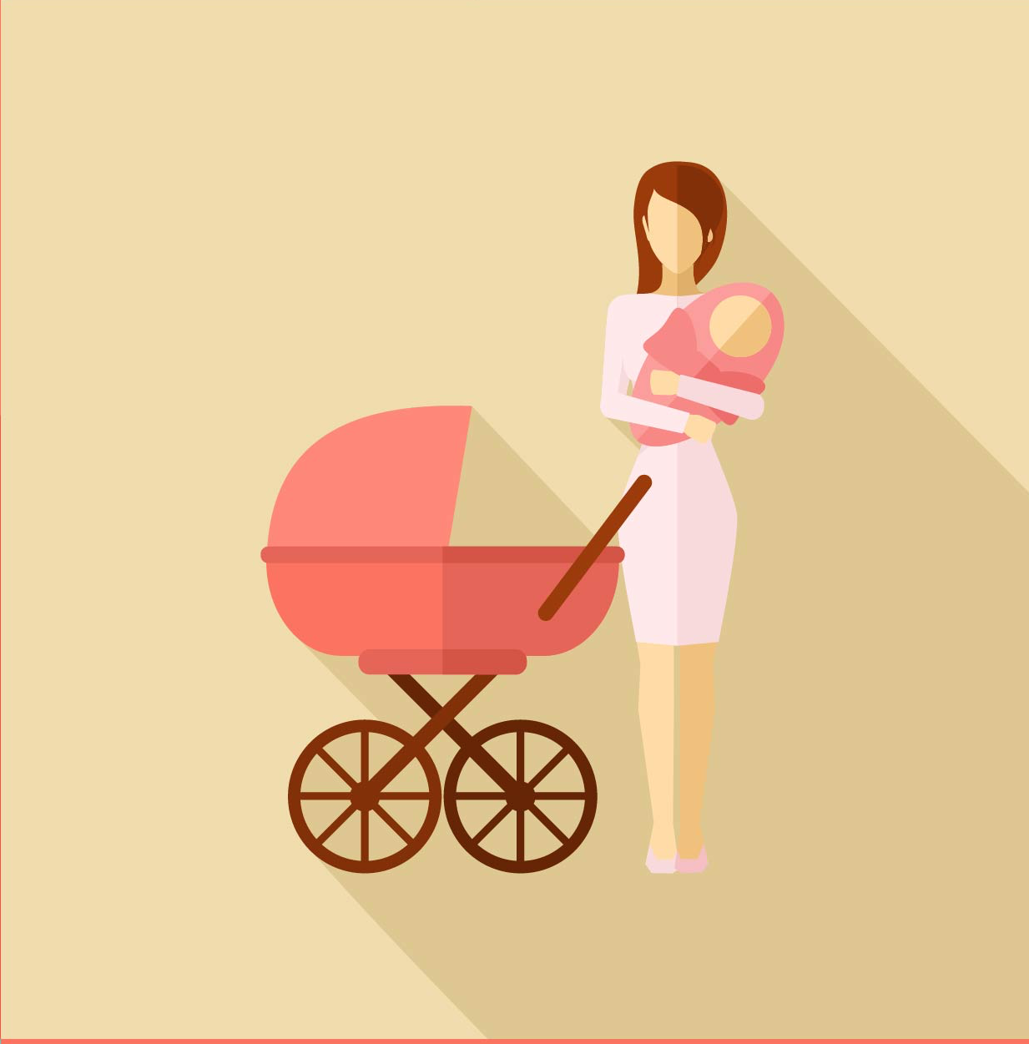
Conclusions
Parents and nonparents generally show similar amounts of decline in overall relationship functioning over the first 8 years of marriage but these changes tend to occur suddenly following the birth of the baby for parents and more gradually over time for nonparents.
Parents showed clear increases in negativity, conflict, and problem intensity following the birth of a child, whereas nonparents did not show such changes at the same point in time, nor did they show such declines over time more generally.

Slide 52
The Transition to Parenthood
A much anticipated event in many relationships but also considered a developmental challenge
Decreased marital satisfaction
Increased negative affect between spouses
Changes in relationships with friends, co-workers
Emotional extremes
Sleep deprivation
Financial stresses
Renegotiating housework/chores
Identity changes
Notes:
Universally challenging (Caucasian/African American), Asia, Europe; Lesbian couple with conception via AI, decreases in love and increases in relationship conflict after birth of baby

Slide 53
The Transition to Parenthood
Challenges in identifying causal effects of parenthood on functioning?
Cross-sectional designs
Comparing parents vs. nonparents
Longitudinal studies beginning in pregnancy
Benefits of interrupted time-series (ITS) design

Slide 54
The Transition to Parenthood
Quite a bit of variability in experience
Some may experience stable or increased marital functioning
Vulnerability-stress-adaptation model (VSA)
Enduring vulnerability = family of origin, education, cohabitation history
Stress = pregnancy timing, gender of baby
Adaptive Processes = communication, commitment

Slide 55
The Transition to Parenthood
Primary DVs:
Marital Satisfaction
Observed negative communication
Relationship Confidence
Relationship Dedication
Poor conflict management
Problem intensity

Slide 56
The Transition to Parenthood
Predictors of change:
Family of origin factors: divorce, parental conflict
Premarital cohabitation history
Child gender
Timing relative to date of marriage
Planned/unplanned pregnancy
Financial stress

Slide 57
Change patterns: Parents
Dotted father; solid mother
Notes:
All DVs showed significant change for mothers; 5/6 changed for fathers (no change in conflict management for fathers)
BOTH mom and dad showed significant and sudden worsening on martial satisfaction, observed negative communication
Mothers also showed significant/sudden worsening on poor conflict management, problem intensity, relationship confidence
Fathers decrease relationship dedication
Fathers show gradual decrease in relationship confidence; gradual increase in problem intensity
Mothers more than fathers sudden increase in problem intensity and poor conflict management

Slide 58
The Transition to Parenthood
Predictors of change:
High negative communication
Difficulties in mothers’ family of origin
Shorter duration of marriage at birth
Giving birth to a girl
Many instances where better pre-birth functioning predicted more severe negative change
e.g., better marital satisfaction

Slide 59
Danzi

Slide 60
Are parents happier?
Study 1. Large, nationally representative survey to assess if parents are happier overall than nonparents
World Values Survey (n = 6,906; ages 17 – 96)
Single-item measures of happiness, life satisfaction, and thinking about meaning in life
Study 2. Experience-sampling to assess if parents feel better moment-to-moment than nonparents
329 adults (ages 18 – 94)
Participants randomly paged 5 times per day over 7 days to complete brief questionnaire
Rated how much they were feeling 19 emotions on 7-point scale and asked how meaningful the moment was
Study 3. Within-subjects study to assess how positive feelings derived from parenting compares to other daily activities
Danzi

Slide 61
Study 1: Are parents happier overall?
Parents reported higher levels of life satisfaction, happiness, and meaning in life than nonparents
Having more children was correlated with life satisfaction and meaning in life (but not happiness)
Danzi
Potential factors that could affect these relationships?

Slide 62
Study 1: Are parents happier overall?
Parent gender as a moderator
Parenthood associated with increased life satisfaction and happiness only for fathers
Marital status as a moderator
Married parents did not differ in satisfaction or happiness from married nonparents
Unmarried parents reported less satisfaction and happiness than nonparents
Parent age as a moderator
Young parents (ages 17 – 25) had less life satisfaction than young nonparents
Mid-age parents (ages 26 – 62) had more life satisfaction than mid-age nonparents
Older parents did not differ from older nonparents in life satisfaction
No moderating effects for happiness or meaning in life
Danzi

Slide 63
Study 2: Are parents happier moment-to-moment?
Parents reported more happiness, more positive emotion, more meaning in life, and less depressive symptoms than nonparents
Parent’s gender, age, race, and SES did not moderate relationship for any variables
Danzi

Slide 64
Study 2: Are parents happier moment-to-moment?
Fathers scored better than childless men on all variables
Mothers had fewer depressive symptoms than childless women
Other variables were not significantly different (trend for positive emotion)
Danzi

Slide 65
Study 3: Happiness while parenting compared to other daily activities?
Parents reported more positive emotions and more meaning when taking care of children than when not
Not moderated by gender
Intended to address selection effects (e.g., people who become parents might be different from people who don’t)
Within-subjects design
186 parents (76% women; 24% men)
Day reconstruction method – described previous day, episode by episode, and rated emotions and meaningfulness for each episode
Calculated two positive emotion/meaningfulness scores – one score for episodes involving childcare and one for other activities
Danzi

Slide 66
Parental (father-favoring) conclusions
Overall, parents are happier, more satisfied, and thinking about meaning in life more than nonparents
For fathers and mid-age parents—not for mothers, young or single parents
Young parents and single parents less happy than nonparents
No difference between mothers and childless women
Parents had more positive emotions and meaningfulness from moment-to-moment
Fathers had more positive scores than childless men
Mothers only showed less depression than childless women
Parents reported more positive emotions and more meaningfulness during childcare than other daily activities
Danzi

Slide 67
Discussion
So are parents happier? How do these findings compare to findings from other studies?
Does Study 3 address the issue of directionality? Does parenting cause happiness, or could happier people be more likely to become parents?
Male vs. Female difference…
Danzi

