Slide 1
Aggression and Risk-Taking
Daniel Messinger, PhD

Slide 2
Overview
Temperament and social inhibition
Gene*environment interaction & self-regulation
More on aggression
Risk-taking
Presence of peers
Presence of adult

Slide 4
Background
Behavioral Inhibition (BI)
Temperament assessed in toddler period
Wariness of novelty/uncertainty (i.e., novel contexts, objects, unfamiliar adults)
Social Reticence (SR)
Onlooking, unoccupied behavior in presence of unfamiliar peers
Do not engage in social or solitary play
BI has been linked to child and adolescent SR and social anxiety but ..
not all end up experiencing such outcomes
Less than 1/3 of sample displayed both behavior patterns at 2 years
Many patterns that do exist do not hold from ages 2-4 years
BI and social reticence also linked to anxiety disorders in later childhood
AIM
Examine differential trajectories from BI (temperament) to behavioral consequences (SR and psychopathology)

Slide 5
Method
Participants:
longitudinal research participants
315 total in sample (199 complete data)
selected for temperamental reactivity to novelty at 4 months, both high and low reactive, and both positively and negatively reactive
Assessment
Behavioral Inhibition (24 & 36 months)-
assessed behavior and affect using BI paradigm (stranger, robot, and tunnel tasks)
composite BI measure created for toddlerhood (average score)
Social Reticence (24, 36, 48, & 60 months)-
interacted in laboratory with unfamiliar peer (free play, cleanup, and social problem solving tasks)
composite SR measure created based on social wariness from free play, proportion of time unoccupied on looking from cleanup, and proportion of passive problem-solving techniques used (average score)
Behavioral Outcomes (Psychopathology at 60-months or 5 years)-
mothers report behavior problems (symptom measures)- CBCL, HBQ
externalizing and internalizing composite scores created from subscales of measures

Slide 6
Analytic Plan
Used growth mixture modeling (SEM) to examine longitudinal trajectories of social reticence across early childhood:
Latent growth trajectories estimated using SR measures at 4 time points
BI then estimated as predictor of probability of membership to latent growth trajectory
Symptom-based psychopathology measures estimated within each growth trajectory and most probable trajectory membership analyzed secondarily using ANOVA

Slide 7
Trajectories of Social Reticence
3 Class Model of Social Reticence Trajectories
High-Stable (n=43, 16% of sample): High level of social reticence at 2 years, with consistently higher levels and small increase over time
High-Decreasing (n=112, 43% of sample): High level of SR at 2 years, with significant decrease over time
Low-Increasing (n=107, 41% of sample): Lower level of SR at 2 years, with significant increase but still consistently low SR over time

Slide 8
BI →Probability of SR Trajectory
High-Stable/High-Decreasing SR > BI than Low-increasing SR trajectory
BI did not
As BI increases, odds of following High-Stable or High-Decreasing SR trajectories higher, but odds of Low-Increasing SR trajectory are lower
BI did not differentiate between High-Stable and High-Decreasing

Slide 9
SR Trajectory Predicts Symptoms of Psychopathology
Trajectories significantly different for internalizing and externalizing problems:
High-Stable SR trajectory predicted greatest internalizing problems
Low-Increasing SR trajectory predicted greatest externalizing problems
High-Decreasing SR trajectory predicted least problems
** But all very much subclinical

Slide 10
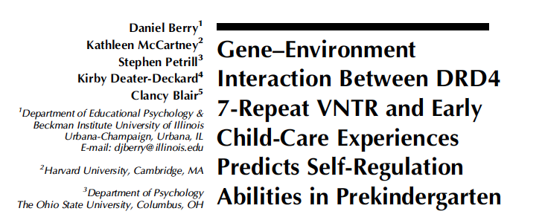

Slide 11
Self-Regulation Background
“Volitional act of managing attention and arousal in a manner that facilitates goal-directed behavior”
Rapidly developing in childhood
Involves managing, modulating, inhibiting, and enhancing attention behavior and emotions
Related to social and academic success
Needed for successful transition into kindergarten
High quality child care may facilitate children’s SR skills
Notes:
-self-regulation which they use a broad definition in that it’s the volitional act of managing attention and arousal in a manner that facilitates goal-directed behavior
There is good evidence that high-quality and center-based child care support children’s academic skills. And we know that self-regulation is rapidly developing in early childhood and plays an important role in children’s transition to kindergarten and more formal schooling.

Slide 12
Self-Regulation
Mixed evidence linking increased exposure of child care to development of behavior problems -> low levels of self-regulation
Genetic and experiential differences may cause children to differentially respond to their experiences (differential susceptibility)
DRD4 7+ allele may moderate the effects of children’s experiences on developmental outcomes thought to reflect SR skills
Notes:
research linking child care exposure and the development of behavioral problems, which might reflect poor self-regulation skills, is mixed.
some researchers have indicated that these mixed findings might be explained by individual differences in the how children respond to their child care experiences so getting back to this idea of differential susceptibility.
There is also some evidence to suggest a gene by environment interaction involving a variant of the dopamine receptor D4 which is called the DRD4. Some research has shown that this variant called the DRD4 7-repeat variant may moderate the effects of children’s experiences on developmental outcomes that are thought to reflect self-regulation skills

Slide 13
Study Aims
Test the degree to which children’s early childcare experiences (quality, quantity, & type) predict SR skills in prekindergarten
Test the degree to which these relations are conditional on genotype (DRD4 7+)
Notes:
So in this study they had 2 aims. The first aim was to test the degree to which children’s early child care experiences (quality, quantity, & type) predict SR skills in preK. And the second was to test the degree to which of these relations are conditional on genotype so specifically looking at children with a copy of the DRD4 7 repeat allele.

Slide 14
Measures
Self-Regulation:
Continuous Performance Task – computer based task where children press a key if the stimulus is presented on the screen
More errors is associated with lower academic achievement and higher levels of aggression & inattention
Higher errors = higher inattention
Day-Night Stroop – card task where children say “day” if they see a picture of the moon and “night” if presented with a picture of the sun
Higher scores indicate more inhibitory control
Delay of Gratification – children asked to wait 7 minutes to receive a larger prize
Waiting 7 min reflects more “desire based” inhibitory control
Latent measure of inattention – made up of teacher report forms and observational measures
Notes:
Used data the National institute of child health and development study of early child care and youth development (NICHD SECCYD), included 1,364 children , but only 711 children got genetic testing done.
In terms of measures, they had a lot.
For self-regulation, they had 4 different measures. The first was the continuous performance task, which is a computer based task where children pressed a key if the stimulus is presented on the screen and to not press the key when a nontarget stimuli was presented on the screen. Those with more errors have higher inattention
The next self-regulation measure is the day-night stroop task, which is a card task where children say day if they see a picture of the moon and night if they see a picture of the sun. Higher scores here indicate better inhibitory control
They also did a delay of gratification task where they presented children with two plates- one with a small amount of a treat and one with a large amount of the same treat and were asked to wait for 7 minutes and if they did they would receive the larger treat.
Lastly they measured more broad scale inattentive and impulsive classroom behavior by creating a latent across multiple measures and raters so both teacher report and observational measures.

Slide 15
Measures cont.
Quantity of childcare - averaged hours in non-maternal care per week
Collected every 3/4 months until 54 months
Quality of childcare – caregiver-child interactions at 6, 15, 24, 36, and 54 months
Rated on various likert scales at different intervals
Type of childcare – center-based care children spent more than 50% of time in non-maternal care
Notes:
They also looked at the quantity, quality and type of child care.
SO for quantity, they looked at maternal reports of weekly average hours of nonmaternal care
Quality of nonmaternal care was measured in the context of caregiver-child interactions using the observational ratings of the caregiving environment scale

Slide 16
Measures cont.
Genotype – DNA collected at 15 years old
DRD4 7+ was coded if homozygous or heterozygous for the 7-repeat allele versus those without a copy of the allele

Slide 17
Childcare, Inhibitory Control & Inattention: DNS
DRD4 7+ children who spent fewer hours in nonmaternal care showed more effective performance on the DNS task than DRD4 7+ children who spent more hours in childcare
The beneficial effect was present for DRD4 7+ children in few hours of childcare but was not a risk factor for children with high number of hours in childcare

Slide 18
Childcare, Inhibitory Control & Inattention: DOG
DRD4 7+ children in few hours of childcare had better inhibitory control in DOG task
Difference was only present for children attending few hours of childcare

Slide 19
Continuous Performance Task Results
Inhibitory control – higher quality care was associated with fewer commission errors on the CPT
Attention – DRD4 7+ allele is associated with more effective attention when children spend fewer hours in childcare
Notes:
Commission errors are pushing button in response to non-stimulus picture

Slide 20
Inattention & Impulsivity Results
DRD4 7+ allele is associated with lower levels of inattention/impulsivity if children experience few hours of childcare
Descriptively, DRD4 7+ allele is associated with higher levels of inattention/impulsivity if children experience high number of hours in childcare

Slide 21
Questions?
Thoughts on finding a weak link between the quality of children’s child care experiences and the development of their SR skills?
What are practical implications of their finding that DRD4 7+ children with less exposure to child care showed more effective SR skills?

Slide 22
Human aggression
Types
Reactive and proactive aggression
Overt and covert anti-social behavior

Slide 23
Processes
Under-socialized aggressive conduct disorder associated with weak inhibition system (BIS)
Impulsivity a key (Quay)
Information Processing
Real-time processes
Somebody bumps into you at a party

Slide 24
Stability of aggression
The earlier a person start, the more intense the form of aggression and the longer it lasts
Stability of aggression can be as high as .76
Remarkably stable over up to 10 years
The aggressive remain so
One of the more stable psychological characteristics

Slide 25
Behavior genetics
One inherits a propensity toward anti-sociality which interacts with an environment in its (non)emergence
Genetic effects greater for self-reported than adjudicated measures of aggression
Environmental, genetic, and interactive effects evident in petty crime (p. 806)

Slide 26
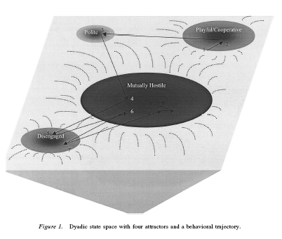
Real-time coercion
A parent–child dyad with two main interaction patterns:
A cooperative, mutually positive pattern and a hostile–withdrawn pattern in which the parent berates the child and the child ignores the parent.
As mutual positivity declines in early adolescence, existing habits of withdrawal will constrain the interactions that emerge next.
A repertoire of distance and disengagement may characterize the adolescent period, leading eventually to complete estrangement and alienation in adulthood.
(Granic & Patterson, 2006).

Slide 27
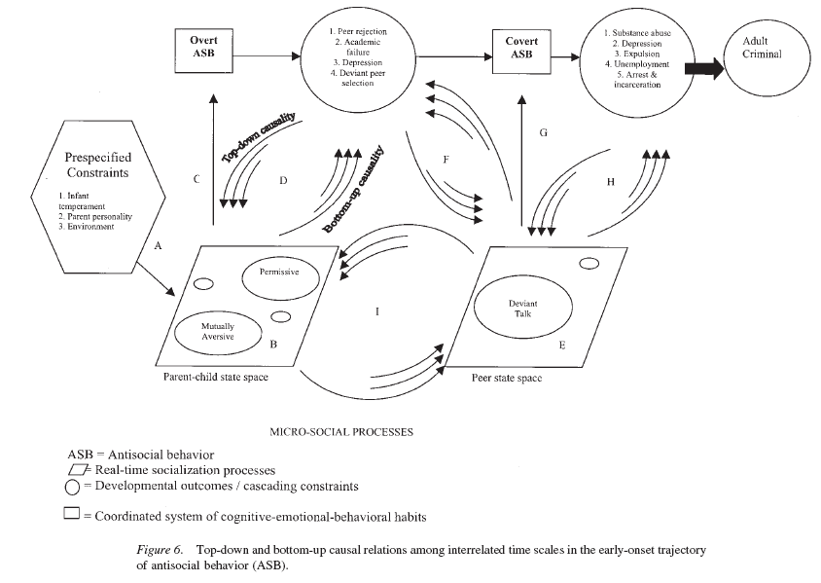
Granic & Patterson, 2006

Slide 28
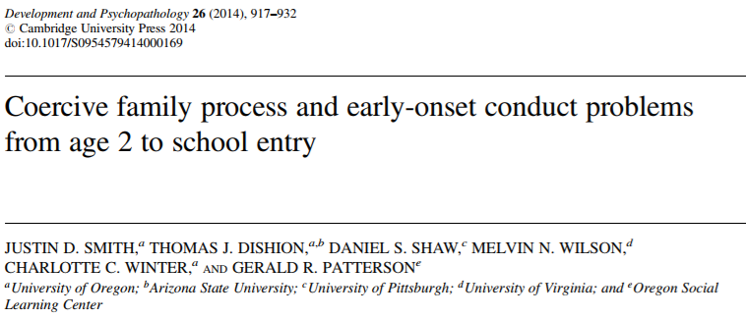
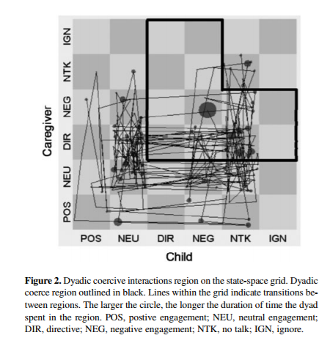

Slide 29
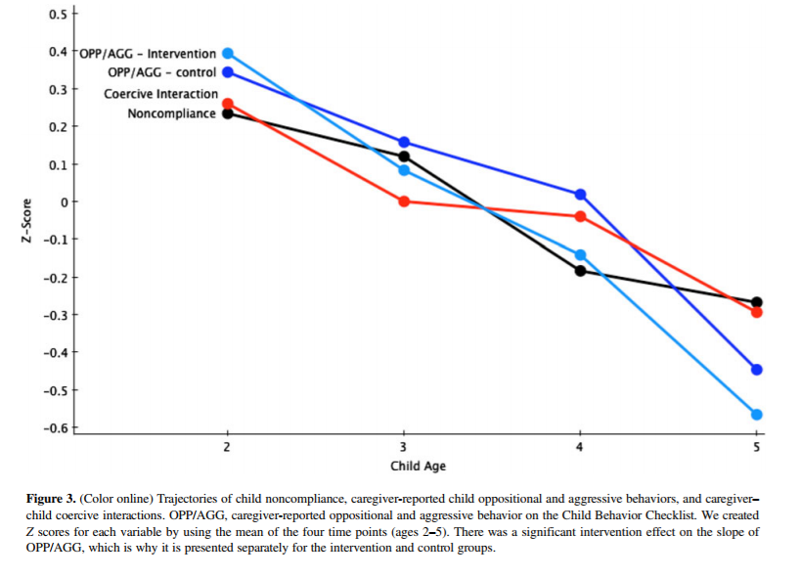
Age-related decreases

Slide 30
Model

Slide 31
Coercion→noncompliance
A parallel process growth model combining latent trajectory and cross-lagged approaches revealed the amplifying effect of observed coercive caregiver–child interactions on children's noncompliance, whereas child oppositional and aggressive behaviors did not consistently predict increased coercion. The slope and initial levels of child oppositional and aggressive behaviors and the stability of caregiver–child coercion were predictive of teacher-reported oppositional behavior at school age. Families assigned to the Family Check-Up condition had significantly steeper declines in child oppositional and aggressive behavior and moderate reductions in oppositional behavior in school and in coercion at age 3. Results were not moderated by child gender, race/ethnicity, or assignment to the intervention condition.
A parallel process growth model … revealed the amplifying effect of observed coercive caregiver–child interactions on children's noncompliance
But child oppositional and aggressive behaviors did not consistently predict increased coercion.
The slope and intercept of child oppositional and aggressive behaviors and the stability of caregiver–child coercion were predictive of teacher-reported oppositional behavior at school age.
Families assigned to the Family Check-Up condition had significantly steeper declines in child oppositional and aggressive behavior and moderate reductions in oppositional behavior in school and in coercion at age 3.
Results were not moderated by child gender, race/ethnicity, or assignment to the intervention condition.

Slide 32
Relational aggression
“Attempts to harm the victim through the manipulation of relationships, threat of damage to them, or both” (Crick et al, ’02 p.98)
Associated with internalizing/externalizing problems and later peer rejection
Preschool
Direct, face-to face behaviors
Exclusion from party
Middle Childhood
More sophisticated, direct and indirect behaviors
Direct: refuse to choose as a team member
Adolescence
Sophisticated and focused on opposite-sex relationships
Indirect: spread a rumor
Stealing a boyfriend

Slide 33
Provocation → aggression
Physically aggressive children exhibited hostile attributional biases and reported relatively greater distress for instrumental provocation situations
Getting pushed into the mud
Relationally aggressive children exhibited hostile attributional biases and reported relatively greater distress for relational provocation contexts
Not getting invited to a birthday party.
662 third- to sixth-grade children
Crick et al., 2002. CD.

Slide 35
Background
Aggression- behavior intended to hurt, harm, or injure another person
Forms:
Physical
Relational
Functions:
Proactive
Reactive
Most measures confound function and form

Slide 36
Purpose of Study
Goal 1: Test developed measurement and analysis system in early childhood
Goal 2: Examine stability of aggression subtypes
Goal 3: Examine whether risk factors for aggression predicted subtypes and increases of subtypes over time

Slide 37
Hypotheses
1: young children will show four distinct forms and functions
Associations between forms and functions would be higher in early childhood than older samples
2: Forms stable but functions unstable over time
Hypothesis 3:
Girls → Relational; Boys → Physical
Older → Relational and Proactive
Social Dominance → Physical, Relational, and Proactive
Peer Exclusion → Relational and Reactive

Slide 38
Methods
Participants (N=101)
61 Girls
45.09 months (3.75 years)
Middle-Class families
Longitudinal design
2 time points
4-5 months apart

Slide 39
Measures
Observer Ratings
Teacher report
Observations of Aggression
Ratings of Aggression
Preschool Social Behavior Scale- Observer Form
Ratings of Form and Function of Aggression
Preschool Proactive and Reactive Aggression- Observer Report
Report of Exclusion
Child Behavior Scale
Report of Social Dominance and Resource Control

Slide 40
Forms and Functions of Aggressive Behavior (Murray-Close & Ostrov, 2009)
Measures (T1 & T2)
Observations of aggression
Problem?
Observer ratings of aggression
Teacher reports
Exclusion
Social Dominance
Notes:
Hypothesize more overlap in early childhood (principle of increasing differentiation with development)
Hypothesize less stability of functions than forms; expect stability in physical aggression, though
Predictors = gender, age, social dominance, experienced exclusion

Slide 41
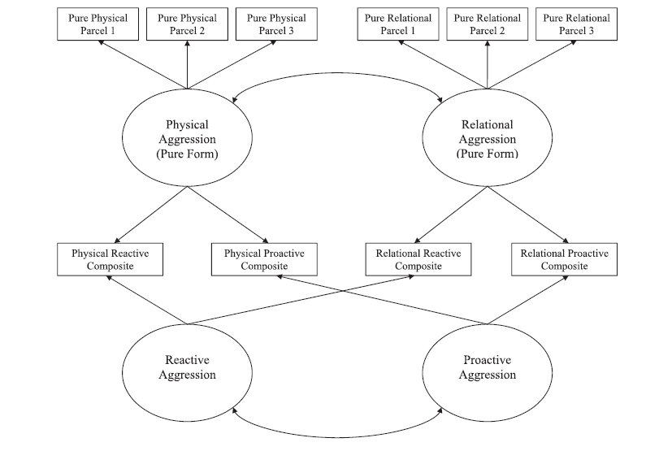
Forms and Functions of Aggressive Behavior (Murray-Close & Ostrov, 2009)
Notes:
Moderate association between physical and relational aggression
Proactive and reactive were positively associated
Overall structure supports relatively distinct forms and functions of aggression
Same structure at T1 and T2

Slide 42
Forms and Functions of Aggressive Behavior (Murray-Close & Ostrov, 2009)
Physical aggression
Less related to relational vs. older kids
Decreases with age
Forms – stable but functions – not stable
Lack of gender differences in physical
Fewer age-related changes than expected
Notes:
Longitudinal analyses control for initial levels
Therefore interpreted as change
Concurrent
Girls more relationally aggressive at T1; but boys not more physically aggressive
Older children less likely to use physical aggression
Social dominance predicted relational aggression; but not physical aggression; not proactive aggression
Exclusion associated with proactive aggression
Longitudinal Analyses
Social dominance predicted decreases in physical aggression
Exclusion predicted increases in relational

Slide 43
4 latent aggression factors: Physical, relational, proactive, & reactive
Physical, relational; proactive, and reactive
Proactive and reactive positively correlated
Physical and relational moderately associated
Forms stable but functions unstable over time
Proactive associated with increase in physical
Notes:
Relational marginally associated with decrease in physical and increase in proactive

Slide 44
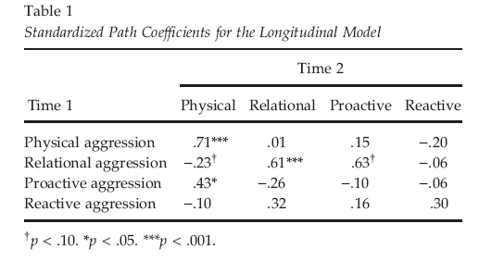
Stability over 1 year
Notes:
Both forms of aggression (physical/relational) stable over time
BUT functions (proactive/reactive) were not: WHY?

Slide 45
Predictors

Slide 46
Conclusion
Distinct forms and functions of aggression emerged by early childhood
Child-level risk factors that are associated with aggression
Intervention work may benefit from tailoring programs based on forms and functions of aggression and considering these child-level risk factors

Slide 47
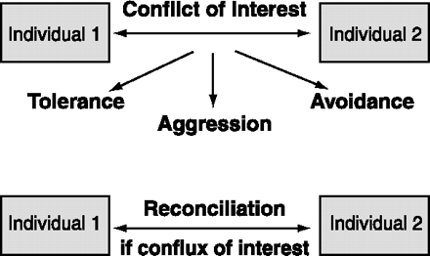
Aggression in a larger context: Relational model
Other possible ways are tolerance (e.g., sharing of resources), or avoidance of confrontation (e.g., by subordinates to dominants).

Slide 48
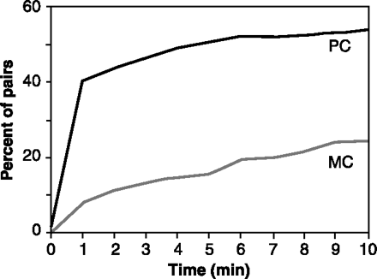
Most primates show a dramatic increase in body contact between former opponents during post conflict (PC) as compared with matched-control (MC) observations
The cumulative percentage of opponent-pairs seeking friendly contact during a 10-min time window after 670 spontaneous aggressive incidents in a zoo group of stumptail macaques

Slide 49
Reconciliations allow rhesus monkeys to maintain tight kinship bonds despite frequent intrafamilial squabbles.
Shortly after two adult sisters bit each other, they reunite sitting on the left and right of their mother, the alpha female of the troop, each female holding her own infant. The sisters smack their lips while the matriarch loudly grunts.

Slide 50
Reconciliation
The nature of the social relationship determines whether repair attempts will be made, or not.
If there is a strong mutual interest in maintenance of the relationship, reconciliation is most likely.
Parties negotiate the terms of their relationship by going through cycles of conflict and reconciliation.

Slide 51
Hypotheses
This increase in risk taking is due to the contribution of two brain systems:
The ventral striatum, nucleus accumbens, and the orbitofrontal cortex: an incentive processing system
The lateral prefrontal cortex: a cognitive control system
During adolescence, changes to the incentive processing system results in heightened sensitivity to rewards while the cognitive control systems are gradually maturing
Peer presence may heighten the activation of reward valuation
Notes:
System 1: biases decision-making based on the valuation and prediction of potential rewards and punishments
System 2: supports goal-directed decision making by keeping impulses in check and by providing the mental machinery needed for deliberation regarding alternative choices
Risky decisions are seen as increased engagement of incentive processing and decreased engagement of cognitive control activity due to an immature capacity to down-regulate reward system outputs through control signaling, which biases adolescents toward risk taking

Slide 52
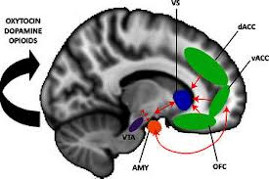
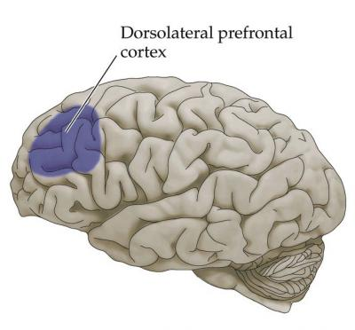

Slide 53
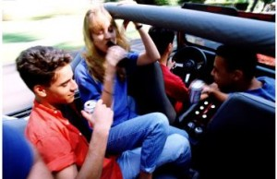

Slide 54
Background
Teenagers engage in more risky behaviors than adults
More likely to binge drink, smoke cigarettes, have casual sex, be involved in a fatal or serious car crash
Adolescents take a substantially greater number of risks when driving when observed by peers
Risk-taking related to brain systems:
Incentive processing system
Cognitive control system

Slide 55
Background
Incentive processing system
The ventral striatum, orbitofrontal cortex, and others
Decision making = valuation and predication of rewards/punishments
Under re-organization during adolescence = heightened sensitivity to reward
Cognitive control system
The lateral prefrontal cortex
Decision making = goal-directed, keeping impulses in check
Gradual and protracted development until early 20’s
Adolescence = heightened sensitivity to reward and under-developed impulse control
Notes:
System 1: biases decision-making based on the valuation and prediction of potential rewards and punishments
System 2: supports goal-directed decision making by keeping impulses in check and by providing the mental machinery needed for deliberation regarding alternative choices
Risky decisions are seen as increased engagement of incentive processing and decreased engagement of cognitive control activity due to an immature capacity to down-regulate reward system outputs through control signaling, which biases adolescents toward risk taking

Slide 56
Hypotheses
Maturational imbalance between competing brain systems:
During adolescence, changes to the incentive processing system results in heightened sensitivity to rewards while the cognitive control systems are gradually maturing
During a simulated driving game, teenager risky behavior will be related to:
Heightened activation of brain regions associated with reward valuation, OR
Altered activity within regions associated with impulse regulation
Peer vs. alone conditions
Adolescents vs. young adults vs. adults

Slide 57
Participants
 | n | Female | Age
Adolescents | 14 | 8 | 14-18 (M=15.7, SD=1.5)
Young Adults | 14 | 7 | 19-22 (M=20.6, SD=0.9)
Adults | 12 | 6 | 24-29 (M=25.6, SD=1.9)
TOTAL | 40

Slide 58
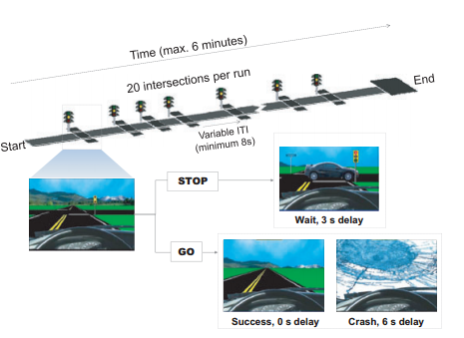
The Stoplight driving game
As the vehicle approaches intersection, light turns yellow
Chance crash or break and wait
Risk-taking = not breaking for yellow light
Notes:
While in the scanner…
The Stoplight task (Figure 1) is a simple driving task in which subjects control the progression of a vehicle along a straight track, from a driver’s point of view.
Subjects completed four rounds of the task; two in the first social condition and two in the second social condition.
Each round used a track with 20 intersections (treated as separate trials), which took under 6 minutes to traverse (dependent on subjects’ choices and providence).
At each intersection subjects rendered a decision (by button press) about whether or not to brake as the vehicle approached a changing traffic signal (which cycled from green to yellow to red).
As the vehicle approached the intersection, the traffic signal turned yellow, and the subject decided whether to chance a possible crash in the intersection (GO decision), or to brake and wait for the light to return to green (STOP
Both the timing of the traffic signals and the probability of a crash in the associated intersections were varied so as to be unpredictable by the participant
Risk taking was encouraged by offering monetary incentives for completing the course in a timely fashion
Barratt: individual differences in impulsivity
Zuckerman: sensation seeking
RPI: resistance to peer influence

Slide 59
Methods
Manipulation of social context (peer vs. alone conditions)
All participants brought two same-age, same-sex, friends
Change of social context = “Surprise manipulation”
Self-report questionnaires:
Complete after fMRI session
Barratt Impulsiveness Scale
Zuckerman Sensation Seeking Scale
Resistance to Peer Influence (RPI) Scale

Slide 60
Behavioral results
While in the ‘Alone’ condition, self-reported…
Sensation seeking predicted greater risky driving behavior
Impulsivity did not predict risky driving behavior
Notes:
Adolescents and adults behaved comparably alone, but adolescent performance was sensitive to social context – did not reach statistical significance (they attribute to sample size)
Behavior was significantly predicted by sensation seeking, but not impulsivity
- Driven more by incentive processing system?

Slide 61
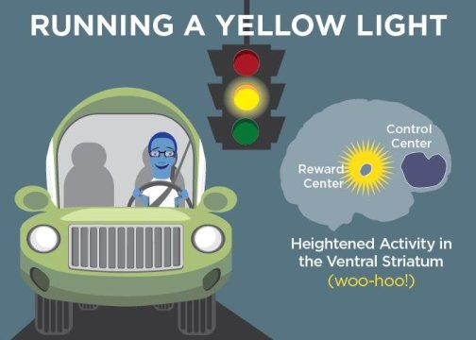
fMRI Results
Notes:
lateral prefrontal cortex activation in older group > strategic decision making
ventral striatum, orbitofrontal cortex, activation

Slide 62
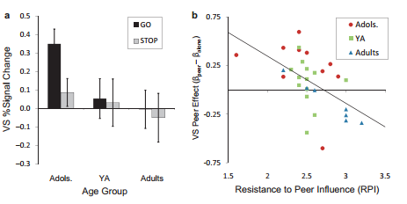
Self-reported resistance to peer influence correlated with neural peer effect
Notes:
Sensation seeking and impulsivity not predicted by fMRI data; but self-reported resistance to peer influence correlated with individual variation in the neural peer effect (Peer vs. Alone) (bigger difference between conditions associated with less resistance)
What if RPI was replaced with LPFC activity?
we treated the obtained
LPFC, VS, and OFC clusters as regions-of-interest
(ROI) and compared activity in these regions during GO
versus STOP trials (collapsing across social context).
Among adolescent subjects, greater activity in both the
VS (Figure 4a) and OFC was associated with risky
decision-making, as indicated by significantly increased
activity in these regions for GO relative to STOP trials.
No decision-dependent differences were found in these
regions for older age groups, and activity in the LPFC
was statistically equivalent for GO and STOP trials
regardless of age (additional detailing of activation in the
VS, OFC, and LPFC clusters is provided with the online
Supporting Information).

Slide 63
Only adolescents took more risks when being observed by peers
Adolescents, but not adults, had greater VS and OFC (reward system) activation in the peer condition vs. alone
Adults don’t perceive task as rewarding?
Adults don’t perceive presence of peers as rewarding?
Better able to recruit the LPFC to suppress reward system outputs
^ LPFC = greater reliance on deliberative strategies with decision making
Adults, but not adolescents, engaged multiple LPFC sites more robustly than adolescents
Not dependent on social context (i.e., presence of peers)
Adults showed no differences in the activation of these brain regions as function of social context
Notes:
“adolescents’ heightened susceptibility to peer influence is due more to the impact of peers on incentive processing than on cognitive control. Evidence that VS and OFC activation tracked with the
riskiness of subsequent decision-making (GO vs. STOP) in the driving task further suggests that the reward sensitization effect of peer presence translates into an observable increase in risky behavior.”

Slide 64
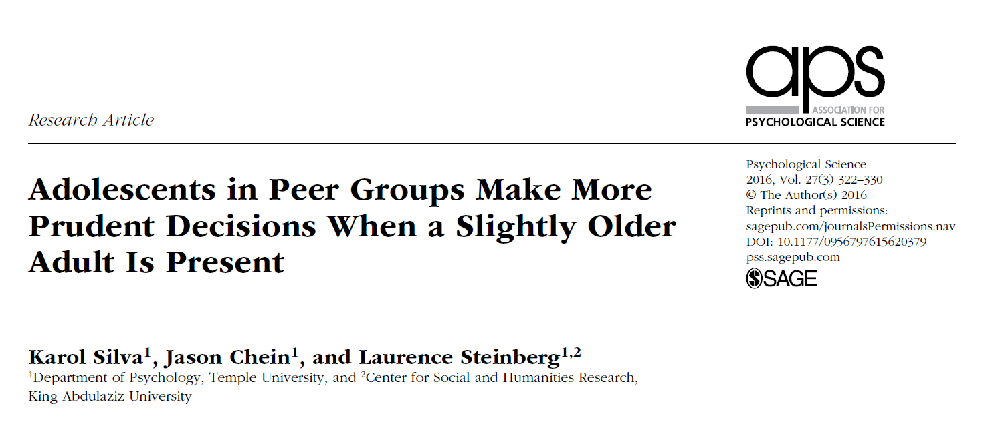
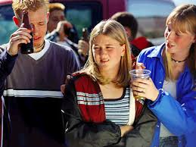
Borenstein

Slide 65
Background
Presence of peers increases risk tasking among youth
Real or illusory
Effects not observed in adults
Prior research focused on link between parental monitoring and teen misbehavior
Do non-familial adults affect risky decision making within groups?
Borenstein

Slide 66
Background
Impact of peers on adolescents’ risk taking is often unconscious
Peers heighten adolescents’ sensitivity to potential rewards
Especially true for immediately available rewards
Temporal discounting of rewards steeper when observed by peers
Could these mechanisms account for the moderating effect of adult’s presence on risky decision making?
Borenstein

Slide 67
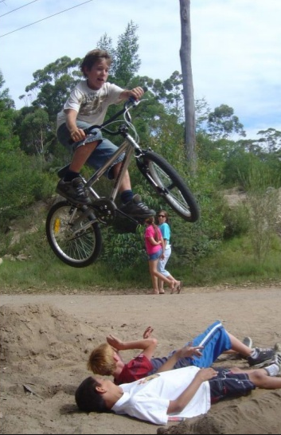
Hypotheses
The presence of a somewhat older adult mitigates the peer effect on adolescents’ risk taking
This mitigation is explained by attenuation of the impact of peers on adolescents’ preference for immediate rewards
Borenstein

Slide 68
Methods
Funded by the U.S. Army
How best to group soldiers in combat teams
Males in late adolescence recruited from colleges in Philadelphia, PA
Other subjects recruited via Temple University’s intro psychology classes
18-22 years of age
3 social-context situations
Solo- tested alone
Peer-group- observed by 3 same-age peers
Adult-present- 2 same-age peers and 25-30 year old confederate
Borenstein

Slide 69
Methods (Cont.)
Peer and adult present conditions constructed to resemble fire teams employed by the military
Testing completed in 2 phases
Recruitment and testing of solo and peer group conditions
Recruitment and testing of adult-present condition
Recruitment stopped when N=100 per condition
Effect sizes of d=.47 and d=.4 found in similar prior studies
10 subjects excluded from final analysis due to incomplete data
Borenstein

Slide 70
Procedure
Encouraged participants to recommend friends to act as peers
Phase 1: Group of 5 - four subjects randomly assigned to peer group and one to alone condition
One member from peer group randomly assigned as subject and performed test while others observed
Left in room for 10 minutes to interact naturally
Phase 2: three instead of four subjects (adult-present condition)
12 confederates took turns acting as the fourth subject
Left in room for 10 minutes to interact naturally AND share their names/year in school (confederate introduced as grad student)
56-59% of group conditions included friends
Borenstein

Slide 71
Measures
Risk Taking – Stop light computerized driving task
Goal to reach end of track as quickly as possible
32 intersections with yellow lights
Decide whether to stop vehicle via spacebar and lose time, or go through the intersection with possibility of crash
Proportion of intersections crossed w/out stopping = risk
Subjects and observers told about $15 bonus for performance
Preference for Immediate Rewards – Delay discounting task
Small immediate reward vs. large delayed reward
Delayed reward constant at $1,000
Delay interval (1wk, 1mo, 6mo, 1yr, 5yrs, 15yrs) (randomized)
Immediate reward = $200, $500, or $800 (randomized)
Nine choices presented in succession – previously chosen rewards cut in half for next choice (e.g., delayed choice= $1,000 -> next delayed option = $500)
Ending value reflects discounted value of the delayed reward (average indifference point)
Borenstein

Slide 72
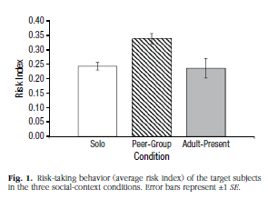
Does the presence of an adult influence risk-taking behavior?
Peer group subjects took significantly more risks in the game, when compared to solo (p<.001) and adult present conditions (p<.002)
Subjects in the adult present condition did not differ from the solo condition (p=.83)
Borenstein

Slide 73
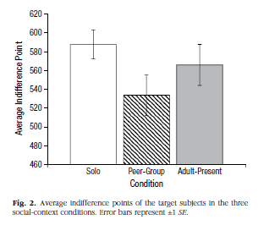
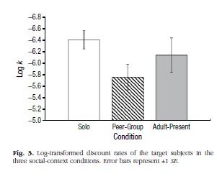
Does adult reduce peers’ influence on preference for immediate rewards?
Subjects in peer group exhibited a lower indifference point
Significantly different than solo
Marginally different than adult-present
Discount rates paralleled indifference points
Higher discount rate= greater orientation towards an immediate reward
Peer group exhibited significantly greater discount rate, compared to solo and adult-present
No differences between solo and adult-present groups for indifference points and discount rates
Borenstein

