Slide 1
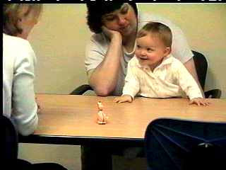
Joint Attention Development
Daniel Messinger, Ph.D.

Slide 2
Developmental overview
From 9 to 15 months, general increase in the % of infants:
  who gesture conventionally
    e.g. offering and pointing, though requesting is unclear
  and who comprehend conventional gestures
The quantity of early gesture use is associated with later differences in both linguistic comprehension and production

Slide 3
Working gestures:
Give & Take
Offers and requests are not only conventional, but universal and reciprocal
  Example video
Notes:
9 - 15 pnt offer request
socially recognizable form
However, these correlations are often weak. Bates et al. concurrent and predictive correlations. A more in depth look at what infants are saying, we can get a clue to better predictors of language.

Slide 4
What infant gestures say
Instrumental: Use gesture to person to get object (or get something done)
  I--> Social --> Object
  Proto-imperative (i.e., "give me that")
Social Approach: Use gesture with object to engage with partner
  I--> Object --> Social
  Proto-declarative (i.e., "look at that")
  What autistic kids appear to do very little of

Slide 5
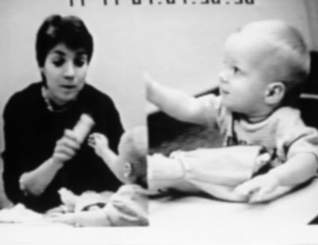
Social approach - offer

Slide 6
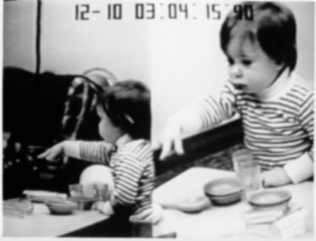
Instrumental - request

Slide 7
Development of gazing at mother
Infants spend increasing amounts of time coordinating attention (looking back and forth) between mother and objects
Gestures are more likely during this coordinated joint attention
This coordinated joint attention tends to occur with affective expressions
  Bakeman & Adamson believe positive affect facilitates joint attention and its development
  but did not look at this issue during gestural communications
Notes:
Hold object in hand. Make offer the example.
9=6
12=7
15=19

Slide 8
Sample (Messinger & Fogel, 1998)
Middle-class sample
11 mother-infant dyads
Playing “as you would at home” for 10 minutes at a table with everyday toys
156 play sessions
  Observed weekly from 9.5 to 12 months
  every two weeks from 12 to 15 months

Slide 9
Coding
Infant and mother
  Offers and requests
Infant offers and requests only
  Vocalization
  Gaze at mother’s face
  Smile
    During or within 2 seconds of gesture
Reliable

Slide 10
Pragmatics: Infants acquire
40% of infant gestures are object requests
  But only 10% of mother gestures are requests
When mothers request objects, infants respond only 44% of the time
  mothers respond to infant requests 83% of the time
Maybe that’s why infants requested more than mothers

Slide 11
Development of gesturing
Infant offers rise with age
  r = .30 (10/11 infants)
Infant requests do not rise with age
  r =.20 (8/11 infants)
Individual and session-to-session variability

Slide 12
Development
The emergence of new forms
  Learning to let go
Co-constructed with another
Gesture development occurs in the cross-purposeful collaboration of normal interaction

Slide 13
Vocalizations
Vocalizations rise with age
  Maybe they piggyback on gestures
  Seems to be true for infant points
    But points can have different functions
Notes:
3/4

Slide 14
Instrumental requests: Vocalizations
Vocalizations rise with age
  May piggyback on gestures
Not associated with gazing at mother or smiling
  Not significantly associated with requests
The proportion of requests involving a vocalization rises with age
  r=.30, 8/9
    Not true of offers
Tendency of vocalizations to reinforce requesting message becomes stronger with age
  Video
Notes:
8/9= p.02
r=.3=p.013

Slide 15
Development of infant requests
The increasing proportion of requests involving vocalizations suggests an increasingly instrumental use of requesting by infants.
As infants become more clearly intentional, they may increasingly use vocalizations with requests in order to compensate for the ambiguity of requesting.
Piggybacking: combining linguistic topics (the object referred to) with comments (the request gesture) in a manner which presages more complex language use

Slide 16
Social approach:
Gazing at mother
Gazing at mother is associated with offering rather than requesting
  50% of infant offers and 32% of infant requests involved gazing at mother
  9/11 infants show effect

Slide 17
Gazing at mother with infant initiated offers
Mother requests lessen the likelihood of infants gazing at mother during ensuing offers
  Gaze at mother in association with 64% of offers in which the mother had not requested an object
  Gazed at mother in association with only 14% of the offers in which the mother had requested an object
Evidence of social approach or pragmatics?

Slide 18
Gazing at mother and smiling
When infants gazed at mother during gestures, they smiled
  62% of gestures involving gazing at mother also involved smiling
  40% of gestures that did not involve gazing at mother involved smiling
  10 of 11 infants
Coordinated gesturing - occasions for positive affect

Slide 19
Social approach
The proportion of gestures involving gazing at mother and smiling is higher among offers than requests
  9/11 infants
    Proviso: Not analytically necessary

Slide 20
Social approach:
No development
No rise in the proportion of gestures involving
  Gazing at mother
  Smiling
  Gazing at mother and smiling
No evidence that importance of displays of positive affect to gestural communication changes between 9 and 15 months
  May facilitate development of these gestures, but doesn’t change
Maybe there’s development in the timing

Slide 21
Development of infant requests
The increasing proportion of requests involving vocalizations suggests an increasingly instrumental use of requesting by infants.
As infants become more clearly intentional, they may increasingly use vocalizations with requests in order to compensate for the ambiguity of requesting.
Piggybacking: combining linguistic topics (the object referred to) with comments (the request gesture) in a manner which presages more complex language use

Slide 22
Summary
Instrumental
  Requests &
  Vocalizations
  Increase with age
Social Approach
  Offers &
  Gazing at mom &
  Smiling
  Don’t increase with age

Slide 23
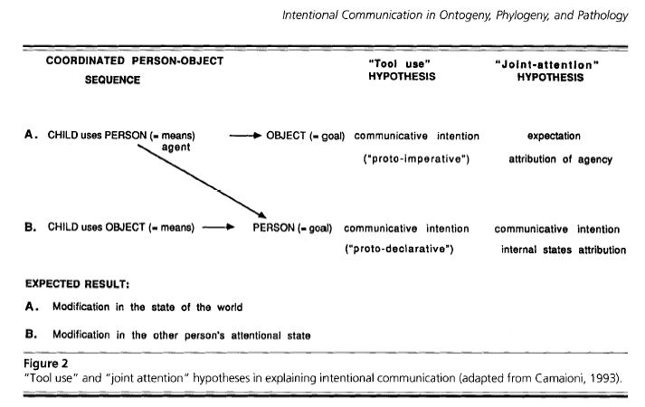
Imperative vs. declarative

Slide 24
Big picture
Infant requests used instrumentally to obtain objects and infant offers used to initiate (positive) social contact.
When infants request, they use a social means (the partner) to attain a nonsocial end, an object.
When infants offer, they use an object as a means to a social end

Slide 25
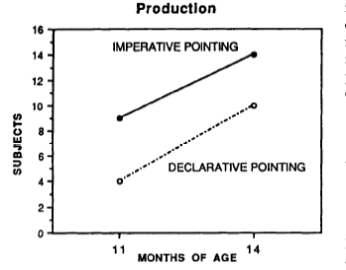
Declarative is more complex
Camaioni, et al., 1997

Slide 26
Developmental Psychopathology
Children with autism children show deficits in social approach
  Eg, offering objects while gazing at a partner & smiling
Children with Downs show deficits in instrumental communication
  such as requesting objects
        (Mundy et al.; etc)

Slide 27
Is joint attention one or several skills?
‘Seventy-two 5- to 10-month-old infants were tested on a variety of joint attention tasks.
Inter-correlations among joint attention tasks were sparse, which puts into question the meaning of these various skills.
In addition, the majority of infants exhibited some joint attention skill before 9 months of age, which points to a more gradual development of joint attention skills than suggested by previous research.
        Striano, T. and E. Bertin (in press). "Social-Cognitive Skills Between 5 and 10 Months of Age." British Journal of Developmental Psychology.

Slide 28
Different functions
Empirical basis for conceptual distinction in infant nonverbal communication
  Clustering of behaviors related to social approach and instrumental functions
  Differing developmental trajectories of those clusters
  Association with different developmental psychopathologies

Slide 29

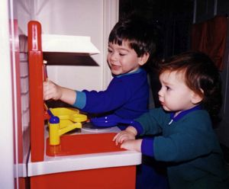
Attention, Joint Attention, and Social Cognition. Mundy and Newell, 2007
Joint attention behaviors
- Responding to joint attention (RJA)
> following gazes/gestures of others
- Initiating joint attention (IJA)
> use of gaze/gestures to direct attention of others
Facilitates > social learning, language acquisition
Associated with > Depth of information processing, > IQ, > Social competence, > Self regulation
Chimpanzees show capacity for RJA but not IJA
  understanding of sharing attention/intentions unique to humans?
Which comes first: joint attention or social cognition?
Autism characterized by pronounced impairments in IJA

Slide 30
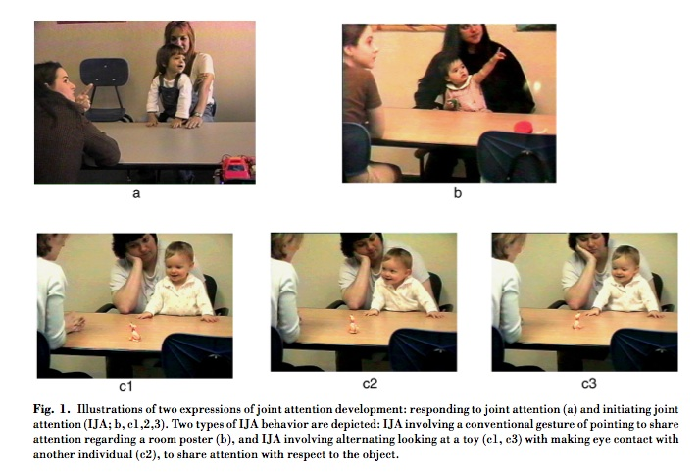

Slide 31
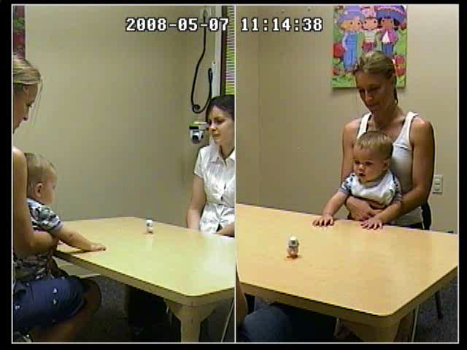
Initiating Joint Attention (IJA)
Shares experience or interest in object or event

Slide 32
Two interacting attention-regulation systems
Integration of the two systems yields joint attention
  - Posterior orienting and perceptual attention system
    RJA development
    Develops in first few months of life
    Orientation towards biologically meaningful stimuli
    “ where others’ eyes go, their behavior follows”
  - Anterior attention system
    IJA development
    Develops later than posterior system
    Volitional, goal-directed attention controlled by reward-related self-appraisal of behavior
    “where my eyes go, my behaviors follow”
Integration furthers cognitive development by:
  - enhancing differentiation of self-agency and attention control versus others’ agency
  - enables monitoring of internal representations about self and others
  - leads to understanding that own intentions lead to goal oriented behavior,
  so goal oriented behavior of others is caused by their own intentions.

Slide 33
Social-cognitive model of joint attention
Social cognition necessary for development of functional joint attention
social cognition develops at about 9 to 12 months
infants come to understand that own intentions lead to goal oriented behavior…
therefore goal oriented behavior of others is caused by their intentions
Model supported by some research
  - 9, 10, 11-month olds follow head turns in “eyes open” condition
  - only 9 month olds follow in “eyes closed”
  > cannot inhibit responding behavior because still lack social-cognitive awareness of the meaning of intent of gaze
Discrepancies with model
  - RJA measured as early as 6 months
  - IJA and RJA not highly correlated in development

Slide 34
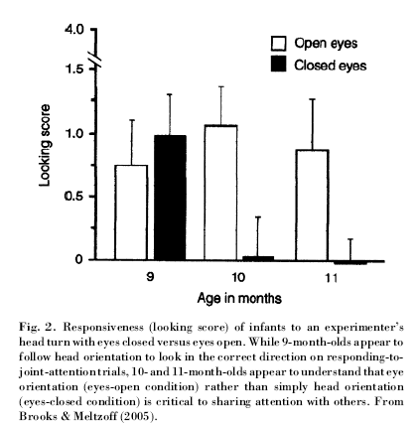
Comprehending joint attention

Slide 35
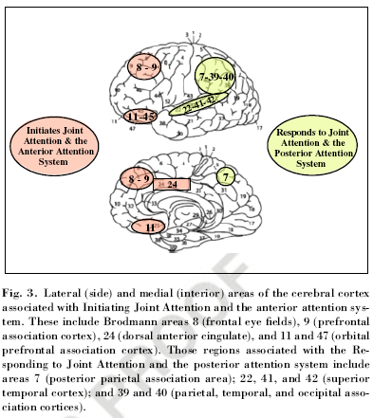
Different brain areas

Slide 36
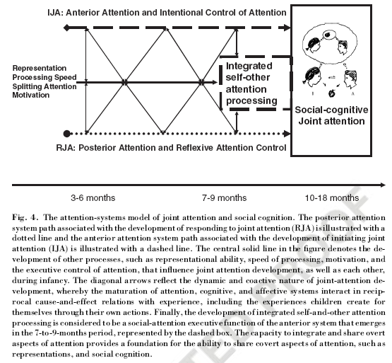
Initiating & responding to JA: Different but linked processes

Slide 37
Integration
RJA: “earlier developing posterior system associated with reflexive orienting and the perception of others behavior”
IJA: “later developing anterior system involved in intentional action selection and attention deployment”
      Mundy & Newell,

Slide 38
“12-month-olds point to share attention and interest"
‘When adult shared attention and interest (i.e. alternated gaze and emoted), infants pointed more frequently and tended to prolong each point - presumably to prolong the satisfying interaction.
  However, when the adult emoted to the infant alone or looked only to the event, infants pointed less across trials and repeated points more within trials - presumably in an attempt to establish joint attention.
Suggests that 12-month-olds point declaratively and understand that others have psychological states that can be directed and shared. ‘
Liszkowski, U., M. Carpenter, et al. (2004). "Twelve-month-olds point to share attention and interest." Developmental Science 7(3): 297-307.

Slide 39
Dyadic to triadic
Dyadic → Triadic (referential) communication
  Infant ←→ Partner → Infant ←→ Object ←→Partner
How are they connected?
Weak evidence that infants who bid more in still-face later show more triadic attention
But everyone agrees the link is positive emotion

Slide 40
Referential communication & affective sharing
‘Coordination of affect in joint attention in 5- to 9-month-olds‘
  Joint attention looks increased with strangers but not with mothers.
Coordination of smiles w joint attention increased w age
  5% of infants @ 5 mo, 12% at 7, 35% at 9 mos
    same developmental increase playing with mothers
      percentage of infants who smile and gaze is significantly lower with the mother than with the experimenter at 9 months.
Affect may play a key role in development of aspects of joint attention that may be unique to humans.
    Striano, T. and E. Bertin (2005). "Coordinated affect with mothers and strangers: A longitudinal analysis of joint engagement between 5 and 9 months of age." Cognition & Emotion 19(5): 781-790.

Slide 41
A different, timing approach
26 typically developing infants
Administered the Early Social-Communication Scales at 8, 10 and 12 months of age
During episodes of joint attention (JA)
  alternating gaze between object and experimenter
Proportion of JA episodes involving smiles
Proportion of Anticipatory Smiles:
  Smiles at an object followed by smiling gaze at the experimenter
Conventional analyses

Slide 42
Anticipatory Smiling: Linking Early Affective Communication and Social Outcome
Parlade, Messinger, Delgado, Kaiser, Vaughan Van Hecke, and Mundy (2009)

Slide 43
Background
The importance of joint attention (JA)
  Social sharing
  Focus is on IJA
Frequent displays of positive affect during JA
  Link between affective display in JA and social emotional outcomes?
Anticipatory and Reactive Smiles (2 Types of IJA)
  Precursors in the dyad and the still-face
  Relations to social outcomes
JA as a behavioral marker of social understanding
  Evidence from at-risk (Sheinkopf et al., 2004) and children with developmental delays (e.g. Lord et al., 2003)
  Less evidence from typically developing (Van Hecke, 2007)

Slide 44
Methods – 2 Studies
Study 1
Study 2
Sample = 22
Measures
  Still-face at 6 months
  ESCS at 8, 10, 12
  ASBI at 30 months
    Comply
    Express
    Disrupt
  FACS for coding smiles
Sample = 39
Measures
  ESCS at 9 and 12 months
  ITSEA at 30 months
    Externalizing
    Internalizing
    Dysregulation
    Social Competence
  FACS

Slide 45
Sharing positive affect?
When infants gaze at an object, smile, and then gaze at their social partners, the joint attention episode appears more intentional
It suggests the infants are communicating something specific – positive emotion about an object – with another.

Slide 46
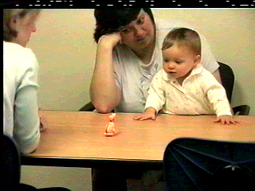
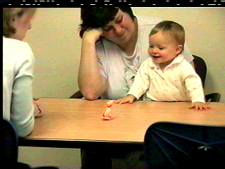
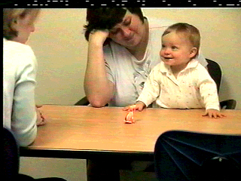
Anticipatory smile
Gaze at object → Smile → Gaze at experimenter

Slide 47
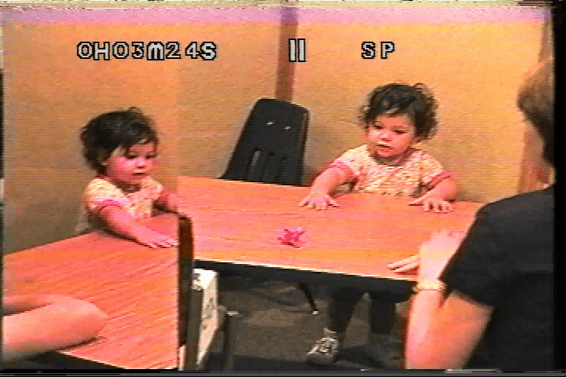
Anticipatory smile

Slide 48
General Discussion
Increase in anticipatory smiling with age
Findings suggest a developmental progression
    (Positive emotion in SF – anticipatory smiling – social outcomes)
    Continuity between infant’s early emotional expressivity and later adaptive relatedness
    Continuity between early dyadic and later triadic positive interaction
Stable individual differences in the tendency to initiate positive affective communication with different partners
IJA frequency and social competence, not related here?
  Just AS with expressivity in study 1, and
  AS with competence in study 2
Consider unique contributions of various dimensions of JA on child outcomes
  AS uniquely associated with later social competence

Slide 49
Anticipatory smiling rises
Venezia, et al., 2004

Slide 50
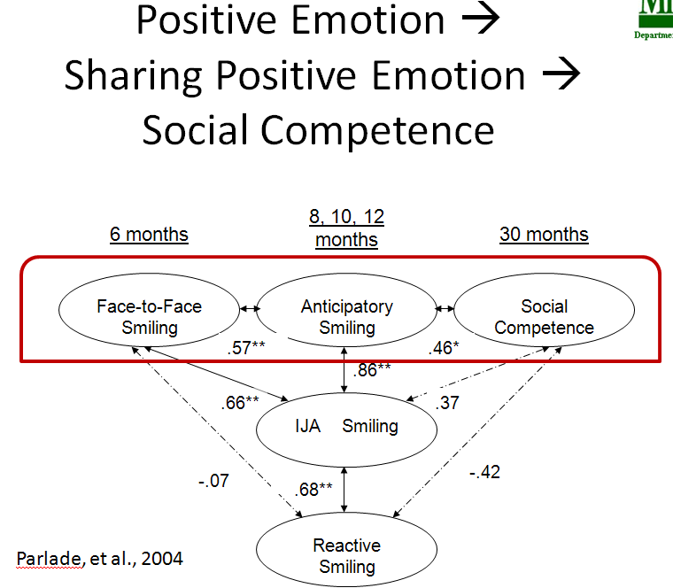
Sharing Positive Emotion → Social Competence

Slide 51
Recap
Observational studies have identified two constellations of gestural behaviors with different functions, patterns of development and deficits
  A requesting function
  And a social approach function which often has a joint attention dimension

Slide 52
Social referencing
Seeking information from others
  Visual cliff video
  How is this related to joint attention?
  Visual cliff and social information processing
A parent’s smiling face will convince an infant to cross over the visual cliff,
social referencing.

Slide 53
Visual cliff
The “ power of emotional information for determining behavioral outcomes”
when baby reaches center mother shifted expression
74% tested with the joy and interested expressions crossed the deep side of the cliff
6% tested with fear and anger crossed
33% of the Ss presented with sadness crossed
        Campos, J. J. (1980). Human emotions: Their new importance and their role in social referencing. Research & Clinical Center for Child Development, Annual Rpt, 1-7.

Slide 54
Introduction
Social approach = Joint attention
Individual differences in joint attention, and nonverbal communication skills in the first 18 months of life
Provide unique and important information about childhood cognitive/intellectual development, language acquisition, and social-emotional development.

Slide 55
Questions
How are different patterns of gesturing associated with different developmental disorders?
What are IJA and are RJA?
How are they measured and what do they predict?
How might early deficits in IJA associated with autism lead to more long-term deficits?

Slide 56
Individual differences

Slide 57
Functionally distinct nonverbal communication skills
Emerge between 6 and 12 months
Individual differences in the development of joint attention skills may be observed as early as 6 months of age, and throughout the second year.
Joint attention skills reflect a distinct integration of social-cognitive, self regulatory, and emotional processes.
      Mundy, 1995; Mundy & Gomez, 1997; Mundy & Sheinkopf, 1998; Mundy & Willoughby, 1996, 1998

Slide 58
Definitions
Joint Attention Behaviors refer to the child's skill in using nonverbal behaviors to share the experience of objects or events with others.
  Initiating Joint Attention (IJA) refers to the frequency with which a child uses eye contact, pointing and showing to initiate shared attention to objects or events.
  Responding to Joint Attention (RJA), refers to the child's skill in following the tester's line of regard and pointing gestures.

Slide 59
Responding to Joint Attention
Lower level behavior
  Following proximal point/touch: In the Book presentation task, the tester points to 6 pictures in the book.
Higher level behavior
  Following line of regard: On left and right trials the child gets credit if they turn their eyes or head sufficiently to indicate that they are looking in the correct direction and beyond the end of the index finger of the tester.

Slide 60
RJA measured in 14-17 month olds predicts receptive language development
  r = .71, Mundy et al. 1995; r = .70, Mundy & Gomes, in press
  this association remains significant after considering initial language or cognitive measures.
Individual differences in RJA may be observed as early as 6 months of age and these predict language development through 24 months
  (Morales, Rojas, & Mundy, in press).

Slide 61
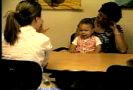
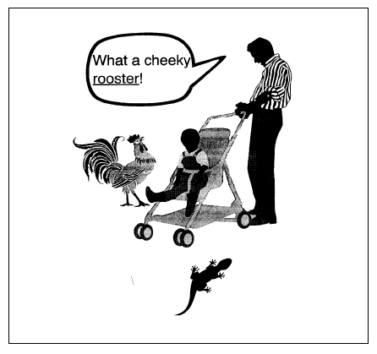
RJA Example
How RJA predicts

Slide 62
RJA development in a high risk low SES sample is depressed at 12 months
  Mean RJA score = 33%, N = 41) compared to a low risk, middle SES sample of 12 month olds (mean RJA score = 66%, N = 21).
RJA at 12 and 18 months predicts language (r = .38) and Bayley II MDI (r = .41) at 36 months of age in a high risk sample of cocaine exposed infants.

Slide 63
RJA summary
Responding to Joint Attention measures have displayed consistent predictive associations with language and cognitive development.
They may be useful in screening infants as early as six months of age.
Early measure of attending to others’ intentional communications.

Slide 64
Requesting
Initiating Object Requesting (IOR), refers to the child's skill in using eye contact, reaching, giving or pointing to elicit aid in obtaining an object, or object related event.
Responding to Requesting (RR), refers to the child's skill in responding to the tester's gestural or verbal simple commands to obtain an object or action from the child.

Slide 65
Initiating Joint Attention
Lower Level Behaviors:
1) Eye Contact: the child makes eye contact with the tester while manipulating or touching an inactive mechanical toy
2) Alternating (referencing): the child alternates a look between an active object spectacle and the tester's eyes.
  Object is active on the table or in the tester's hand, or the child looks up to the tester after an object becomes active in their own hands.

Slide 66
Higher level IJA behaviors
3) Pointing: the child points to an active toy, or pictures in the book before the tester has pointed, or to wall posters before the tester has pointed. Pointing may occur with or without eye contact.
4) Showing: The child raises a toy upward toward the tester's face.

Slide 67
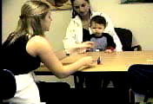
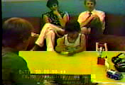
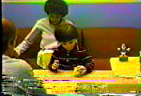
IJA Examples
TD
Down Syndrome
Autism

Slide 68
What IJA predicts
A 12 month measure of IJA has been observed to predict Stanford Binet IQ (r = .31), as well as language outcome, through age 8 in a sample of high risk infants (Ulvund & Smith, 1996).
These relations hold after considering variance shared with a visual information processing measure (Smith, Fagan, & Unlvund, 1997).

Slide 69
Typically Developing Infants
12-month IJA and RJA on the ESCS predicted parent report on the 30-month social competence and externalizing behavior scales of the Infant and Toddler Social-Emotional Assessment (ITSEA)
  after considering variance shared with 18-month Bayley MDI and Inhibitory Control from the 24 month Toddler Behavior Assessment Questionnaire.

Slide 70
IJA in a high-risk sample
IJA was better developed among infants of teen-age mothers who displayed more optimal interactions with their children (Flannagan; 1994)
IJA development has been observed to be attenuated in “at risk “ infants with insecure (C) attachment status
        (Clausen, Mundy, & Willoughby, April, 1998).
IJA development between 12 and 18 months is a positive predictor of prosocial behavior in a high risk sample
  experimenter observations at 27 months and teacher observations at 36 months
Infant 12 month IJA and RJA were each significantly associated with lower teacher ratings of 36 month disruptive behaviors in a regression equation.
  the relations between joint attention and 36 month behavior outcomes using the Adaptive Social Behavior Inventory, the Penn Peer Play Scale, and selected sub-scales from the Child Behavior Checklist/2-3 were analyzed
  Three aggregate scores of Disruptive Behavior, Withdrawn Behavior, and Positive Social Behavior were computed.
  (Willoughby & Mundy, April, 1998; Sheinkopf & Mundy, in preparation).

Slide 71
Autism
94% of autistic kids show some IJA deficit
  Regardless of their IQ
IJA level is a significant predictor of language one year later within an autistic sample

Slide 72
Individual differences and the development of infant joint attention
(Mundy, et al., 2007)
Universal Cognitive Model
  General cognition as underlying factor driving individual differences in JA
    Also the underlying factor in numerous other developmental outcomes
  General cognition explains predictive ability of JA to later outcomes
Social Cognitive Model
  Specific social aspects of cognition drive individual differences in JA
  Social cognition explains predictive ability of JA to later outcomes
Multiple Process Model
  A combination of various executive functions/motivational factors drive individual differences in JA
  Such underlying mechanisms would suggest that JA measures are differentially related to each other and to developmental outcomes
Designed study to test assumptions of each theoretical model
Notes:
There are various models that try to explain the development of JA – some from a more social perspective and others from a more cognitive perspective.
The challenge for all these models is in trying to understanding individual differences in JA, while acknowledging that these behaviors may reflect different functions. Like Shira mentioned earlier, behaviors like RJA and IJA serve a more social affiliative function, because the child is being responsive to a social situation for the purpose of sharing that event, whereas IBR and RBR serve more instrumental purposes (either eliciting help in another or responding to another’s request). The latter is known as protoimperatives whereas the former are called protodeclaratives.
Our research is focused on the more protodeclarative functions of JA and we’ve seen that even within this group of functions there are key individual differences that cannot fully explained by a model that assumes that these dimensions of JA have a common underlying basis that completely explains their connection to later outcomes. So, based on our experiences we decided to go for the MPM model, which emphasizes the role of common as well as divergent cognitive processes in the development of JA behaviors.
Here we’ve also listed the UCM and the SCM, as comparison points because they both account for the JA growth and individual differences in terms of cognitive processes.. Additionally, there’s a particularly useful study by Mundy et al.(2007) that tests the assumptions of each of these 3 models. This study tried to examine which of these models best explained the growth patterns of different JA measures, from ages 9 to 18.
I will discuss shortly some of the core findings, in support of the Multiple Process Model..

Slide 73
Neurological Rationale for MPM
RJA is best represented by the EF functions associated with the posterior-parietal system
  The combination of parietal and occipital functions may help with encoding visual-spatial information during social orienting
IJA may best be represented by an anterior system
  IJA may involve voluntary processes due to the integration of the anterior and limbic systems
Connected to neurological maturation:
Early Infancy Late Infancy
RJA behaviors
IJA behaviors
Posterior
Anterior
RJA Consolidation
IJA Consolidation

Slide 74
What Data Would the Models Explain?
 | Universal Cognitive Model | Social Cognitive Model | Multiple Process Model
What drives individual differences in JA? | General cognition | Social cognition | Executive functions & motivational factors
How would JA correlate with general cognition? | High correlations | Only modest correlations with general cognition | Significant correlations would not explain all the variance shared between JA and later outcomes
How stable would JA dimensions be? | High intra-dimensional correlations | High intra-dimensional correlations | High intra-dimensional correlations
How would different JA dimensions be intercorrelated? | High inter- dimensional correlations | High inter- dimensional correlations | Low inter -dimensional correlations
What would growth patterns look like across JA dimensions? | Similar growth | Similar growth | Possible differential growth
How would JA dimensions predict later outcomes? | Similar prediction | Similar prediction | Possible differential prediction

Slide 75
Support for MPM: Data
Data showed: RJA & IJA
  Intra-dimensional correlations stable
  Inter-dimensional correlations not significant
  Differentially predicted later language, social competence, and psychopathology
  Growth patterns differed
Notes:
As we had mentioned earlier, this study by Mundy et al. sought to explain JA development through these three models to see which had the best fit according to the data found.
Basically they tested the model assumptions which primarily centered on the correlations within dimensions of JA and across dimensions of JA.
They also looked at growth patterns of each JA dimension
Finally, they tried to see the predictive ability of JA measures to language outcomes, and whether this relationship would be primarily explained by a common cognitive process or a combinations of both common and divergent processes.
I apologize for just including RJA and IJA in this slide, we just want to maintain the focus on the behaviors most relevant to our research. But I will still briefly cover some of the findings associated with IBR and RBR
As far as intra-dimensional correlations: both RJA and IJA seemed pretty stable over time, so that 9-12, 12 to 15, 15 to 18 test retest coefficients remained significant after controlling for the variance associated with cognition. So across time, there were stable differences in infants abilities to engage in these behaviors.
For IBR and RBR there was limited to no evidence of stability, respectively.
A second issue was looking at how different measures of JA were related to each other. There were no significant concurrent associations across IJA and RJA at any age.
Alternatively, IBR and RBR displayed significant concurrent correlations across all time points, showing evidence of commonality of processes.
RJA was primarily characterized by a linear growth pattern, and RBR appears to be more quadratic
As far as predictions to subsequent language outcomes. No regressions were run with IBR and RBR because there were no significant associations between these and the 24 months language outcomes. As far as RJA and IJA, when cognition at 18 months was considered, only IJA at 18 months was a significant predictor of subsequent language.
So indeed, different types of JA measures had different paths of associations with the language outcomes.

Slide 76
DSM-IV Diagnostic Criteria
Autism Spectrum Disorder (ASD)
Onset by 3 years of age
Restricted interests, repetitive and stereotyped patterns of behavior
Linguistic communication impairments
Social interaction impairments
Notes:
Diagnostic characteristics of children with autism
Early screening and diagnosis
Broad Phenotype
Younger siblings of children with ASDs:“Baby-Sibs”
New concepts in the treatment of young children with autism.

Slide 77
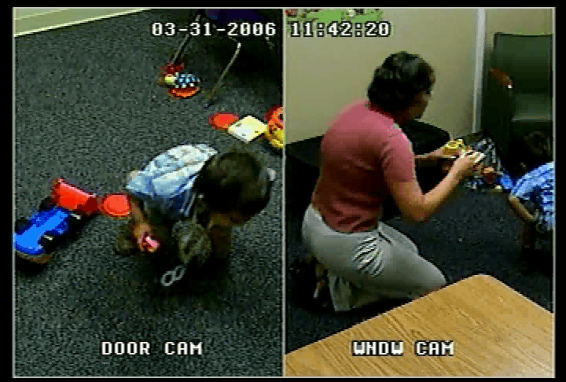

Slide 78

Frith & Frith, 2001
Biological Basis of Social Interaction
Theory of mind (mentalizing)…
    -important in social communication and social interaction
    -Development
    <12 months: Joint attention
    12-18 mos: Imitation
    4yr: False belief understood
    -What can be said when it fails?
    -research with autistic children and children with brain damage
    -Is it innate or learned?
    -Is it present in other nonhuman primates?
False belief
http://www.youtube.com/watch?v=MapnGqrY_jw&feature=related

Slide 79
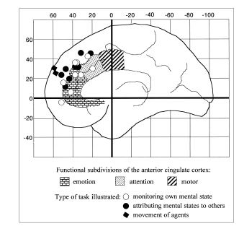
Frith & Frith, 2001
Medial Prefrontal Cortex
  Monitoring own mental state
  Attributing other’s mental states
  Interpreting actions of freely moving agents

Slide 80
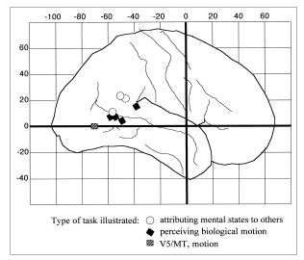
Frith & Frith, 2001
Temporo-Parietal Junction
  Attributing mental states of others
  Perceiving motion

Slide 81
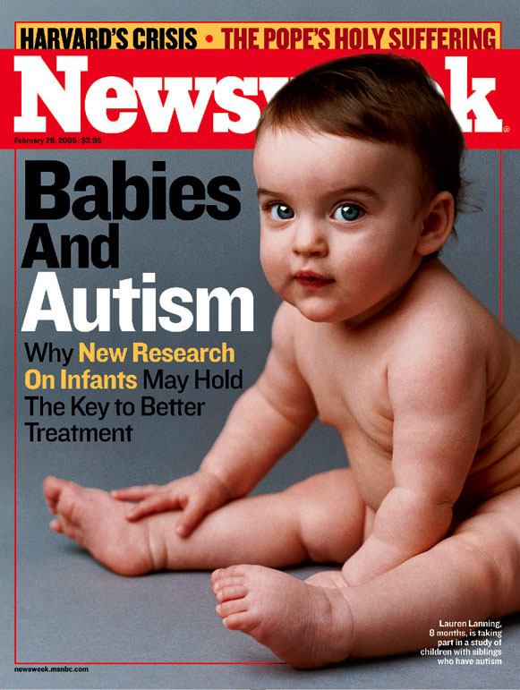
Prospective studies of Autism Siblings
Help identify early markers of ASD
(~20%)
and
illuminate ASD development

Slide 82
Spectrum associations
Heritability approaching 90%.
  MZ twin concordance: 65-90%
  DZ twin concordance: 5-15%
6.5% of first degree relatives (e.g. siblings) show a deficit in social or communicative functioning
  from family history.
Six- to sixteen-year-old siblings of children with autism show deficits in prosocial behaviors
  autism-like symptoms
  deficits in reciprocal social interaction
        (Constantino & Todd, 2003; Constantino et al., 2003; Hastings, 2003)

Slide 83
Autism, Autism Spectrum Disorders, and the Broad Autism Phenotype
Autism Spectrum Disorders
Broad
Phenotype
Autism
Asperger's
PDD-NOS
Communic.
Difficulties
???

Slide 84
Rogers (2009)
Broader Phenotype (a.k.a. BP, BAP)
  subclinical characteristics of autism
    "The presence of subclinical characteristics related to social relatedness, pragmatics of communication, and special interests"
    The definition varies
      Therefore the results vary
  ASD vs. High Risk vs. Low Risk
    Sibling studies and importance of design
  General pattern of Risk groups
    High vs. Low risk differences seen at 12 months but not at 6.
Areas less related to social/emotional development-
  Motor delays emerge by 14 months
  Repetitive movements involving hand and arm behaviors
  Visual attention differences at around 12 months

Slide 85
Temperament and Social Deficits
Temperament
  Differences appear to emerge some time after 6 months, do not predate symptom emergence
    Zwaigenbaum et al., 2005 - Behavioral approach and effortful emotional regulation at 24 months differential at 36
      not at 6 months
    According to Toth et al. (2007) Only differences in social deficits, no differences in Parent's difficulties.
Still Face
  Varied results (Ibanez, 2008; Merin, 2007; Yirmiya, 2006)
    Differences in gaze patterns and neutral affect
    Predictability of development is mixed
    Not consistently related in ASD, risk groups

Slide 86
Gestures and Language
Delays consistently found at 12 months for those that develop ASD, inconsistent in risk groups.
  Toth finds RL deficits but affect sharing, joint attention, interaction, conventional gestures unaffected.
  Yirmiya gives evidence of a profile that eventually corrects by around 3 years in a high risk group
    Smaller group sizes
  Some marginal findings in Adult vs. Infant-directed speech.
  Some marginal findings in Adult vs. Infant-directed speech.

Slide 87
Attention and Imitation
Response To Name (RTN)
  Nadig (2007) differences at 12 but not 6
    Attention shifts a good predictor
Response to Joint Attention(RJA)
  Lower responses predictive of social impairment in the Presmanes et al. study
  Sullivan (2007) risk groups show inconsistency and less improvement depending on severity of delays
Imitation
  At 12 months differentiated in Zwaigenbaum's (2005) study and non-object related in Toth's (2007)

Slide 88
Developmental Profiles and Key Points
Bryson case studies of developmental progression in 9 children who developed ASD
  Not profound social-affective impairment in the earliest months of life as per Kanner's (1943) projection
  Some flags at 12 months, stronger at 24
Take home messages
  No clearbehavioral identifiers at 6 months
    Biology could be the early marker
  Variety in the speed and severity of symptoms
    Flags not as clear cut across development in some studies

Slide 89
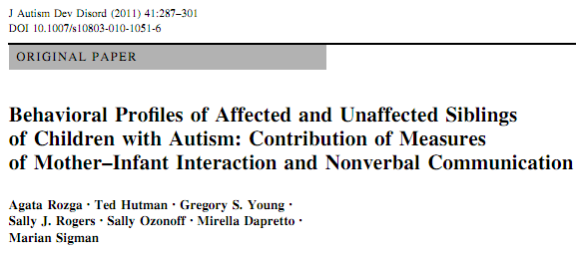
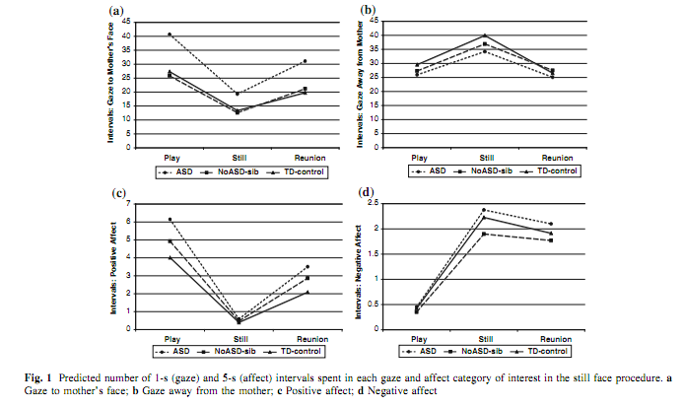
No 6-month FFSF differences

Slide 90
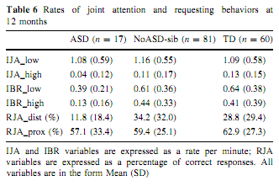
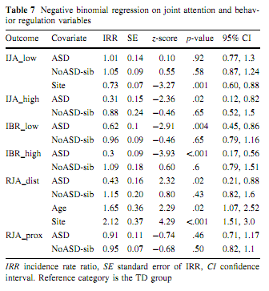
Requesting ASD Deficits

Slide 91
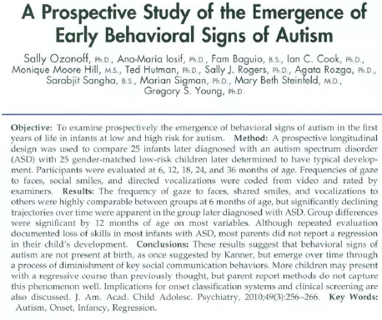
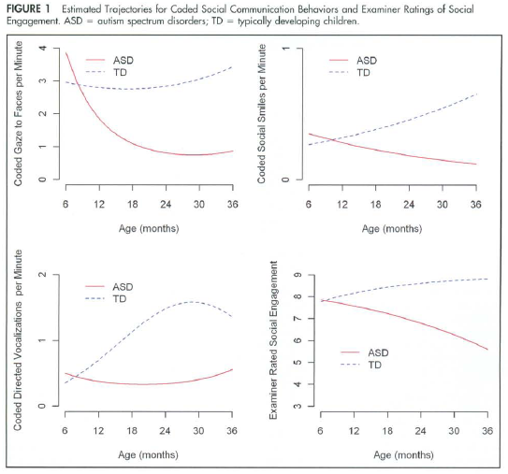

Slide 92
RJA, IJA, and autism
The early development of children with autism is characterized by a robust disturbance of IJA (Mundy et al. 1986; 1990; 1994).
Initially RJA is effected, but a disturbance in RJA may remit while an IJA disturbance may be chronic.
Individual difference in IJA in the first five years predict social outcomes in children with autism through adolescence (Sigman, April, 1998).

Slide 93
Feedback process in autism
In autism, and related disorders, a primary neurological disturbance leads to a robust impairment in the development of IJA by 12-18 months.
This impairment in social information seeking contributes to additional social and social cognitive disturbance in these children
  (see Mundy & Markus, in press).

Slide 94
Feedback process in social risk
Mundy & Willoughby, 1996

Slide 95

ASD-sibs: Early Visual & Joint Attention Deficits
Infant siblings of children with an ASD (ASD-sibs) are:
- 3-9% risk of developing an ASD
- 20% risk of exhibiting deficits indicative of the broader phenotype (Gamliel, Yirmiya, & Sigman, 2007; Landa & Garrett Mayer, 2006; Zwaigenbaum et al., 2005).
Compared to infant siblings of TD children (COMP-sibs), ASD-sibs exhibit:
- differences in shifting their visual attention (Zwaigenbaum et al., 2005; Ibanez et al., 2008).
- impaired IJA (Cassel et al., 2007; Goldberg et al., 2005).
- relationships between joint attention and later ASD classification and language (Sullivan et al. ,2007).

Slide 96
12-month risk markers for 24 month autism diagnosis
Lower expressive and receptive language, and lower gestural repertoire
Atypical eye contact and visual tracking
  difficulty disengaging visual attention from nonsocial stimulus
Difficulty orienting to name, imitating, social smiling
  Reactivity and sensory-oriented behaviors
        Zweigenbaum et al., 2005

Slide 97
ASD & DD vs. DD Red Flags
(suspect a developmental delay)
(1) lack of response to contextual cues;
(2) lack of pointing;
(3) lack of vocalizations with consonants;
(4) lack of playing with a variety of toys conventionally.
  Best estimate diagnosis under 24 months of age using the Systematic Observation of Red Flags (SORF) for Autism Spectrum Disorders in Young Children
    Wetherby, A. M., Woods, J., Allen, L., Cleary, J., Dickinson, H., & Lord, C. (2004). Early Indicators of Autism Spectrum Disorders in the Second Year of Life. Journal of Autism and Developmental Disorders, 34(5), 473-493.

Slide 98
ASD vs. DD & TD Red Flags
Suspect an ASD
Social interaction deficits
  appropriate gaze;
  warm, joyful expressions with gaze;
  sharing enjoyment or interest;
  response to name;
Communication deficits
  coordination of gaze, expression, gesture, and vocalization;
  showing;
  unusual prosody;
Repetitive behaviors
  repetitive movements or posturing of body/arms/hands
  repetitive movements with objects.
    Best estimate diagnosis under 24 months of age using the Systematic Observation of Red Flags (SORF) for Autism Spectrum Disorders in Young Children .
    Wetherby, A. M., Woods, J., Allen, L., Cleary, J., Dickinson, H., & Lord, C. (2004). Early Indicators of Autism Spectrum Disorders in the Second Year of Life. Journal of Autism and Developmental Disorders, 34(5), 473-493.

Slide 99
Early behavioral intervention, brain plasticity, and the prevention of autism spectrum disorder
Geraldine Dawson
Risk Indices in Autism Spectrum Disorder (ASD)
Genetic:
  EN – 2 gene plays a role in cerebellar development
  Elevated levels of platelet serotonin (5-HT)
  Disruption of synaptic plasticity
Environmental:
  Toxins, viruses, exposure to sex hormones, Interaction of genes with each other and environment
Behavioral:
  12 month markers (name response, imitation, eye tracking, IJA, etc)
  6-12 months: visual attention and temperament
  18 months: gross and fine motor, language, overall intelligence
  Assessment measures for infants
Neurophysiological:
  More sensitive at detecting later problems
  Face-processing impairment (familiar v. unfamiliar, object processing areas activated)
  Different listening preferences (prefer mechanical auditory signals to speech)
  Atypical head/brain growth

Slide 100
Early Experience as a Risk Process
The social motivation hypothesis
  core impairment in social motivation results in other ASD impairments
  Indicated by lack of “social orienting,” focus on objects, not people
  Brain regions that mediate social cognition affected
  A result of lack of reward value of social stimuli (problems with dopamine system)
Early Environmental Enrichment
  Affects brain development /neural plasticity in animals
  Improved learning, memory, exploration, habituation, etc
  Offsets effects of earlier environmental stressors
  Might be able to change course of brain and behavioral development in infants at risk for ASD
Interventions
Early intensive interventions with preschoolers - substantial improvements
Infant and toddler interventions being developed (Early Start Denver Model)
Impact on brain function/organization
  Brain-based measures: EEG coherence (cortical connectivity)
Enhancing parent-child interactions
  Joint attention, maternal sensitivity

Slide 101
Variability in Outcomes
Severity of risk factors:
  influence range of neural plasticity, early interactions between child and environment, degree of normal social input from others
Treatment started before age 4 has better outcomes
Child Variables:
  Social engagement, intellectual ability, prelinguistic/linguistic ability
Presence and severity of:
  Core autism
  Co-morbid mental retardation
  Co-morbid language impairment
Goals
Develop behavioral interventions for ASD
Develop interventions that eliminate or mitigate effects of genetic and environmental risk factors
ID other predictors by looking at treatment response
Tailor interventions to different subtypes of ASD

Slide 102
Theory of Mind Meta-Analysis:
Autism and Mental Retardation
Autistic children have impaired TOM
But so do MR children
  Relative to other MR children, Downs children have relatively unaffected TOM abilities

Slide 103
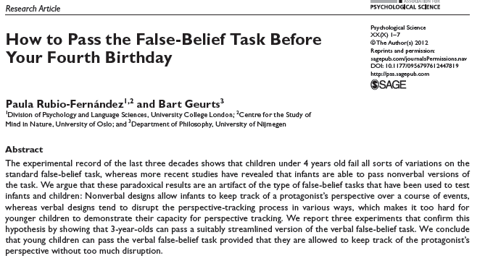
Theory of Mind

Slide 104
Theory of mind (ToM) in autism
Individuals with autism and MR have impaired ToM abilities.
  Etiology of MR (i.e., Down's syndrome,is an important moderator.
  Chronological age (CA) and verbal mental age (VMA) of the normally developing children and CA, VMA, and performance mental age of individuals with MR, and type of matching between groups also moderators.
Need to consider the specific etiology of comparison groups when studying abilities and impairments of individuals with autism and MR.
        Yirmiya, Nurit; Erel, Osnat; Shaked, Michal; Solomonica-Levi, Daphna . Meta-analyses comparing theory of mind abilities of individuals with autism, individuals with mental retardation, and normally developing individuals. Psychological Bulletin. 1998 Nov Vol 124(3) 283-307

Slide 105
Understanding mind and emotion by talking to your friends
Relates lab tasks and social life
Longitudinal increases between 4 & 5 years
  Understanding false-belief tasks
  Affective perspective taking tasks
  Mental-state talk with friends
    Increase in shared or others’ mental-state talk
    Increase in the context of a shared interest
Understanding mind and emotion: Longitudinal associations with mental-state talk between young friends (Dunn et al)

Slide 106
Relating naturalistic talk and experimental investigations
Mental-state talk frequency predicted false belief performance one year later
Early affective perspective taking also predicted false belief performance
Developmental shift in mental-state talk from self to other/shared supports
  Supports idea that one understands others by understanding self (simulation theory)

Slide 107
Questions?
Is joint attention an early form of theory of mind?
Do joint attention experiences facilitate formation of a theory of mind?
Is anticipatory smiling a particularly privileged path to theory of mind?

Slide 108
Additional readings
Kasari, -. C., Sigman, -. Mundy, -Peter, & Yirmiya, N. (1990). Affective sharing in the context of joint attention interactions of normal, autistic, and mentally retarded children.Journal-of-Autism-and-Developmental-Disorders. Mar; Vol 20(1):
Mundy, P., & Hogan, A. (1994). Intersubjectivity, joint attention, and autistic developmental pathology. In D. Cicchetti & S. L. Toth (Eds.), Disorders and dysfunctions of the self (Vol. 5, pp. 1-30). Rochester, NY: University of Rochester Press.
Mundy, P., & Willoughby, J. (1996). Nonverbal communication, joint attention, and early socioemotional development. In M. Lewis & M. W. Sullivan (Eds.), Emotional development in atypical children (pp. 65-87). Mahwah, NJ: Erlbaum.

Slide 109
More readings
Sheinkopf, S., Mundy, P., Oller, K., Steffens, M. (2000). Atypical vocal development in young children with autism. Journal of Autism and Related Disorders, 30, 345-354.
Mundy, P. & Neal, R. (2001). Neural plasticity, joint attention and autistic developmental pathology. In L. M. Glidden (Ed.), International Review of Research in Mental Retardation, 23, 139-168. New York:Academic Press.
Mundy, P. (1995). Joint attention, social-emotional approach in children with autism. Development and Psychopathology, 7, 63-82.
Mundy, P, Sigman, M., & Kasari, C. (1990). A longitudinal study of joint attention and language development in autistic children. Journal of Autism and Developmental Disorders, 20, 115-128.
Mundy, P., Sigman, M., & Kasari, C. (1993). The theory of mind and joint attention deficits in autism. In S. Baron-Cohen, H. Tager-Flusberg & D. Cohen (Eds.), Understanding other minds: Perspective from Autism, (p. 181-203). Oxford, UK: Oxford University.
Mundy, P., Sigman, M., & Kasari, C. (1994). Joint attention, developmental level, and symptom presentation in young children with autism. Development and Psychopathology, 6, 389-401.
Mundy, P., Sigman, M., Ungerer, J., & Sherman, T. (1986). Defining the social deficits of autism: The contribution of nonverbal communication measures. Journal of Child Psychology and Psychiatry, 27, 657-669.

