Slide 1

Epigenetics
Daniel Messinger, Ph.D.

Slide 2
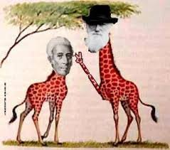
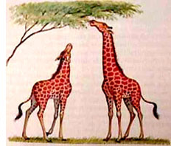

Slide 3
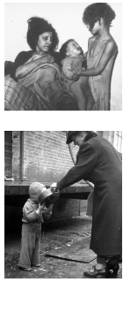
Hmmm…
‘Mothers who were pregnant during a 1944 famine in the Netherlands were more likely to have children—and grandchildren—prone to heart disease, diabetes, and obesity.
Female mice that are underfed during pregnancy give birth to pups that are more likely to develop diabetes—and their male offspring have epigenetic changes in their sperm.
  The offspring of those males are also prone to diabetes.
Male rats that are overfed, when mated with healthy females, also had offspring prone to developing diabetes.”
        http://www.sciencemag.org/news/2015/12/weight-gain-and-loss-can-alter-men-s-sperm

Slide 4
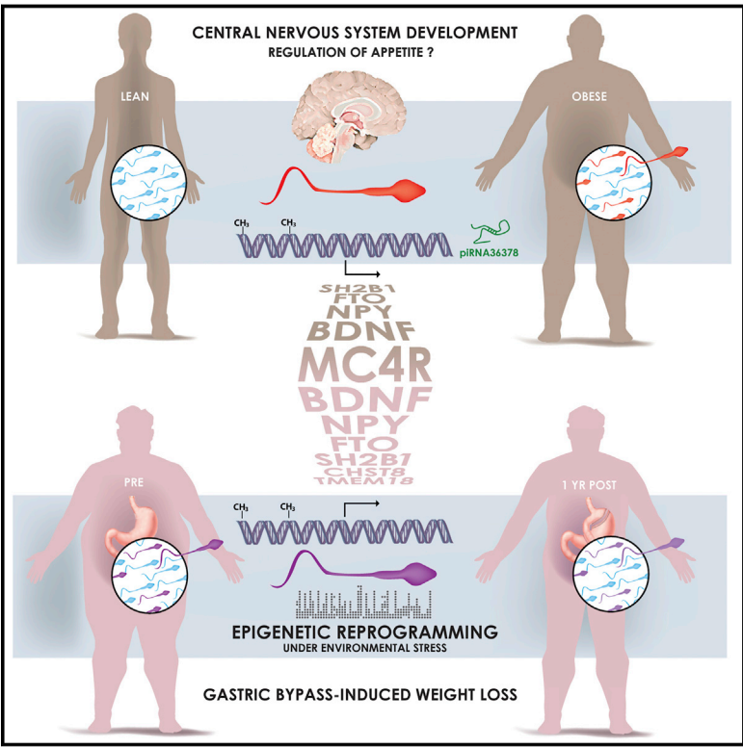
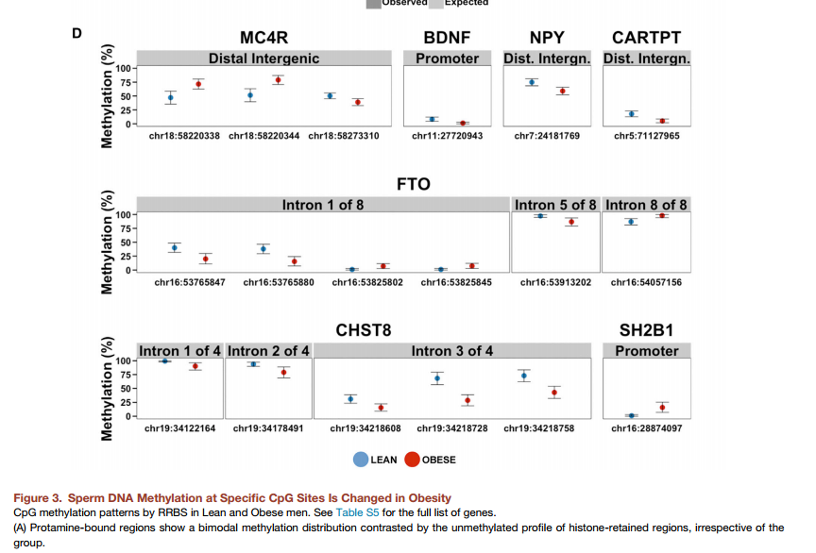
“[S]urgery-induced weight loss was associated with a dramatic remodeling of sperm DNA methylation, notably at genetic locations implicated in the central control of appetite.”
Donkin, I., Versteyhe, S., Ingerslev, L. R., Qian, K., Mechta, M., Nordkap, L., . . . Barres, R. (2015). Obesity and Bariatric Surgery Drive Epigenetic Variation of Spermatozoa in Humans. Cell Metab. doi: 10.1016/j.cmet.2015.11.004

Slide 5
Obesity is a heritable disorder, with children of obese fathers at higher risk of developing obesity. Environmental factors epigenetically influence somatic tissues, but the contribution of these factors to the establishment of epigenetic patterns in human gametes is unknown. Here, we hypothesized that weight loss remodels the epigenetic signature of spermatozoa in human obesity. Comprehensive profiling of the epigenome of sperm from lean and obese men showed similar histone positioning, but small noncoding RNA expression and DNA methylation patterns were markedly different. In a separate cohort of morbidly obese men, surgery-induced weight loss was associated with a dramatic remodeling of sperm DNA methylation, notably at genetic locations implicated in the central control of appetite. Our data provide evidence that the epigenome of human spermatozoa dynamically changes under environmental pressure and offers insight into how obesity may propagate metabolic dysfunction to the next generation.

Slide 6
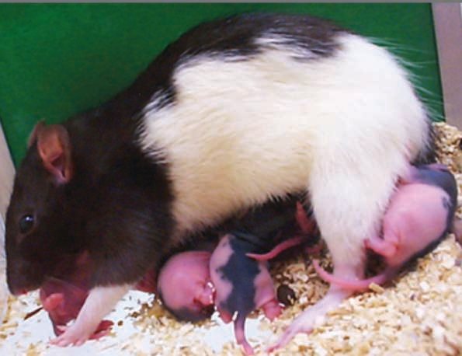
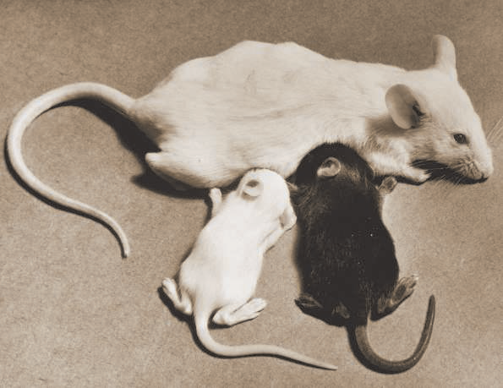
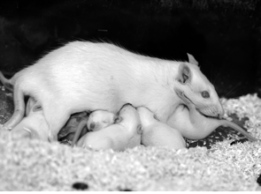
Which is better?

Slide 7
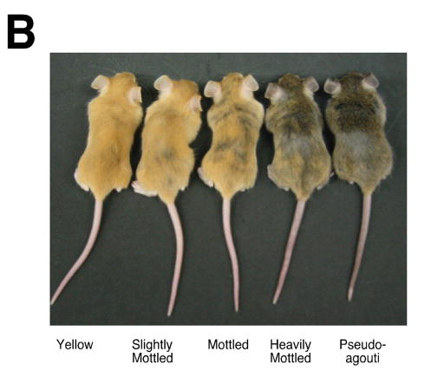
Genetically identical adult viable yellow agouti (A^{vy}) mice representing the five coat color phenotypes. Yellow mice are hypomethylated at the transposable element upstream of the Agouti gene allowing maximal ectopic expression, whereas hypermethylation of this site silences ectopic agouti expression in the pseudoagouti animals. Mice that are predominately yellow are also clearly more obese than brown mice. Reprinted from Dolinoy et al. (2007)¹¹with permission.
Notes:
A) A contraoriented IAP insertion within pseudoexon 1A (PS1A) of the murine agouti gene contains a cryptic promoter (short arrowhead labeled A^{vy}) that drives ectopic agouti expression. Transcription of A and a alleles initiates from a hair-cycle-specific promoter in exon 2 (short arrowhead labeled A, a). B)

Slide 8
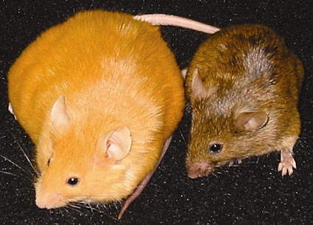
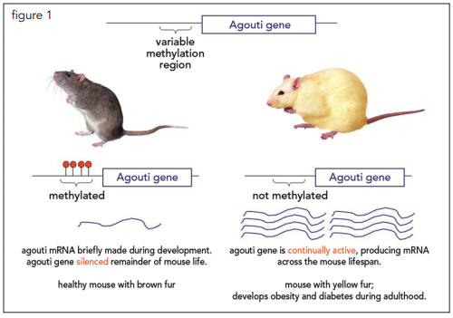
Agouti gene
http://hudsonalpha.org/wp-content/uploads/2014/04/epigenetics.pdf

Slide 9
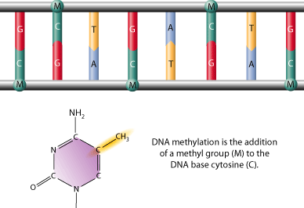
Global Epigenomic Reconfiguration During Mammalian Brain Development (Lister et al., 2013)
Types
1. mCG
2. mCH
(where H = A, C, or T)
DNA methylation is a stable covalent modification that persists in post-mitotic cells throughout their lifetime, helping define their cellular identity

Slide 10
What is Epigenetics?
“Epigenetics refers to modification of genetic information not encoded in the DNA sequence of genomes.
Epigenetics marks can change a gene expression pattern without a change in primary nucleotide sequence - without changing an A, C, G or T.
Changes in gene expression often correspond with epigenetic changes such as methylation of DNA, changes in chromatin conformation (methylation, acetylation), and expression of non-coding RNAs.”
  http://www.sickkids.ca/Research/Weksberg-Lab/Research-focus/BWS/Genetic-Imprinting-and-Epigenetics/index.html

Slide 11
Contextual Determinants of Gene Function
Gene = sequence of DNA
Transcription = enzymes “read” DNA
Environment around DNA makes it possible to “read” DNA
Epigenetic – “in addition to genetic”
  Influences that determine expression without altering the DNA

Slide 12
Environmental Influences on Gene Activity
In rodents:
  Low maternal care → elevated methylation
  Prenatal exposure to chronic stress → increased methylation
Less nurturing mothering leads to poorer stress response in rat pups
    Fewer corticosterone receptors
    Linked to DNA methylation
    Enzymes reverse methylation, improve receptor numbers
      Szyf & Meany (2004)

Slide 13

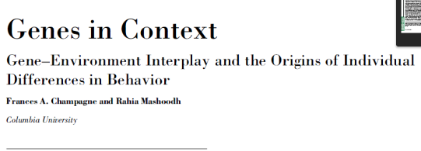
Epigenetics in Rodents
Extension to later mothering
  Less mothering attention -> Greater methylation
    Less mothering attention in the next generation
Roth and Sweatt (2009)
  Stressed mothers spend less time nurturing
  Lower BDNF hormone -> Greater methylation - > Lower neural growth
    Linked to anxiety in mice, responds to antidepressants
    Miller and Sweatt (2007)- Inhibition of methylation →detrimental to memory
Nestler et al. (2010) Cocaine exposure
  Higher acetylation and methylation of histones
    Stimulates reward circuitry

Slide 14

Imagine you have access to a library…
1 DNA Sequence = 1 Book
(Champagne & Mashoodh, 2009; Syzf & Bick, 2012) Rumper

Slide 15


DNA transcription: the process of DNA being read by an enzyme called RNA polymerase > leading to the production of mRNA > which is then translated into a protein
DNA methylation: one type of epigenetic mechanism; reduces the accessibility of DNA and can lead to “silencing” of the gene
Epigenetic influences do NOT alter the sequence of DNA
(Champagne & Mashoodh, 2009; Syzf & Bick, 2012)
Rumper
(Champagne & Mashoodh, 2009; Syzf & Bick, 2012)
Notes:
Former belief: individual differences result from differences in sequence/structure of DNA
Transcriptome: what is transcribed from the genome
Former belief: once DNA methylation patterns are generated during embryogenesis, they remain “fixed” throughout life

Slide 16
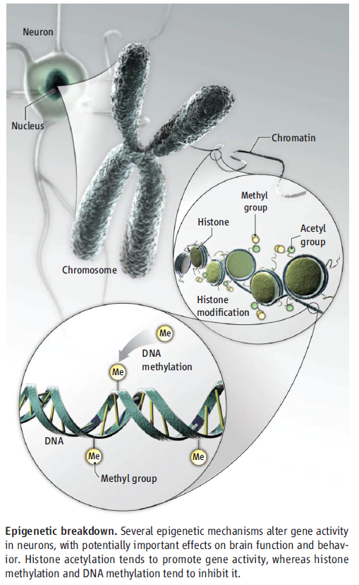
Epigenetic mechanisms
Histone acetylation tends to promote gene activity
Histone methylation and DNA methylation tend to inhibit it.

Slide 17
How can an organism have different cell types yet one genome?
“The idea that DNA function could be stably diversified without changing the sequence comes from the study of cellular differentiation during embryonal development.” (Szyf & Bick, 2012)

Slide 18
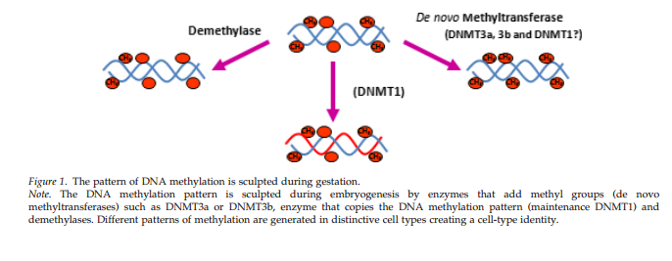
DNA methylation pattern
Szyf & Bick, 2012

Slide 19
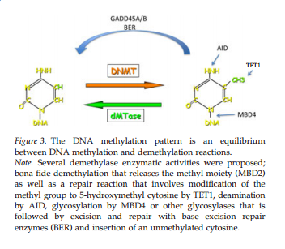
Dynamic DNA methylation
Szyf & Bick, 2012

Slide 20
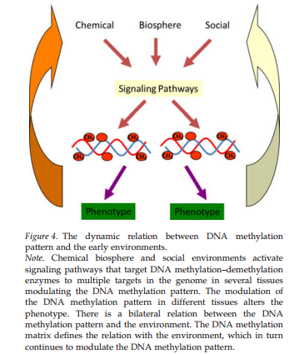
DNA methylation adaption are system wide and involve multiple gene circuitries

Slide 21
The Epigenetic Explanation of the Stress-Vulnerability Model
Humans have genetic variations that lead to either high or low levels of the serotonin transporter
Dunedin study: risk of depression was predicted by the interaction of the serotonin transporter genotype and the number of stressful life events experienced
If few stressful life events, no risk difference by genotype
If many stressful life events, genotype effects
  Individuals with the low-serotonin-transporter-level gene variant were at greater risk of depression
(Champagne & Mashoodh, 2009; Syzf & Bick, 2012)
Notes:
Studies have found that differences in DNA methylation in response to variations in environment emerged early in life and remained stable into adulthood > epigenetic programming early in life could set up life-long behavioral trajectories

Slide 22
Why some books are read and others not?
How could epigenetics play a role in your research?

Slide 23
Goals
Better understand the unique role of DNA methylation in brain development and function → Unravel the genetic program and experience-dependent epigenetic modifications leading to a fully differentiated nervous system
Methods: Integrate empirical data of genome-wide composition, patterning, cell specificity, and dynamics of DNA methylation at single-base resolution in human & mouse frontal cortex at different developmental stages
Offer framework for testing the role of epigenome in:
Healthy function vs. Pathological disruptions of neural circuitry

Slide 24
Global Epigenomic Reconfiguration During Mammalian Brain Development (Lister et al., 2013)
Background
Early postnatal burst of synaptogeneis → activity-dependent pruning of excess synapses during adolescence
  This process forms the basis for experience-dependent plasticity
  Disruption leads to behavioral alterations & neuropsychiatric disorders
Epigenome: Network of chemical compounds surrounding DNA that modify genomic expression without altering DNA sequences
  Dynamic epigenetic changes occur during brain development, maturation, & learning
  DNA METHYLATION PLAYS KEY ROLE:
    Major transcriptional changes → adult electrophysiological characteristics in neocortical neurons

Slide 25
Global Epigenomic Reconfiguration During Mammalian Brain Development (Lister et al., 2013)
Types
1. mCG
2. mCH
(where H = A, C, or T)
DNA methylation is a stable covalent modification that persists in post-mitotic cells throughout their lifetime, helping define their cellular identity

Slide 26
CH methylation accumulates in neurons through early childhood & adolescence – becoming the dominant form of DNA methylation in mature human neurons
  Demonstrates large-scale reconfiguration of neuronal epigenome!
Notes:
Widespread methylome reconfiguration occurs during fetal to young adult development, coincident with synaptogenesis.
Fig. 1. Methylcytosine in mammalian frontal cortex is developmentally dynamic and abundant in CG and CH contexts
(C) Synaptic density (for mouse, per 100 μm2; for human, per 100 μm3) and mC level in CG and CH contexts through development in mouse and human frontal cortex. †Synaptic density quantitation from De Felipe et al. (27) and Huttenlocher and Dabholkar (28). (E) Fraction of cytosine base calls with each modification in fetal and adult mouse frontal cortex.

Slide 27
Inaccessible genomic regions are protected from de novo methylation
  A2: Timing matters!
Example: Central nervous system deletion of Dnmt3a
If during late gestation → Motor deficits, premature death ☹
If during second postnatal week → Plays critical role in establishing normal brain methylation profile and allowing healthy brain development ☺
Notes:
Figure 1: (G) Transcript abundance, chromatin accessibility [8-week mouse cortex ChIP input and DNaseI hypersensitivity (HS) normalized read density], and mC levels in 5-kb bins at the mouse immunoglobulin VH locus. (H) Density (z) plot of 10-week mouse frontal cortex mCH level (x) versus 8-week mouse cortex ChIP-input normalized read density (y) for all 10-kb bins of the mouse genome.
Note: Although mCG is unaffected in these regions, lower chromatin accessibility appears to be highly inhibitory to deposition of mCH and hmC, potentially via inaccessibility to de novo methyltransferases and Tet mC hydroxylases. Furthermore, this indicates that accumulation of mCH and hmC during mammalian brain development occurs via processes that are at least partly independent from methylation at CG dinucleotides.

Slide 28
Neurons and glia show cell type-specific DNA methylation patterns
  Suggests a role for DNA methylation in distinguishing these 2 broad classes of cortical cells!
Notes:
During this period, highly conserved non-CG methylation (mCH) accumulates in neurons, but not glia, to become the dominant form of methylation in the human neuronal genome.
Fig. 2. mCH is positionally conserved and is the dominant form of DNA methylation in human neurons
(A) Browser representation of mCG and mCH in NeuN+ and NeuN− cells. Human NeuN+/ NeuN− samples: R1, 53-year-old female; R2, 55-year-old male. Mouse NeuN+/NeuN− samples: R1, 7-week males; R2, 6-week females; R3, 12-month females (not shown). (B) Percentage of methylated base calls in each sequence context throughout the genome.

Slide 29
Global Epigenomic Reconfiguration During Mammalian Brain Development (Lister et al., 2013)
Other Key Findings:
The mCH position is highly conserved:
  Precise positioning of mCG and mCH marks (which are conserved between individuals and across humans and mice) is consistent with a functional role
X chromosome shows gender-specific DNA methylation patterns

Slide 30
Global Epigenomic Reconfiguration During Mammalian Brain Development (Lister et al., 2013)
Discussion Qs
What’s the bigger picture?
What are the benefits of such experience-dependent epigenetic modifications contributing to the development of a fully differentiated nervous system? Any potential drawbacks?
Are we any closer to a framework for testing the role of epigenome in healthy function vs. pathological disruptions of neural circuitry?

Slide 31
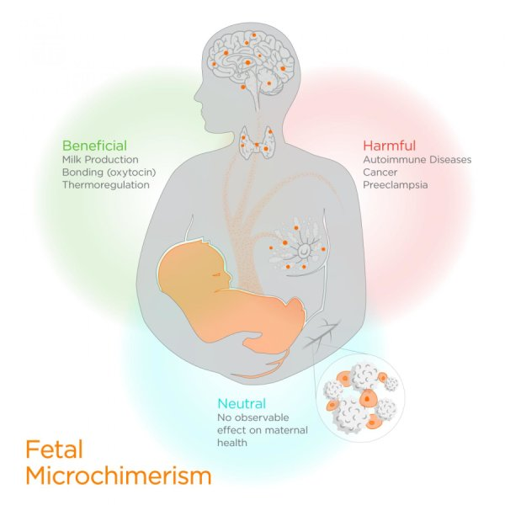
A word on identity
Amy M. Boddy, Angelo Fortunato, Melissa Wilson Sayres, Athena Aktipis. Fetal microchimerism and maternal health: A review and evolutionary analysis of cooperation and conflict beyond the womb.BioEssays, 2015; DOI: 10.1002/bies.201500059

Slide 32
Culture and Neuroscience in Developmental Psychology (Miller & Kinsbourne, in press)
Possible influences of culture on neural maturation
  Structural differences between cultures
  Cultural differences in patterns of utilization that mirror behavioral differences
  Cultural differences in patterns of utilization not reflected in behavioral differences
Reviews of recent findings
  Genetics as potential and influences of environment determine which of the potentials will be realized

Slide 33
Biological Bases of Development
Developmental Neuroscience
  Methods
    Direct vs. indirect assessment
  Brain Development
    Pre- and Postnatal development
      Differential growth rates
        and individual differences (see Shaw et al., 2006)
    Activity-dependent differentiation
    Functional effects of specialization
    Plasticity

Slide 34
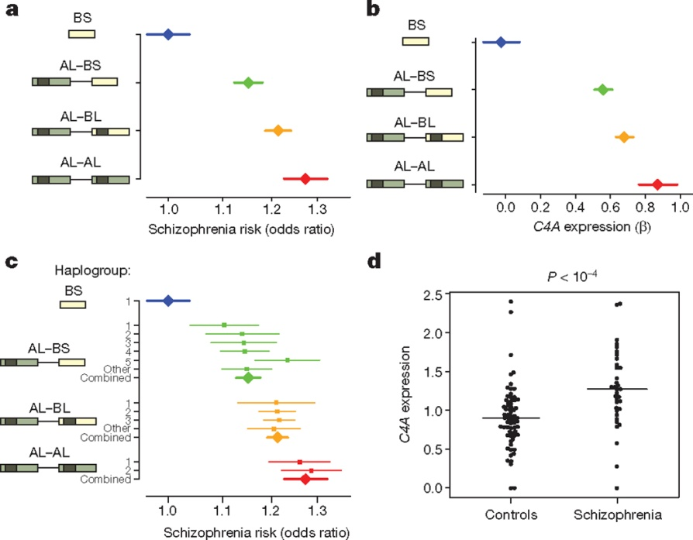

Schizophrenia risk from complex variation of complement component 4
schizophrenia is increased with inheritance of specific variants in a gene related to "synaptic pruning“
http://www.sciencedaily.com/releases/2016/01/160127141400.htm risk
C4 structures, C4A expression, and schizophrenia risk
A Sekar et al. Nature 1–6 (2016) doi:10.1038/nature16549

Slide 35
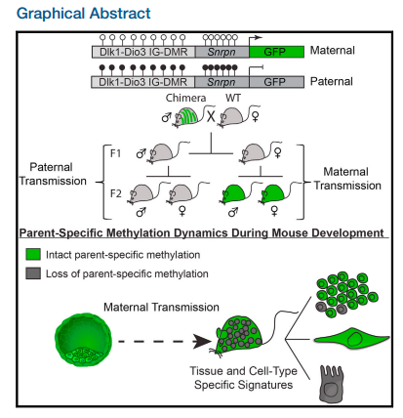

Parent-of-Origin DNA Methylation Dynamics during Mouse DevelopmentYonatan Stelzer, Hao Wu, Yuelin Song, Chikdu S. Shivalila, Styliani Markoulaki, Rudolf Jaenisch
Cell Reports
Volume 16, Issue 12, Pages 3167-3180 (September 2016)
DOI: 10.1016/j.celrep.2016.08.066
Using a recently established DNA methylation reporter, Stelzer et al. study parent-specific methylation dynamics at the Dlk1-Dio3 imprinted control region. Reporter activity uncovered tissue- and cell-dependent signatures through mouse development and in adult tissues, suggesting that dynamic methylation changes regulate imprinted gene expression in pre- and postnatal animals.
Copyright © 2016 The Authors Terms and Conditions

