Slide 1
Emotion
Daniel Messinger, Ph.D.

Slide 2
Infant emotions
Core elements of infant behavior
Quickly motivate behavior
  Hunger-Distress-Cry
  Interest-Attentive face
  Engaging playful other – joy - smile
Organize action, physiology, cognition, & perception
To meet environmental and internal demands
Patterns constitute core aspects of temperament/personality functioning

Slide 3
Infant emotional development
Distress is present at birth
Interest and joy emerge in the first 2 mos.
  joy developing through at least 6 mos.
Anger, sadness, fear differentiate after 4 m.
Pride and shame develop between 1 & 2 years

Slide 4
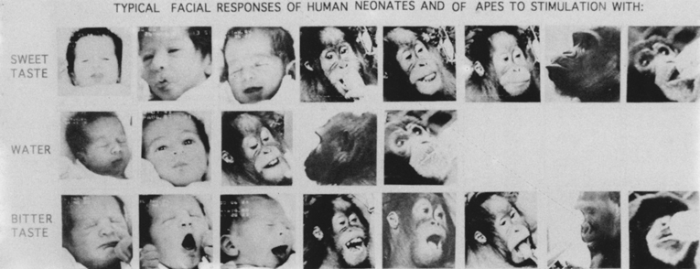
Structuralist vs. functional emotion theories
  Structuralist (aka discrete, natural kinds)
    Emotions comprise unique patterns of subjective feeling, cognitive appraisal, physiological arousal, facial expressions
      Basic emotions promote survival and reproductive success

Slide 5
Discrete infant emotions

Slide 6
Is there emotional feeling without knowledge of feeling?
Infantile memory
  Strong emotional associations
  Without explicit knowledge of associations
  Makes associations inaccessible to reflection and difficult to change
  Memories of smells, movements, even abuse

Slide 7
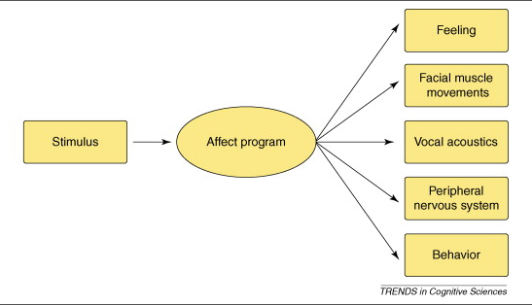
The Structuralist View
“Many models assume that each emotion kind is characterized by a distinctive syndrome of hormonal, muscular, and autonomic responses that are coordinated in time and correlated in intensity “
p. 30 Barrett, 2006

Slide 8
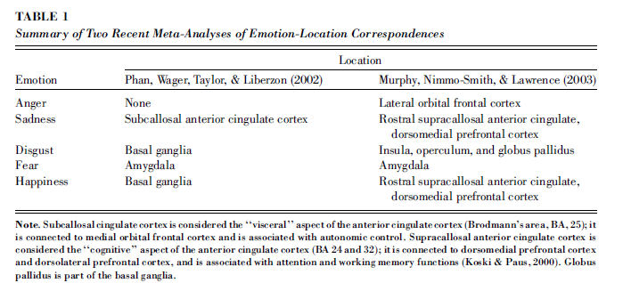
But where are specific emotions?

Slide 9
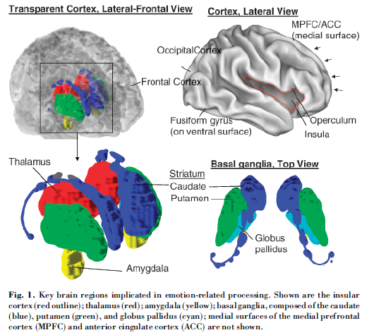
Key brain regions implicated in emotion-related processing.

Slide 10
Facial affect programs?
Current evidence:
  Relevant linked brain systems
  But not distinct affect programs
  Fear may be exception
  Panskepp and current animal work

Slide 11
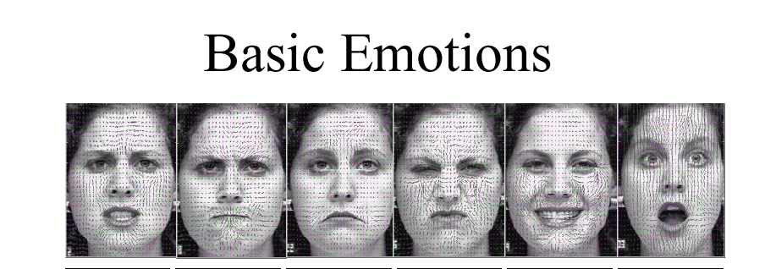
What emotions do you see here?
Cohn

Slide 12
Negative emotional expressions are not situationally specific
Through 2 months, Justine
  shows distress to bathing, being moved, & pacifier removal (inoculation and hunger)
After 2 months, anger and, to a much lesser degree, sadness are most common reaction to all negative elicitors
  infants cry, not a specific reaction
        Camras, 1992

Slide 13
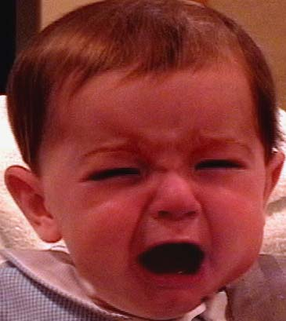


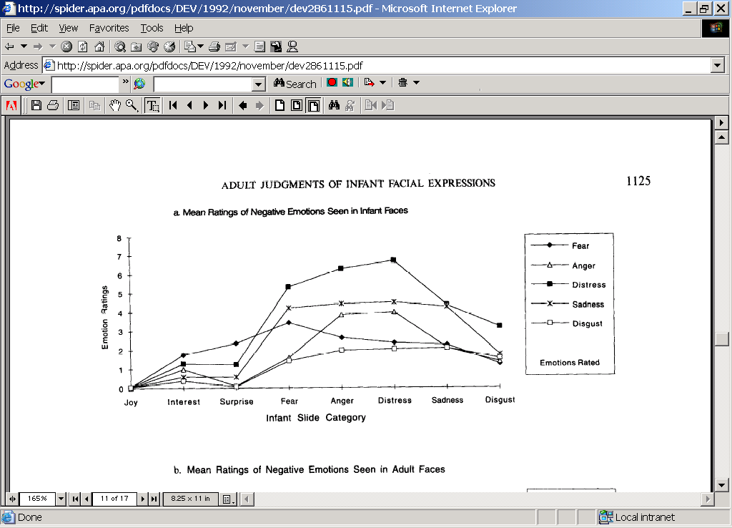
Infant negative expressions rated as distress
(Oster et al., 1992)

Slide 14
Situational appropriateness: Production studies
Premise:
In response to an appropriate elicitor (situation), hypothesized emotional expression should occur significantly more than other expressions

Slide 15
Examples
Sad → distress→smile: http://www.youtube.com/watch?v=akPVtObBUOk&feature=related
Distress:
Sad→disress: https://www.youtube.com/watch?v=l7oD9WX-1CU
Smiloe→Fear/orient→distress: http://www.youtube.com/watch?NR=1&feature=fvwp&v=QiBrPkGoqFM
Fear→distress: http://www.youtube.com/watch?v=fASp42ZvjIM&feature=fvwrel,
http://www.youtube.com/watch?feature=fvwp&NR=1&v=H-1me_wsuyk (alligator bite)
Sad: http://www.youtube.com/watch?v=szLjXta0Szw, dad singing http://www.youtube.com/watch?v=dAzLsnYvdYo&feature=related (lower lip in response to rasberries)
Examples (Slides 3-10 are pictures) : http://www.slideserve.com/marilu/emotions
http://www.youtube.com/watch?v=NS8rZb79-As&feature=related

Slide 16
Maze game—Scary—children
http://www.youtube.com/watch?v=ZGd5NqP6qd4
Slow-motion: http://www.youtube.com/watch?v=LC5qPvTQUdo
Compendium: http://www.youtube.com/watch?v=cypeLuCIrU0
Long: http://www.youtube.com/watch?v=q9kNCBGEyfk 0:55-1:07, 1:45-2:30

Slide 17
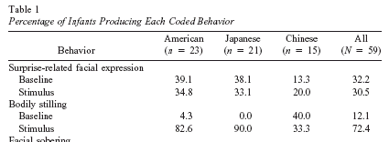
Surprise! Its not in the face
Covert toy switch

Slide 18
Surprise examples
Expression on demand: http://www.youtube.com/watch?v=8DaKcKqVheE&NR=1
Coordinative structure? http://www.youtube.com/watch?v=cOvtNPljtv0&feature=related
Posed adult: http://www.youtube.com/watch?v=f4AyfrM8Q2o
Girl and Dad 1:05—1:40. http://www.youtube.com/watch?v=q5HXl_zJ5po

Slide 19
Emotion (cont)
Structuralist vs. functional perspectives on emotion (cont)
  Functionalist
    Emotions serve to establish, maintain, or change relation between person and environment on matters of significance to person

Slide 20
Developmental patterns
Socialization
  Emotion displays become more restricted
  Full-face to partial face - miniaturization
Cognitive input
  shame, guilt, contempt emerge
    involve rudimentary appraisal of self vis-à-vis other
      dynamic systems

Slide 21
Developmental Changes in Emotion
Psychobiological foundations
  Subcortical mediation of basic emotions
  Developing subcortical-frontal connections permit more effective emotion regulation
Emotion Perception
  Discrimination/categorization of expression by 5 months of age
  Rely on others’ reactions to interpret unfamiliar situations = social referencing (12+ months)
  Understanding of subjective state of emotion (24+ months), allows for prosocial displays of comforting etc.

Slide 22
Developmental Changes in
Emotion (cont)
Emotion and Self-Development
  Increases in self-awareness (2/3 yrs) leads to expression of new, more complex emotions
    Self-Conscious Emotions
      Pride
      Guilt
      Shame
      Embarrassment

Slide 23
Developmental Changes in Emotion (cont)
Understanding effects of emotions on others:
The use of display rules
  Increased ability to understand and apply social rules for display of emotion in social situations
    Emotion masking
      Primitive forms in preschool; more flexible, reasoned use in middle childhood

Slide 24
Developmental Changes in Emotion (cont)
Emotion Regulation
  Adaptive management of emotional experiences
  Developmental transition from other-regulation to self-regulation
    Internalization of socialization experiences

Slide 25
Dynamic systems
Development, interaction, and (emotional) behavior are complex
involving multiple interfacing/interacting constituents
which produce patterns we see as pre-designed regularities
A bottom-up approach
  Discrete emotions as preferred states formed from the interface of multiple constituents

Slide 26
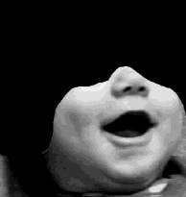
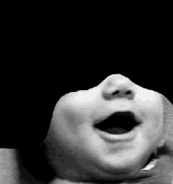
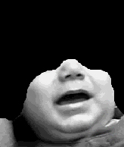
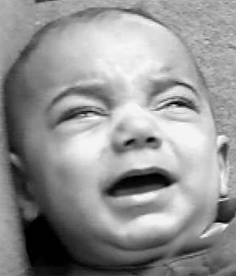
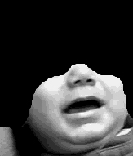
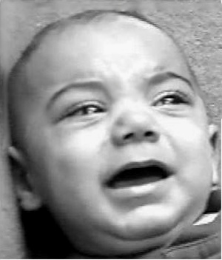
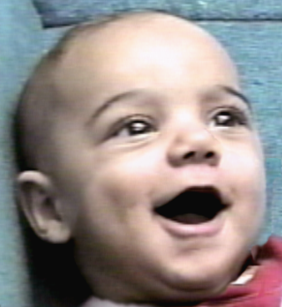
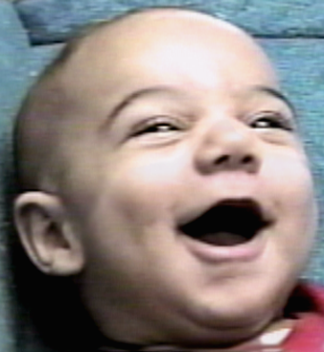
Facial expression communication
A systems view
+ Eye constriction
- Eye constriction
Positive Emotion
Positive Rating
Negative Rating
8
7
6
5
4
3
Messinger, 2002

Slide 27
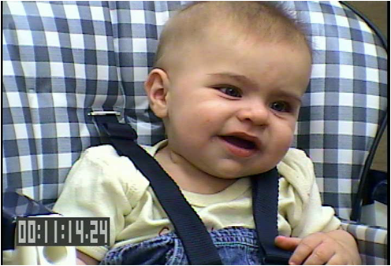


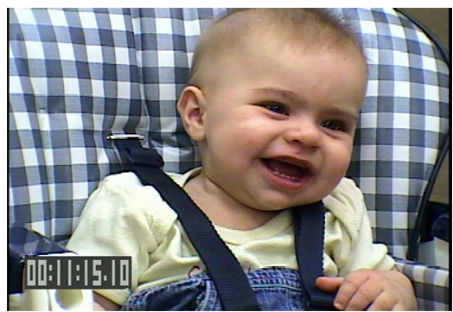




But what about dynamic expressions?
Messinger, Mattson, Mahoor, & Cohn, Emotion, 2012
Bolzani-Dinehart, et al., 2005

Slide 28
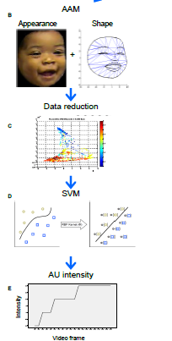
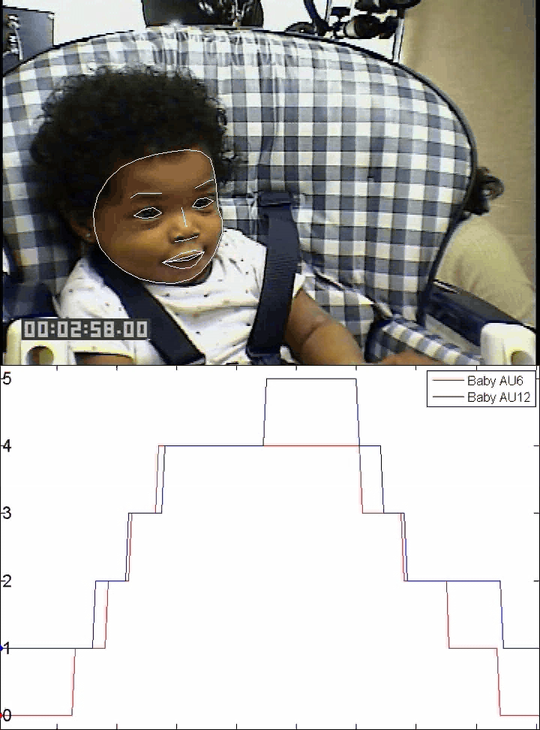
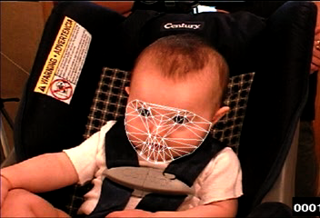
Automated Measurement
Computer
Vision
Pattern
Recognition

Slide 29
Intensifiers of positive and negative
Messinger , Mattson, Mahoor, & Cohn, 2012

Slide 30
Intensifiers of positive and negative
Messinger , Mattson, Mahoor, & Cohn, 2012

Slide 31
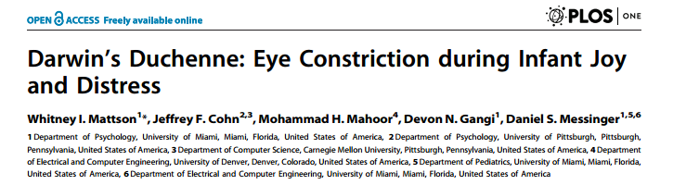
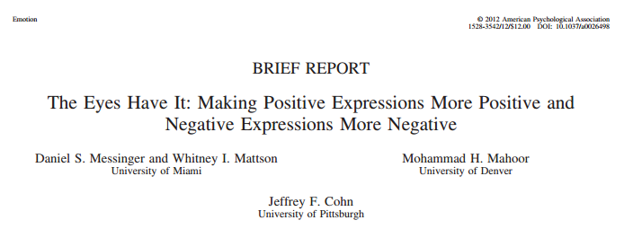

Slide 32
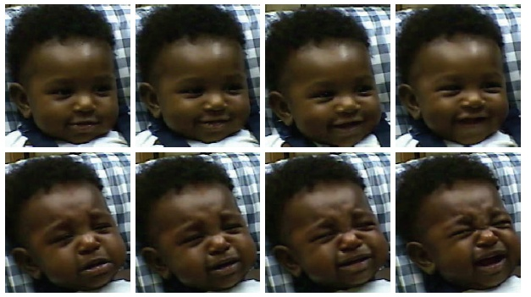
Eye constriction has a common meaning—intensification—across positive and negative expressions
Signals a focus on internal state to self and other
Notes:
Isre icon

Slide 33
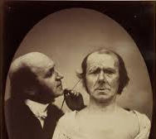

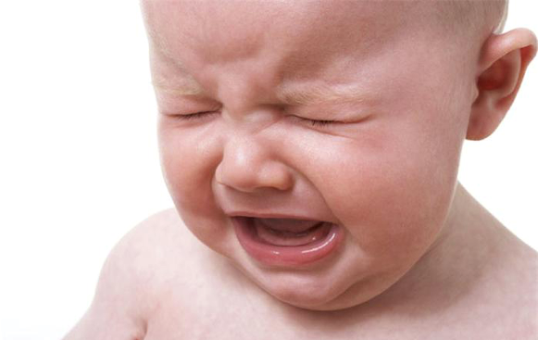
Darwin’s Duchenne:
Eye Constriction during Infant
Joy and Distress
(Mattson et al., 2013)

Slide 34

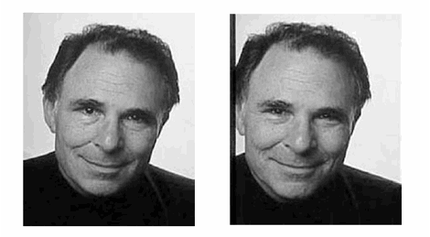
Darwin’s Duchenne
(Mattson et al., 2013)
What We Know…
Research has supported Darwin’s proposal that smiles with eye constriction (Duchenne smiles) are indices of strong positive emotion
In both infants & adults, Duchenne smiles are…
  A more frequent response to positive emotion elicitors
  Perceived as more joyful than other smiles
Notes:
Following early research by 19th century French neurologist Duchenne de Boulogne (who identified two types of smiles), Darwin highlighted the role of eye constriction (orbicularis oculi, pars orbitalis) in facial expressions of positive emotion
Duchenne Smile: Engages multiple facial muscles and elicits wrinkling around the eyes

Slide 35

Darwin’s Duchenne
(Mattson et al., 2013)
What We Don’t Know…
Darwin also proposed that eye constriction plays a role in weeping/crying (especially during infancy), but little parallel research has examined cry-faces
No study has simultaneously examined the role of infant eye constriction in both smiling & cry-face expressions in reaction to experimental elicitation of positive and negative emotion
Notes:
Cry Face = Open-mouth expression with lateral lip stretching

Slide 36
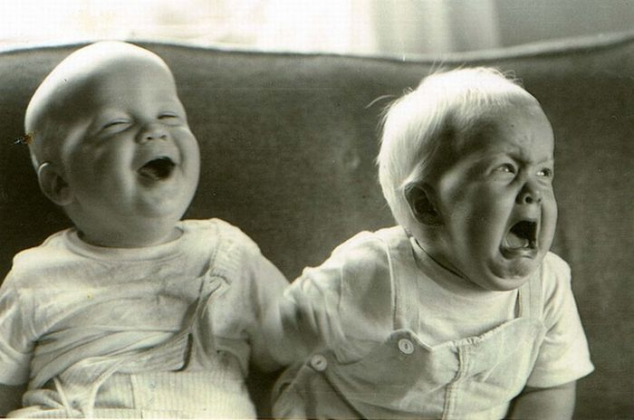
Darwin’s Duchenne
(Mattson et al., 2013)
Q: Does eye constriction index the affective intensity of both positive and negative emotions
?
Hypotheses: Duchenne marker (eye constriction) expected to be associated with both stronger smiles and cry faces; smiles during play would be more emotionally positive than still face; cry-faces would be more emotionally negative in still-face than play.
Clennan
Notes:
Fixation Duration: Time between saccadic eye movements when eyes are relatively stable
Infant attention correlates with attention in toddlerhood/preadolescence
Infant attention correlates with IQ at age 11

Slide 37
Darwin’s Duchenne
(Mattson et al., 2013)
Q: Does eye constriction index the affective intensity of both positive and negative emotions
?
Notes:
Fixation Duration: Time between saccadic eye movements when eyes are relatively stable
Infant attention correlates with attention in toddlerhood/preadolescence
Infant attention correlates with IQ at age 11

Slide 38

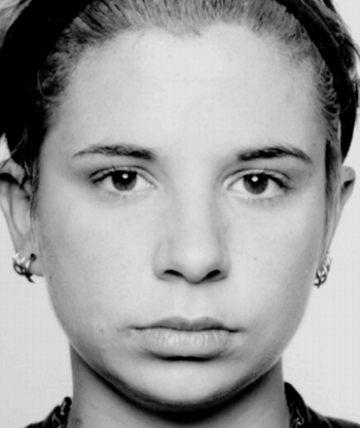
Darwin’s Duchenne
(Mattson et al., 2013)
Study 1: Face-to-Face/Still Face (FFSF)
PLAY
3 minutes Elicits more positive emotion Smiles during play more emotionally positive – Duchenne?
STILL FACE
2 minutes Elicits more negative emotion Cry-faces during still face more emotionally negative – Duchenne?
Notes:
Play elicits more positive emotion (i.e. higher proportions of infant smiling) than the Still-Face; the Still- Face elicits more negative emotion (i.e. a higher proportion of cry- face expressions) than Play. Based on these findings, we reasoned that smiles during Play would be more emotionally positive than smiles in the Still-Face, and that cry-faces in the Still-Face would be more emotionally negative than cry-faces during Play. Accordingly, we hypothesized that a greater proportion of smiles would involve eye constriction during Play than during the Still- Face; and that a greater proportion of cry-faces would involve eye constriction during the Still-Face than during Play.
In the current dataset and others [26], however, the strength of eye constriction covaries with the strength of smiles and cry-faces [9]. Consequently, we expected the Duchenne marker to be associated with both stronger smiles and cry-faces.

Slide 39
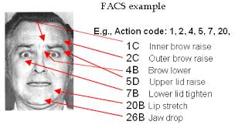
Darwin’s Duchenne
(Mattson et al., 2013)
PARTICIPANTS
  12 6-month old infants + parents (11 moms, 1 dad)
    4 EA, 4 Hispanic American, 2 AA, 2 Asian American
  66.7% male
METHOD
  Facial Coding
  Repeated-measures ANOVAs
Clennan
Notes:
Participants. Twelve six-month-olds and their parents (11 mothers, 1 father) were video-recorded in the FFSF [9] to elicit a range of negative and positive infant emotional expressions. Play lasted three minutes and the Still-Face lasted two minutes. The six- month-olds (M = 6.20, SD = 0.43) were 66.7% male and ethnically diverse (16.7% African American; 16.7% Asian American, 33.3% Hispanic American, and 33.3% European American).

Slide 40
Darwin’s Duchenne
(Mattson et al., 2013)
Study 1: Face-to-Face/Still Face (FFSF)
PARTICIPANTS
  12 6-month old infants + parents (11 moms, 1 dad)
  66.7% male
2
4
2
4
METHOD
  Facial Coding
  Repeated-measures ANOVAs
Notes:
Participants. Twelve six-month-olds and their parents (11 mothers, 1 father) were video-recorded in the FFSF [9] to elicit a range of negative and positive infant emotional expressions. Play lasted three minutes and the Still-Face lasted two minutes. The six- month-olds (M = 6.20, SD = 0.43) were 66.7% male and ethnically diverse (16.7% African American; 16.7% Asian American, 33.3% Hispanic American, and 33.3% European American).

Slide 41
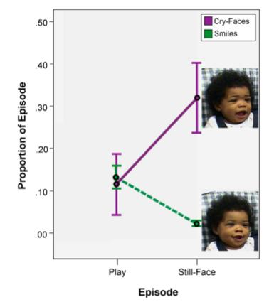
Darwin’s Duchenne
(Mattson et al., 2013)
Study 1: Face-to-Face/Still Face (FFSF)
RESULTS
Figure 1. Time in smiling and cry-faces as a proportion of time in each episode of the Face-to-Face/Still-Face (FFSF)
Smiles & cry-faces distributed differentially in Play & Still-Face episodes
Overall still-face effects
Notes:
Figure 1. Time in smiling and cry-faces as a proportion of time in each episode of the Face-to-Face/Still-Face (FFSF). Error bars indicate standard errors of the mean. The images are of smiles and of cry-faces without eye constriction. The images are from a six-month-old in the FFSF in the current study. Written informed consent, as outlined in the PLOS consent form, was obtained for publication of these images.
We posited that eye constriction would be differentially distributed with smiles and cry-faces during the FFSF. To lay the groundwork for testing this hypothesis, we used repeated- measures ANOVAs to ascertain whether there were still-face effects in the overall levels of smiles and cry-faces in the FFSF.
Smiles and cry-faces were distributed differentially in the Play and Still-Face episodes of the FFSF, F (2, 22) = 7.24, p,.01, gp2 = .40 (see Figure 1). The mean proportion of time involving smiling declined from Play (M = .13, SD = .08) to the Still-Face (M = .02, SD = .03), F (1, 11) = 17.10, p,.01, gp2 = .61. The mean proportion of time involving cry-faces increased from Play (M = .11, SD = .25) to the Still-Face (M = .32, SD = .29), F (1, 11) = 4.97, p,.05, gp2 = .31.
These overall still-face effects are the background against which we test whether the proportion of smiles involving eye constriction and the proportion of cry-faces involving eye constriction vary systematically over the course of the FFSF.

Slide 42
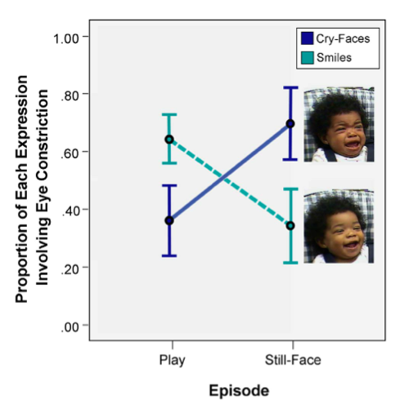

Darwin’s Duchenne
(Mattson et al., 2013)
Study 1: Face-to-Face/Still Face (FFSF)
RESULTS
Figure 2. Eye constriction is differentially associated with smiles & cry-faces in FFSF
Greater proportion of smiles in Play with eye constriction
Greater proportion of cry-faces in Still-Face with eye constriction
^{Hypothesis}
Notes:
Figure 2. Eye constriction (the Duchenne marker) is differentially associated with smiles and cry-faces in the Face-to-Face/ Still-Face (FFSF). Mean proportions of smiles and of cry-faces occurring with eye constriction. Error bars indicate standard errors of the mean. The images are of smiles and cry-faces with eye constriction. The images are from a six-month-old in the FFSF in the current study. Written informed consent, as outlined in the PLOS consent form, was obtained for publication of these images.
A repeated-measures ANOVA indicated that proportions of smiling and cry-faces that involved eye constriction were differentially distributed over episodes of the FFSF, F (2, 22) = 11.28, p,.001, gp2 = .51 (see Figure 2). A higher proportion of smiles involved eye constriction during Play (M = .64, SD = .30) than did smiles during the Still-Face (M = .34, SD = .38), F (1, 11) = 6.70, p = .03, gp2 = .38. A higher proportion of cry-faces involved eye constriction during the Still-Face (M = .70, SD = .38) than during Play (M = .36, SD = .39), F (1, 11) = 11.43, p,.01, gp2 = .51.
These results provide evidence in support of the hypothesis. In a positive-emotion eliciting context, smiling was more likely to be accompanied by eye constriction. In a negative- emotion eliciting context, cry-faces were more likely to be accompanied by eye constriction.

Slide 43
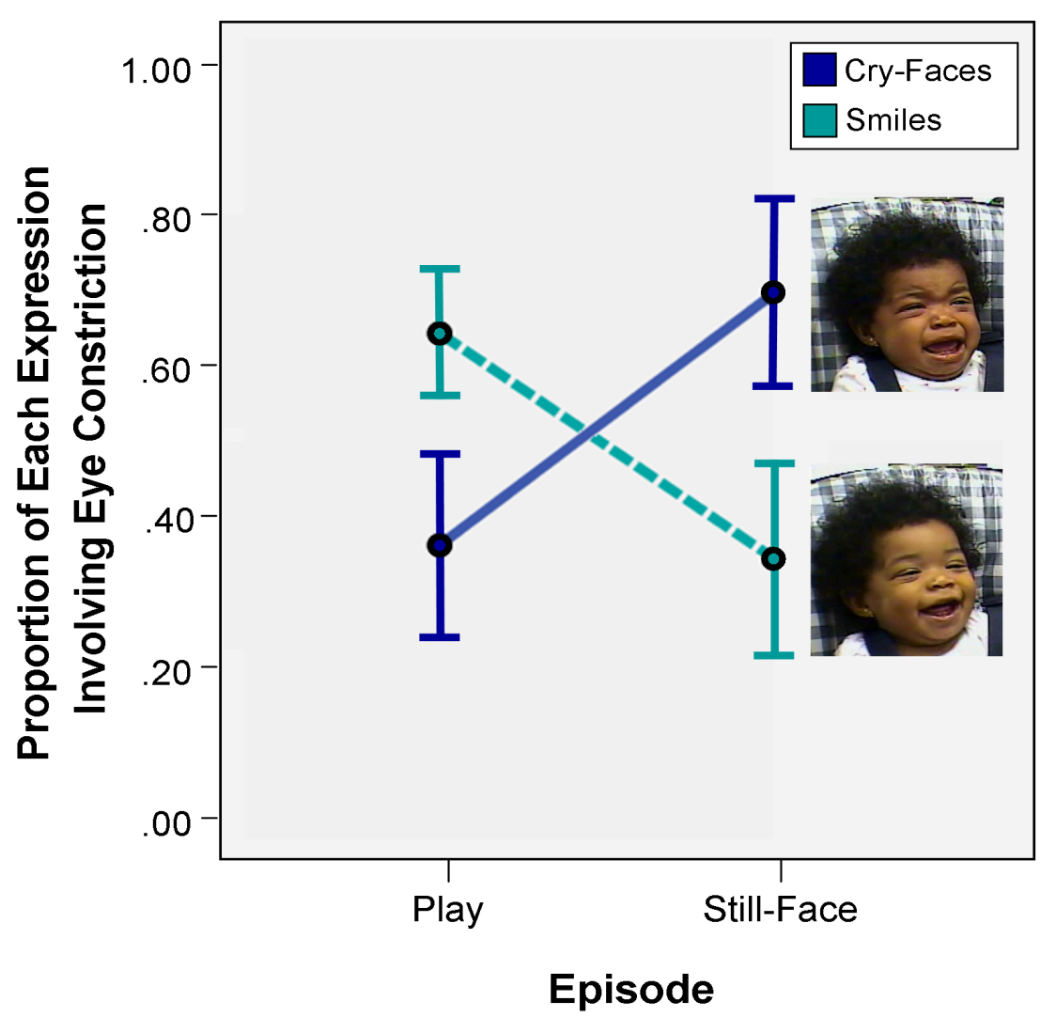
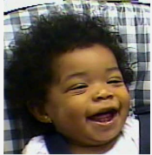
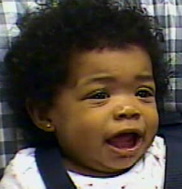
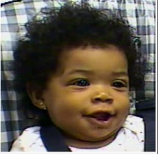
Experimental evidence for role of eye constriction
Mattson, et al.,PLOS One, in press
Mattson, et al., 2013, under review

Slide 44
Darwin’s Duchenne
(Mattson et al., 2013)
DISCUSSION
During play, infant smiles are more emotionally positive than when trying to elicit a response from non-responsive parent
When stymied by parent, infant cry-faces are more emotionally negative than cry-faces during play
Duchenne marker (eye constriction) is associated with BOTH stronger smiles & stronger cry-faces
Notes:
The results indicate that when infants are engaged in play with a parent, their smiles are more emotionally positive than when they are trying to elicit a response from a non- responsive parent. Likewise, when infants are stymied by their non-responsive parent, their distress expressions are more emotionally negative than distress expressions that occur during play. Finally, the Duchenne marker, eye constriction, accompa- nied both stronger smiles and stronger cry-faces.
Study 1 results add to a growing body of research suggesting that smiling with eye constriction is stronger and more likely to occur in situations that elicit positive emotion than smiles without eye constriction [5,6,34]. Early distress expressions that involved eye constriction also tended to be stronger and were more likely to occur in periods intended to elicit negative emotion than distress expressions without eye constriction. To ascertain the generality with which infants respond to strong elicitors of negative emotion with cry-faces involving eye constriction, we next examined responses to naturally occurring vaccination injections.

Slide 45
Darwin’s Duchenne
(Mattson et al., 2013)
Study 1: Face-to-Face/Still Face (FFSF)
DISCUSSION
During play, infant smiles are more emotionally positive than when trying to elicit a response from non-responsive parent
When stymied by parent, infant cry-faces are more emotionally negative than cry-faces during play
Duchenne marker (eye constriction) is associated with BOTH stronger smiles & stronger cry-faces
Notes:
The results indicate that when infants are engaged in play with a parent, their smiles are more emotionally positive than when they are trying to elicit a response from a non- responsive parent. Likewise, when infants are stymied by their non-responsive parent, their distress expressions are more emotionally negative than distress expressions that occur during play. Finally, the Duchenne marker, eye constriction, accompa- nied both stronger smiles and stronger cry-faces.
Study 1 results add to a growing body of research suggesting that smiling with eye constriction is stronger and more likely to occur in situations that elicit positive emotion than smiles without eye constriction [5,6,34]. Early distress expressions that involved eye constriction also tended to be stronger and were more likely to occur in periods intended to elicit negative emotion than distress expressions without eye constriction. To ascertain the generality with which infants respond to strong elicitors of negative emotion with cry-faces involving eye constriction, we next examined responses to naturally occurring vaccination injections.

Slide 46

Darwin’s Duchenne
(Mattson et al., 2013)
Q: Do the cry-face results of the FFSF generalize to a naturalistic elicitor of intense negative emotion
?
Notes:
Fixation Duration: Time between saccadic eye movements when eyes are relatively stable
Infant attention correlates with attention in toddlerhood/preadolescence
Infant attention correlates with IQ at age 11

Slide 47

Darwin’s Duchenne
(Mattson et al., 2013)
Study 2: Vaccinations
PARTICIPANTS
  Identified through YouTube videos of infant vaccinations
  12 6-month old & 12-month old infants
METHOD
  Facial Coding of 10 seconds following first injection
  Repeated-measures ANOVAs
Notes:
Participants. Twelve six-month-olds and their parents (11 mothers, 1 father) were video-recorded in the FFSF [9] to elicit a range of negative and positive infant emotional expressions. Play lasted three minutes and the Still-Face lasted two minutes. The six- month-olds (M = 6.20, SD = 0.43) were 66.7% male and ethnically diverse (16.7% African American; 16.7% Asian American, 33.3% Hispanic American, and 33.3% European American).

Slide 48

Darwin’s Duchenne
(Mattson et al., 2013)
Study 2: Vaccinations
RESULTS
  Most cry-faces involved Duchenne marker
  6-month olds = 12-month olds in…
    Proportion of time involving crying faces
    Proportion of cry-faces with eye constriction
DISCUSSION
  Extends results to naturalistic elicitor of negative emotion
  “Duchenne distress expression” is predominant response to both parents ceasing play & noxious stimulus
Notes:
Results: We determined the overall proportion of time involving cry-face expressions after injections and tested whether this proportion varied with age. The mean proportion of time involving cry-faces was.50. There was not a significant difference in the proportion of time involving cry-faces at 6 months (M = .43, SD = .25) compared to 12 months (M=.56, SD=.24), F (1, 22)=1.71, p=.20. We next examined the proportion of time in which cry-faces were accompanied by eye constriction. The mean proportion of time in cry-faces which involved eye constriction was.87. There were no differences in the proportion of cry-faces involving eye constriction at 6 (M=.82, SD=.28) and 12 months (M=.92, SD=.07), F (1, 21) = 1.43, p = .24. These results indicate that in an intense negative-emotion eliciting context, cry-faces were likely to be accompanied by eye constriction at both 6 and 12 months of age. That is, the overwhelming majority of cry-faces occurring in response to a painful elicitor of negative emotion involved the Duchenne marker.
Discussion: Study 2 vaccination findings extend the Study 1 FFSF cry-face results to a naturalistic elicitor of intense negative emotion. Immediately following vaccination injections, the overwhelming majority of cry-faces involved eye constriction at both 6 and 12 months. These results provide an anatomically specific documen- tation of infant eye constriction responses to painful injections In response to this elicitor of intense negative emotion, infants combined a cry-face expression with eye constriction, the same Duchenne marker they combine with smiling during the elicitation of intense positive emotion during play. These cry-faces involving eye constriction, termed Duchenne distress expressions (see Fridlund) [35], were the predominant responses both to parents’ abruptly ceasing playful interaction and to a noxious stimulus.

Slide 49
Darwin’s Duchenne
(Mattson et al., 2013)
Conclusions
Results support hypotheses
  Eye constriction indexes the affective intensity of both positive & negative facial configurations
  “Duchenne distress expression” parallels “Duchenne smile”
    Facial action has consistent function in various facial expressions
    Parsimonious way to communicate emotional intensity
Eye constriction
  Possible functions: (1) Regulates exposure to intense emotional stimuli, (2) Increase attention to internal emotional state
  Signals: ☺ Intense positive engagement & ☹ Intense need for comfort
  In adults: Pain, Orgasm
Notes:
Ultimately these findings support the contention of Darwin and others that a given facial action may have a consistent function in a variety of facial expressions [36,37,38].
Eye constriction (obicularis occuli pars orbitalis), the Duchenne marker, reduces but does not completely occlude the visual field. This suggests that the Duchenne marker may regulate exposure to intense emotional stimuli [34], and may also increase the expresser’s attention to his or her own internal emotional state [8]. Duchenne smiling and Duchenne distress appear to serve, respectively, to communicate intense positive engagement and an intense need for comfort. Smiling and the cry-face expression are the infant’s most commonly used facial configurations, suggesting the importance of eye constriction to early emotion expression and communication [12,13].
In adults, the role of eye constriction is well documented in Duchenne smiling [3,4,7]. Eye constriction is also a key element of the adult pain configuration [21,22], and may index the intensity of this expression which, when it is maximally displayed, is an adult analog of the infant cry-face. The same expressive configuration is present during other intense experiences such as orgasm [39], suggesting that eye constriction is associated with the intensity of facial expressions of extreme positive and negative valence in adults.

Slide 50
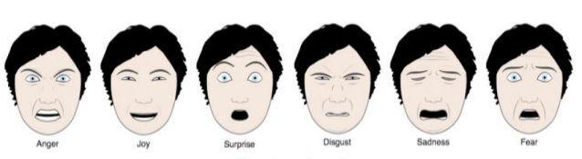
Darwin’s Duchenne
(Mattson et al., 2013)
Future Directions
What about facial expression of other emotions?
What about other modalities of emotional expression?
  Which other modalities are important for the expression of emotion?
  How do we make sense of inconsistent signals from different modalities of emotional expression?
Notes:
From an evolutionary perspective, eye constriction provides a parsimonious means for indexing the intensity of both positive and negative emotions. However, an evolutionary focus on the function of facial movements for the organism in its environment suggests that eye constriction will not have an identical role in all (adult) expressions of negative emotion [22].
Facial expressions of fear, for example, may serve to enhance sensory input, widening the visual field to facilitate quick defensive reactions [40].
Anger configurations in adults also involve eye opening (AU5) [15], which is likely to facilitate and communicate potential aggression to the target [35,41]. This suggests that the intensity of fear and anger might be indexed by eye opening rather than eye constriction.
Disgust, by contrast, is characterized by rejecting sensory input through eye and nostril constriction [40]. Eye constriction might index the intensity of disgust, and of sadness, which may also involve a narrowing of the visual field in adults, but this remains a topic for future research.
Ultimately, the current focus on the general functions of facial actions across a range of expressions (see Susskind et al.) [40] is likely to produce new insights into both expression-specific and pan-expression features of expressive action.
The face is one modality of emotional expression. Aviezer, Trope, and Todorov found that other modalities of expression such as body posture carry more weight than the face when adults rate the valence of still images of other adults during positive and negative events [42]. Nevertheless the facial expressions in response to both positive and negative events (e.g., winning or losing a match point during a tennis match) exhibited in Aviezer et al.’s figures (Figures 1–4) [42] all involved eye constriction and/ or eye shutting, potentially underlining the role of these actions in communicating intense positive and negative emotional valence.

Slide 51
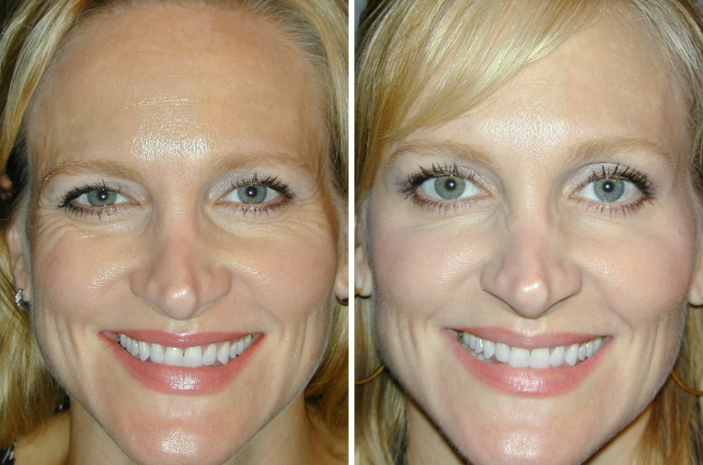
Darwin’s Duchenne
(Mattson et al., 2013)
Discussion Qs
What are some other directions for future research? How could this work be extended?
What are some potential implications for development?
How might Duchenne expressions impact our perceptions & behavior?
Professional Photos
Botox
Notes:
More time-points/extend beyond 6 and 12 months to examine developmental trajectory; compare to adults
If studying children or adults, use self-report likert scale to match self-reported intensity with coded intensity
2. No change across development? Or only within the 1st 12 months? Do we change in the proportion of intense expressions as we age?
3. Other possible social functions? Communication beyond internal state – for a smile: trustworthiness, appeasement, friendliness?
What about Duchenne distress? Are we more likely to help or offer comfort?

Slide 52
Darwin’s Duchenne
(Mattson et al., 2013)
DISCUSSION QUESTIONS:
How can these findings be extended (i.e. clinical implications)? Do you think these findings can be replicated in an adult population?
  If the findings are similar in an older sample, what does this imply?
How might these Duchenne expressions (eye constriction) impact our behavior?
From and evolutionary perspective, how are Duchenne expressions beneficial?
Clennan
Notes:
2. Communication beyond internal state – for a smile: trustworthiness, appeasement, friendliness?
What about Duchenne distress? Are we more likely to help or offer comfort?
3. From an evolutionary perspective, eye constriction provides a parsimonious means for indexing the intensity of both positive and negative emotions. However, an evolutionary focus on the function of facial movements for the organism in its environment suggests that eye constriction will not have an identical role in all (adult) expressions of negative emotion [22].
Facial expressions of fear, for example, may serve to enhance sensory input, widening the visual field to facilitate quick defensive reactions [40].
Anger configurations in adults also involve eye opening (AU5) [15], which is likely to facilitate and communicate potential aggression to the target [35,41]. This suggests that the intensity of fear and anger might be indexed by eye opening rather than eye constriction.
Disgust, by contrast, is characterized by rejecting sensory input through eye and nostril constriction [40]. Eye constriction might index the intensity of disgust, and of sadness, which may also involve a narrowing of the visual field in adults, but this remains a topic for future research.

Slide 53
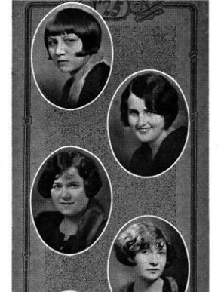
Yearbook pictures
…and
life

Slide 54
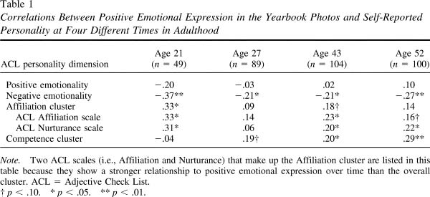
Smile intensity & self-reported personality

Slide 55
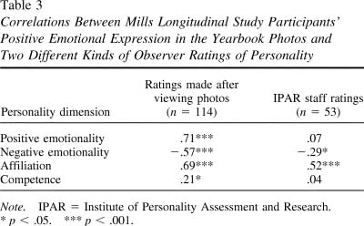
Smile intensity & other-reported personality

Slide 56
Smile intensity and Observer Expected Interactions (n=114)
Observer Expectations | Positive emotional expression
Expected positive emotions | .70
Expected negative emotions | -.57
Approach-acceptance | .52

Slide 57
Smile intensity and Life Outcomes
Life Outcome | Positive expression | Controlling for Attract./Social Desirability
Married by age 27 | .19 | .18/.16
Single into adulthood | -.20 | -.18/.20
Ever divorced | .15 | ~.15/~.15
Personal Well-being
Age 21 (n=112) | .20 | .20/.11
Age 27 (n=86) | .25 | .26./.23
Age 43 (n=105) | .18 | .19/12
Age 52 (n=101) | .27 | .28/.24

Slide 58
Expressions by behavior rating
Why?
Keltner et al., 1999
Notes:
80th%ile. Higher % of their own expressions

Slide 59
Functionalist theory
Emotion is the person’s attempt or readiness to establish, maintain, or change the relation between the person and the environment on matters of significance to that person (Saarni et al., 1998).
  Emotion is associated with goal-attainment, social relationships, situational appraisals, action tendencies, self-understanding, self regulation, etc.

Slide 60
Halloween Candy
http://www.youtube.com/watch?v=WOlpdd7y8MI

Slide 61
Emotions
Organize action, physiology, cognition, and perception to meet ever-changing environmental and internal demands
In patterns constituting core aspects of temperament/personality functioning
Motivate action and thought, creating value in life—and impacting wellness and sickness

