Slide 1
Social and Emotional Development PSY624 Predictors of interactive competence
Daniel Messinger, PhD

Slide 2
Overview
Do individual differences in associative learning (Reeb-Sutherland) facilitate social engagement?
Do rhesus macaques engage in face-to-face interaction?
Are individual differences in infant macaque neonatal imitation levels associated with
Attention to the eyes (Paukner);
Peer play and self-grooming (Kaburu)

Slide 4
Overview
Examined whether individual differences in the rate of associative learning at 1 month of age predicts social, imitative, and discriminative behaviors across first year
Faster learning at age 1 month associated with extent of social behaviors across time points during first year

Slide 5
Methods
70 healthy infants
1 Month Assessment
Delay eyeblink conditioning paradigm while asleep
UCS: airpuff
CS: tone
EMG data collected via electrodes on infant
Tone-airpuff paired trials, airpuff alone trials, and tone-trials
Each trial examined for eyeblink response defined as rapid deflection in EMG signal

Slide 6
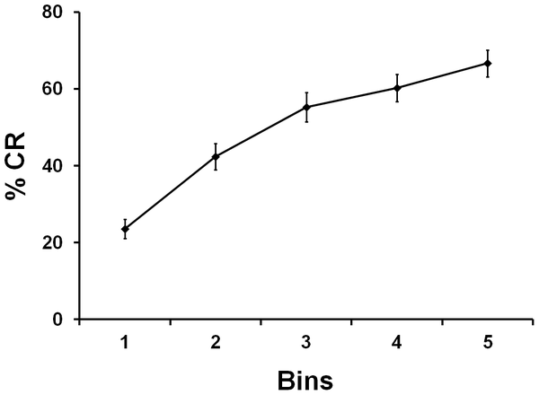
Learning curve for one-month-old infants
Reeb-Sutherland BC, Levitt P, Fox NA (2012) The Predictive Nature of Individual Differences in Early Associative Learning and Emerging Social Behavior. PLoS ONE 7(1): e30511. doi:10.1371/journal.pone.0030511
http://127.0.0.1:8081/plosone/article?id=info:doi/10.1371/journal.pone.0030511
Notes:
Infants learned to associate presentations of a tone with presentations of an airpuff (classical conditioning)
Percentage of condition responses across five 3-trial bins

Slide 7
5 Month Assessment
Peek-A-Boo Task
Mom played peek-a-boo with infant
Puppet Task
Watches puppet show and is tickled by puppets 3 times
Assessed Social Responsivity
Coded social positivity – smiling intensity, intensity of vocalizations, and intensity of positive motor acts
Coded social referencing – looking at mother
Infant Behavior Questionnaire
Measured maternal report of infant temperament

Slide 8
Learning slope varied across infants
Learning slope varied across infants
Some showed rapid learning; others showed little to no learning
Infants who learned more rapidly at 1 month showed more Social Responsivity at 5 months
Correlation still significant after controlling for maternal report of temperamental positivity

Slide 9
9 Month Assessment
Still-face task
2 min normal interaction with mother
2 minute mother looking at infant with neutral face with no interaction
2 minute mother re-engages infant in normal interaction
Coded negativity (protest, withdrawn behaviors)
Social Contingency Detection – difference between proportion of negativity during still face phase and proportion of negativity during interaction phase
Modified peek-a-boo task
Mom behind screen
Trials 1, 2, 3, & 6: screen opens and mother says “peek-a-boo”
Trials 4 & 5: screen opens and mother is gone
Coded social positivity – smiling intensity, intensity of vocalizations, and intensity of positive motor acts
Social Contingency Detection – difference in social positivity between mother-present trials and mother-absent trials

Slide 10
1 month Learning Slope positively correlated with Social Contingency Detection at 9 months
Infants who learn more rapidly have more changes in behavior following violations of social expectation

Slide 11
9 Month Assessment
Imitation Task
Presented infant with four novel toys
Experimenter demonstrated how to play with the toy (e.g., pushing button to ring bell)
Coded whether infant imitated target behaviors when given the toy

Slide 12
1 month Learning Slope positively correlated with 9 month Imitation

Slide 13
9 Month Assessment
Mother-Stranger Face Discrimination Task
Assessed face-evoked neural activity
Infant shown 60 images of mother’s face and 60 images of a female stranger’s face while EEG data was recorded
Examined the Nc component, a fronto-central negative deflection that reflects aspects of visual attention
Larger amplitude when infants view mother’s versus stranger’s face
Examined correlation between Learning Slope and differences in Nc amplitude between mother’s face and stranger’s face

Slide 14
Distribution of correlations between Learning Slope and Nc mean amplitude difference
Infants who learned more rapidly at 1 month showed greater discrimination in medial fronto-central activation to the mother’s versus a stranger’s face

Slide 15
12 Month Assessment
Early Social Communication Scale
Assessed joint attention
Experimenter presented attractive toys to infant
Infant’s behavior coded for responding to joint attention and initiating joint attention
Mullen Scales of Early Learning (MSEL)
Standardized test of general cognition
Assesses gross motor, fine motor, visual reception, receptive language, expressive language, and overall learning

Slide 16
Results
No significant correlation between 1 month Learning Slope and MSEL overall learning composite (or any MSEL subscale)
1 month Learning Slope positively correlated with Joint Attention at 12 months
Infants who learn more rapidly at 1 month show greater amounts of joint attention at 12 months

Slide 17
Infants who learn more rapidly at 1 month -- greater 12 month joint attention
No significant correlation between 1 month Learning Slope and MSEL overall learning composite (or any MSEL subscale)
No significant correlation between 1 month Learning Slope and MSEL overall learning composite (or any MSEL subscale)
1 month Learning Slope positively correlated with Joint Attention at 12 months

Slide 18
Discussion
Why would infants who exhibit a steeper associative learning slope show greater social responsivity, social contingency detection, imitation, facial discrimination, and joint attention (but not overall learning as assessed by the MSEL)?
How might performance on a test of general cognition (MSEL) differ from associative learning (classical conditioning) in predicting the emergence of social behaviors?

Slide 19
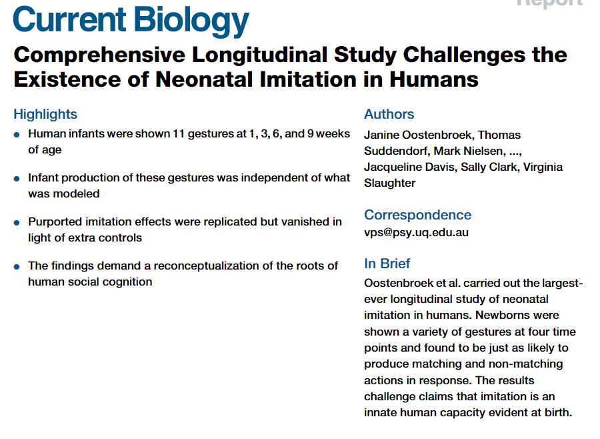
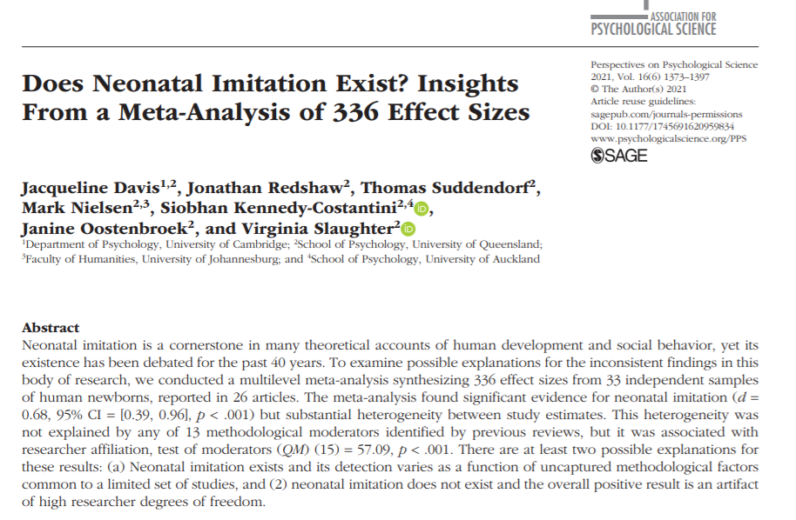
Controversy

Slide 20
Neonatal imitation predicts how infants engage with faces
Paukner, Simpson, Ferrari, Mrozek, & Suomi (2014)
Leung

Slide 21
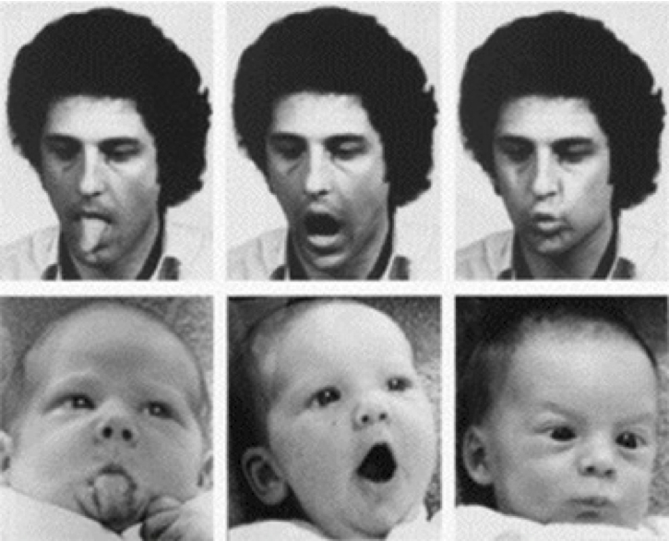
Neonatal imitation
Infants mirror facial movements.
This is associated with social and communicative skills.
Attention to eyes can also be related to these skills.
Leung

Slide 22
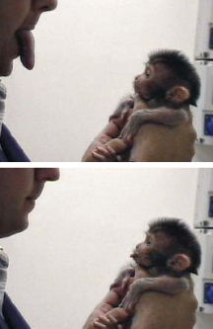
Response to nonverbal cues
Imitation of nonverbal cues promotes bonding and communication.
Lipsmacking is an affiliative gesture.
Tongue protrusion is not commonly used.
Hypothesis: infant macaques who imitate mouth movements will show more scanning of the eye region.
Leung

Slide 23
Neonatal imitation (Days 1-7): Control Disk (DK)
Notes:
Here you see a 2 day old nursery infant making LPS gestures in the LPS imitation condition. Infants also saw TP and CTRL conditions.
In this test there is a 40 sec baseline in which the model presents a still face or disk.
Then there is a 100 sec stimulus period in which the model produces LPS or TP gestures, or rotates the disk.

Slide 24
Neonatal imitation (Days 1-7): Lipsmacking (LS)
Notes:
Here you see a 2 day old nursery infant making LPS gestures in the LPS imitation condition. Infants also saw TP and CTRL conditions.
In this test there is a 40 sec baseline in which the model presents a still face or disk.
Then there is a 100 sec stimulus period in which the model produces LPS or TP gestures, or rotates the disk.

Slide 25
Neonatal imitation (Days 1-7): Tongue Protrusion (TP)

Slide 26
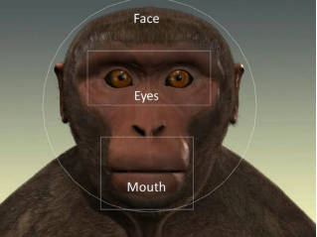
Current study
Infants were tested on a neonatal imitation task at one week.
At 10-28 days, they were shown avatars of a still face and lipsmacking/tongue protrusion.
Eye tracking: looks towards face, eyes, and mouth
Leung

Slide 27
Current Study
In macaque infants…
Lipsmacking plays a large role in communication between the mother and the infant
Tongue protrusion does not carry any communicative meaning
gaze is associated with affiliation
Test showed an avatar with a neutral still face followed by lipsmacking or tongue protrusion movements
Measured infant’s gaze towards the eye and mouth
Fixation of gaze
Duration of gaze
Notes:
In the first 10-28 days of life

Slide 28
Looks towards eyes and mouth

Slide 29
Results
Only lipsmacking imitation predicted a preference for the eyes during the Still Face condition
Infant macaques who imitated lipsmacking gestures at 1 week-old looked longer at the eyes than mouth of a still face at 10-28 days old
Lipsmacking imitators fixated more frequently on the eyes (relative to the mouth) than non-imitators during SF
Overall, infants looked less at the face during TP compared to SF & LPS
Socially relevant characteristics affect general interest in a display
More gazing at the eyes could be an indicator of the infant’s motivation to extract social information from others
Lipsmacking non-imitators
(n=21)
Lipsmacking imitators (n=16)
Notes:
Tongue protrusion failed to show any significant main effects or interactions
Infants were equally attentive in all periods (SF, LP, TP)
An individual’s social and communicative abilities, even very early in life, appear related to a visual preference for the eye area in a neutral still face

Slide 30
Discussion
Neonatal imitation patterns may be indicators of social attention biases.
They can be used to indicate biases and for screening.
Individual differences in neonatal imitation may play a role in later outcomes.
Leung

Slide 31
Questions to think about
Will infants be at higher risk if their mothers do not visually engage as much?
How might infants be affected by mothers who become more/less interactive over time?
Would human infants respond similarly to the lipsmacking stimulus?
Could we use verbal cues?
Is imitation recognition related to the infant’s imitation tendencies?
Leung

Slide 32
Neonatal imitation predicts infant rhesus macaque social and anxiety-related behaviours at one year
Kaburu, Paukner, Simpson, Suomi, & Ferrari, 2016

Slide 33
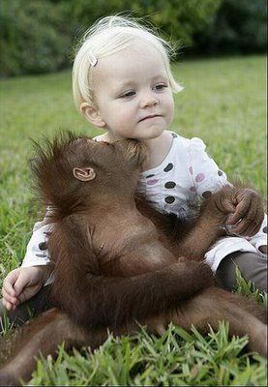
Background
The ability to maintain social relationships is associated with psychological well-being
Lacking these skills leads to negative psychological consequences
Therefore, predicting social development is important in order to establish early interventions
Neonatal imitation – earliest measure detecting individual differences in social skills
In both humans and non-human primates, imitators tend to be more socially advanced
Notes:
Neg psych: social anxiety, phobias, depression, etc.
NI: the ability of infants to match facial gestures w/in the first 4 weeks of life
Imitators: have less gaze aversion, more looks to faces (especially the eyes), and are better at gaze following… also, more attentive, remember social partners, and have better delayed imitation

Slide 34
Current Study
Does neonatal imitation predicted later social development?
Examined:
Neonatal imitation in nursery raised newborn macaques (n = 126)
2x’s a day, every other day in their first week of life
LPS gesture and non-social gesture (disk) performed by the model
40 second baseline and 20 seconds on/off for 3 min.
Social development at 1-year
Observed 5 min. twice a week
Aggression, play, social grooming, self-scratching (anxiety)

Slide 35
Neonatal imitation (Days 1-7): Lipsmacking (LS)
Notes:
Here you see a 2 day old nursery infant making LPS gestures in the LPS imitation condition. Infants also saw TP and CTRL conditions.
In this test there is a 40 sec baseline in which the model presents a still face or disk.
Then there is a 100 sec stimulus period in which the model produces LPS or TP gestures, or rotates the disk.

Slide 36
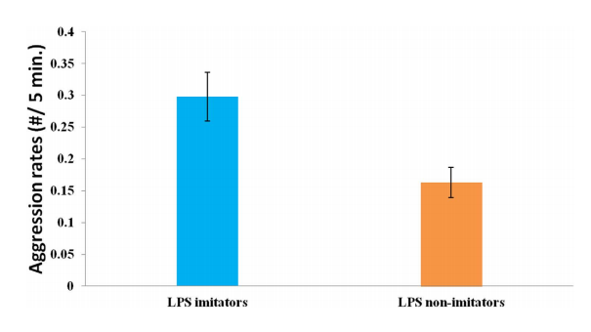
Results
Male imitators spent more time playing with their peers
Imitators directed more aggression toward peers

Slide 37
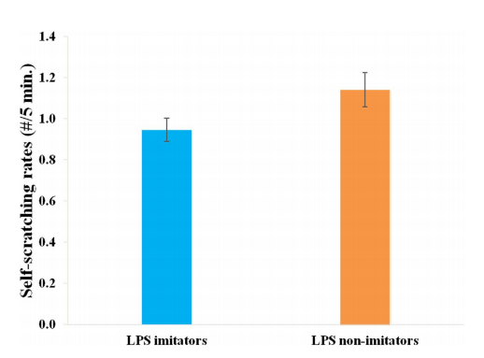
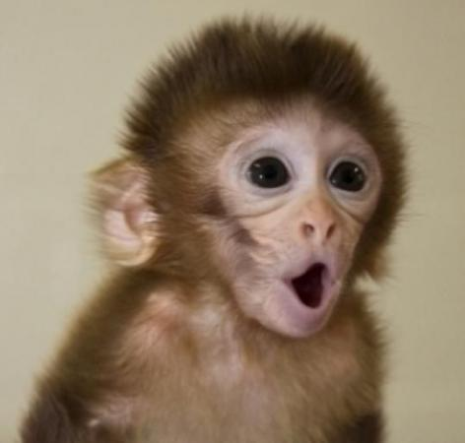
Results
Imitators self-scratched less frequently that non-imitators

Slide 38
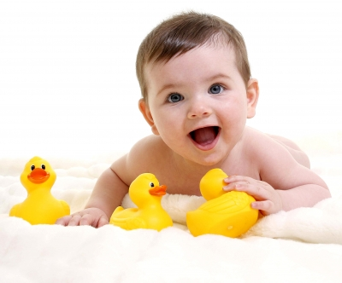
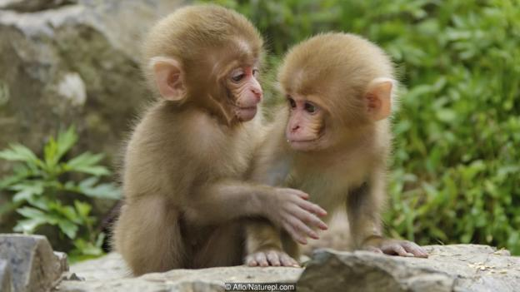
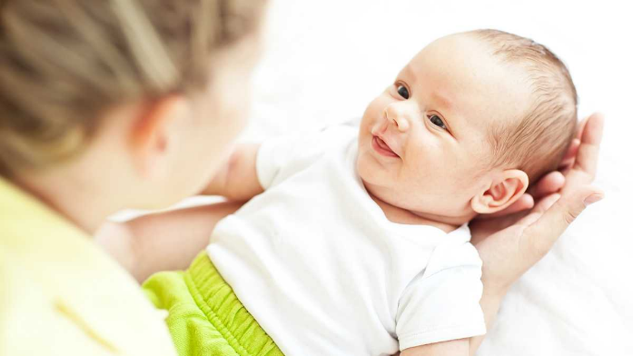
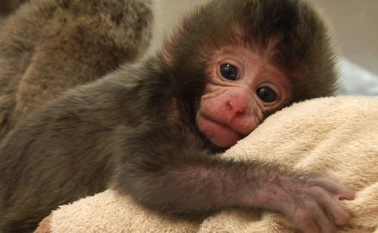
What does this mean?
We can predict social skills w/in the first week of like
Important implications for screening infants’ at risk for cognitive, social, and emotional difficulties
Could lead to earlier interventions
Discussion
There is some debate whether neonatal imitation is a real phenomenon… Are you convinced?

Slide 39
Neonatal imitation (Days 1-7): Tongue Protrusion (TP)

Slide 40
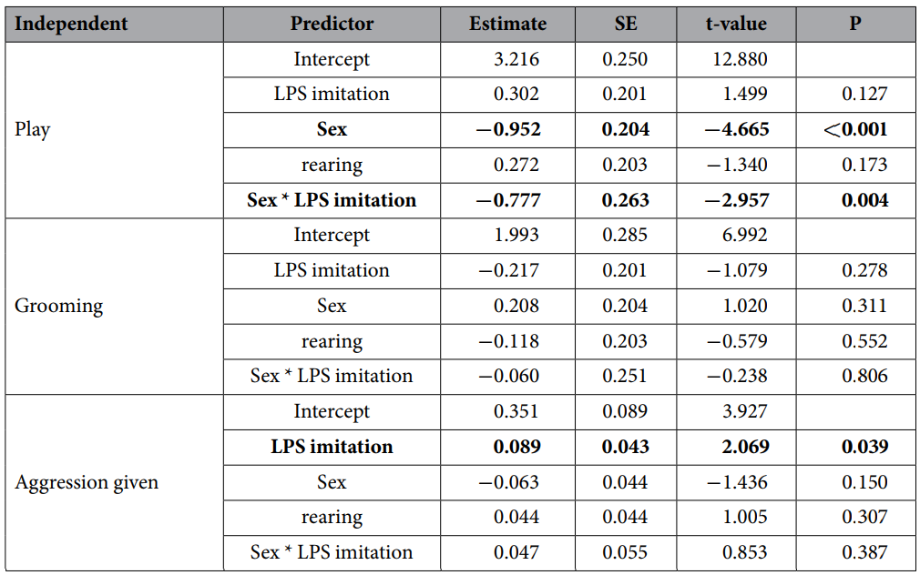
More results

Slide 41
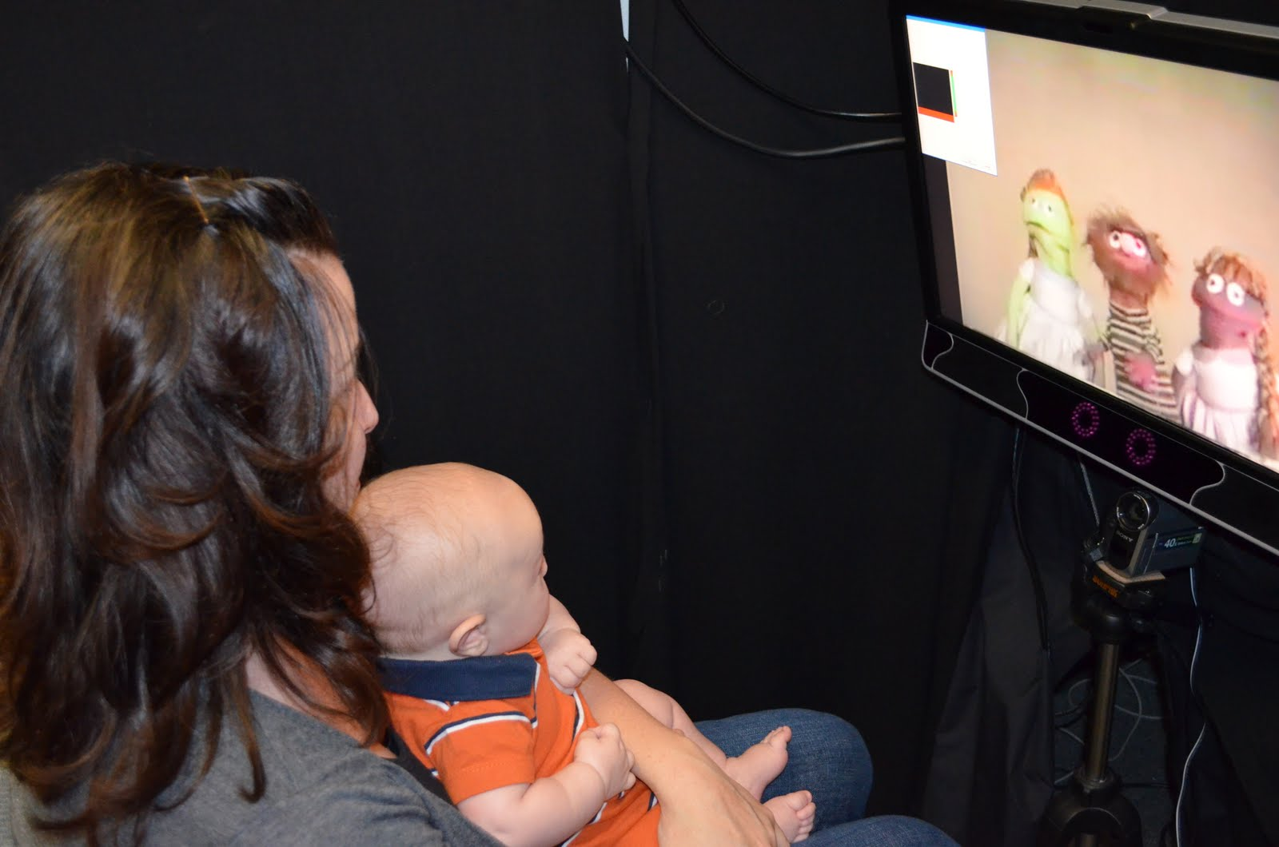
Infant temperamental fear, pupil dilation, and gaze aversion from smiling strangers
Zeng, Guangyu ; Maylott, Sarah E. ; Leung, Tiffany S. ; Messinger, Daniel S. ; Wang, Jue ; Simpson, Elizabeth A.

Slide 42
Introduction
Temperamental fear: seen in infants’ distress to novel or intense situations
Provide insights into infants’ developmental outcomes.
Fear of strangers: milestone in early development emerging around 6 months
Unclear if individual differences present in visual attention and physiological reactivity to unfamiliar people
Risk for social anxiety & withdrawal
Temperamental fear
Fearfulness and sociality
Social responsivity
Notes:
- measured at 2-3 months, stabilizes in toddlerhood
- high fear and less sociable

Slide 43
Theoretical Model

Slide 44
Temperamental fear & attention to face
Examine social attention may allow to study individual differences in fear of strangers
Attention to faces
Greater temperamental affect is linked to faster orientation and difficulty to disengage
Little is known how infants attentional bias in response to positive strangers faces
Fear linked to unfamiliarity or threat
Notes:
-

Slide 45
Gaze aversion to regulate
Temperament: self-regulation and reactivity
Infants with high temperamental fear are slower to disengage – which may lead to higher stress
Infants use gaze aversion to maintain suitable arousal level, preventing overstimulation
Smiles & gaze aversion during mother infant interaction?

Slide 46
Pupil dilation to measure physiological arousal
Reactivity component of temperament
Associated with attention to faces- higher fearfulness are higher in reactivity and aversiveness to strangers
Pupil dilation is unobtrusive indicator of physiological reactivity – reflects autonomic nervous system

Slide 47
Current study
Hypothesis: Infants’ behavioral self-regulation (gaze aversion) and physiological reactivity (pupil dilation) when encountering a videotaped smiling stranger are associated with their temperamental fear
MLM approach to address nested data

Slide 48
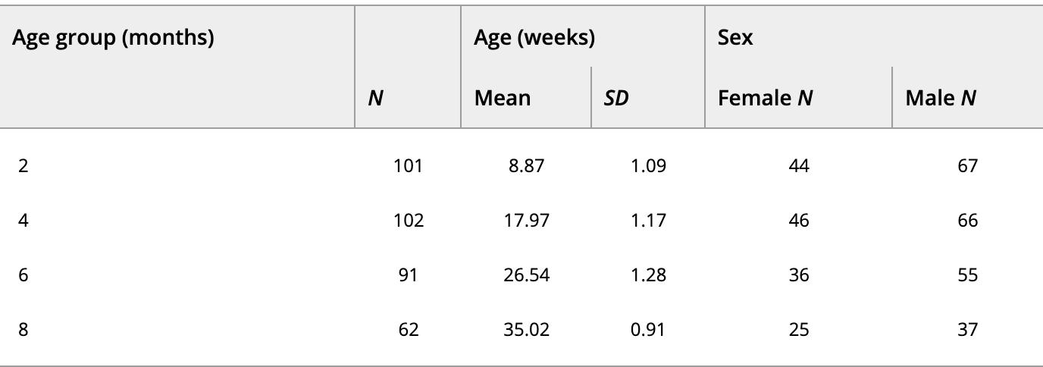
Methods
Participants: 124 infants followed from 2-8 months.
Smiling stranger video: 12.5 s silent video of lady smiling
Measures: Infant behavior questionnaire and eye tracking data (Gaze aversion and pupil dilation)

Slide 49
Latency in Gaze aversion
At 2 and 4 months, infants with higher levels of fear temperament had greater overall pupil dilation, but by 8 months, infants with higher levels of fear temperament had less pupil dilation compared to infants with lower levels of fear temperament.

Slide 50
Pupil dilation prior to gaze aversion
Increase in arousal levels until gaze aversion is reached. Infants with high fear had steeper slopes.
However, association reversed at 8 months, why?
Notes:
Increase in arousal levels until gaze aversion is reached. Infants with high fear had steeper slopes.
However, association reversed at 8 months, why?

Slide 51
Temporal pattern

Slide 52
Discussion
The study found that more fearful infants took longer to look away from a smiling stranger's face, indicating slower arousal regulation.
Thoughts on external validity of the study?
These findings suggest that individual differences in infants' gaze aversions and pupil dilation can be indicators of the development of fearful temperament in early infancy .
Race effects: Non-white infants shower to avert their gaze than white infants.
Why?
Notes:
- Stable increase in look latency in the first year- better regulation
- Changes in techniques used to regulate themselves. What can they be?
- Think back to mother-infant interaction and smiling when looking away.

Slide 53
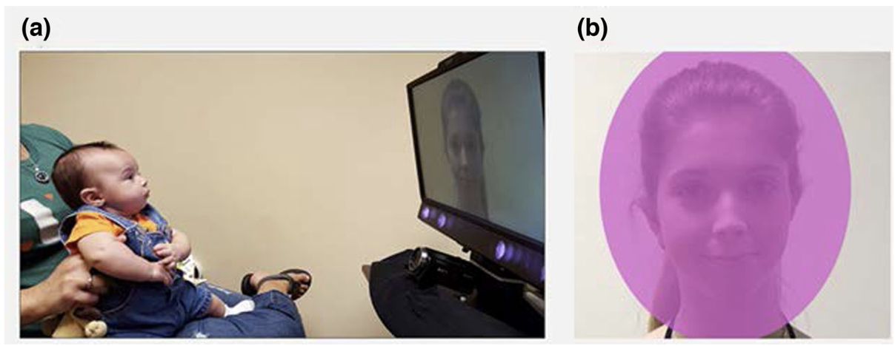
Conclusion
The study concludes that individual differences in infants' gaze aversions and pupil dilation can serve as indicators of the development of fearful temperament in early infancy .

Slide 54
Ferrari, P. F., Paukner, A., Ionica, C., & Suomi, S. J.
Is face-to-face interaction human-specific?
). Reciprocal Face-to-Face Communication between Rhesus Macaque Mothers and Their Newborn Infants. Current biology : CB, 19(20), 1768-1772.
http://www.ncbi.nlm.nih.gov/pmc/articles/PMC2784245/bin/NIHMS145640-supplement-02.mpg FF around suckling
http://www.ncbi.nlm.nih.gov/pmc/articles/PMC2784245/bin/NIHMS145640-supplement-03.avi FF on ground (mock aggression)
Click here to view.^{(7.2M, avi)} 04. FF in cage
Click here to view.^{(6.7M, avi) 05 FF(ish)} in group context

Slide 55
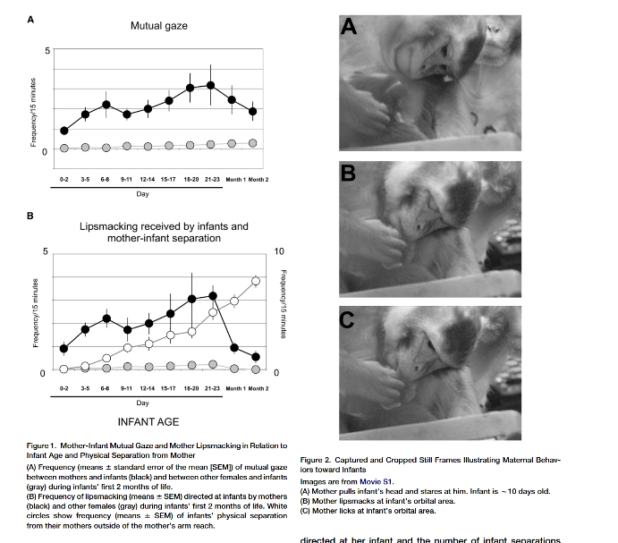
Mutual gaze and lipsmacking in the macaque (infant-mother)
http://www.ncbi.nlm.nih.gov/pmc/articles/PMC2784245/bin/NIHMS145640-supplement-02.mpg FF around suckling

Slide 56
Responsive lipsmacking

Slide 57
Is face-to-face interaction neotenous?
‘In rhesus macaques, mother-infant pairs communicate intersubjectively via complex forms of emotional exchanges including exaggerated lip-smacking, sustained mutual gaze, mouth-mouth contacts, and neonatal imitation.
Infant macaques solicit their mother’s affiliative responses and actively communicate to her.
However, this form of communication disappears within the infant’s first month of life.”
Why?
challenge the view that themother-infant communicative system functions in order tosustain proximity and that infants are simply passive recipi-ents in such interaction. Thus, emotional communicationbetween mother and infant is not uniquely human

Slide 58
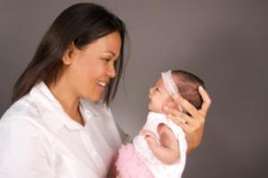
Background: Early Social Interactions
Early social interactions provide a context for infants to learn social communication norms
Quality of face to face interactions in the first weeks of life can affect cognitive and social-emotional development
Eye contact is an important signal for social interaction and communication
Scanning of the eye area is a predictor of social & communicative abilities
Notes:
2nd bullet: previous findings - Infants who do not imitate at 2-3 days of age exhibit increased gaze aversion during play interactions at 3 months

