Slide 1
Sustained attention, Joint Attention, & Gesture
Daniel Messinger, Ph.D.

Slide 2
Overview—Special Topics
Sustained attention
Intro
Longitudinal
Yu & Smith x2
Joint engagement in give-n-take context
Initiating and responding to joint attention
Adding affect: Initiating joint attention with smiles
Prediction
Gesture and joint attention: chimp pointing
But what really predicts language
Gesture vs. babbiling
And SES

Slide 3
Individual Differences in Infant Fixation Duration Relate to Attention and Behavioral Control in Childhood
(Papageorgiou et al., 2014)

Slide 4
Individual Differences in Infant Fixation Duration (Papageorgiou et al., 2014)
Results
Parent-reported Childhood Temperament
Preschool: Early Childhood Behavior Qnr (ECBQ) School-age: Children’s Behavior Qnr (CBQ)
Effortful Control | Attentional focusing
 | Inhibitory control
 | Low-intensity pleasure
 | Perceptual sensitivity
Surgency | Activity level
 | High-intensity pleasure
 | Impulsivity
 | Shyness (reverse-scored
Infant Fixation Duration
Covariates: Child’s age, Qnr version, Child’s sex, Total # of eye tracking trials completed and fixations detected

Slide 5
Individual Differences in Infant Fixation Duration (Papageorgiou et al., 2014)
Results
Parent-reported Childhood Behavior
Hyperactivity-Inattention Scale
Preschool: Revised Ruttner Parent Scale (RRPSPC) -- Rate frequency of 4 different behaviors School-age: Children’s Behavior Qnr (CBQ) -- Rate frequency of 5 different behaviors
Infant Fixation Duration
Covariates: Child’s age, Qnr version, Child’s sex, Total # of eye tracking trials completed and fixations detected

Slide 7
What is Sustained Attention (SA)?
Ability to voluntarily control one’s attention
Before the emergence of SA, young infants’ attention is often characterized by fleeting interest in novelty and distractions

Slide 8
Why do we care about sa?
Emerges around 10 – 12 months
Growing steadily through early childhood
Attributed internal, individual factors
i.e. temperament, self-regulation, EF, cognitive control
Relates to language, exploration, problem solving, and school readiness
Predicts development outcomes and diagnosis for attentional disorders

Slide 9
Social Origins of SA?
Infants develop in social contexts
Thus development depends on social interactions
Everyday interactions (particularly play time) with caregivers scaffolds infant’s development of SA
Parents’ attention
Parent Responsiveness
Joint attention (JA)

Slide 10
Current Study
Aim:
To examine the influence of social context on infants’ sustained attention
Hypothesis:
JA timing does not relate to infants’ SA duration
Duration of JA relates to overall SA of infant
Parent attention (JA) extends infants visual attention to an object (even after JA ends)

Slide 11
Methods
36 parent-infant dyads (11-13 m)
Head-mounted cameras/eye-trackers worn during free-play with 6 novel toys 2 different sets of 3 toys (played 1.5 min each set, twice)

Slide 12
Coding
Human coders identified instances when eye gaze fell within one of 4 ROIs (3 toys & partner’s face)
Identified moments and duration of JA & SA
JA: parents & infants were jointly fixated on same object at same time for at least 500ms (can have looks away <300ms)
SA: 3+ seconds of infant consistent looking at a single object (without any looks away)
Notes:
a joint attention bout was defined as a continuous alignment of parent and infant fixation that lasted longer than 500 ms but that could include looksbriefer than 300 ms elsewhere.
This threshold ensures that the defined sustained attention bouts are on the tail of the distribution (exceeding the mean of the overall distribution) and thus are at the upper end of what children this age can do when visually focusing attention on a single object
More specifically, we operationally defined 3 s of consisten tlooking within the ROI for a single object without any looks else whereas the threshold for sustained attention by the infant.

Slide 13
Video
https://ars.els-cdn.com/content/image/1-s2.0-S0960982216302020-mmc2.mp4

Slide 14
JA & sa durations
Notes:
Histogram of JA duration. Note that JA bouts are defined as lasting longer than 500 ms. Parents and infants, on average, jointly attended to the same object34.24% (SD=6.04%) of the total toy-play time, which wa scomposed of 9.37 (SD=1.65) distinct JA bouts with an average duration per bout of 2.39 (SD=0.61) seconds.
(B) Histogram of infant gaze duration. Infants generated many brief gazes, but fewer than 20% were longer than 3 s, which was the threshold used to define sustained attention. The majority of infant looks to an object were brief. Given this definition, infants generated 4.72 sustained attentionbouts per minute with a mean duration of 5.05 s, which ismuch longer than the observed average duration of looks to asingle object when one considers all such looks (t(35)=12.54,p<0.001, d=4.24)

Slide 15
Instances of JA + child SA
Notes:
Sustained attention (SA) was defined based on infant eye region of interest (ROI). (B) Joint attention (JA) was measured independently based on infant and parent eye ROI streams. (C) SA instances were categorized as two types: SA with an accompanying JA and SA without any accompanying JA. (D) Sequential patterns between SA and JA were examined for instances of SA with JA and were compared to the instances of SA without JA.
Divided infants SA bouts into SA + JA and SA alone 65% of instances of child SA occurred in accompany with JA and the average duration of SA was significantly longer than without (increasing on average by 1 second

Slide 16
Instances of JA + child SA
Notes:
Sustained attention (SA) was defined based on infant eye region of interest (ROI). (B) Joint attention (JA) was measured independently based on infant and parent eye ROI streams. (C) SA instances were categorized as two types: SA with an accompanying JA and SA without any accompanying JA. (D) Sequential patterns between SA and JA were examined for instances of SA with JA and were compared to the instances of SA without JA.
Divided infants SA bouts into SA + JA and SA alone 65% of instances of child SA occurred in accompany with JA and the average duration of SA was significantly longer than without (increasing on average by 1 second

Slide 17
Instances of JA + child SA
Notes:
Sustained attention (SA) was defined based on infant eye region of interest (ROI). (B) Joint attention (JA) was measured independently based on infant and parent eye ROI streams. (C) SA instances were categorized as two types: SA with an accompanying JA and SA without any accompanying JA. (D) Sequential patterns between SA and JA were examined for instances of SA with JA and were compared to the instances of SA without JA.
Divided infants SA bouts into SA + JA and SA alone 65% of instances of child SA occurred in accompany with JA and the average duration of SA was significantly longer than without (increasing on average by 1 second

Slide 18
Instances of SA with and w/out ja
\\website.psy.miami.edu
Notes:
Sustained attention (SA) was defined based on infant eye region of interest (ROI). (B) Joint attention (JA) was measured independently based on infant and parent eye ROI streams. (C) SA instances were categorized as two types: SA with an accompanying JA and SA without any accompanying JA. (D) Sequential patterns between SA and JA were examined for instances of SA with JA and were compared to the instances of SA without JA.
Divided infants SA bouts into SA + JA and SA alone 65% of instances of child SA occurred in accompany with JA and the average duration of SA was significantly longer than without (increasing on average by 1 second

Slide 19
Results
H1: Mean SA-with-JA was longer than SA-without-JA
(M_{SA-with-JA}=5.33 s, M_{SA-without-JA}=4.38 s, β=1.27, SE=0.11, p < 0.001)
H2: No difference in total durations of the SA-with-JA bouts for long and short lags
M_{long-lag}=5,231 ms; M_{short-lag}=4,876 ms; β=0.07, SE=0.17, N.S.)
H3: SA instances with long JA were longer overall
M_{long-JA}=6,540 ms; M_{short-JA}=4,293 ms; β=0.87, SE=0.17, p < 0.001)
H4: Infant attention to the target after JA ended was longer for longer JA periods than for shorter ones
M_{long-JA}=2,146 ms; M_{short-JA} =959 ms; β=0.82, SE=0.09, p < 0.001)
Nicolais, C.J..

Slide 20
“Extension” Hypothesis
Notes:
In all three cases, SA instances are divided into twogroups based on the accompanying JA instances(red arrows), and SA durations (blue arrows) in thetwo groups are compared.
(A) SA instances are divided into SA instances withshort-lag JA and those with long-lag JA. SA dura-tions in the two groups show no significant differ-ence.
(B) SA instances are divided based on JA duration,and the results show that longer JA is associatedwith longer overall SA. (C) SA instances are divided again into long-JA andshort-JA cases, as in (B). Infant SA to the targetafter JA ended is longer for longer-JA periods thanfor shorter ones.

Slide 21
Results
Speed/timing of JA did not relate to infant SA duration
Duration of JA determined overall duration of child SA
Parent looks to child’s interest:
sustained infant’s interest in the object
extended SA duration after parent looked away
“Extension” Hypothesis

Slide 22
Take-homes
Social interactions influence infant SA
Duration of infant’s attention on an object is extended by the visual attention of parent.
JA extends SA during & after it ends
Implies that differences in SA abilities/ development may be associated with differences in early social experiences
Relates to parent responsiveness
Key role in multiple domains of early development

Slide 23
Discussion
Do these results in fact suggest that there is a social component influencing sustained attention?
Could there be a different component at play?
Could the parent being the “adult play partner” have a different effect than, for example, a sibling or a daycare provider?
What implications, if any, does this have for children of parents who's attention wanders?
If true, could this finding be helpful to children developing atypically?
Is it generalizable in that sense?
If true, how can we expand on this study to further promote sustained attention?
How can the findings in this study be better supported?

Slide 25
What we know…
The coordination of visual attention among social partners is central to:
Language learning
Joint action
One’s ability to read social cues and understand other’s intentions
Individual differences in ability to coordinate visual attention predict individual differences in language, social, and cognitive development
Limitations of gaze following as a measure of Joint Attention (JA) in laboratory tasks
Notes:
Everyday parent-infant interactions, such as toy play, take place in visual environments which are much more cluttered than the visual environments of traditional laboratory studies.
The increased complexity of the real-world visual environments that infants are immersed in within their everyday life make head and eye direction of their social partners insufficient cues for them to be able to differentiate between objects that are close to one another in space

Slide 26
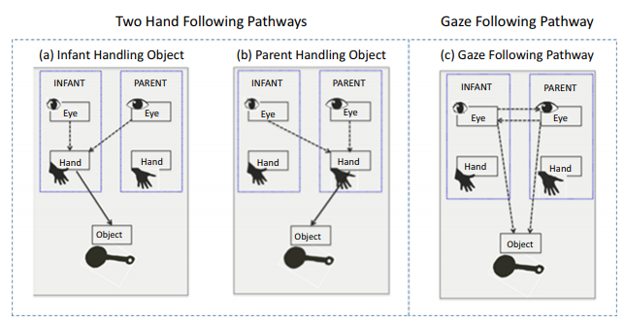
Pathways to Joint Attention
Traditional route to Joint Attention to an object is through Gaze Following

Slide 27
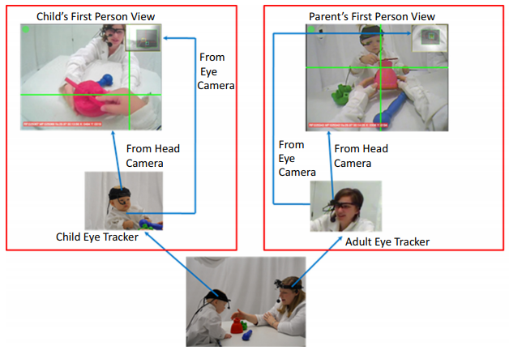
Method
Participants:
51 infant-parent dyads
11-24 months of age
Procedure:
Videos of infant-parent dyads were collected using head-mounted eye-trackers and head cameras worn by both participants as they played with 6 novel toys
Human coders identified instances where eye gaze (as visible in headcamera view) fell within one of four ROIs (3 toy objects and partner’s face)

Slide 28
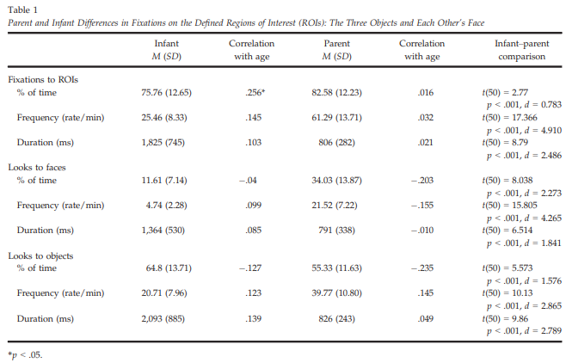
Parents more ROI total time & more switches between objects and faces than infants. Infants had longer unbroken looks within ROI than parents. Infants fixated objects more than parents; parents fixated infant faces more than infants.
Notes:
Infants and parents spent a high proportion of time fixating the ROIs, but parents spent more total time overall than infants and exhibited more attentional switches between objects and faces than infants.
Infants had longer unbroken looks within the same ROIs than did the parents.
Infants fixated the objects more than their parents whereas the parents fixated the faces of their infants much more than infants looked to their parents’ face.

Slide 29
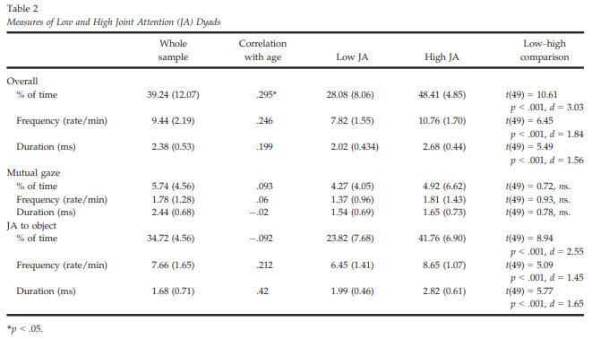
High JA and Low JA Dyads Differ on JA to Objects but Not Mutual Gaze

Slide 30
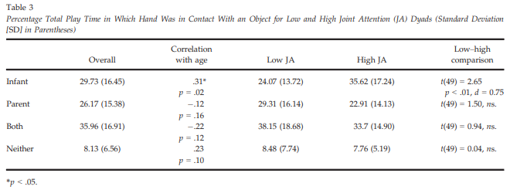
High JA Infants Exhibit Increased Object Manipulation Relative to Low JA Infants

Slide 31
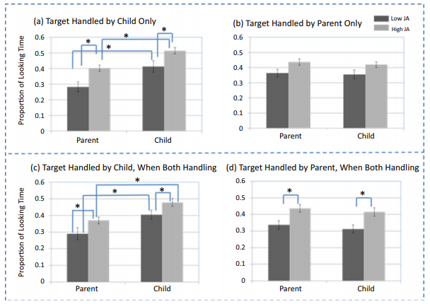
Increased Infant Object Manipulation → and Looking to Objects → Increased JA Bouts with Parents

Slide 32
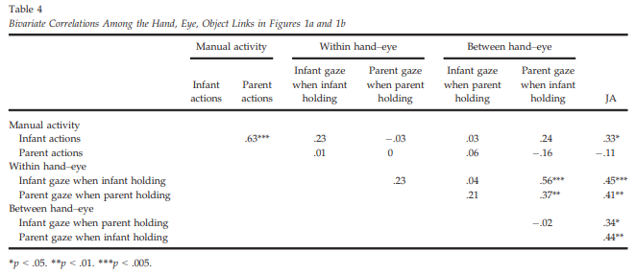
Infant Object Manipulation and Within and Between Hand-Eye Coordination are Reliably Correlated with JA to Objects

Slide 33
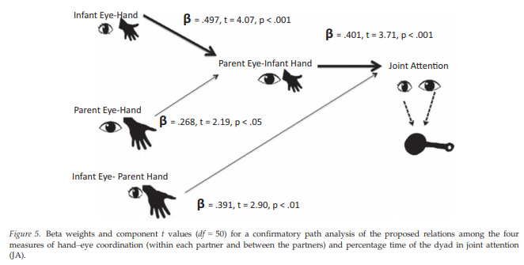
Parent Visual Attention to Infant Object Handling Mediates Relationship Between Infant Hand-Eye Coordination and JA

Slide 34
Conclusions
These findings suggest an alternate route to JA to an object (i.e., hand-following pathway) that provides more precise cues for infants to read in complex visual contexts.
The hand-following pathway may scaffold more precise gaze following.
Infants who exhibit increased hand-eye coordination are likely to experience more bouts of JA with their parents, which in turn lead to better developmental outcomes.

Slide 35
Discussion Questions
What do these findings mean for atypical development?
Practical significance? Strategies for increasing coordination of attention during object play in the low JA dyads?
Future directions?
Other thoughts?

Slide 36
Developmental overview
Dyadic communication
Infant ←→ Partner
Direct, unmediated communication
2-6 months
Triadic (referential) communication
Infant ←→ Object ←→Partner
Communication about something
9 months on
Older infant in FFSF
https://www.youtube.com/watch?v=apzXGEbZht0&t=22s

Slide 37
Why gestures are important
Infant gestures are typically earliest conventional communications
Infant gestures are tied to current and future language use
Notes:
9 - 15 pnt offer request
socially recognizable form
However, these correlations are often weak. Bates et al. concurrent and predictive correlations. A more in depth look at what infants are saying, we can get a clue to better predictors of language.

Slide 38
Developmental overview
Infant gestures are typically earliest conventional communications
From 9 to 15 months, general increase in the % of infants:
who gesture conventionally
e.g. offering and pointing, though requesting is unclear
and who comprehend conventional gestures
The quantity of early gesture use is associated with later differences in both linguistic comprehension and production

Slide 39
Working gestures: Give & Take
Offers and requests are not only conventional, but universal and reciprocal
Example video—requests 4-5
IJA clips
Notes:
9 - 15 pnt offer request
socially recognizable form
However, these correlations are often weak. Bates et al. concurrent and predictive correlations. A more in depth look at what infants are saying, we can get a clue to better predictors of language.

Slide 40
What infant gestures say
Instrumental: Use gesture to person to get object (or get something done)
I--> Social --> Object
Proto-imperative (i.e., "give me that")
Social Approach: Use gesture with object to engage with partner
I--> Object --> Social
Proto-declarative (i.e., "look at that")
What autistic kids appear to do very little of

Slide 41
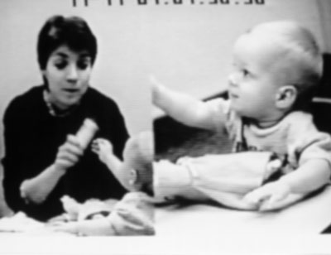
Social approach - offer

Slide 42
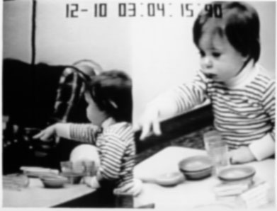
Instrumental - request

Slide 43
Development of gazing at mother
Infants spend increasing amounts of time coordinating attention (looking back and forth) between mother and objects
Gestures more likely during this coordinated joint attention
Coordinated joint attention tends to occur with affective expressions
Bakeman & Adamson: positive affect facilitates joint attention and its development
but did not look at gestural communications
Baby-dog toy offer exchange https://www.youtube.com/watch?v=p8boAmzaxMY
Notes:
Hold object in hand. Make offer the example.
9=6
12=7
15=19

Slide 44
Sample (Messinger & Fogel, 1998)
Middle-class sample
11 mother-infant dyads
Playing “as you would at home” for 10 minutes at a table with everyday toys
156 play sessions
Observed weekly from 9.5 to 12 months
every two weeks from 12 to 15 months

Slide 45
Development of infant requests
The increasing proportion of requests involving vocalizations suggests an increasingly instrumental use of requesting by infants.
As infants become more clearly intentional, they may increasingly use vocalizations with requests in order to compensate for the ambiguity of requesting.
Piggybacking: combining linguistic topics (the object referred to) with comments (the request gesture) in a manner which presages more complex language use

Slide 46
Social approach: Gazing at mother
Gazing at mother is associated with offering rather than requesting
50% of infant offers and 32% of infant requests involved gazing at mother
9/11 infants show effect

Slide 47
Gazing at mother and smiling
62% of gestures involving gazing at mother also involved smiling
40% of gestures that did not involve gazing at mother involved smiling
When infants gazed at mother during gestures, they smiled
10 of 11 infants
Coordinated gesturing - occasions for positive affect

Slide 48
Big picture
Infant requests used instrumentally to obtain objects and infant offers used to initiate (positive) social contact.
When infants request, they use a social means (the partner) to attain a nonsocial end, an object.
When infants offer, they use an object as a means to a social end

Slide 49
Developmental Psychopathology
Children with autism children show deficits in social approach
Offering objects while gazing at partner & smiling
Children with Downs show deficits in instrumental communication
such as requesting objects
(Mundy et al.; etc)

Slide 50
Attention to eyes is present but in decline in 2–6-month-old infants later diagnosed with autism. W Jones & A Klin Nature 000, 1-5 (2013) doi:10.1038/nature12715
Example stimuli, visual scanpaths, regions-of-interest, and
longitudinal eye-tracking data from 2 until 24 months of age.

Slide 51
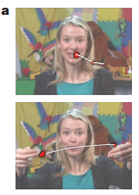
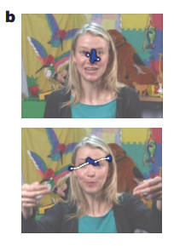
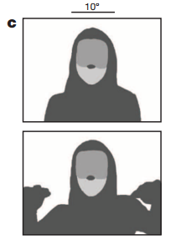
Methods
Tracked eye gaze during naturalistic “caregiver interaction” videos
Measured percentage of visual fixation to eyes, mouth, body and objects in a naturalistic video
Tracked over time

Slide 52
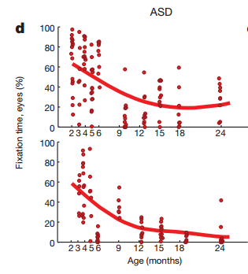
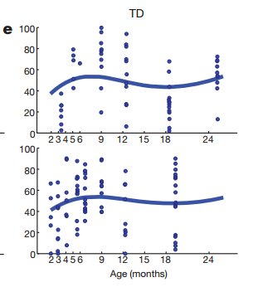
TD vs ASD
TD
Look more at eyes than anywhere else from 2 to 6 months
Mouth fixation increases during 1st year, peaks at 18 months
Body and object fixation drops through first year
ASD
Eye fixation declines from 2-24 months
Mouth fixation increases until 18m
Object and body fixation declines slowly in 1st year
Object fixation rises in 2nd year
Notes:
Two individual kids

Slide 53
Growth charts of social visual engagement for typically
developing children and children diagnosed with ASD.
Early decrease in gazing at eyes
W Jones & A Klin Nature 000, 1-5 (2013) doi:10.1038/nature12715

Slide 54
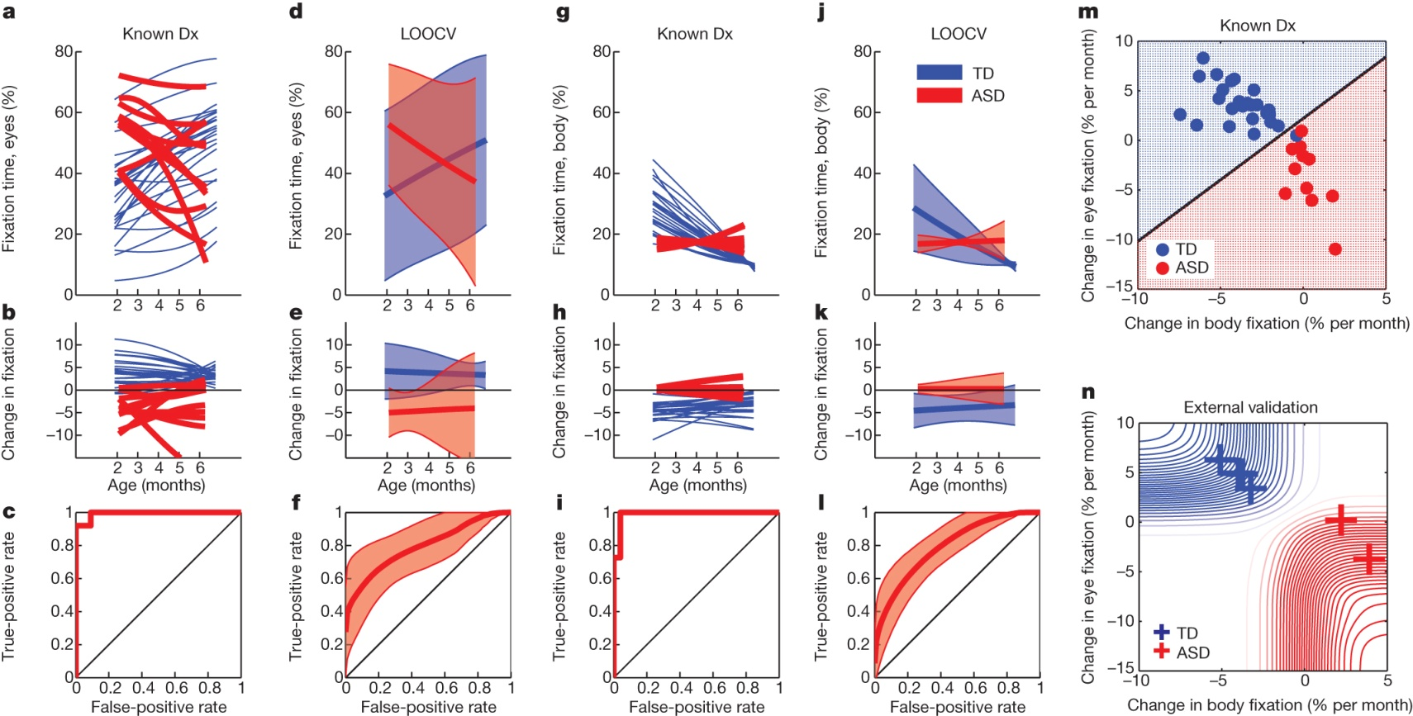
Male ASD marker
Visual fixation between 2 and 6 months of age relative to diagnosis at year 3
W Jones & A Klin Nature 000, 1-5 (2013) doi:10.1038/nature12715

Slide 55
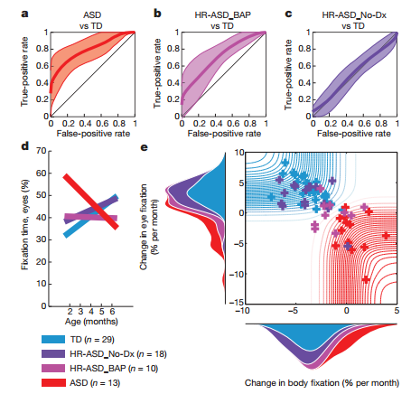

Slide 57
ADOS (Severity Scales)
30 Month

Slide 58
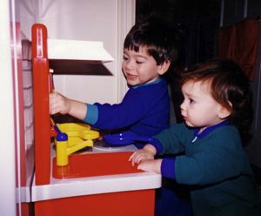
Attention, Joint Attention, and Social Cognition. Mundy and Newell, 2007
Facilitates > social learning, language acquisition
Joint attention behaviors
- Responding to joint attention (RJA)
> following gazes/gestures of others
- Initiating joint attention (IJA)
> use of gaze/gestures to direct attention of others
Associated with > Depth of information processing, > IQ, > Social competence, > Self regulation
Which comes first: joint attention or social cognition?
Autism characterized by pronounced impairments in IJA

Slide 59
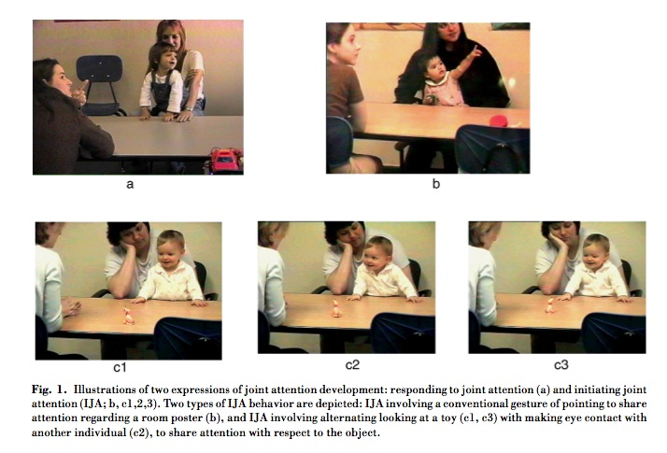

Slide 60
Initiating Joint Attention (IJA)
Shares experience or interest in object or event

Slide 61
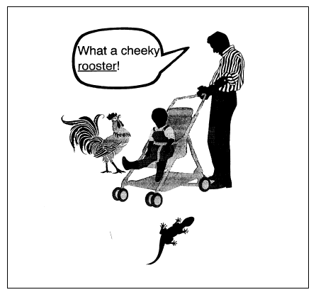
RJA Example
How RJA predicts

Slide 62
Sensitive Structuring

Slide 63
An Expanded View of Joint Attention: Skill, Engagement, and Language in Typical Development and Autism
Adamson, Bakeman, Suma, & Robins, 2017
Leung

Slide 64
Child-Related Components of Parent-Child Interactions
Supported joint engagement: child and caregiver are involved with the same object or event
Coordinated joint engagement: child and caregiver are involved with the same object or event + child acknowledges the caregiver’s participation
Symbol-infused joint engagement: the child is in joint engagement while also using words, gestures, or signs
Leung

Slide 65
Parent-Related and Interaction-Related Components
Scaffolding: the caregiver supports the child’s activities and opportunities for learning
Following-in (on child’s focus): the caregiver’s actions are based on the child’s interest
Fluency and connectedness: the flow and cohesion of the interaction
Leung

Slide 66
Joint Attention and Joint Engagement
By the second year, toddlers typically have a substantial expressive vocabulary.
Joint attention skills facilitate communication during parent-child interactions.
Responding to Joint Attention (RJA) versus Initiating Joint Attention (IJA)
Joint engagement allows for a child to attend to their parent and their shared activity.
Leung

Slide 67
Study Aims
Aim 1a: document children’s joint engagement and parents’ support for shared activities
Aim 1b: look at the relationship between joint attention skills and joint engagement
Aim 2a: test how variations in joint attention skills and joint engagement predict expressive vocabulary
Aim 2b: ask how joint engagement may vary as a function of the child’s language use
Leung

Slide 68
Methods
144 toddlers (40 typically developing (TD), 58 Autism Spectrum Disorder (ASD), 46 developmental delay (DD)) participated at 24 months of age and 31 months of age
Parent-Child Interactions: 6 scenes that each lasted 5 minutes
Early Social Communication Scale (ESCS): RJA and IJA
MacArthur Communicative Development Inventory: Words and Sentences: expressive language outcome
Leung

Slide 69
Joint Engagement and fluency&connectedness depend on responding to joint attention for ASD/DD toddlers
Leung
Notes:
(Aims 1a and 1b)

Slide 70
RJA and Fluency&Connectedness Predict Expressive Language in ASD/DD Toddlers
Fluency and connectedness correlated strongly with RJA, IJA, and CDI
At-risk group: fluency and connectedness accounted for 33% of the variance
Typically developing group: fluency and connectedness accounted for 9.8% of the variance
Leung

Slide 71
Talking→Not Talking During Interaction – higher levels of scaffolding, supported joint engagement
SJE=supported joint engagement
CJE=coordinated joint engagement
SIJE=symbol-infused joint engagement
PSc=scaffolding
PFIn=following-in
F&C=fluency and connectedness
Leung
Notes:
(Aim 2b)

Slide 72
Take-aways
Joint engagement is a strong predictor of expressive vocabulary in children with ASD and DD
The association was not as strong in TD children
Early development of expressive vocabulary is facilitated by events that occur during periods of joint engagement (even if joint attention skills are impaired)
Leung

Slide 74
Methods….
14 children with ASD and 15 TD children contributed head-mounted eye-tracking data for the current study.
5 children with ASD and 5 TD children were excluded from analyses for having insufcient data (< 3 min of usable data).
28 children with ASD and 2 TD children were less tolerant of wearing eye tracker or allowing personnel to make adjustments

Slide 75
Supplementary Table S 1. Characterization of ASD Participants with and without Successful Eye Tracking

Slide 76
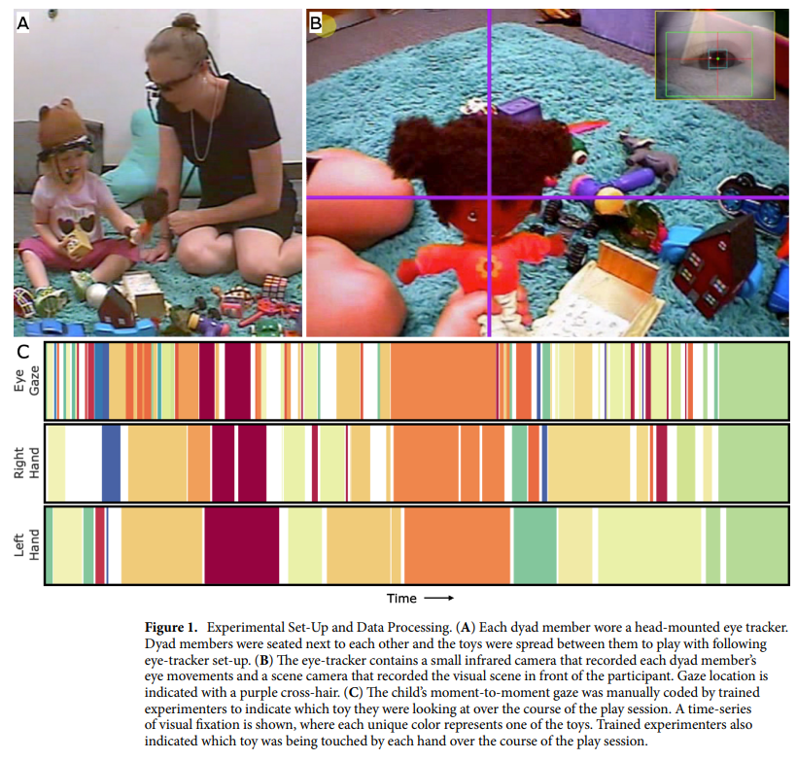

Slide 77
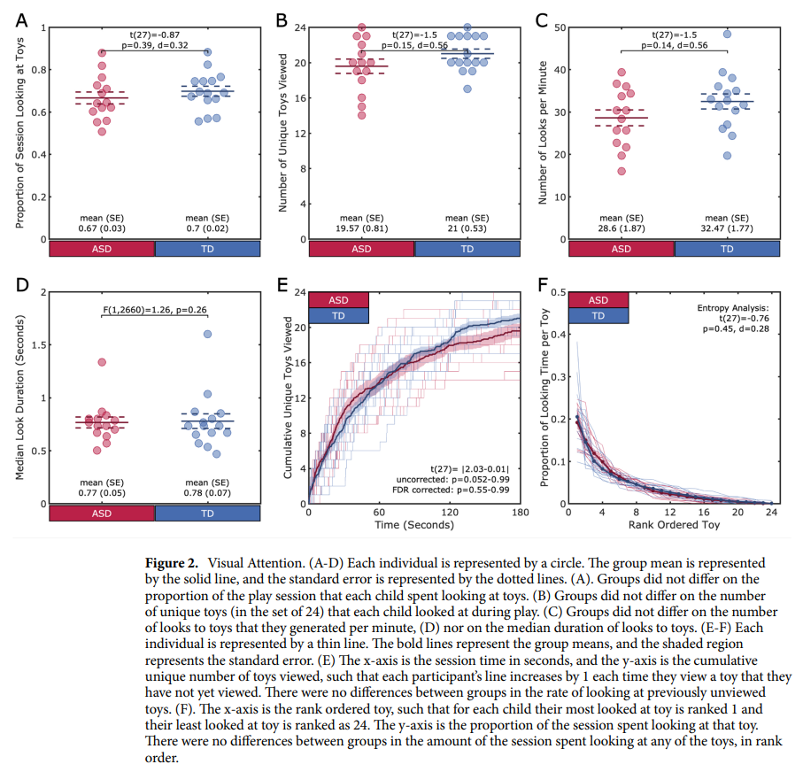

Slide 78
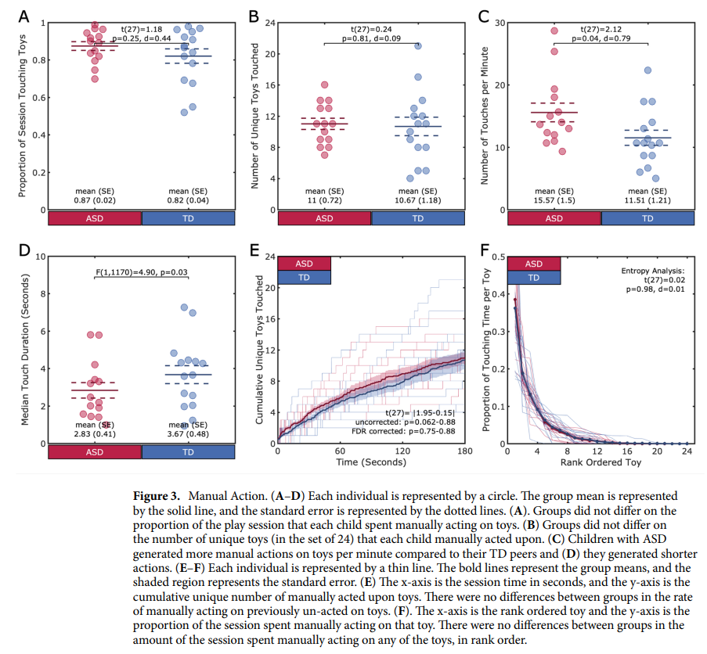

Slide 79
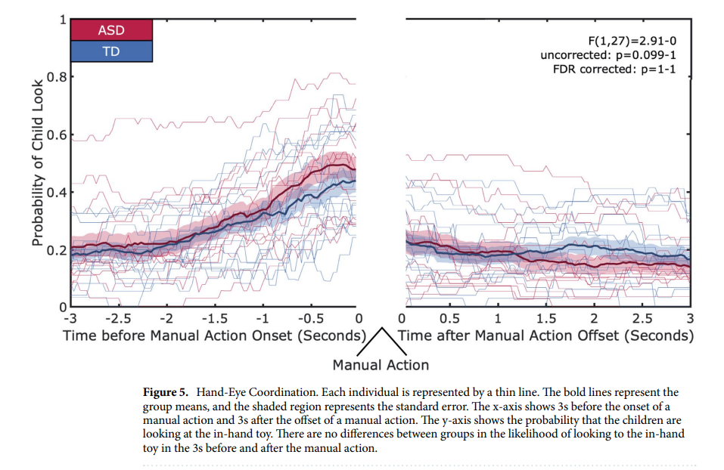

Slide 81
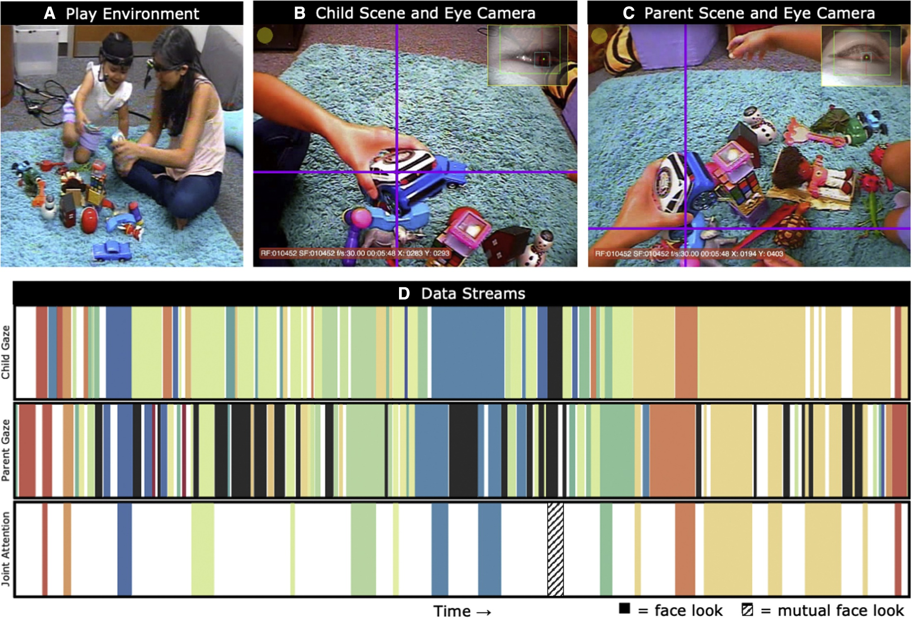

Slide 82
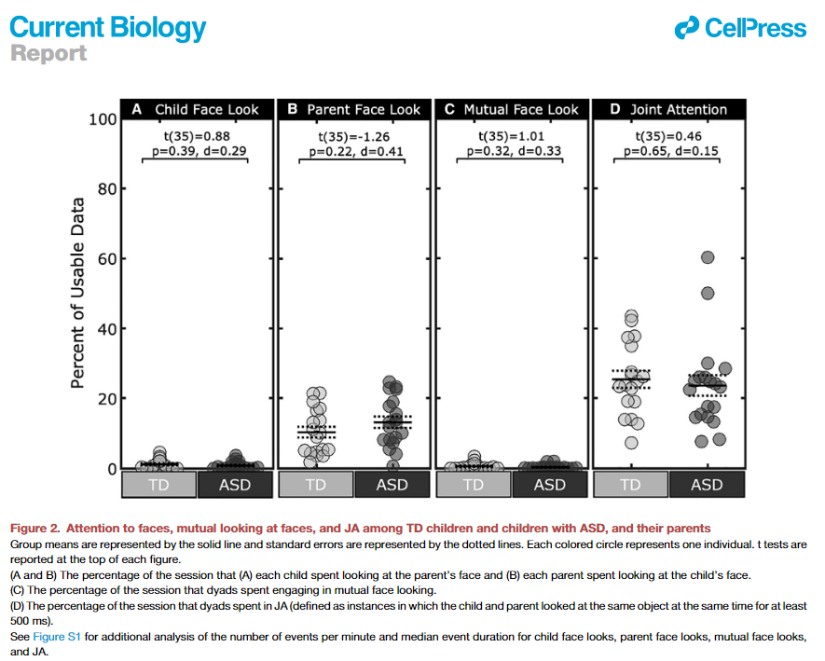

Slide 83
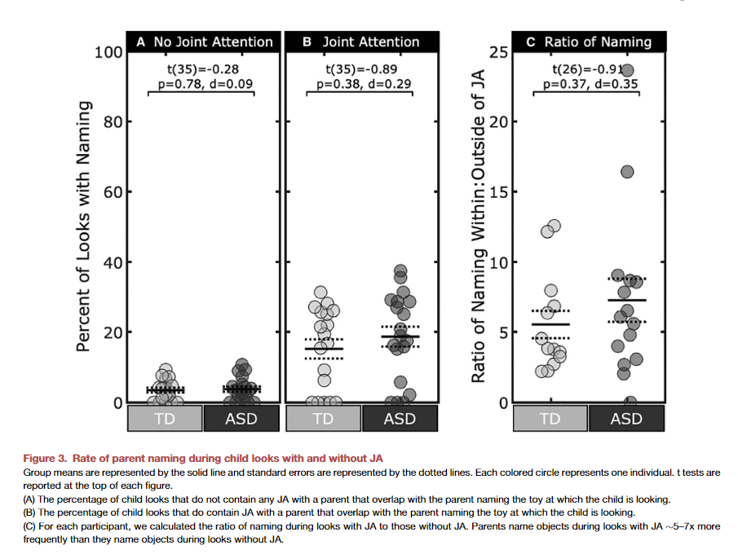

Slide 84
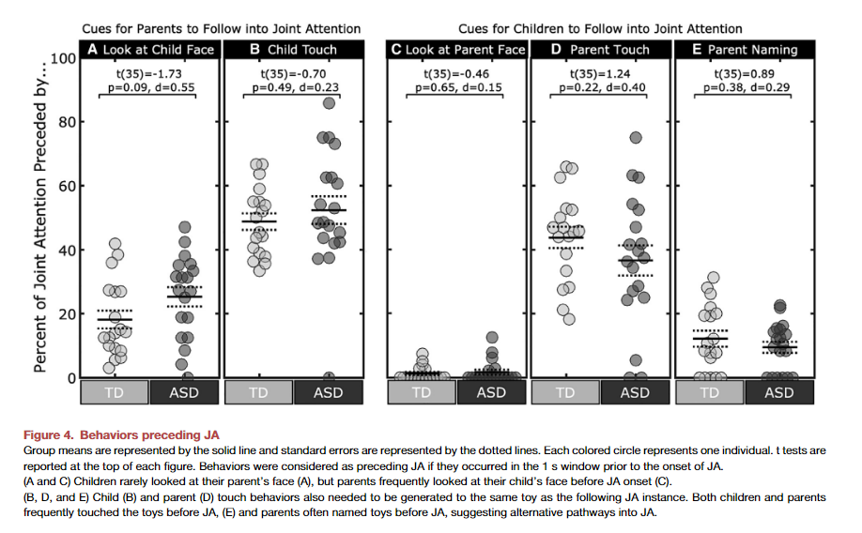

Slide 85
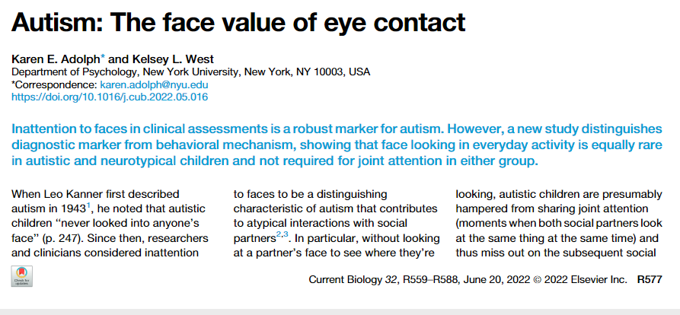

Slide 86
Two interacting attention-regulation systems whose integration yields joint attention
- Posterior orienting / perceptual attention system
RJA development
Develops in first few months of life
Orientation towards biologically meaningful stimuli
“ where others’ eyes go, their behavior follows”
- Anterior attention system
IJA development
Develops later than posterior system
Volitional, goal-directed attention controlled by reward-related self-appraisal of behavior
“where my eyes go, my behaviors follow”

Slide 87
Initiating & responding to JA: Different but linked processes
Integration of IJA and RJA furthers cognitive development:
- enhancing differentiation of self-agency versus others’ agency
- enables monitoring of internal representations about self and others
- leads to understanding that own intentions lead to goal oriented behavior,
goal oriented behavior of others is caused by their own intentions.

Slide 88
Social cognition necessary for development of functional joint attention?
social cognition develops at about 9 to 12 months
infants come to understand that own intentions lead to goal oriented behavior…
therefore goal oriented behavior of others is caused by their intentions
Model supported by some research
- 9, 10, 11-month olds follow head turns in “eyes open” condition
- only 9 month olds follow in “eyes closed”
> cannot inhibit responding behavior because still lack social-cognitive awareness of the meaning of intent of gaze
Discrepancies with model
- RJA measured as early as 6 months
- IJA and RJA not highly correlated in development

Slide 89
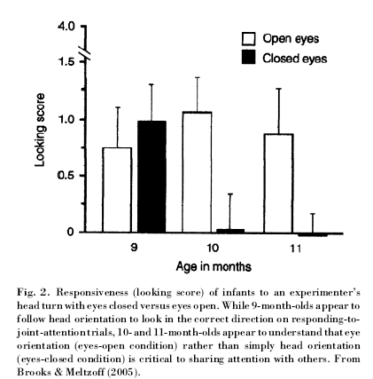
Comprehending joint attention

Slide 90
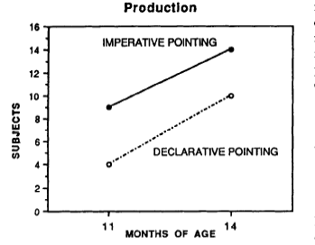
Declarative is more complex
https://www.youtube.com/watch?v=5Y-ZH6uAweE
Camaioni, et al., 1997
https://www.youtube.com/watch?v=5Y-ZH6uAweE

Slide 91
“12-month-olds point to share attention and interest"
‘When adult shared attention and interest (i.e. alternated gaze and emoted), infants pointed more frequently and tended to prolong each point … to prolong the satisfying interaction.
However, when the adult emoted to the infant alone or looked only to the event, infants pointed less across trials and repeated points more within trials - presumably in an attempt to establish joint attention.
Suggests that 12-month-olds point declaratively and understand that others have psychological states that can be directed and shared. ‘
Liszkowski, U., M. Carpenter, et al. (2004). "Twelve-month-olds point to share attention and interest." Developmental Science 7(3): 297-307.

Slide 92
Visual attention→Joint Attention
Infants’ attention orienting at 1 month significantly predicted more frequent initiating joint attention at 12 (but not 18) months
Social engagement at 4 months predicted initiating joint attention at 18 months
Infants’ early visual attention and social engagement as developmental precursors to joint attention (Salley, Sheinkopf, et al., 2016)
Notes:
This study examined infants’ early visual attention (at 1 month of age) and social engagement (4 months) as predictors of their later joint attention (12 and 18 months). The sample (n=325), drawn from the Maternal Lifestyle Study, a longitudinal multicenter project conducted at 4 centers of the National Institute of Child Health and Human Development Neonatal Research Network, included high-risk (cocaine-exposed) and matched noncocaine-exposed infants.

Slide 93
Dyadic to triadic
Dyadic → Triadic (referential) communication
Infant ←→ Partner → Infant ←→ Object ←→Partner
How are they connected?
Weak evidence that infants who bid more in still-face later show more triadic attention
But everyone agrees the link is positive emotion

Slide 94
Referential communication & affective sharing
‘Coordination of affect in joint attention in 5- to 9-month-olds‘
Joint attention looks increased with strangers but not with mothers.
Coordination of smiles w joint attention increased w age
5% of infants @ 5 mo, 12% at 7, 35% at 9 mos
same developmental increase playing with mothers
percentage of infants who smile and gaze is significantly lower with the mother than with the experimenter at 9 months.
Affect may play a key role in development of aspects of joint attention that may be unique to humans.
Striano, T. and E. Bertin (2005). "Coordinated affect with mothers and strangers: A longitudinal analysis of joint engagement between 5 and 9 months of age." Cognition & Emotion 19(5): 781-790.

Slide 95
A different, timing approach
26 typically developing infants
Administered the Early Social-Communication Scales at 8, 10 and 12 months of age
During episodes of joint attention (JA)
alternating gaze between object and experimenter
Proportion of JA episodes involving smiles
Proportion of Anticipatory Smiles:
Smiles at an object followed by smiling gaze at the experimenter
Conventional analyses

Slide 96
Anticipatory Smiling: Linking Early Affective Communication and Social Outcome
Parlade, Messinger, Delgado, Kaiser, Vaughan Van Hecke, and Mundy (2009)

Slide 97
Background
The importance of joint attention (JA)
Social sharing
Focus is on IJA
Frequent displays of positive affect during JA
Link between affective display in JA and social emotional outcomes?
Anticipatory and Reactive Smiles (2 Types of IJA)
Precursors in the dyad and the still-face
Relations to social outcomes
JA as a behavioral marker of social understanding
Evidence from at-risk (Sheinkopf et al., 2004) and children with developmental delays (e.g. Lord et al., 2003)
Less evidence from typically developing (Van Hecke, 2007)

Slide 98
Methods – 2 Studies
Study 1
Study 2
Sample=22
Measures
Still-face at 6 months
ESCS at 8, 10, 12
ASBI at 30 months
Comply
Express
Disrupt
FACS for coding smiles
Sample=39
Measures
ESCS at 9 and 12 months
ITSEA at 30 months
Externalizing
Internalizing
Dysregulation
Social Competence
FACS

Slide 99
Sharing positive affect?
When infants gaze at an object, smile, and then gaze at their social partners, the joint attention episode appears more intentional
It suggests the infants are communicating something specific – positive emotion about an object – with another.

Slide 100
Anticipatory smile
Gaze at object → Smile → Gaze at experimenter

Slide 101
Anticipatory smile

Slide 102
General Discussion
Increase in anticipatory smiling with age
Findings suggest a developmental progression
(Positive emotion in SF – anticipatory smiling – social outcomes)
Continuity between infant’s early emotional expressivity and later adaptive relatedness
Continuity between early dyadic and later triadic positive interaction
Stable individual differences in the tendency to initiate positive affective communication with different partners
IJA frequency and social competence, not related here?
Just AS with expressivity in study 1, and
AS with competence in study 2
Consider unique contributions of various dimensions of JA on child outcomes
AS uniquely associated with later social competence

Slide 103
Anticipatory smiling rises
Venezia, et al., 2004

Slide 104
Sharing Positive Emotion → Social Competence

Slide 105
Recap
Observational studies have identified two constellations of gestural behaviors with different functions, patterns of development and deficits
A requesting function
And a social approach function which often has a joint attention dimension

Slide 106
Social referencing
Seeking information from others
Visual cliff video
How is this related to joint attention?
Visual cliff and social information processing
A parent’s smiling face will convince an infant to cross over the visual cliff,
social referencing.

Slide 107
Visual cliff
The “ power of emotional information for determining behavioral outcomes”
when baby reaches center mother shifted expression
74% tested with the joy and interested expressions crossed the deep side of the cliff
6% tested with fear and anger crossed
33% of the Ss presented with sadness crossed
Campos, J. J. (1980). Human emotions: Their new importance and their role in social referencing. Research & Clinical Center for Child Development, Annual Rpt, 1-7.

Slide 108
Introduction
Social approach=Joint attention
Individual differences in joint attention, and nonverbal communication skills in the first 18 months of life
Provide unique and important information about childhood cognitive/intellectual development, language acquisition, and social-emotional development.

Slide 109
Questions
How are different patterns of gesturing associated with different developmental disorders?
What are IJA and are RJA?
How are they measured and what do they predict?
How might early deficits in IJA associated with autism lead to more long-term deficits?

Slide 110
Individual differences

Slide 111
Functionally distinct nonverbal communication skills
Emerge between 6 and 12 months
Individual differences in the development of joint attention skills may be observed as early as 6 months of age, and throughout the second year.
Joint attention skills reflect a distinct integration of social-cognitive, self regulatory, and emotional processes.
Mundy, 1995; Mundy & Gomez, 1997; Mundy & Sheinkopf, 1998; Mundy & Willoughby, 1996, 1998

Slide 112
RJA measured in 14-17 month olds predicts receptive language development
r=.71, Mundy et al. 1995; r=.70, Mundy & Gomes, in press
association significant after considering initial language or cognitive measures.
Individual differences in RJA may be observed as early as 6 months of age and these predict language development through 24 months
(Morales, Rojas, & Mundy, in press).
RJA at 12 and 18 months predicts language (r=.38) and Bayley II MDI (r=.41) at 36 months in a high risk sample of cocaine exposed infants.

Slide 113
RJA Example
How RJA predicts

Slide 114
RJA summary
Responding to Joint Attention measures have displayed consistent predictive associations with language and cognitive development.
They may be useful in screening infants as early as six months of age.
Early measure of attending to others’ intentional communications.

Slide 115
Requesting
Initiating Object Requesting (IOR), refers to the child's skill in using eye contact, reaching, giving or pointing to elicit aid in obtaining an object, or object related event.
Responding to Requesting (RR), refers to the child's skill in responding to the tester's gestural or verbal simple commands to obtain an object or action from the child.

Slide 116
Initiating Joint Attention Lower Level Behaviors:
1) Eye Contact: the child makes eye contact with the tester while manipulating or touching an inactive mechanical toy
2) Alternating (referencing): the child alternates a look between an active object spectacle and the tester's eyes.
Object is active on the table or in the tester's hand, or the child looks up to the tester after an object becomes active in their own hands.

Slide 117
Higher level IJA behaviors
3) Pointing: the child points to an active toy, or pictures in the book before the tester has pointed, or to wall posters before the tester has pointed. Pointing may occur with or without eye contact.
4) Showing: The child raises a toy upward toward the tester's face.

Slide 118
IJA Examples
TD
Down Syndrome
Autism

Slide 119
Infant conventional gestures

Slide 120
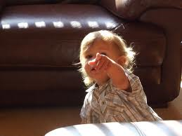
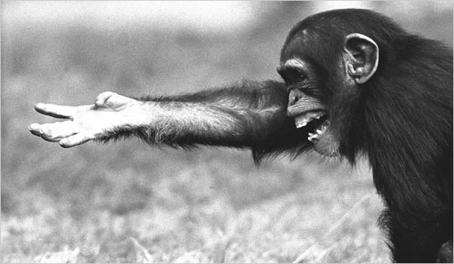
Chimpanzees in captivity point, wild apes do not
A point’s specific meaning is determined by location of pointer, object indicated, and communicative partner (referential triangle)
Referential triangle believed to be foundational for development of speech
Same gene pool …
Captive chimpanzees exist within their own ecological framework
Not all children learn to point (Barai of Papa New Guinea)
No other primate physically restrains its offspring as much humans
Leavens, Hopkins, & Bard 2005
Notes:
Pointing does not rely on pre-occurring changes in the genome; novel phenotypes emerge in certain developmental contexts

Slide 121
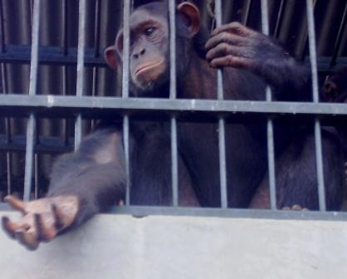
Complexity of Communication
Differences in complexity level in chimpanzees?
Open vs. Fully Articulated
Chimp Requesting Gesture
Whatever works?

Slide 122
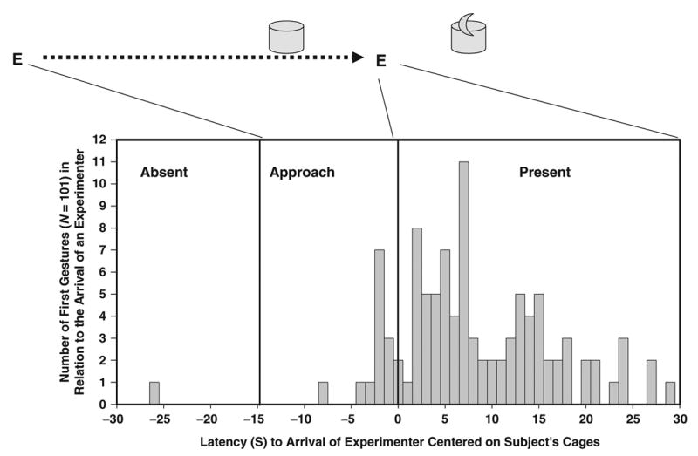

Slide 123
Captive chimpanzees exist within their own ecological framework
Captive chimpanzees are selected from same gene pool as wild chimpanzees
Is this attributable to epigenetic processes?
Yes – pointing does not rely on pre-occurring changes in the genome; novel phenotypes emerge in certain developmental contexts

Slide 124
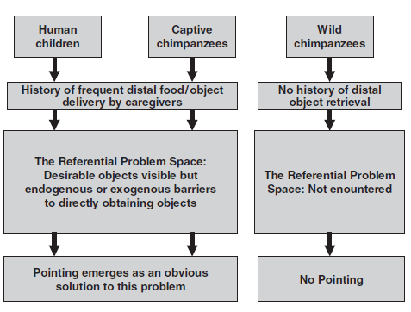
Pointing emerges only when environment provides function
Not all children learn to point (Barai of Papa New Guinea)
No other primate physically restrains its offspring as much humans
Referential problem space
Leavens, Hopkins, & Bard 2005

Slide 125
Chimps point, but how well?
Comparison of 12-month-olds and adult chimpanzees
Pointing as a precursor to language
Communicating about objects out of view
Liszkowksi, Schäfer, Carpenter & Tomasello (2009). Prelinguistic infants, but not chimpanzees, communicate about absent entities.

Slide 126
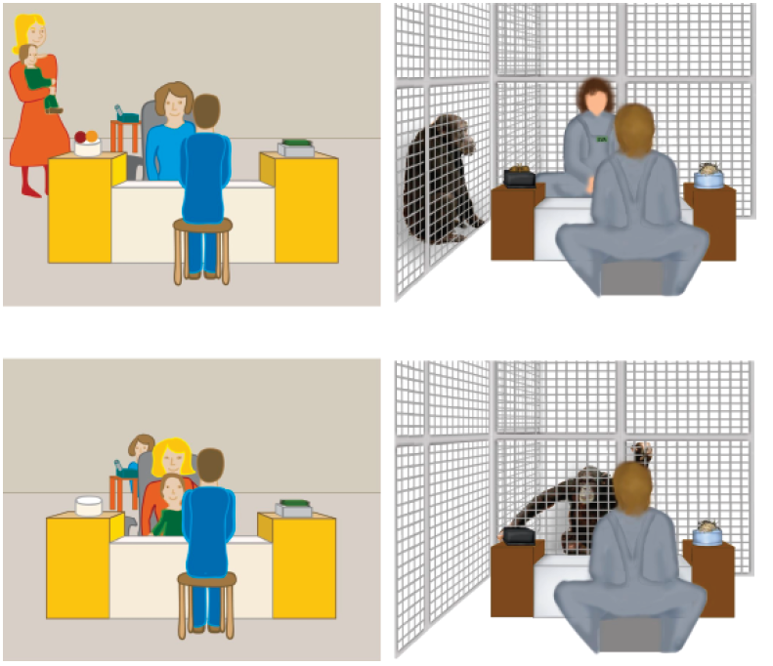
Requesters and Givers
Two Training conditions
Absent Referent
Occluded Referent
Notes:
Illustration of the experimental setup for infants (left) and chimpanzees (right), viewed from behind the giver. In the demonstration (a), participants watched an interaction between the giver and requester. Two desirable objects of the same kind (for infants: balls or blocks that could be used with a chute or slide toy, depicted in the back; for chimpanzees: packages of food) were repeatedly placed by the giver on the left or right location (counterbalanced) and successively requested by the requester. Undesirable objects (paper towels or bedding material) were placed on the alternative location. In the test (b), participants were in the requester's position and faced the giver to interact with her directly. The location that had held the desirable kind of objects was empty (absent-referent condition) or contained a desirable object inside (occluded-referent condition).

Slide 127
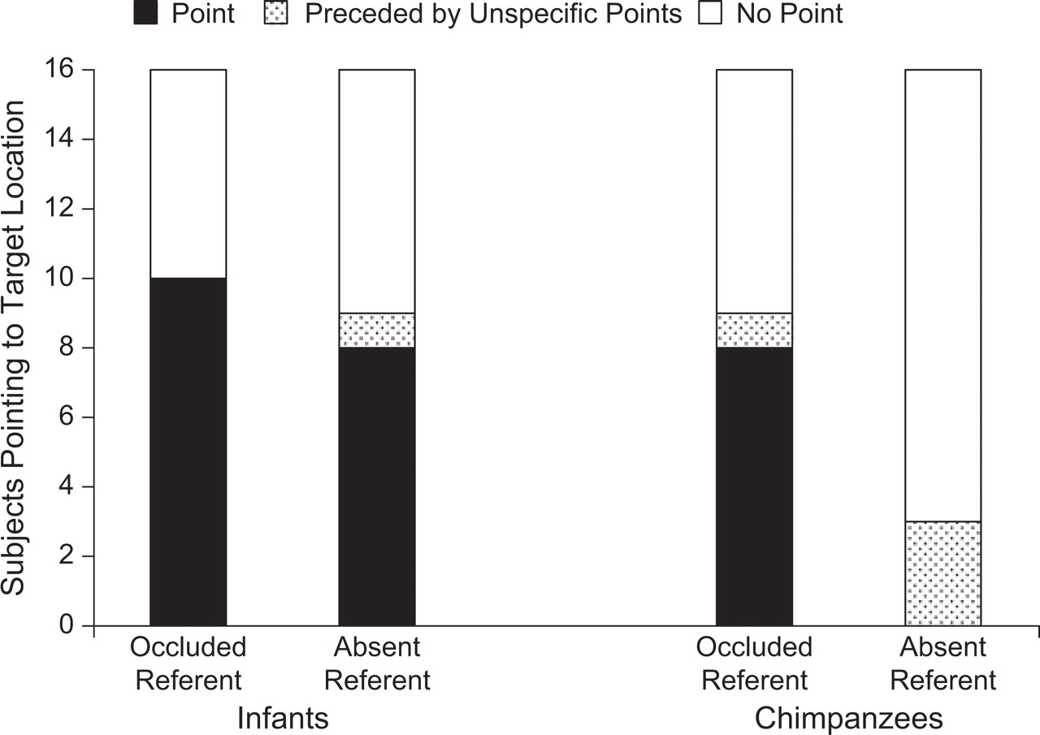
Fig. 2. Number of participants who pointed at least once to the target location (i.e., the location of the occluded or absent entity).
Ulf Liszkowski et al. Psychological Science 2009;20:654-660
Copyright © by Association for Psychological Science
Notes:
Number of participants who pointed at least once to the target location (i.e., the location of the occluded or absent entity). The graph differentiates target points that were and were not preceded by points to unspecified locations somewhere between the target and alternative locations (i.e., unspecific points). In addition, the number of participants who did not point to the target location is indicated. In the occluded-referent condition, a desired object was under (inside) the platform. In the absent-referent condition, the desired kind of objects was absent from its usual location.

Slide 128
Definitions
Gestures
Movements with meaning
Conventional gestures
Movements with shared meaning
Symbols
Signs that represent the world
Distance between referent object and sign
Which can be made with hand or mouth

Slide 129
Gestural development
Working gestures (pointing, offering)
between 9 & 12 months;
Get things done: request, name, offer
Social gestures
between 9 & 12 months;
Performatives: wave bye-bye, shake head no, etc.
Enacted or representational gestures (10 – 15 months)
begin with symbolic play
include pretending to drink from a cup
Symbolic gestures – represent things or events
emerge around the same time as first words (14-15 months)
used to make requests, describe attributes, name objects
degree of context-free representation varies

Slide 130
Debate
Is language a specific module in the brain?
Or
One manifestation of sophisticated intellectual capacity?

Slide 131
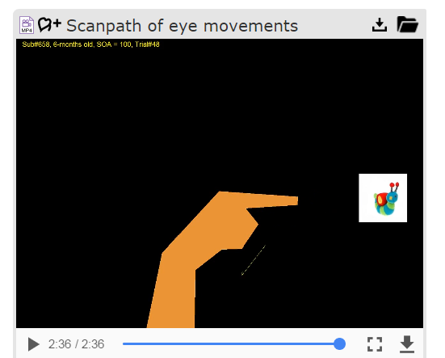
Following a point
https://nyu.databrary.org/volume/53

Slide 132
Language need not be verbal
“A view of the child . . . endowed with special linguistic input and output devices is giving way to a view of the child as a creature equipped with ears and eyes and with various moving parts that can be harnessed to form the sounds and sights of its species communicative signals (Studdert-Kennedy, 1991, p. 89)”
http://www.babysigns.com/babysigns_research_symbolicgesturingarticle.shtml

Slide 133
Friend’s 11-month-old
Has (hand) signs for:
more, bird, dog, (her first 3),
nurse, eat, drink, potty,
flower
her invention: sniffing, face scrunched,
hat, sleep, cat (with word 'zaza’)
Myers (1999)
Teach gestures to some at-risk populations
What’s source of gestural advantage?

Slide 134
‘Symbolic gesture versus words’
37 infants ~ 11 months of age exposed to 8 gestures by pairing the vocal word (for example, ``bird'') with the gesture (for example, arm-flapping) any time an opportunity arose.
Families were provided with toys and picture books that exemplified the objects.
Development of symbolic use, both gesturally and verbally, was tracked via weekly interviews with the child's parents.

Slide 135
Symbolic gestures in sign training children’s repertoires
Drink: Thumb to mouth DS: To ask for bottle
Cheerios: Index fingers to thumbs MR: To request more Cheerios
Fish: Smacking lips together KA: To fish toy in tub and goldfish crackers
Water: Rubbing palms together CH: With FISH gesture to fish in pond
Book: Open/Close with palms AT: With MORE gesture to ask for another book

Slide 136
Symbol use: Referring to multiple exemplars
The onset of symbol use in the gestural modality reliably preceded the onset of symbolic use in words.
The time lag between gestural and verbal symbol use was rather small (less than 1.1 month)

Slide 137
Gestural Advantage
Infants of this age, provided with appropriate input, use enactive gestures to refer to objects and activities before they do so with words
Goodwyn & Acredolo, 1993

Slide 138
“Symbolic gesturing impacts early language development”
103, 11-month-old infants were divided into
Sign Training group modeled symbolic gestures
Non-intervention did not know about symbolic gestures
Verbal Training group – controls for training per se
Standard language tests at 15, 19, 24, 30, 36 months.
“The results provide strong evidence that symbolic gesturing does not hamper verbal development and may even facilitate it.
Susan W. Goodwyn, Linda P. Acredolo and Catherine A. Brown (2000) Journal of Nonverbal Behavior, 24, 81-103.

Slide 139
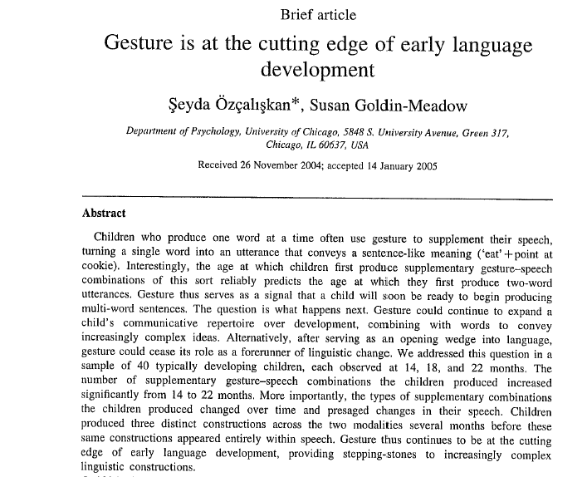

Slide 140
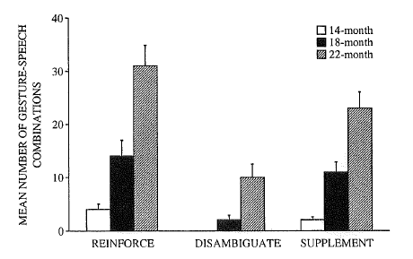

Slide 141
Deaf
Signed motherese
Prolonged, exaggerated signs
Signed (manual) babbling
Deaf infants exposed conventional sign language develop normally linguistically
E.g. ASL
Delays but evidence of idiosyncratic symbol used among deaf infants not exposed to a conventional sign language
Quittner
Toddlers Chatting in Car ASL https://www.youtube.com/watch?v=5-fwQpCylW4

Slide 142
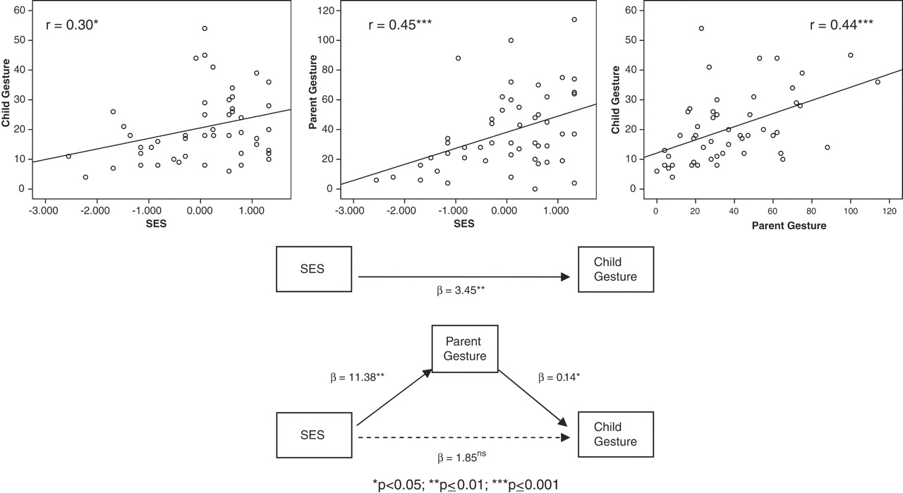
SES → gesture
(i) SES and child gesture at 14 months (top left), (ii) SES and parent gesture at child age 14 months (top middle), and (iii) parent gesture and child gesture (top right)
M L Rowe, S Goldin-Meadow Science 2009;323:951-953
Published by AAAS
Notes:
Scatter plots showing relations between (i) SES and child gesture at 14 months (top left), (ii) SES and parent gesture at child age 14 months (top middle), and (iii) parent gesture and child gesture (top right). The bottom portion of the figure represents analysis (iv) showing that parent gesture mediates the relation between SES and child gesture, controlling for child speech at 14 months (n=50 children). Taken together, SES and child speech explain 45% of the variation in child gesture; adding parent gesture explains 52%. Asterisks indicate the level of statistical significance as noted; β indicates the regression parameter estimate; ns, not significant (at the P < 0.05 level).

Slide 143
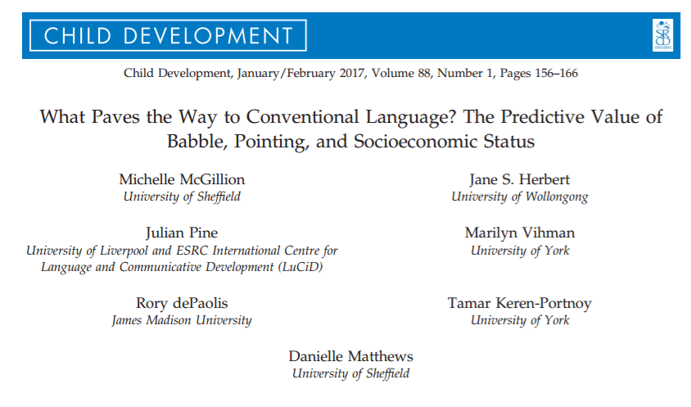

Slide 144
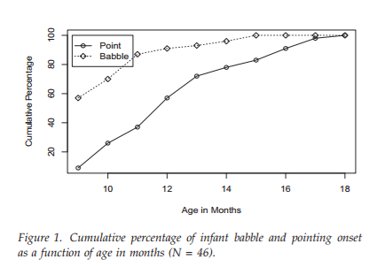
Babble before point
r=-.13

Slide 145
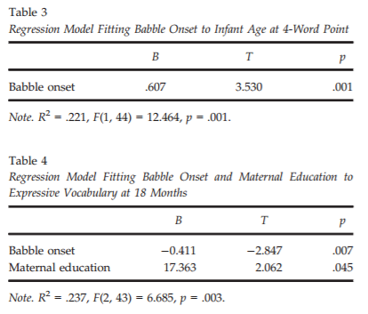
Babble onset predicts expressive language
(pointing onset does not help)

Slide 146
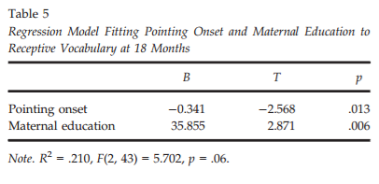
Pointing onset predicts receptive language
(babble onset does not help)

Slide 147
References
Messinger & Fogel, 1988
Venezia et al.
Parlade et al.
Striano

Slide 148
Theory of Mind Meta-Analysis: Autism and Mental Retardation
Autistic children have impaired TOM
But so do MR children
Relative to other MR children, Downs children have relatively unaffected TOM abilities

Slide 149
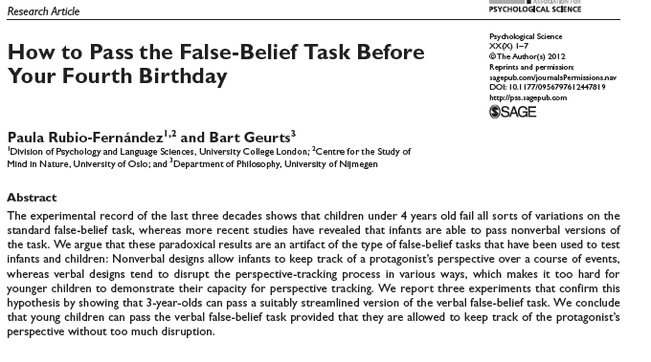
Theory of Mind

Slide 150
Theory of mind (ToM) in autism
Individuals with autism and MR have impaired ToM abilities.
Etiology of MR (i.e., Down's syndrome,is an important moderator.
Chronological age (CA) and verbal mental age (VMA) of the normally developing children and CA, VMA, and performance mental age of individuals with MR, and type of matching between groups also moderators.
Need to consider the specific etiology of comparison groups when studying abilities and impairments of individuals with autism and MR.
Yirmiya, Nurit; Erel, Osnat; Shaked, Michal; Solomonica-Levi, Daphna . Meta-analyses comparing theory of mind abilities of individuals with autism, individuals with mental retardation, and normally developing individuals. Psychological Bulletin. 1998 Nov Vol 124(3) 283-307

Slide 151
Understanding mind and emotion by talking to your friends
Relates lab tasks and social life
Longitudinal increases between 4 & 5 years
Understanding false-belief tasks
Affective perspective taking tasks
Mental-state talk with friends
Increase in shared or others’ mental-state talk
Increase in the context of a shared interest
Understanding mind and emotion: Longitudinal associations with mental-state talk between young friends (Dunn et al)

Slide 152
Relating naturalistic talk and experimental investigations
Mental-state talk frequency predicted false belief performance one year later
Early affective perspective taking also predicted false belief performance
Developmental shift in mental-state talk from self to other/shared supports
Supports idea that one understands others by understanding self (simulation theory)

Slide 153
Additional readings
Kasari, -. C., Sigman, -. Mundy, -Peter, & Yirmiya, N. (1990). Affective sharing in the context of joint attention interactions of normal, autistic, and mentally retarded children.Journal-of-Autism-and-Developmental-Disorders. Mar; Vol 20(1):
Mundy, P., & Hogan, A. (1994). Intersubjectivity, joint attention, and autistic developmental pathology. In D. Cicchetti & S. L. Toth (Eds.), Disorders and dysfunctions of the self (Vol. 5, pp. 1-30). Rochester, NY: University of Rochester Press.
Mundy, P., & Willoughby, J. (1996). Nonverbal communication, joint attention, and early socioemotional development. In M. Lewis & M. W. Sullivan (Eds.), Emotional development in atypical children (pp. 65-87). Mahwah, NJ: Erlbaum.

Slide 154
More readings
Sheinkopf, S., Mundy, P., Oller, K., Steffens, M. (2000). Atypical vocal development in young children with autism. Journal of Autism and Related Disorders, 30, 345-354.
Mundy, P. & Neal, R. (2001). Neural plasticity, joint attention and autistic developmental pathology. In L. M. Glidden (Ed.), International Review of Research in Mental Retardation, 23, 139-168. New York:Academic Press.
Mundy, P. (1995). Joint attention, social-emotional approach in children with autism. Development and Psychopathology, 7, 63-82.
Mundy, P, Sigman, M., & Kasari, C. (1990). A longitudinal study of joint attention and language development in autistic children. Journal of Autism and Developmental Disorders, 20, 115-128.
Mundy, P., Sigman, M., & Kasari, C. (1993). The theory of mind and joint attention deficits in autism. In S. Baron-Cohen, H. Tager-Flusberg & D. Cohen (Eds.), Understanding other minds: Perspective from Autism, (p. 181-203). Oxford, UK: Oxford University.
Mundy, P., Sigman, M., & Kasari, C. (1994). Joint attention, developmental level, and symptom presentation in young children with autism. Development and Psychopathology, 6, 389-401.
Mundy, P., Sigman, M., Ungerer, J., & Sherman, T. (1986). Defining the social deficits of autism: The contribution of nonverbal communication measures. Journal of Child Psychology and Psychiatry, 27, 657-669.

