Slide 1
Temperament & Emotional
Development

Slide 2
Emotion and Social Development
Temperament
  Definition
  Models
  Mechanisms
Emotional Capacities
  Expression
  Understanding
  Awareness
Self-Awareness
  Components and developmental change

Slide 3
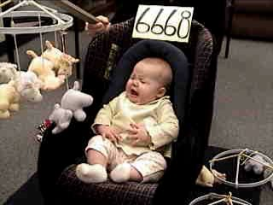
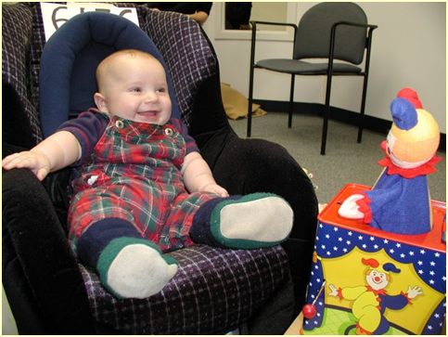
Temperament
  Biologically based individual differences in behavior tendencies that are present early in life and are relatively stable across various situations and over the course of time (Goldsmith et al., 1987; Rothbart & Bates, 2006; Wachs & Kohnstamm, 2001)
  personality in formation

Slide 4
The Child Is Father of the Man?
My heart leaps up when I behold
A rainbow in the sky:
So was it when my life began;
So is it now I am a man:
So be it when I shall grow old,
Or let me die!
The Child is father of the Man;
And I could wish my days to be
Bound each to each by natural piety.
      William Wordsworth, "My Heart Leaps Up When I Behold"

Slide 5
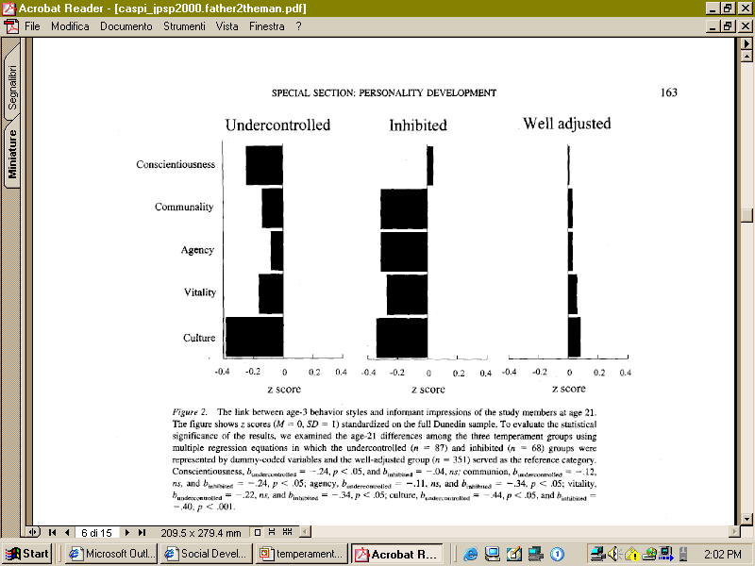
Age-3 behavior styles and informant impressions at age 21
Caspi

Slide 6
But…
Calling something temperament does not make it more ‘biological,’ inherited, or stable than any other construct
Temperament is a measured construct with particular characteristics
  Stable/Unstable
  More heritable/Less heritable

Slide 7
Evolution in our Conceptualization of the Neural Basis of Temperament
Hippocrates-Galen
  Personality types = balance of bodily humors
Pavlov & Students
  Relation of CNS to individual differences
  Interplay between cortex and subcortex
  Influence of contextual factors
Notes:
AFTER CURRENT 12

Slide 8
Models of Temperament:
Thomas & Chess
  Parents’ descriptions of 141 infants and children based on structured interviews
  Derive 9 dimensions of responding
    Activity Level, Rhythmicity, Distractibility, Approach/Withdrawal, Adaptability, Attention Span/Persistence, Intensity of Reaction, Threshold of Responsiveness, Quality of Mood
  Dimensions cluster to describe 3 basic types
    Easy Child (40%)
    Difficult Child (10%)
    Slow-to-Warm Up (15%)
Which one are you?

Slide 9
Models of Temperament:
Goldsmith & Campos
    Individual differences in the expression of primary emotions (anger, fear, joy, interest)

Slide 10
Models of Temperament:
Rothbart
    Individual differences in reactivity and self-regulation
      Reactivity = excitability or arousability of behavioral, endocrine, autonomic, & CNS responses
      Self-Regulation = processes that serve to modulate reactivity including attention and inhibition

Slide 11
Models of Temperament:
Rothbart
    Individual differences in reactivity and self-regulation
Reactivity–
  speed, strength & valence of response to stimulation
    excitability or arousability of behavioral, endocrine, autonomic, & CNS responses
Self Regulation –
  behaviors that control behavioral and emotional reactions to stimulation (+ or -)
    develops: reactive control, then active self regulation at end of 2nd year
    maps to development of brain areas involved in executive attention control
Current brain-behavior models:
  behavioral approach/activation system and behavioral inhibition/anxiety system
  Henderson, H. A., & Wachs, T. D. (2007). Temperament theory and the study of cognition-emotion interactions across development. Developmental Review, 27(3), 396-427. doi: 10.1016/j.dr.2007.06.004

Slide 12
BAS and BIS: motivational tendencies
Behavior Approach System (BAS)
  - governs approach/appetitive motivations
  - responds to signals of reward/end of punishment
  - behavior towards goals, positive feelings
Behavior Inhibition System (BIS)
  - inhibition, interruption of behavior , increase in arousal/vigilance
  - responds to signals of punishment, nonreward, novelty
  - underlies states of fear and anxiety
- Temperament differences: relative balance of positive affect/approach versus negative affect/inhibition behaviors

Slide 13
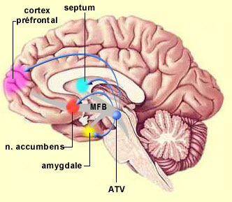
Neurolophysiology of approach/withdrawal
Amygdala
- connections with brainstem nuclei—universal fear reactions
- sensitive to ambiguity and uncertainty
- temperament related to differences in amygdala activity
Nucleus accumbens
- anticipatory reward-related responding
- activity related to size of anticipated reward
EEG asymmetry
- resting EEG asymmetry during stressful task related to differences in dealing with novel/stressful events
- right frontal EEG asymmetry discriminated among preschoolers’ levels of social play

Slide 14
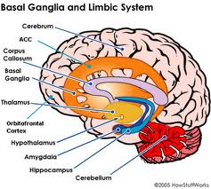
Self-regulation
Attentional and effortful processes that modulate reactivity
  regulate behaviors and emotions through voluntary inhibition, response modulation, and self-monitoring (Ahadi et al, 1993)
  form basis for well-regulated behavior and emotion
  executive system monitors and regulates reactivity
Anterior cingulate cortex (ACC) and Effortful control
  ACC facilitates voluntary control of thoughts and emotions
  ACC as neural alarm

Slide 15
Inhibited and Uninhibited Infants
“Grown Up”
“[A]dults who had been categorized in the second year of life as inhibited, compared with those previously categorized as uninhibited, showed greater functional MRI signal response within the amygdala to novel versus familiar faces.”
  22 adults (M = 21.8 years)
  at two years were inhibited (n=13) or uninhibited (n = 9)
        20 JUNE 2003 VOL 300 SCIENCE Carl E. Schwartz,1,2,3* Christopher I. Wright,2,3,4 Lisa M. Shin,2,5 Jerome Kagan,6 Scott L. Rauch2,3

Slide 17
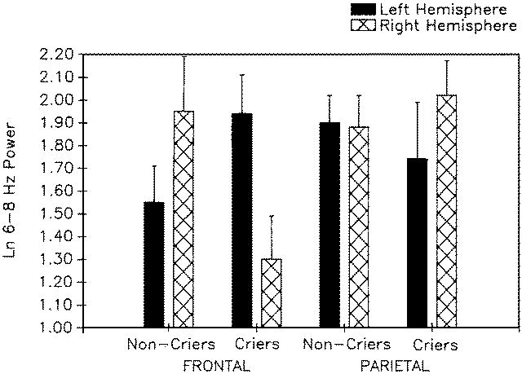
Greater right frontal power among 10-month-olds who cried in response to maternal separation

Slide 18
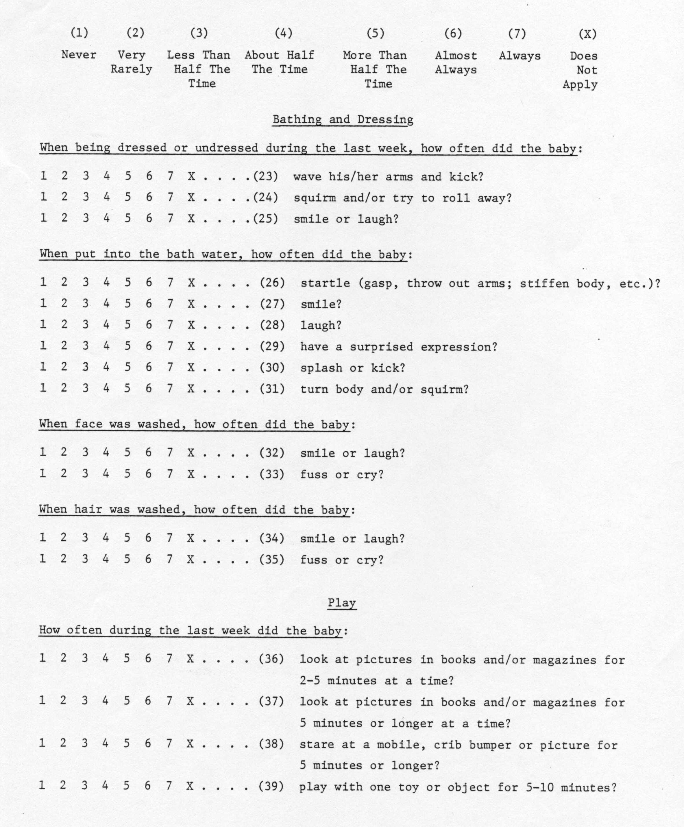
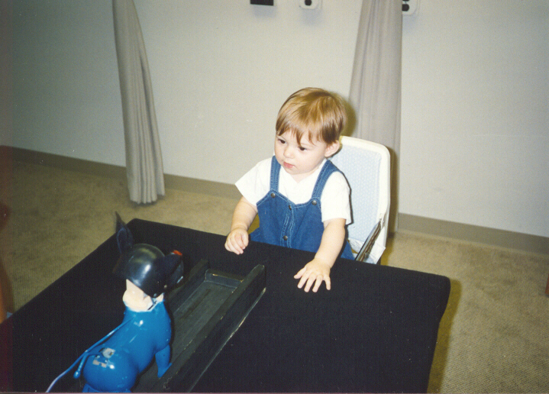
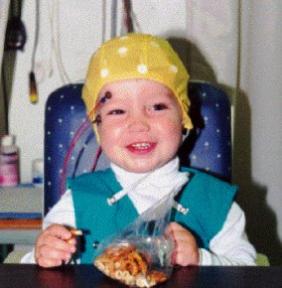
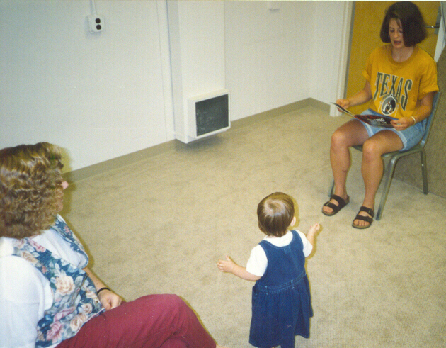
Assessment of Temperament
Parental Report
Laboratory Observations
Physiological Assessment

Slide 19
When do parents and raters agree?
When there’s non-optimal behavior
  “maternal and observer ratings of infant negativity converged when infants manifested high degrees of negative affect during routine home-based activities.
  …ratings of infant positivity converged when infants experienced low mutually positive affect during play….
      Hane et al., 2006

Slide 20
Temperament (cont)
Mechanisms through which temperament affects later development
  Direct effects
  Indirect effects
  Evocative effects (on social relationships; on perceptions of others)
  Niche picking
  Goodness-of-fit

Slide 21
Temperament mechanisms
Mechanisms through which temperament affects later development
  Direct effects
  Indirect effects
Temperament
Adjustment
Temperament
Environment
Adjustment

Slide 22
Example – Indirect effect of shyness on academic skills
Shy (M)
1.00
Shyness
Lang (K)
-.11 (.06)
1.00 (1.20)
Shy (CG)
1.50
Math (K)
Academic Skills
.94
-.82 (.20)
.04 (.01)
SPS Competence
.96
Lang (G1)
IC (M)
1.08 (.26)
.85
1.00
Inhibitory Control
.76 (.12)
Math (G1)
IC (CG)
1.47
SPS = social problem solving skills
Walker & Henderson, 2012

Slide 23
Temperament (cont)
  Evocative Effects
Actor Partner Interdependence Model

Slide 24
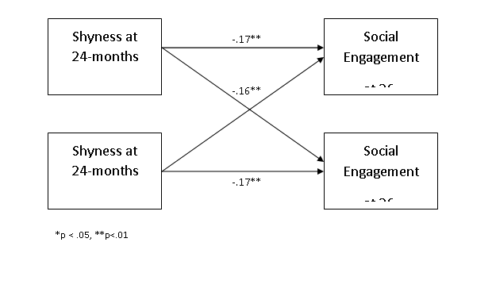

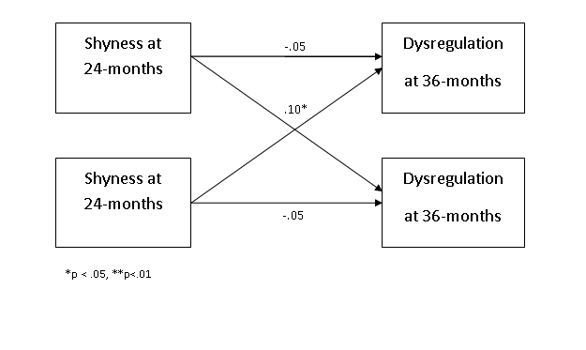
Example- Evocative Effects

Slide 25
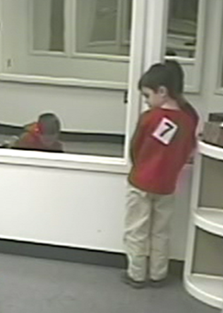

Temperament (cont)
  Niche Picking

Slide 26
Temperament (cont)
  Temperament x Environment Interactions (Goodness-of-fit)
Environment
#1
Outcome a
Temperament
Environment
#2
Outcome b

Slide 27
Goodness-of-Fit Model
The “meshing” of temperament with environmental properties, expectations, and demands
  Implications for parents and educators for creating environments that recognize each child’s temperament while encouraging adaptive functioning

Slide 28
Applications of Goodness-of-Fit
A “difficult” temperament promotes survival during famine conditions in Africa (De Vries, 1984)
    Why?
Low activity level is a risk for mental retardation among children raised in a poor institution (Schaffer, 1966)
    Why?

Slide 29
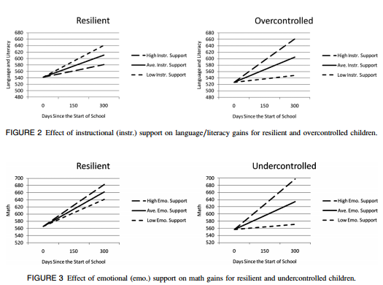
Goodness-of-fit applications
Vitiello et al., 2012

Slide 30
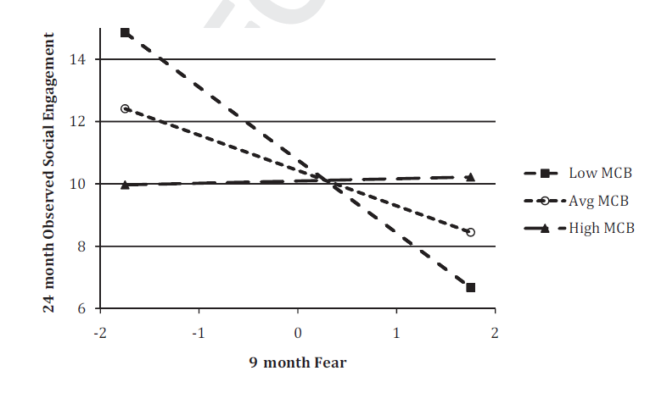
Applications of Goodness-of-fit
MCB – Maternal
Caregiving Behavior
(Quality)
Penela et al., 2012

Slide 31
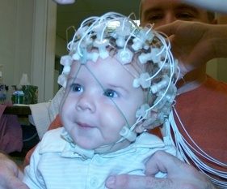
Gene-Endoenvironment Interaction
DRD4 - Long Allele
  Novelty/Sensation Seeking
  Attention Problems/Aggression
  Susceptibility to Parenting
EEG Asymmetry
  Left Frontal – “Easy” Temperament
  Right Frontal – “Negative Reactive” Temperament
  Schmidt, Fox, Perez-Edgar & Hamer (2009)
"Long" versions of polymorphisms are the alleles with 6 to 10 repeats. 7R appears to react less strongly to dopamine molecules.[8]
http://en.wikipedia.org/wiki/Dopamine_receptor_D4

Slide 32
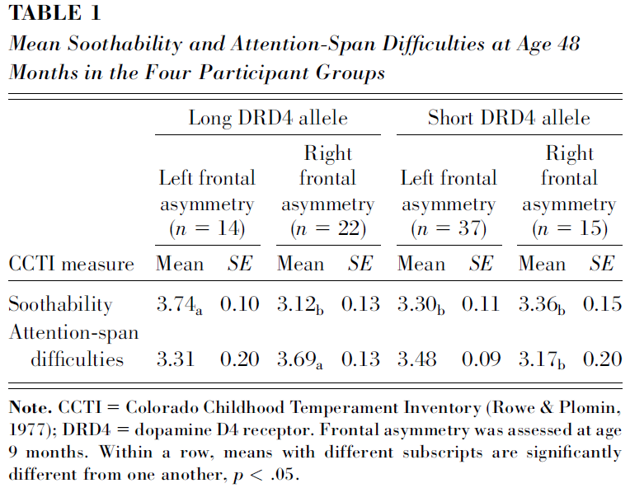
Frontal Asymmetry, DRD4, Temperament
Differential susceptibility
9 mo
  EEG, Genes
48 mo
  Temperament
CCTI – Maternal Report
  Soothability
  Attention Difficulties

Slide 33
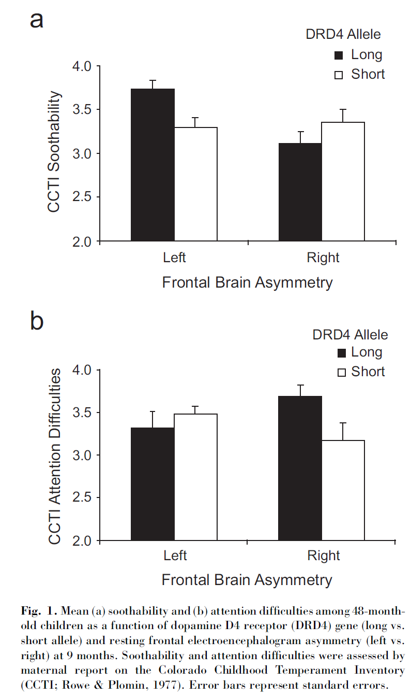
Group Differences
DRD4 by Asymmetry
  Susceptibility to Asymmetry
    Soothability
    Attention Difficulties
      Asymmetry unrelated to DRD4
      Complex Gene-Gene Interaction?

Slide 34
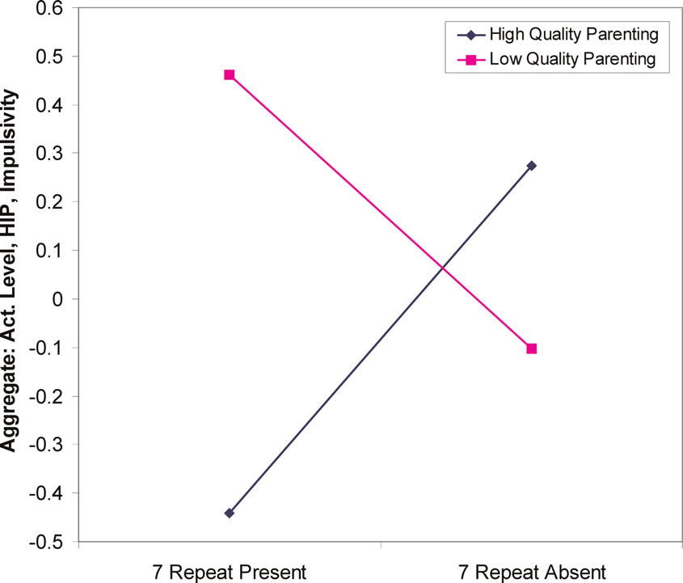
Genes influence relation between parenting and temperament
18-21 month olds
DRD4 48 (7-repeat allele) “long”
allele increased sensitivity to environmental factors such as parenting.
  Lower quality parenting→ higher sensation seeking.
  Higher quality parenting→ lower sensation seeking
  Parenting quality interacts with genetic variation in dopamine receptor D4 to influence temperament in early childhood Sheese BE, et al. Dev Psychopathol 2007 19(4):1039-46

Slide 35
Stability of Temperament
Is a child’s temperament immutable?
Example from Fox et al. (2001)
    4-month-old infants selected based on reactions to unfamiliar sensory stimuli
    3 groups of infants
      High Negative
      High Positive
      Low Reactive

Slide 36
Shyness/Inhibition by
4-month temperament group
.
8
.6
.4
.
2
Standardized measure of inhibition (+/- 1 SE)
Low Reactive
0.0
High Negative
High Positive
-.2
-.4
-.6
-.8
14
24
48
Age (months)
Fox, Henderson, et al. (2001)
      Kagan classic: http://www.youtube.com/watch?v=CGjO1KwltOw

Slide 37
Possible Influences on Stability?

Slide 38
Experience in out-of-home care

Slide 39
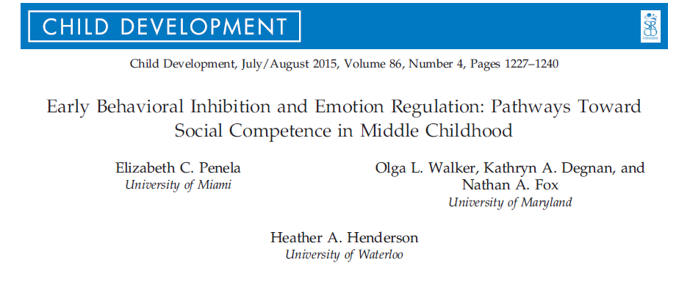

Slide 40
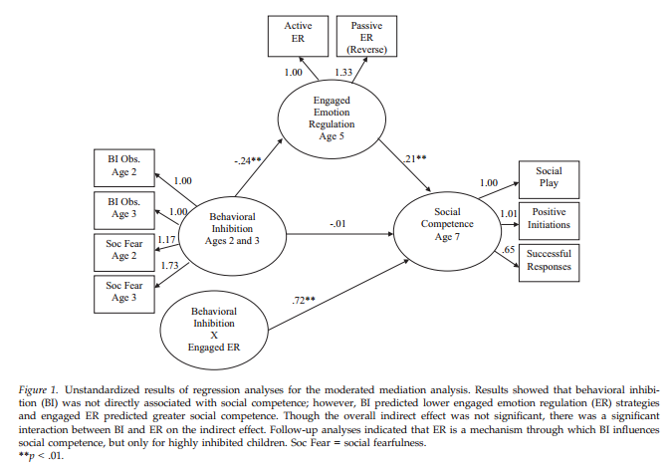
Moderated Mediation Model for
BI, ER and Social Competence
Panela et al., 2015

Slide 41
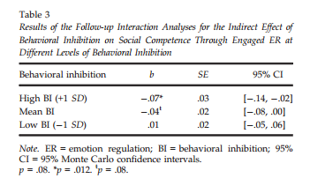
Indirect Effect of Low, Medium and High BI on Social Competence
Panela et al., 2015

Slide 42
Emotions
Organize action, physiology, cognition, and perception to meet ever-changing environmental and internal demands
In patterns constituting core aspects of temperament/personality functioning
Motivate action and thought, creating value in life—and impacting wellness and sickness

Slide 43
Infant emotions
Core elements of infant behavior
Quickly motivate behavior
  Hunger-Distress-Cry
  Interest-Attentive face
  Engaging playful other – joy - smile
Organize action, physiology, cognition, and perception
To meet environmental and internal demands
Patterns constitute core aspects of temperament/personality functioning

Slide 44
Infant emotional development
Distress is present at birth
Interest and joy emerge in the first 2 mos.
  joy developing through at least 6 mos.
Anger, sadness, fear differentiate after 4 m.
Pride and shame develop between 1 & 2 years

Slide 45
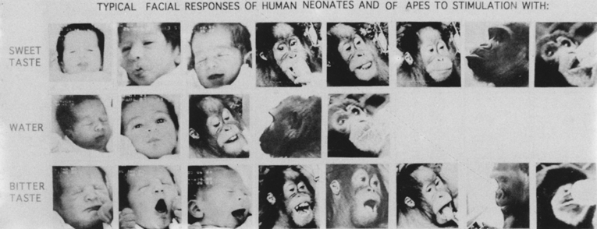
Structuralist vs. functional emotion theories
  Structuralist (aka discrete, natural kinds)
    Emotions comprise unique patterns of subjective feeling, cognitive appraisal, physiological arousal, facial expressions
      Basic emotions promote survival and reproductive success

Slide 46
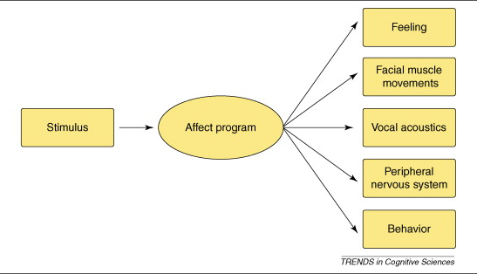
The Structuralist View
“Many models assume that each emotion kind is characterized by a distinctive syndrome of hormonal, muscular, and autonomic responses that are coordinated in time and correlated in intensity “
p. 30 Barrett, 2006

Slide 47
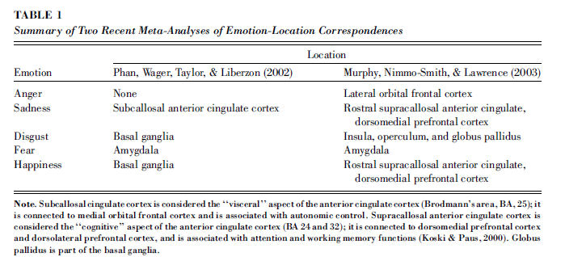
But where are specific emotions?

Slide 48
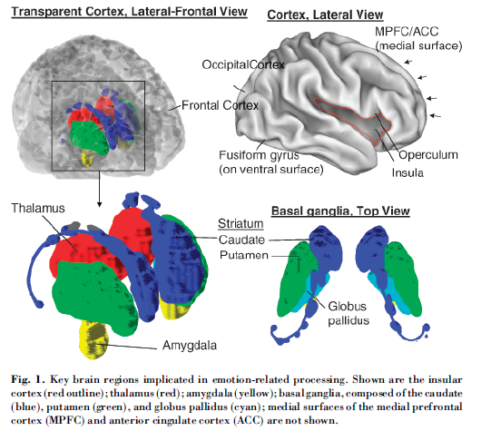
Key brain regions implicated in emotion-related processing.

Slide 49
Facial affect programs?
Current evidence:
  Relevant linked brain systems
  But not distinct affect programs
  Fear may be exception
  Panskepp and current animal work

Slide 50
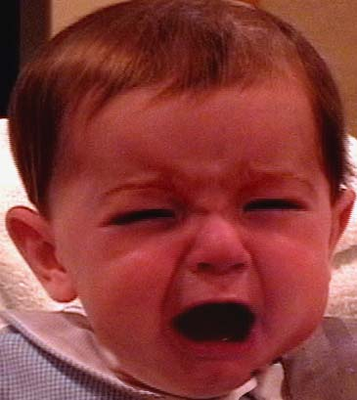
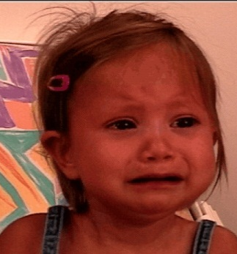
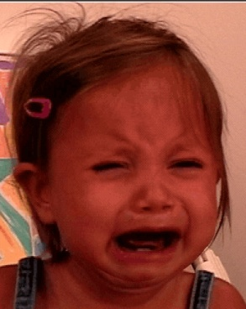
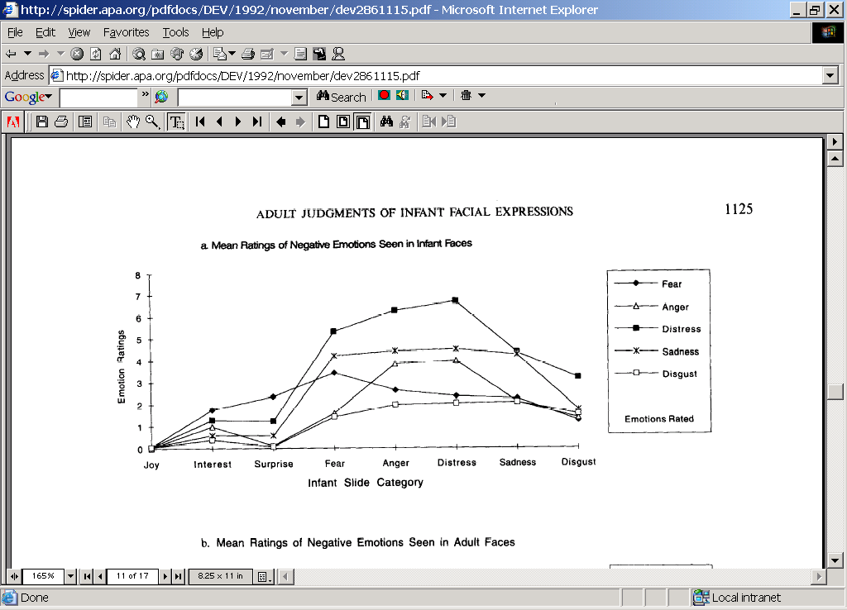
Infant negative expressions rated as distress
(Oster et al., 1992)

Slide 51
Situational appropriateness: Production studies
Premise:
In response to an appropriate elicitor (situation), hypothesized emotional expression should occur significantly more than other expressions

Slide 52
Negative emotional expressions are not situationally specific
Through 2 months, Justine
  shows distress to bathing, being moved, & pacifier removal (inoculation and hunger)
After 2 months, anger and, to a much lesser degree, sadness are most common reaction to all negative elicitors
  infants cry, not a specific reaction
        Camras, 1992

Slide 53
Examples
Examples (Slides 3-10 are pictures) : http://www.slideserve.com/marilu/emotions
Sad → distress→smile: http://www.youtube.com/watch?v=akPVtObBUOk&feature=related
Distress:
Sad→disress: https://www.youtube.com/watch?v=l7oD9WX-1CU
Fear/orient→distress: http://www.youtube.com/watch?NR=1&feature=fvwp&v=QiBrPkGoqFM
Fear→distress: http://www.youtube.com/watch?v=fASp42ZvjIM&feature=fvwrel,
http://www.youtube.com/watch?feature=fvwp&NR=1&v=H-1me_wsuyk (alligator bite)
Sad: http://www.youtube.com/watch?v=szLjXta0Szw, dad singing http://www.youtube.com/watch?v=dAzLsnYvdYo&feature=related (lower lip in response to rasberries)
http://www.youtube.com/watch?v=NS8rZb79-As&feature=related

Slide 54
Maze game—Scary—children
http://www.youtube.com/watch?v=ZGd5NqP6qd4
Slow-motion: http://www.youtube.com/watch?v=LC5qPvTQUdo
Compendium: http://www.youtube.com/watch?v=cypeLuCIrU0
Long: http://www.youtube.com/watch?v=q9kNCBGEyfk 0:55-1:07, 1:45-2:30

Slide 55
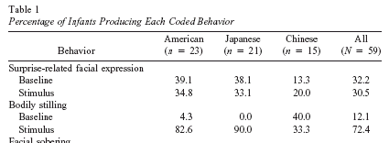
Surprise! Its not in the face
Covert toy switch

Slide 56
Surprise examples
Expression on demand: http://www.youtube.com/watch?v=8DaKcKqVheE&NR=1
Coordinative structure? http://www.youtube.com/watch?v=cOvtNPljtv0&feature=related
Posed adult: http://www.youtube.com/watch?v=f4AyfrM8Q2o
Girl and Dad 1:05—1:40. http://www.youtube.com/watch?v=q5HXl_zJ5po

Slide 57
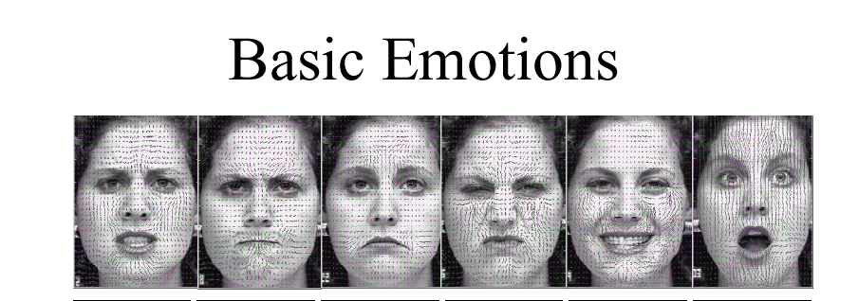
What emotions do you see here?
Cohn

Slide 58
Emotion (cont)
Structuralist vs. functional perspectives on emotion (cont)
  Functionalist
    Emotions serve to establish, maintain, or change relation between person and environment on matters of significance to person

Slide 59
Developmental patterns
Socialization
  Emotion displays become more restricted
  Full-face to partial face - miniaturization
Cognitive input
  shame, guilt, contempt emerge
    involve rudimentary appraisal of self vis-à-vis other
      dynamic systems

Slide 60
Developmental Changes in Emotion
Psychobiological foundations
  Subcortical mediation of basic emotions
  Developing subcortical-frontal connections permit more effective emotion regulation
Emotion Perception
  Discrimination/categorization of expression by 5 months of age
  Rely on others’ reactions to interpret unfamiliar situations = social referencing (12+ months)
  Understanding of subjective state of emotion (24+ months), allows for prosocial displays of comforting etc.

Slide 61
Developmental Changes in
Emotion (cont)
Emotion and Self-Development
  Increases in self-awareness (2/3 yrs) leads to expression of new, more complex emotions
    Self-Conscious Emotions
      Pride
      Guilt
      Shame
      Embarrassment

Slide 62
Developmental Changes in Emotion (cont)
Understanding effects of emotions on others:
The use of display rules
  Increased ability to understand and apply social rules for display of emotion in social situations
    Emotion masking
      Primitive forms in preschool; more flexible, reasoned use in middle childhood

Slide 63
Developmental Changes in Emotion (cont)
Emotion Regulation
  Adaptive management of emotional experiences
  Developmental transition from other-regulation to self-regulation
    Internalization of socialization experiences

Slide 64
Development of Self
Components of self:
  Subjective self-awareness (“I-self”)
    Develops via experiences of agency in first year
    Recognition of others’ subjective entities (e.g., IJA)
  Self-representation (“me-self”)
    Objective characteristics of self
    Verbal self-reference, assertion of competence, emergence of self-conscious emotions
    Concrete, observable characteristics, rudimentary psychological characteristics

Slide 65
Development of Self
Components of self (cont):
  Autobiographical personal narrative
    Personally-significant memories bound together because of relevance to self
  Self-evaluations
    Positive bias in preschool years. Why?
    With development, more differentiated and realistic
  Social self
    Enhanced self-monitoring leads to intentional management of self-presentation in presence of others

Slide 66
Dynamic systems
Development, interaction, and (emotional) behavior are complex
involving multiple interfacing/interacting constituents
which produce patterns we see as pre-designed regularities
A bottom-up approach
  Discrete emotions as preferred states formed from the interface of multiple constituents

